Slide 1
RAF 100 STEM Project - Moray
Teacher CPD – Thursday 17th May 2018

Slide 2
Aims for the session:
Introduce the project
Activities – Aircraft Design, Satellite Age
Review the materials
Research tasks – your ideas for sessions 6-10
Planning

Slide 3
RAF100: Aiming for Awesome Introduction
Aiming for Awesome celebrates the centenary of the RAF and explores the engineering achievements of the RAF over the last 100 years.
There are 10 lessons, each covering a different decade of RAF history.
1918-1928: Aircraft design
1928-1938: Radar
1938-1948: Speed record
1948-1958: Ejection seat
1958-1968: Code breaking
1968-1978: Satellite age
1978-1988: Disaster relief
1988-1998: Logistics challenge
1998-2008: Remotely piloted air systems
2008-2018: Stealth

Slide 4
RAF100: Aiming for Awesome – Moray Project Report
As well as the STEM activities, each session you will find out a bit more about the topic through research.
Over the course of the 10 sessions you will create a project report.
The Project Report will contain:
A page for each session topic with:
Reflection on what you did in the session and what you learned.
What you found out in your research.
A final reflection telling us what you learned, what you liked best and what you might like to find out next!

Slide 5
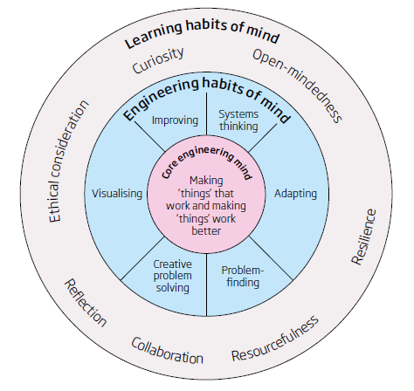
RAF100: Aiming for Awesome – Skills
Notes:
Systems thinking Seeing whole systems and parts and how they connect, pattern-seeking, recognising
interdependencies, synthesising
Problem-finding Clarifying needs, checking existing solutions, investigating contexts, verifying
Visualising Being able to move from abstract to concrete, manipulating materials, mental rehearsal of
physical space and of practical design solutions
Improving Restlessly trying to make things better by experimenting, designing, sketching, guessing,
conjecturing, thought-experimenting, prototyping
Creative problem-solving Applying techniques from di.erent traditions, generating ideas and solutions with others,
generous but rigorous critiquing, seeing engineering as a ‘team sport’
Adaptability Testing, analysing, rejecting, rethinking, changing both in a physical sense and mentally

Slide 6
Session 1 - 1918-1928: Aircraft design Learning Intentions
I will investigate the STEM behind aircraft design.
I will explore the forces acting on an aircraft during flight
I will use the iterative design process to design and improve the perfect paper aircraft.
I will find out about the career of Aerospace Engineer and what skills are needed in this job.

Slide 7
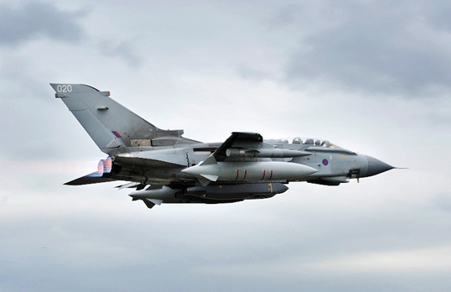
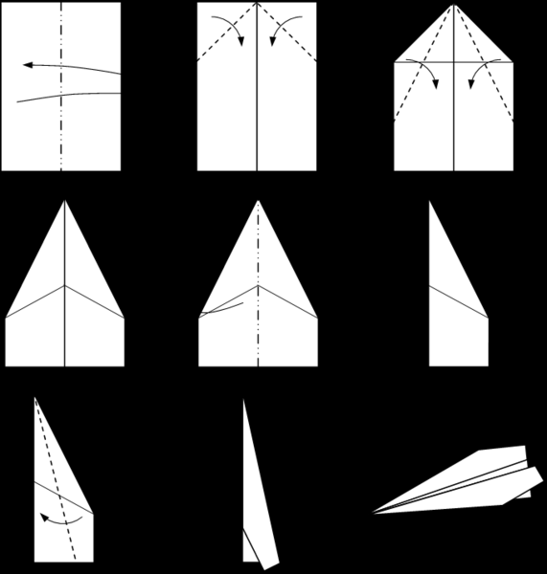
Session 1 - 1918-1928: Aircraft design STEM Activities
Time to Think
Stretch & Challenge
Model Aircraft
Part 1
Part 2
Part 3

Slide 8
Session 1 - 1918-1928: Aircraft design Research Task
Go onto the website www.myworldofwork.co.uk and search for aerospace engineer.
What is an aerospace engineer?
What sorts of things might you do in this job?
What are the top skills that people in the job might have?
How might you get into this job?

Slide 9
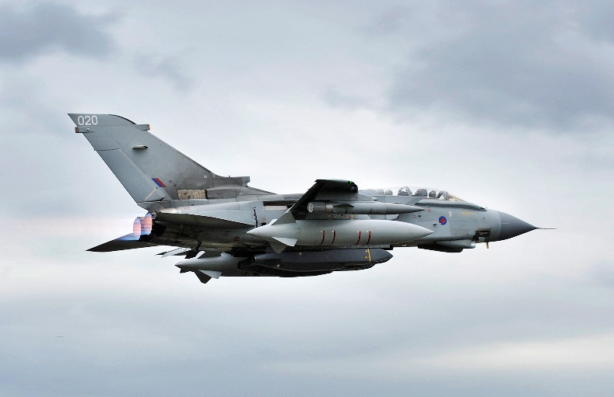
Session 1 - 1918-1928: Aircraft design Debrief
Did today’s lesson meet the Learning Intentions?
I will investigate the STEM behind aircraft design.
I will explore the forces acting on an aircraft during flight
I will use the iterative design process to design and improve the perfect paper aircraft.
I will find out about the career of Aerospace Engineer and what skills are needed in this job.
Have you completed the first page of RAF100: Aiming for Awesome – Moray Project Report on Aircraft Design?

Slide 10
Session 6 – 1968-1978 Satellite Age Learning Intentions
I can demonstrate and record, through practical investigations, that light travels in straight lines and that it can be reflected by highly-polished surfaces and that curved faces can distort the image.
I can apply this knowledge to explain how satellite dishes work

Slide 11
Session 6 – 1968-1978 Satellite Age STEM Activities
Time to demonstrate:
Demonstrate how an event is broadcast around the world using satellites
Time to investigate:
Investigate how light travels in straight lines
Investigate how light is reflected by mirrors – the relationship between the angle of light hitting the mirror (incidence) and the light reflected (reflected ray).

Slide 12
Session 6 – 1968-1978 Satellite Age Research Task
PAGE 6 of Project – Title = Satellite Age
Reflection on what you did in the lesson and what you learned.

Slide 13
Session 6 – 1968-1978 Satellite Age Debrief
Did today’s lesson meet the Learning Intentions?
I can demonstrate and record, through practical investigations, that light travels in straight lines and that it can be reflected by highly-polished surfaces and that curved faces can distort the image.
I can apply this knowledge to explain how satellite dishes work
Have you completed the sixth page of RAF100: Aiming for Awesome – Moray Project Report on Satellite Age?

Slide 14
Session Materials – What’s in the Box?
Teacher Guides
Student Guides
Physical Resources
What else might be needed?
Digital copies of all materials: https://glowscotland.sharepoint.com/sites/MorayCouncil/curriculum/spey/SitePages/Home.aspx
Original Materials: www.raeng.org.uk/RAF100

Slide 15
Development of Moray Project Examples of Research Tasks I have added:
Careers Link – use of MyWOW to investigate Aerospace Engineering
Radar Research Task:
Reflection on what you did in the lesson and what you learned.
Describe or draw a diagram of your initial design and your finished tower.
Why was it necessary to make these changes?
How has the cost changed and why?
Explain how radar works.
Speed record:
RAF Lossiemouth is the base for three Typhoon combat aircraft squadrons and a RAF Regiment squadron. Typhoons can fly at 1,550mph. Using a map, work out where the aircraft could fly to in one hour?
The Typhoon is also described as flying at Mach 2 – what does this mean?
The North American X-15 is the fastest manned plane ever recorded. Find out how fast it went in 1967 to be this record breaker. Why do you think this record has not been beaten yet?

Slide 16
Research Task Ideas
In your groups/pairs review some of the lessons – teacher/pupil guides and on the Blank PPT add ideas for research tasks
Time for discussion…
My job – I will add these in to complete the materials and upload them to the GLOW.

Slide 17
Planning…
How might you use these materials in your ASG?
How do you see this being shared? Issues? What can we do to help?
How will you show others this resource?
Time to plan…

Slide 18
Plenary/ Evaluation
Aims of session:
Introduce the project
Activities – Aircraft Design, Satellite Age
Review the materials
Research tasks – your ideas for sessions 6-10
Planning
Please complete the evaluation and hand it in before you go.
Many thanks ☺

Slide 19
RAF 100 STEM Project - Moray
Teacher CPD – Thursday 17th May 2018

