Slide 1
National STEM Strategy
Notes:
Published in October 2017 following a period of consultation and gathering of a STEM Evidence Base. This evidence base will continue to be built upon as the STEM Strategy is rolled out.
As well as explaining the background and aims of the National STEM Strategy; the document contains a number of Case Studies to exemplify key points. These are particularly helpful for practitioners to help connect with this document and relate it to their practice.
A good example is Shaw Mhor Early Years Centre, Glasgow and how they have implemented STEM. They have just won the Scottish Education STEM Award. As a RAiSE Officer I had the opportunity to visit this centre and see first hand what they were doing with STEM. When I came back to Moray and visited some of our establishments it was clear that they are moving forward with STEM and are keen to develop this further through staff training.

Slide 2
STEM in Scotland
Notes:
From the STEM Evidence Base published in 2017:
STEM Sector Employment was 37% of total employment in Scotland in 2016
STEM Sector Employment by Scottish Region (based around College regions) includes Moray within Highlands and Islands with 83,800 people in STEM jobs – that is 35% of the Employment.
STEM-related sectors of the economy have been growing faster than Scotland’s economy as a whole and this trend is set to continue – Projected figures from Oxford Economics is that there will be a 4% growth in STEM Related Employment in Scotland from 2015-2027 equating to 42,600 jobs with the majority of this growth being between 2021 and 2024.
As practitioners we must support the development of a skilled and adaptable workforce that can take advantage of the growing number and evolving range of STEM jobs.
Developing our wider STEM knowledge and literacy is important to us all as active citizens

Slide 3
What are the challenges that need to be addressed?
Notes:
The Challenges Identified within the National Strategy reflect issues highlighted by many of the practitioners in this room:
We need to ensure children, young people and adults are encouraged to develop an interest in, and enthusiasm for, STEM that is reinforced throughout their lives.
We need to ensure our education system has the right number of practitioners, including teachers, with the appropriate STEM capability, delivering excellent learning and teaching.
We need to ensure that our education and training system is equipping people with the skills that employers need and that it has the flexibility to respond to the inevitable changes in labour market demand.
We need to tackle the gender imbalances and other inequities that exist across STEM education and training including in relation to race, disability, deprivation and geography. These are unfair and undermine our ability to deliver inclusive economic growth in Scotland.

Slide 4
National STEM Strategy aims:
Excellence
Equity
Inspiration
Connection
Notes:
This strategy has four key aims:
• to build the capacity of the education and training system to deliver excellent STEM learning so that employers have access to the workforce they need;
• to close equity gaps in participation and attainment in STEM so that everyone has the opportunity to fulfil their potential and contribute to Scotland’s economic prosperity;
• to inspire children, young people and adults to study STEM and to continue their studies to obtain more specialist skills; and
• to connect the STEM education and training offer with labour market need – both now and in the future – to support improved productivity and inclusive economic growth.
The Moray STEM Strategy group reviewed these aims in depth and the actions outlined within the report to see which actions aligned with work we have been doing over the past year and what could be our next steps…
Please note we hope that feedback from the evaluation of this event will help us to meet the needs of Moray practitioners.

Slide 5
National STEM Strategy Actions
Excellence
Equity
Inspiration
Connection
Notes:
Excellence:
improving the supply of STEM talent into the teaching profession;
delivering a new, enhanced STEM professional learning package for practitioners, teachers and technicians;
introducing new measures to improve STEM learning and teaching;
prioritising STEM in the expansion of apprenticeships; and
maintaining research excellence in our universities and forging closer links between universities, colleges and industry
Equity:
introducing new measures to tackle inequality and inequity, including gender stereotypes, in STEM learning and careers from the early years onwards;
tackling targeted action to improve participation in STEM further and higher education courses and apprenticeships; and
introducing new measures to increase access to public science engagement events by under-served groups including a focus on audiences in deprived and rural areas.
Inspiration:
Creating networks of positive STEM role models, mentors and coaches to inspire children and young people to develop their STEM capability.
Promoting the opportunities and benefits offered by STEM learning and careers, including fostering a better understanding of the wider cultural, health and environmental benefits of engaging with STEM and helping learners to make informed choices about STEM study and careers.
Recognising and celebrating the successes of learners and providers in developing their STEM capability.
Connection:
Improving and streamlining the support available to schools.
Delivering up-to-date advice and information on STEM careers.
Increasing the responsiveness of colleges, universities and apprenticeship programmes to the needs of the STEM economy.

Slide 6
STEM Moray Position Statement 2018 - 2021
Notes:
Our Vision:
By creating a common language around STEM education in line with the Moray Skills Pathway and Family Learning Strategy; we are ensuring our young people, parents, practitioners and partners work collaboratively to support the development of STEM based skills, knowledge and opportunities. In turn increasing the skills for life, learning and work of all our young people and supporting Moray’s economic development.

Slide 7
Moray’s Economic Context
Moray Skills Pathway
Labour Market Intelligence - Regional Skills Assessment Moray
Local Outcome Improvement Plan
Notes:
The eight key sectors for Moray’s economy, as defined by Moray Skills Pathway these are Early Education & Childcare, Health & Social Care, Engineering, Construction, Food &Drink/Tourism, Information Technology/Creative Industries, Business/Professional services and Land Based. STEM and its associated skills are integral to these sectors.
The commitment of the partnerships within the Moray Skills Pathway is four interactions in each of the eight sectors throughout a young person’s broad general education (BGE). Providing clear pathways for young people to follow their career aspirations and promoting the development of STEM skills in our young people will allow them to be well equipped for these growth areas in their future.
Labour market intelligence from Skills Development Scotland highlights that the business base in Moray is aligned with STEM – through the Regional Skills Assessment Moray.
Moray’s Local Outcome Improvement Plan aims to Grow a diverse and sustainable economy and Build a better future for our children & young people in Moray.

Slide 8
Partners in the Moray STEM Strategy Group
Moray Council
Moray College UHI
Skills Development Scotland
DYW Moray
RAF Lossiemouth
Notes:
The partners within the Moray STEM Strategy Group are representative of the key stakeholders mentioned in the actions section of the National STEM Strategy with the addition of RAF Lossiemouth as one of our key STEM partners locally.
Links with other key STEM Businesses is through the sector groups of the Moray Skills Pathway. The links with STEM and DYW are clear within the national DYW and STEM Strategies and I think in Moray we are lucky to have very clear links allowing us to dovetail our strategy with the Moray Skills Pathway.

Slide 9
Excellence through Staff Development
Equity in Learner Experience
Inspiration - Family Learning
Connection - Our Partnerships
Notes:
MORAY STEM Strategy – Key AIMS
Excellence - Staff development: continue to support staff to build confidence and understanding in STEM through high quality career long professional learning and opportunities to develop Professional Learning Networks
Equity in Learner experience: ensure that all learners have an entitlement to high quality STEM experiences throughout their education from 3-24 in line with the four interactions in each sector through the Moray Skills Pathway
Inspiration - Family Learning: support Associated School Groups (ASGs) in their development of family learning approaches that develop parental confidence to support their child’s STEM learning
Connection - Partnerships: develop and strengthen our work with partners including colleges, universities, business and public sector through the Moray Skills Pathway

Slide 10
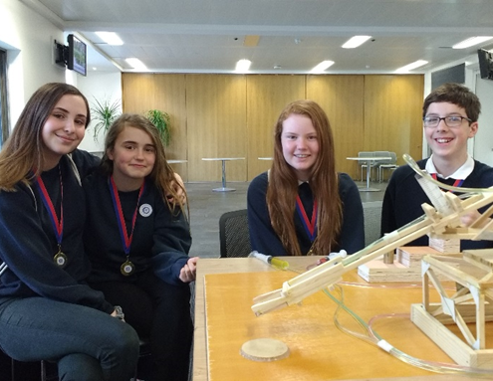
Examples of Partnership Work this session
Little Lighthouse Project
Primary & Secondary Engineer
Bloodhound Project
CLPL sessions – Early Years, Primary Science Mentors, Improving Gender Balance
Moray Skills Pathway – Sector Days/Activity Overview Guides for STEM
DYW Moray videos showcasing STEM careers
Notes:
The Little Lighthouse Project – SCDI/Moray Council Learning Technologists and a number of our primary schools(). I was invited out to see an excellent example of how this was being embedded into an IDL by Brenda King at St Sylvesters PS.
You have already seen a snapshot of Primary and Secondary Engineer in Moray. So far 2/3 of our primary schools have benefitted from the CPD training and all of our secondary schools. We have had a great Moray Celebration Event and represented Moray at the North/East of Scotland final. Actually a key part of this for me has been hearing from teachers about young people who have engaged with this project in a way that they have perhaps not done with other aspects of school.
BloodHound Project – Moray College is the lead in this project. We are now in the stage that we are ready to offer this project out to our schools for STEM Clubs/STEM events and it will form a part of next years Moray STEM week. For more details go over to the BloodHound stand in the marketplace.
CLPL Sessions – Extension of the SSERC PCP into a Moray Primary Science Mentor Programme. This will be running again next session and I know we already have interested teachers. Early Years CPD – four sessions this year and plans for further sessions next year. Joint CPD with Primary/Secondary and Moray College – we had a session with the IOP this year and I’m working with the RSC and RSB for sessions next year. Improving Gender Balance – after a great CPD yesterday with Moray HTs this will be rolled out across Moray in all sectors (MC/SDS/DYW Moray)
Moray Skills Pathway Sector Days – looking forward to a Land Based Sector Day with secondary pupils next week organised by Maxine Scott. The AOGs will go live on the Moray Skills Pathway website – these help practitioners to embed CES into their lessons. A number of these are STEM based so far…because I’ve been working on them with schools!
DYW Moray have created a number of videos that showcase different careers around Moray and STEM is a key focus in many of these.

Slide 11
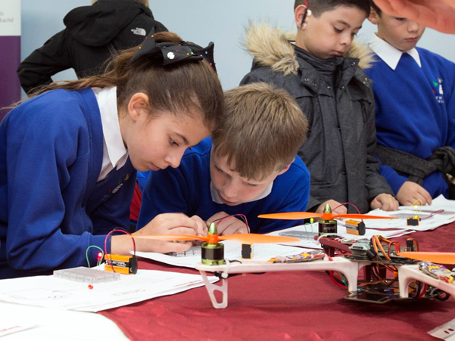
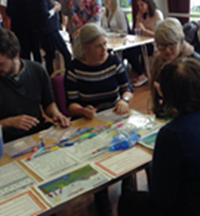
Next Steps…
Notes:
Tonight is really launching our work together in Moray.
Over the next year we will refine our support and offers to meet the needs that YOU tell us about. We will move forward with the aims defined in our position statement.
The National STEM Strategy will be taken forward in STEM Hubs based around the Colleges. At the recent UHI meeting I felt that in Moray we have already been moving forward with the actions outlined this evening and we will continue to work within this group to make sure that Moray has a strong voice within the UHI STEM HUB.

