Slide 1
RAF 100 STEM Project - Moray
1998-2008 Remotely Piloted Air Systems

Slide 2
RAF100: Aiming for Awesome Introduction
Aiming for Awesome celebrates the centenary of the RAF and explores the engineering achievements of the RAF over the last 100 years.
There are 10 lessons, each covering a different decade of RAF history.
1918-1928: Aircraft design
1928-1938: Radar
1938-1948: Speed record
1948-1958: Ejection seat
1958-1968: Code breaking
1968-1978: Satellite age
1978-1988: Disaster relief
1988-1998: Logistics challenge
1998-2008: Remotely piloted air systems
2008-2018: Stealth

Slide 3
RAF100: Aiming for Awesome – Moray Project Report
As well as the STEM activities, each week you will find out a bit more about the topic through research.
Over the course of the 10 lessons you will create a project report.
The Project Report will contain:
A page for each weeks topic with:
Reflection on what you did in the lesson and what you learned.
What you found out in your research of that weeks topic.
A final reflection telling us what you learned, what you liked best and what you might like to find out next!

Slide 4
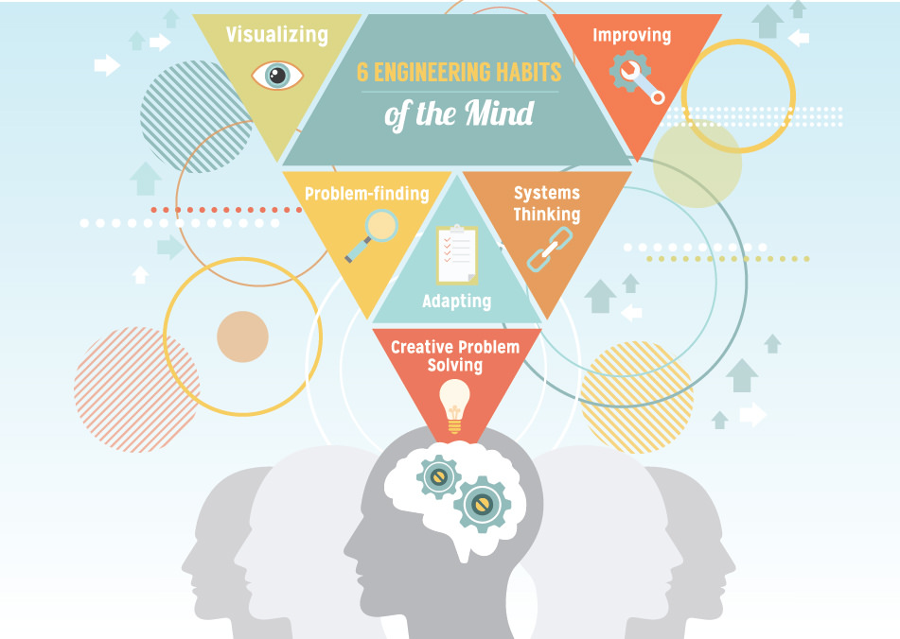
RAF100: Aiming for Awesome – Skills
Notes:
Systems thinking Seeing whole systems and parts and how they connect, pattern-seeking, recognising
interdependencies, synthesising
Problem-.nding Clarifying needs, checking existing solutions, investigating contexts, verifying
Visualising Being able to move from abstract to concrete, manipulating materials, mental rehearsal of
physical space and of practical design solutions
Improving Restlessly trying to make things better by experimenting, designing, sketching, guessing,
conjecturing, thought-experimenting, prototyping
Creative problem-solving Applying techniques from di.erent traditions, generating ideas and solutions with others,
generous but rigorous critiquing, seeing engineering as a ‘team sport’
Adaptability58 Testing, analysing, re¡ecting, rethinking, changing both in a physical sense and mentally

Slide 5
Session 9 – 1998-2008 Remotely Piloted Air Systems Learning Intentions
I can evaluate the implications for individuals and societies of the ethical issues arising from technological developments.
Using computational thinking; I can evaluate solutions in response to a design challenge (flight plans).
Challenge: Using computational thinking; I can create computing solutions in response to a design challenge (flight plans).

Slide 6
Session 9 – 1998-2008 Remotely Piloted Air Systems STEM Activities
Time to Think: Do you think self-driving cars are a good or bad idea? In pairs, come up with three positives and three concerns about self-driving cars.
Time to Investigate: You need to write a flight plan for the RPAS to get from base to landing strip A. To avoid being detected you must not fly over radar towers. Which of the three programmes should you use? Can you write a simpler flight plan to get to landing strip A?
Stretch & Challenge: The RPAS you are responsible for is stationed at landing strip A. Your challenge is to write a flight plan to deliver aid to a village at B and return to base. In pairs, test each other’s flight plans. Are your flight plans the same? If not, which flight plan is more efficient?

Slide 7
Session 9 – 1998-2008 Remotely Piloted Air Systems Research Task
PAGE 9 of Project – Title = Remotely Piloted Air Systems
Reflection on what you did in the lesson and what you learned.
Research how technology has changed since 2008. Look at Boston Dynamics and the work they are doing. How do you feel about this? How could it affect our lives?
Space X - research the Falcon Heavy. What do you think the engineers had to do to get the landing mechanism to work? What barriers did they have? How did they overcome them?
Discussion: Drone/RP Air Systems used for surveillance – safety or invasions of privacy?

Slide 8
Session 9 – 1998-2008 Remotely Piloted Air Systems Debrief
Did today’s lesson meet the Learning Intentions?
I can evaluate the implications for individuals and societies of the ethical issues arising from technological developments.
Using computational thinking; I can evaluate solutions in response to a design challenge (flight plans).
Challenge: Using computational thinking; I can create computing solutions in response to a design challenge (flight plans).
Have you completed the ninth page of RAF100: Aiming for Awesome – Moray Project Report on Remotely Piloted Air Systems?
Reflection on what you did in the lesson and what you learned.
Research how technology has changed since 2008. Look at Boston Dynamics and the work they are doing. How do you feel about this? How could it affect our lives?
Space X - research the Falcon Heavy. What do you think the engineers had to do to get the landing mechanism to work? What barriers did they have? How did they overcome them?
Discussion: Drone/RP Air Systems used for surveillance – safety or invasions of privacy?

Slide 9
RAF 100 STEM Project - Moray
Next time: 2008-2018 Stealth

