Slide 1
RAF 100 STEM Project - Moray
1968-1978 Satellite Age

Slide 2
RAF100: Aiming for Awesome Introduction
Aiming for Awesome celebrates the centenary of the RAF and explores the engineering achievements of the RAF over the last 100 years.
There are 10 lessons, each covering a different decade of RAF history.
1918-1928: Aircraft design
1928-1938: Radar
1938-1948: Speed record
1948-1958: Ejection seat
1958-1968: Code breaking
1968-1978: Satellite age
1978-1988: Disaster relief
1988-1998: Logistics challenge
1998-2008: Remotely piloted air systems
2008-2018: Stealth

Slide 3
RAF100: Aiming for Awesome – Moray Project Report
As well as the STEM activities, each week you will find out a bit more about the topic through research.
Over the course of the 10 lessons you will create a project report.
The Project Report will contain:
A page for each weeks topic with:
Reflection on what you did in the lesson and what you learned.
What you found out in your research of that weeks topic.
A final reflection telling us what you learned, what you liked best and what you might like to find out next!

Slide 4
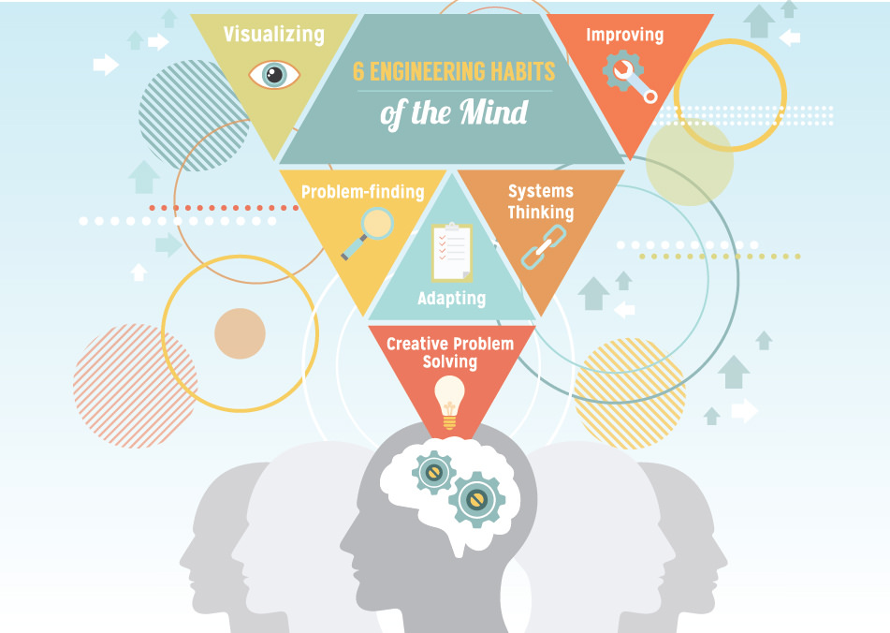
RAF100: Aiming for Awesome – Skills
Notes:
Systems thinking Seeing whole systems and parts and how they connect, pattern-seeking, recognising
interdependencies, synthesising
Problem-.nding Clarifying needs, checking existing solutions, investigating contexts, verifying
Visualising Being able to move from abstract to concrete, manipulating materials, mental rehearsal of
physical space and of practical design solutions
Improving Restlessly trying to make things better by experimenting, designing, sketching, guessing,
conjecturing, thought-experimenting, prototyping
Creative problem-solving Applying techniques from di.erent traditions, generating ideas and solutions with others,
generous but rigorous critiquing, seeing engineering as a ‘team sport’
Adaptability58 Testing, analysing, re¡ecting, rethinking, changing both in a physical sense and mentally

Slide 5
Session 6 – 1968-1978 Satellite Age Learning Intentions
I can demonstrate and record, through practical investigations, that light travels in straight lines and that it can be reflected by highly-polished surfaces and that curved faces can distort the image.
I can apply this knowledge to explain how satellite dishes work

Slide 6
Session 6 – 1968-1978 Satellite Age STEM Activities
Time to demonstrate:
Demonstrate how an event is broadcast around the world using satellites
Time to investigate:
Investigate how light travels in straight lines
Investigate how light is reflected by mirrors – the relationship between the angle of light hitting the mirror (incidence) and the light reflected (reflected ray).

Slide 7
Session 6 – 1968-1978 Satellite Age Research Task
PAGE 6 of Project – Title = Satellite Age
Reflection on what you did in the lesson and what you learned.
How many satellites are currently in orbit?
Who owns the satellites?
What happens to de-commissioned satellites?
Can you design a method to bring old satellites back to earth to clean up or orbit?

Slide 8
Session 6 – 1968-1978 Satellite Age Debrief
Did today’s lesson meet the Learning Intentions?
I can demonstrate and record, through practical investigations, that light travels in straight lines and that it can be reflected by highly-polished surfaces and that curved faces can distort the image.
I can apply this knowledge to explain how satellite dishes work
Have you completed the sixth page of RAF100: Aiming for Awesome – Moray Project Report on Satellite Age?
Reflection on what you did in the lesson and what you learned.
How many satellites are currently in orbit?
Who owns the satellites?
What happens to de-commissioned satellites?
Can you design a method to bring old satellites back to earth to clean up or orbit?

Slide 9
RAF 100 STEM Project - Moray
Next time: 1978-1988 Disaster Relief

