Slide 1
RAF 100 STEM Project - Moray
2008-2018 Stealth

Slide 2
RAF100: Aiming for Awesome Introduction
Aiming for Awesome celebrates the centenary of the RAF and explores the engineering achievements of the RAF over the last 100 years.
There are 10 lessons, each covering a different decade of RAF history.
1918-1928: Aircraft design
1928-1938: Radar
1938-1948: Speed record
1948-1958: Ejection seat
1958-1968: Code breaking
1968-1978: Satellite age
1978-1988: Disaster relief
1988-1998: Logistics challenge
1998-2008: Remotely piloted air systems
2008-2018: Stealth

Slide 3
RAF100: Aiming for Awesome – Moray Project Report
As well as the STEM activities, each week you will find out a bit more about the topic through research.
Over the course of the 10 lessons you will create a project report.
The Project Report will contain:
A page for each weeks topic with:
Reflection on what you did in the lesson and what you learned.
What you found out in your research of that weeks topic.
A final reflection telling us what you learned, what you liked best and what you might like to find out next!

Slide 4
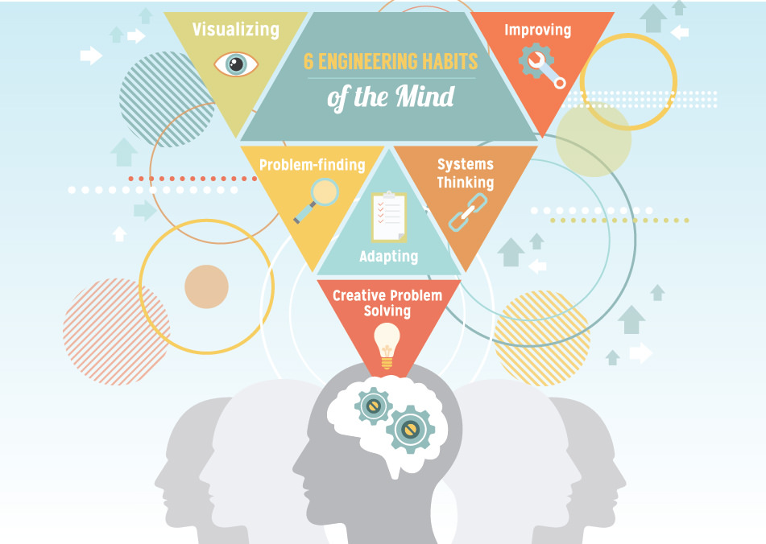
RAF100: Aiming for Awesome – Skills
Notes:
Systems thinking Seeing whole systems and parts and how they connect, pattern-seeking, recognising
interdependencies, synthesising
Problem-.nding Clarifying needs, checking existing solutions, investigating contexts, verifying
Visualising Being able to move from abstract to concrete, manipulating materials, mental rehearsal of
physical space and of practical design solutions
Improving Restlessly trying to make things better by experimenting, designing, sketching, guessing,
conjecturing, thought-experimenting, prototyping
Creative problem-solving Applying techniques from di.erent traditions, generating ideas and solutions with others,
generous but rigorous critiquing, seeing engineering as a ‘team sport’
Adaptability58 Testing, analysing, re¡ecting, rethinking, changing both in a physical sense and mentally

Slide 5
Session 10 – 2008-2018 Stealth Learning Intentions
I can demonstrate that white light/sunlight can be dispersed to show the colours of the visible spectrum (red, orange, yellow, green, blue, indigo and violet).
I can explain that we see objects because they give out or reflect light rays that enter our eyes.
Drawing on findings from practical investigations I can describe the effect that coloured filters have on white light and how they can be used to make other colours.
I can explain how we can recognise the colour of an object due the reflection and absorption of particular parts of the visible spectrum.
I have investigated how the position, shape and size of a shadow depend on the position of the object in relation to the light source.

Slide 6
Session 10 – 2008-2018 Stealth STEM Activities
Time to Investigate – 1: How are different colours made?
Stretch & Challenge: Use the filters to work out how to make the secondary colours of light.
Time to Investigate – 2: The size and shape of an aircraft is also important to consider to avoid it being detected. Shine a torch on the cut-outs of the RAF aircraft through the ages. What do you notice about the area of the shadows? Write a method to investigate how the shadow changes for each of the cut-outs.
Time to Think: What do you think you will see if you look into the corner cube, or retroreflector? Do you think it will be different if you look at the vertex from the other side?

Slide 7
Session 10 – 2008-2018 Stealth Research Task
PAGE 10 of Project – Title = Stealth
Reflection on what you did in the lesson and what you learned.
Light Vs Pigment (Paint) Colours – What are the 3 primary colours of light and the 3 primary colours in paint?
What colours do animals see? Humans, Insects, Mantis Shrimp
Why would an animal use camouflage?
How do aircraft make themselves invisible and deflect missile attack?

Slide 8
Session 10 – 2008-2018 Stealth Debrief
Did today’s lesson meet the Learning Intentions?
I can demonstrate that white light/sunlight can be dispersed to show the colours of the visible spectrum (red, orange, yellow, green, blue, indigo and violet).
I can explain that we see objects because they give out or reflect light rays that enter our eyes.
Drawing on findings from practical investigations I can describe the effect that coloured filters have on white light and how they can be used to make other colours.
I can explain how we can recognise the colour of an object due the reflection and absorption of particular parts of the visible spectrum.
I have investigated how the position, shape and size of a shadow depend on the position of the object in relation to the light source.
Have you completed the tenth page of RAF100: Aiming for Awesome – Moray Project Report on Stealth?
Reflection on what you did in the lesson and what you learned.
Light Vs Pigment (Paint) Colours – What are the 3 primary colours of light and the 3 primary colours in paint?
What colours do animals see? Humans, Insects, Mantis Shrimp
Why would an animal use camouflage?
How do aircraft make themselves invisible and deflect missile attack?

Slide 9
RAF 100 STEM Project – Moray Self Evaluation of Project Report:
Check that your Project Report contains:
A page for each weeks topic with:
Reflection on what you did in the lesson and what you learned.
What you found out in your research of that weeks topic.
A final reflection telling us what you learned, what you liked best and what you might like to find out next!

Slide 10
RAF 100 STEM Project - Moray

