Slide 1
RAF 100 STEM Project - Moray
1918-1928 Aircraft Design

Slide 2
RAF100: Aiming for Awesome Introduction
Aiming for Awesome celebrates the centenary of the RAF and explores the engineering achievements of the RAF over the last 100 years.
There are 10 lessons, each covering a different decade of RAF history.
1918-1928: Aircraft design
1928-1938: Radar
1938-1948: Speed record
1948-1958: Ejection seat
1958-1968: Code breaking
1968-1978: Satellite age
1978-1988: Disaster relief
1988-1998: Logistics challenge
1998-2008: Remotely piloted air systems
2008-2018: Stealth

Slide 3
RAF100: Aiming for Awesome – Moray Project Report
As well as the STEM activities, each week you will find out a bit more about the topic through research.
Over the course of the 10 sessions you will create a project report.
The Project Report will contain:
A page for each weeks topic with:
Reflection on what you did in the session and what you learned.
What you found out in your research of that weeks topic.
A final reflection telling us what you learned, what you liked best and what you might like to find out next!

Slide 4
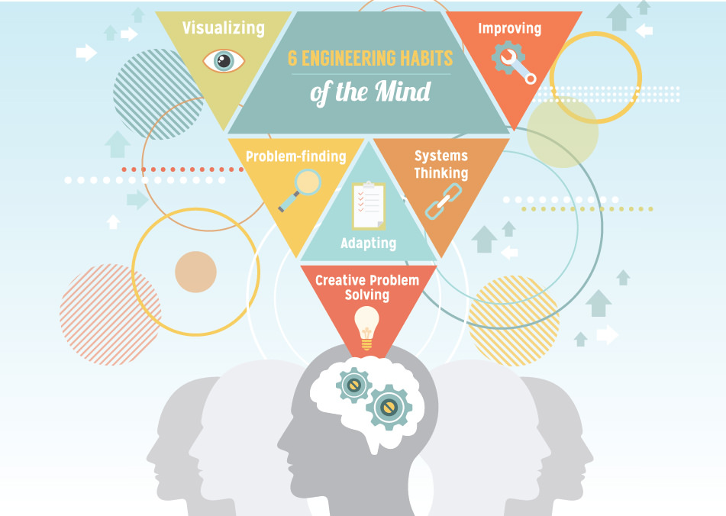
RAF100: Aiming for Awesome – Skills
Notes:
Systems thinking Seeing whole systems and parts and how they connect, pattern-sni¢ng, recognising
interdependencies, synthesising
Problem-.nding Clarifying needs, checking existing solutions, investigating contexts, verifying
Visualising Being able to move from abstract to concrete, manipulating materials, mental rehearsal of
physical space and of practical design solutions
Improving Restlessly trying to make things better by experimenting, designing, sketching, guessing,
conjecturing, thought-experimenting, prototyping
Creative problem-solving Applying techniques from di.erent traditions, generating ideas and solutions with others,
generous but rigorous critiquing, seeing engineering as a ‘team sport’
Adaptability58 Testing, analysing, re¡ecting, rethinking, changing both in a physical sense and mentally

Slide 5
Session 1 - 1918-1928: Aircraft design Learning Intentions
I will investigate the STEM behind aircraft design.
I will explore the forces acting on an aircraft during flight
I will use the iterative design process to design and improve the perfect paper aircraft.
I will find out about the career of Aerospace Engineer and what skills are needed in this job.

Slide 6
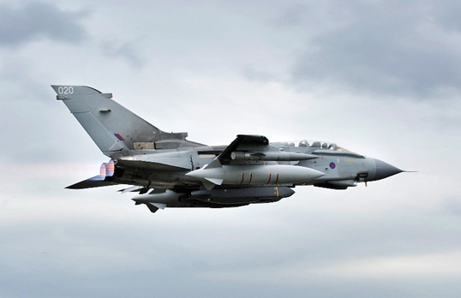
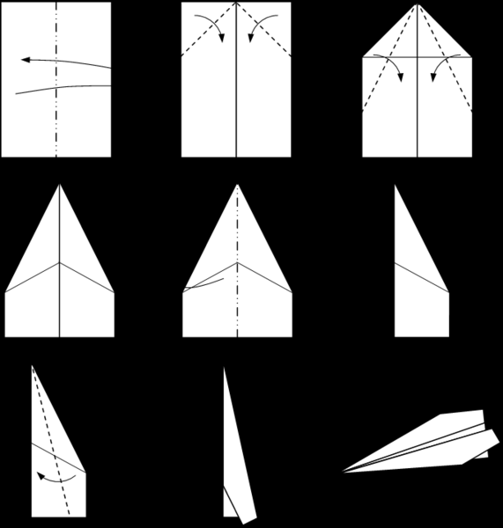
Session 1 - 1918-1928: Aircraft design STEM Activities
Time to Think
Stretch & Challenge
Model Aircraft
Part 1
Part 2
Part 3

Slide 7
Session 1 - 1918-1928: Aircraft design Research Task
Go onto the website www.myworldofwork.co.uk and search for aerospace engineer.
What is an aerospace engineer?
What sorts of things might you do in this job?
What are the top skills that people in the job might have?
How might you get into this job?

Slide 8
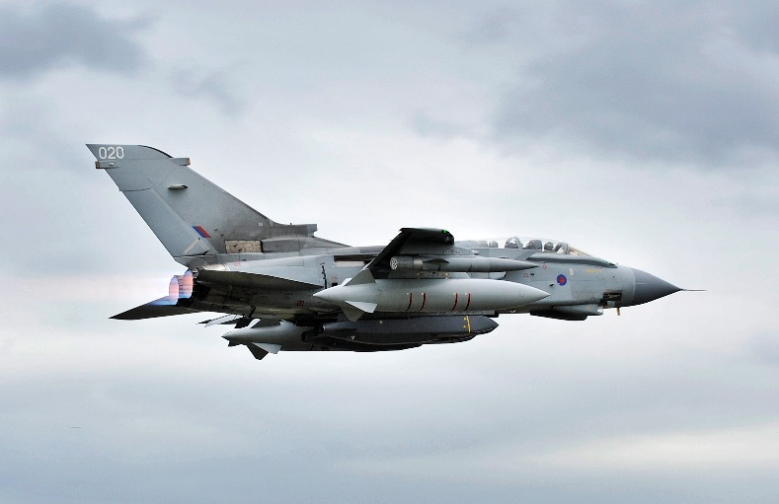
Session 1 - 1918-1928: Aircraft design Debrief
Did today’s lesson meet the Learning Intentions?
I will investigate the STEM behind aircraft design.
I will explore the forces acting on an aircraft during flight
I will use the iterative design process to design and improve the perfect paper aircraft.
I will find out about the career of Aerospace Engineer and what skills are needed in this job.
Have you completed the first page of RAF100: Aiming for Awesome – Moray Project Report on Aircraft Design?

Slide 9
RAF 100 STEM Project - Moray
Next time: 1928-1938: Radar

