Slide 1
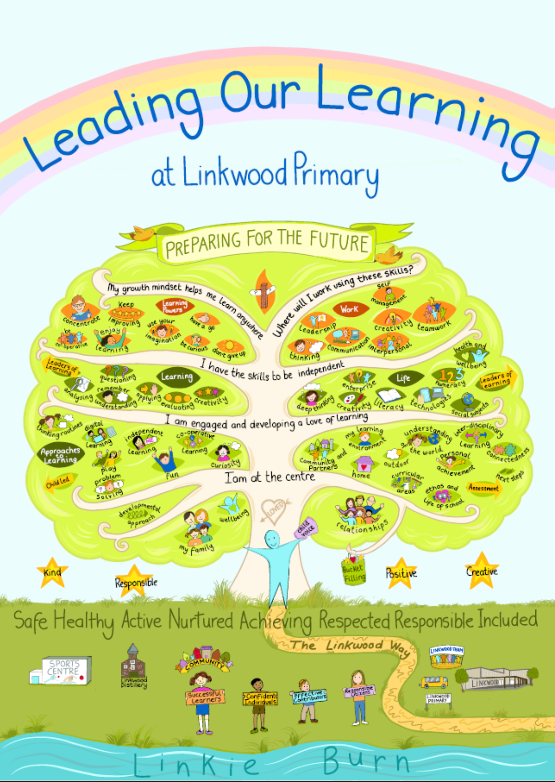
Leading Our Learning At Linkwood
Pupil Voice

Slide 2
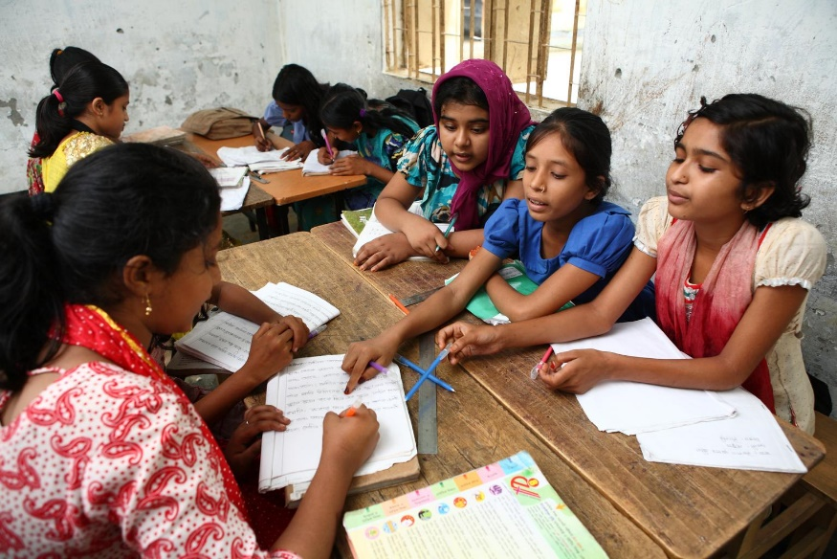
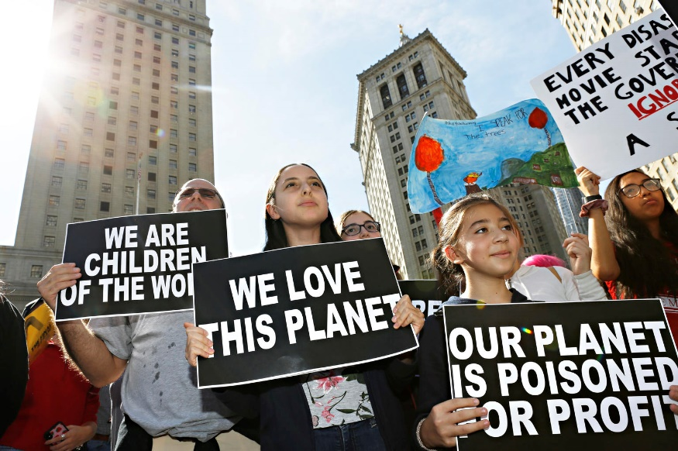
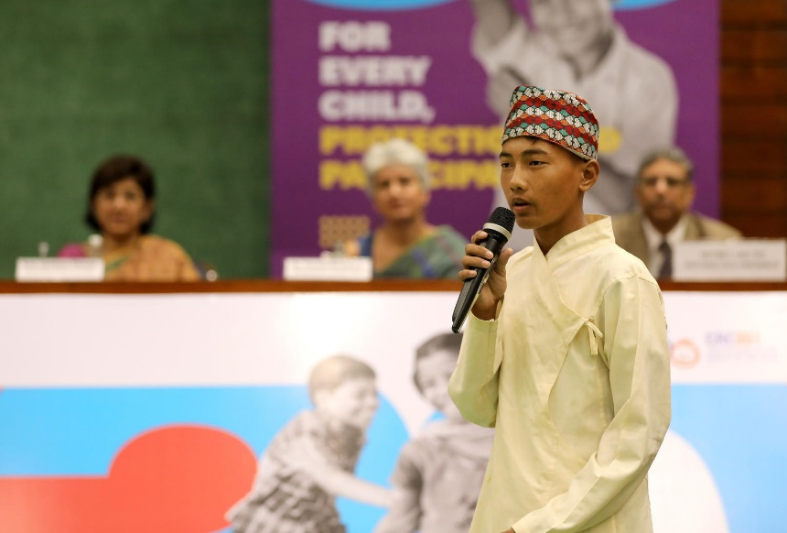
GUESS THE ARTICLE
@UNICEF/Kiron
@ UNICEF/ Chalasani
@UNICEF/Altaf Ahmad
These pictures provide a clue to this week’s articles.
How do these pictures help you? Can you guess how they are linked together?
Write down your thoughts or discuss with someone in your class.

Slide 3
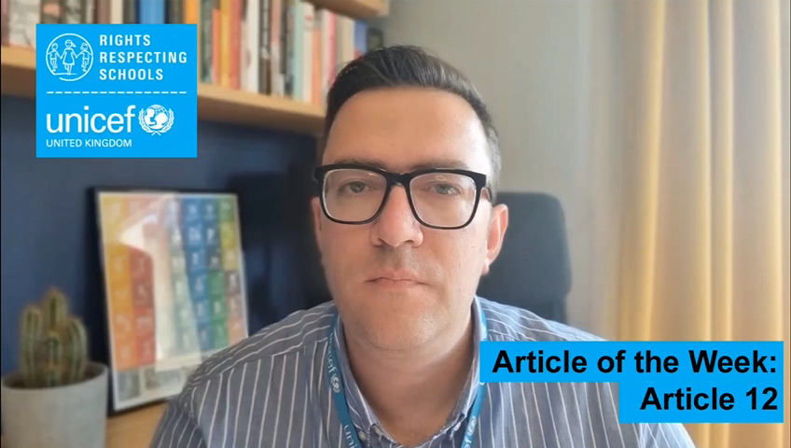
INTRODUCING ARTICLE 12
Steven Kidd, RRSA Professional Adviser, introduces Article 12
Article 12 – respect for the views of the child
Every child has the right to express their views, feelings and wishes in all matters affecting them, and to have their views considered and taken seriously. This right applies at all times, for example during immigration proceedings, housing decisions or the child’s day-to-day home life.
Click here to watch on YouTube

Slide 4
EXPLORING ARTICLE 12
Why should you be able to share your views and opinions on matters that affect you?
Have a think and write down some answers.

Slide 6
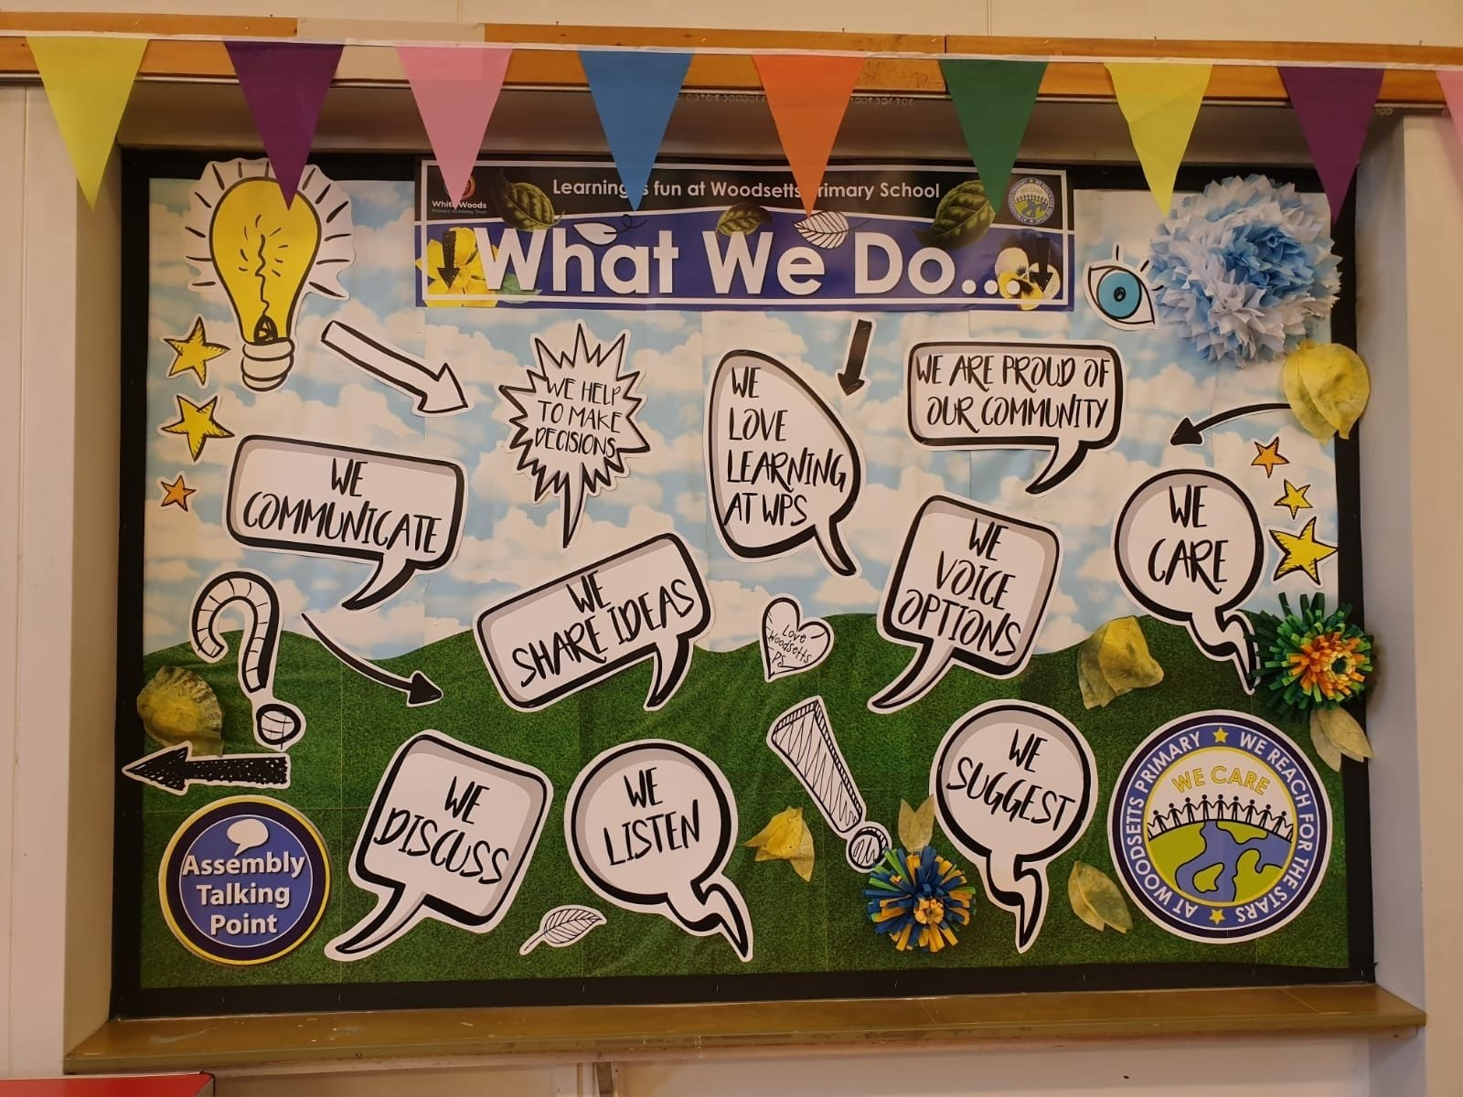
Leadership Groups at Linkwood
Pupil Council P1-7
Eco Schools P1-7
School Ambassadors P5-7
Military Leaders P4-7
Health and Wellbeing with Sensory Garden Gang P1-7
Rota Kids P7
RRS Award P1-7
Digital Schools Award P4-7
Anti Bullying Gang P1-7
Makaton Leaders P1-7
Reading School Award P1-7
STEM Leaders P4-7
Play Leaders P7
Junior Road Safety Officers
Linkwood Leaders Award P7

Slide 7
What is a Pupil Council:
Gives pupils the chance to tell teachers and staff their ideas. Represents each class in the school. Meets regularly to talk about important school issues and projects. Puts forward the class views at council meetings. Takes forward the views of the very young classes, who may find it difficult to put forward other's opinions.
Positions
Staff Leader- Mrs Stevenson
Chairperson (P7)
Secretary (P7)
Class reps (P1-7)

Slide 8
Eco Schools
Committee
1 Eco Committee 2 Environmental Review 3 Action Plan 4 Measuring 5 Curriculum 6 Community 7 Eco Code
Classes
P1 Litter and Waste P2 Food and Environment P3 Climate Action P4 Biodiveristy P5 Water P6 Health & Wellbeing and Transport P7 Energy
Positions
Staff Leader Mr Lake/ Miss Hennessey
Chairperson (P7)
Secretary (P6)
Class reps (P1-7)
https://www.keepscotlandbeautiful.org/climate-action-schools/eco-schools/new-to-eco-schools/
https://thesustainablesacademy.com/

Slide 9
School Ambassadors
What is a School Ambassador:
Shares with others why Linkwood is a special place to learn and develop Welcomes visitors and gives tours of the school Represents pupil voice and tells others how our learners feel Is confident and willing to meet new people and share good news
Positions
Staff Leader- Mrs Herschell
Class reps (P5-7)

Slide 10
Rota Kids
What are Rota Kids?:
RotaKids is a fun and exciting to get involved with important activities in the community, all while having a great time in the process. You can gain a valuable experience in helping others and learning interesting, new things. It also brings an exciting and practical approach to becoming a Responsible Citizen Some examples are: Filling shoeboxes with toys for underprivileged children around the world as part of the Rotary Shoebox Scheme Raising money for charities in your area with a sponsored bike ride, non-uniform day, cake sale or school fun days Supporting the environment by setting a nature project in the school playground or local community Collecting books for children in countries around the world
Positions
Staff Leader- Mrs Sim
Chairperson (P7)
Vice Chairperson (P7)
Secretary (P7)
Treasurer (P7)
P7 Class

Slide 11
Anti Bullying Gang
What does the Anti Bullying Gang do?
Anti Bullying Gang work alongside the P7 Peer Mediators to support kind play in the playground They will run our Anti Bullying week and present at assembly They will help us review our Anti Bullying policy and share ideas on how to help all at Linkwood say ‘No to Bullying’ They will lead us through the Kindness Challenge with NSPCC Share information about Childline.org and RespectMe.org.uk
Positions
Staff Leader- Mrs Sim, Mrs Fraser
Class reps (P1-7)
P7 Peer Mediators- rota

Slide 12
Makaton Leaders
What do Makaton Leaders do?
They will meet Miss Dunlop each week to learn a sign of the week. They will take turns to share our sign of the week at assemblies They will raise awareness of the importance of learning Makaton with us all. They will make videos to share with our school community
Positions
Staff Leader- Miss Dunlop
Class reps (P1-7)

Slide 13
Reading School Leaders
What do Reading School Leaders do?
Plan reading groups or events, including World Book Day Share favourite books and meet other readers Work together in a group Represent our school’s reading choices Get the whole school excited about reading!
Positions
Staff Leader- Mrs MacGregor
Class reps (P1-7)

Slide 14
Sensory Garden Gang
What is the Sensory Garden Gang?:
Gives pupils the chance to meet others who enjoy learning about and looking after plants Keep raised terrace tidy and plant watered/ looked after Enjoy time at lunchtimes chilling in the sensory space
Positions
Staff Leader- Mr Simpson
Class reps (P1-7)

Slide 15
Health and Wellbeing Gang
What is the Health and Wellbeing Gang?:
Helps to ensure we are a healthy school Helps us prepare for Healthy Fridays in May- Mind, body, diet Reminds us how to look after ourselves by sharing important messages Works with the Sensory Garden Gang to ensure we have places to relax and be calm
Positions
Staff Leader- Mrs Whitlee/ Mrs McCann
Class reps (P1-7)
https://www.keepscotlandbeautiful.org/eco-schools/topics/health-wellbeing/
https://www.keepscotlandbeautiful.org/media/egilrdd0/environmental-review-general-editable.pdf

Slide 16
Digital Schools Award
What is the Digital Schools Awards?:
The Digital Schools Award Scotland is a national award to promote, recognise and encourage a whole school approach to the use of digital technology in our school, Digital Leaders will support the whole school to develop key digital skills Digital Leaders will help run a Digital Lunchtime club. Digital Leaders will help us purchase new digital equipment
Positions
Staff Leader- Miss Main and Mrs Pirie
Chairperson (P)
Secretary (P)
Class reps (P4-7)

Slide 17
What is the RRS Awards?:
The UNICEF UK Rights Respecting Schools Award supports schools across the UK to embed children’s human rights in their ethos and culture. The Award recognises achievement in putting the UN Convention on the Right of the Child (CRC) at the heart of a school’s practice to improve wellbeing and help all children and young people realise their potential. The Award is based on principles of equality, dignity, respect, non-discrimination and participation
Positions
Staff Leader- Miss Hancock, Miss Tunnicliffe
Chairperson (P7)
Secretary (P7)
Class reps (P1-7)

Slide 18
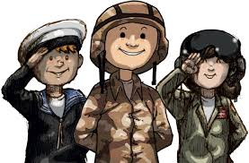
Military Kids Club
What is the Military Kids Club?:
Gives pupils the chance to meet others who may be experiencing the same things. Meet adults who are aware of what your family are coping with Have fun sharing ideas and tips for one another.
Positions
Staff Leader- Ms Bury
Chairperson (P7)
Secretary(P6 or 7)
Members

Slide 19
Junior Road Safety Officers
What do Reading School Leaders do?
They will make an action plan to help us understand the importance of road safety They will help keep our school grounds safe They will review our active travel plan https://www.highland.gov.uk/info/20005/roads_and_pavements/87/road_safety/6
Positions
Staff Leader- Miss Johnson
Chairperson (P7)
Secretary (P7)
Class reps (P1-7)

