Slide 1
OPTION 1 - KEITH

Slide 2
Keith Grammar School Trail Running Club
Fancy a bit of a run? Join Mr Cowie and Mr Paterson on a 10 mile circuit of Keith on road, path and trail. The route will start and end at the school.
You’ll need a pair of running trainers, some hydration and food.
Factoring in the different terrain and rest stops, we would expect to take between 2.5 → 3 hours to complete our circuit but will obviously take it as it comes on the day.
If you are interested then come and speak to one of us BEFORE you sign up.
NOTE: 10 miles is a long way (from here to Huntly) and as a result, a good level of physical fitness is required.

Slide 3
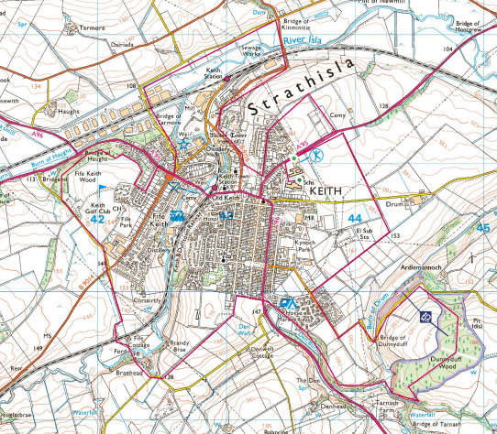
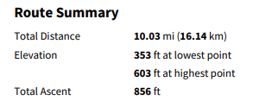
Keith Grammar School Running Club
Activity Day 1 – Thursday 30th May
Keith Clockwise 10 miler
M. COWIE
R. PATERSON

Slide 4
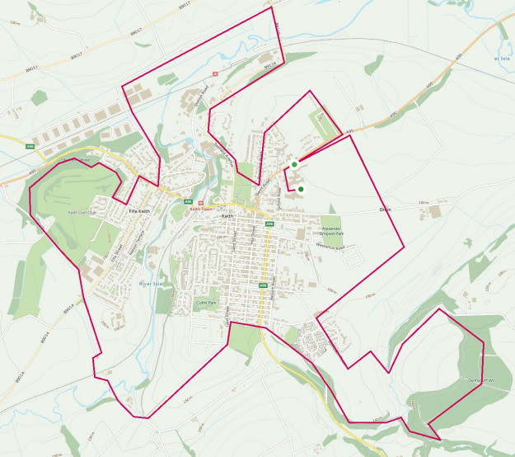
10 MILE ROUTE ON A MIX OF ROAD / PATH / TRAIL
STOPS ROUGHLY EVERY 2 MILES
3 DROP OUT POINTS FOR KGS RETURN

Slide 5
Drop Out 2
Fife-Keith Square
6.5 miles
Drop Out 3
Banff Road
9 miles
Drop Out 1
Moss Street
3.5 miles

Slide 6
Drop Out 2
Fife-Keith Square
6.5 miles
Drop Out 1
Moss Street
3.5 miles
Drop Out 3
Banff Road
9 miles

Slide 7
KIT LIST
Appropriate running footwear for the conditions
Appropriate running clothing for the conditions
Shorts / Leggings
T-shirt / Long sleeve top
Hat or Cap
Lightweight wind cheater or waterproof jacket (if poor weather)
Sun cream
Appropriate Nutrition for 3 hours
Food (600 → 800 calories)
Hydration (500 → 1000ML)
*SEE MR COWIE / MR PATERSON IF YOU HAVE ANY QUESTIONS REGARDING THIS

Slide 8
OPTION 2 - BENNACHIE

Slide 9
Keith Grammar School Trail Running Club
Fancy a bit of a run? Join Mr Cowie and Mr Paterson on a 9 mile introductory hill run on Bennachie, Aberdeenshire.
You’ll need a pair of running trainers, some hydration and food.
Factoring in the different terrain and rest stops, we would expect to take between 3 → 4 hours to complete our circuit but will obviously take it as it comes on the day.
If you are interested then come and speak to one of us BEFORE you sign up.
NOTE: 9 miles on a hill is a long way and as a result, a good level of physical fitness is required.

Slide 10
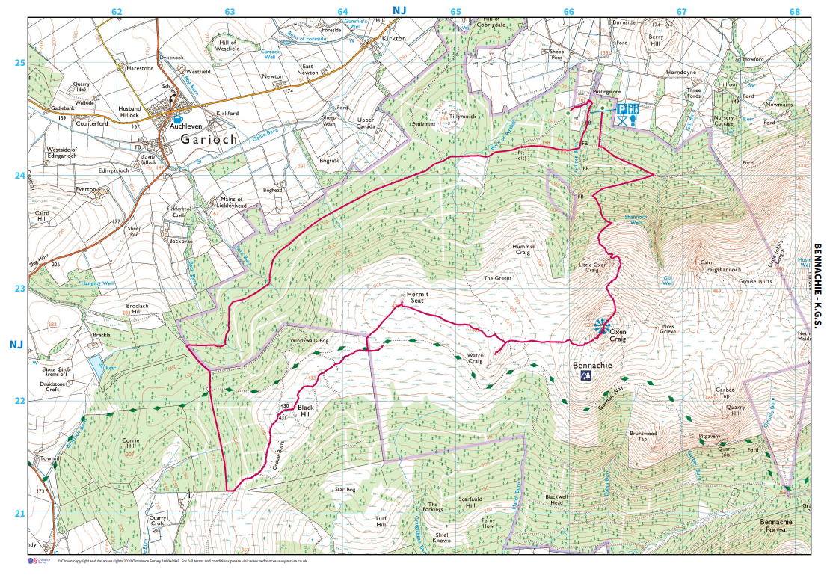
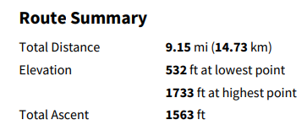
Keith Grammar School Running Club
Activity Day 1 – Thursday 30th May
Bennachie Loop
M. COWIE
R. PATERSON

Slide 11
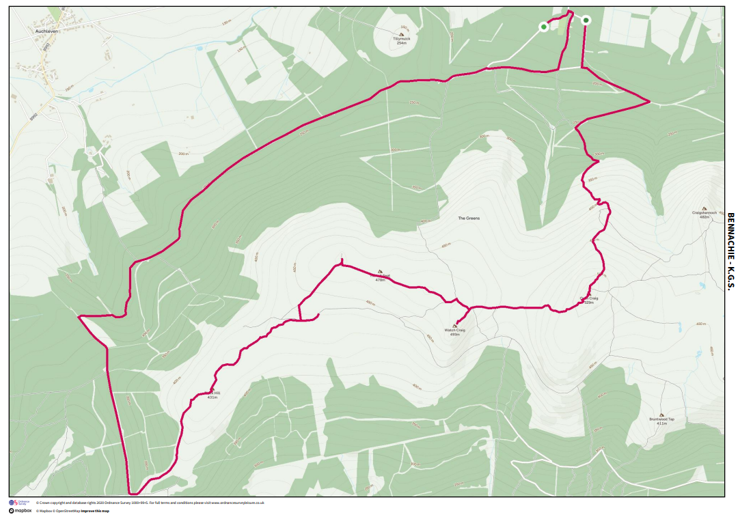
Drop Out Point
5 Miles (Black Hill)
Location of Drop-Out Point
Easier descent and run back to the beginning
Actual Route shown on slide below

Slide 12
Drop Out Point
5 Miles (Black Hill)

Slide 13
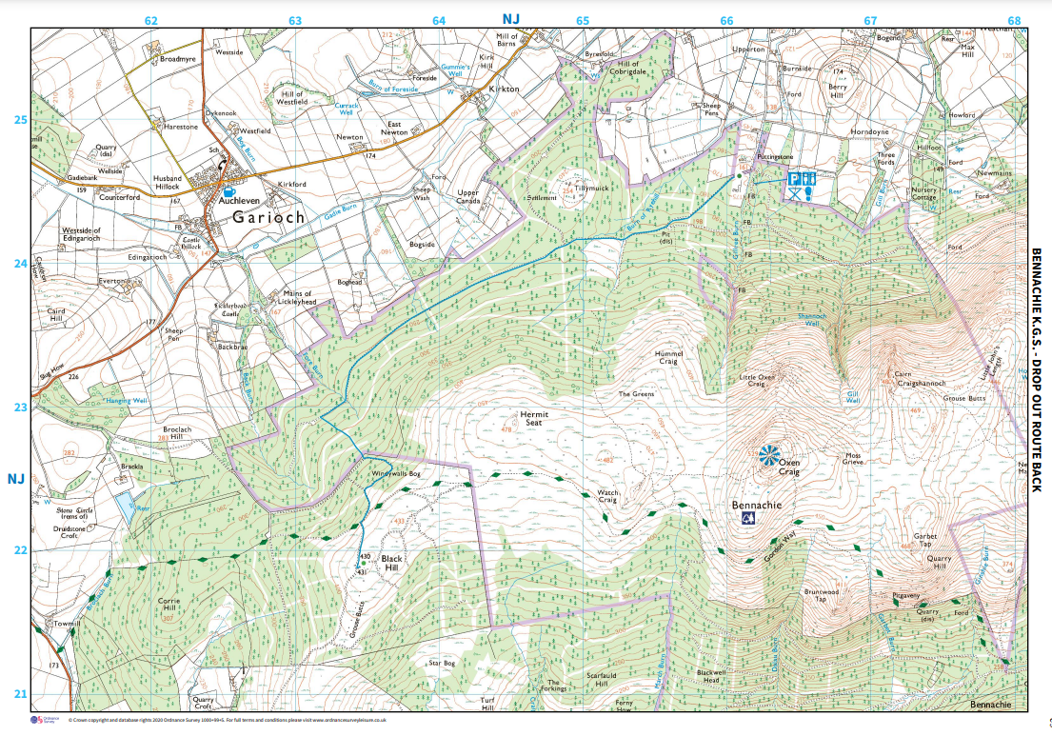
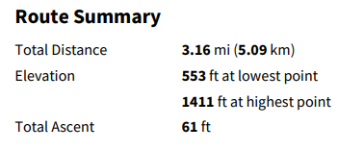
Activity Day 1 – Thursday 30th May
Bennachie Loop
DROP-OUT ROUTE BACK
M. COWIE
R. PATERSON

Slide 14
KIT LIST
Appropriate running footwear for the conditions
Appropriate running clothing for the conditions
Shorts / Leggings
T-shirt / Long sleeve top
Hat or Cap
Lightweight wind cheater or waterproof jacket (if poor weather)
Sun cream
Appropriate Nutrition for 3 hours
Food (600 → 800 calories)
Hydration (500 → 1000ML)
*SEE MR COWIE / MR PATERSON IF YOU HAVE ANY QUESTIONS REGARDING THIS

