Slide 1
Parents’ Guide to UCAS
The Universities and Colleges Admissions Service operates the application process for British universities.

Slide 2
Top Tips
Start research early – there are a lot of higher education options to choose from!
Know the deadlines – for some courses, the application deadline is almost a year in advance of when the course starts.
Browse through courses – so they can work out what they would enjoy or be interested in.
Go to UCAS events and course provider open days – speak to us and higher education staff to get answers to their questions.
Check entry requirements – make sure they can get the grades they need to get a place on a course.

Slide 3
UCAS Deadlines
For 2018 entry
September 2017: Ucas applications open.
15th October: Oxbridge, medicine, dentistry and veterinary medicine/science deadline.
15th January 2018: General Ucas application deadline (Prepare for the Ucas deadline with our advice hub)
25th February: Ucas Extra begins.
24th March: Art and design course application deadline (note: some may have a January deadline).
16th April: Must reply to any offers or you'll be declined (if you received decisions by 17th March).
2nd May: Must reply to any offers or you'll be declined (if you received decisions by 31st March).
3rd May: Decisions usually back from universities for January applications.
7th June: Must reply to any offers or you'll be declined (if you received decisions by 3rd May).
21st June: Must reply to any offers or you’ll be declined (if you received decisions by 7th June).
30th June: Applications received after this date are entered into Clearing.
4th July: Application deadline for Ucas Extra.
5th July: Clearing begins.
13th July: Final decisions back from universities (if you applied after 5th June but before 30th June).
30th July: Must reply to any offers (including Extra offers) or they’ll be declined.
7th August: Highers results published; Clearing vacancies published (Scotland).
16th August: A-level results published; Clearing vacancies published (England, Wales, Northern Ireland).
31st August: Adjustment closes.
20th September: Last date for applications for 2018 entry.
23rd October: The deadline for adding Clearing choices and for unis or college to accept Clearing applicants.

Slide 4
School Deadlines
UCAS 2017-2018 Deadlines (for 2018 Entry)
Most courses
1st draft 25th October
Final draft 29th November
Teacher reference 13th December
All completed and sent away by 20th December 2017
Medical Application and the Conservatoire
Music applications at the Conservatoire 2nd October 2017
Medical applications completed and sent away by 15th October 2017

Slide 5
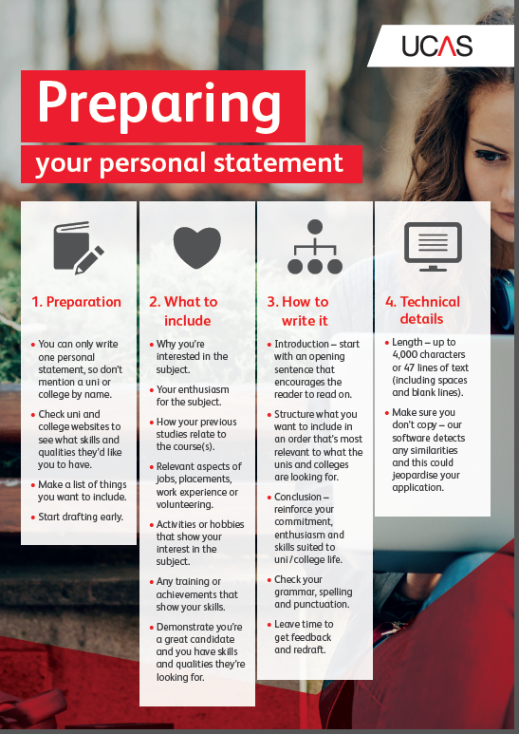

Slide 6
Erin
Throughout my life, I have always been interested in aspects of Geography. Even when I was in primary school, learning about the world was something that inspired and motivated me. My passion for this subject area developed in secondary school, so much so these classes were the highlight of my school week. I am very interested in the different facets of our world and would love to expand this knowledge at University. In Higher Geography, I gained an excellent insight into both the Human and Physical sides of Geography, and I particularly enjoyed studying the Human Impact on Cairngorm Mountain, after visiting Aviemore and carrying out research as part of a school trip. In groups we carried out a questionnaire which asked tourists where they had travelled from and we also measured the amount footpath erosion on the mountain, which was later converted into a cross-section graph. I believe the study of Geography is very relevant today as it encompasses important issues such as global climate change, sustainability and globalisation. I feel that young people need to have an understanding of these issues because they are important for the future of the planet. The study of Geography allows an understanding into other places and cultures and during this current time of conflict, it is important for us to understand, communicate and tolerate differences between societies. Geography has allowed me to develop transferable skills which have links to both Sciences and Arts. I also really enjoyed Higher German, and I really believe that learning another language is important for this type of course. This year I have chosen to further this by studying Intermediate German through the Open University YASS Programme, as my school did not offer German at Advanced Higher. This has given me the chance to take responsibility for my own learning and develop my skills of time management and self-motivation. I recently worked alongside other student linguists in organising an activities week for European Day of Languages, including assemblies, an Inter-House quiz, European sports and traditional food tasting.

Slide 7
At school I would describe myself as hardworking, determined and enthusiastic. I have always built good relationships with my teachers and I am proactive in asking questions and discussing my doubts. This year I was elected as House Captain after a rigorous selection process, and so far, this opportunity has given me the chance to develop my leadership skills, work with other pupils, and gain an insight into ways of improving the life of students by organising events, leading meetings and encouraging others. This has not only developed my confidence, but has also boosted my skills in public speaking, presenting and organisation. Peer Support is something I really enjoy and has allowed me to use my previous knowledge to assist younger pupils. The School Netball team is a hobby of mine which has taught me things that I never would have expected, such as communication, concentration and determination. Sports has never been something I was interested in participating in; however, I really enjoy taking part in competitions and learning about the individual techniques that are necessary for working in a team. In terms of work experience, I have a part-time job in a cafe, which has given me the experience to work in a fast-paced environment and has built up my self-confidence and communication skills, which has prepared me socially for the step up to University. A course that encompasses culture, languages and environment would be perfect for me as it would open up a whole new world of career opportunities in Geography, Languages and Tourism. It is a dream of mine to travel to new countries, learn about their languages, lifestyles and cultures. Studying abroad would be a great opportunity for me to experience these; University, hopefully would facilitate this. Motivated for challenge, I intend to give it my all.

Slide 8
Caitlin
Since the beginning of the Information Age, digital technology has become increasingly fundamental in every aspect of society, industry, and commerce. I believe undertaking a course in Computer Science would allow me to be a part of further exciting developments in this dynamic field. For me, the most compelling aspect of computer programming is the fact that it presents a challenge but also gives an immense sense of satisfaction when you solve a problem. I have always enjoyed solving mathematical problems; deciphering numerical puzzles in newspapers throughout my childhood undoubtedly contributed to me excelling in Maths. I am skilled at communicating and explaining difficult topics and gain satisfaction in helping others with complex mathematical problems as this helps me to gain a fuller understanding of the topics. Given the strong overlap between the logic required for Mathematics and Computer programming, Computer Science would be the perfect way of practically applying my love of Maths. I am tenacious, conscientious and have a strong work ethic which I apply to every aspect of life. I am an enthusiastic learner, picking up new subjects without difficulty; I have consistently achieved excellent grades, particularly in the STEM subjects as these interest me the most; I was delighted to achieve 100% in my National 5 Maths exam and 98% at Higher. At the end of fifth year, I was awarded the school prizes for English, Maths and Biology and I also achieved the Silver Annual Award for consistent hard work. A new challenge is studying for an Open University module in French to facilitate insight into independent study. I also attend the school Engineering Club each week in order to reinforce theoretical concepts. In my senior years, I have been proud to be a Prefect and a Peer Mediator which has given me a strong sense of responsibility. I have also been Pupil Voice Representative, putting forward the views of fellow classmates. I have also been part of the winning group for the Youth and Philanthropy Initiative, securing GBP3,000 for The Sunshine Developmental Playgroup. This involved research and communication skills as our team liaised with staff to prove that our chosen charity was most deserving.

Slide 9
I also volunteer as a library assistant in the school, enhancing my organisational abilities and for this work I am in the process of gaining a Saltire Award. As part of my Duke of Edinburgh Silver and Gold awards I have volunteered with the local Cub Scouts which has helped develop my organisational and leadership skills. Participating in Duke of Edinburgh expeditions has shown me that I am capable of pushing myself when the going gets tough. Being in the School Netball Team for three years has resulted in participation in tournaments against other schools, showing that I am an able team player, good at discussing and communicating tactics with my fellow team members. All of this will stand me in good stead at university as these skills are transferrable. Juggling academic, leisure and volunteering commitments with a part-time job delivering newspapers demonstrates that I am sufficiently self-disciplined. Currently, I work as a customer assistant in my local Tesco supermarket where I have been fortunate enough to be trained in all departments. I have also been offered the exciting opportunity to undertake work experience next summer at Gigabyte Software Limited in London to give me first-hand experience of a software development firm. I eagerly accepted this placement as it will give me an invaluable insight into how software is developed for business, giving me the chance to put my theoretical knowledge of computing into practice. This is such an exciting time in the world of Computer Science with so many new developments and I truly believe that my logical and mathematical skills have put me in the perfect position to be able to contribute to the innovative future of digital technology.

Slide 10
Funding
Tuition fees
If you live in Scotland and choose to study full-time at a Scottish university or college, you will not have to pay tuition fees. However, you will need to apply to SAAS to have your tuition fees paid for you, as this is not automatic.
Scottish students who wish to study elsewhere in the UK will be charged the standard tuition fees for their chosen course provider, but may apply for a loan to cover the costs through SAAS.
Part-time students with an individual income of up to £25,000 per year can apply for a fee grant. The amount paid depends on your course.
http://www.saas.gov.uk/_forms/funding_guide.pdf

Slide 12
Be prepared for results day – make sure they’re prepared for all the possible outcomes.
Understand how Extra and Clearing work – different ways to apply for more courses.
Visit UCAS’ Facebook and Twitter regularly to get advice and ask questions

Slide 13
SIGN UP
https://web.ucas.com/parents-signup
DON’T LIKE READING?
https://www.ucas.com/connect/videos

Slide 14
Support in school
Guidance team
SDS Careers Adviser
Subject teachers

