Slide 1
RotaKids at Dallas Primary School
2017-18

Slide 2
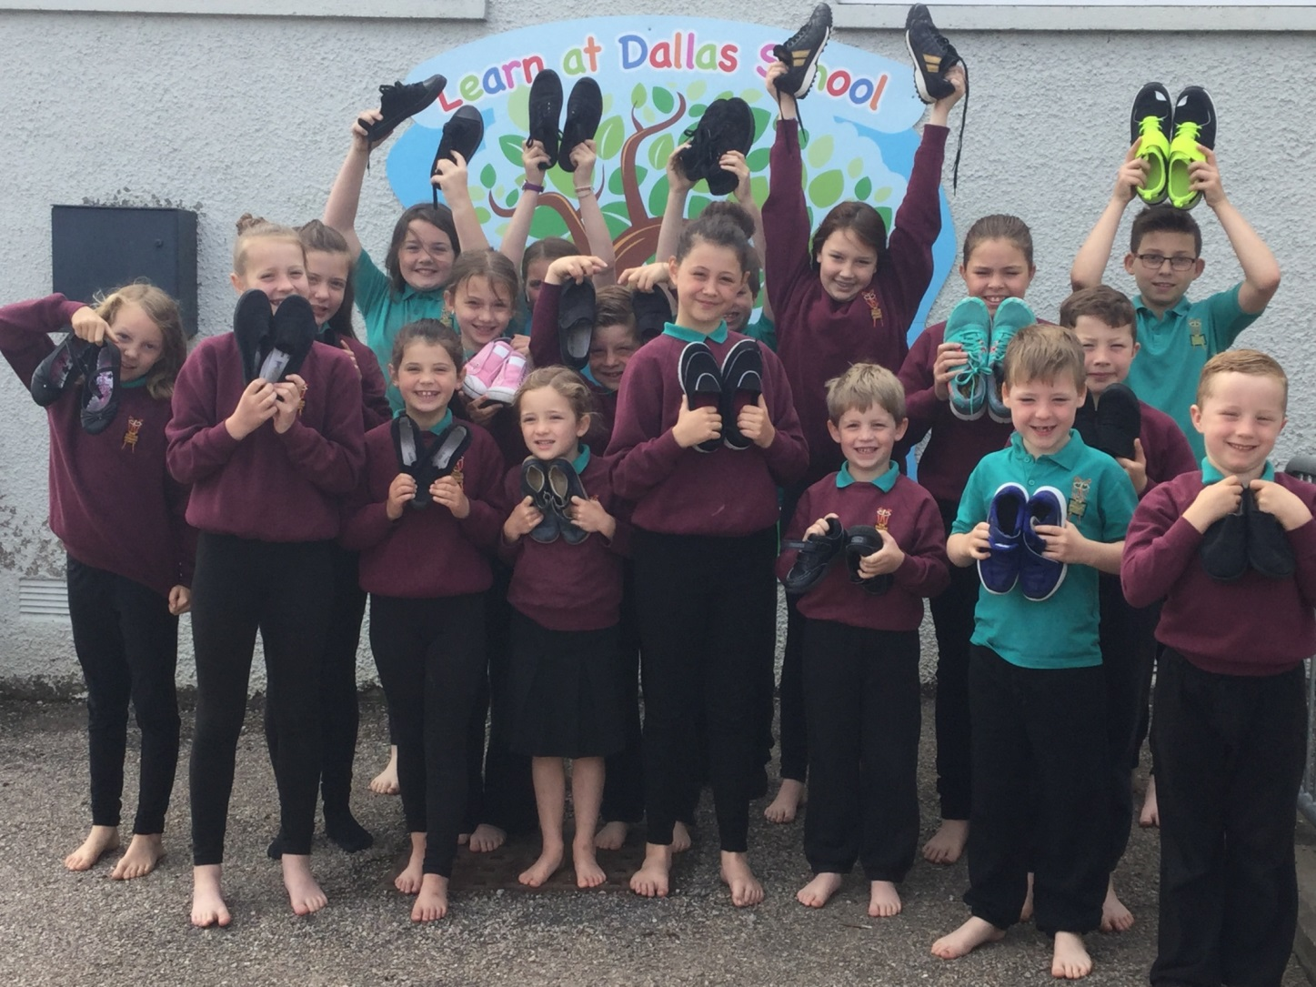
Shoes for Africa

Slide 3
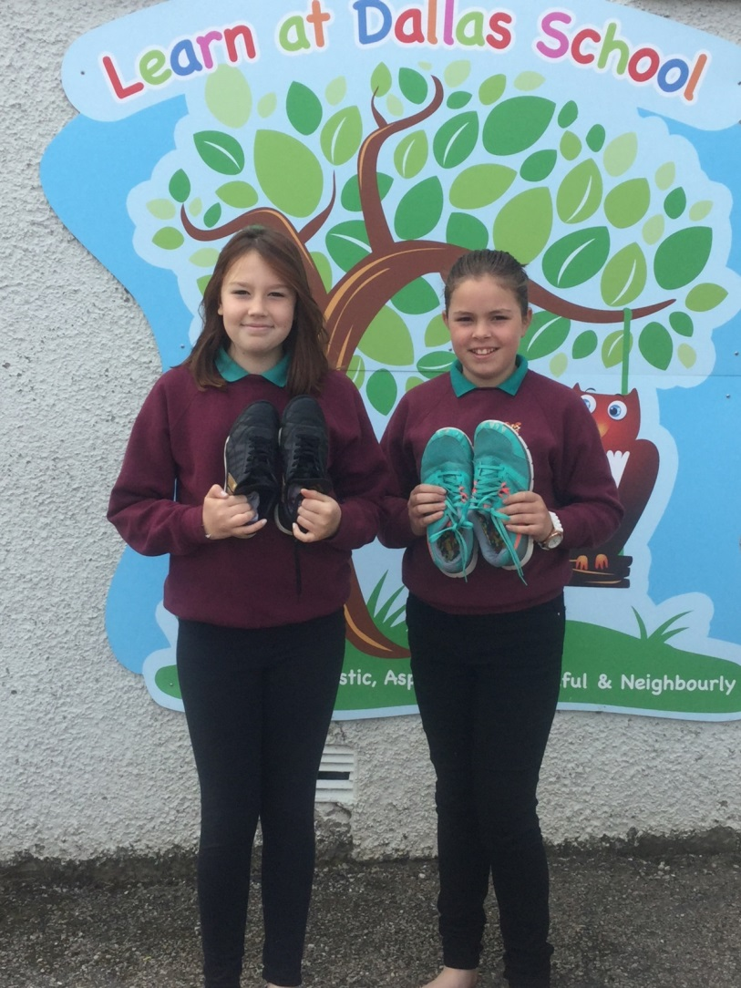
Shoes for Africa – a UNICEF project
We donated our shoes to raise money so children in Africa can go to school.

Slide 4
End Polio – Awareness raising assembly

Slide 5
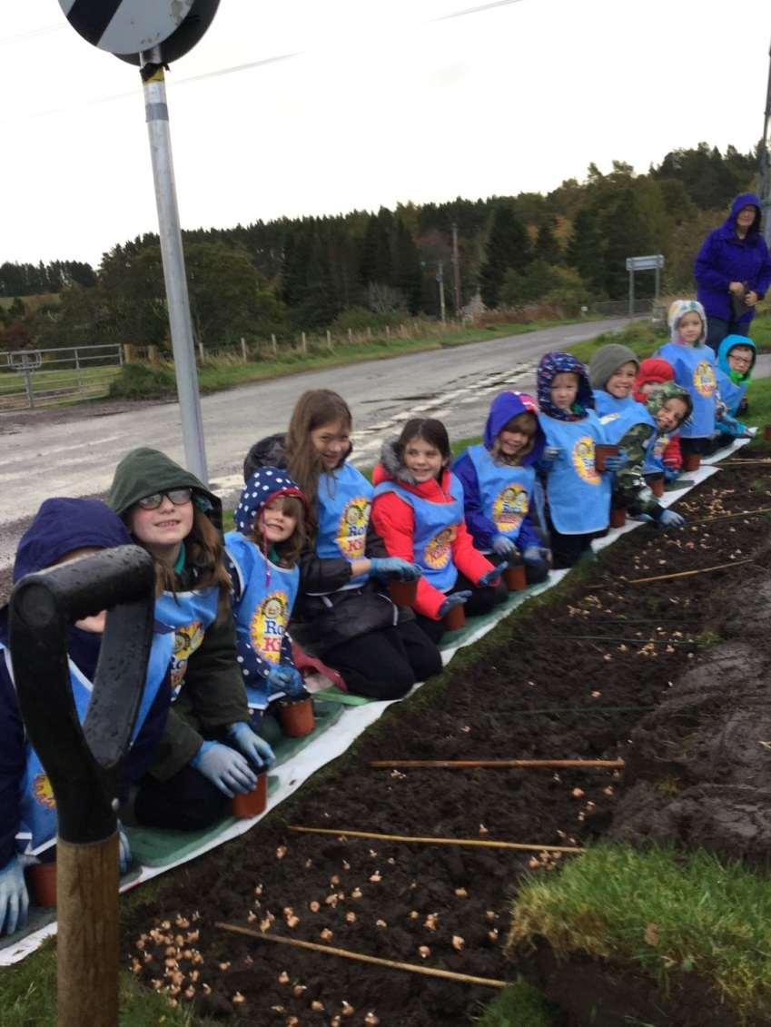
End Polio – Planting purple crocuses – in the rain

Slide 6
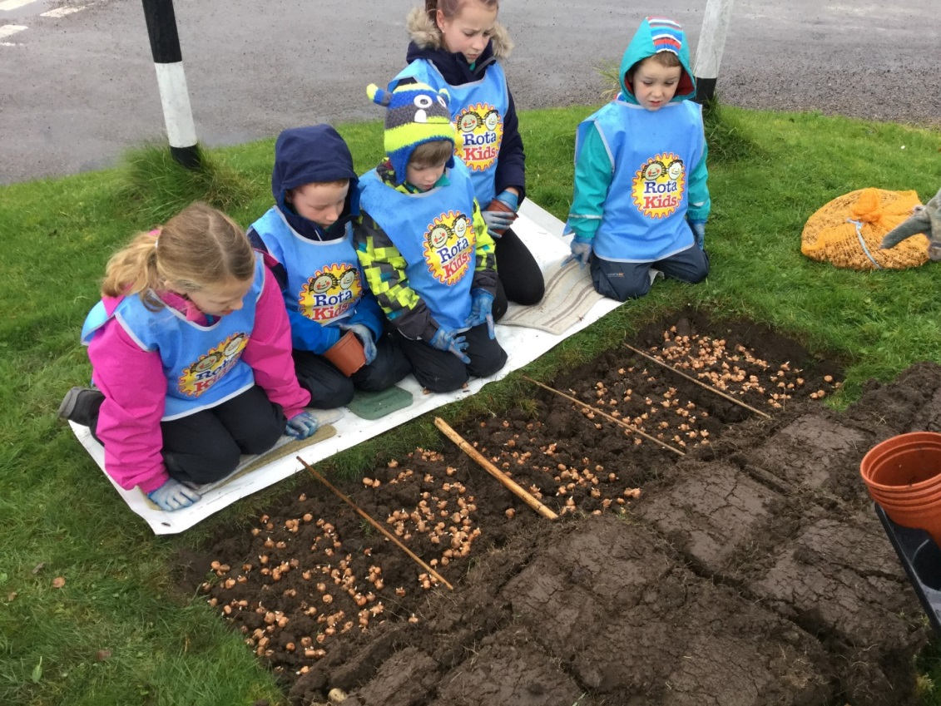
All members of the school were involved in the planting

Slide 7
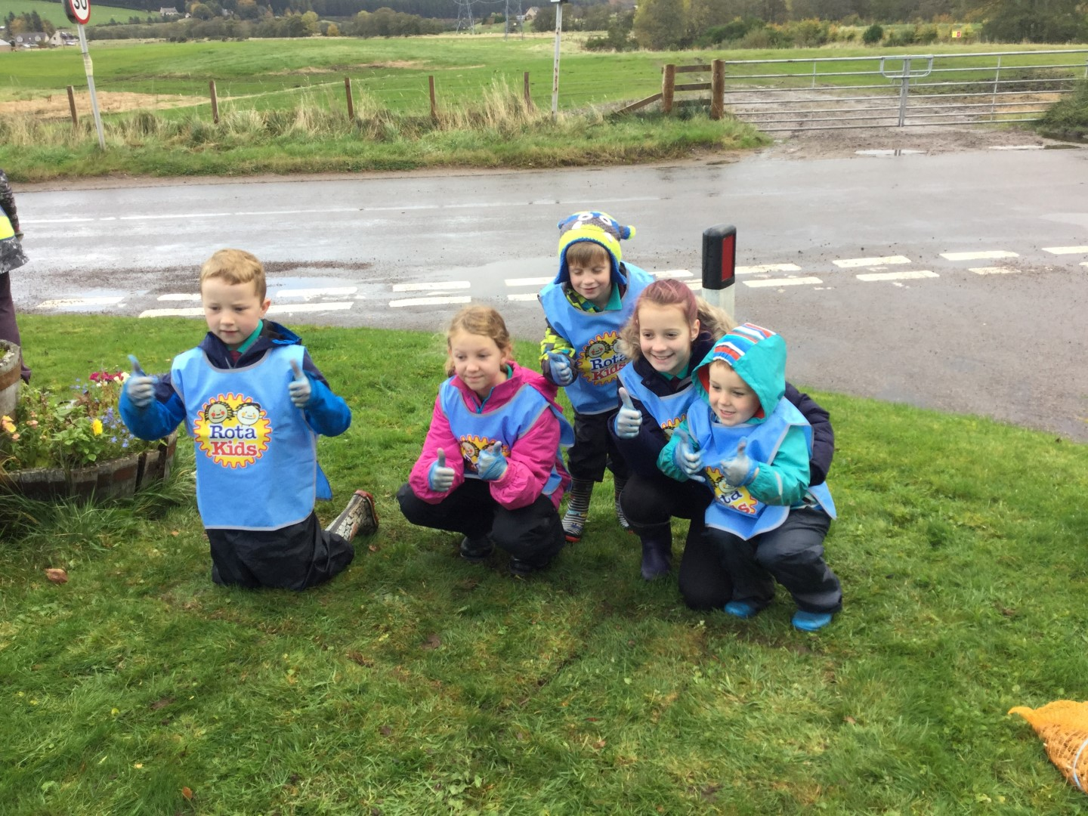
We are looking forward to seeing the crocuses grow

Slide 8
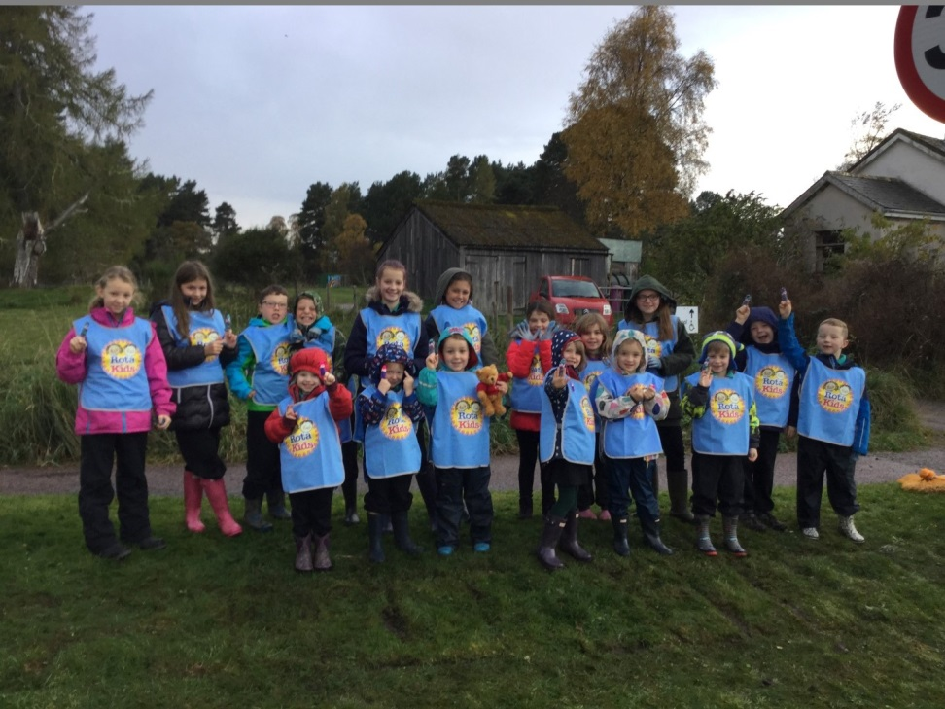
Finger puppets
We all got finger puppets to remind
us the children who get inoculated get a purple mark on their finger.

Slide 9
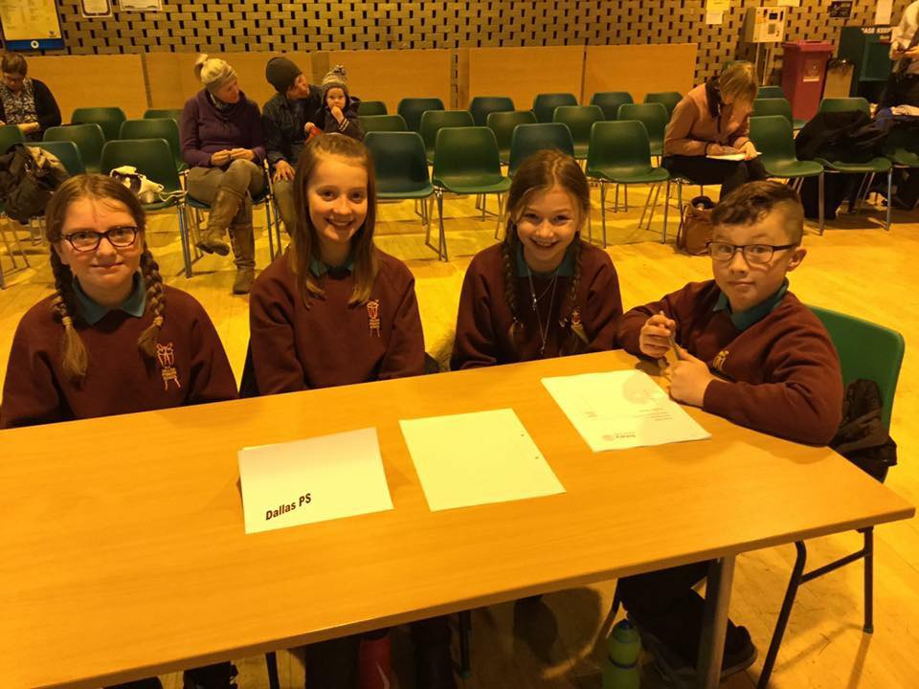
Primary School Quiz – this was our team

Slide 10
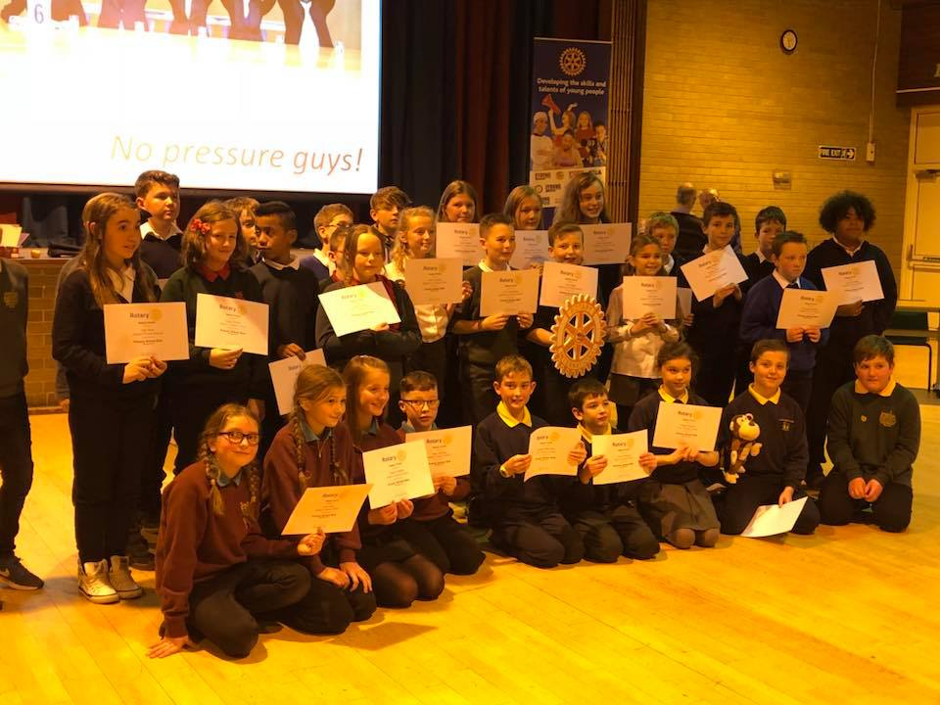
We did not win but enjoyed taking part

Slide 11
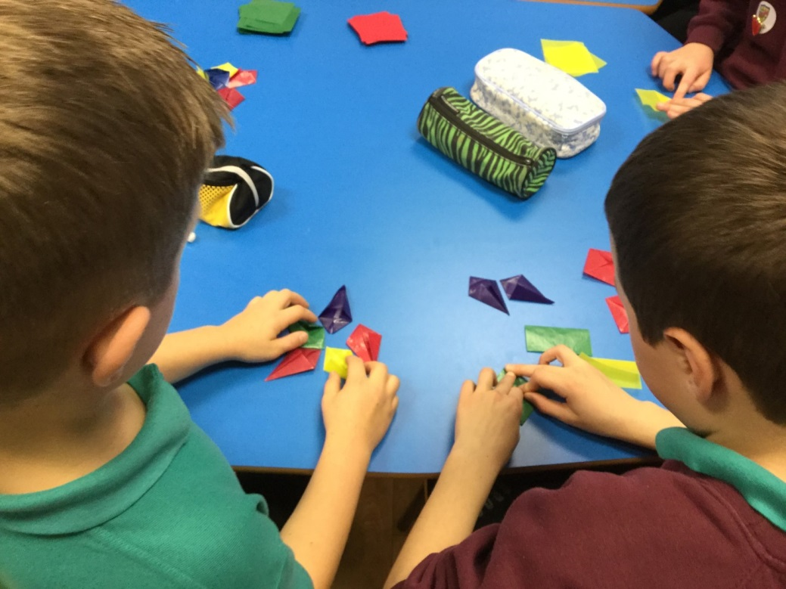
Making stars for people in the village at Christmas

Slide 12
Christmas at Cathay Nursing Home
We helped the residents get in the Christmas spirit by performing our nativity play.

Slide 13
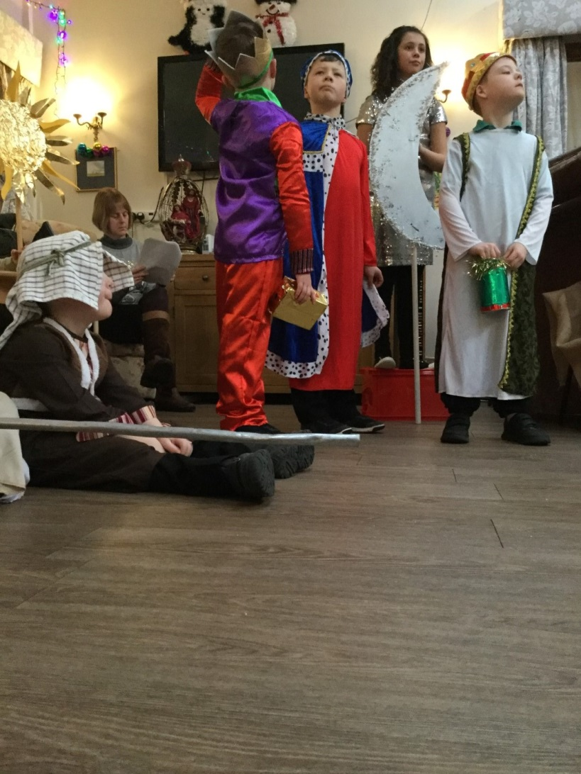

Slide 14
Bonfire Night – we made an eco friendly guy for the Rotary competition

Slide 15
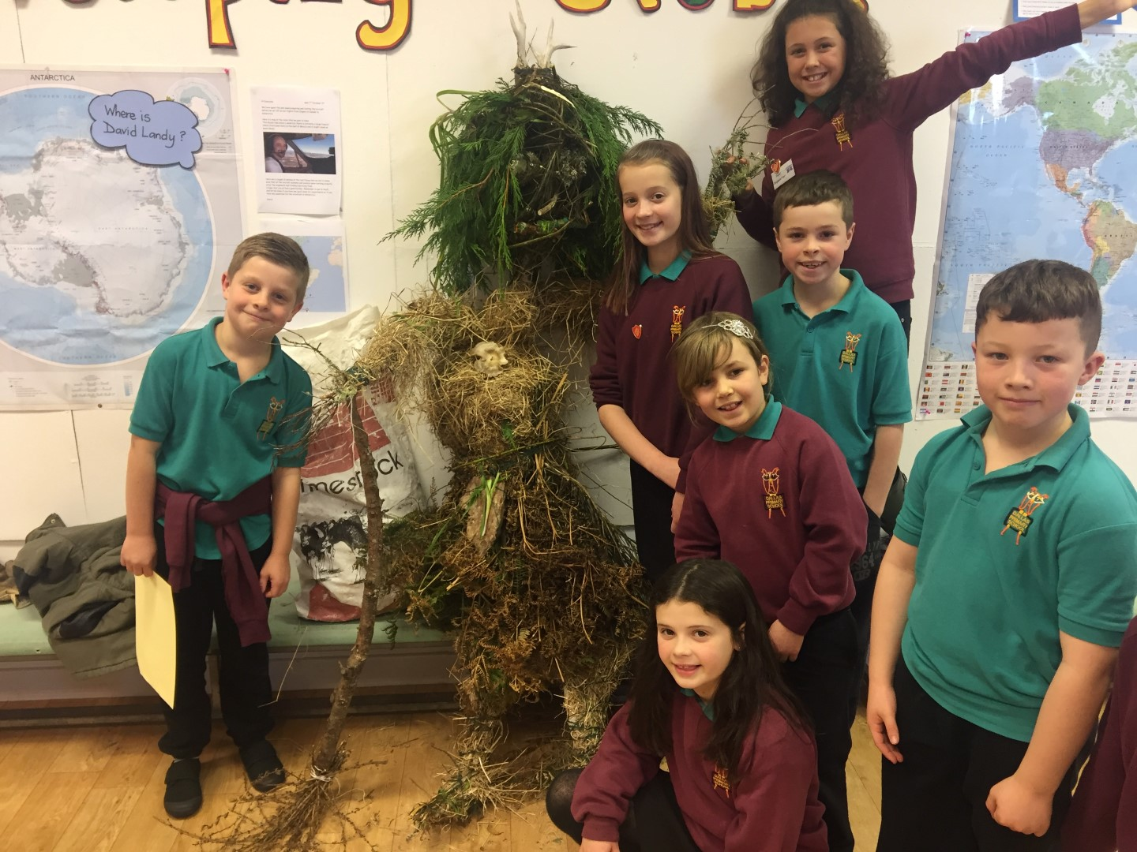
We won a First Prize

Slide 16
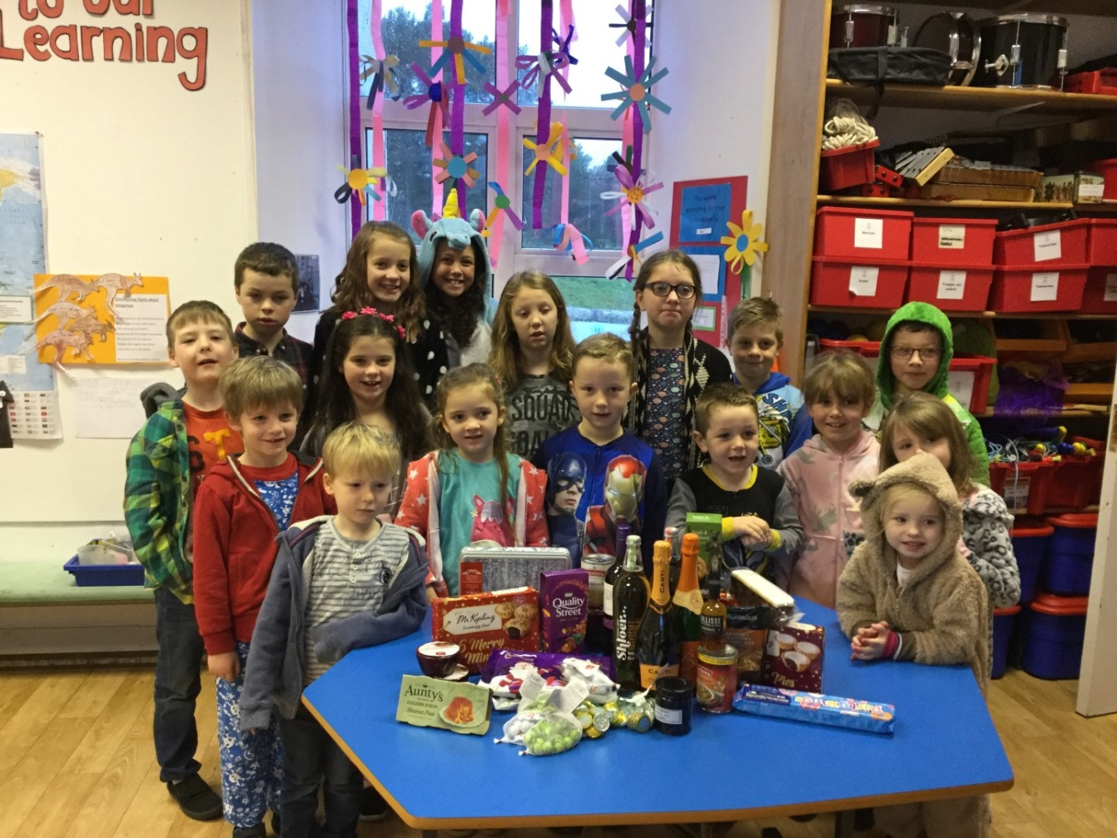
Dress Down Day – we organised this to get prizes for our raffle

Slide 17
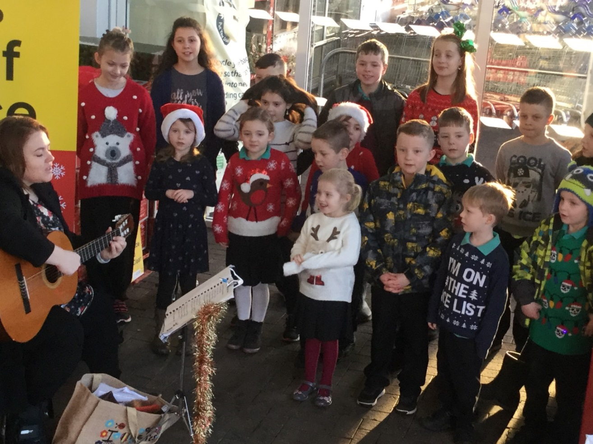
We raised money by singing at Tesco’s

Slide 18
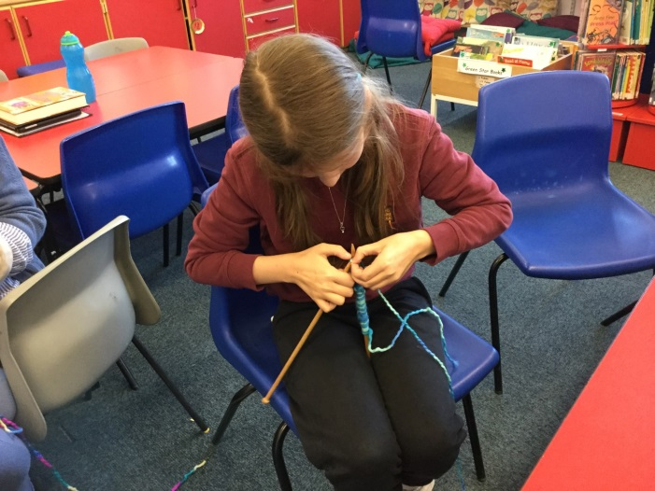
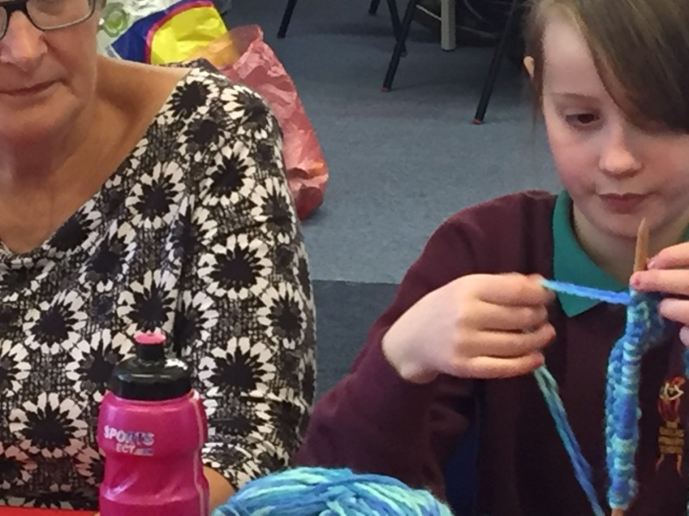
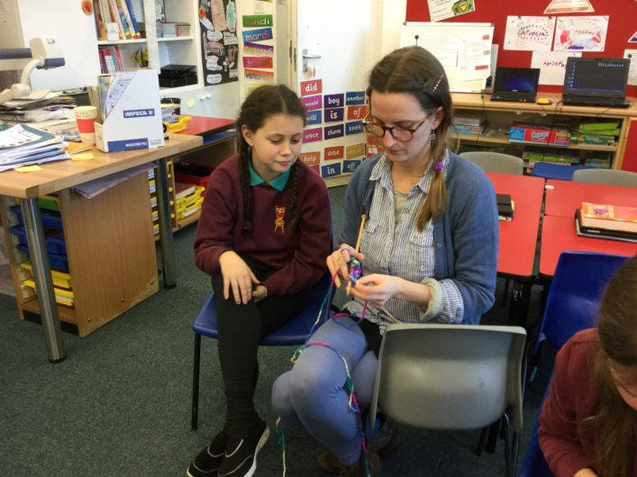
Knitting for Uganda

Slide 19
We are learning to knit and with the help of Forres Rotarians and friends we hope to make a blanket to send to the pupils at Bunono School in Uganda.

Slide 20
Cooking for the Community event to raise money for Bunono School

Slide 21
All were involved

Slide 22
£450 was raised

