Slide 1
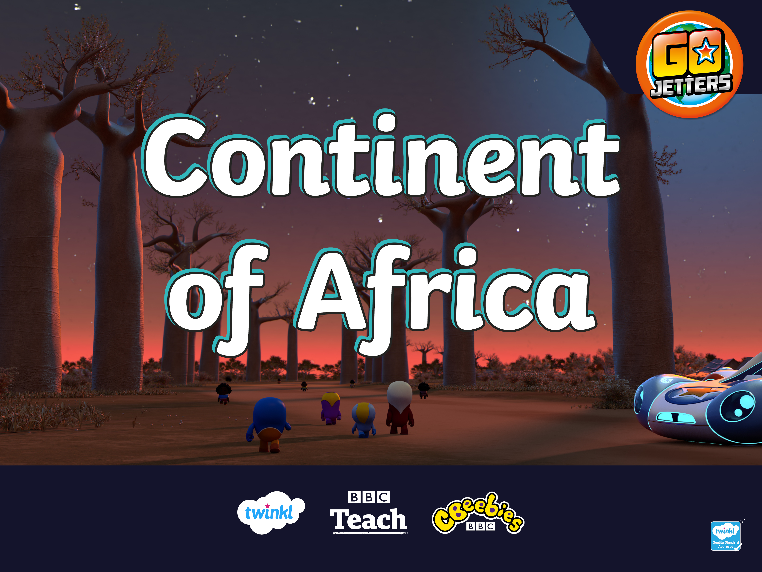

Slide 2
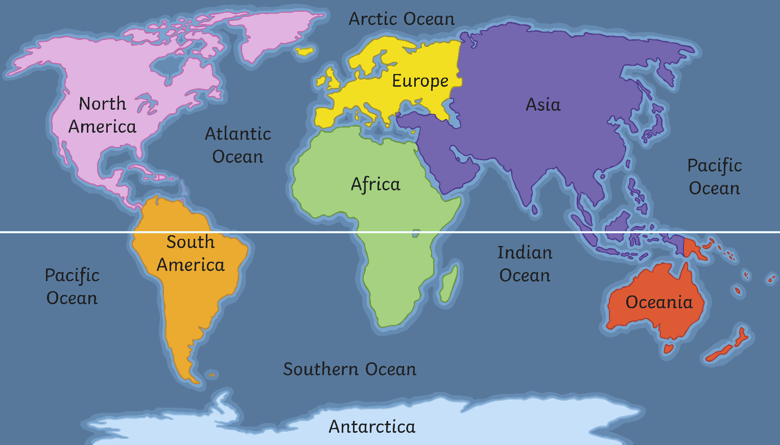
What Is a Continent?
Here are the seven continents of Planet Earth. A continent is a massive piece of land that is often separated from other areas of land by water or another feature such as mountains.
Equator

Slide 3
Continents
S_u_h A_e_i_a
South America
_o_t_ _m_r_c_
North America
A_r_c_
Africa
E_r_p_
Europe
A_i_
Asia
O_e_n_a
Oceania

Slide 4
Africa
Here is a map which shows the countries that are in the continent of Africa. Geographic!

Slide 5
Africa
Today, we are going to be learning about the continent of Africa. Tell your partner anything you already know about Africa.
Here’s Ubercorn with some Funky Facts.

Slide 6
What Is a Landmark?
Can you remember what a landmark is?

Slide 7
What Is a Landmark?
A landmark is something that stands out in an area. It could be a building, a bridge, a lake or river, a sculpture or something else. These places might be special because of their age or their size.

Slide 8
What Is a Landmark?
A landmark makes a place recognisable. This means you could look at a picture of a landmark and know straight away where it is.

Slide 9
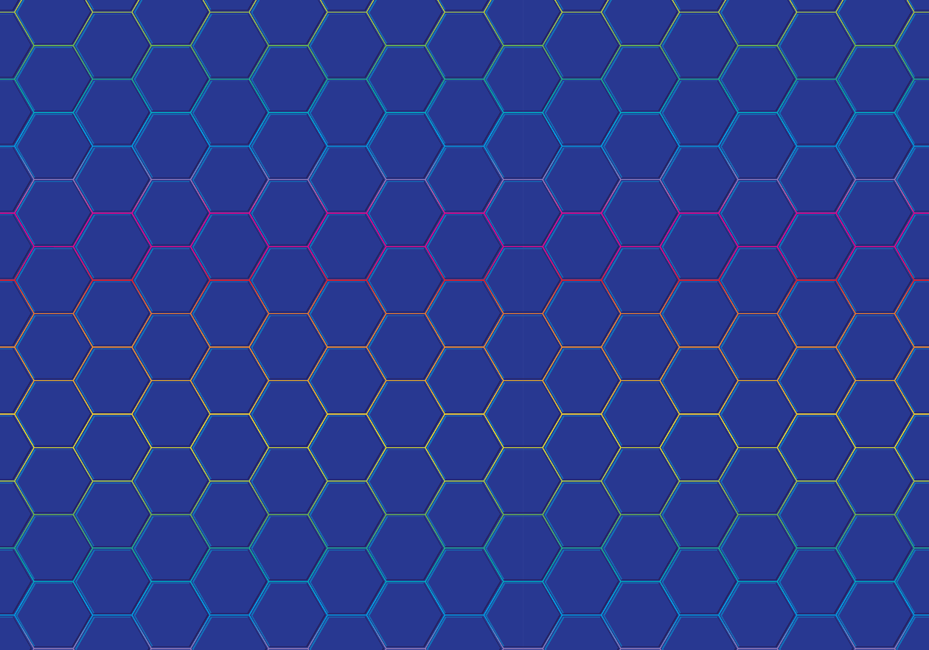
Famous Landmarks
Do you recognise any of these famous landmarks from around the world?

Slide 10
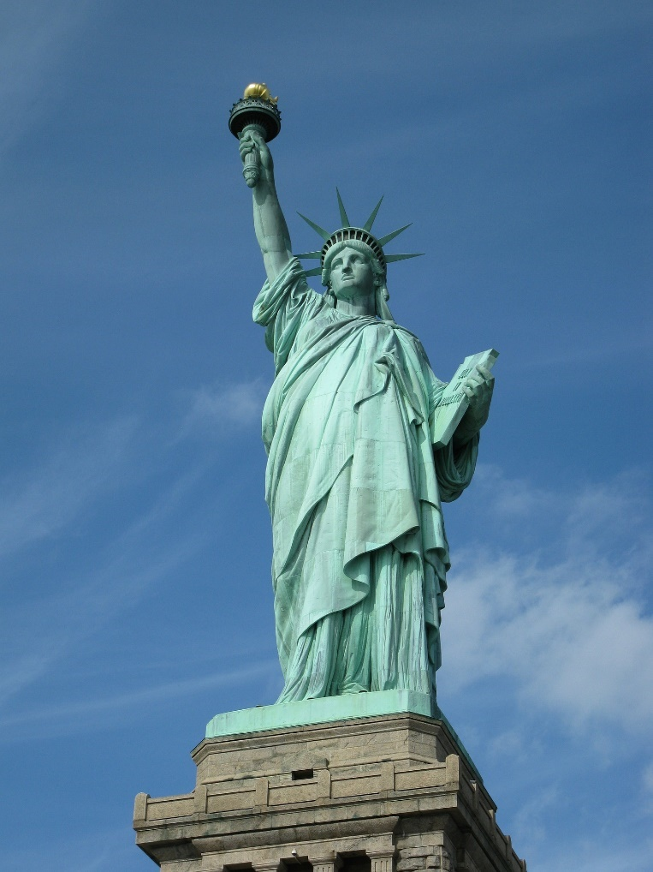
Famous Landmarks
Statue of Liberty, USA

Slide 11
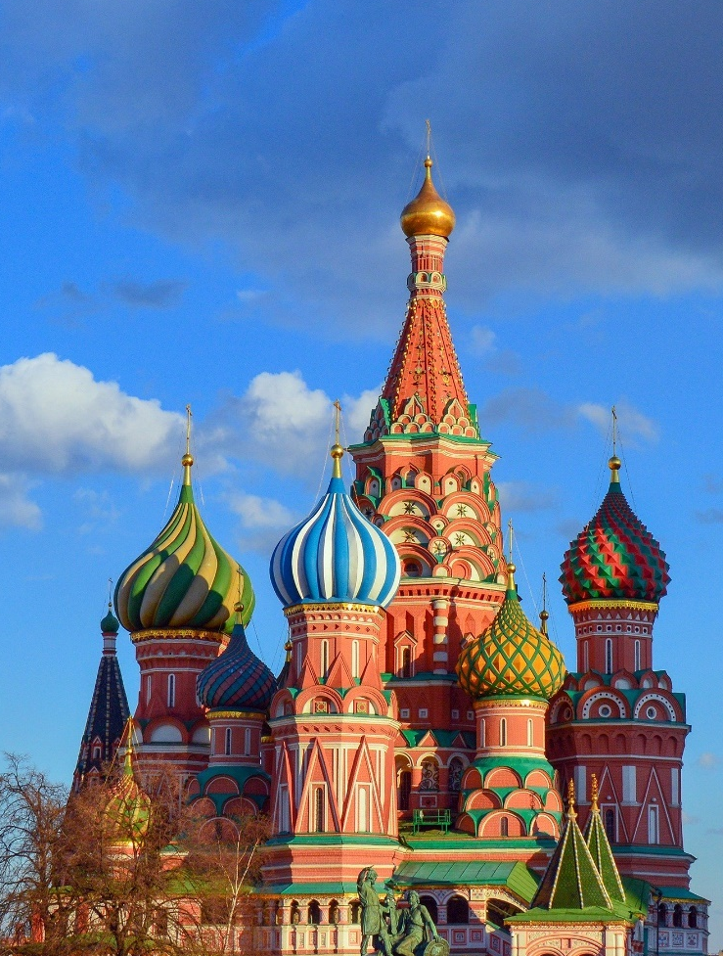
Famous Landmarks
St Basil’s Cathedral, Russia

Slide 12
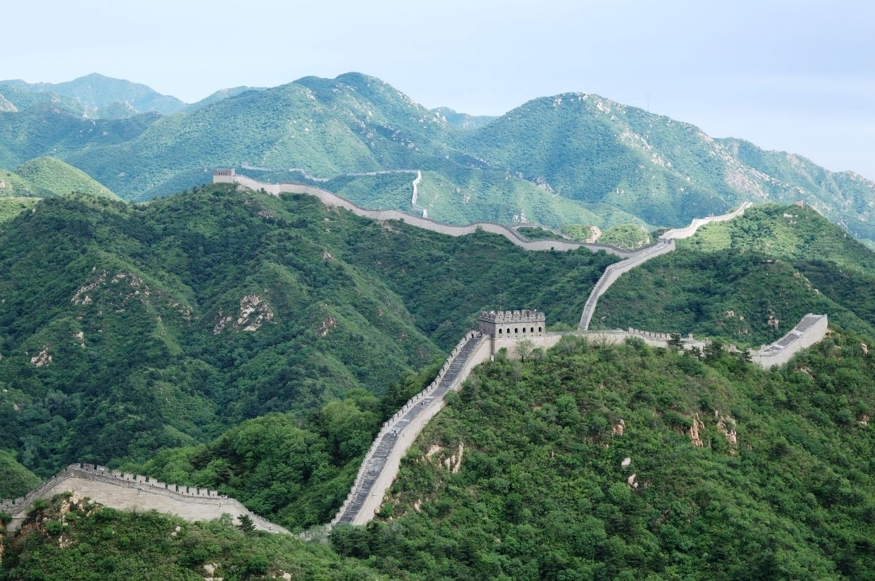
Famous Landmarks
The Great Wall, China

Slide 13
The Sahara Desert
Now let's look at landmarks in Africa!
A desert is place that has less than 25cm of rain a year. Deserts don’t have to be hot – there are deserts in very cold places too. The Sahara Desert is in northern Africa. It is the largest hot desert in the world and stretches across 11 different countries.

Slide 14
Maasai Mara
This is the Maasai Mara in Kenya. It is named after the Maasai, a group of people who have lived in the region for many hundreds of years. Here is Ubercorn with some Funky Facts.

Slide 15
Timgad Ruins
The Timgad ruins are what is left of a Roman city built almost two thousand years ago. The ruins are in Algeria in North Africa. In the photo, you can see
the Trajan Arch.

Slide 16
Pyramids of Giza
Some of Africa’s most famous landmarks are the pyramids of Giza in Egypt. Ubercorn is here to tell us more about it.

Slide 17
Victoria Falls
Victoria Falls is on the Zambezi river, along the border of two countries, Zambia and Zimbabwe. It is one of the world’s largest waterfalls. The noise of the water is so loud that it can be heard from almost 40 kilometres away! This is why the falls are known locally as ‘Mosi-oa-Tunya’ which
means ‘the smoke that thunders’.

Slide 18
Table Mountain
Table Mountain is an unusual mountain in South Africa.
Let’s find out more from Ubercorn’s Funky Facts.

Slide 19
El-Tabia Mosque
The El-Tabia mosque is in Egypt. A mosque is where Muslim people go to worship. The mosque has two tall towers called minarets. Every day, a special call to tell Muslims it is time to pray is given from a minaret.

Slide 20
Landmarks Quiz
How much have you learnt about African landmarks?
It’s time to find out!

Slide 21
Landmarks Quiz
1. What is a landmark?
a. A patch of dirt on some land.
b. Something that stands out in an area.
c. A sign on a map.

Slide 22
Landmarks Quiz
2. Which of these is not a country in Africa?
a. Egypt
b. Zambia
c. England

Slide 23
Landmarks Quiz
3. What is the name of the desert we have learnt about?
a. The Sahara Desert
b. The Landmark Desert
c. The Africa Desert

Slide 24
Landmarks Quiz
4. What shape are the special buildings in Egypt that Ubercorn told us about?
a. Pyramid
b. Cuboid
c. Sphere

Slide 25
Landmarks Quiz
5. What is unusual about the mountain in South Africa that Ubercorn took us to?
a. It is the tallest mountain in the world.
b. It is impossible to climb.
c. It is shaped like a table.

Slide 26


