Slide 1




Take the Biscuit
P5 Project
What is the difference between a biscuit and a cake?
This Photo by Unknown Author is licensed under CC BY-SA

Slide 2
Cake or Biscuit?
The difference between biscuit and cake is that a biscuit is a cookie while a cake is a rich, sweet dessert food, typically made of flour, sugar and eggs and baked in an oven, and often covered in icing.
Can you think what would come under the headings?
BISCUIT CAKE
??????????? ??????????

Slide 3
Ingredients
We spoke in class about healthy fillings and unhealthy fillings?
Can you remember any of them:
Hazelnuts, cherries, apples, cinnamon ……………..
Unfortunately we will not be going to the academy to make cookies but maybe you could make them at home if you have the ingredients.

Slide 4
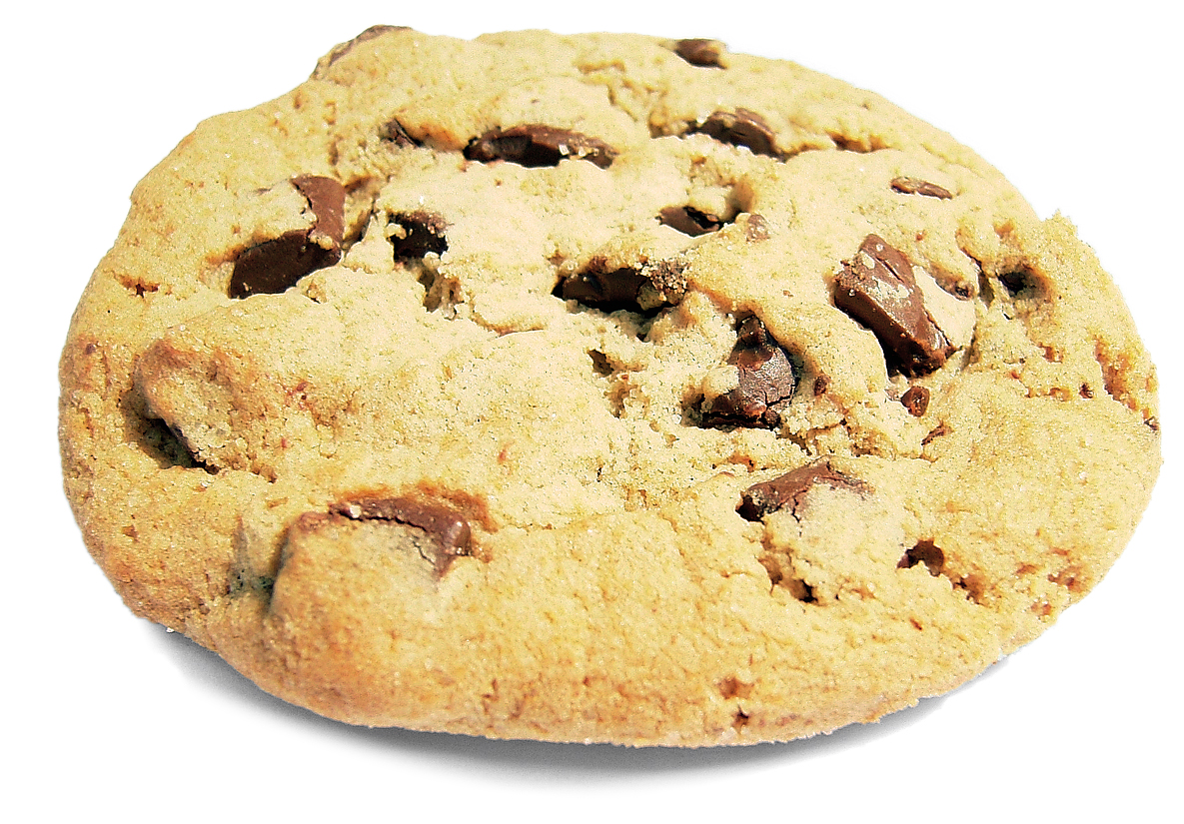
Cookie Recipe
Ingredients
225g Butter
110g Caster Sugar
275g Plain Flour
1 tsp Cinnamon
Any fillings
Method
Cream the butter and sugar together.
Sift in the flour and cinnamon. Add any other ingredients you have.
Then combine with your hands to form a dough
Chill for an hour / Preheat oven to 190’C
Remove from fridge and roll into small balls, place onto greased paper tin and flatten out with a fork.
Place in oven to bake for 10-12 minutes or until golden brown

Slide 5
Food Labels
We were learning about food labels and how the traffic light system can help us to identify healthy foods.
Can you check any labels of food in your house, can you identify which one has most fat? Salt? Carbohydrates?
Which colour is usually the healthiest?

Slide 6
Ingredients – Makes 6 Cookies
225g Butter
110g Caster Sugar
275g Plain Flour
1 tsp Cinnamon
Any fillings
Problem
Solving
Time
What ingredients would you need to make 12 cookies?
What ingredients would you need to make 3 cookies?
What ingredients would you need to make 9 cookies?
If you started baking your cookies at 1.15pm what time would they be ready?
If you wanted your cookies ready for lunch at 1pm what time would you put them in the oven?

Slide 7
Design
Name – its all in the name
A name needs to be exciting so it sticks in peoples minds.
We made up our own names for the cookies, can you remember them or can you make up another one?
We were learning about persuasion. Packaging is also persuasive to try to make the buyer purchase the product.
Watch this link about adverts persuading people Persuasion
Can you make up your own advert or jingle?
Can you design packaging for your biscuit?
This link will show you how to make a box to keep your cookies in, can you decorate it attractively to persuade people to buy it. Paper Box

Slide 8
Remember to include:
Cookie Name
Attractive packaging
Food label with traffic light system
Advert or jingle
A photo of your completed item

Slide 9

Finally
Take photos of your boxes and cookies if you can, we would love to see them, you can share them on glow email, teams or twitter!
Finally lets check if you are the master of biscuits by taking this short quiz. Have fun.
Press Control and click on link
Biscuit Quiz.
Mrs McLeod

