Slide 1
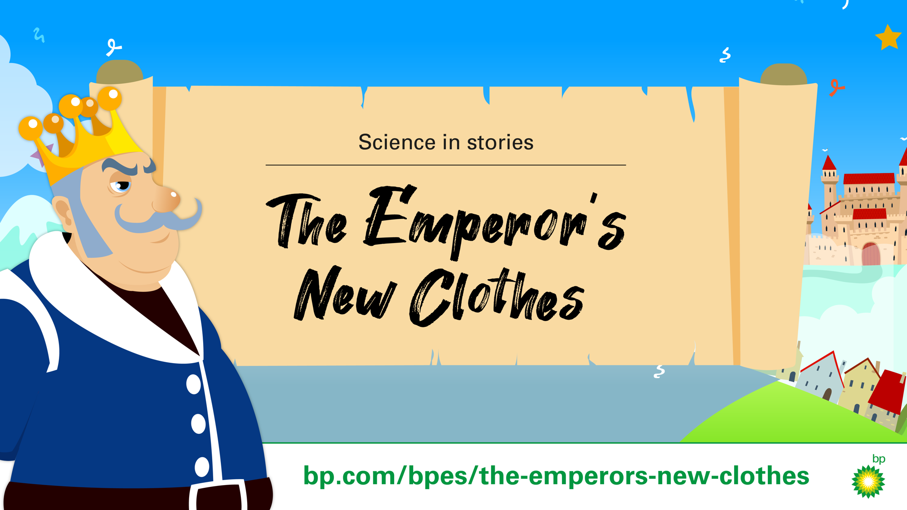

Slide 2
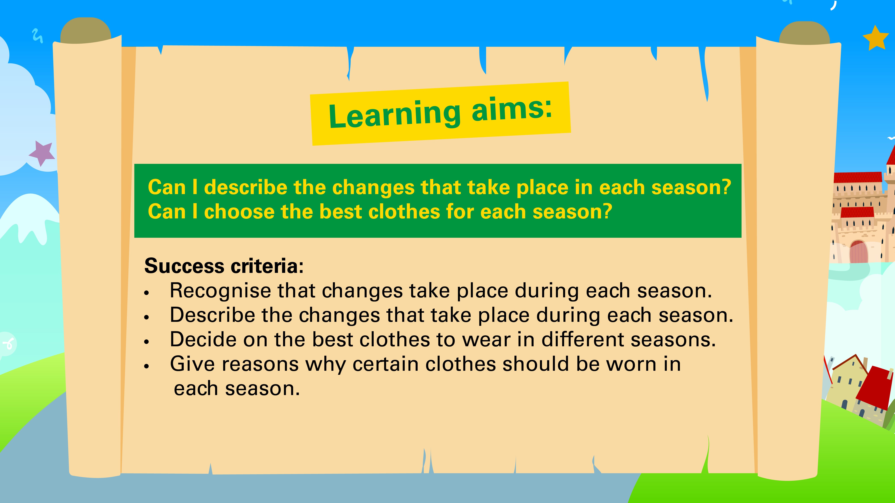

Slide 3
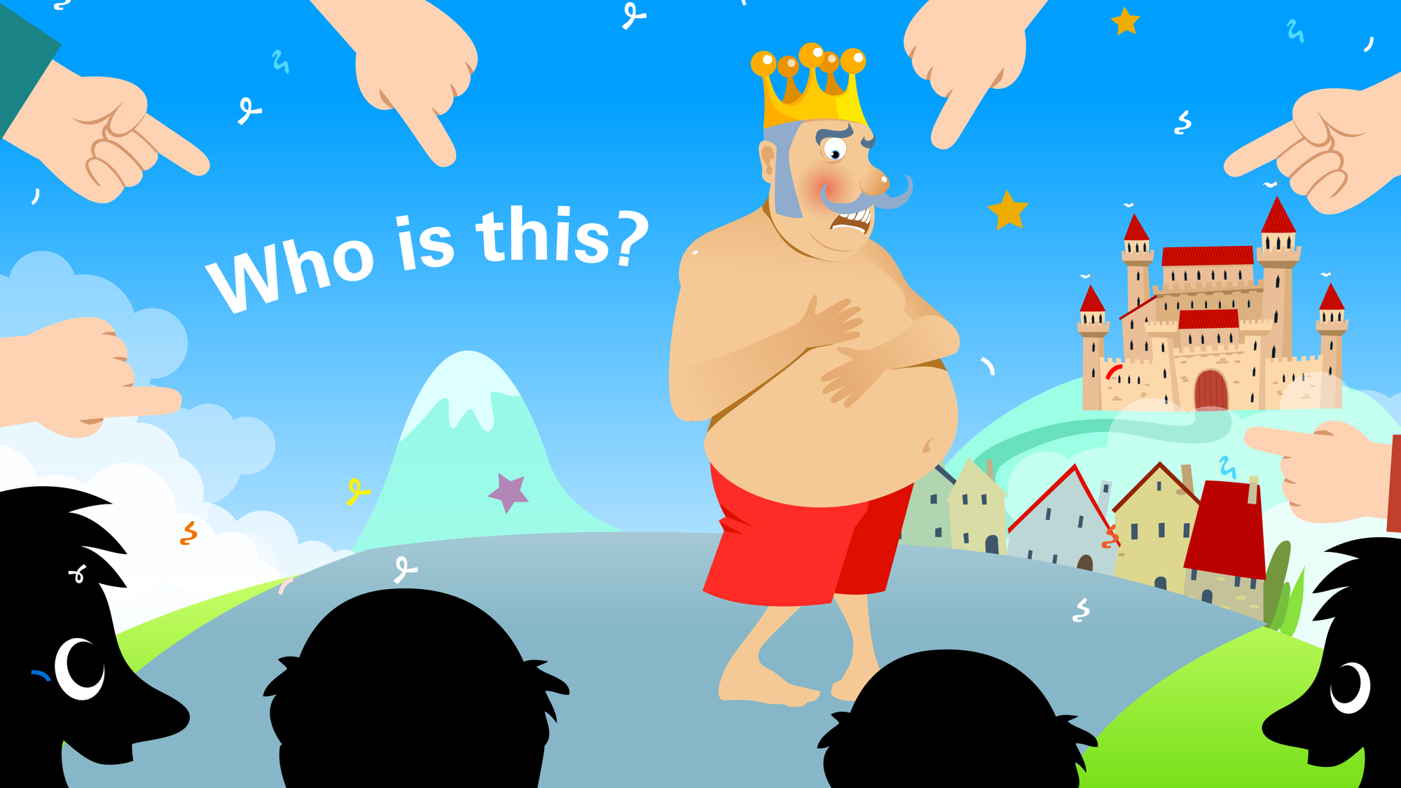
Who is this?
Notes:
Q. Who is this? Does anyone know who this character is? Why is his face so red?

Slide 4
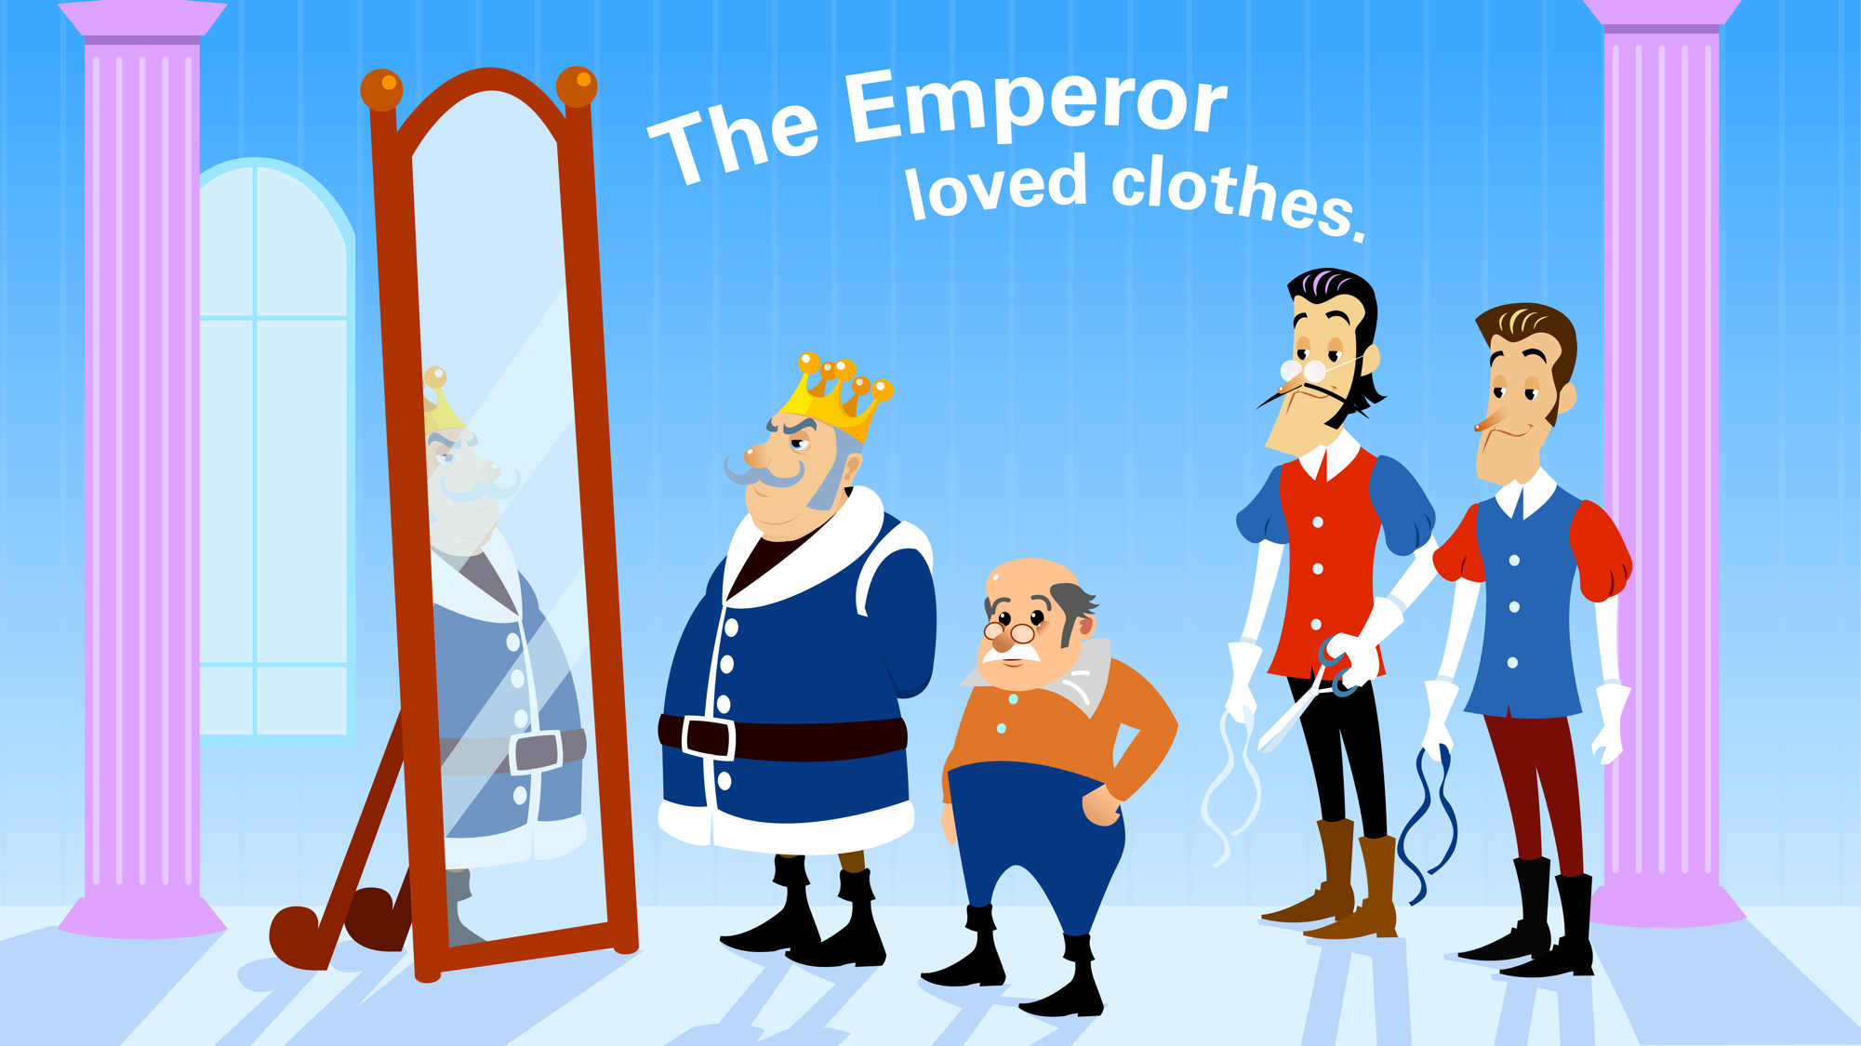
The Emperor loved clothes.
Notes:
Read the story along with the picture
Once upon a time there was an Emperor who absolutely loved clothes.
Two naughty tailors heard about the Emperor’s love of clothes and decided to fool the Emperor and make some money at the same time.
They told him that they were tailors who would make him the finest clothes in the world, using the finest cloth, and anyone who was a fool wouldn’t be able to see the cloth because it was so fine and delicate.
The Emperor was thrilled and paid the naughty tailors a huge sum of money to make him a new outfit.

Slide 5
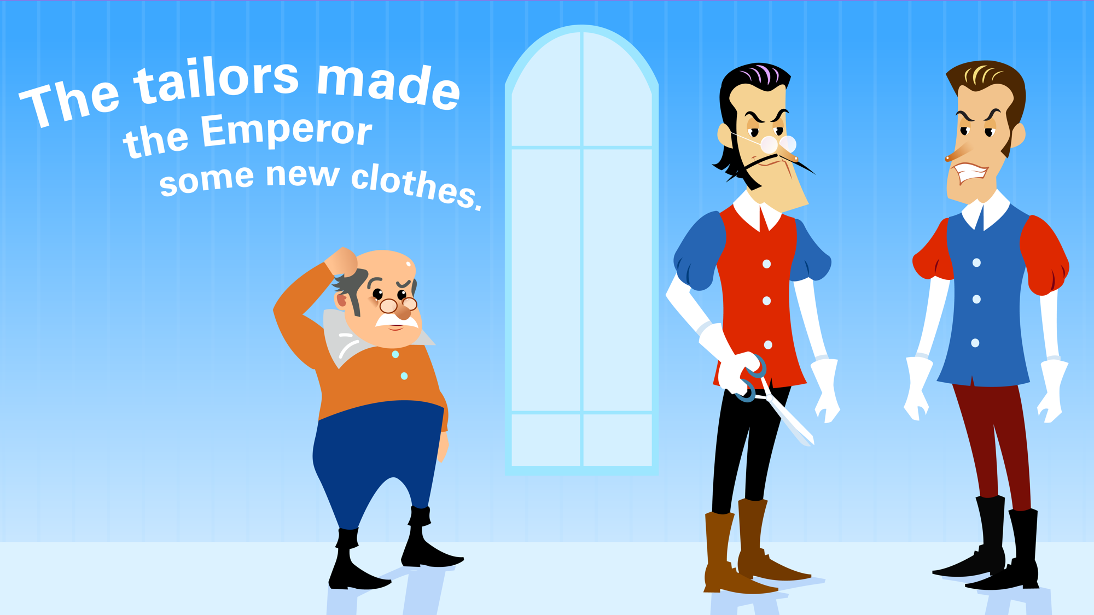
Notes:
The tailors got to work and pretended to make the fine cloth for the Emperor’s new outfit.
After a few days, the Emperor sent his Minister to check how things were going. The Minister couldn’t see a single thread.
But the Minister didn’t want the Emperor to think he was stupid, so he told the Emperor that the cloth was the finest and most beautiful he had ever seen.

Slide 6
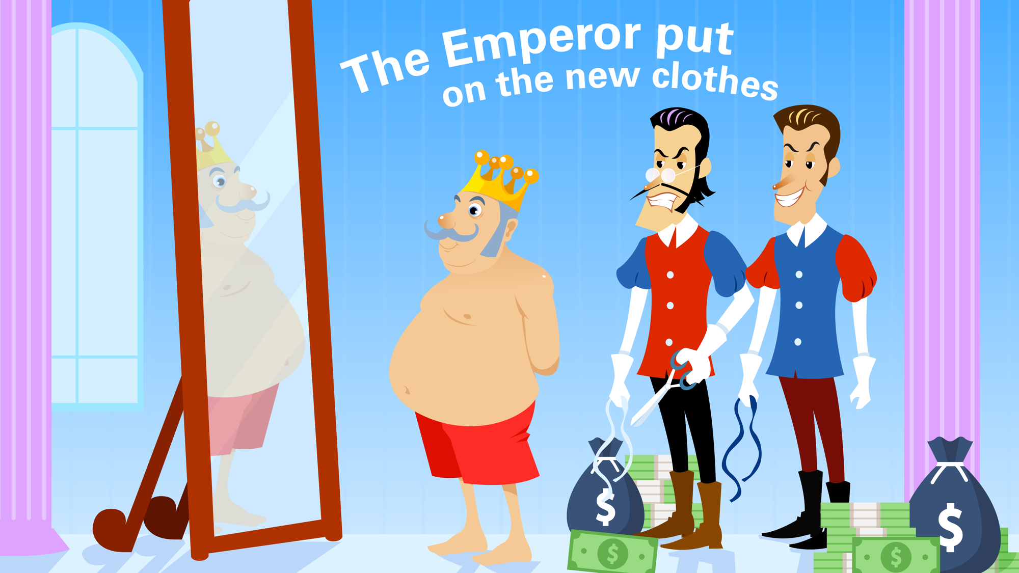
The Emperor put on the clothes.
Notes:
Before long, the tailors were finished and they dressed the Emperor in the new clothes.
Just like the Minister, the Emperor couldn’t see the clothes, but he didn’t want to appear stupid. He told the tailors that the clothes were the most beautiful he had ever seen. He thanked them for their work and paid them well.

Slide 7
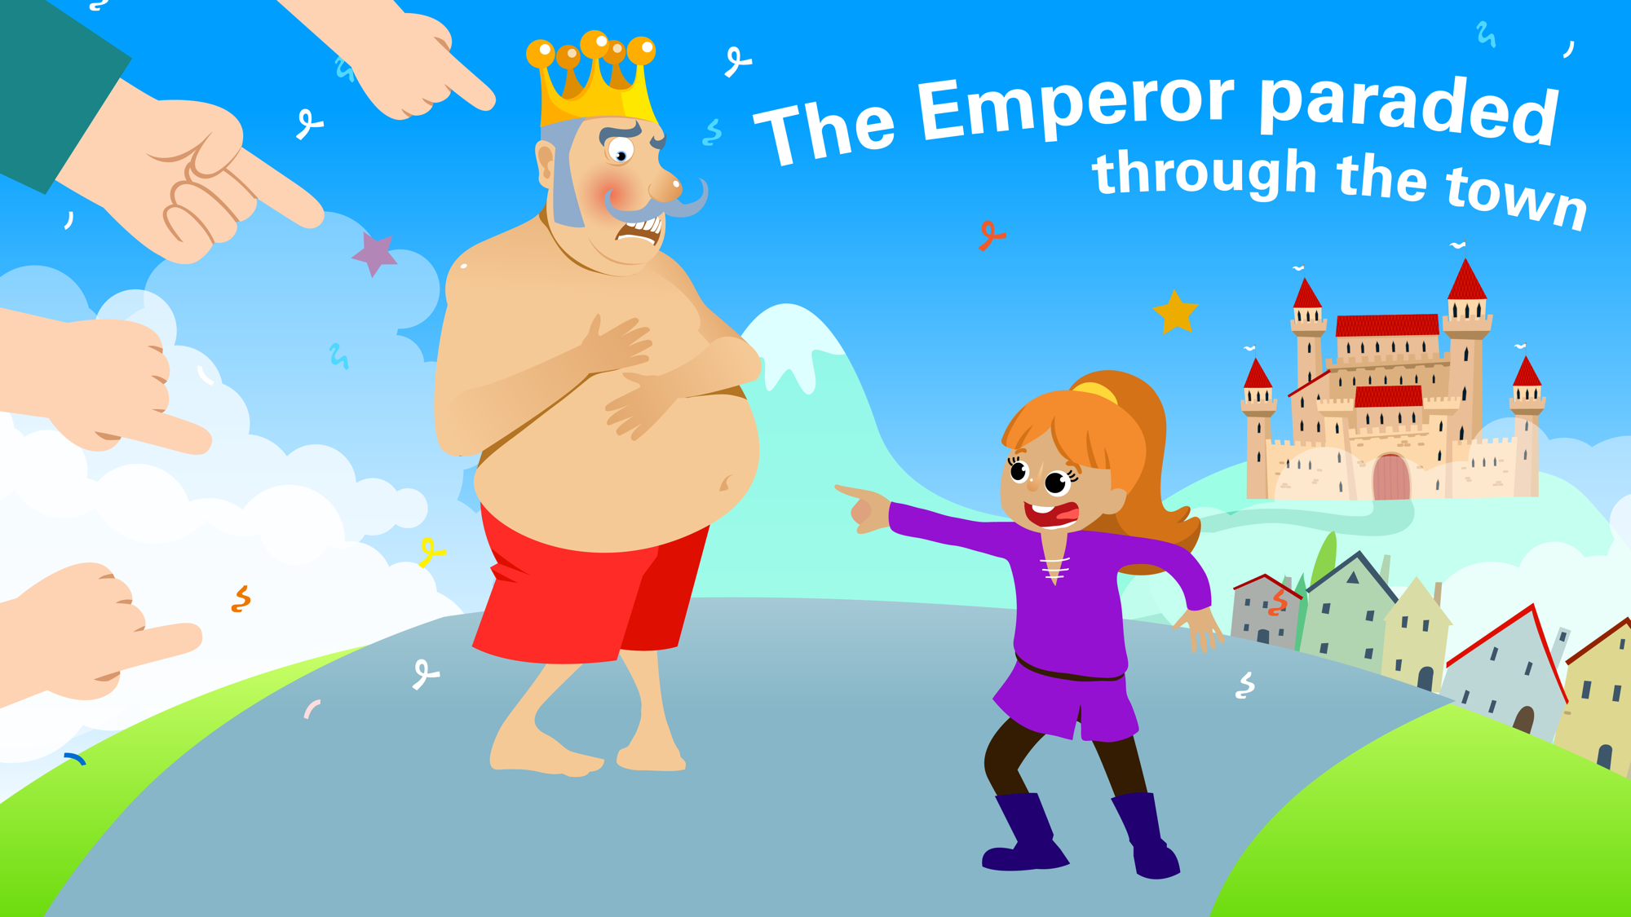
The Emperor paraded through the town.
Notes:
Later that day the Emperor paraded through the streets of the town.
Everyone knew that anyone who was a fool wouldn’t be able to see the cloth, so to begin with, they all pretended to see it and cheered as the Emperor went by.
But one little girl suddenly shouted out ‘Why isn’t the Emperor wearing any clothes?’ Suddenly all of the people realised they’d been fooled and began to laugh at the Emperor.
The Emperor was embarrassed and ashamed. He sent his guards to find the naughty tailors but they had vanished and were never seen again.

Slide 8
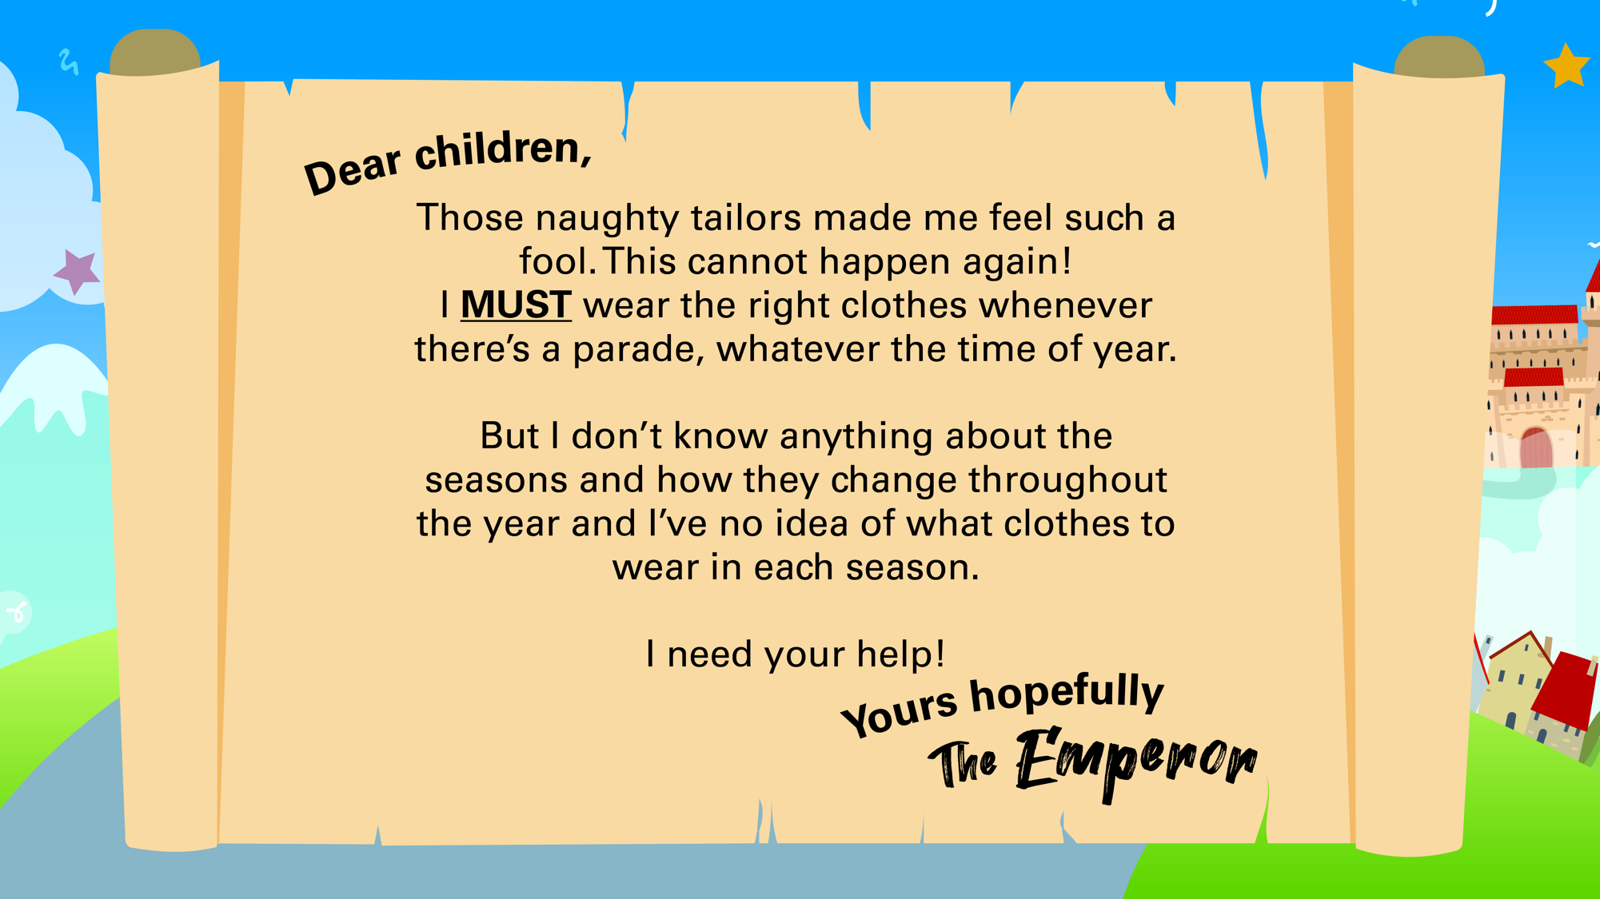

Slide 9
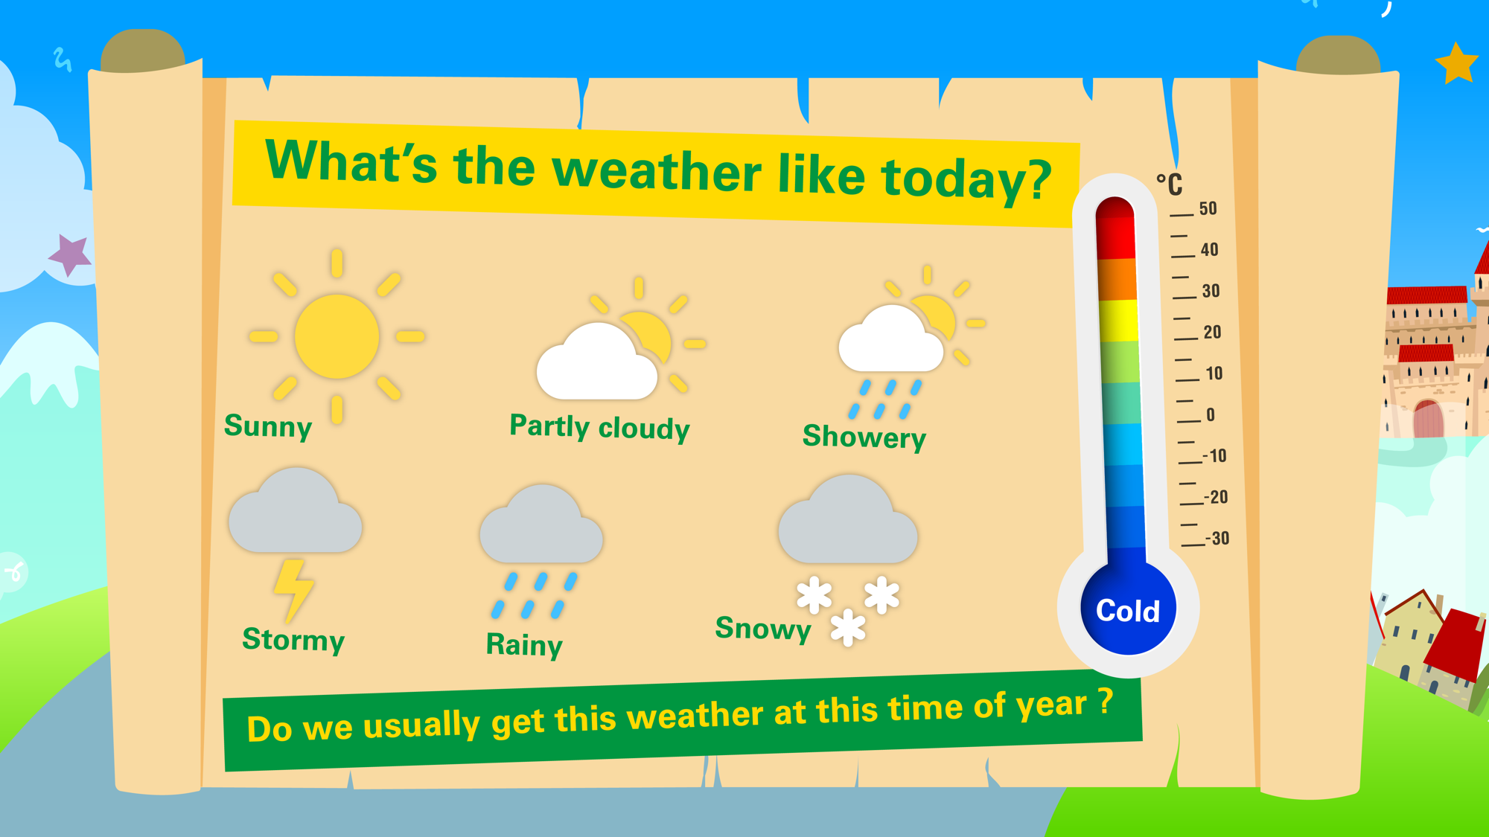
Notes:
Look out of the window, what is the weather like today?
Go outside, what does the weather feel like?
Check later in the day, does the weather look and feel any different?
Weather can change daily
Weather changes over a period of time and creates weather patterns. This is what we call seasons.
Which month is it? What season is it?

Slide 10



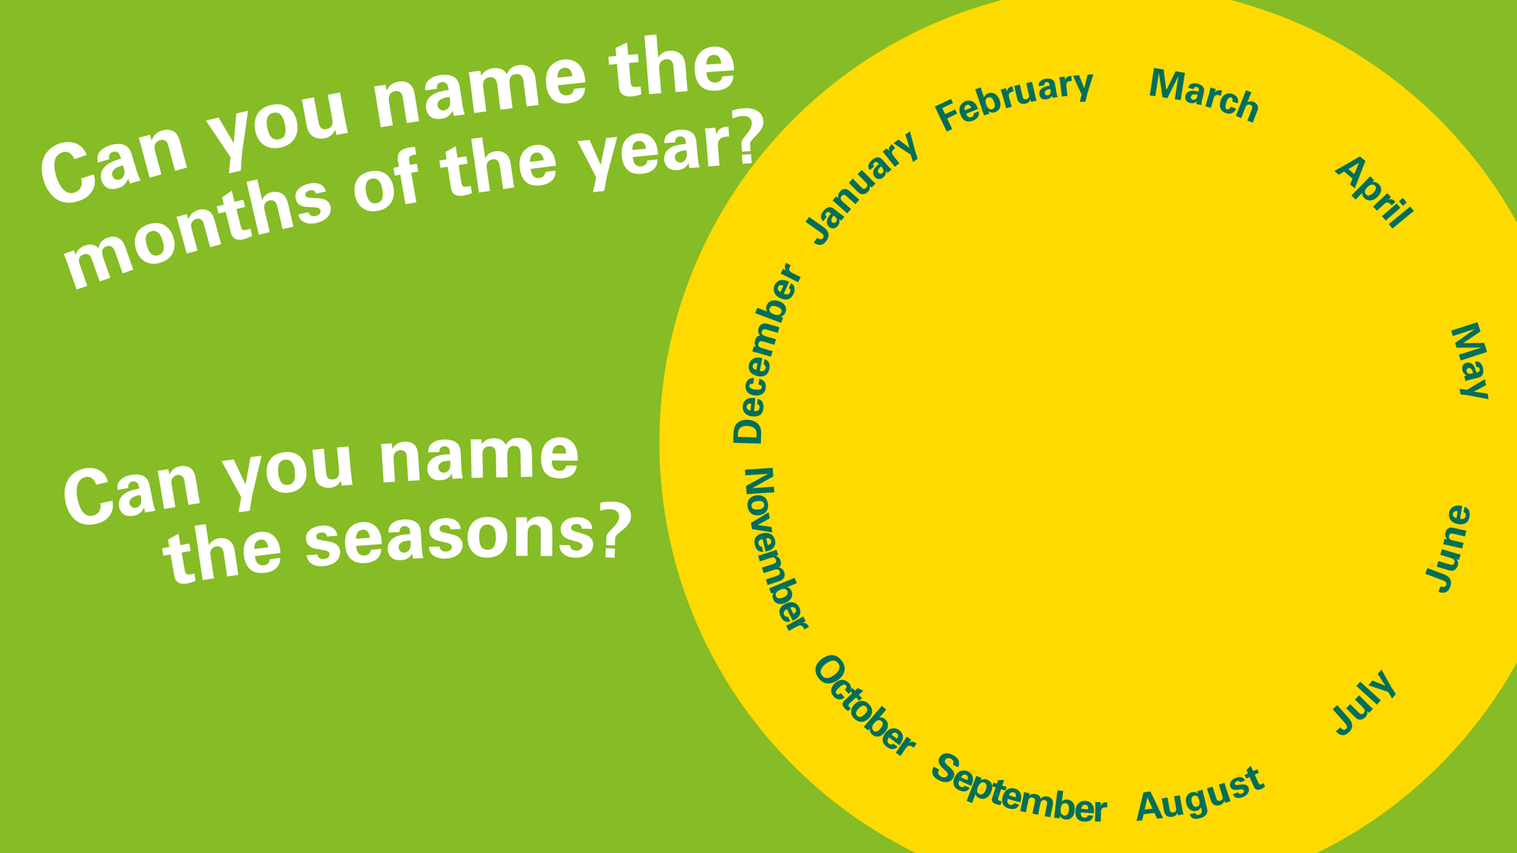
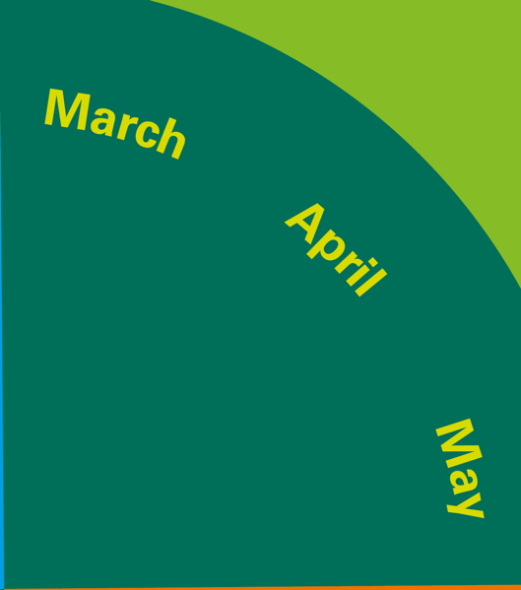



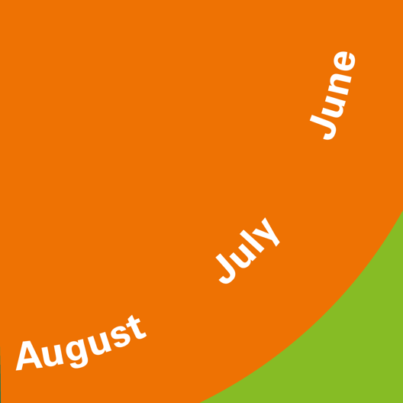
Notes:
Mrs McLeod and Mrs Bokor is asking:
Q. Can you name the months of the year?
Q. How many months are there in a year? What’s the first month? What’s the last month? When is your birthday?
Q. Can you name the seasons?
There are four seasons in a year.
Q. What season are December, January and February in?
Q. What’s the weather like in winter?
Q. What season are March, April and May in?
Q. What’s the weather like in spring?
Q. What season are June, July and August in?
Q. What’s the weather like in summer?
Q. What season are September, October and December in?
Q. What’s the weather like in autumn?
Other places in the world can have different weather to us. In summer here the weather is quite hot but somewhere else it might be quite cold.
At the North and South pole there are only two seasons: summer and winter. Countries on the Equator have two seasons (wet and dry). When it is summer in the Northern hemisphere it is winter in the southern hemisphere.

Slide 11
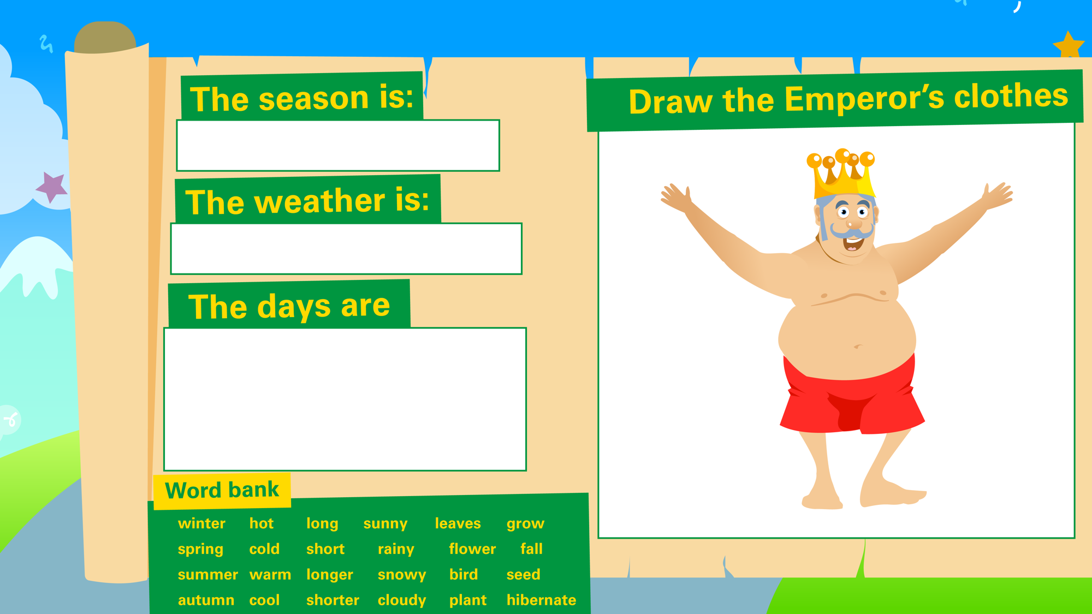
Notes:
Can you draw the emperor and the clothes he should be wearing this season. Label his clothes and take a picture. I would love to see it

Slide 12
Can you guess the season?
c
This season covers three months of the year.
Many trees have green leaves during this season.
The weather is hot and sunny and the days are long.

