Slide 2
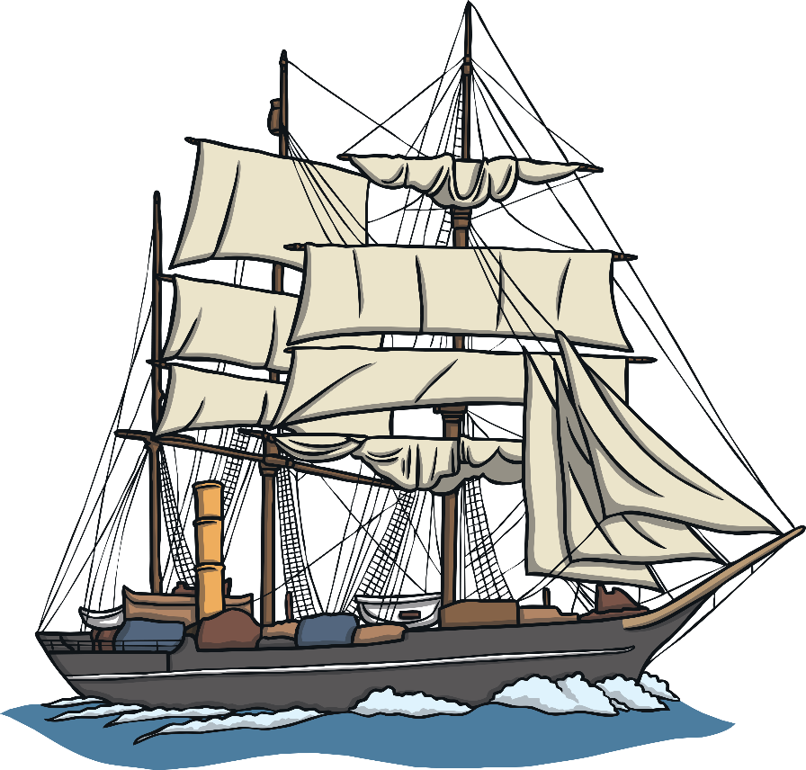
Transport
People first started travelling on aeroplanes around 100 years ago.
The first cars were built nearly 150 years ago. Trains were invented over 200 years ago.
Talk About It
Before all these things were invented,
how do you think people travelled when
they were going on very long journeys?
One of the ways people travelled on journeys was on ships.

Slide 3
Ships
Today when ships sail at night, they have a special thing called radar which helps the captain know if they are near land and need to sail further away.
A long time ago, ships didn’t have radar. When sailing at night, ships had no way of knowing if they were close to land. There was a danger that they could crash into land.
Lighthouses were also built near
places where there were dangerous
rocks hidden under the water that
could cause a shipwreck.

Slide 4
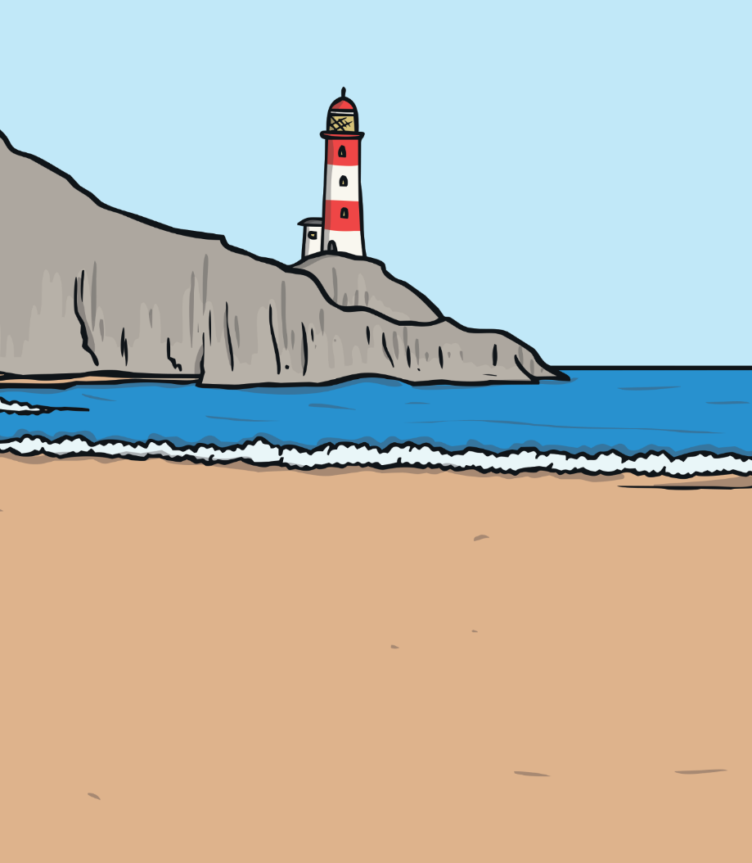
Lighthouses
A lighthouse is a big tower with a light at the top. They were built near places where lots of ships sailed. The light warned sailors that land was near and that they needed to sail further away.

Slide 5
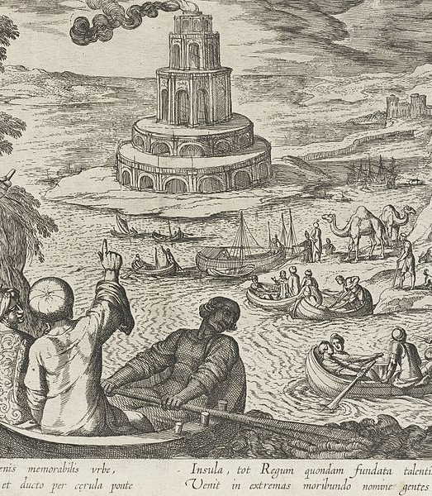
Lighthouses From Long Ago
Over 2000 years ago, the Lighthouse of Alexandria was built in a country called Egypt.
Talk About It
This is a drawing of what the lighthouse looked like.
What can you see in the picture?

Slide 6
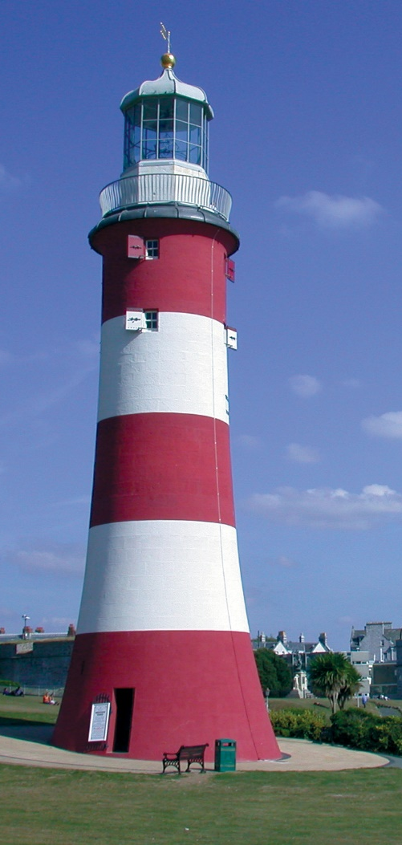
Lighthouses From Long Ago
This is Smeaton’s Tower, which is now in the city of Plymouth. It was build around 250 years ago, 14 miles off the coast of Plymouth. The Eddystone Reef is a group of dangerous rocks that can’t usually be seen above water. Many ships had been wrecked on them and so a lighthouse was built.
The lighthouse eventually got old and a new one was needed. Because Smeaton’s Tower was so important, it was rebuilt stone-by-stone in Plymouth. It is now a popular place for people to visit.
The design of Smeaton’s Tower has been used for the design of lighthouses all around the world
ever since.

Slide 7
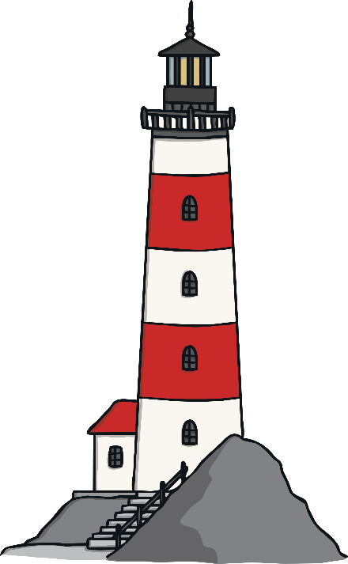
How Is a Lighthouse Designed?
Click on the label to find out more about how a lighthouse is designed.
Lightning rod – This is a rod that is attached to a copper wire that runs to the bottom of the building. If lightning strikes the lighthouse, the lightning is carried along the wire and down into the ground.
lightning rod
Lamp – the light that guides sailors.
lamp
Lantern room – This has a lens to make the light more powerful. Some lantern rooms have a revolving sheet to make it look like the light is flashing.
Gallery deck
lantern room
Gallery deck – The lighthouse keeper could walk along the deck to keep the windows of the lantern room clean.

Slide 8

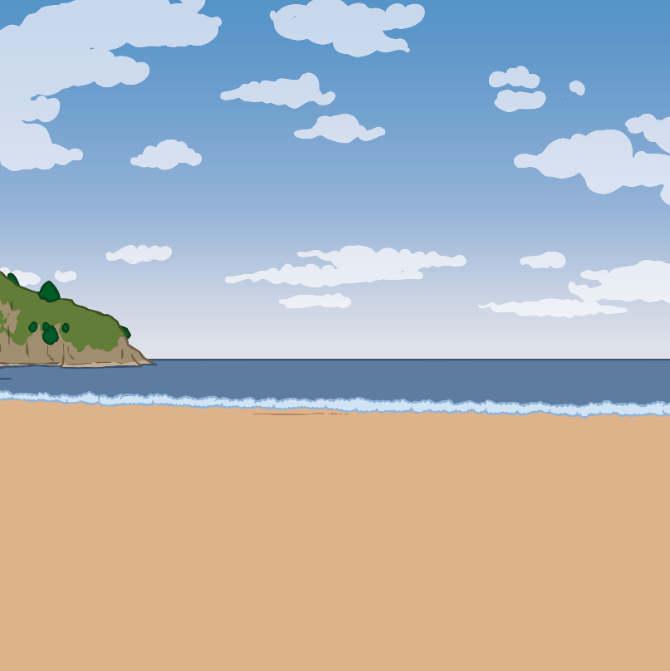
How Have Lighthouses Changed?
In the olden days, the light would have been an oil lamp or
even a candle. Now it is a powerful, electric light.
Lighthouses used to be run by people called lighthouses keepers. They would live in the lighthouse, making sure it stayed in good condition. The lighthouse keeper would live on the lighthouse for months and wouldn’t leave during that time. Now all lighthouses are run by computers. The last lighthouse keeper in the UK left their lighthouse in 1998.

Slide 9
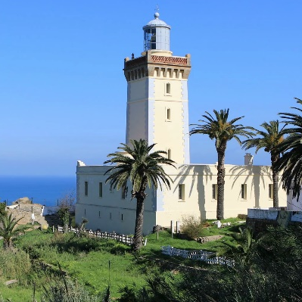
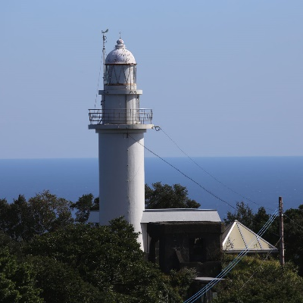
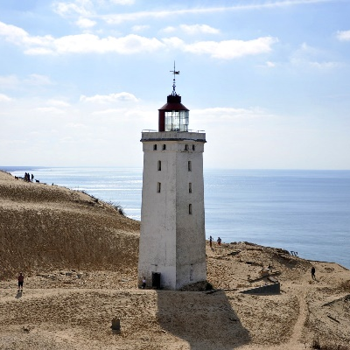
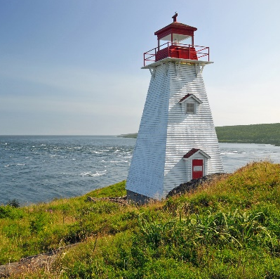
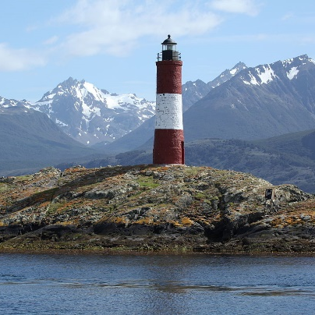
Lighthouses Around the World?
Morocco
Japan
Denmark
Canada
Argentina

