Slide 1
Transition
Parental Information
Evening
P1 D (Mrs Donegan),
P1G (Mrs Grimson) and
P1/2G (Mrs Gee)

Slide 2
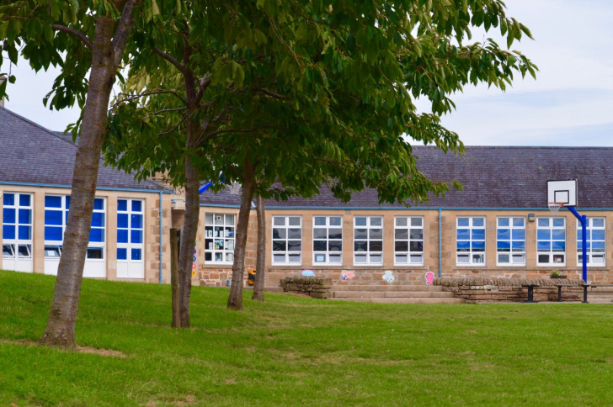
Transitional Visits
Visits 1 and 2
9.15am – 10.15am
Adults to stay and play. On these visits the accompanying adult will be responsible for their child. The class teacher will chat to children and adults to get to know both.

Slide 3
Visits 3 and 4
Adults to drop off their child and collect at 10.15am. There will be a separate room for any adult wishing to stay.
Your child will meet their buddy on these visits.
You are free to choose which visits to attend as we know there may be other activities you may have planned and cannot attend all sessions.

Slide 4
The school day
9am – 10.40am
10.40am – 11.00am Break
11.00am – 12.30pm
12.30pm – 1.10pm Lunch
1.10pm – 3pm
All pupils for P1 – P7 now have the same length of school day.

Slide 5
School Lunches
One snack only for playtime ( think about can your child open them, peeling oranges etc.)
All lunches are free – helpful to read the menu with your child prior to the start of the day.
6 week rolling program, even on a half week it moves on
Juice tokens on sale before 9am around 25p

Slide 6
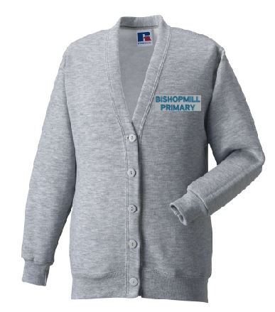
School uniform
Order from Dallas Designs directly
PLEASE name all clothing !

Slide 7
PE
Shorts, T shirt, socks and slip on gym shoes.
Practise getting into gym clothes and putting school clothes back in the gym bag!
Also turning clothes the right way eg trousers, sweatshirts etc
Spynie – Red
Findrassie – Green
Pitgaveny – yellow
Morriston - blue

Slide 8
Jackets
Hook for hanging them up desirable.
Jackets every day please.
Zips
Hoods

Slide 9
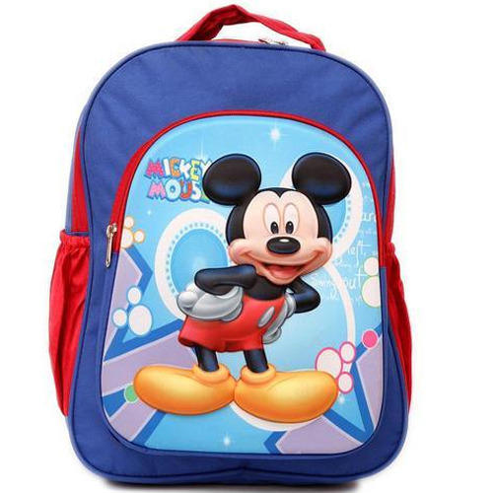
Schoolbag
Things to think about……….
Can it fit a library book?
Spare pants and socks.
Is the bag easy for your child to carry?
Water bottle
Tissues
Pencil case – not crammed with lots of pencils!
Can your child close it easily?

Slide 10
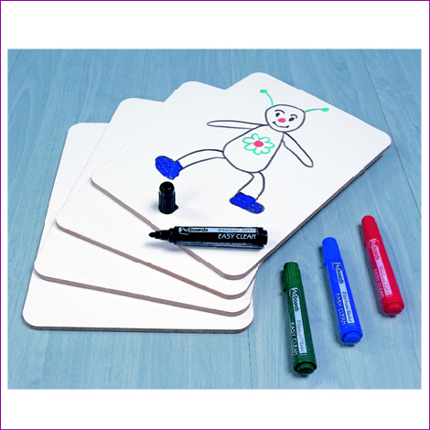
whiteboards
twistables

Slide 11
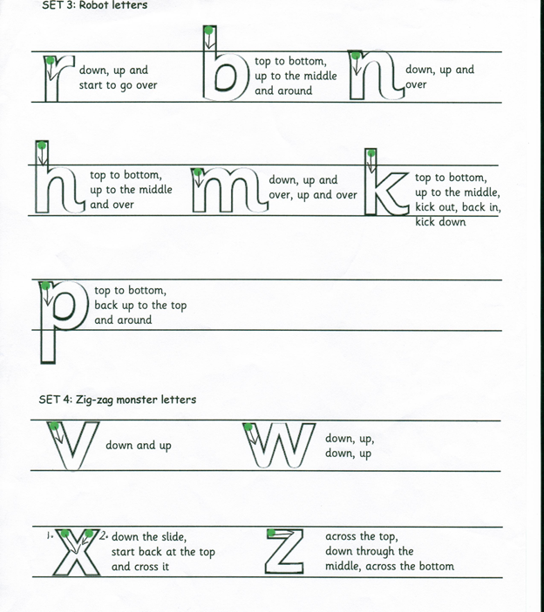
Only if your child is writing, teach good habits!
Letter formation
Pencil grip

Slide 12
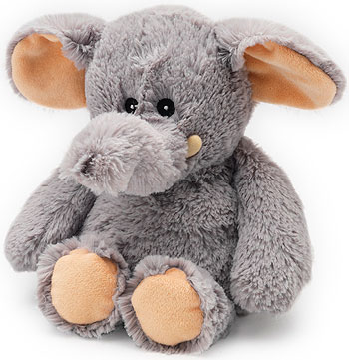
Show and tell
Mondays only please
One thing only
If it is a holiday on a Monday – no show and tell
Discourage taking
toys to school

Slide 13
Lining up
Parents – can you drop your child in the class line and stand in the designated drop off area!
Remember your child lines up without you at break and lunchtime!
Tell your child that you can see them even if they can’t see you, you will be there!
Lines are gender neutral

Slide 14
Curricular areas
Workshops second week of term
Many share the learning opportunities throughout the year
Give out letters!

