Slide 1
Vision and Values
Bishopmill Primary

Slide 2
Proud
In February we became a RR level 1 school
We are very proud of our ethos and consider it to be respectful and welcoming
Where you will experience positive relationships across the school
To ensure that this prevails we must all know and understand our shared vision and values reflected in article 29 of the UN Convention on the rights of the child
Where
Education must develop every child’s personality, talents and abilities to the full……….
And to do this we must all adhere to a shared vision and values………

Slide 3
DREAM Article 29 ( goals of education)
Being happy
Being successful
Having a vision and setting a goal
Thinking about something you want to do in life
Believing that you can do some
Setting your heart on something and doing it
Doing well in school
Believing that you are able to do something and no one will stop
Reaching goals and try your best
Imagining with determination

Slide 4
ACHIEVE Article 28 ( right to education)
Doing your best and working hard
Managing to do something you haven’t done before
Achieving personal goals
Getting better, improving things
Finishing what you started
Practising skills to get better
Completing work and being proud
Being the best you can be
Going that extra bit further
Doing something you have not done before

Slide 5
RESPECT (Article 13 Freedom od expression)
Listening to people and valuing each others’ opinions
Being kind to each everyone
Including everyone
Treating others how you want to be treated
Sharing
Appreciating someone for who they are
Helping and supporting each other
Having manners
Saying sorry
Being friends
Kind words and kind actions
Respecting difference

Slide 6
SUCCEED Article29 – goals of education
Getting things right
Working hard
Completing something
Persevering to the end
Completing a challenge
Getting better at things
Never giving up
Finding different ways to do something
Trying your best and never giving up
Doing better each time
Getting to where you want to be
Letting nothing stand in your way

Slide 7
SHARED VALUES ( Articles 13, 28 and 29)
A Achievement
C Cooperation
O Outstanding behaviour
R Respect
N New beginnings
Our positive relationships policy and behaviour management system in school is based on our shared values

Slide 8
ACORN – How it works…..
A is for Achievement
Trying hard
Meeting the Learning Intention and Success Criteria for a lesson.
Producing work which demonstrates a learner’s development and progression.
Acting on feedback and next steps to improve.
C is for Co-operation
Working in collaboration with peers, teachers and other adults to complete a given task.
Demonstrating social skills when interacting with other learners.
Citizenship skills.

Slide 9
Continued….
O is for Outstanding Behaviour
Following our class and whole school rules to the best of our ability.
Striving to achieve the 5 aspects of ACORN both in school and out in the playground.
Respecting the visitors and guests who come to join our school community.
R is for Respect
Displaying good manners to all children and adults in our school.
Looking after our school property and resources.
Valuing the contributions made by all in our learning community.
N is for New Beginnings
Each new day in school is a new beginning for learning.

Slide 10
Positive Relationships How it works ………
1. Be given an informal reflection time.
2. Name moved to yellow.
3. Second time name moved to orange.
4. Third time name moved to red and name recorded on the class record sheet
5. A 3 minute reflection time given
6. A 5 minute reflection time in another classroom.
7. A ten minute reflection time with a Depute Head Teacher or Principal Teacher.
8. Any further reflection time - sent to Head Teacher.
9. A pre exclusion letter may be sent by the HT at this stage.
10. An exclusion may be incurred.

Slide 11
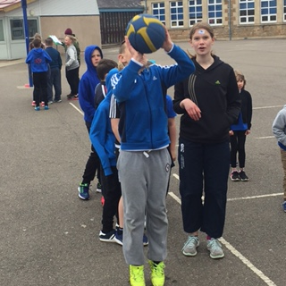
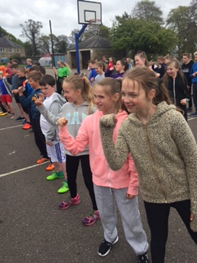
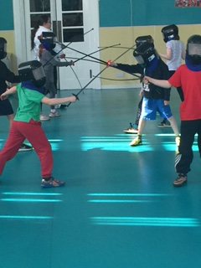
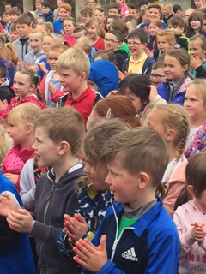
Broad and balanced education Happy and safe children ( 1,3,12,13,14,15,19,23,24,28,29,31)

Slide 12
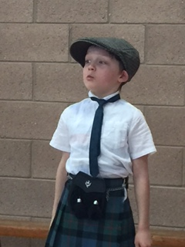
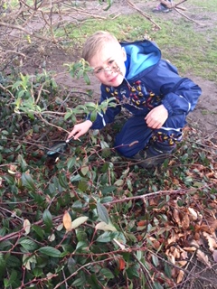
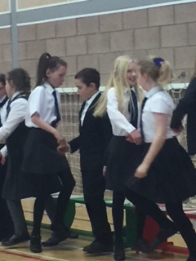
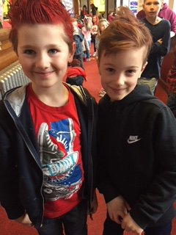
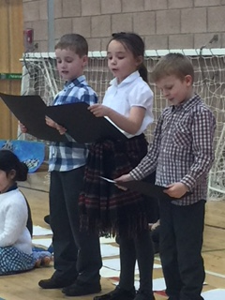
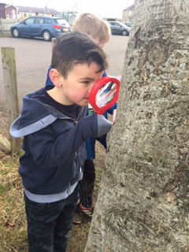
Confident,responsible,successful…

Slide 13
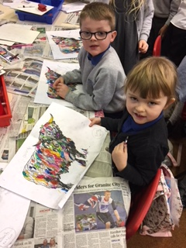
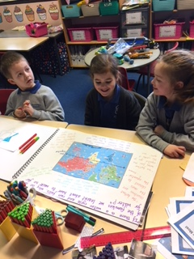
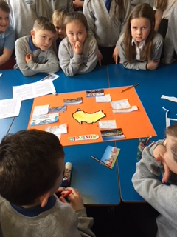
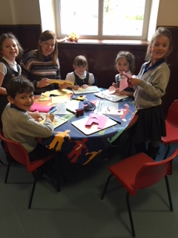
Learning together

Slide 14
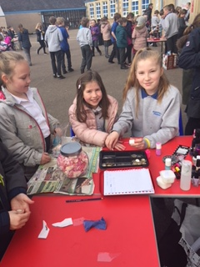
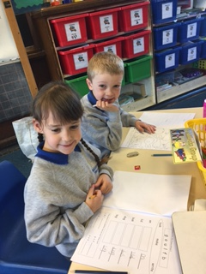
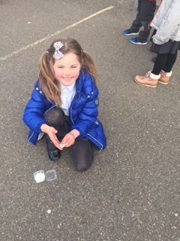
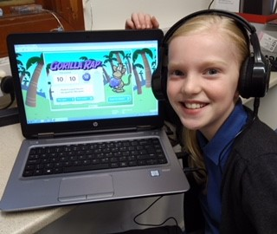
Happy……..the best place to be in order to Dream, Achieve, Respect and Succeed

