Slide 1
Rights Respecting School Bishopmill Primary school

Slide 2
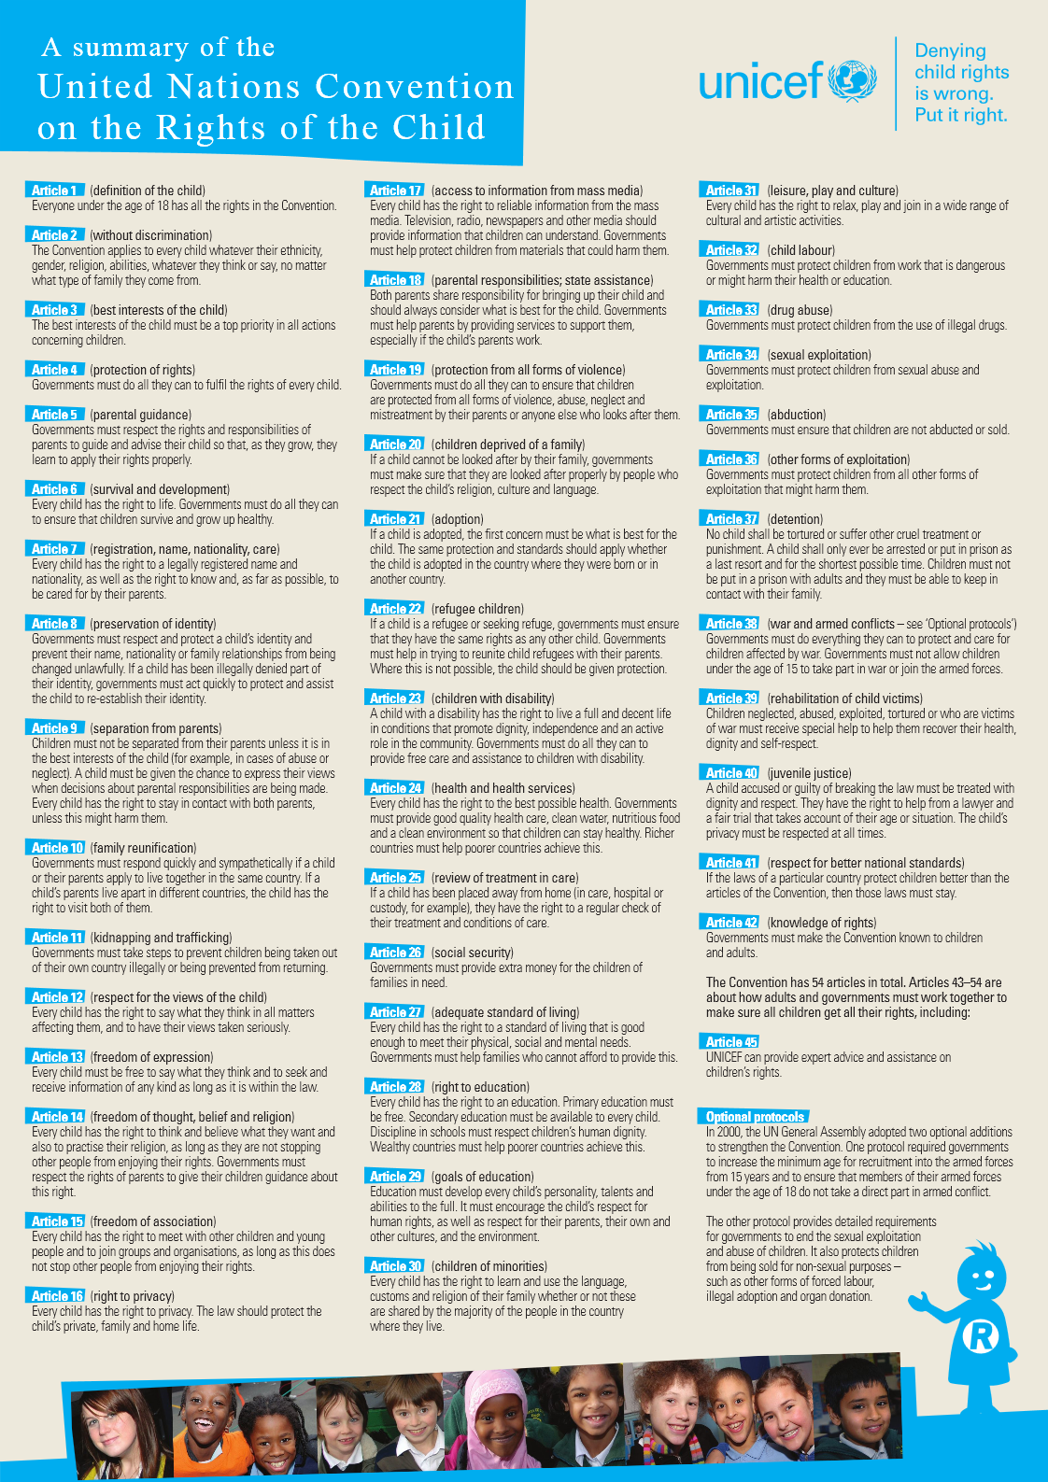
What is it?
The Rights Respecting School Award (RRSA) is an initiative run by UNICEF UK, which encourages schools to place the UN Convention on the Rights of the Child (CRC) at the heart of its ethos and curriculum.

Slide 3
What is it?
Principles
EQUALITY
DIGNITY
RESPECT
NON-DISCRIMINATION
PARTICIPATION
A Right Respecting School
is where children’s rights are learned, practised, respected, taught, protected and promoted.

Slide 4
WHY? - EVIDENCE
Pupils develop a long-term commitment to values such as social justice and inclusion
There is a reduction in bullying and discriminatory behaviour among children
Pupils enjoy and feel safe at school
Pupils feel included and valued
Pupils’ wellbeing and emotional resilience is improved
Pupils’ engagement in the school and their own learning is improved
Pupils are more engaged in their local and global communities as ‘active citizens’
Pupils’ attainment is improved, and the attainment gap between disadvantaged and non-disadvantaged pupils is narrowed

Slide 5
Our Journey
We started our journey in August 2016 looking at the difference between wants and needs. We linked this to or vision and values – as we want our children to have the best education possible and be developed to reach their full potential.
Article 28: (Right to education):
All children have the right to a primary education, which should be free.
The government should support children and young people in education. It should:
make efforts to reduce dropout rates from school
make sure teachers can’t use violence against children or young people
make sure teachers don’t publically humiliate children or young people
make sure children or young people aren't bullied by their teachers or classmates.

Slide 6
Our Journey
On 26th February 2018, we achieved Level 1, Rights Respecting School.
To achieve this;
We were audited by representatives from the Moray Council and Unicef.
The pupils in the RRS group gave a tour of the work we had done.
Questioned staff, parents/carers and agencies we work with.
Questioned pupils in class.
Studied our journey.

Slide 7
Aspects of our Journey

Slide 8
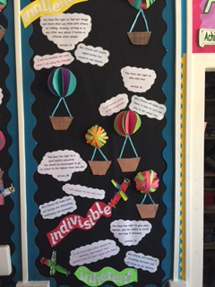
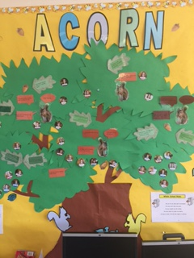
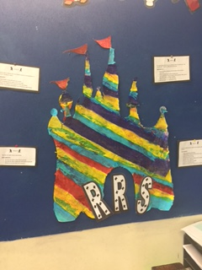
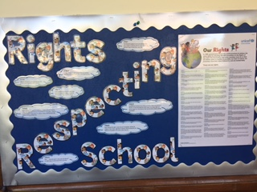
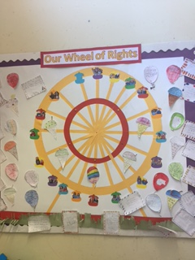
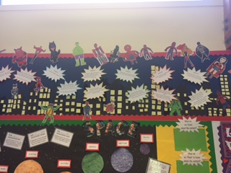
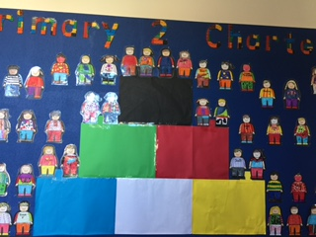
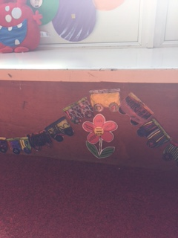
Class Charters

Slide 9
GIRFEC and SHANARRI
We have linked RRS closely to GIRFEC and SHANARRI thus incorporating the following articles:
Article 3 (Best interests of the child):
The best interests of children must be the primary concern in making decisions that may affect them. All adults should do what is best for children. When adults make decisions, they should think about how their decisions will affect children.
Article 12 (Respect for the views of the child):
When adults are making decisions that affect children, children have the right to say what they think should happen and have their opinions taken into account.
Article 31 (Leisure, play and culture):
Children have the right to relax and play, and to join in a wide range of cultural, artistic and other recreational activities.

Slide 10
Recognition of Commitment
December
2016

Slide 11
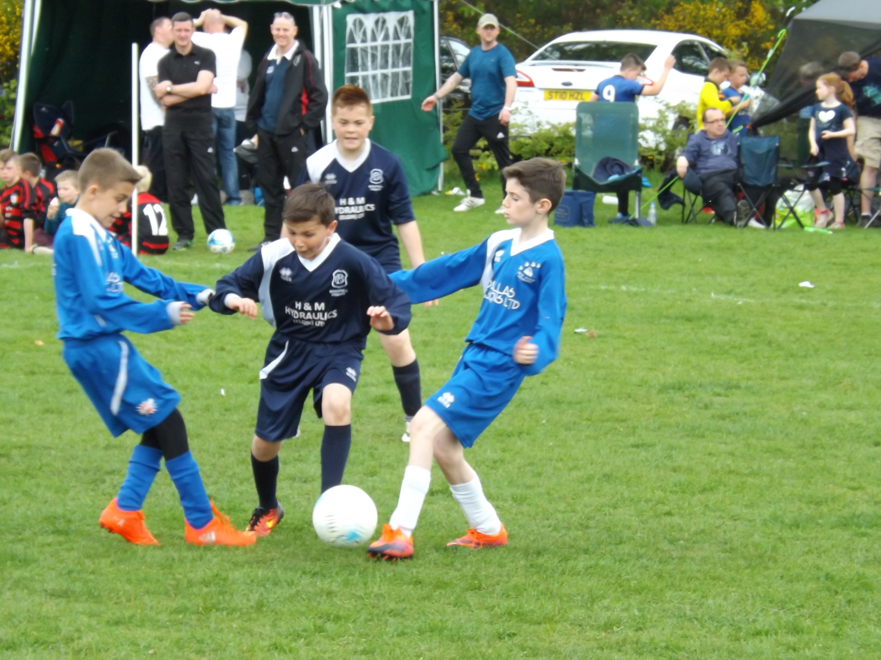
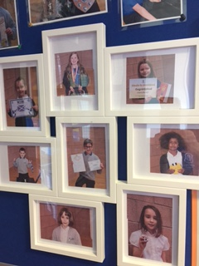
Wider achievement pictures

Slide 12
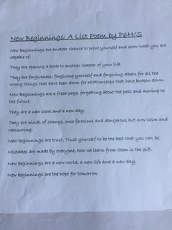
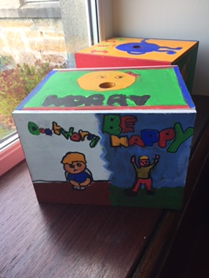
Listen to Pupil Feedback

Slide 13
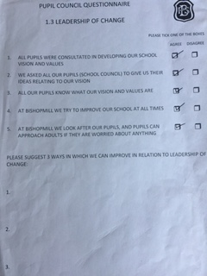
Listen to Pupil Feedback

Slide 14
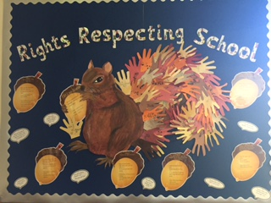
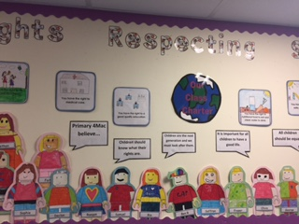
Pupil Awareness

Slide 15
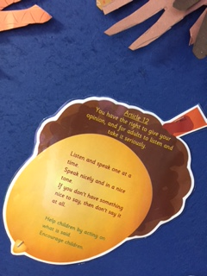
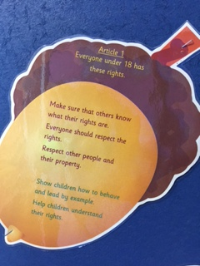
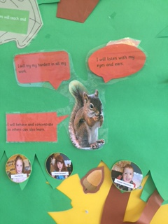
Pupil Discussion

Slide 16
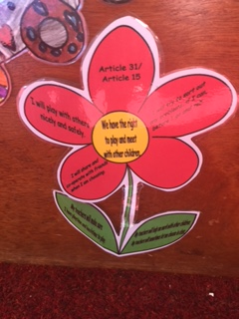
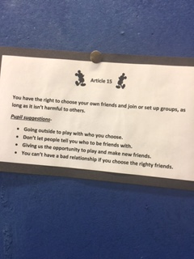
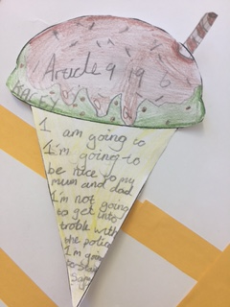

Slide 17
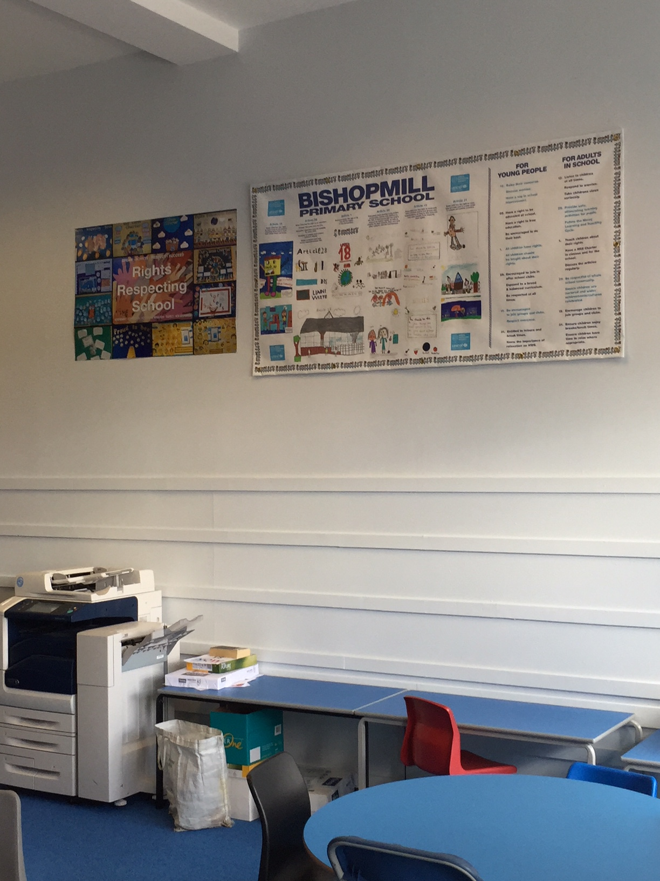
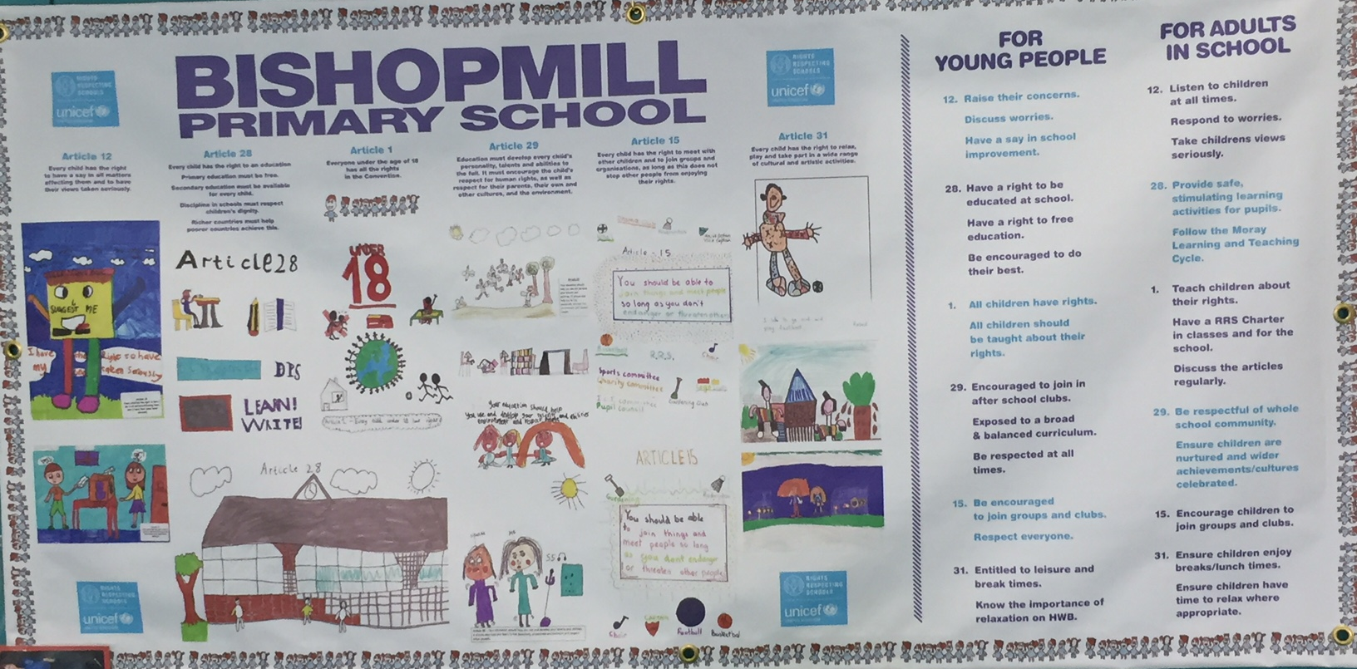
School Charters

Slide 18
Further Developments
Whole school assemblies and then this should be discussed by teachers in class
All staff made aware of RRS
Continue to alter/design new charters with our classes.
Continue to use charters to discuss articles on a daily basis.
Reflect upon our Vision and Values to ensure they reflect RRS
Promoting a respectful ethos
We have linked ACORN and DARS with RRS
Supported charities to improve the lives of children locally and globally.

Slide 19
Next Steps
Build into our social studies pathway next session along with global citizenship – to include young people having a say in their learning.
Continue to promote a respectful ethos.
Continue to link ACORN and DARS with RRS.
Continue to support charities to improve the lives of children locally and globally.
Meet the criteria for Level 2.

