Slide 1
CLASS STRUCTURE
Bishopmill Primary

Slide 2
How is class structure worked out?
Schools are staffed on the total number of pupils within the school regardless of the numbers of pupils at each year stage.
Head teachers need to organise classes to make best
use of available staff, resources and space.
A lot of discussion takes place between teaching staff and SMT in order to do this effectively.

Slide 3
GROUPING CHILDREN
Pupils are organised into single class sizes e.g. Primary 3, or into composite classes, which contain pupils at more than one year stage e.g. Primary 3/4, Primary 5/6
Moray Council Policy is followed at all times
We look at groups functioning at similar levels in Reading, Writing or Mathematics to help us organise the classes
“A number of pupils of broadly the same attainment, who show the capacity of
working well as a learning group”.
There cannot be more than 25 pupils in a composite class

Slide 4
Numbers in classes
According to the teachers’ contract, the normal maximum number of pupils
in P1-P3 is 25
In P4-P7 is 33
In a composite class is 25

Slide 5
When do you know?
Normally, parents will be informed of the process for annual class
structuring arrangements before the summer
You should be confident that the
professionalism of the staff in your school in delivering an appropriate education for your child
The school will ensure that your child will always work within a programme appropriate for his/her age, ability and aptitude.

Slide 6
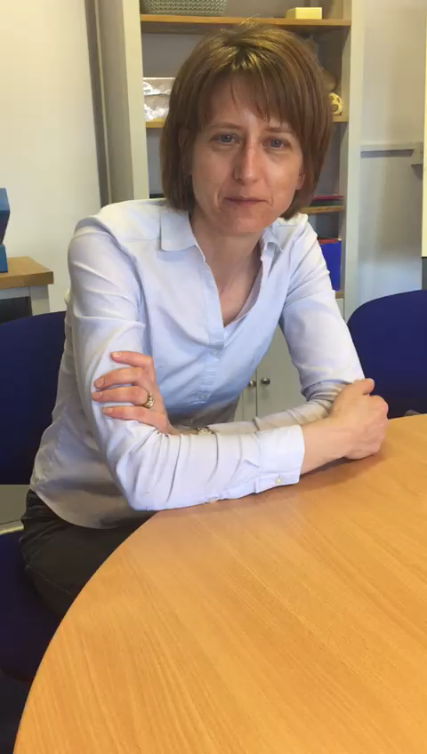
What the adults say……

Slide 7
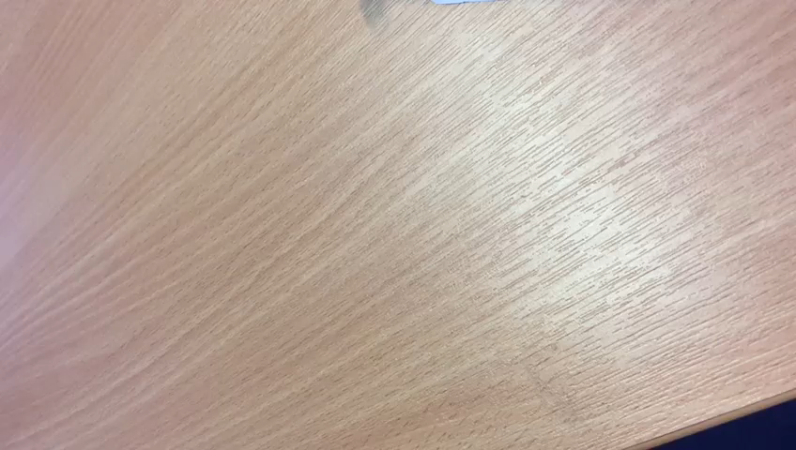
Final words to adults….

Slide 8
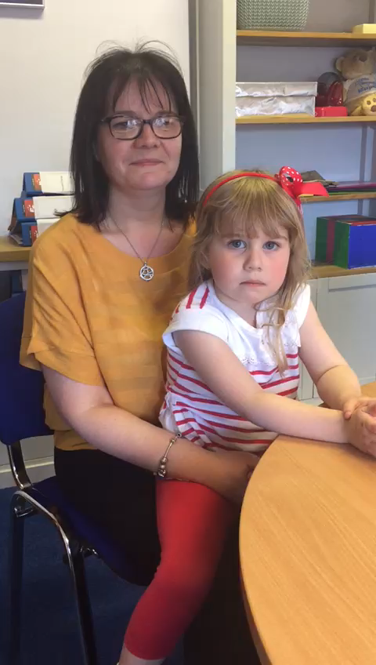

Slide 9
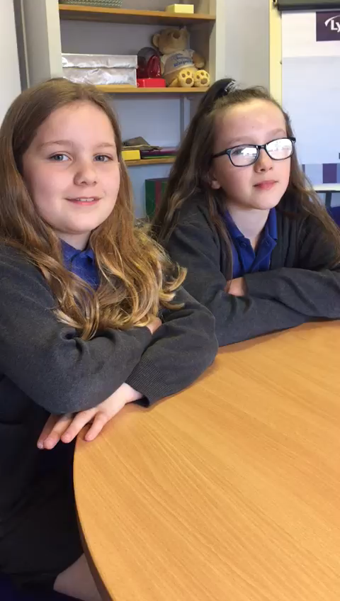

Slide 10
ANY QuESTIONS?…

