Slide 1
Numeracy Parent Information

Slide 2
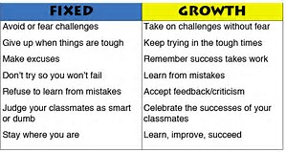
Growth Mindset
I want my class to know……..
Its ok to make mistakes – we can learn from them
AKA – Maths Talk
Process and not the product!

Slide 3
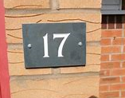
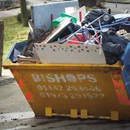
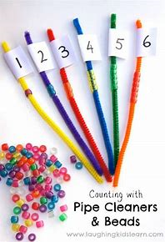
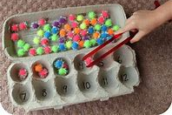
Making Links with Literacy
*Concept of print
*Oral language
*Fine motor skills

Slide 4
Number Knowledge
&
Number Strategy
• Strategy describes the mental processes children use to estimate and solve problems
• Knowledge describes what we want children to be able to recall without having to think about it
Learning is a cycle, where knowledge provides the foundation for developing strategies, and use of strategies develops new knowledge.

Slide 5
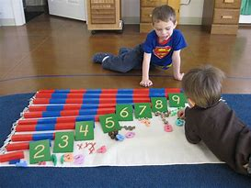
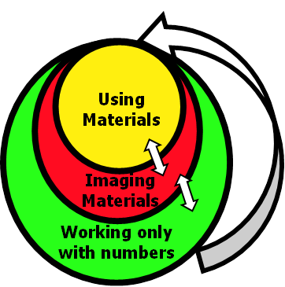
When introducing a new concept or strategy:
First we always use MATERIALS. These could be concrete materials, equipment or diagrams.
Then we use IMAGING: materials are shielded or screened from the children and they are encouraged to imagine them and the actions they will take using them to solve the problem.
Finally, once this is mastered we move on to use NUMBER PROPERTIES. Now we don’t use materials at all, and use problems involving bigger numbers so that images are no longer possible and children see the problem as an abstract idea.
Children may need to “fold back” or move between these different phases as they learn.

Slide 6
NUMERACY
Number Knowledge
*Number Identification
*Number Word Sequences and Order FNWS/ BNWS
*Basic Number Facts
*Grouping & Place Value
*Written recording

Slide 7
NUMERACY
Number Strategies
Addition & Subtraction
Multiplication & Division
Fractions, Decimals & Percentages
Some examples are…
*Doubles & Halves
*Commutative Law
*Count on / back in 1’s
*Skip counting in 2’s, 5’s & 10’s
*Partitioning & Recombining
*Make 10 to add 9/ compensation

Slide 8
Example - Maths Talk
Number Strategy - Word Problem
Mrs Blair has 34 children in her class. 12 children go off to do forest school with Earthtime. How many are left in Mrs Blair's class?
Maths Talk Outline
*****Word problem, Strategy discussion & teaching, Using materials & Applying learning

Slide 9
Possible strategies
34 – 12 = 22
Strategy A
****Counting in ones backwards
Strategy B
Thirty-four minus ten is twenty-four. Twenty -four minus two is twenty-two.
****Working with tidy numbers
Using the tens to bridge
34 – 10 = 24
24 – 2 = 22
Strategy C
Pupils can carryout part-whole thinking.
****Partitioning then…
****recombine
34 – 12 = 22
30 + 4
10 + 2
30-10 = 20
4-2=2

Slide 10
Our role is to increase independence in….
Interpreting questions
Selecting and communicate processes and solutions
Helping pupils to justify their choice of strategy used
Making links with mathematical concepts
Using mathematical language and notation
Confidently using mental agility

Slide 11
Supporting your child at home…
Homework examples on tables to discuss!
See handout for examples in and around the home.

