Slide 1
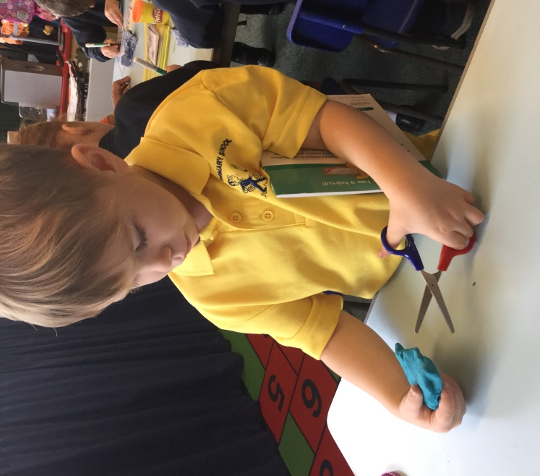
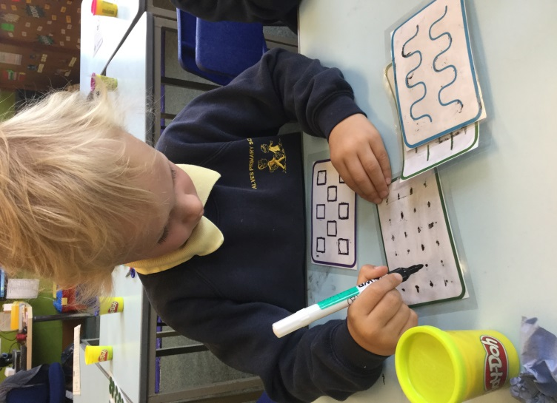
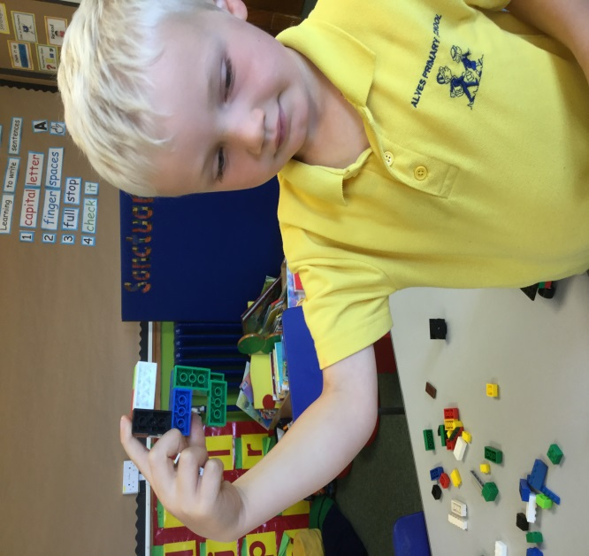
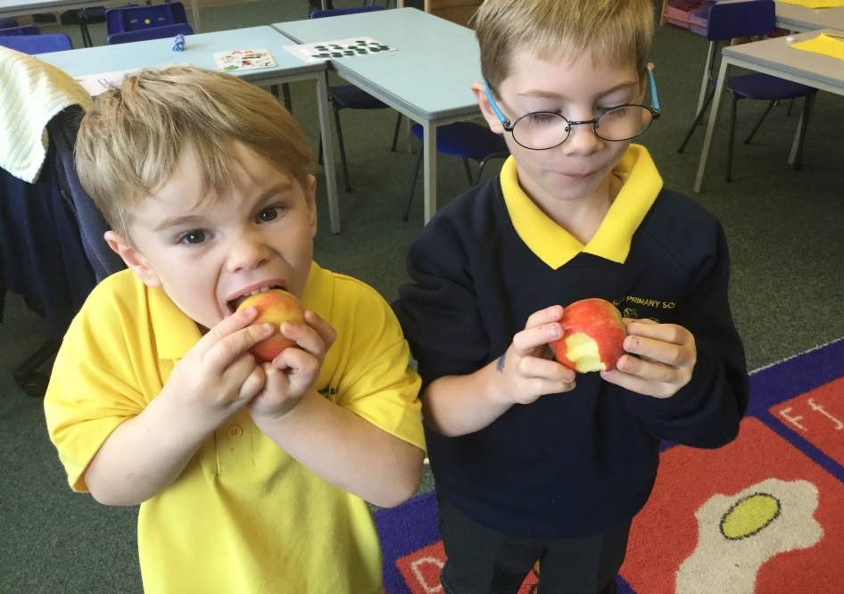
Emerging Literacy
Parent Information

Slide 2
HEALTH WARNING!!!!!
You have already given your child the best start in Life!
Consciously or sub-consciously your child has been exposed to a wealth of valuable learning experiences prior to becoming a pupil here at Alves. You are your child's first educator and we value the input you have nurtured within your child so far. They have come to us with their enthusiasm and curiosity bursting at the seams and are ready to learn.
Please don’t feel patronised by any of the information tonight as you are probably doing many of these things already.
Please stop us at any time if you have a …

Slide 3
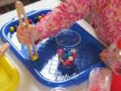
Concepts of Print | Oral Language
Phonological Awareness | Pre-Handwriting Skills

Slide 4
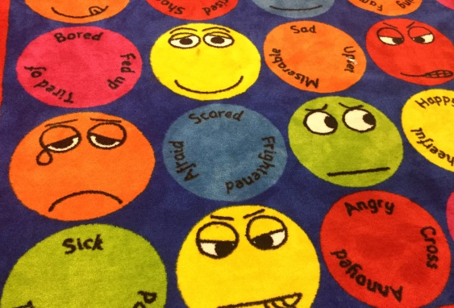
Concepts of print
Reading print is all around us all the time.
Here are some examples of where your child may have been exposed to print today.
1. Within the home we have access to books, recipes, games, instruction, newspapers, cereal boxes, birthday cards, Subtitles, etc. 2. In the car there are road signs, number plates, building names, etc 3. In the community we see shop names, posters, signs, adverts, opening times, price lists, etc
Print isn't just a home reading book!!!!!!!
Use the advice we give you for reading homework and transfer into the environment .

Slide 5
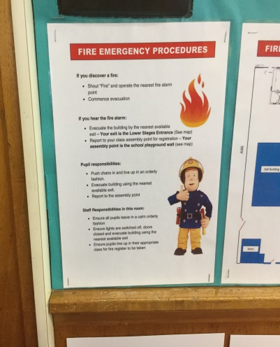
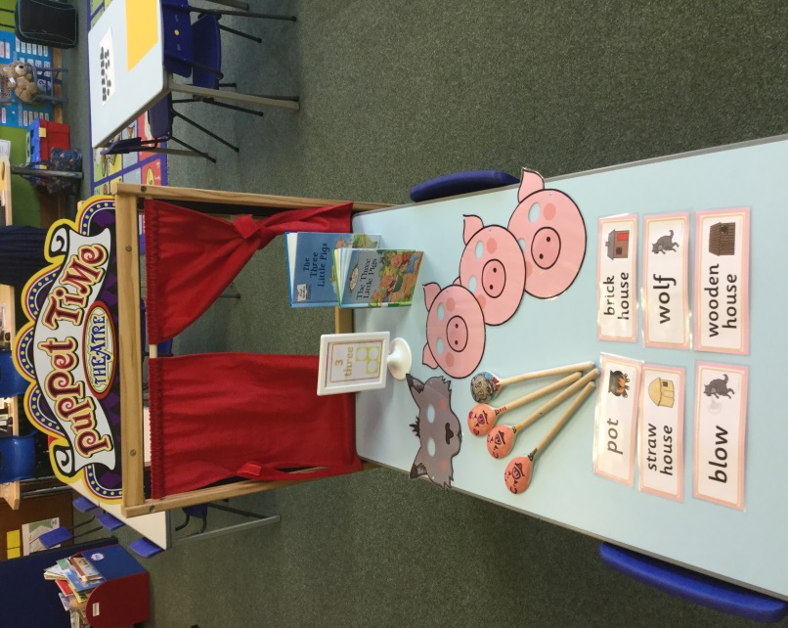
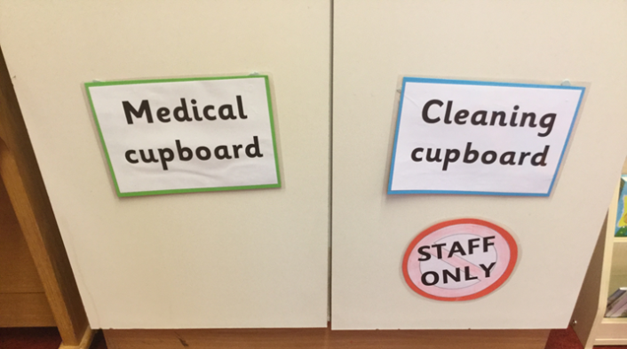
Concepts of Print within the early stages
Reading and sharing stories for enjoyment
Names on labels, trays, pegs, etc
Lunch menu
Role play – use imagination to explore where print is used in
different contexts. E.g Costa Coffee , Alves Pizzeria
Wall displays – learning tools/aids
Stickers and certificates
Even before children begin to read they understand that there is a relevance.

Slide 6
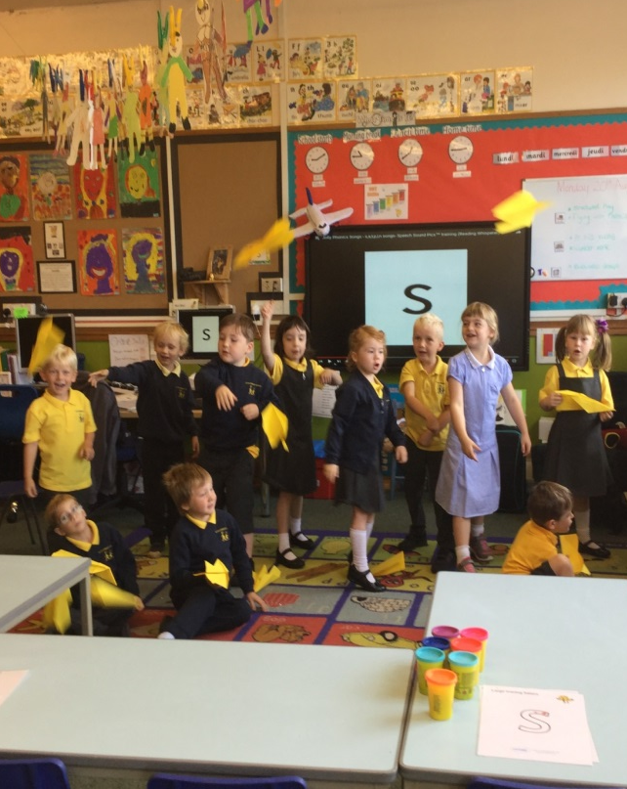
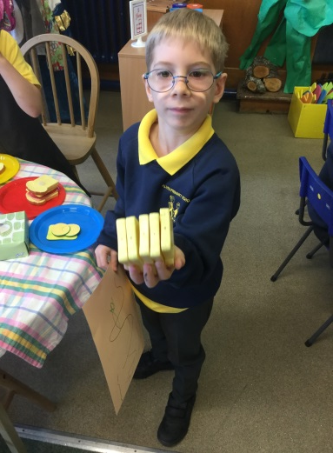
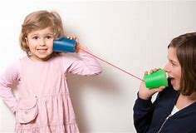
Oral Language Oral language in its simplest terms relates to Listening and Talking. How your child will process language being used around them and how they are able to construct appropriate vocabulary.
Expressive Language – Can use language
to describe a scene
to gain information and give own ideas
to start, takes turns and stops, in longer conversations
to communicate their thoughts and feelings
Understanding of language - Shows understanding
of story by simple question or commenting
of who, what happened questions
Of sorting objects according to category
Building vocabulary – encourage a natural curiosity about words and offer alternatives.
E.g big should also be given as colossal, enormous, etc.

Slide 7
Phonological Awareness It is so much more than just remembering the Jolly Phonics sounds!!!
1. Talking and Listening
2. Auditory Discrimination
3. Visual and auditory memory
4. Word boundaries
5. Rhyme awareness and detection
6. Syllable blending
7. Syllable detection
8. Rhyme production
9. Onset-rime
10. Phoneme discrimination and Alliteration
11. Phoneme blending
12. Phoneme segmenting

Slide 8
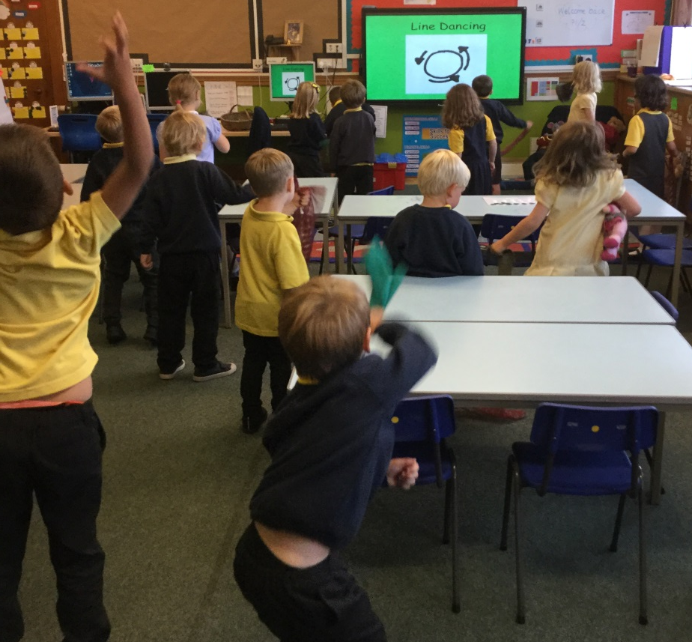
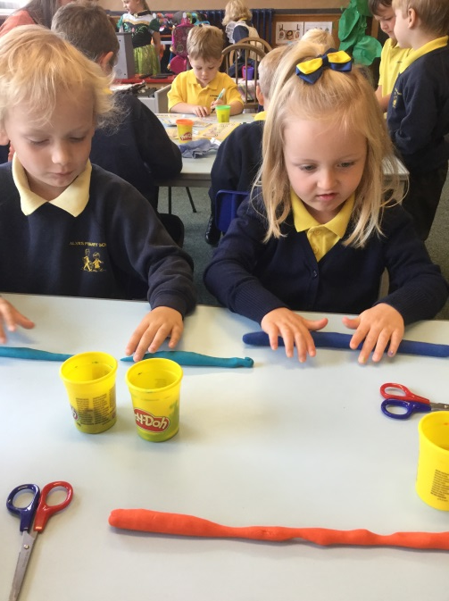
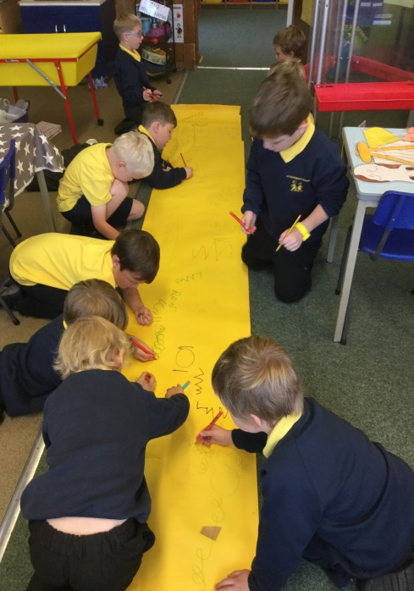
Pre-Handwriting Stages
Fine Motor Skills
Scissors skills
Pre-writing skills
Pencil Control – shapes and lines
Teaching Letter Formation

Slide 9
Fine Motor Skills – ideas for home
Threading pasta
Lego
Cheerios on pipe cleaners
Colouring in pictures
Dressing dolls, teddies, etc (Zips, buttons, velcro, etc)
Planting seeds
Jigsaw puzzles
Freezing toys in ice cubes to chisel out
Drawing people
Finger painting
Chop sticks and tweezers

Slide 10
EXIT PASS Feedback

