Slide 1
Numeracy in P1/2

Slide 2
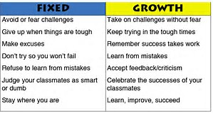
Growth Mindset
I want my class to know……..
Its ok to make mistakes – we can learn from them
AKA – Maths Talk
Process and not the product!

Slide 3
NUMERACY
Number Knowledge
&
Number Strategy
VOCABULARY VOCABULARY VOCABULARY

Slide 4
NUMERACY
Number Knowledge
Number and number processes
*Subatising patterns (know how many in a pattern without counting)
*Number ID
*Number sequences FNWS/ BNWS
*Basic number facts
*2 digit numbers teen, ty (decades)
*estimating and rounding
*Place Value
Short 10 minute lessons

Slide 5
NUMERACY
Number Strategies
Doubles & Halves
Commutative Law
Count on / back in 1’s
Skip counting in 2’s, 5’s & 10’s
Partitioning
Make 10 to add 9/ compensation

Slide 6
Example - Maths Talk
Number knowledge (10 min lessons)
Word Problem
Mrs Blair has 34 children in her class. 8 children go off to do forest school with Earth Time. How many are left in Mrs Blair's class?
Maths Talk Outline
*****Word problem, Strategy discussion & teaching, Using materials & Applying learning

Slide 7
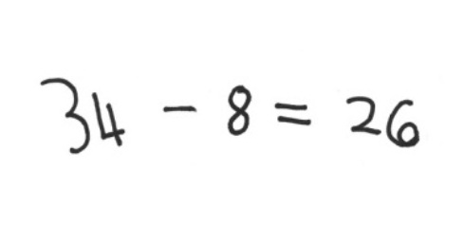
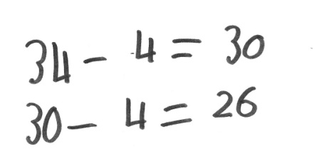
Possible strategies
Strategy A
****Counting in ones backwards
Strategy B
Thirty-four minus four is thirty. Thirty minus another four is twenty-six.
****Working with tidy numbers
Using the tens to bridge
Strategy C
Pupils can carryout part-whole thinking. ****Partitioning then recombining.

Slide 8
My Role….
Promote/teach a selection of strategies
Challenge pupils to explain their thinking, facilitate discussions between pupils around their problem solving.
Explore wrong answers and promote resilience.
Give the children a process to go through – lesson outline (Maths Talk)
Provide opportunities to be challenged and number knowledge recapped daily.

Slide 9
What can you do to help?
*Work on maths problems around the home. Gardening/hanging washing out, etc
*Discuss the everyday numbers you come across
*Explore counting in lots of ways
*Take an interest in the way your child figures things out.
*Help your child to manage time and money
*Play mathematical games together – dominoes/darts
*Use media to encourage them to explore number (YouTube)
*Look at our blog for numeracy updates
*Recap number knowledge concepts.

