Slide 1
Welcome to Seafield Primary School
W

Slide 2
Aims of meeting

Slide 3
Seafield Primary School
Seafield Primary School was opened in 1955 and throughout the years has developed a strong sense of community with families, partner agencies, RAF and local businesses.
Current roll of 368 P1-7 pupils
14 Primary Classes
Our values are :
Happiness Nurture Positivity Equality Resilience
Respect and Communication

Slide 4
Our School
Seafield Primary School is built on two levels with separate accommodation for Nursery, P1 (The Modular) and P6-7 (The Hub) and includes extensive grounds
15 classrooms currently in use
The Creative Zone (Music and Art room)
The Rainbow Room-Cooking and Nurture room
ICT Suite
Library
The Learning Lounge-Enhanced Provision
Seafield is surrounded by beautiful open green areas which classes make regular use of as part of planned learning experiences within the classroom.

Slide 5
Seafield Vision
At Seafield we are
This is achieved by promoting
Our Vision –Together We Learn, Together we Grow
where parents, pupils, partner agencies and the wider community work together for the benefit of the school and its learners.

Slide 6
Seafield Values
To achieve this vision, our current pupils, colleagues and parents created a set of SEAFIELD values where we promote our children and young people at Seafield to demonstrate
Happiness Nurture Positivity Equality Resilience
Respect and Communication
All children are aware of what these values are and how they can be applied
within the classroom and outside in the playground.

Slide 7
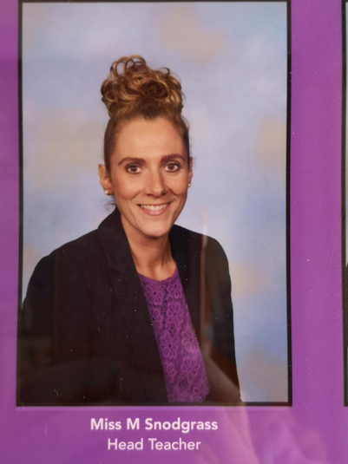
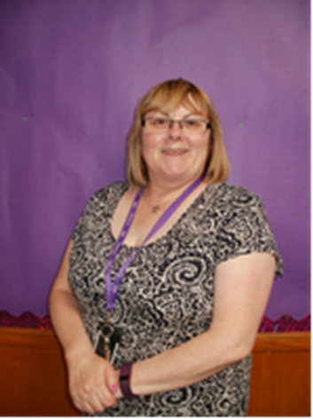
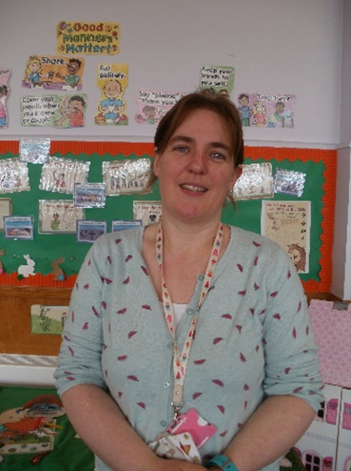
Senior Leadership Team
Depute Head Teacher Head Teacher Principal Teacher
Miss Angela Stuart Miss Morven Snodgrass Mrs Heather Reid
(Primary 1-3) (Additional Support Needs)

Slide 8
Visits to Seafield
Under COVID-19 restrictions in educational settings, parents and carers not permitted to attend for tours.
ELCC settings within Elgin are invited to attend a ‘Stay and Play’ session.
(Following clear mitigations and approval from Moray Council HQ)
Please see our Virtual Tour on our School Website
https://blogs.glowscotland.org.uk/my/SeafieldPrimarySchoolWebsite/

Slide 9
Class Formation
When creating classes, the staff at Seafield consider
Friendships
Pre-school groups
Spread of ages
Balance of boys and girls
ASN pupils
Following Moray Council policy, there is a limit to 25 pupils in a Primary 1 class.
Notification of pupil classes will be coming soon to all parents and families in P1.

Slide 10
Intake Arrangements
First Day
Children will be attending at 8.50am until 2.50pm
The children will line up inside Gate 2.
There will be a sign for their classes and staff will be available to guide them
They will be escorted down to their lines by their class teachers
The pupils will meet at these lines each morning until Term 3-4 when we encourage them to be a bit more independent

Slide 11
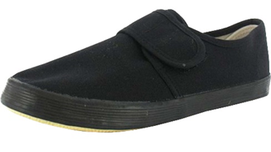
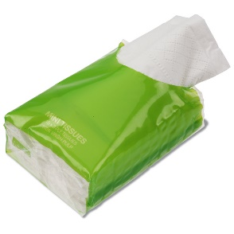
What Will Your Child Need?
a big schoolbag every day
water bottle
play piece
Brain Break Snack
Packet of tissues
Plimsolls for use in class and the gym
A full change of spare clothes in a plastic bag to be left in school in case of accidents
Please name everything!

Slide 12
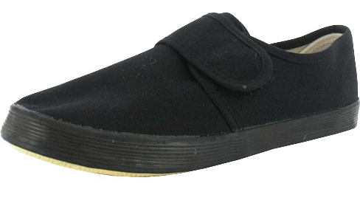
Curricular Items
Infant Book Bag
P.E. kit
(plain coloured t-shirt and dark shorts)
Slip on gym shoes
Pupils should come to school in PE kit on PE days. For outdoor PE, especially in Winter please come in jogging bottoms

Slide 13
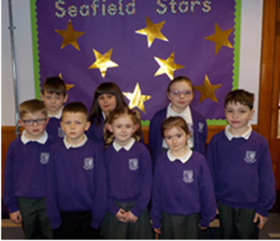
School Uniform
Our uniform encourages a sense of belonging and avoids competition
Purple sweatshirts or cardigans
white polo shirts
grey or black trousers, skirts or pinafores
dark shoes

Slide 14
PE KIT
Every week, children in Primary 1 receive 2 hours of planned Physical Education by their class teacher.
Coloured house t-shirt FLEMING – blue t-shirt
Black/ dark P.E. shorts BAIRD – green t-shirt
Indoor gym shoes BELL – yellow t-shirt
WATT – red t-shirt

Slide 15
Formal Occasions
At formal occasions, we encourage children to wear formal school uniform.(White Shirt and School Tie)
‘Starting School’ photograph by the Northern Scot.
Individual/ family/ class photographs throughout the year
annual award ceremony in June
representing the school at local authority events
photographs in the local press

Slide 16
Buying School Uniform
School uniform is available to be purchased from Dallas Designs
https://www.dallasdesignsltd.co.uk/
Uniform comes in a range of sizes.
Sample sizes for your child to try on when making an order.

Slide 17
What will your child do?
renew friendships
make new friends
get to know teacher and school staff
build on from pre school
be introduced to classroom routines
early assessments
PIPS

Slide 18
Teaching Staff
welcome you and your child
get to know you both
provide a happy and stimulating environment
communicate with you through Class Dojo
introduce class routines
observe and assess
plan appropriate learning and teaching activities
be available to parents electronically

Slide 19
Playtimes
sometimes scary at first
Mrs Matheson our Playground Supervisor and our PSAs available in the school grounds
P7 Helpers as Buddies for the first few weeks
Separate play areas for year groups
First Aid Trained staff
Playground equipment
Rights Respecting Schools Playtime Charter

Slide 20
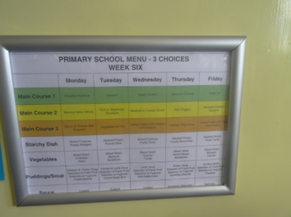
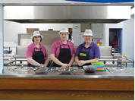
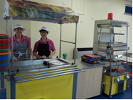
Lunchtimes
All children in P1-5 eligible for free school meals
3 daily choices
4 week menu
3 lunchtime supervisors
Senior Leadership or Pastoral Care staff support

Slide 21
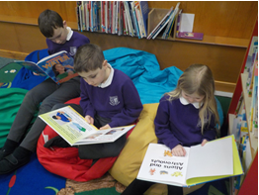
Getting Ready for School
encourage your child to be independent
fastening coats
trousers - no belts please!
hanging up coats
unpacking bags
please ensure you read the lunch menu with your child so they know what choice they are to make for their lunch
read lots of stories
talk lots and encourage lots of questions
play board games
singing nursery rhymes and read fairy tales
spot numbers and shapes in the environment

Slide 22
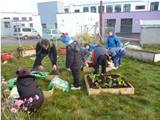
Advice and Preparation
please name all belongings
absence procedures –inform the office
check schoolbag nightly for letters
check your email
Punctuality
School newsletter
home-school partnership – let staff know of any concerns
keep valuables and toys for home

Slide 23
Homework Tasks
All Primary 1 pupils receive weekly homework tasks
TERM 1
Terms 1 and 2
-phonic sounds and actions to practise at home and reading will be issued when children are ready. They don’t all receive a book at the same time.
-Weekly numeracy task
Terms 3 and 4
-Reading homework
-New phonic sounds and actions
-Weekly literacy task
-Weekly numeracy task
.

Slide 24
Moving Forwards
Allocation of P1 classes coming out in the next few weeks
Telephone calls to ELCC settings next week
P7 buddy for next session arranged soon

Slide 25
In Closing
We do hope that you have found our first induction session helpful for your child starting Primary 1.
If you have any questions or queries following today’s session, please contact us on admin.seafieldp@moray-edunet.gov.uk
. Alternatively, please call Seafield School Office and we will try our best to answer any questions you may have.
Miss Angela Stuart
(Depute Head Teacher)

Slide 26
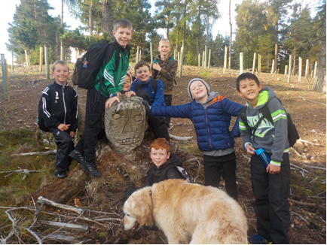
Finally…
Welcome to
Seafield Primary!

Slide 27
Enquiries
School Address
Seafield Primary School
Deanshaugh Terrace
Elgin
Moray
Scotland
IV30 4ES
Contact Number
School Telephone: 01343 547792
E-mail
admin.seafieldp@moray-edunet.gov.uk

