Slide 1
Teaching EAL Pupils who are New to English
Secondary

Slide 2
Definitions
EAL Learner- has been exposed to another language during early childhood and continues to be exposed to this language in the home or in the community. If a child was exposed to more than one language (which may include English) during early development, the language other than English should be recorded irrespective of the child’s proficiency in English.’
'First language is the language to which the child was initially exposed during early development.
Bilingual Learner- pupils who function in more than one language in their daily lives.
New to English/ Early Acquisition- can last anywhere between 6 months to a number of years.

Slide 3
New to English
Targets
Can participate in very basic, short, formulaic spoken exchanges (e.g. good morning, how are you) and may respond non-verbally (e/g/ with a gesture of smile)
Expresses needs using gesture/1-2 words/home language
Shows understanding of simple information by responding to yes/no, either/or questions, with visual support and gesture
Beginning to give information on familiar topics (e.g. self/home) using basic vocabulary, single words and short phrases
Beginning to decode text but with limited understanding
Beginning to read and understand simple text with some familiar vocabulary, with clear context and visual support
Writes short, simple sentences with support using basic punctuation (capital letter, full stop)
Uses basic vocabulary and beginning to use taught subject-specific vocabulary

Slide 4
Early Acquisition
Targets
Requires visual support and rephrasing
Communicates meaning using basic vocabulary, simple phrases and sentences, though with some inaccuracies
Grammatical errors
Decodes text with some accuracy and understanding
Requires clear context and visual support
Beginning to use texts for research purposes with guidance and collaboration with supportive peers
Writes short, simple sentences with limited but current sentence structure, with some inaccuracies (e.g. omission, word order)
Uses basic vocabulary, some mature and subject-specific vocabulary
Writes a short paragraph with support

Slide 5
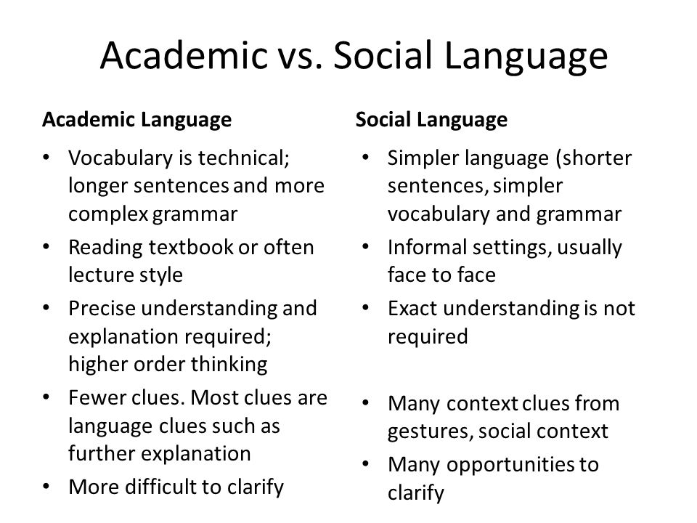
Language Proficiency
Takes about 7-10 years to learn
Takes about 2 years to learn

Slide 6
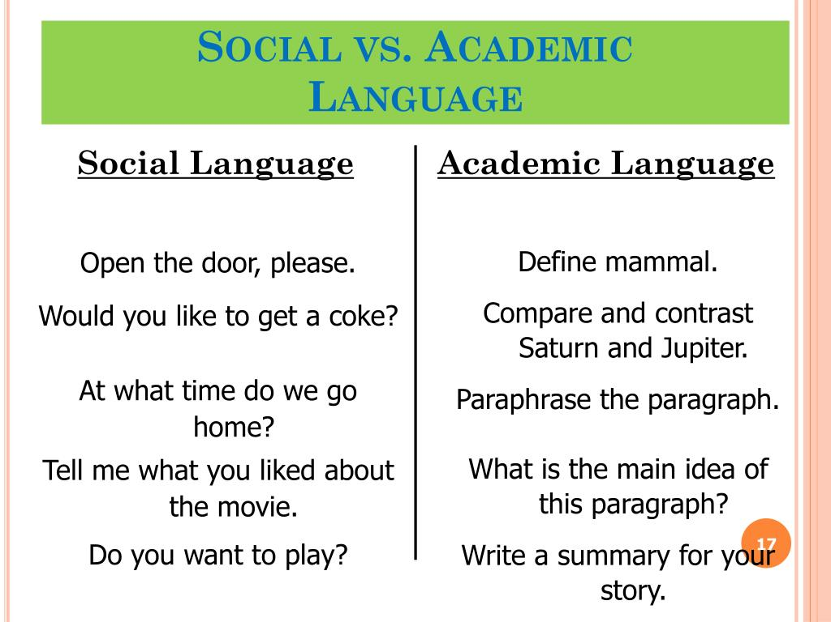
Language Proficiency
Examples
Notes:
2-3 years 7-10 years
Good Bics can mask Calps.
Teachers can use Bics to help pupils acquire Calps .
6

Slide 7
Isolated Learners
‘Isolated learners’
The pupil is the only learner of EAL in the class or a speaker of a language not represented elsewhere in the school – an ‘isolated learner’.
The pupil will be totally immersed in an English-speaking environment at school but may not feel included.
It may be some time before the pupil builds the confidence to risk saying anything in English.
What can we do to help isolated learners?
Key Stage 3
National Strategy
Access and engagement
in English
Teaching pupils for whom English
is an additional language
Notes:
In many inner city schools there are a larger groups of pupils all speaking another language. BHS tends to have more isolated learners

Slide 8
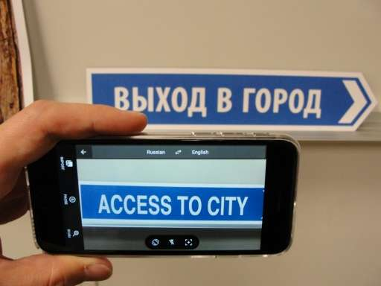
Understanding needs to be gained through first language.
When pupil becomes more proficient, only key words will need to be translated.
Understand the concepts
Transfer concepts to English and learn new vocab
Learn the skills
e.g. PEE or WIST
Notes:
A lot of secondary is assessment driven. Before we can assess, what do pupils need?

Slide 9
Understanding Concepts
Building on prior knowledge
Microsoft® Translator
Type L1 into search bar
Translate selected text
using review function in word, publisher, powerpoint, outlook
Google translate app- camera scan
Developing
concepts in L1
Use visuals
Use google translate
https://translate.google.co.uk/
Whole document translator using review function
Notes:
For pupils who are new to English and Early Acquisition

Slide 10
Transfer Concepts
Give translated material a week or day before class so they can be prepared and listen in class
Bilingual Dictionary
Word banks
Transferring
concepts into English
audio-visuals
DARTs
Directed Activities Related to text
Microsoft® Translator
Mini-translator

Slide 11
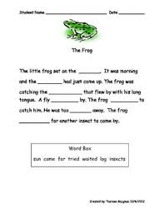
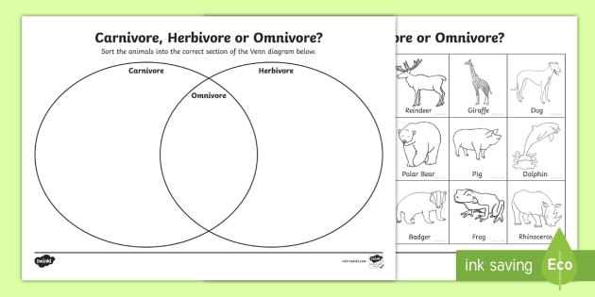
More about DARTs
Sorting
activities
What are directed activities related to texts (DARTs)?
DARTs are activities which get students to interact with texts. They check understanding of concepts without requiring pupils to produce a lot of written English.
Text
reconstruction
Gap filling
Cloze
With word bank provided
Matching
e.g. words to pictures
Highlighting
helps pupils to see the key points and to find the substance of a text.
Sequencing

Slide 12
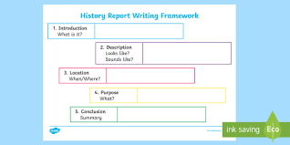
Writing
Use of translation app or bilingual dictionary
Framework
Model
answers
Beginning to produce written English
Sentence
Starters/ response stems
Simplify into 5 bullet summary
Word banks with L1 and/or pictures
Text
reconstruction

Slide 13
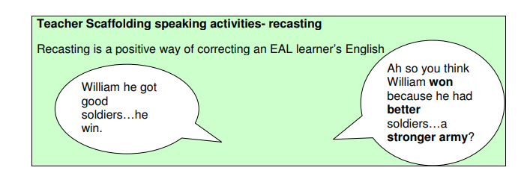
Recasting to model English
Lots of opportunities to talk and rehearse ideas.
https://www.solgrid.org.uk/education/wp-content/uploads/sites/43/2019/06/Secondary-booklet-1-updated-2016.pdf

Slide 14
Talk Frames and Prompts
https://www.solgrid.org.uk/education/wp-content/uploads/sites/43/2019/06/Secondary-booklet-1-updated-2016.pdf

Slide 15
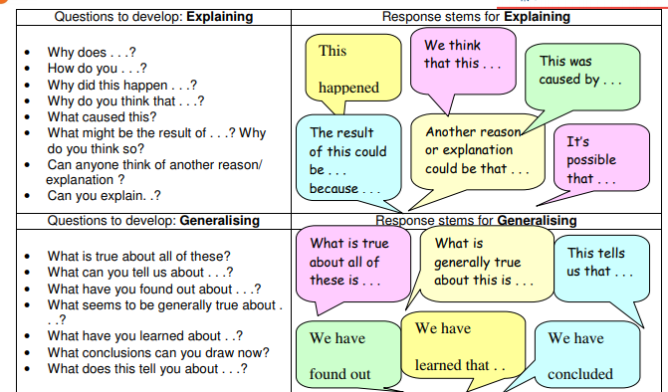
Response Stems
Notes available
https://www.solgrid.org.uk/education/wp-content/uploads/sites/43/2019/06/Secondary-booklet-1-updated-2016.pdf
Notes:
Blooms Taxonomy

Slide 16
First Language or English?
Key Stage 3
National Strategy
Access and engagement
in English
Pupils should be encouraged to use their first language in lessons when:
The cognitive challenge is likely to be high: problem solving and critical thinking are difficult in a second language, even when the target language has been learnt for several years;
They are still developing proficiency in English: this can be particularly supportive when pupils try out ideas in their first language before writing in English;
Oral rehearsal will help reflection: for example, before responding to a text.
Notes available

Slide 17
First Language or English?
It may not be appropriate for pupils to use their first language when:
Pupils need to be encouraged to practise the target language to improve fluency;
Oral rehearsal needs to be conducted in the target language so that pupils are prepared for writing tasks;
Pupils are being encouraged to take risks in their spoken English in order to build confidence;
Pupils need to practise expressing themselves quickly in English, for examination preparation.
Notes available

Slide 18
Good for EAL, Good for All
When we do these things, we help all leaners to succeed.

Slide 19
Questions to discuss in departments
Key Stage 3 National Strategy
Access and engagement
in English/ EAL
language
Securing progress for pupils learning EAL
These questions could be used to begin a departmental review of how pupils learning EAL are currently supported.
Does the current marking policy support diagnostic marking and the identification of targets for pupils?
Have language-learning targets for pupils learning EAL been clearly identified?
Where teachers work with EMA colleagues, do both teachers have a clearly defined and negotiated role in delivering the lesson?
Are opportunities for planned talk maximised in group tasks and plenary sessions?
Does planning allow all pupils to contribute or give feedback over the course of a half-term?
What is the departmental policy on the effective use of pupils’ first languages in lessons?
How do teachers plan for the use of first languages to move pupils
into proficient use of the target language in English lessons?
Notes available

