Slide 1
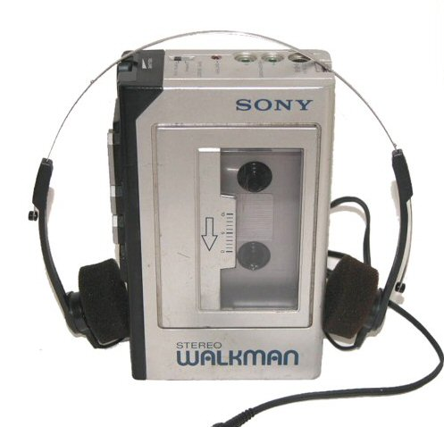
Sony Walkman
A Design Case Study

Slide 2
Learning Objectives
To further develop the learners understanding of factors that influence product design.
To emphasis the importance of considering more than just function when designing.
To introduce the transferable skill of ‘note taking’.

Slide 3
Tasks
Write up a summary of the You Tube video we watched yesterday in class.
The summary should be written up in Word and should have the following title:
Sony Walkman Design Case Study
You should use your notes to help write up the summary, however the following points might help focus your response.
Links to Culture and Religion
Aesthetics
Miniaturisation
Technology Transfer
Effects of Technology
Advances in Technology
Time for task = 10 minutes

Slide 4
You Tube link
https://m.youtube.com/watch?v=OtLn49UjM9k&feature=youtu.be

