Slide 1
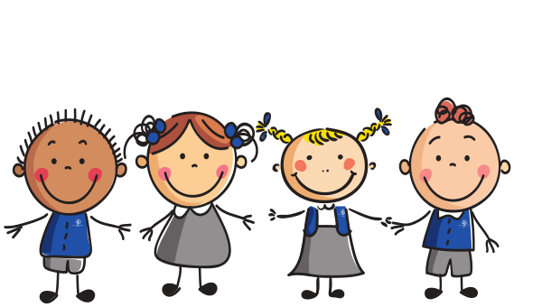
Wemyss Bay Primary School
P1 Pupil Passport
Your passport from Nursery to Primary 1!

Slide 2
Pupil Passport
Hello!
It is nearly time for you to start school! This is a very exciting time.
Your new teacher is already getting ready to welcome you.
We want to make sure you know a bit about our school. We also want to find out a bit more about you!
We would like you to look at the Information Booklet in your pack, and then complete this passport so that we can learn about each other.
Have fun!

Slide 3
P1 Pupil Passport
All about me
My name is: ____________________________________
This is my family.
Here are two things that I am good at.
Here are two things that I like.

Slide 4
P1 Pupil Passport
All about me
When I was in nursery I liked to play with...
Here are two things that I don’t like.
Here are two things that I might need help with.

Slide 5
P1 Pupil Passport
All about me
When I come to school, I would like to learn about these things.
This is what I look like!

Slide 6
P1 Pupil Passport
All about me
Colour the boxes which show things that you can do..
I can go to the toilet by myself
I can put on my own shoes
I can put on my jacket
I can brush my own teeth
I can sing some nursery rhymes
I can put on my own shoes
I can count to 10
I can write my own name
My favourite place to visit is:
My favourite book is:

Slide 7
P1 Pupil Passport
All about my new school
This is what I will wear to school.
This is what my teacher looks like

Slide 8
P1 Pupil Passport
My future - an adult should help you by talking to you about these things and then doing the writing in the boxes
When I think about starting school, I feel
When I grow up I want to be
because
To do this job, I will need to learn about:

Slide 9
P1 Pupil Passport
This page is for your parent to complete.
Does your child have any special requirements – eg., dietary?
If so, please tell us what they are.
Does your child have any allergies? If so, please tell us what they are.
Do you have any concerns about your child’s speech and language development? If so, please summarise below.
Please note below anything else that you think we should know.

Slide 10
Pupil Passport
Ask an adult to help you with a special drawing or message for Mrs Carswell.
Thank you for completing your pupil passport.
We will see you very soon!

