Slide 1
Wemyss Bay Primary School
Primary 1 2021
Information for parents

Slide 2
Welcome to Wemyss Bay Primary School
Welcome to Wemyss Bay Primary School and Nursery Class. We are delighted that your child is about to start their primary education with us.
This booklet has been designed to provide you with information that should be helpful for you as your child starts school. We are still in the midst of great change and it may be that we require to update this information as time progresses. We will keep you informed as necessary.
We consider every child at Wemyss Bay as an individual – and this won’t change. All children are encouraged to develop positive attitudes towards learning and show care and respect for themselves and others. Our aim is to do our very best to ‘get it right for every child” in all areas of school life.
All of our staff work together to create a safe community and stimulating learning environment where pupils have a sense of value and belonging and we are committed to developing all of our pupils as successful learners, responsible citizens, confident individuals and effective contributors, encouraging all to achieve their full potential.
We endeavour to equip our pupils with the skills and attributes which will enable them to lead fulfilling and healthy lives in the 21st century, with the capacity to make the best life choices and decisions.
We welcome all parents and actively encourage them to become involved in both their children’s learning and the wider life of the school. Our Parent Partnership and Parent Partnership Fundraising Group contribute very effectively to the school by working with staff to support improvement initiatives, contribute to learning opportunities and raise funds to enhance children’s learning and social experiences.
We look forward to welcoming you and your child on this stage of their learning journey.

Slide 3
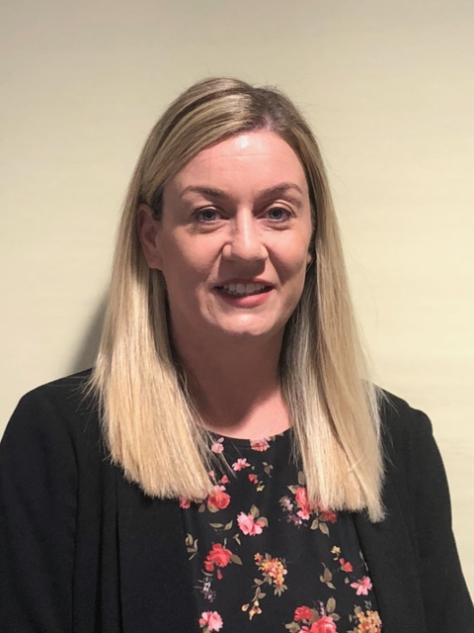
School Information
Address: Wemyss Bay Primary School and Nursery Class
Ardgowan Road
Wemyss Bay
PA18 6AS
Telephone: 01475 715976
Email: INWemyssBay@glowscotland.onmicrosoft.com
Website: https://blogs.glowscotland.org.uk/in/wemyssbayps/
Mrs Alison Gillespie
Acting Head Teacher
Mrs Lynne Cushnahan
Acting Depute Head Teacher
Our Values
Our school values are very important to us. They are reflected in everything we do. Please talk to your child about these concepts and help them to develop a simple understanding of their meaning.
Respect: We look after each other treat each other kindly. We listen to each other, even when we have a different opinion and try to understand each other.
Equality: We treat everyone fairly and make sure that everyone has what they need to have the same opportunities to learn and succeed.
Achievement: We all work hard to be the best we can be in everything we do
Commitment: We contribute to our school community and we keep going even when things are hard.
Honesty: We tell the truth at all times. This helps us to trust each other.

Slide 4
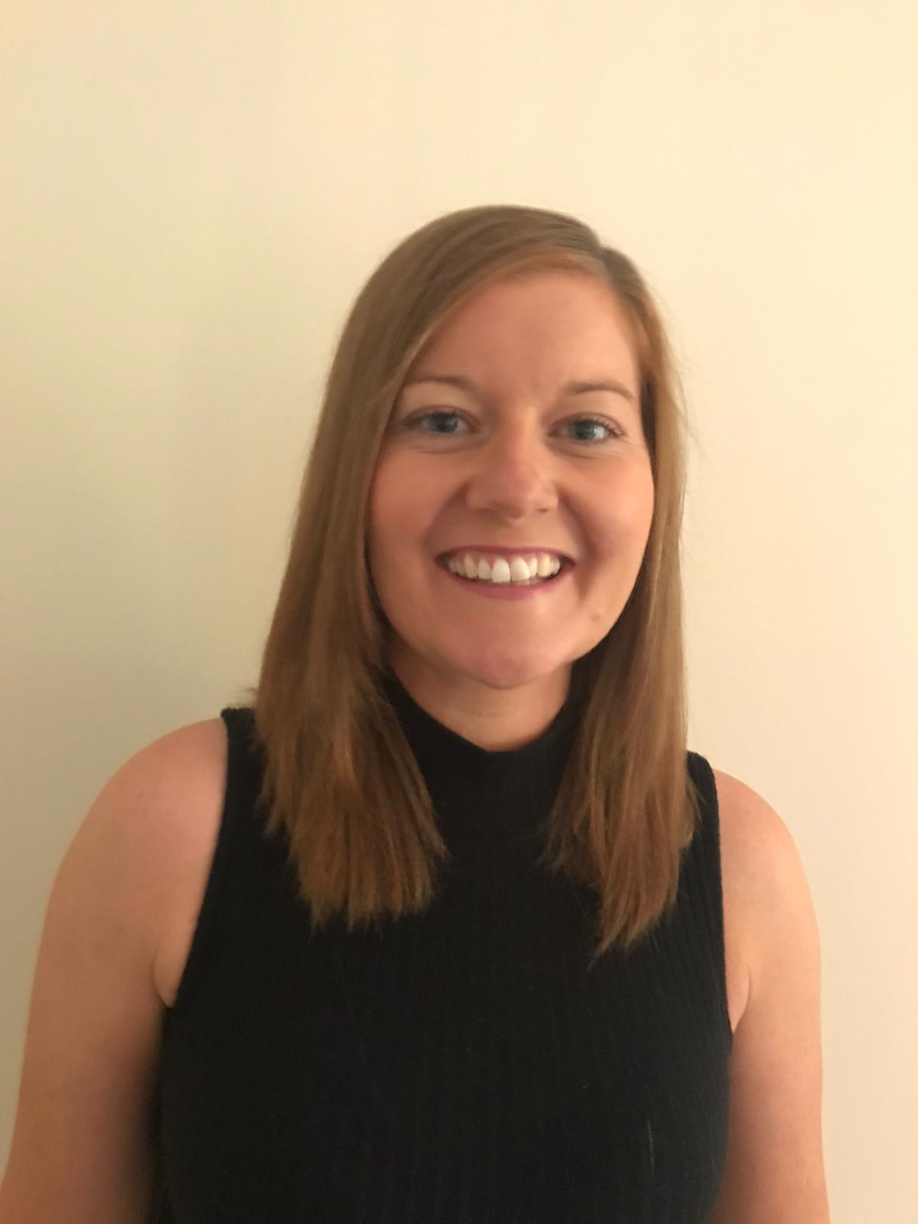
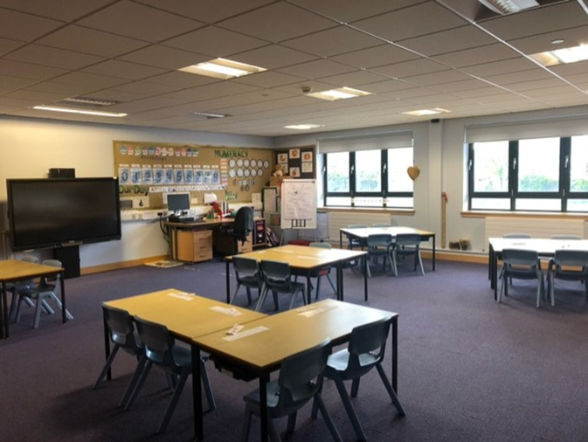
Primary 1
Your child’s teacher will be Mrs Julie Carswell.
Most learning in Primary 1 is play based. Play is valuable and helps a child to develop cognitive, social, emotional and physical capacities. It is such a wide concept that it can be difficult to define and what an adult constructs as a play activity may not mean the same for a child.
Our staff are committed to observing and listening to our pupils so that we can structure play activities that are appealing and that contribute to learning and the development of skills.
Whilst life in Primary 1 this year may not be typical, it will still be exciting for you child and it is important that we focus on this rather than any deficit.
Mrs Carswell will be in regular contact with you so that you know exactly how you can best support your child's learning.
We will all work together to make sure that this is a good year for our Primary 1 new starts!

Slide 5
School Facilities
We have ten bright and spacious classrooms. All classes are fitted with an interactive whiteboard. A fully functioning ICT suite operates within the school. We have a separate Gym Hall and Dining area but please note that these spaces may require to be re-purposed in order to fulfill current safety guidance. Our Wellbeing Room is available to all members of our school community. It is a welcoming space where pupils can have go to have some quiet time if required. We have disabled access to all areas of the school.
We make valuable use of large level playgrounds and our all weather astro-turf pitch. We will be making increased use of our outdoor space and so it essential that your child has sturdy outdoor shoes and a jacket every day please.
House Groups
Every child within the school and nursery is allocated to a school house group when they enrol. Each house has an associated colour:
Arran Red
Bute Blue
Cumbrae Yellow
Iona Green
During special events e.g. Inter-house challenges and Potted Sports, pupils wear coloured bibs relating to their house group. This promotes a sense of belonging for pupils and promotes friendships across all age groups. House Captains and Vice Captains are elected from our P7 class by the pupils.
Your child’s house will be confirmed before the end of June.
Behaviour Policy
With the support and co-operation of parents, we promote positive behaviour encouraging pupils to take responsibility for their own actions. The relationship between pupils and staff is enhanced by mutual respect and consideration on both sides. Wemyss Bay Primary School and Nursery Class implements the Local Authority “Positive Relationships Policy”. A copy of this is available at the school office by request.

Slide 6
The Curriculum
Curriculum for Excellence provides the curriculum framework for all Scottish educational establishments with pupils aged 3-18. The aims of Curriculum for Excellence are that every child and young person should:
• Know they are valued and will be supported to become a successful learner, an effective contributor, a confident individual and a responsible citizen
• Experience a traditionally broad Scottish curriculum that develops skills for learning, skills for life and skills for work, with a sustained focus on literacy and numeracy, which encourages an active, healthy, environmentally sustainable lifestyle and builds an appreciation of Scotland and its place in the world.
The experiences and outcomes under Curriculum for Excellence are written at five levels, with progression to qualifications described under the senior phase.
Early level – the pre-school years and P1 or later for some
First level – to the end of P4, but earlier for some
Second level – to the end of P7, but earlier for some
Third and Fourth – S1 to S3, but earlier for some
Senior phase – S4-S6 and college or other means of study
In addition to the formal curriculum, we offer extra curricular activities and encourage our pupils to share their achievements realised outwith the school environment. The school has a Pupil Partnership Group, a Rights Respecting Schools Steering Group and an Eco-Action Team. We have achieved Rights Respecting Schools’ Gold Award status and have our fifth Green Flag for our ECO work
Due to the ongoing international health pandemic, our curricular priority is the Health and Wellbeing of our children, with Literacy and Numeracy being additional key areas of learning, with access to the wider curriculum We hope that by August, we will one again have a full curriculum offer. We will be facilitating as much outdoor learning as we can so that pupils will experience different but consistently high quality approaches to learning in a fun but safe way, taking full advantage of inter-disciplinary learning opportunities.

Slide 7
Supporting Learning
All children and young people need support to help them learn. The main sources of support in early years and in schools are the staff who, through their normal practice, are able to meet a diverse range of needs. With good quality teaching and learning and an appropriate curriculum most children and young people are able to benefit appropriately from education without the need for additional support.
The definition of additional support is a wide one and it is not possible to provide an exhaustive list of all possible forms of additional support. The type of support offered will vary according to the needs of pupils. This includes consideration given to children who have a disability, children with social, emotional and behavioural challenges, children who find learning difficult, either in specific aspects or more generally, children who are exceptionally able, those who demonstrate underachievement relating to gender issues, children whose learning has been interrupted through absence or illness, bilingual children who have English as an additional language, travelling children and those children whose family circumstances impact on attendance and learning.
In order to provide appropriate education for every pupil we recognise the following:
a) the wide range of children’s abilities and learning styles and barriers to learning
b) the importance of early identification of and strategies to meet individual needs
c) continual monitoring of progress
d) review of teaching strategies
The school can also seek advice from external agencies, e.g. Educational Psychology, School Health and Speech and Language Therapy when necessary.
If a parent considers that his/her child requires additional support for learning and wishes to discuss the matter further they should not hesitate to approach the school. Parents are informed of any difficulties identified by school staff and are both consulted and involved at every stage in supporting the needs of their child. Parental support is of immense value in helping pupils make progress at school.

Slide 8
Attendance at School
Section 30 of the 1980 Education Act lays a duty on every parent of a child of ‘school age’ to ensure that their child attends school regularly.
In usual circumstances, attendance must be recorded twice a day, every day. If your child will not be attending school on an allocated day, then you should inform us by telephone on the first morning of an absence and provide the reason for your child’s absence. The school will contact you and thereafter other emergency contacts if no phone call is received. This contact will be made before 10am on the first morning of an absence and early after the restart after lunch in the case of an afternoon absence. Other agencies may be contacted if no contact with the pupil’s family can be achieved and if there are continuing or emerging concerns about a pupil’s safety or wellbeing. On return to school you should provide a letter confirming the reasons for absence.
Please keep the school informed of any changes of address or telephone numbers, both your own and those of additional emergency contacts.
School Meals
Inverclyde Education Services Health Policies supported by the Scottish Executive publication ‘Hungry for Success’ encourages all schools to continue to be ‘Health Promoting’ Schools improving health awareness, greater opportunities for physical activity and ensuring healthier school meals. School meals are freshly prepared in our own school kitchen. A menu will be made available to all families at the beginning of each session and will also be available on the school website. A cashless cafeteria system is in operation in the Dining Hall and parents are encouraged to sign up to Parentpay to pay for school meals. Pupils in P1-4 are currently entitled to a free school meal every day.
Those who prefer to bring packed lunches may do so. Special diets can be catered for where medical evidence is supplied. Please note that our school is a ‘nut-free’ zone.

Slide 9
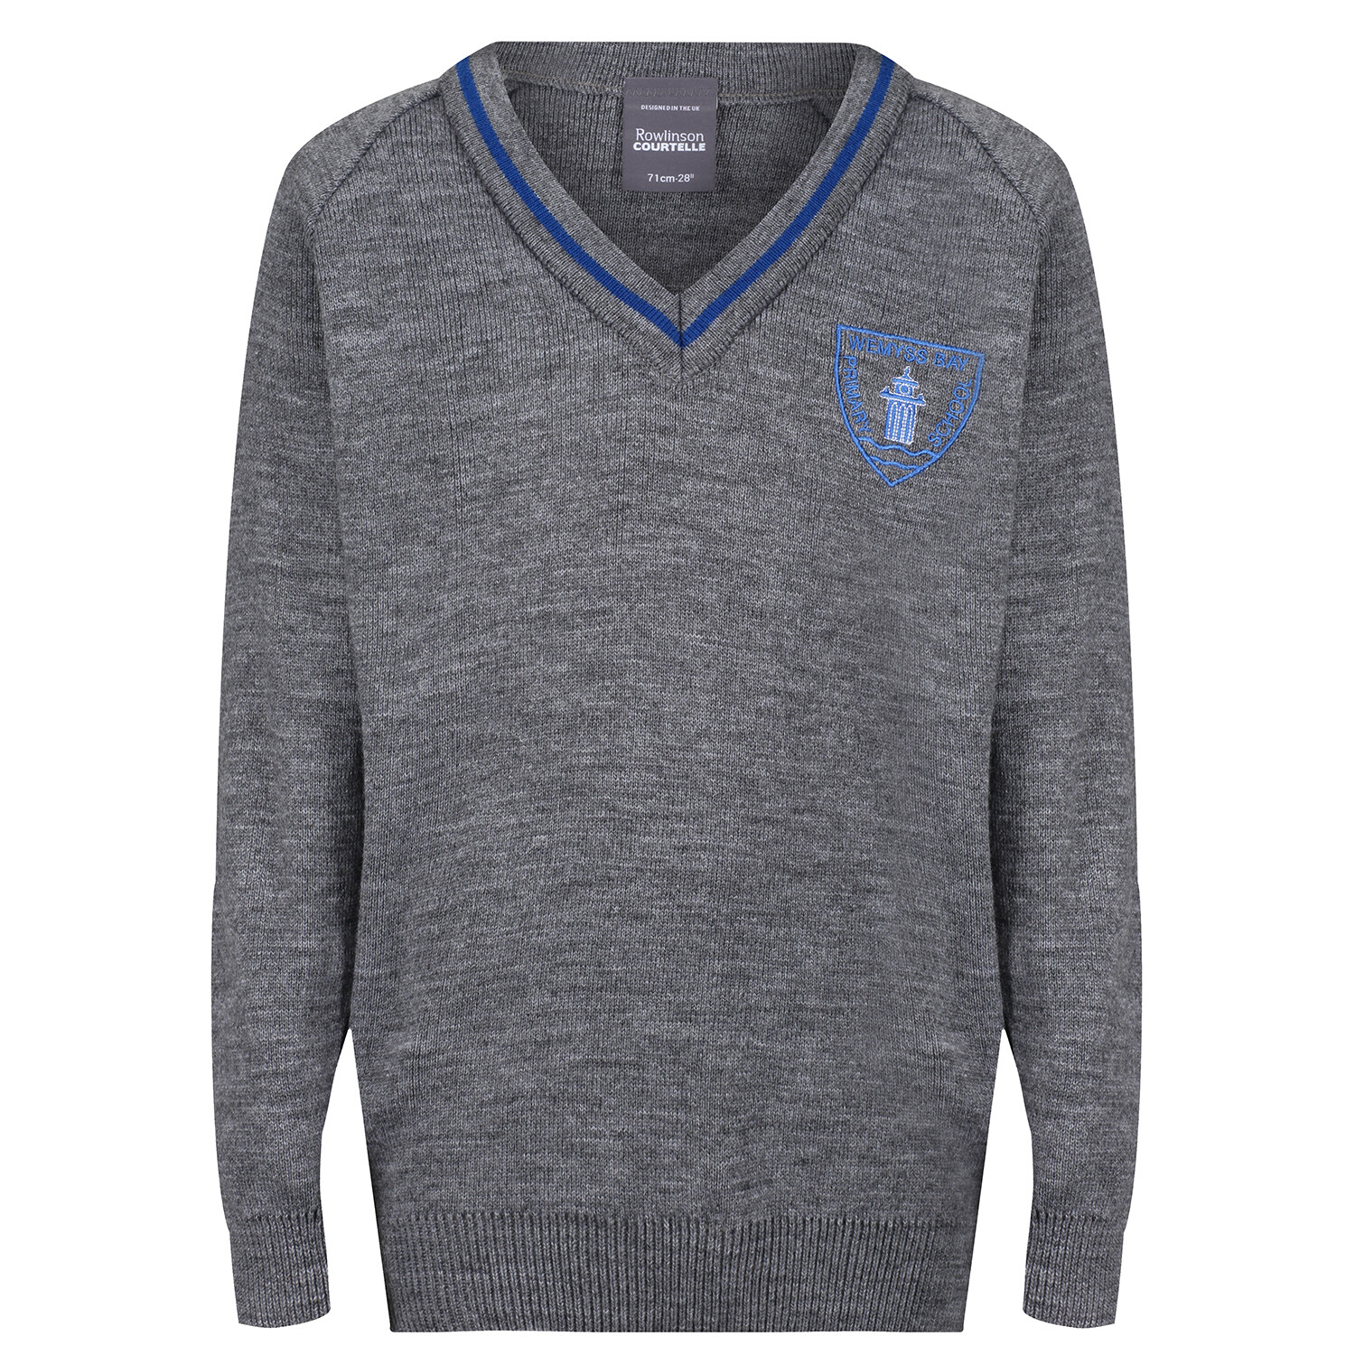
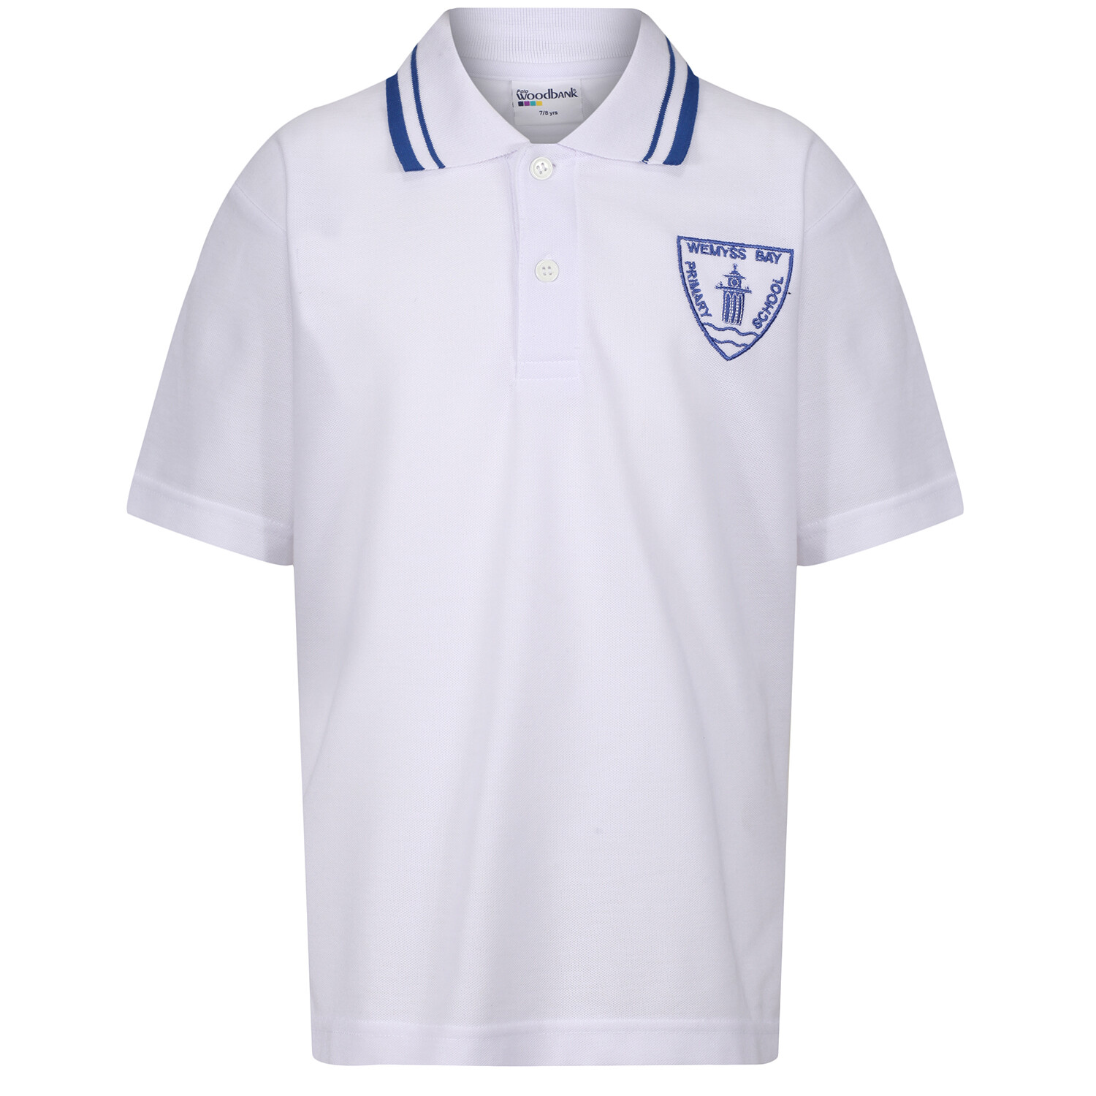
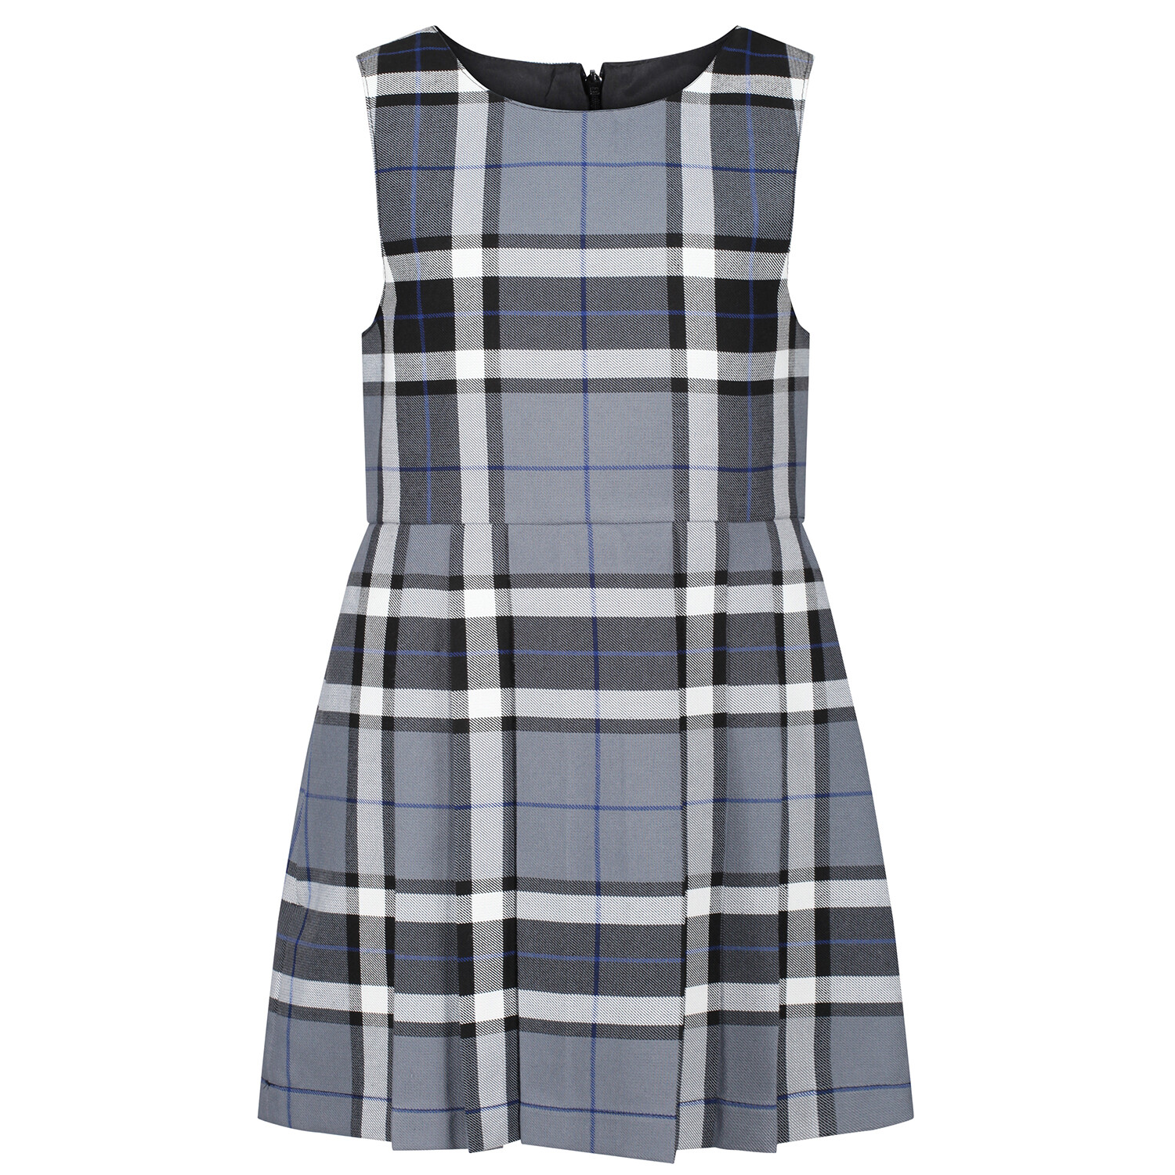
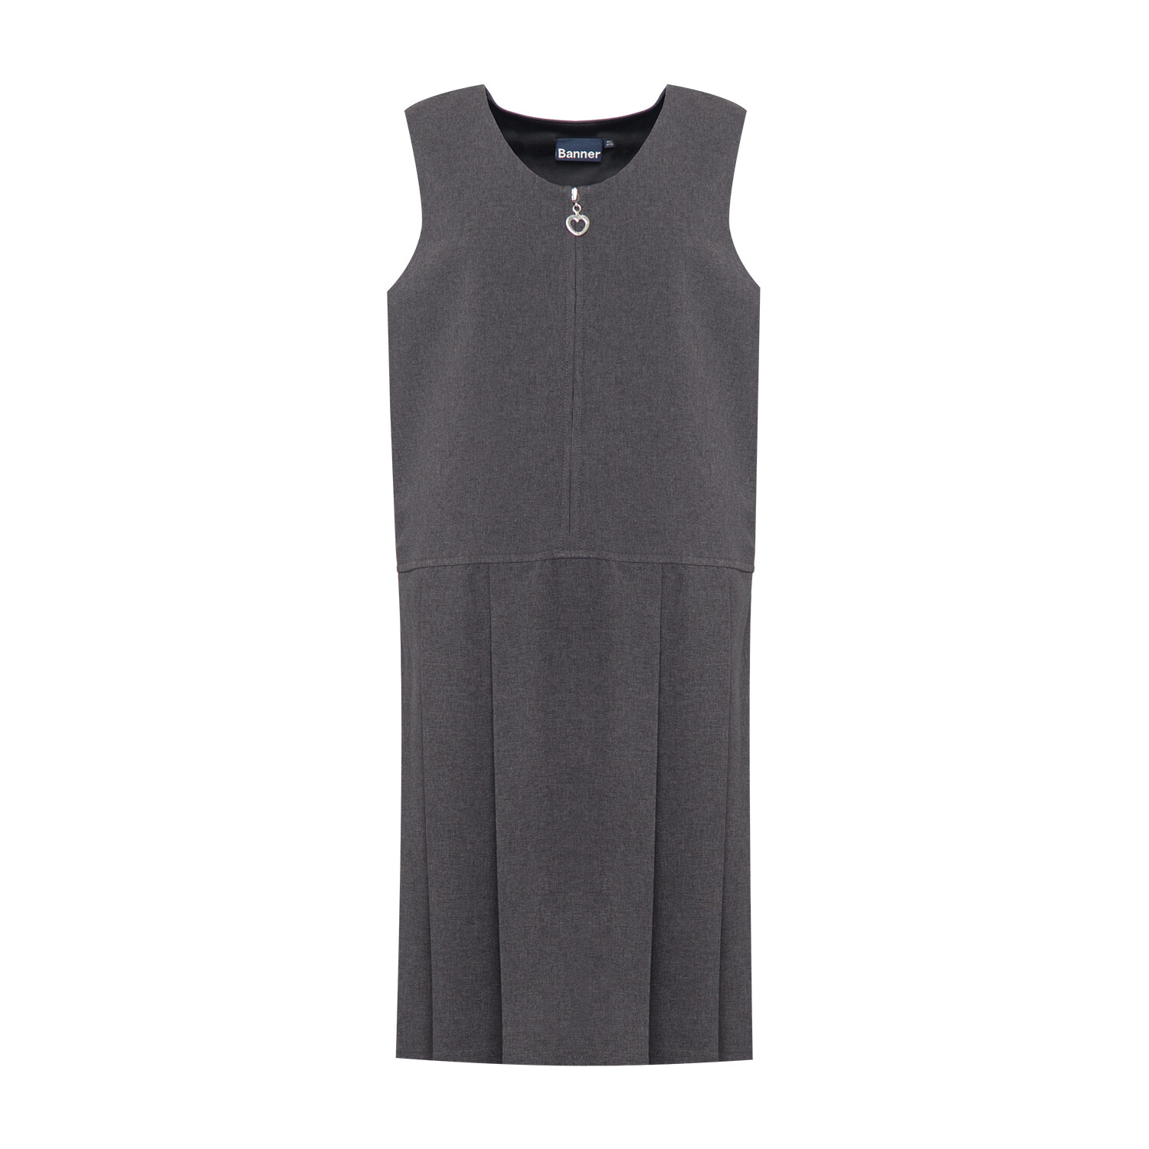
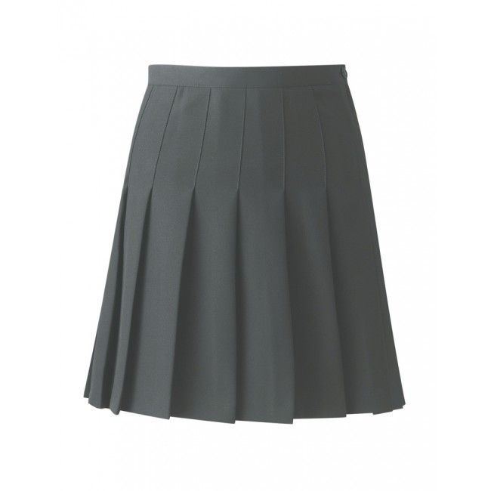
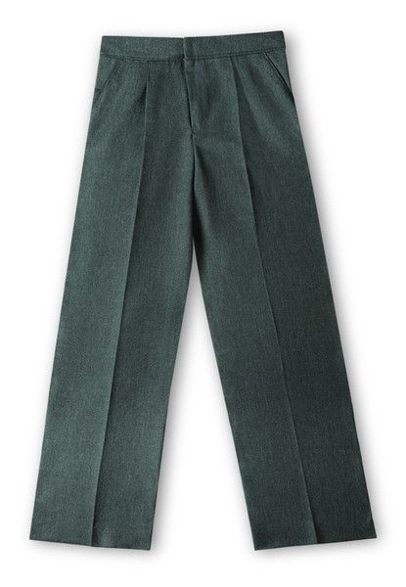
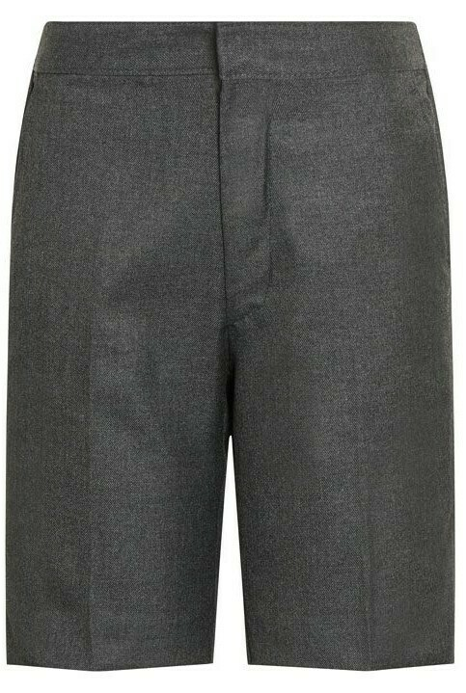
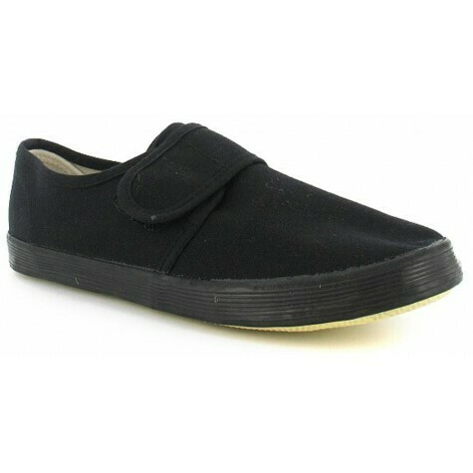
School Uniform
Schools in Inverclyde encourage the wearing of school uniform. It helps to show that we all belong to the same school community.
Our school uniform consists of:
Girls Boys
Grey pinafore or skirt Grey trousers
White blouse/polo White shirt/polo
School tie School tie
White or grey socks or Grey socks
White or grey tights Royal blue school sweatshirt
Royal blue or grey cardigan Grey jumper
school sweatshirt
Royal blue and white checked summer dress
Most children wear a more relaxed version of their uniform on outdoor learning days, with dark plan jogging trousers / leggings being suitable alternatives to skirts and trousers. Your child will require shorts, a T-shirt and soft shoes for PE. Many children wear their school polo shirt for PE and this is fine. PE items should be kept in a named bag.
School uniform items branded with the school badge and are available but please note that it is not an expectation that branded items are worn. Plain clothing is perfectly acceptable.
Please ensure all items of uniform are cleary named. Please also ensure that your child has sturdy outdoor shoes and a jacket with them every day.

Slide 10
Clothing Grants
Parents of children receiving one or the following benefits will normally be entitled to monetary grants for footwear and clothing for their children:
Income Support
Income based Job Seeker’s Allowance
Child Tax Credit, but not Working Tax Credit, and where income is less than £16,105 (as assessed by the Inland Revenue)
An asylum seeker receiving support under Part V1 of the Immigration and
Asylum Act 1999
Any income related element of Employment and Support Allowance
Parent or carer is in receipt of both maximum Child Tax Credit and Working Tax Credit with an income below £6,420
Universal Credit – where maximum monthly income from employment does not exceed £610, as shown on your monthly Universal Credit statement
Approval of any requests for such grants made by parents in different circumstances is at the discretion of the Corporate Director of Education and Communities.
Information and application forms may be obtained from schools and from
Education Services,
Wallace Place,
Greenock,
PA15 1JB
We all know that children can grow seemingly overnight and this can result in a surplus of uniform items that are still in very good condition but are simply too small. We operate a uniform swap, with the support of our Parent Partnership. Under usual circumstances, parents can simply come in and access the rails but a present, we ask you to phone or drop us a note with the details of what you are looking for or need, and we will then bag the items – if we have them - and get them to you.

Slide 11
Medical and Health Care
Should any child take ill or be involved in an accident, first aid will be given and every endeavour will be made to contact the child’s parents. Immediate medical aid would be sought, or arrangements made to get the child to a hospital, should such action be necessary. Up-to-date information regarding an emergency contact – someone who could look after your child should you be unavailable – is essential, as are up-to-date telephone numbers of parents and emergency contacts.
Selective medical examinations for children with additional health needs are usually made at the age of 5 and age 11. Parents are informed and invited to attend these examinations. We will let you know well in advance when these are due to take place.
The school nurse will visit the school whenever it is felt her assistance is required.
Occasionally a dental inspection is made with the recommendations passed on to the parents. This examination is at the discretion of parents and you will be notified prior to the visit.
A programme of daily tooth brushing takes place for all children in the nursery and also pupils in Primaries 1 and 2. We are awaiting advice as to whether this will recommence in August 2021.
The current health pandemic means that we have additional measures in place to ensure as far as possible, the safety of all members of our school community. This information will be refreshed in advance of August 2021 according to the guidance at that time, and communicated as appropriate.

Slide 12
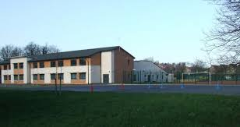
And finally...
We will be inviting our prospective Primary 1 pupils in to school to see their classroom and to meet Mrs Carswell. This will be a shorter visit than we would usually be able to provide but we will make sure that it is a meaningful experience, that it contributes to your child's confidence about starting school, and that it builds anticipation towards this important step.
Further details will follow.
We look forward to welcoming you very soon!

