Slide 1
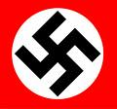


Historical Study: World
Hitler and Nazi Germany, 1919-1939
Level 4

Slide 2

In this unit, you will learn about..
A. Weimar Germany, 1919–29
B. Nazi rise to power, 1929–1933
C. Nazi control of Germany
D. Nazi social and economic policies
As always, remember to use your checklist!!

Slide 3
Introduction to Germany
Read page 1
Copy out the timeline and glossary
Complete Activity 2 on page 2.
1933
1918
Monarchy
Dictatorship
Republic

Slide 4
Lesson 1 - The End of the Reich
What you will learn
Why 1918 was a bad year to be German
The extent to which German civilians were suffering by 1918
Why the Kaiser fell from power

Slide 5
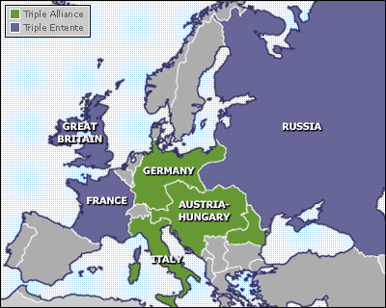

World War I started in July/August 1914.
Germany and Austria-Hungary were fighting against Britain and France on their Western Front and Russia on their Eastern Front.
Trench warfare and stalemate meant that millions were killed but neither side could break through and win.
RUSSIA
CLASS DISCUSSION:
What was Trench Warfare?

Slide 6
The War in 1918
Revolution in Russia results in Russia withdrawing from the war. (Why did this benefit Germany enormously?)
The German command ordered one last, all-out attack (the ‘Spring Offensive’) before Americans were there in large numbers.
They made early advances and by March 1918 they were close to victory.
However, American ‘doughboys’ were arriving in huge numbers. Also, German troops had been told they’d break through, but despite many gains the war continued
Exhausted and hungry, German troops lost morale.
When the Allies counter-attacked in July 1918, the Germans were pushed back all along the front line.
By October, all of their allies had surrendered, leaving Germany fighting on alone.

Slide 7
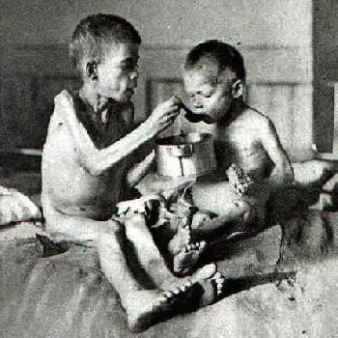
Inside Germany in 1918
The British Naval Blockade meant that vital food and other supplies were not getting through to Germany
This led to hunger, malnutrition, starvation and disease
As a result, morale crashed as more and more Germans wanted an end to the war
There were riots in major cities, with German people demanding food and an end to war

Slide 8
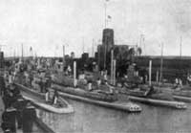
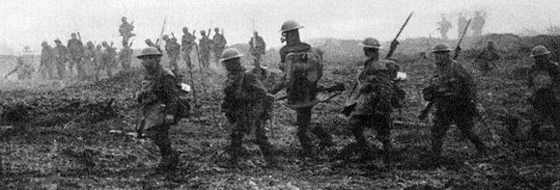
Civilians: Demoralised, Starving. 400,000 dead from flu virus and food shortages
Sailors mutiny at Wilhelmshaven
Spring offensive fails

Slide 9
Tasks
Read the section ‘Why was Germany facing such serious difficulties by 1918?’ on page 5 of the textbook
Create a spider diagram outlining the difficulties Germany faced in 1918.
Problems in Germany

Slide 10
Tasks Cont.
Read the section ‘Why did the war end in November 1918’ on pages 5-6
Copy out both glossaries
Explain why the sailors at Kiel mutinied in November 1918.
Describe the ways in which German soldiers and workers were influenced by the Russian revolution.
What evidence is there that the revolution was (a) violent and (b) successful?

Slide 11
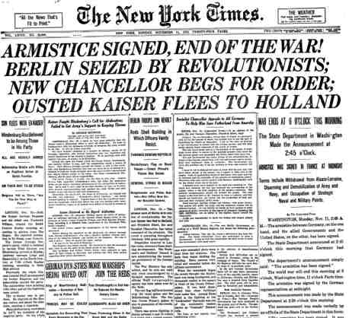
The Fall of the Kaiser
What you Will Learn
Why did the Generals not want to be the ones to make peace?
What was the attitude of the Allies towards the Kaiser?
Why did the Kaiser have to abdicate?
How fully…? questions

Slide 12
Success Criteria
By the end of this lesson, you will be able to…
Explain why the German Army leadership wanted a new government in place.
Describe the attitude of the Allies towards Germany and the Kaiser
Give a number of reasons why the Kaiser had to abdicate

Slide 13
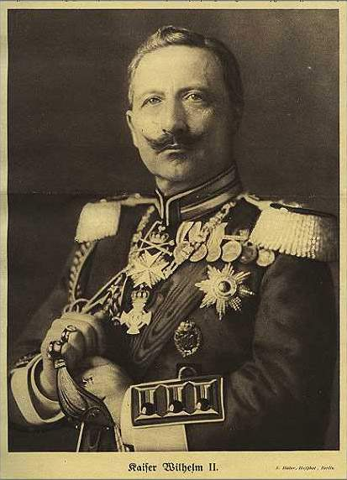
The Kaiser Abdicates

Slide 14
Tasks
Read the section ‘Why did the Kaiser have to abdicate?’ on p. 5
What actions did Germany take to try to convince the Allies to treat them leniently?
What evidence is there that Germany wanted an end to war?
What had President Wilson changed his mind about in 1918?
What was the attitude of the Allies towards the Kaiser in 1918?
How fully does Source A (p.8) explain why the Kaiser abdicated in November 1918?
6 marks

Slide 15
‘How fully…’ questions
Start by answer the question and making a judgement:
‘Source A partly describes……’
Then take information from the source IN YOUR OWN WORDS that relates to the question – 3-4 points
Then say, ‘However, the source could have been fuller had it also mentioned that….’ and include some developed points from your own knowledge.

Slide 16
Source 1.5 partly explains the reasons why the Kaiser abdicated. It tells us that the Americans had joined the war, causing problems for Germany. It also tells us that Germany was losing the war as a result of the Allied counter-attack. It also tells us that German losses were massive. As a result, the German population wanted the Kaiser to stand down. However, the source could have been fuller had it also mentioned other factors, such as President Wilson’s insistence that the Allies would not negotiate peace with the Kaiser and would refuse an armistice (ceasefire) until he stood down. Also, the mutiny of sailors at Kiel and Wilhelmshaven showed that the Kaiser was losing the support of his military too. German politicians and generals felt that the Kaiser should go in order to avoid a heavy post-war punishment. Finally, there was a threat of revolution in the streets of Germany as anger at hunger began to boil over.

Slide 17
Germany at the end of the War:
SOURCE SKILLS
By the end of this lesson, I will have developed my ability to:
Discuss how fully a source describes a historical issue
Use the 5 Ws to come to a judgement about how useful a source is
Demonstrate ways in which two different sources agree with each other

Slide 18
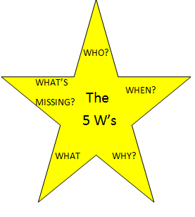
Evaluating the usefulness of a source
The 5 W’s!!
WHO wrote it, and why is that useful?
WHEN was it written and why is that useful?
WHAT accurate information does it give us?
WHAT’S missing?
WHY was it written and does that affect its usefulness?
TASK:- In your groups, complete the first page of your workbook.

Slide 19
The How Fully question
Start by making a judgement: ‘Source A is quite full in describing….’
Go on to state what the source tells you (in your own words!)
Then give examples of important information that the source doesn’t mention -
‘However, it could have been fuller if it stated that ….’
TASK:- complete the next page of your workbook.

Slide 20
Comparing Sources
Opening sentence which compares the sources overall, followed by point by point comparisons.
For example:
Sources A and B agree to a large extent about ……..
Source A states that…(QUOTE)…..Source B agrees by stating that……(QUOTE)…..Therefore both sources agree that …….(OWN WORDS).
TASK:- complete the next page of your workbook.

Slide 21
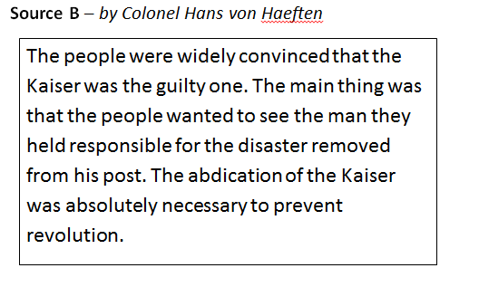
Now try a complete answer on your own.
How fully does Source B explain why the Kaiser abdicated in November 1918? 5 marks

Slide 22
The Spartacist Revolt
What you will learn….
Who was Friedrich Ebert, and why did he make a pact with the army?
Who were the Spartacist League and what did they want?
Who were the Friekorps?
What was the outcome of the Spartacist Revolt?

Slide 23
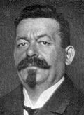
Friedrich Ebert
Friedrich Ebert was leader of the SPD party (the Social Democrats)
He was a socialist, but did not want a communist revolution
He was head of the provisional government, and later President of Germany

Slide 24
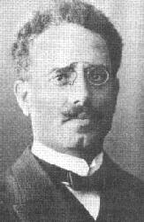
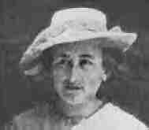
Spartacist leaders
Rosa Luxembourg
Karl Liebknecht
Spartacist leaders who formed the KPD – German Communist Party

Slide 25
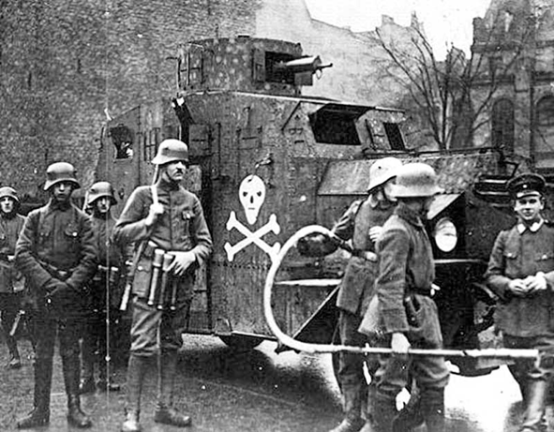
The Freikorps
Ex WWI soldiers
Brutal and battle hardened by war
Experienced and well equipped
Hated communists

Slide 26
Spartacists
Formed in 1915 when leaders Rosa Luxembourg and Karl Liebknecht left the moderate SPD because it supported WW1
Dec 1918 – Liebknecht and Luxembourg formed the German Communist Party – KPD
Jan 1919 – The Spartacists & Communists rose up in revolt in Berlin. It was a futile gesture, doomed to failure. Ebert withdrew the government to Weimar, and sent in the Freikorps to crush the rebels. Liebknecht and Luxembourg were arrested and shot

Slide 27



Spartacists V Freikorps
Mainly intellectuals and politicians
Poorly equipped
No military training
Ex WWI soldiers
Brutal and battle-hardened by war
Experienced and well equipped
Hated communists

Slide 28
Tasks
Copy out the glossary on page 10
List two of the Spartacists’ demands.
What deal did Ebert come to with the Army?
Who were the Freikorps, and why did they hate the Spartacists?
Summarise the events of the Spartacist Revolt of January 1919.
Complete activities 1-3 on page 13.

Slide 29
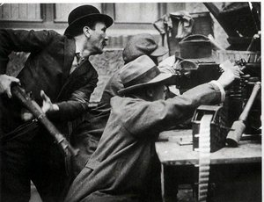
Reasons for Defeat:
Turn this information into a spider diagram
Freikorps were better organised and armed.
They also had a military background
Spartacists were all civilians, not soldiers
Election 1919: Communist get no seats

Slide 30
Group Task
Create a poster which describes either the Spartakists or the Freikorps:
Their politics
Their background/history
Membership/leadership
Strengths
Weaknesses
Any other important/relevant information
USE THE PRINTED MATERIALS THAT YOU ARE GIVEN TO HELP YOU

Slide 31
The Left Divided
What you will learn
Why the left was divided
Why it was difficult for the two sides to work together
How the government responded to the Spartacist revolt
How these events affected Germany in the years to come.

Slide 32



The Political Spectrum
Left Wing
Centre
Right Wing
Communists
Spartakists
Nazis
Friekorps
Ebert
Socialists

Slide 33
Working Class Groups
Before WW1
Socialists SPD Party
SPD
Social
Democrats
Moderate
USPD
Independent
Socialists
Radical
KPD
German
Communists
Extreme
After 1918
Split in 1917 over disagreements
SPARTACISTS

Slide 34
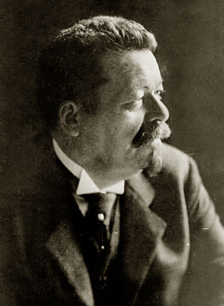
Ebert
Leader of Social Democratic Party
Although split emerged within the communist movement when WW1broke out, he still included USPD members within his cabinet.
It was however difficult for the two groups to work together

Slide 35
Left Divided
Ebert and SPD want to bring Germany back to normal after war
Worried that German people would face more hardship if stability wasn’t restored
Were willing to work with the army and old civil service to achieve this
USPD and KPD more extreme views
Wanted a revolution to turn Germany in to a socialist state
Believed the time had come and that if they didn’t act, then they might never get a chance again
Were angry with Ebert for not pushing ahead with revolution.

Slide 36
The Left Divided - Results
Rather than having one party or movement representing the left wing and working class, there were three.
The working class vote is split three ways
Socialists were unable to unite against their real enemy, the Nazis

Slide 37
Tasks
Read the bottom of page 12
Copy out the glossary
What did the SPD and the KPD have in common?
What did the SPD and the KPD disagree about?
Explain why the differences between the KPD and SPD helped Hitler to come to power.
Complete activity 1 on page 13.

Slide 38
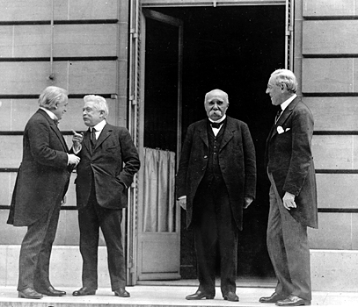
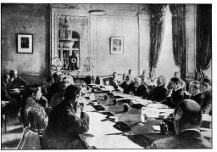
The Peace Settlement
What you will Learn
Who was present at the Versailles Treaty
Who wasn’t present and why
What kind of peace the different leaders wanted and why they had different views

Slide 39
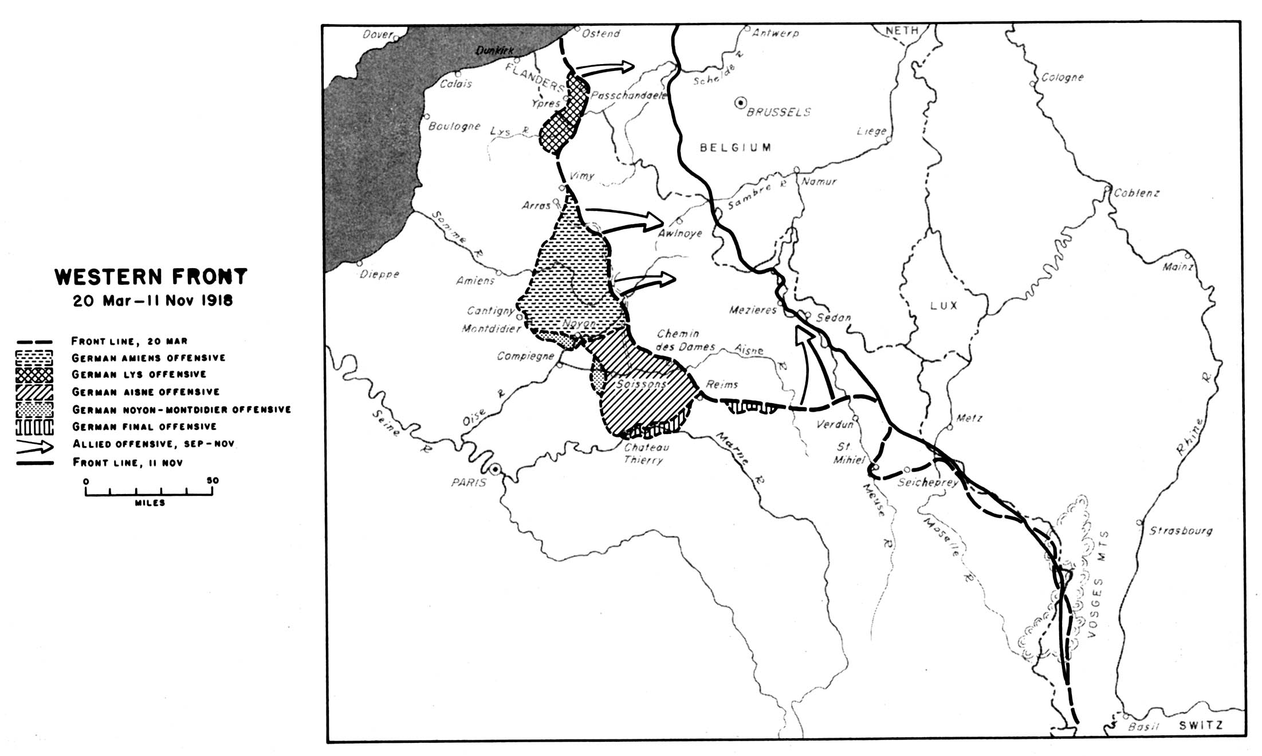

Slide 40
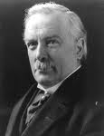
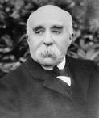

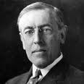
The ‘Big Four’
    David Lloyd George Georges Clemenceau
    British Prime Minister French Prime Minister
    Vittorio Orlando Woodrow Wilson
    Leader of Italy President of USA

Slide 41
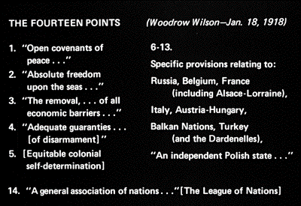

Slide 42
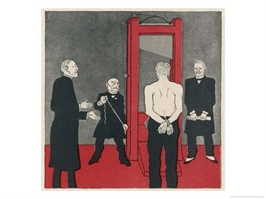
Who’s who? What is the cartoon saying?

Slide 43
Terms of The Treaty of Versailles
What you Will Learn
What the main terms of the treaty were
How Germany reacted to the treaty
What the long term impact of the treaty was
Watch this!!

Slide 44
Remembering the terms - BRAT
Blame
Reparations
Terms of Versailles
Using the information on pages 20 and 21, provide A LOT more detail for each of these points
Armaments
Territory

Slide 45
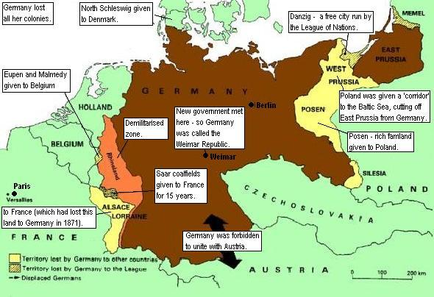

Slide 46
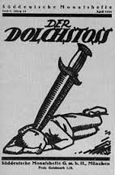
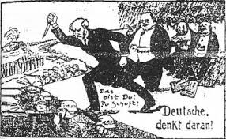
Tasks
Read pages 22-24
Who were the ‘November Criminals’?
What was the ‘stab in the back’ myth?
Why were Germans expecting a fair treaty?
Explain what was meant by ‘diktat’?

Slide 47
Reaction to the Treaty of Versailles
The TOV was hated by the German public and they blamed the new democratic government for signing it
The German media were calling for vengeance and called the TOV ‘the shame of 1919’.
The long term effects of the treaty were that Germany very quickly suffered from economic problems which were directly related to the terms of the TOV, and it also gave Hitler ammunition to use against the Government, and undermine it further in the eyes of the German people.
Hitler promised he would destroy the treaty and that got him a lot of support from the German public.

Slide 48
Tasks
Evaluate the usefulness of Source A (p.25) as evidence of German reactions to the treaty of Versailles. 6 marks
What were the long terms effects of the Treaty of Versailles?
Complete Activity 1 on page 24

Slide 49
Source A is very useful as evidence of German feeling towards the Treaty of Versailles as it is a primary source, written on the 28th June 1919, the day that the Treaty was signed. It is also useful because it was written by a German newspaper, which would therefore be giving the views of most German people. The content is useful as it describes how many Germans viewed the treaty as dishonourable and disgraceful, which is accurate. The content is also useful as it states that Germans would seek revenge for it which is again good detail. However, the source could have been more useful had it mentioned that Germans felt that the treaty was highly unfair because they saw it as a ‘diktat’, or dictated peace. Also if the source had told us some of the terms of the treaty, such as Germany having to accept full blame for the war, would have added to its usefulness.

Slide 50
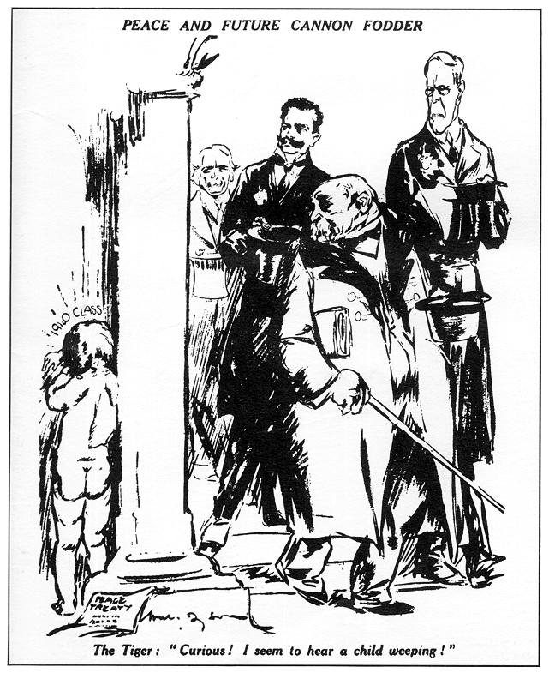
This cartoon was published the day after the Treaty of Versailles was presented to Germany (late June 1919).
What comment is it making about the Treaty?

Slide 51
The Weimar Republic
What you Will Learn
Why the assembly met in Weimar
How the new parliament would be elected and organised
What problems the new government faced
What criticisms were made of the new arrangements for ruling Germany
What weaknesses the new system had

Slide 52
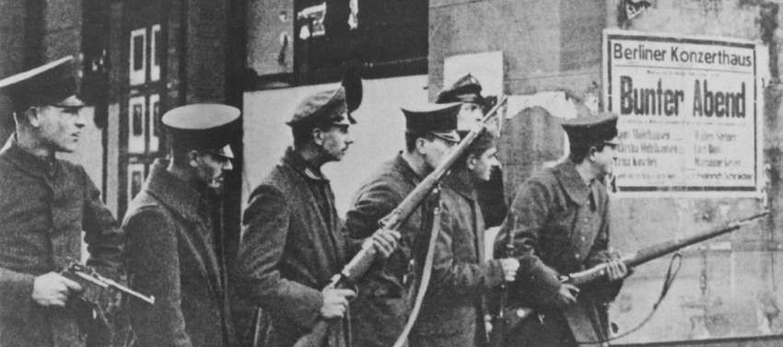

Why Weimar?
As the Freikorps brutally put down the Spartacist revolt, Berlin became a dangerous and unstable place. Ebert and the rest of the Provisional Government fled to the small town of Weimar for safety.

Slide 53
The Weimar Government
REICHSTAG
Elected by proportional representation
President would decide Chancellor from Party Leaders in the Reichstag
Reichsrat
Upper House could delay measures passed by Reichstag
PRESIDENT WHO WOULD BE ELECTED EVERY 7 YEARS

Slide 54
The Fundamental Laws
Personal Freedom would be guaranteed
Freedom of expression
The Right to join a trade union
A Right to Hold Public Meetings
Home was Private Property
Property was guaranteed

Slide 55
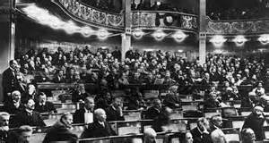
Tasks:
Read page 15.
Copy out the Glossary
Who had the right to vote in Germany?

Slide 56
Weaknesses of Weimar
Proportional representation – led to weak, ineffective government
Associated with defeat/
Versailles
Article 48
Proportional representation – gave small parties like the Nazis a national voice

Slide 57
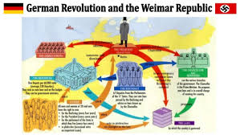
The Constitution
Read page 16.
In what ways was the German constitution fair and democratic? Give three examples.
In what ways could it be argued that it was not fair and democratic? Give two examples.
What was Article 48 and what powers did it give to the President?

Slide 58
PR
Read page 17.
Explain why PR created problems. Give two reasons.
Read pages 17 & 18
Copy out the spider diagram on page 18
Complete the summary activity on the bottom of page 18

Slide 59
Problems with Weimar Republic
Proportional Representation
- Gave extreme parties like the Nazis seats Reichstag
- also made it difficult to make decisions (no majority)
Article 48
- gave the President the right to suspend the Fundamental laws at times of crisis – dictatorship
Associated with Defeat in WWI
Many Germans hated democracy from the start because it was linked to defeat in WWI and the humiliation of the Treaty of Versailles

Slide 60
How Fully Question
Complete the N5 ‘How fully…?’ question on page 20
Remember the Process:
Source A is quite full in explaining the reasons for the weaknesses of the Weimar Republic as it tell us………………………… However it could have been fuller had it also told us………………………………….

Slide 61
How fully? questions
Have you:
Made a judgement (‘The source is quite full in explaining …’)
Taken as many relevant points from the source as you can, and put them in your own words?
Included recall? (“However, the source could be fuller if it stated….”)

Slide 62
Source A is quite full in explaining the reasons for the weakness of the government during Weimar Germany.
It tells us that for most of the time, governments had support of less than half of the Reichstag which made governing difficult.
It also tells us that this meant that coalition governments were very common, which kept being defeated then fell apart.
It also tells us that government changed very frequently which was unstable.
However, it could have been fuller if it had mentioned proportional representation’s other weakness, that it gave small extreme parties a national voice.
Also, it doesn’t mention that the government was unpopular from the beginning because of its association with defeat and the Treaty of Versailles.
Finally, it doesn’t mention Article 48, which allowed the President to rule the country as a dictatorship in times of crisis.

Slide 63

The Nazi Party
What You Will Learn
Nazi party was formed at a time when there was widespread opposition to Weimar.
What the Nazi Party believed in.
Who the Brownshirts (SA) were and what their role was.

Slide 64
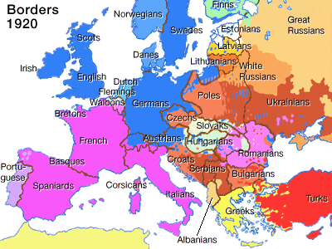

Slide 65
Nazi Programme
We demand the union of all Germans in a Great Germany.
We demand land and territory (colonies) for our people and the settlement of our surplus population.
Only those who have German blood can be our countrymen. Hence no Jew can be a countryman
An understanding of national consciousness must be taught in the schools from the very beginning.
In order to carry out this program we demand: the creation of a strong central authority
The Nazis were a strongly nationalist party (they loved Germany). What evidence in backs this up?
The Nazis were a strongly racist party . What evidence in backs this up?
Hitler felt that Germany was too small to fit all Germans and so wanted extra Lebensraum (Living Space) for Germany. What evidence tells us this?
What evidence suggests that the Nazis hated democracy?

Slide 66
Tasks
Create a spider diagram entitled ‘Who did the Nazis appeal to?’ using the info in the first half of page 40.
Copy the diagram (and the information surrounding it) on the bottom of p. 40 into your jotter

Slide 67
The military supported Hitler’s ideas of discipline and order
Some working class people, because the Nazis had ‘worker’ and ‘socialist’ in their name
Who did the Nazis appeal to?
Nationalists (proud Germans) supported them because they had ‘National’ and ‘German’ in their name
Wealthy business owners who believed the Nazis would fight communism
Powerless people who wanted someone to blame (eg Jews) for their problems

Slide 68

What did the Nazis stand for?
Hitler to be supreme leader of all the German people
Ignore the Treaty of Versailles
Nazi Party to have total control – dissent not tolerated
Germans to be made into a ‘master race’ by eliminating all ‘undesirable’ races
Germany to include all German speaking people – even those in other countries.

Slide 69

The SA
What was the SA?
What other names did they have?
Why were they formed?
What sort of person joined?
What reputation did they have?

Slide 70
Brownshirts/ SA
Hitler's private army
Disguised at first as a gymnastics club
Purpose was to bound young party members together; Provide protection for the propaganda activity of the leaders; prevent opponents from breaking up Nazi meetings; disrupting meetings held by other parties.
Members were given a military style uniform and trained in a military fashion.

Slide 71
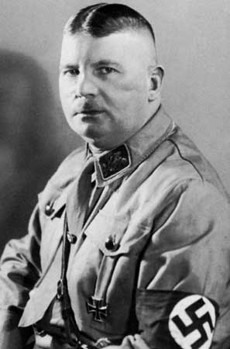
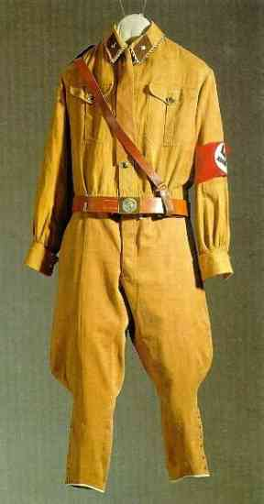
Ernst Rohm SA uniform

Slide 72
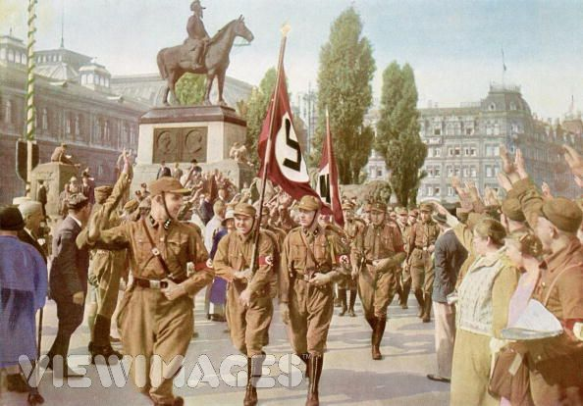

Slide 73
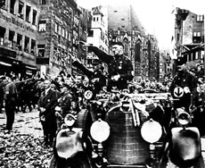

Slide 74
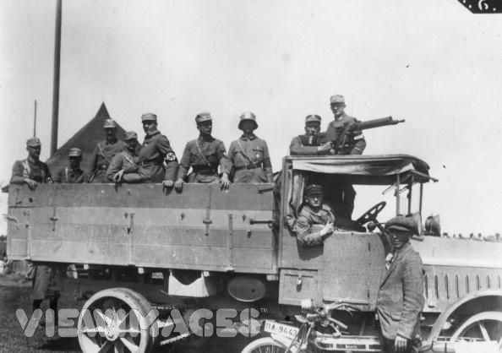

Slide 75
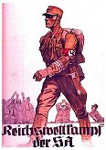

Slide 76
The SA: Activities
Read the section ‘The Brownshirts’ on pages 26-28 of the OLD textbook.
What does Sturm Abteilung mean in English?
Answer question 6 on page 29 of the text book
Study sources 5.5 and 5.6 (page 27) and answer the following question:
Evaluate the usefulness of source 5.5 as evidence of the purpose of the SA. 5 marks Remember the 5 Ws!!!

Slide 77
When was it written and why is that useful?
Source 5.5 is useful as evidence of the purpose of the SA because it was written in 1921, at the time where the SA were formed.
Who wrote it and why is that useful?
It was written in the Nazi Party newspaper, making it useful as they would be knowledgeable about the purpose of the SA.
What does it tell us…is this good detail?
The content is useful as it states that “it is intended to bind our young members together” and this is accurate.
The content is also useful as it tells is that the SA “is to provide protection for the propaganda activity of the leaders” and this is accurate.
What’s missing?
Evaluate the usefulness of source 5.5 as evidence of the purpose of the SA. 5 marks Remember the 5 Ws!!!

Slide 78
Source 5.5 is useful as evidence of the purpose of the SA as it is a primary source, written in 1921 at the time when the Nazi party created the SA (1).
It was published in the Nazi party newspaper, making it useful as the writer would know the reasons why the SA was being set up (2).
The content is quite useful as it tells us that its purpose is to protect party leaders during meetings and speeches, and this is accurate (3).
It also tells us that another aim is to create a sense of belonging among young party members, and again this is useful because it is accurate (4).
However, the source could be more useful if mentioned that another purpose of the SA was to disrupt the meetings of the Nazis enemies such as the KPD (5).

Slide 79
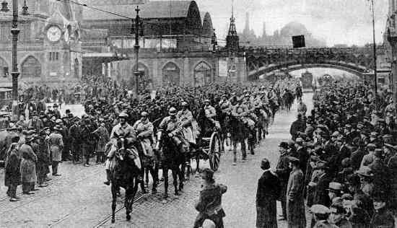
Problems in Germany
Inflation and Discontent
The Ruhr Occupation

Slide 80
Inflation
Starvation & Unemployment
Treaty of Versailles and loss of territory
Accept blame and pay the cost of the damage
War and Blockade had damaged the German economy
Loss of Industrial land had made the situation a lot worse
Germany had to pay reparations to France and Belgium of £100 million a year for 66 years

Slide 81
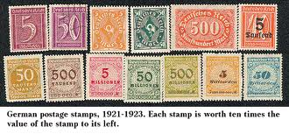
Impact on Economy
Goods in short supply so price of goods increased.
Prices rose continuously Inflation

Slide 82
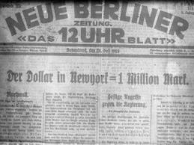
By 1923, 1 Dollar was equivalent to 1million German Marks

Slide 83
Problems in Germany
Inflation & Discontent
German economy damaged by war
Situation made worse by the terms of the Versailles treaty
Germany had to pay for war damage
Most of this was to be paid in goods such as coal, Iron and timber
Goods were in short supply and prices rose
Prices continued to rise resulting in inflation
German mark became worthless
Inflation caused high unemployment
People went hungry, disease spread
Middle Classes also suffered. They were now as poor as ordinary workers
People blamed the Government

Slide 84
Tasks
Read pages 30-31 of old book and complete tasks 1-3 on p31

Slide 85
The Ruhr Occupation
Versailles treaty made it impossible for Germany to produce enough for itself and the allies
Anger directed towards the Weimar Government intensified, leading to increased popularity of more extreme parties
German anger turned towards the French
France believed that Germany was failing to keep up with its reparations payments.
France and Belgium occupied the industrial area of the Rhur to make sure they received their goods/payments
German government ordered workers and business officials not to cooperate with the French and called a general strike

Slide 86
$
$
$
Printing more and more bank notes makes money have less value.
$
$
$
$
$
$
$

Slide 87
The Government paid the workers’ wages.
This united the German people against a common foe but it was disastrous for the economy: money was printed to pay the workers – too much money in circulation, devalued currency even further
Hyperinflation:
  Hunger Malnutrition Unemployment
  Saving/pensions wiped out – worthless
  Middle class badly affected
  Weimar government blamed for incompetence
  Democracy even more unpopular than before
  Fringe and extremists parties gained popularity

Slide 88
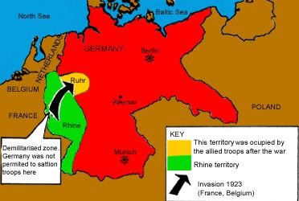
Tasks
Read pages 27-29
Explain why France and Belgium invaded the Ruhr. Give at least three reasons.
Describe the reaction of the German government to the invasion.
Explain why the Ruhr crisis led to hyperinflation.

Slide 89
Tasks
Create a detailed spider diagram outlining the effects of the hyperinflation on the German people.
Did anyone benefit from hyperinflation?
Was the Weimar government responsible for the hyperinflation? Give a balanced answer.
What were the political effects of the hyperinflation crisis?
Complete Activities 1-3 on page 30.

Slide 90
How important were the weaknesses of the Weimar Republic in the rise of the Nazis to power? 9 marks
Introduction: Address question, list other factors:
“________________ were very important in the rise to power of the Nazis. However, there were other important factors such as _____________ and ___________”
1st Paragraph:
Write about Weimar’s weaknesses AND HOW THEY HELPED NAZIS GAIN POWER
Start: “The weaknesses of the Weimar Republic were very important in the Nazis’ rise to power”
- Association with defeat in war, ‘November Criminals’
- blamed for Versailles
- Constitutional weaknesses (PR!, Article 48?)
- Handling of Ruhr invasion – hyperinflation crisis.
2nd Paragraph:
Start: “However, there were other factors which were also important…”
- Nazi Strengths (propaganda)
- Hitler's powers as a public speaker; use of SA
Conclusion:
Which was most important factor? Why? – GIVE A REASON
IN TOTAL, THERE ARE 5 MARKS AVAILABLE FOR KNOWLEDGE POINTS ACROSS BOTH PARAGRAPHS

Slide 91
The weaknesses of Weimar were very important in the rise of the Nazis to power. However, there were other important factors such as Nazi strengths.
The weaknesses of the Weimar republic were very important in the Nazis’ rise. Firstly, it was forced on the German public as a result of defeat in WWI. It was therefore unpopular from the start because of this association. Hitler and the Nazis used the idea of the ‘November Criminals’ – the democratic politicians who signed the armistice – in their speeches. Secondly, the Weimar Govt. signed the hated Versailles treaty, which made them even more unpopular. The Nazis criticised them for this and promised to rip up the treaty if they got power. The Weimar constitution also helped Hitler. PR both gave his small party a voice in the Reichstag, and created weak, coalition governments. Hitler was able to point this out and promise a return to strong leadership which many Germans responded to. Article 48….)
Finally, the Weimar government were seen to have handled the Ruhr invasion badly and created hyperinflation. The effects on Germans was terrible, and many never forgot this. One historian described this as ‘the scar that never healed’, and it made democracy even more unpopular and encouraged many to turn towards Hitler and the Nazis.
However, there were other factors which contributed…

Slide 92
However, there were other factors which contributed to the Nazis gaining power in 1933, such as the strengths of the Nazi party. Firstly, Hitler was a very good public speaker, and his fiery, passionate speeches won many Germans over top his point of view, causing his support to grow. Secondly, the Nazis used propaganda very effectively by using newspapers, newsreel and posters and sticking to the same simple points. By telling German people what they wanted to hear, they gained more support.
In conclusion, the most important factor was……(pick one!)
This was because (give reason!!)

Slide 93
One reason why many Germans were opposed to their new government was because it was always associated with defeat in WW1 – the politicians who signed the armistice were known as the “November Criminals”.
Another reason why many Germans were opposed to their new government was because it was Weimar politicians who signed the hated Treaty of Versailles which Germans felt humiliated by.
Another reason why many Germans were opposed to their new government was because it’s voting system of PR led to weak coalition governments and Germans were used to strong leadership.
Another reason why many Germans was because they blamed them for the political chaos in the country.

Slide 94
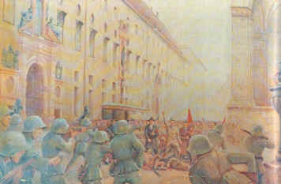
The Munich Putsch

Slide 95
The Munich Putsch
What you will Learn
What happened at the Beer Hall in Munich in November 1923
What the outcome of the Revolt was
How Hitler was treated

Slide 96

Tasks
Read pages 32-33
Summarise the Nazis’ arguments in the early 1920s (diagram p. 32)
Describe the link made by Hitler between Jews and communism.

Slide 97
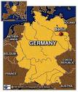
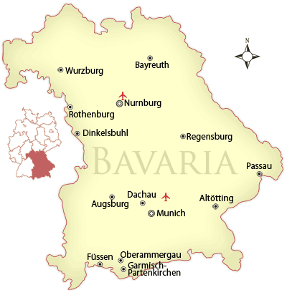
In 1923, the Nazis were based in Munich in Bavaria (southern Germany)

Slide 98
Munich Putsch
Hitler and his storm troopers burst into a Beer Hall in Munich in November 1923 where Bavarian government figures are meeting
600 SA surround the building
25 enter with Hitler. Hitler fires a gun in the air
They announce their intention to take over the regional government of Bavaria
Plan to March on Berlin and establish a new national government
Hitler and 3000 Nazis marched through Munich
Revolt is crushed and 16 Nazis are Killed
Hitler imprisoned serves only 9 months of a 5 year sentence

Slide 99
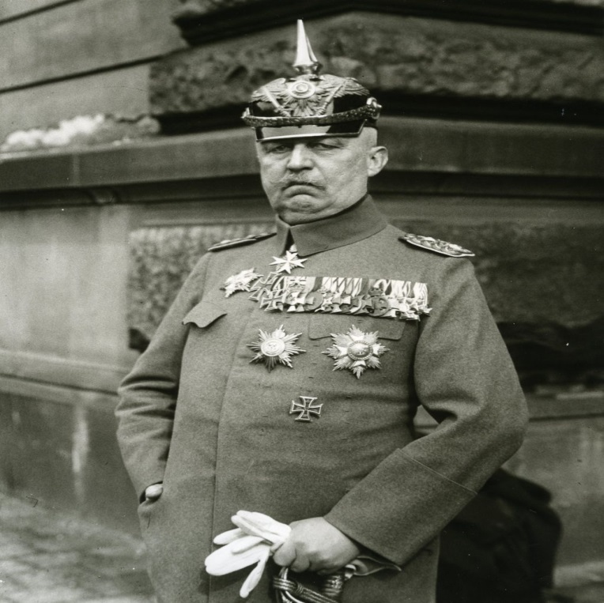
Tasks
Read page 34
What positions did the following men hold?
Von Kahr - Von Lossow - Von Seisser
3. Describe the deal that these men offered Hitler in 1923.
4. Describe the events in the Beerhall after Hitler entered the building.
(mention General Ludendorff!!)
5. Why did the Putsch fail? (detailed spider diagram! – use page 35)
Ludendorff
If you are finished…
Complete the National 4 and National 5 activities on page 37 of the textbook

Slide 100
Source A is useful as evidence of the reasons for the failure of the Beerhall Putsch as it is a primary source, written not long after the events of the Putsch in 1923.
Source A was written by a policeman who was present at the Putsch making it useful because he was an eye-witness to the events.
Source A states that “General von Lossow had escaped from the meeting and warned us” and this is useful because it is accurate.
Source A also states that “Hitler’s men fled like cowards” and this is also useful as it is accurate.
The source could be more useful if it mentioned that a reason for its failure General Ludendorff allowed the three leaders to leave the Beerhall to tell their wives they were okay, which gave them the chance to stop the Putsch.

Slide 101
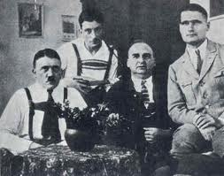
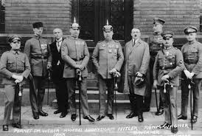
Hitler on Trial
By the end of the lesson you will be able to:
Describe the events that took place at Hitler’s trial
Explain why he was punished so lightly
Describe Hitler's experience in Prison.

Slide 102
Hitler’s Trial
Read pages 38-39
Describe the ways Hitler managed to turn his trial into a great success.
On what points did the German ‘Establishment’ agree with Hitler? – bullet points at bottom of p. 39

Slide 103

Hitler in Prison
CLASS DISCUSSION –
Look at this photograph of Hitler
in prison. What does this tell you
about his treatment in jail?
Read page 41.
What important decision about tactics did Hitler make while in prison?
Read page 42.
What evidence is there that the Nazis were not an important party in the 1920s?
Do Activity 1 and 2 on p. 42 & the N 5 task on p.43

Slide 104
Evaluate the usefulness of Source A (page 43) as evidence of the effects of the Munich Putsch. 5 marks

Slide 105
Years of Hope:
The Golden Age of Weimar
1924-1929

Slide 106
What You Will Learn
Why the outside world could not allow Germany’s problems to continue
What was introduced by the Dawes Plan
What evidence there was to show that life in Germany was improving
Who was Gustav Stresemann, and why was he important?
In what way international relations also improved

Slide 107
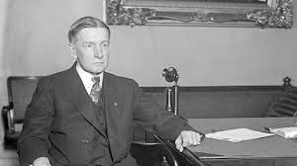
Germany’s Recovery: the Dawes Plan
The world could not risk a total collapse in Germany (WHY?)
An American banker, Charles Dawes (above) came up with a plan:
  reparations were to be reduced
  Germany was to receive huge loans from the USA
  a new currency (the Rentenmark) was introduced
  industry was modernised
This was very successful (for a while)
German industry became stronger than before WWI

Slide 108
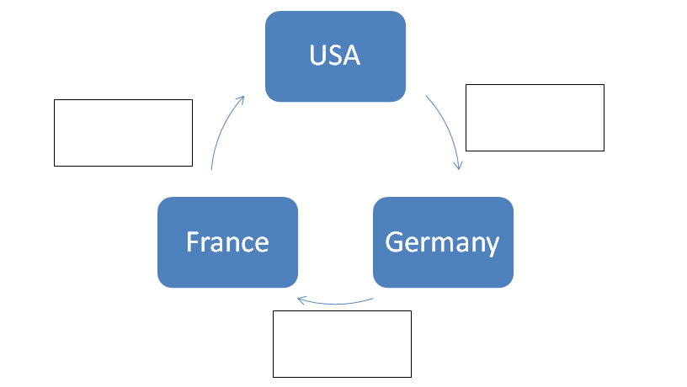
Tasks: Dawes Plan
Read page 44-5
What additional information does p. 44 tell you about the Dawes Plan?
In what ways was the Dawes plan a success?
Collect a copy of the Dawes plan diagram from your teacher. Use the version on the top of page 45 to complete it, then stick in in your jotter.

Slide 109
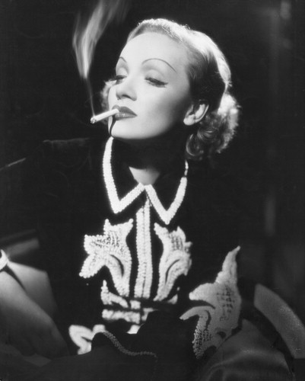


Marlene Dietrich
Albert Einstein
The Roaring Twenties
‘Charleston’ Dancers in the 1920’s

Slide 110

Gustav Stresemann
Stresemann was Germany’s foreign minister in the 1920’s.
His greatest achievement was restoring Germany back into the international community.
• In 1925, he signed the Locarno Treaties with France and Belgium, settling borders between them.
• As a result of this Germany joined the League of Nations in 1926

Slide 111

Tasks: Stresemann and the Golden Age
Read pages 45
Why was Gustav Stresemann so important to Germany? Give three reasons.
Why did Stresemann’s introduction of the Rentenmark help sort out the German economy?

Slide 112

Read page 46
Why was the Locarno Treaty important in improving Germany’s international reputation?
What were Stresemann’s other foreign policy achievements?
What evidence is there that Germans were more supportive of the Weimar Republic during this time?

Slide 113
9 marker page 48
The work of Gustav Stresemann was a very important reason why Germany entered a Golden Age in the 1920s. However, there were other factors such as the Dawes Plan and cultural factors.
Gustav Stresemann was very important as a reason why Germany entered a Golden Age in the mid 1920s. Evidence…..
However, there were other factors which led to a Golden Age in Germany in the mid 1920s. Evidence….
In conclusion, the main reason why Germany entered a golden age in the mid 1920s was (come to a judgment) because (give a reason!)

Slide 114

Vote for Hitler!
The lessons of failure

Slide 115
What you will learn
What lesson Hitler learned from the failure in Munich
How Hitler went about re-organising the Nazi party
What propaganda methods were used to get the message across
What was meant by the ‘Fuhreprinzip’

Slide 116
The Nazi party Organisation
Party had to become nationally organised
Party Headquarters
Overall it became a well organised, well oiled machine, which had a clear structure from the bottom up
Copy this down!
Regional Headquarters
District organisation
Local Branch

Slide 117
Voting for Hitler
Hitler realised that to get the vote the party would need a good image
The SA would wear smart uniforms
There would be big parades with the SA marching to band music behind the Swastika flag
They were to look young disciplined and strong
Turn this into a spider diagram entitled ‘Re-organising the SA’

Slide 118


Propaganda
'The seed of peace, not dragon's teeth' cartoon of Hitler, from the magazine Kladderadatsch,

Slide 119
Paired Task
Read pages 45 – 50 of the blue textbook (41-45 of the old book)
Using a full jotter page, produce a detailed spider diagram outlining the methods used by the Nazis to try to win votes.

Slide 120
Vote For Hitler!
The Nazis used various methods to win votes:
SA parades with banners and music
Propaganda squads – with sports days and concerts
Propaganda posters with Hitler as Germany’s Saviour
Massive party rallies
Planes – allowed Hitler to speak in several towns in one day
Nazi newspapers
Promising something for everyone

Slide 121
National 5 Question practice
Describe the methods used by the Nazi party to win votes. 4 marks
2. Evaluate the usefulness of Source 9.13 (p. 48) as evidence of the Nazis’ electoral methods. 6 marks

Slide 122
The Nazis used a number of methods to win votes. They employed Dr Josef Goebbels a propaganda expert. He used methods such as posters, newspapers and newsreel to put across the simple messages that democracy and Jews were the cause of Germany’s problems, and that Hitler was the answer. Hitler was also a very good orator and so the Nazis made sure that he spoke to as many Germans as possible. The use of planes to fly Hitler from place to place helped this. The SA were also used for propaganda purposes. Squads of them would arrive in towns and villages for days to drum up support with bands and sporting events. The Nazi party also held rallies, which were massive meetings designed to be dramatic as possible, with bands, lighting and speeches.

Slide 123
Source 9.14 is very useful as evidence of the Nazis’ electoral methods as it is a primary source, from 1932 at the time when the Nazis were campaigning for an election.
It is useful as it was written by Josef Goebbels, the Nazi propaganda chief, who was in charge of election campaigns, making him knowledgeable about it.
The content is useful as it describes the use of planes to transport Hitler from town to town, and this is accurate.
It also mentions that Hitler was to speak to as many people as possible, and again this is useful as it is accurate about Nazi election methods.
However, the source makes no mention of the use of posters and newspapers to try to win support.
It also makes no mention of the fact that the Nazis became a nationally organised party in order to reach out into every area of Germany, again making it less useful.

Slide 124
The Nazis Come to Power
What you will Learn
The impact the Great Depression had on Germany
Nazi Electoral support
The Reichstag fire

Slide 125
Hitler Comes to Power - Timeline
1929 – the Wall Street stock market crash. The Great Depression begins.
1930-32 – unemployment rises to 6 million. The Nazis grow enormously in popularity as desperate Germans look for extreme solutions.
1932 – The Nazis become the largest single party in the Reichstag. President Hindenburg refuses to appoint Hitler as Chancellor.
Jan 1933 – politician Franz von Papen persuades Hindenburg to appoint Hitler as Chancellor, thinking that he can control Hitler behind the scenes.

Slide 126
Tasks – Great Depression
Read pages 49-50
Copy out the Glossary on page 49
Explain why the Wall Street Crash affected Germany’s economy.
Was Stresemann’s death important in Hitler’s rise to power? Explain your answer.
“It was the Great Depression that put the wind in Hitler’s sails.”
- Historian AJP Taylor
What evidence is there that the Nazis benefitted from the Great Depression?

Slide 127

“Our last hope: Hitler”

Slide 128

Alfred Hugenburg
Leader of German People’s Party
Agreed with some of Hitler’s views and thought he could use Hitler’s popularity
He was a very wealthy businessman who owned most German cinemas and 100s of local newspapers
He used these to give Hitler lots of free publicity
This in turn won the support of other rich business people

Slide 129

President Hindenburg
As President, he had the power to appoint the chancellor
Hated Hitler, but began to run out of options for Chancellor
Offered Hitler vice-chancellor, which he refused.
Was persuaded by von Papen to appoint Hitler Chancellor on 30 January 1933

Slide 130


Von Schleicher vs. Von Papen
Both were conservative German politicians
However, they were rivals who both wanted power
They both tried to use Hitler and manipulate Hindenburg

Slide 131
Tasks – Rise of Hitler
Read pages 51-53
1. Look at the poster on p. 51. The caption means: ‘Hitler: our last hope.’ In what ways does this poster try to appeal to all Germans?
2. Describe how democracy was weakened during 1930-32 . You should mention Heinrich Bruning and Article 48 in your answer.
3. (a) Who was Alfred Hugenberg?
(b) In what ways did he help Hitler gain power?
4. Describe the role played by Hindenburg, Papen and Schleicher in Hitler’s rise to power. Use all of the information and sources on pp. 52-53 to come to a detailed answer.
IF FINISHED – complete activities 1 and 2 on page 54

Slide 132
Describe the appeal of Adolf Hitler to many Germans between 1929 and 1933. 5 marks
Hitler’s oratory skills (his ability to put into words the frustrations of millions of Germans)
Hitler gave people somebody to blame for their problems: Communists, Jews etc.
Hitler promised something for everyone/claimed he was the only person who could create jobs and end Depression
To a worried middle class Hitler looked like the only person willing to take on the Communists
The SA Brownshirts seemed well-organised and disciplined/made Hitler look like a strong leader
Hitler’s uncompromising stance against the Treaty of Versailles/the Weimar Republic
Hitler’s genius at propaganda (e.g. uniforms, Swastika etc.) made the Nazis stand out from other political parties/clear and simple message that appealed to many

Slide 133
Explain why the Nazis gained power in 1933.
6 marks
“One reason that the Nazis gained power in 1933 was……Another reason why the Nazis gained power in 1933 was…….”

Slide 134
The Reichstag Fire
What you will learn….
In what way did Hitler take advantage of the Reichstag fire?
What was the result of the March election?
Describe the powers that the Enabling Law gave Hitler.

Slide 135
The Reichstag Fire
Read pages 53-4 of the blue textbook
Answer questions 1-3 on page 54.
Read page 55.
Why did some opponents of the Nazi Party believe that members of the SA had started the fire?
What restrictions were announced by Hindenburg the day after the fire?
What did the Nazis do to the Communists and how did they justify their actions?

Slide 136
The March Election
After the Reichstag Fire, the Nazi Propaganda machine went in to overdrive
The Communists were blamed, and hundreds were arrested
However, Hitler didn’t outlaw the communist party, making sure that the working class vote would be split between them and the Social Democrats.
This would reduce the strength of the Social Democrats within the Reichstag
In the election the Nazis became the largest party but they didn’t get a majority. 56% of Germans voted against them

Slide 137
Hitler demanded that the Reichstag pass an enabling law giving him complete control
The Catholic Zentrum party voted for the law giving Hitler the two-thirds majority he needed to pass the law

Slide 138
The Enabling Law
Article 1. National laws can be enacted by the Reich Cabinet
Article 2. The national laws enacted by the Reich Cabinet may deviate from the Constitution
Article 3. The national laws enacted by the Reich Cabinet shall be prepared by the Chancellor
Why did Hitler need an Enabling Law?
What powers did the Enabling Law give Hitler?
How did Hitler use the Enabling Law to create a total dictatorship?

Slide 139
Why was Hitler able to become Chancellor
Weimar Republic was weakened because system of PR created weak governments
People associated the Weimar Republic with the Treaty of Versailles which was hated
There had been widespread discontent during the great depression which resulted in many Germans being willing to listen to extreme parties
Nazi party used propaganda very well and seemed to offer something for everyone
No effective opposition and Storm troopers reduced what opposition there was

Slide 140

Der Fuhrer
What you will Learn
How Hitler governed Germany
How he treated his enemies within and outwith his own party – The night of the long knives!

Slide 141
The Night of the Long Knives
Although Hitler now had complete dictatorial power, Hitler still had to gain the confidence of the German establishment (army, civil service, business)
He needed a period of stability to do this
Hitler’s old friend, Ernst Rohm, who was leader of the SA, wanted to take control of the army and push for further change
Rohm and the SA had become a liability to Hitler- they were unruly and disloyal

Slide 142


Ernst Rohm, SA leader Heinrich Himmler, SS Leader

Slide 143
Hitler decided on decisive action:
  on the 30th June 1934, Hitler ordered the arrest and execution of Rohm and other SA leaders
  he also took the opportunity to rid himself of other enemies, both within and outside of the Nazis: over 400 were killed
Hitler was helped in this by the SS, his fanatically loyal personal bodyguards led by Heinrich Himmler
Hitler now had absolute control of his party and Germany

Slide 144

They salute with both hands, now!

Slide 145
Tasks:
Read page 58 of the textbook.
What plans did Ernst Rohm have for the army?
Why was Hitler worried about these plans?
What were the SS? Use the text and the Glossary to help you answer this.
Describe in detail what happened during the Night of the Long Knives.
Explain why the Night of the Long Knives was useful to Hitler. Give at least two reasons.

Slide 146
President Hindenburg died on 2 August 1934
Immediately, Hitler combined the roles of President and Chancellor, and declared himself Der Fuhrer
The Armed Forces’ oath of loyalty was changed to a personal oath of loyalty to Hitler
Hitler’s position was now secure

Slide 147
Tasks:
Read page 59
Explain why Hindenburg’s death made Hitler’s position secure.
What does ‘Der Fuhrer’ mean?
Does the result of the plebiscite on 19 August 1934 accurately show the views of the German people? Give a balanced answer.
Why was the new oath of loyalty important to Hitler?
Complete tasks 1 and 2 on page 60 of the textbook

Slide 148
Co-ordination
What You Will Learn
What was meant by the term
Co-ordination
What this meant for ordinary German People.

Slide 149
Co-ordination
In power, the Nazis introduced Gleichschaltung (Co-ordination)
Its purpose was to control Germany by giving all aspects of life a ‘Nazi’ feel
non-Nazi organizations that could influence people, such as trade unions, youth groups and political parties, were banned
Teachers, civil servants and lawyers who were anti-Nazi were fired
Censorship of newspapers, radio, cinema and theatre was enforced. Non-Nazi books were banned and many were publicly burned from May, 1933
The Nazis created a terror-state whereby those living in Germany were too scared to disobey Nazi laws. This was achieved through spying on people, intimidation and brutality, which was carried out by the SS and the Gestapo.

Slide 150
Tasks:
Read the section ‘Why were so many Germans afraid to speak out against the Nazis?’ on pages 62-63
Describe how Hitler created an atmosphere of fear in Germany.
(a) What was the Gestapo?
(b) What role did it play in the Nazi state?
(c) Describe the methods of the Gestapo.
4. How many members and informers were the Gestapo believed to have had?
5. Why did some people inform on their friends and neighbours?
6. Read the section ‘What is a police state? on page 64
7. What is a totalitarian state?
8. What effect did the totalitarian state have on opposition to the Nazis?

Slide 151
The Gestapo
secret police who gathered intelligence on people living in Germany.
They had over 150,000 informants who would report any anti-Nazi sentiment.
They did not wear uniforms and so Germans did not know when they were being spied on. This created tension and fear throughout the country.
They had powers to arrest and detain suspects, who were often violently questioned before being released or imprisoned.

Slide 152

Concentration Camps

Slide 153

Concentration Camps
What You Will Learn
Who might be sent to a Concentration Camp
What the rules were in a Concentration Camp
How people suffered in concentration camps

Slide 154
Concentration Camps
Not only for Jews
Anyone who didn’t fit the Nazi ‘ideal’ could be sent: politicians, Union Leaders, mentally ill, disabled
Harsh punishments were give out to those who didn’t follow the rules
This included hard labour, solitary confinement or even death
Prisoners hair would be shaved off and they had to wear a uniform
Constant presence of SS men and the threat of being sent to a Concentration Camp made many Germans unwilling to oppose the Nazi regime.

Slide 155
Tasks: Concentration Camps
Read the section ‘Concentration Camps’ on page 63-64.
In the early days, what type of person was sent to a concentration camp?
Describe the conditions in a concentration camp.
Describe the colour-coded badges worn by prisoners.
In what ways were concentration camps an important part of the fear that the Nazis used to keep control?
Summarise the ways in which Nazi Germany was not a democratic country (info at top half of page 65) – this can be done as a spider diagram
IF FINISHED – do tasks on page 66.

Slide 156
The Master Race
What you will learn
Why Hitler disliked Jews
How Jewish people were treated in Nazi Germany
How the Nuremberg Laws affected Jews in Germany

Slide 157


Slide 158

Tasks
  Read page 79 and the first half of page 80.
  Copy out the Glossary on page 79
  Describe what the Nazis meant by (a) a Jew, (b) a half Jew and (c) a quarter Jew.
  What did the Nazis claim Jews were responsible for?
  Describe in detail the Nazi ideal of racial purity.

Slide 159
5. Identify ways in which Jews were persecuted from 1933.
Nazi anti-semitic policies
6. Describe the treatment of Jewish children in German schools.

Slide 160
Racism & The Jews:
The Nuremberg Laws
Nuremberg laws were passed in 1935
Aim was to protect Aryan race from ‘contamination’ by Jews
Jews were to lose their identity as Germans
They could not be citizens of the Reich
Banned from voting and from public office
Jews were forbidden from marrying German nationals
Jews were banned from employing female German workers as house servants
By the 2nd World War Jews had to mark themselves by wearing yellow stars

Slide 161

The yellow star, inscribed with the word "Jude," has become a symbol of Nazi persecution

Slide 162
Tasks: Nuremberg Laws
Read the section ‘How did the Nuremburg Laws make life very difficult for Jews? on page 80.
What evidence is there that the Nuremburg Laws caused many Jews to leave Germany?
Describe what life was like for those who could not afford to leave.

Slide 163
Kristallnacht
November 1938
The night of Broken glass
All across Germany there were attacks on Jews and their property
Attacks started mostly by the SA
Houses, shops and synagogues destroyed
20, 000 Jews arrested
Clear sign of how Jews would be treated in Germany

Slide 164
Tasks
Read page 81.
Describe the events of Kristallnacht.
Why was the event called Kristallnacht?
What was the official reason for why Kristallnacht took place?
What evidence is there that Kristallnacht was not carried out by ordinary Germans. Provide as many points as you can.
Draw a timeline of 1933 – 1939. Include in it the important events in the Nazi persecution of Jews.
Complete the N5 task on page 84

Slide 165

Timeline of Nazi Policies on Jews

Slide 166
Source A is quite full in describing..
It tells us that “…..” x3
However, it could be fuller if it mentioned …… (3 points of recall)

Slide 167


Slide 168
Lesson Starter - Revision
Describe the Nazis’ treatment of the Jews. 6 marks

Slide 169
Life Under Hitler
What you will Learn
Propaganda
What happened at the Nuremberg rallies
Militarism – Every aspect of German life had to have a military outlook

Slide 170

Propaganda
Who was the head of the Ministry for public Information and Propaganda
How the mass media was controlled
How Nazi propaganda changed after 1933

Slide 172


Slide 173
Tasks
Read pages 85-86
In what way did the Nazis control access to information?
How true is it to say that propaganda actually changed the minds of many German people? Give a balanced answer.
In Hitler’s view, how could propaganda be most effective?
According to Goebbels, what was the core message of all Nazi propaganda?
Does Goebbels’ view of propaganda agree with Hitler’s? Explain.

Slide 174






Slide 175

“All of Germany hears the Fuhrer on the People’s Loudspeaker”
The Nazis produced millions of radios and tried to ensure that all homes had one, in order that their propaganda could be broadcast directly into Germans’ homes

Slide 176



Slide 177

‘The Jewish spirit undermines the healthy powers of the German people.’

Slide 178

"This person suffering from hereditary defects costs the community 60,000 Reichsmarks during his lifetime. Fellow Germans, that is your money, too."

Slide 179
Use of mass media:
Newspapers
Posters
Newsreel
Organised by Dr Joseph Goebbels
METHODS
Radios were made available very cheaply
Used to advertise successes:
In economy
In foreign policy
Propaganda in the Third Reich
Nuremburg Rallies
Used to promote Nazi ideology e.g. on race/Jews, women, militarism…
Films and plays were Nazi in tone, e.g. ‘Triumph of the Will’
Used to promote Hitler as Fuhrer – ‘cult of personality’
Message kept simple – same slogans repeated constantly
PURPOSE

Slide 180
Tasks
Read pages 86-87
Describe the use of radios in spreading the Nazi message.
Explain why Hitler himself was vital to Nazi propaganda.
What evidence is there that the Nazis tried to hide aspects of their rule during the 1936 Berlin Olympics?
In what ways were the Olympics a propaganda triumph for the Nazis?
Explain who Jesse Owens was and how he undermined Nazi ideology.

Slide 181

The Nuremberg Rallies

Slide 182


Slide 183


Slide 184
Tasks – Rallies & Militarism
Read page 88
Create a spider diagram outlining the features of the Nuremberg rallies.
(a) Describe what is meant by militarism.
(b) How did Nazi militarism rely on propaganda?
(c) What evidence is there that the Nazis exaggerated German military strength?
Complete Activity 1 p. 89.
Complete the N5 Source Comparison task on page 90.
REMEMBER THE METHOD!! 2 DEVELOPED, POINT BY POINT COMPARISONS!! -
‘Source A states that….Source B states that…..Therefore the sources agree that……’

Slide 185
Sources A and B agree about Hitler as a speaker. Source A states that Hitler spoke ‘quietly at first’ but rose to ‘hoarse shriek’. Source B states that Hitler started very quietly, but by the end ‘was yelling at the crowd’. Therefore, both sources agree that Hitler gradually built up the volume of his speech for maximum effect. Source A states that he held the crowd ‘under his hypnotic spell’. Source B states that ‘the crowd were hypnotised by Hitler’. Therefore, both sources agree that Hitler had an almost entrancing effect on those who listened to his speeches.

Slide 186
The Nazis and the Economy
What you will learn….
How did the Nazis reduce unemployment?
What was the German Labour Front (DAF)?
What was Strength through Joy (KdF), and what was its purpose?
How successful were Nazi economic policies?

Slide 187
The Economy
As Germany re-armed unemployment fell rapidly
Men joined the armed forces, or found jobs building armaments or in the huge public building projects which would transform Germany with Autobahns (motorways), Stadiums and Government Buildings
Unemployment was also reduced due to the numbers in concentration camps and the numbers of Jews who fled the country
Strikes were made illegal and Unions were replaced by the German Labour Front (DAF)
Wages were slightly higher than they had been under Weimar
Schemes such as ‘Strength through Joy’ (KdF) were introduced to encourage and reward workers.

Slide 188


Slide 189

Volkswagens (‘People’s car’) were first developed by the Nazis
Workers were encouraged to save stamps, which could then be traded for a car

Slide 190

Heavily subsidised holidays to beach resorts were available as part of Strength through Joy

Slide 191
The Economy
Read pages 97-100 and complete these tasks
Describe how Hitler created jobs in Germany.
What role did the DAF perform for German workers?
In what way did SdA try to keep German workers happy?
Why was the Reich Labour Service (RAD) popular?
Draw a spider diagram showing what sort of activities did Strength through Joy (KdF) provided for German workers?
What evidence is there that it was popular?

Slide 192



Economic Policy Cont.
Using the section ‘Were the targets met?’ on page 100, describe how the Nazis “hid” unemployment.
(a) What was meant by Autarky?
(b) what evidence is there that it failed?
9. Attempt the 9 mark question on page 102.

Slide 193
To what extent did Germans benefit from Hitler’s economic policies?
Intro:-
Germans benefited from Hitler’s economic policies in some was, such as… (briefly list!). However, there were ways in which it didn’t benefit Germans such as (briefly list!)
Para 1:-
Germans benefitted from Hitler’s economic policies in a number of ways…….
Para 2:-
However, there were ways in which Germans did not benefit from Hitler’s economic policies….(P2)
Conclusion:-
Overall, (JUDGEMENT – ANSWER THE QUESTION) because (PROVIDE A SUPPORTING REASON)

Slide 194

The Nazis and Women
What you will learn……
What were the Nazis’ attitudes towards women?
How important were women in Nazi Germany?
What methods did the Nazis use to implement their policies on women?

Slide 195

‘The Family’ – In what ways does this painting illustrate the perfect Nazi ideal?

Slide 196
The family has four children, and the mother has just had a baby.
The mother is caring for the baby.
She wears a plain dress.
She has her hair in a bun; she is not wearing make-up.
The mother is not skinny.
The family lives in a rural/farming environment.
The boy wears his Hitler Youth uniform and is making something out of the clay.
The younger sister plays with a doll - preparation for motherhood.
The elder sister has plaited hair (acceptable fashions), and gazes longingly at the baby (longing for motherhood).
The family have fair hair, athletic bodies and ruddy complexions - they are the ideal Aryans.

Slide 197
‘Women have the task of being beautiful and bringing children into the world, and this is not as old-fashioned as one might think. The female bird preens herself for her mate and hatches her eggs for him. In exchange, the mate takes care of gathering the food and stands guard and wards off the enemy.’ a speech by Joseph Goebbels, 1930s
‘I detest women who dabble in politics. And if their dabbling extends to military matters it becomes utterly unendurable. In no section of the Party has a woman ever had the right to hold even the smallest post.’
Adolf Hitler
TASK:-
Using these two primary sources and any other knowledge that you have, create a spider diagram outlining the Nazis’ attitudes towards women.

Slide 198
Source A:
Hitler, speaking at the Nuremberg rally, 1934
‘If one says that man’s world is the State one might be tempted to say that the world of women is a smaller world. For her world is her husband, her family, her children and her house. But where would the greater world be if there were no-one to care about the smaller world?’
Evaluate the usefulness of this source as evidence of Nazi beliefs about the role of women
5 marks.

Slide 199
Source A is very useful as evidence of Nazi beliefs about the role of women as it is a primary source, taken from 1934 when the Nazis were in power and were beginning to implement their ideas.
It is part of a speech made by Hitler, making it useful as he was the Nazi leader who is in charge of Nazi policy.
The source content is useful because it tells us that a woman’s “world is her husband, her family, her children and her house”, and this is accurate.
The source could be more useful if it mentioned that the Nazis believed that no woman should have any role or say in political or military matters.
Also, it could be more useful if it stated that women were rewarded for having children by being given a military style medal – ‘The Cross of Motherhood’.

Slide 200
Education
What You Will Learn
How young Germans learned about Nazi ideas at school
Hitler's beliefs about the purpose of schools
How education was reorganised by the Nazis

Slide 201

How does this image, from a high school biology textbook, act as an example of Nazi propaganda on the need to prevent births of the “unfit’?

Slide 202
Nazi Maths Challenge!
The Jews are aliens in Germany. In 1933, there were 66 million people living in Germany. Of this total, 499,862 were Jews. What is the percentage of aliens in Germany?
A bomber aircraft on take off carries 144 bombs, each weighing ten kilos. The aircraft bombs Warsaw, the centre of international Jewry. On take off with all bombs on board and a fuel tank containing 1000 kilos of fuel, the aircraft weighs about 8 tons. When it returns from its victorious mission, there are still 230 kilos of fuel left. What is the weight of the aircraft when empty?
It costs, on average, 4 RM (Reichmarks) a day to keep a cripple or a mentally ill person in hospital. There are currently 300,000 mentally ill, lunatics and so on in Germany’s hospitals. How much would the German government save if they got rid of all these people?

Slide 203
Tasks – Purpose of Education
Read page 91
What does indoctrination mean?
What was the main aim of the Nazi education system?
What did Hitler want to create?

Slide 204
Re-organising Schools
Read ‘Reorganising schools’ on page 92
How did Hitler ensure that schools taught what the Nazis believed in?
In what ways were different school subjects used to put across the Nazis’ ideology?
Describe the purpose and entry requirements for the Napolas?
In what ways did the Nazis change university education?
Complete the N5 tasks on page 96 – source comparison.

Slide 205
The sources agree to a large extent about the Nazis’ changes to education.
Source A states that “the number of PE periods was increased at the expense of religious instruction”. Source B states that “PE was increased to five periods by 1938. This was instead of religious instruction”. Therefore the sources agree that the Nazis introduced more PE in school and took time away from RE to make the space.
Source A also describes the “loud Nazi songs we had to sing”. Source B describes weekly assemblies “where hymns were replaced by Nazi songs”. Therefore, both sources agree that pupils were required to sing Nazi songs as part of their education.

Slide 206

Hitler Youth
What you Will Learn
How the youth movement was organised
What young people were taught at youth groups
What the purpose was of the Hitler Youth Movement

Slide 207


Slide 208


Slide 209



Slide 210
Young Germany
The Hitler Youth Movement had separate organisations for boys and girls of different ages
Boys aged 6-10 belonged to the ‘Cubs’ or ‘Little Fellows’. From 10 to 14 they belonged to the ‘Young Folk’ Between 14 and 18 they belonged to the ‘Hitler Youth’ itself.
Girls aged 10 to 14 belonged to the ‘Young Girls’. Between 14 and 18 they belonged to the ‘German Girls league’.
Both boys and girls were taught loyalty to Hitler, indoctrinated in Nazi ideas and policies (such as hatred of Jews), participated in parades, did sports, went on long marches in the countryside and attended weekend camps

Slide 211
Cont
However, boys spent much of their time doing military training drill, war games and learning to use weapons).
Girls, meanwhile, were taught about childcare and how to do household chores.
The purpose of the Hitler Youth movement is clear from what the children did. All young people were being indoctrinated to become loyal supporters of Hitler and the Nazi party. Boys were being prepared for their future role as soldiers, while girls were being readied for their future roles as wives and mothers.

Slide 212
Tasks – Hitler Youth
Read pages 92-93
What evidence is there that the Hitler Youth was popular even before the Nazis gained power?
Create a spider diagram showing the militaristic nature of the Hitler youth.
Describe in detail how the Nazis used the Young Maidens to prepare girls for their future role in life.

Slide 213
Compulsion
Read the section ‘Were people forced to join?’ on page 94 and answer the following questions…
What steps did the Nazis take to ensure that as many young Germans as possible attended the youth groups?
Using the two accounts of Hitler Youth members on page 94, explain why many young people joined the Nazi youth groups.
Evaluate the usefulness of the source on page 93 (Martha Dodd) as evidence of the Nazis policies towards young people. 6 marks

Slide 214
Source A is useful as evidence of the Nazis policies towards young people because it is a primary source published in 1939, when the Nazis were in power and implementing their policies on the young (1).
It was written by someone who lived in Germany in the 1930s, making it useful as an eye witness account (2).
The source content is useful as it tells us that girls youth groups were used to indoctrinate girls to be loyal to the Nazis, which is accurate information (3).
It is also useful as it mentions how girls were encouraged from an early age to see motherhood as their future role in life, and again this is accurate(4).
However, the source would be more useful if it mentioned that the boys’ youth groups were used to prepare them to be soldiers later in life (5).
It also doesn’t mention that all non-Nazi groups were banned and young people were required by law to attend the HJ (6).

Slide 215
Opposition to the Nazis
What you will learn….
Why was so little opposition to the Nazi regime?
From which social class did most resistance come?
Resistance:
- individuals
- groups
- the Edelweiss Pirates

Slide 216

Task 1: complete this spider diagram. Use pages 68-9 of the textbook and any other knowledge that you have
Censorship meant many Germans didn’t know what was going on
SS and Gestapo spies were everywhere
Fear of arrest and concentration camps
Why was
there so little
opposition to
the Nazis?
Enemies like communists had been rounded up
Raids on working class areas
All political parties were banned
Trade Unions were banned
Nazis were popular :
Gave people what they wanted
- propaganda

Slide 217
Explain…..practice
Explain why there was so little opposition to the Nazis between 1933 and 1939. 6
“One reason why there was so little opposition to the Nazis was because…….
Another reason why there was so little opposition to the Nazis was because…….”

Slide 218

The Edelweiss Pirates

Slide 219

The Edelweiss Pirates

Slide 220

The Edelweiss Pirates

Slide 221
Who were the Edelweiss Pirates?
Age: 14-19 years old approximately
Activities: met in parks or street corners at weekends, took hikes, went on camping trips, played music
Social Class: sons and daughters of working class Germans. Some had communist parents who were imprisoned.
Motto: "Eternal War on the Hitler Youth”
Song: "Our song is freedom, love and life,
We're the Pirates of the Edelweiss.”
Graffiti: "Down with Hitler"
"Down with Nazi Brutality"

Slide 222
Source A: by Jean Jülich, an Edelweiss Pirate during the 1930s
‘We threw bricks through munitions factories and poured sugar water into the petrol tanks of Nazis' cars. We stole food and supplies from stores or freight trains, and derailed train cars full of ammunition.’
How fully does Source A describe the ways in which the Edelweiss Pirates opposed the Nazis? 6 marks

Slide 223
Source A is quite full in describing the ways in which Edelweiss Pirates opposed the Nazis as it states that “we threw bricks through munitions factories”.
It also states that they “poured sugar water into the petrol tanks of Nazis' cars”.
It also states that they “derailed train cars full of ammunition”.
However, the source could have been fuller had it also stated that the Edelweiss Pirates refused to join the Hitler youth.
It also doesn’t mention that they attacked and beat up Hitler Youth patrols at every opportunity.
Also the source does not mention that they daubed anti-Nazi graffiti on walls, such as ‘Down with Hitler!’

Slide 224
Who opposed?
On page 69, read from the section ‘Who did oppose the Nazis?’, and then onto all of page 70
Write two sentences for each of the following groups:
The White Rose
The Red Orchestra
The Edelweiss Pirates
The Meuten
The Swing Kids
The German Army
Who were they?
In what ways did they oppose the Nazis?

Slide 225
Opposition to the Nazi Regime –
Recap
Socialists and Communists
They had been Hitler's greatest opponents before 1933. After the Reichstag fire, many were imprisoned. Those who remained free set up anti-nazi groups. Their secret headquarters were frequently raided by the SA, SS and Gestapo. Although the greatest opposition came from the working class, on the whole they supported the regime.

Slide 226

The Church and Nazism
What you will learn….
- Ways in which Nazis controlled the Churches
co-operation with Nazis
opposition to Nazis

Slide 227
Tasks: the Protestant Churches
1. (a) Why do you think the Nazis wanted to destroy the church in Germany?
(b) Why would the Nazis have difficulty in attempting to destroy Christianity in Germany?
2. Describe the methods used by the Nazis to gain control of the Protestant Churches in Germany.
3. What evidence is there of opposition to the Nazis from within the Protestant church?
4. Describe the role played by the Confessional Church in opposing the Nazis.
5. Why were Martin Neimoller and Deitrich Bonhoeffer treated differently by the Nazis?

Slide 228
Tasks: the Catholic Church
1. Describe the deal that Hitler made with the Pope.
2. In what ways did the Nazis break their part of the Concordat?
3. Give two examples of opposition to the Nazis from within the Catholic Church.
4. What other religious groups did the Nazis oppose?
5. Complete activity 1 page 76.
6. Complete the National 5 task on page 78: Evaluate the usefulness.

Slide 229
Source A is useful as evidence of the actions of the Nazi state to control the Christian churches as it is a primary source, taken from June 1937, at the time when the Nazis are in power and are clamping down on opposition from the various churches.
The source is also useful as it was written by Martin Niemoller, a Protestant pastor who was opposed to the Nazis who would therefore have direct experience of the actions taken to control the churches.
The content is useful as it tells us that “the secret police penetrated the closed church …and arrested at the alter eight members of the confessional church”, and this is accurate.
The content is also useful as it tells us that members “of the Protestant community were arrested because they had circulated an election leaflet of the confessional church” and again this is accurate.
The source would be more useful if it mentioned the 1933 Concordat between the Pope and Hitler, which was an agreement made in attempt to control the Catholic church in Germany.
Also, the source fails to mention the fact that the Nazis set up the German Christian Church, which had Nazi style uniforms and marches, as a means of trying to control the Protestant churches in Germany.

Slide 230
by Rev. Martin Niemoller, 1945
First they came for the Communists, and I didn’t speak up, because I wasn’t a Communist.
Then they came for the Jews, and I didn’t speak up, because I wasn’t a Jew.
Then they came for the Catholics, and I didn’t speak up, because I was a Protestant.
Then they came for me, and by that time there was no one left to speak up for me.

