Slide 1
A guide to using Microsoft Teams
For pupils & Parents

Slide 2
What is Microsoft Teams?
It is a hub for team collaboration.
It is the place where you will have all the resources to successfully learn.
It is a safe space to ask questions for further clarification or to deepen your understanding.
It will support your home learning.

Slide 3
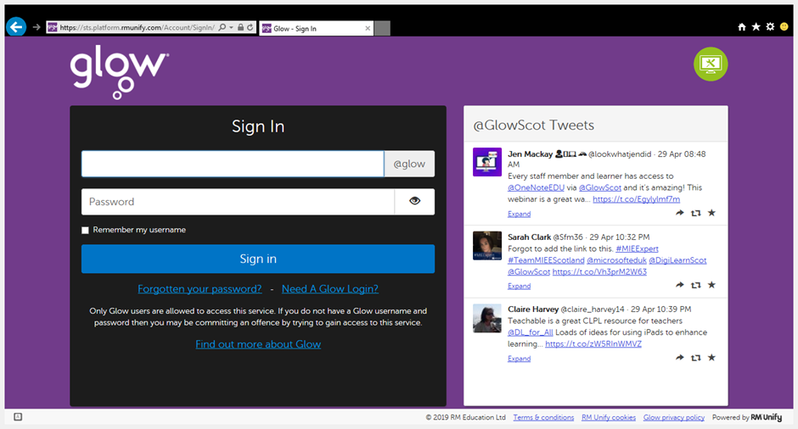
Logging In
Type in Glow Login in to google
This page will appear
Username in top box
Password in bottom box
Sign in
Email the school if you need your log in details: instpatricks@glowscotland.onmicrosoft.com

Slide 4
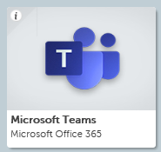
Finding the Teams Tile There are 2 options – this is OPTION 1
Search the App library for Microsoft Teams and add it to your Launch pad.

Slide 5
Accessing Teams
Click on the Teams tile.
Now go to slide 9

Slide 6
Finding Teams This is OPTION 2
Select the Mail icon

Slide 7
Finding the ‘waffle’
Select the ‘waffle’ at the top left corner of screen.

Slide 8
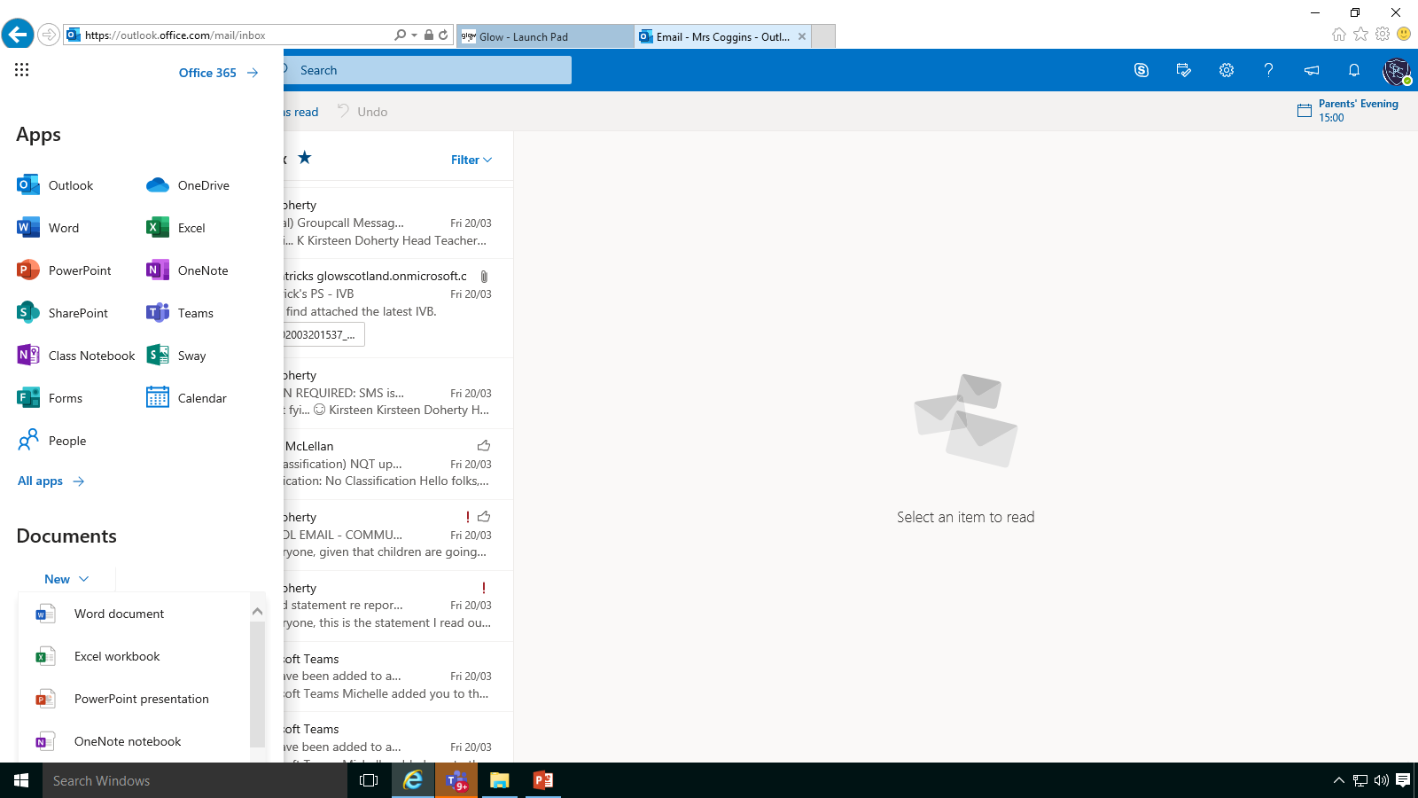
Enter Teams
Select Teams icon
Your teacher will have added you to the selected group which you will have access to OR you can use a group code issued by teacher.

Slide 9
Joining a Team
Click on Teams at left hand side
or
To use a group code you can enter it in the top right hand corner.

Slide 10
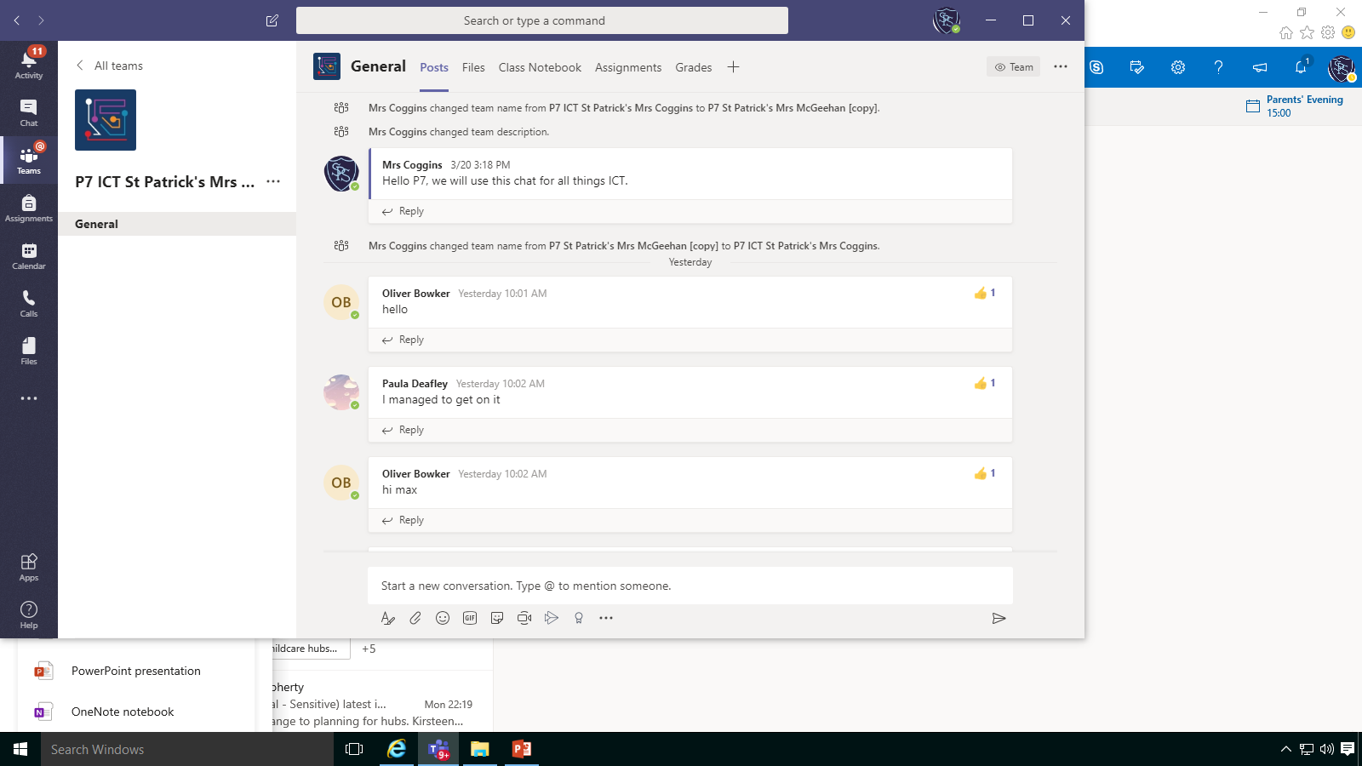
Once in your Team
In your Team you will find the following information:
Click on General
Posts – discussions/chats
Files – Important files you will use.
Assignments – dates and deadlines for assignments.

