Slide 1
Welcome to St Ninian’s

Slide 2
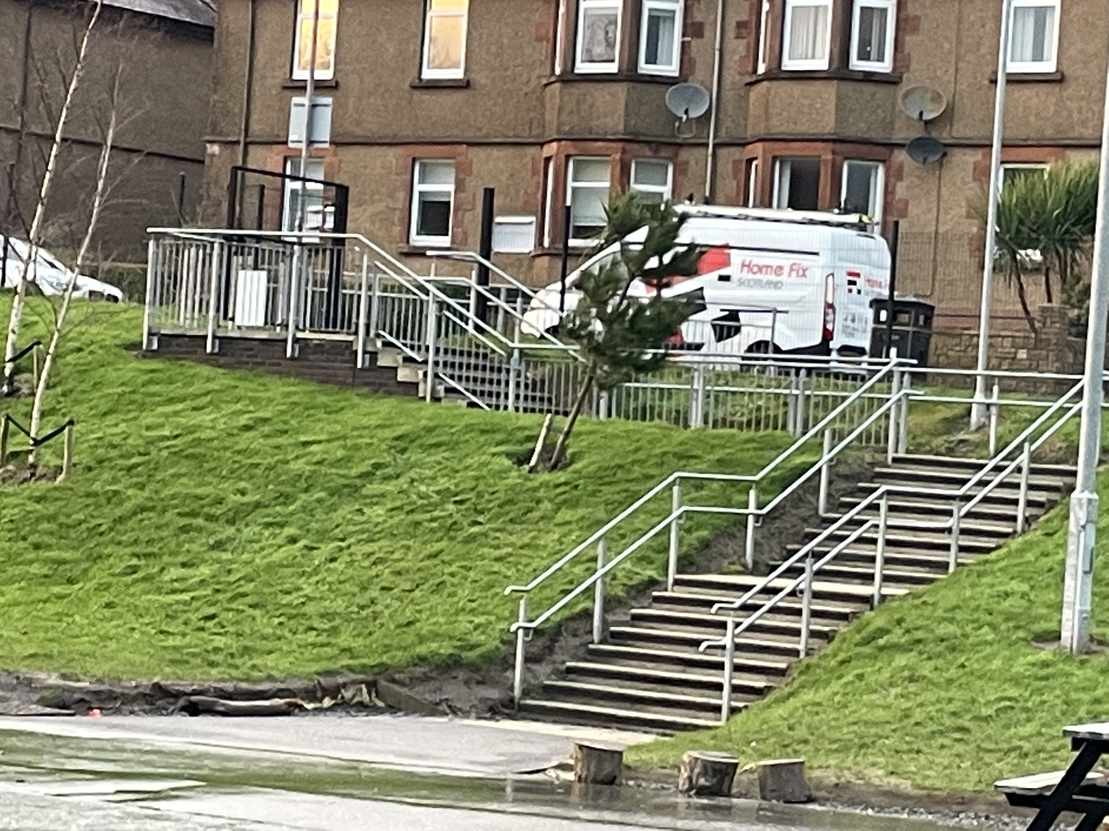
When you come to school, you will come down these stairs into the playground. Mrs Currie will be waiting in the playground for you every morning.

Slide 3
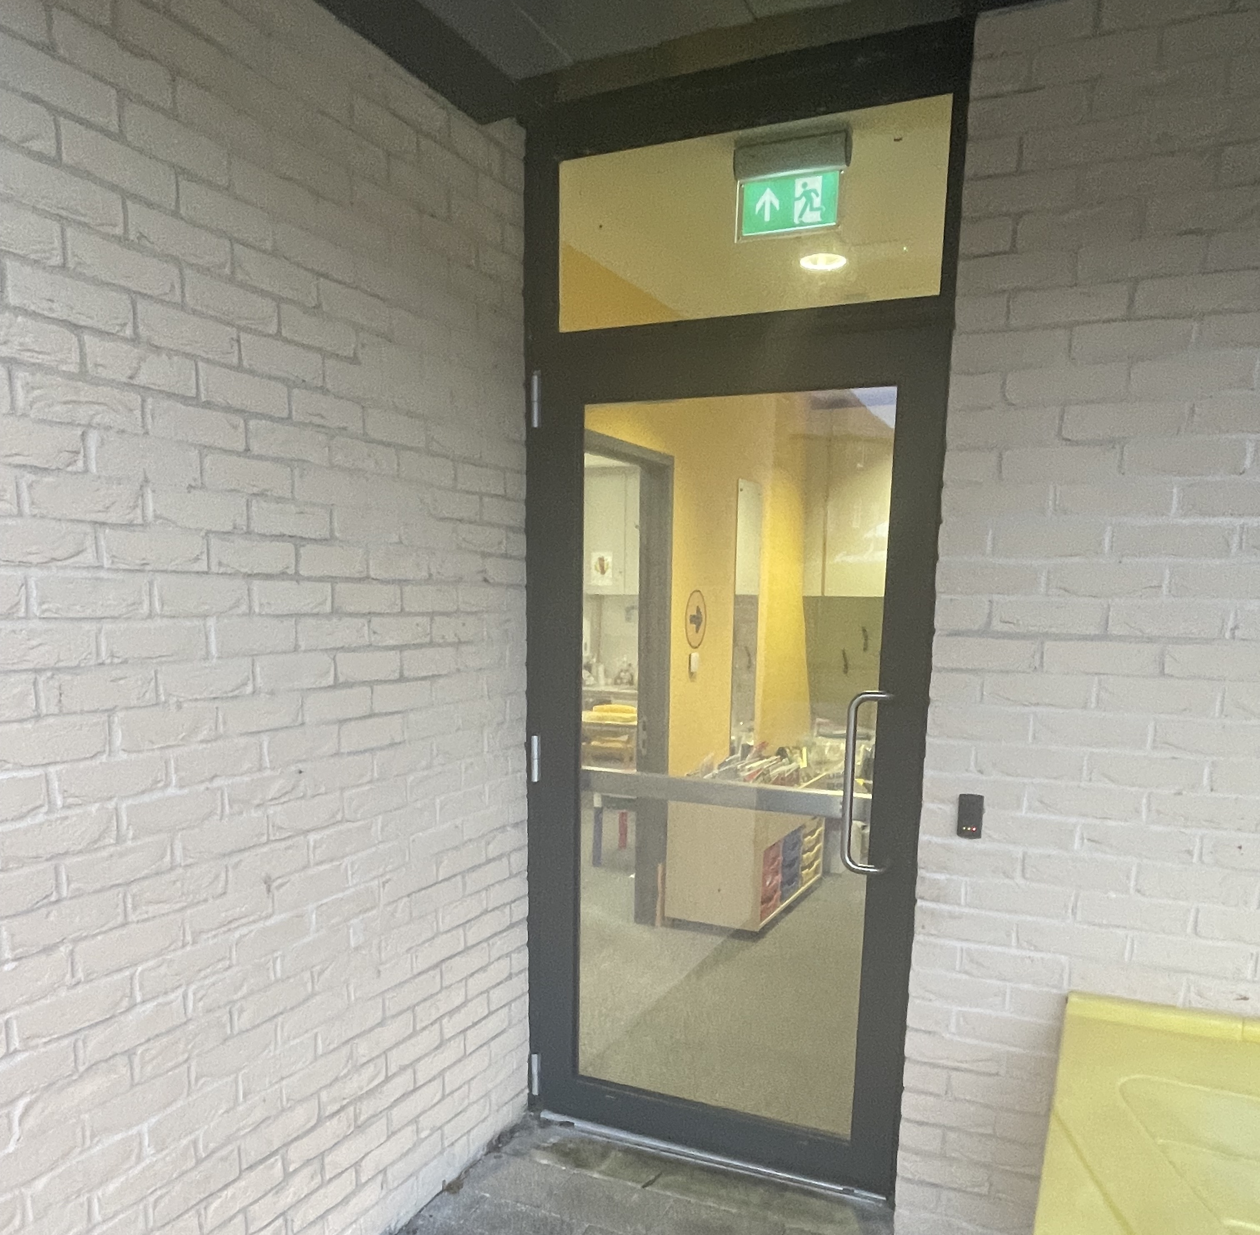
This is the door which will take you into your classroom.

Slide 4
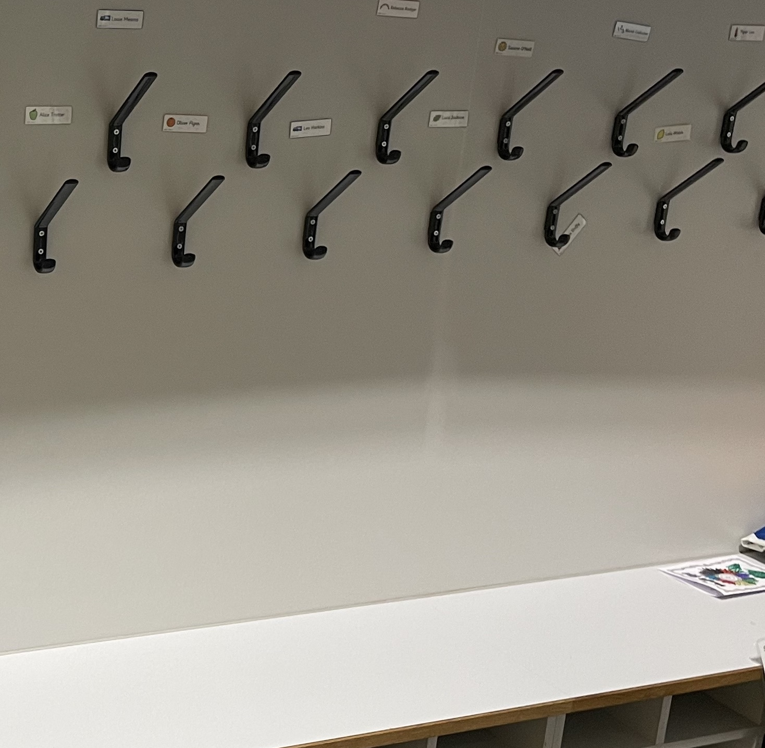
This is the cloakroom where you will hang your coat.

Slide 5
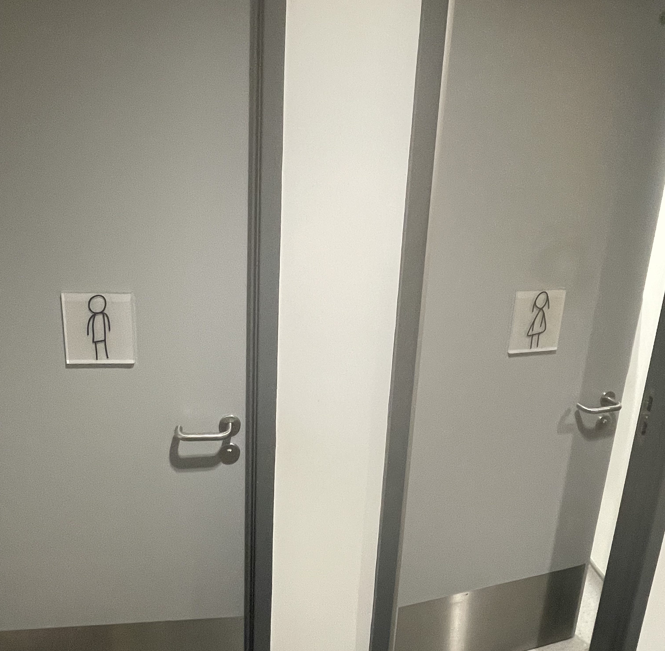
The toilets are in the cloakroom.

Slide 6
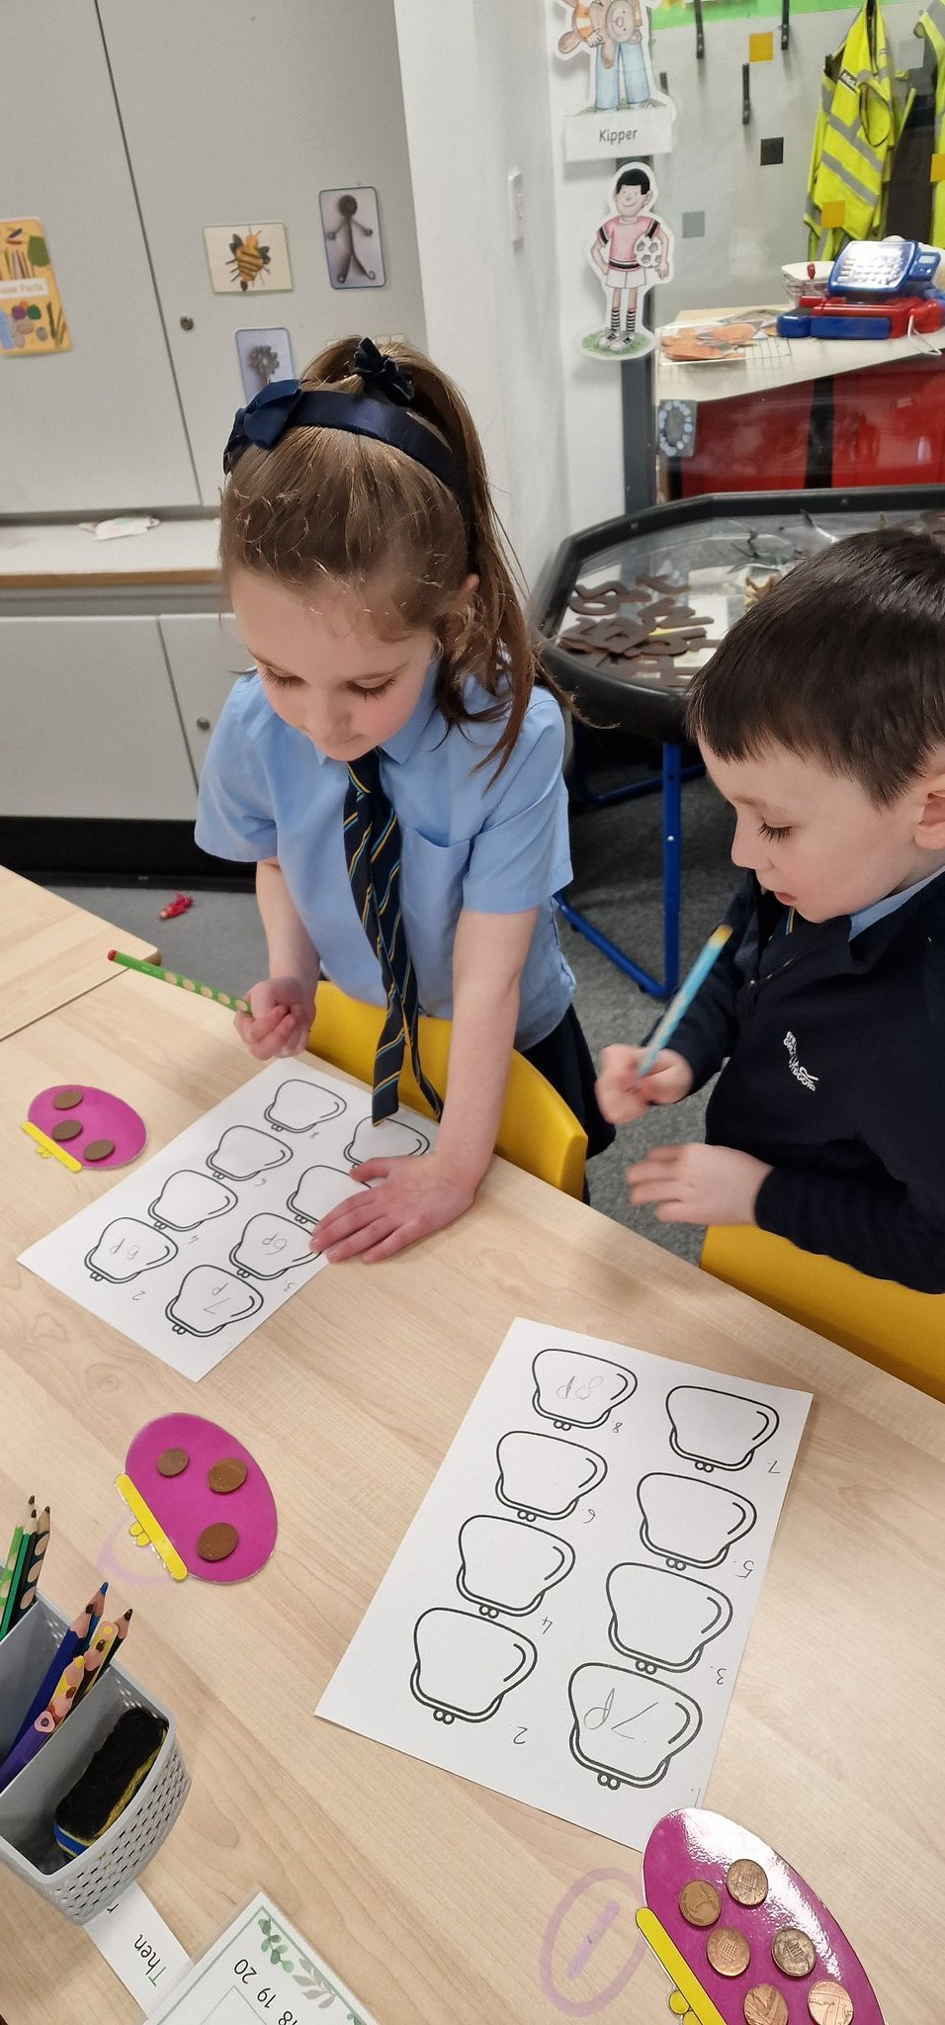
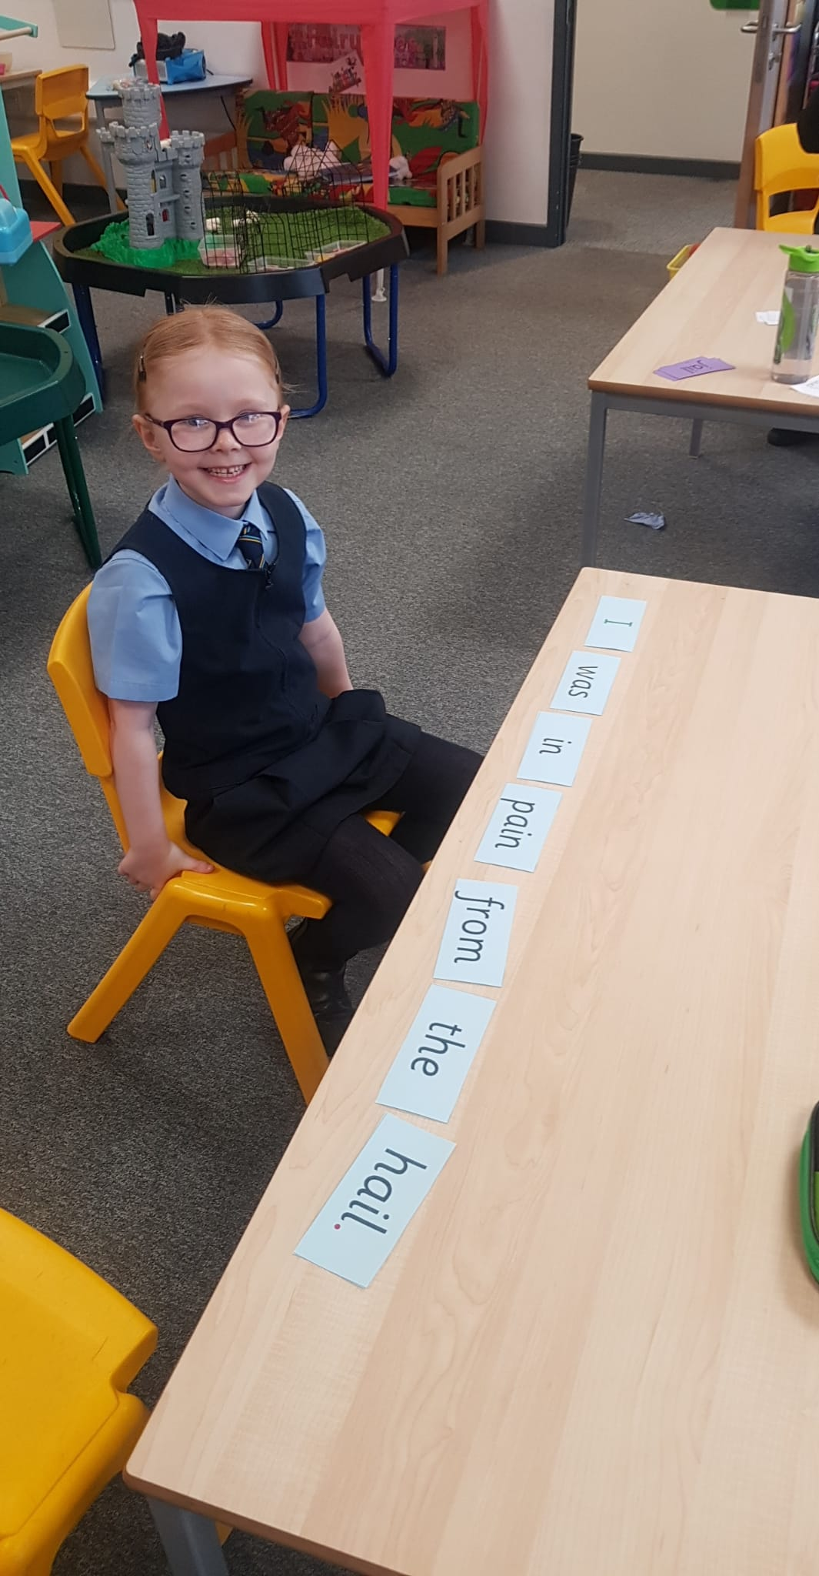
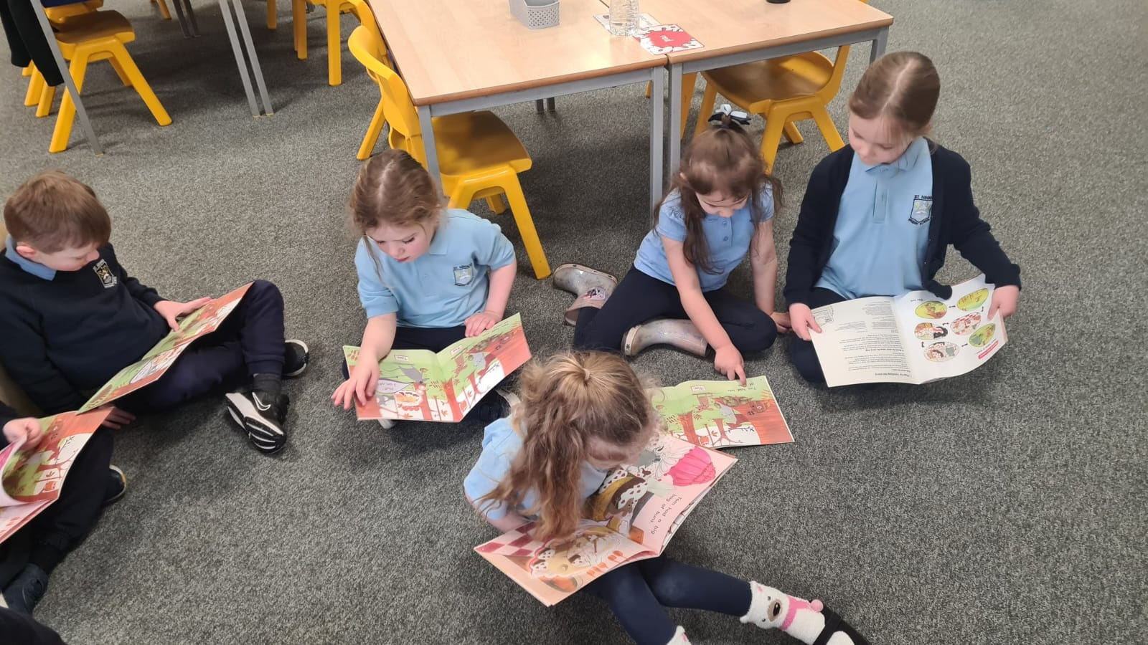
In your classroom. You will have your own chair and table. You can sit beside a friend. You will do lots of great playing and learning.

Slide 7
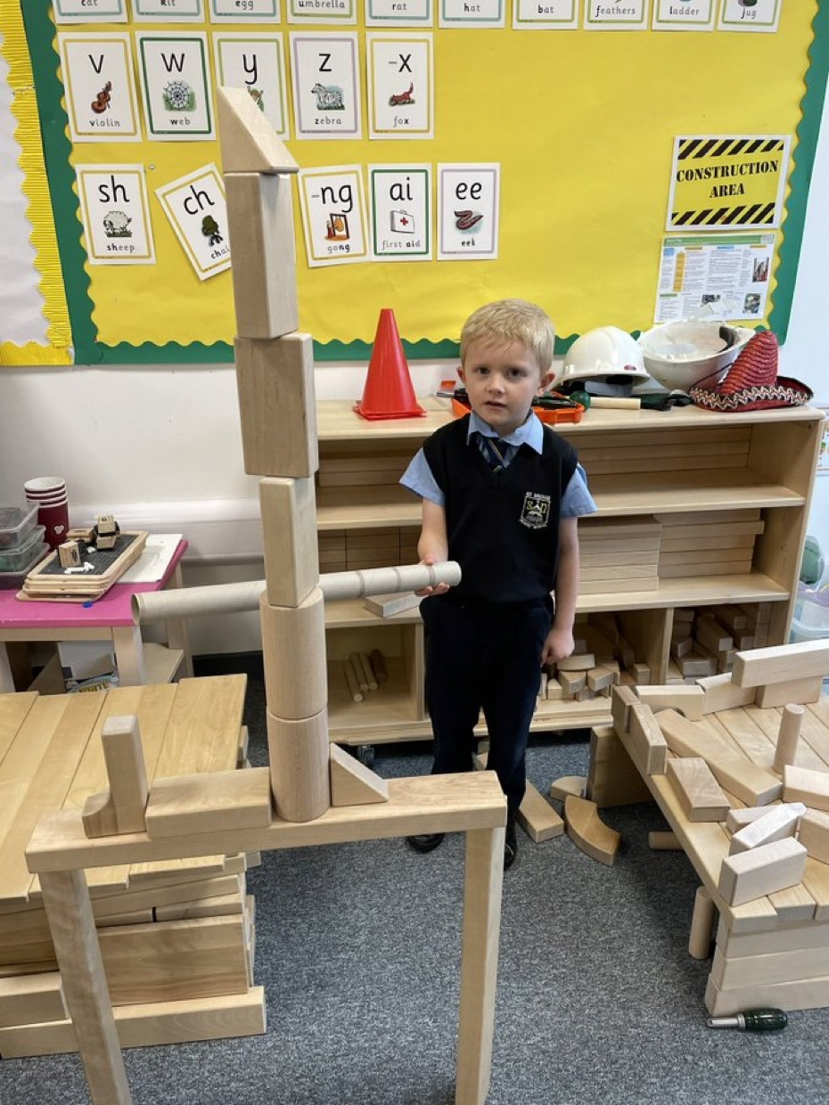
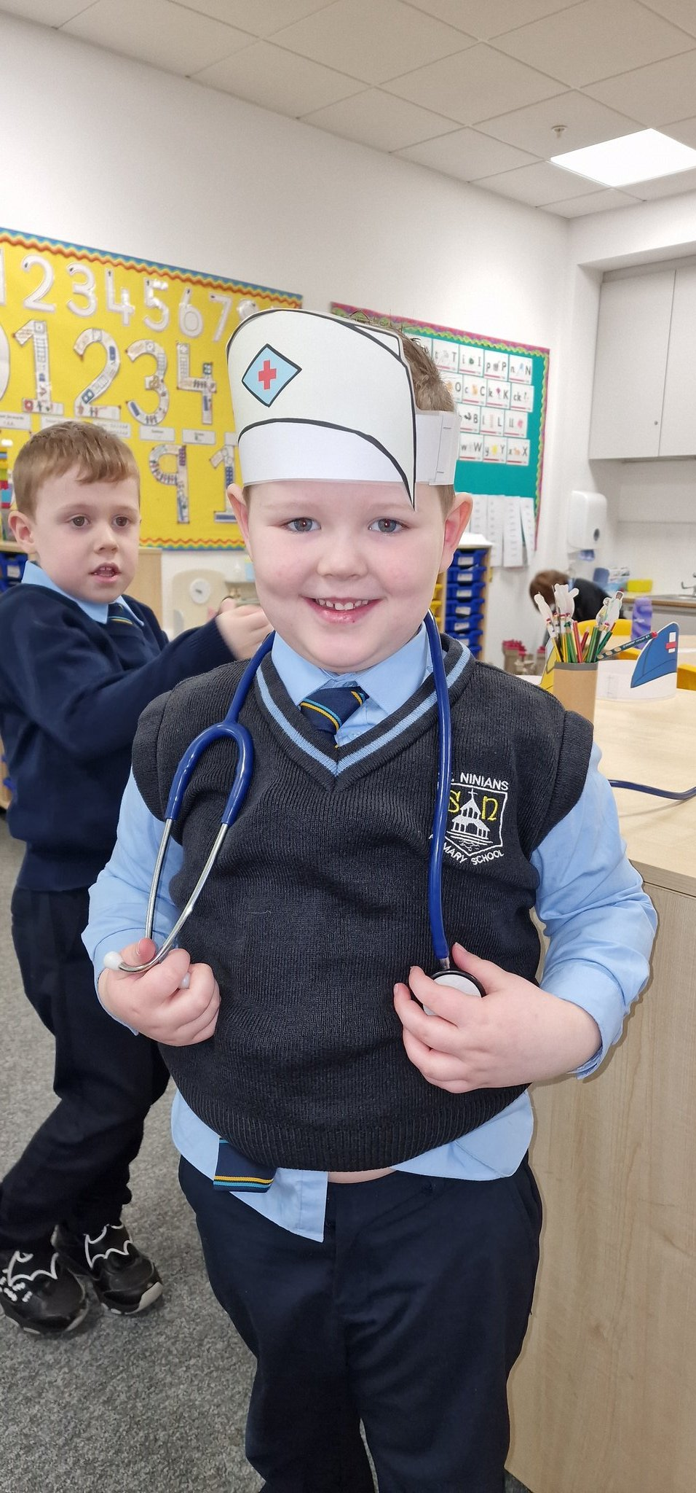
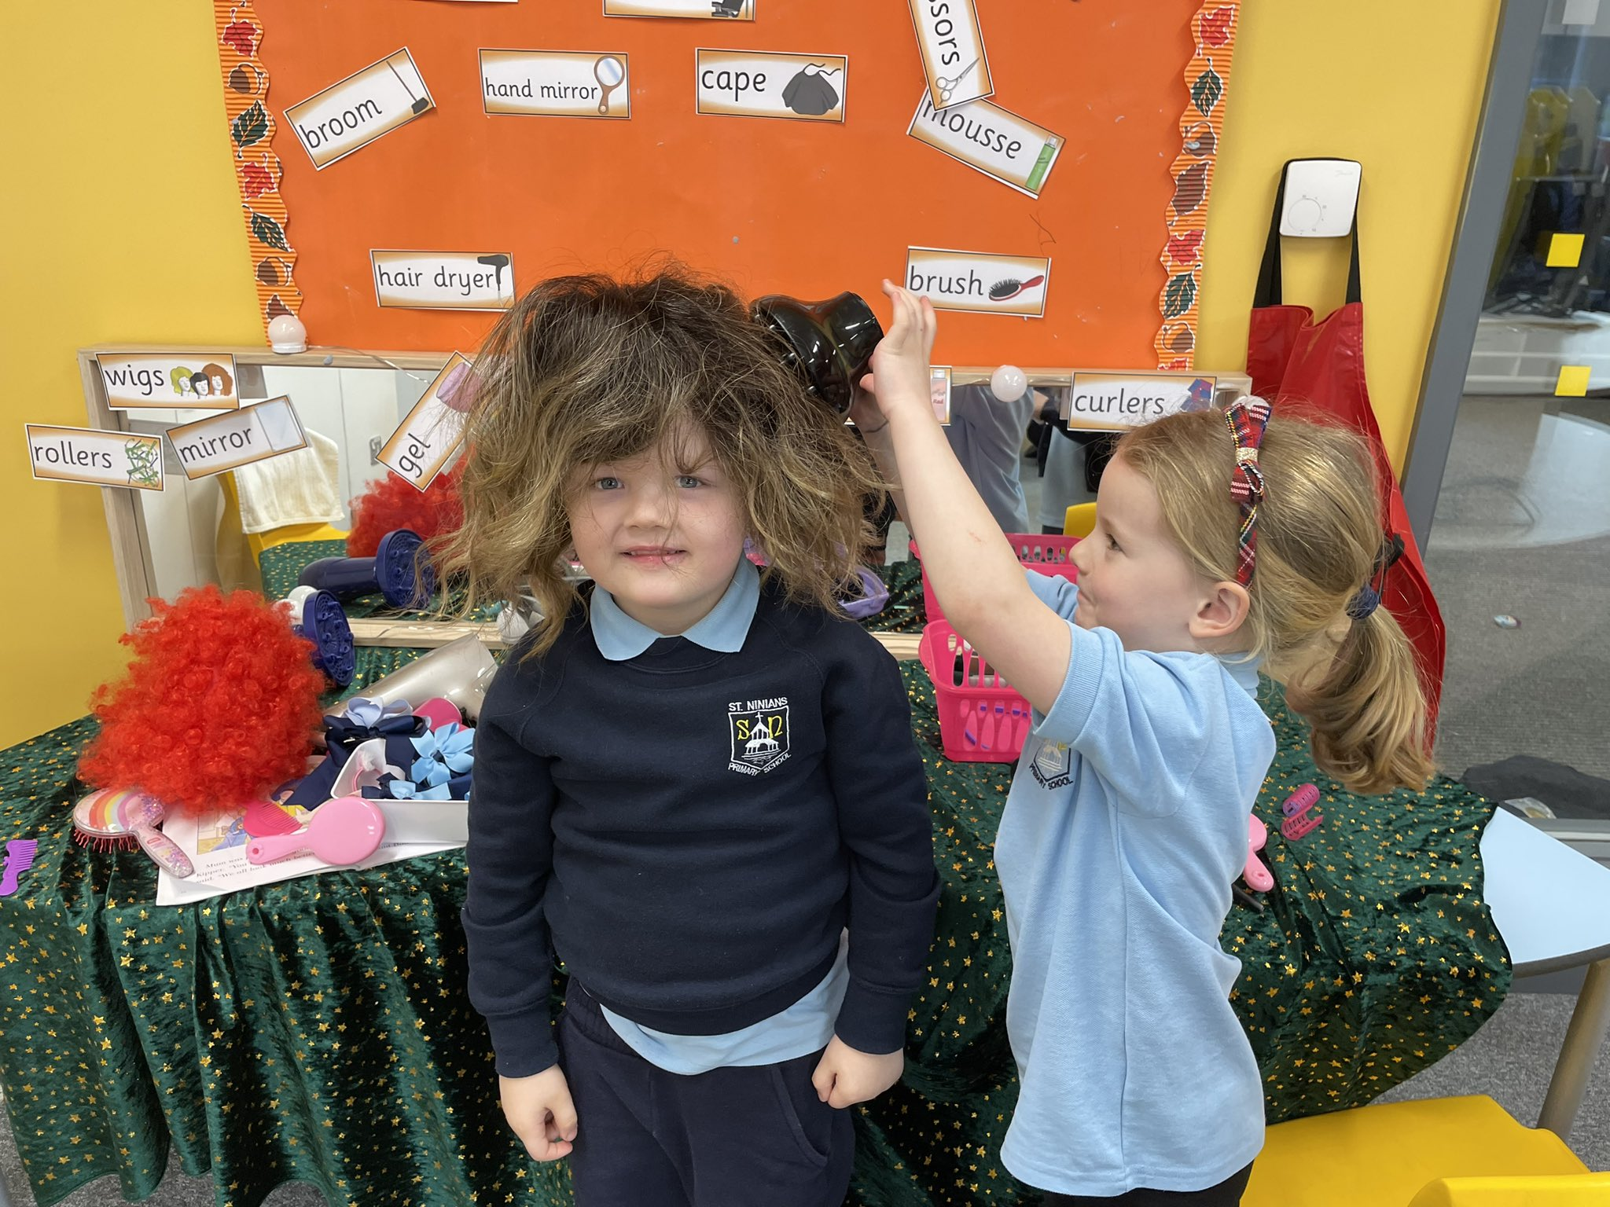
This is the Rainbow Room you will come in here for lots of fun activities and learning.

Slide 8
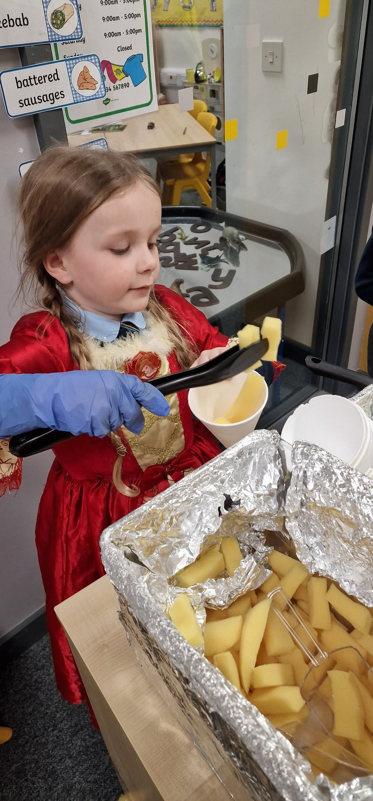
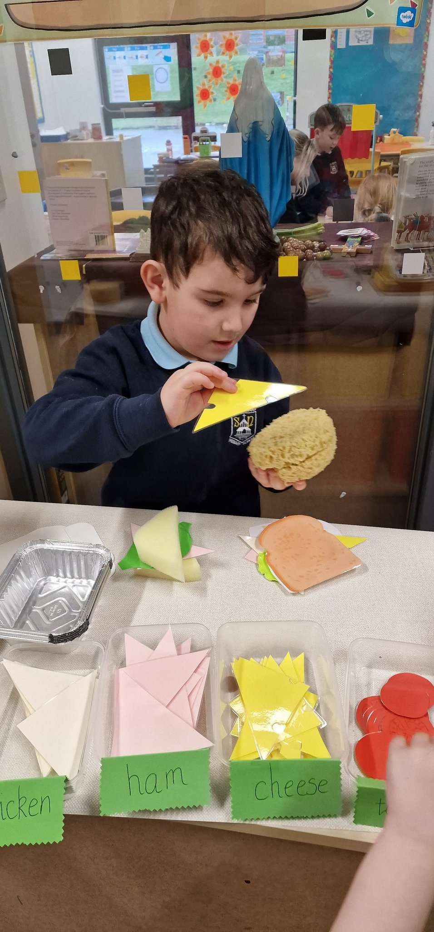
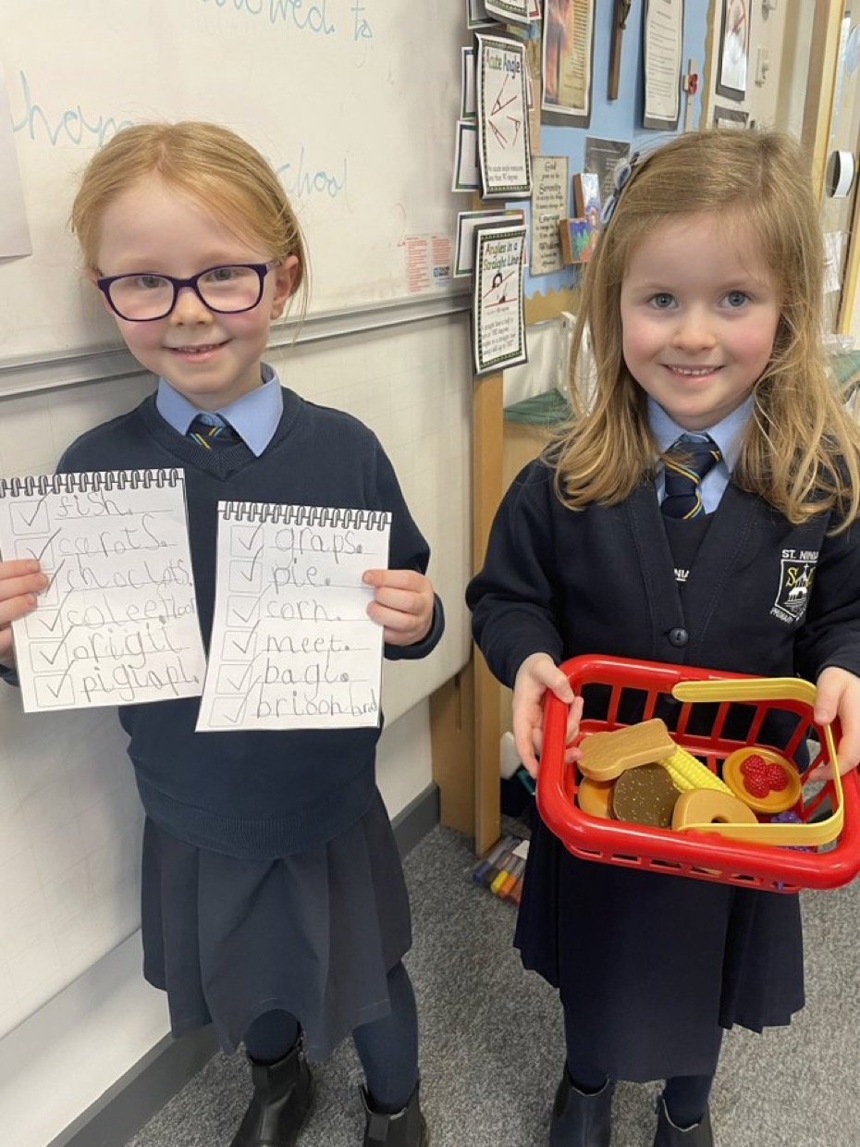
You will do lots of learning and play activities in the learning spaces outside your classroom.

Slide 9
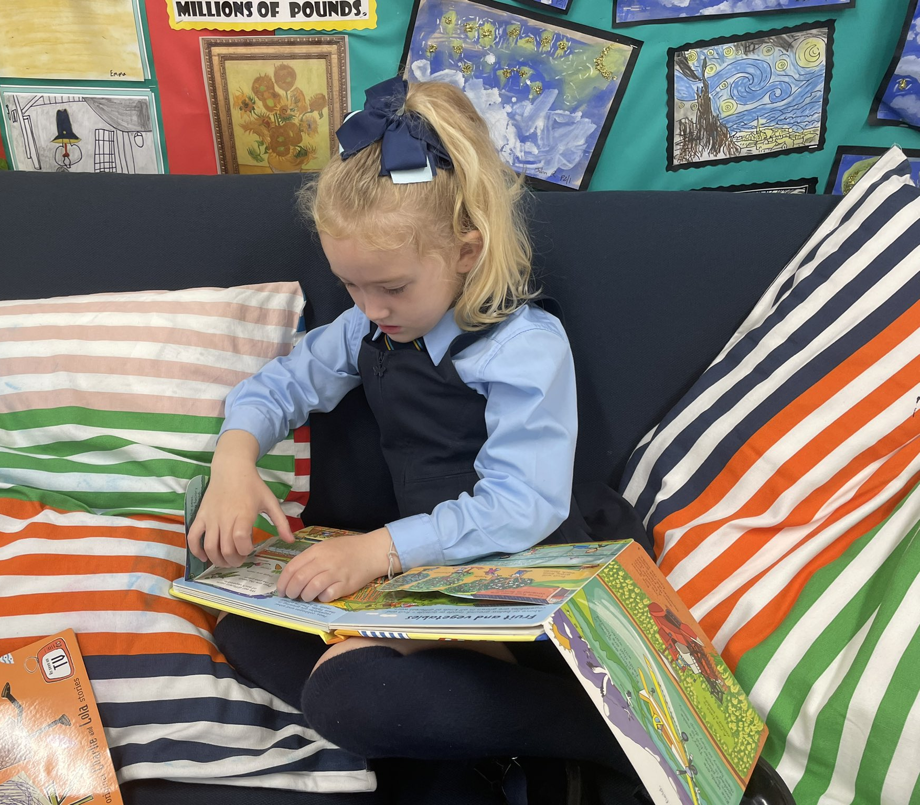
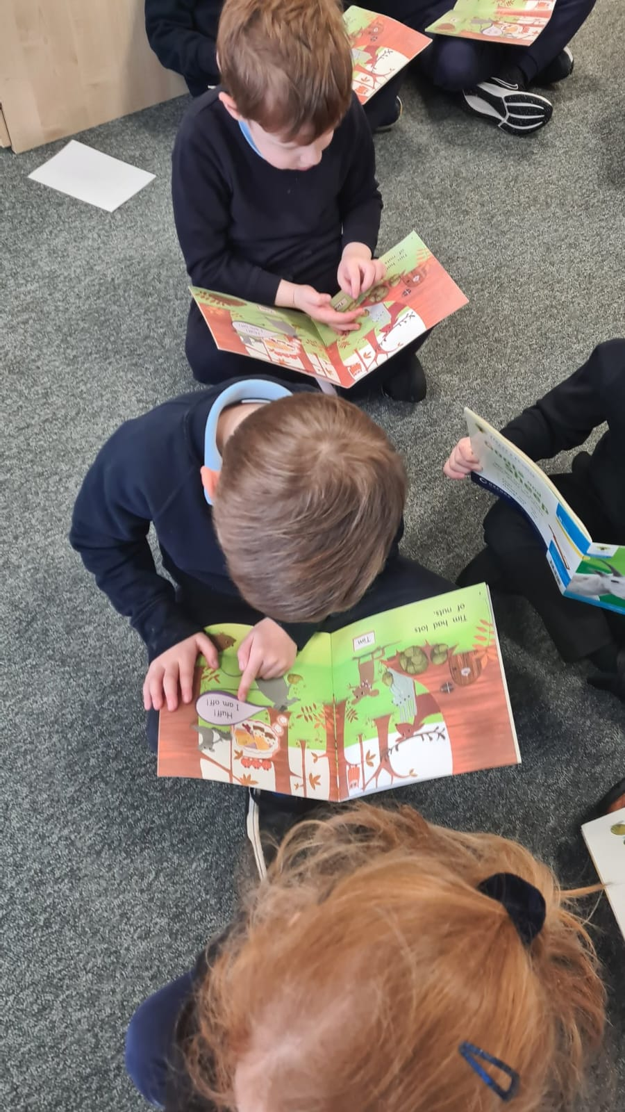
We love reading in St Ninian’s. There are lots of quiet spaces to look at books.

Slide 10
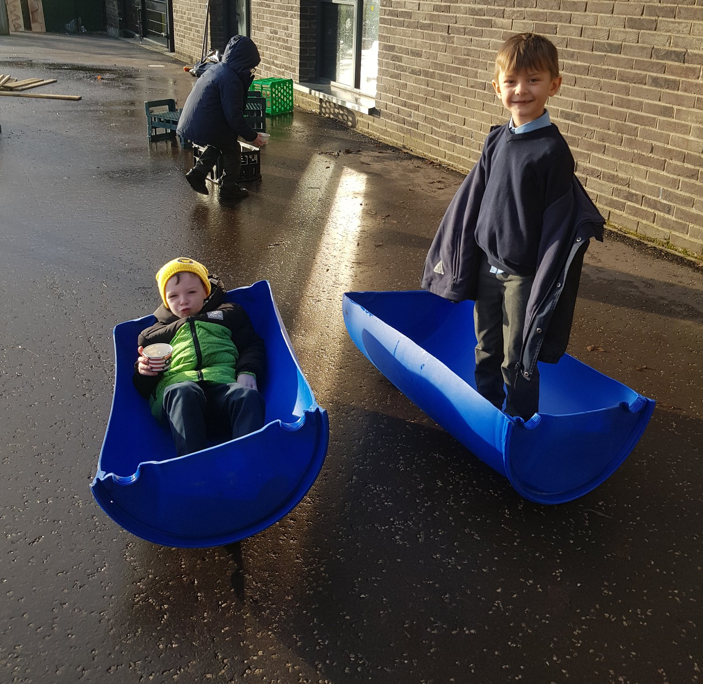
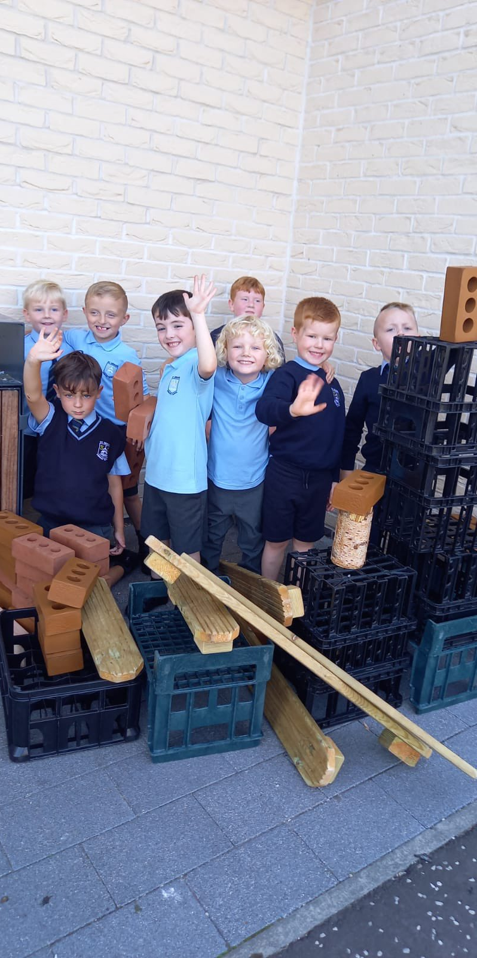
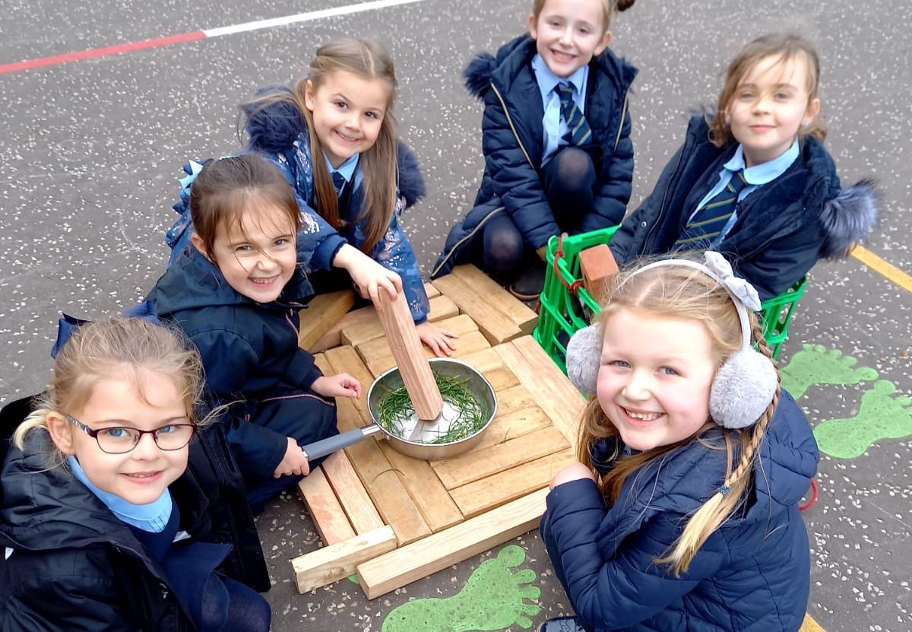
You will do lots of learning outdoors too.

Slide 11
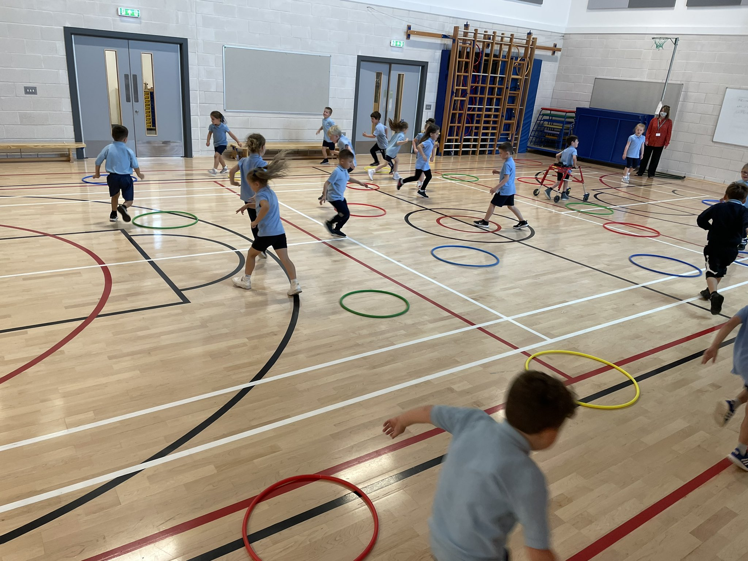
This is the gym hall.

Slide 12
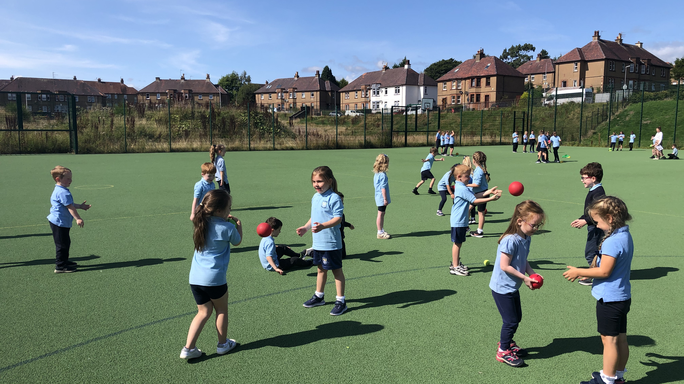
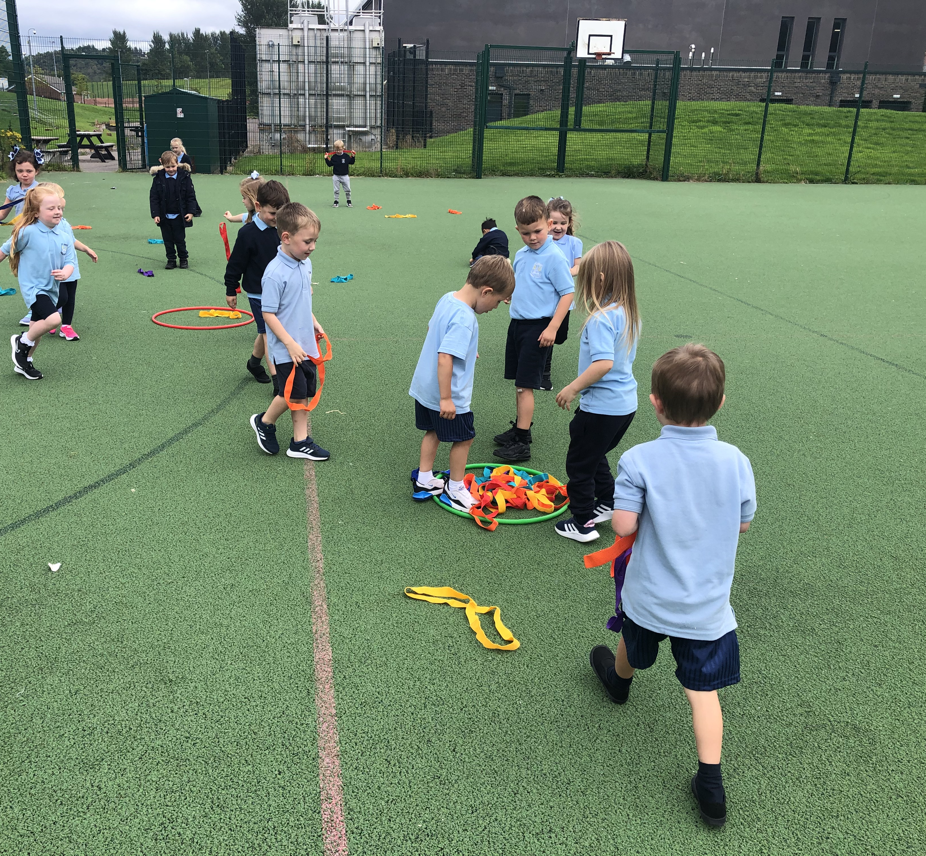
You will do gym on the MUGA too.

Slide 13
You can bring a healthy snack to eat at playtime.

Slide 14
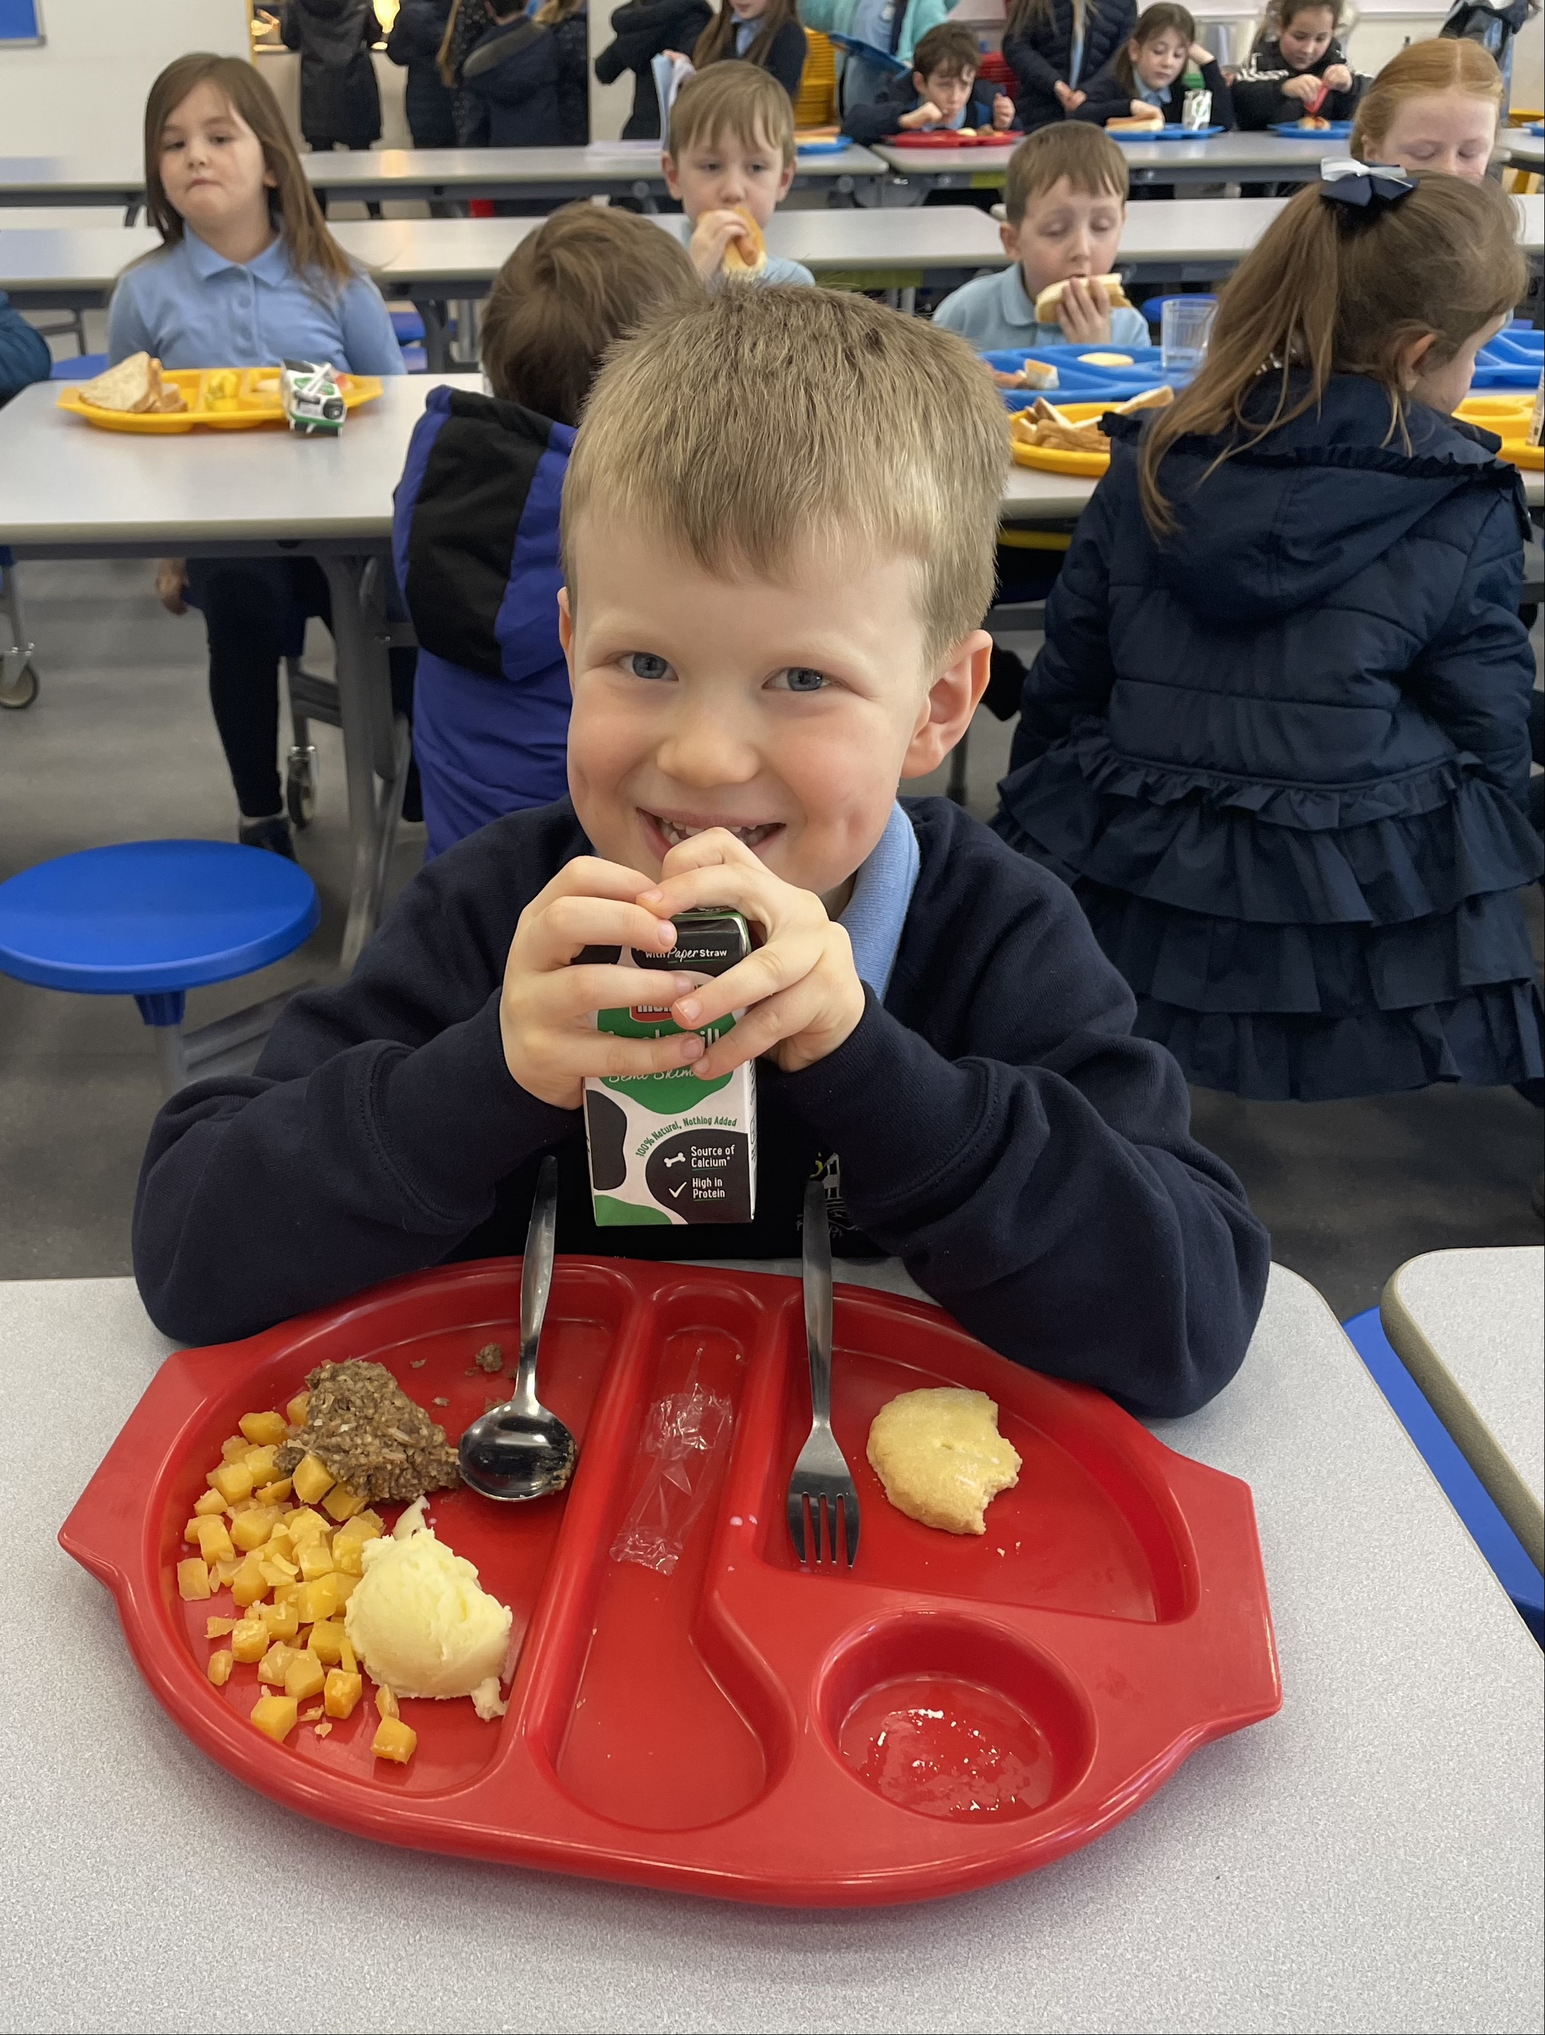
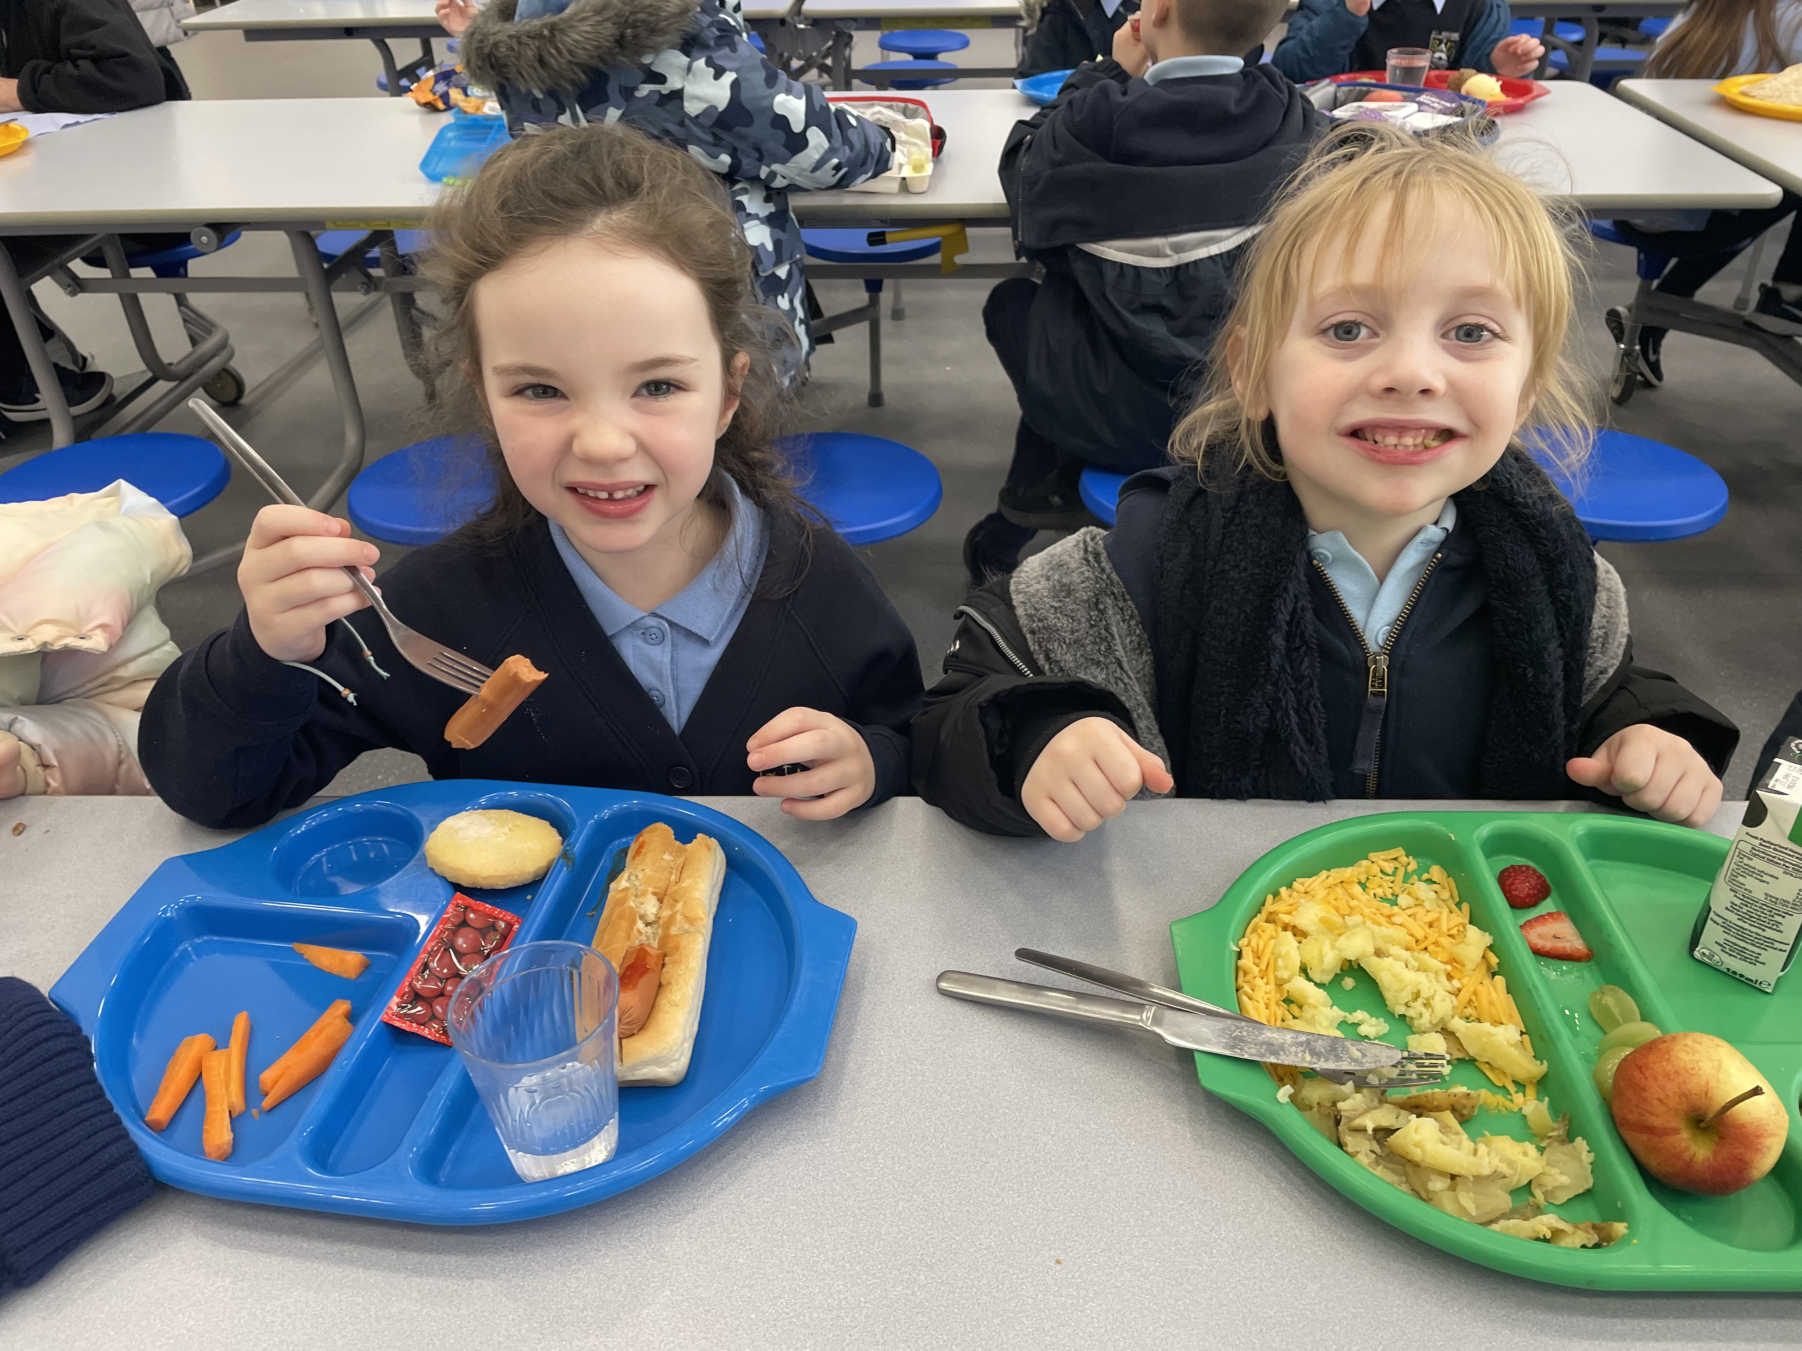
This is the canteen. You can have a school lunch or you can bring a packed lunch.

Slide 15
At home time you will go back up the stairs. Someone you know will be there to collect you.

Slide 16
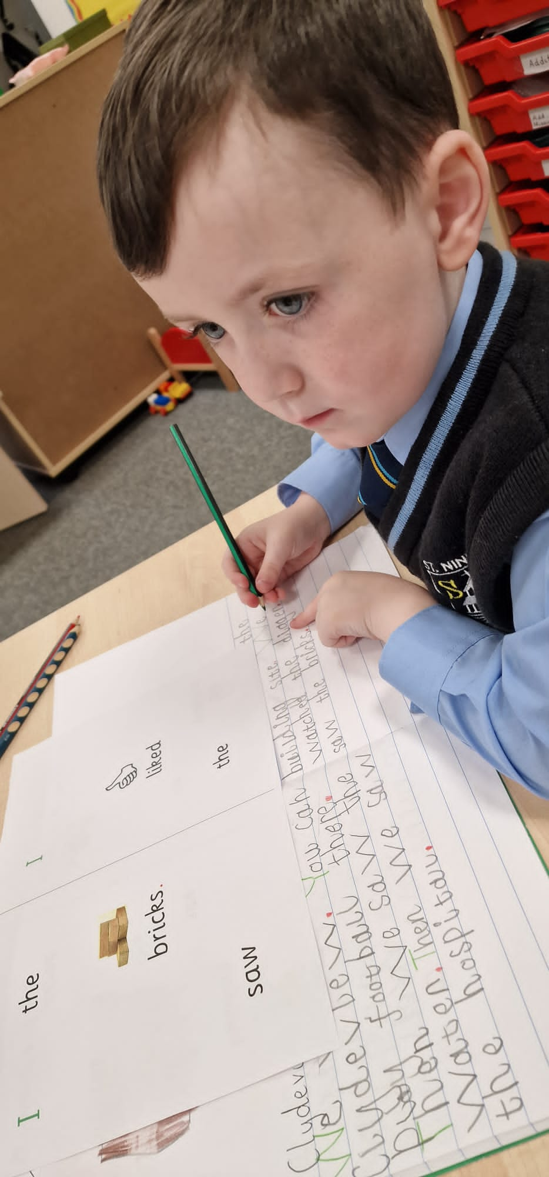
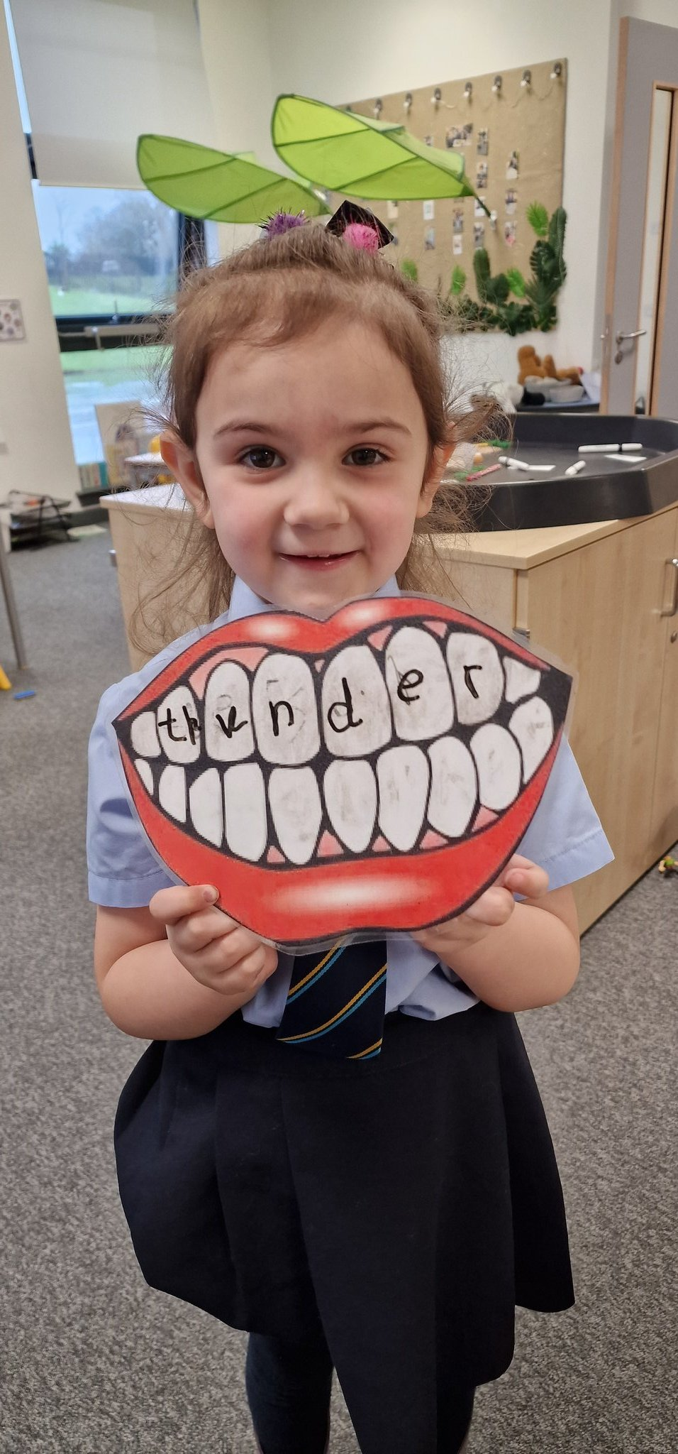
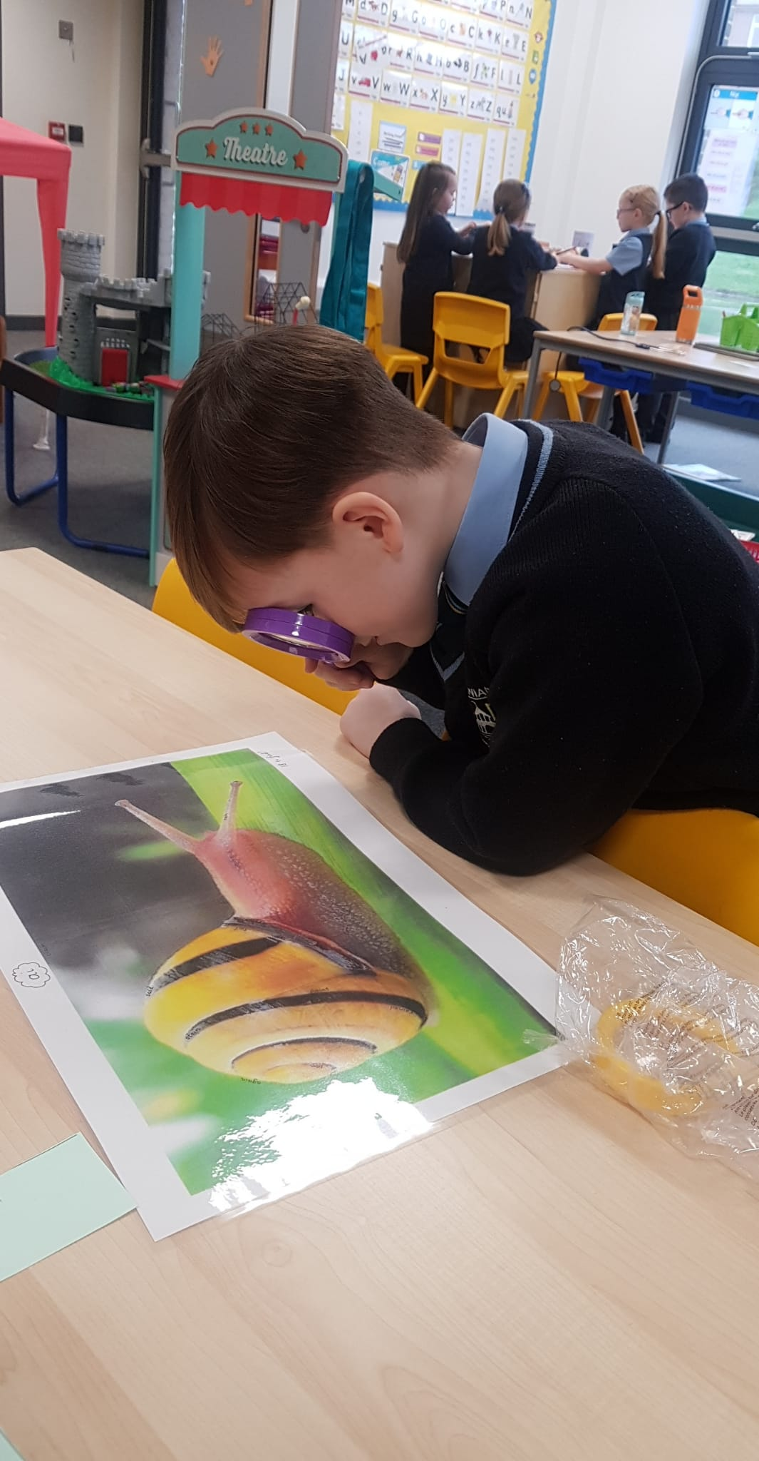
You are going to have so much fun and do lots of great learning in St Ninian’s.

Slide 17
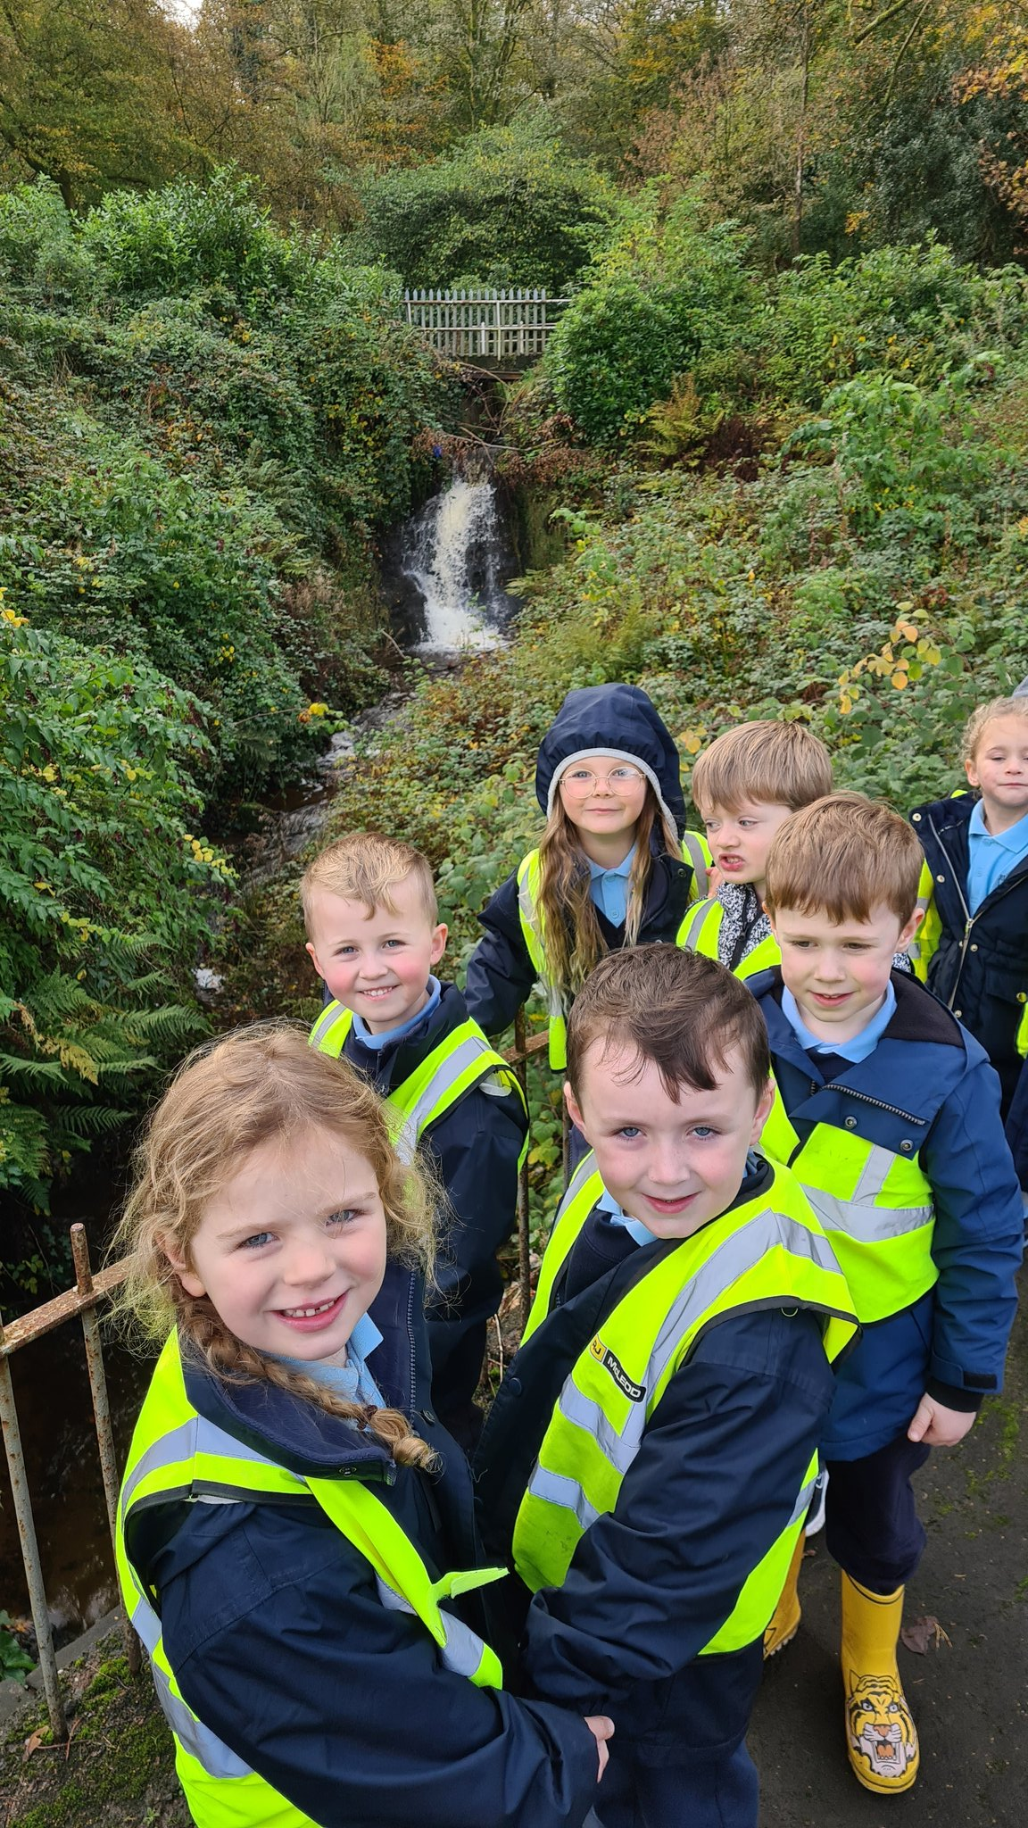
We are looking forward to welcoming you to St Ninian’s

