Slide 1
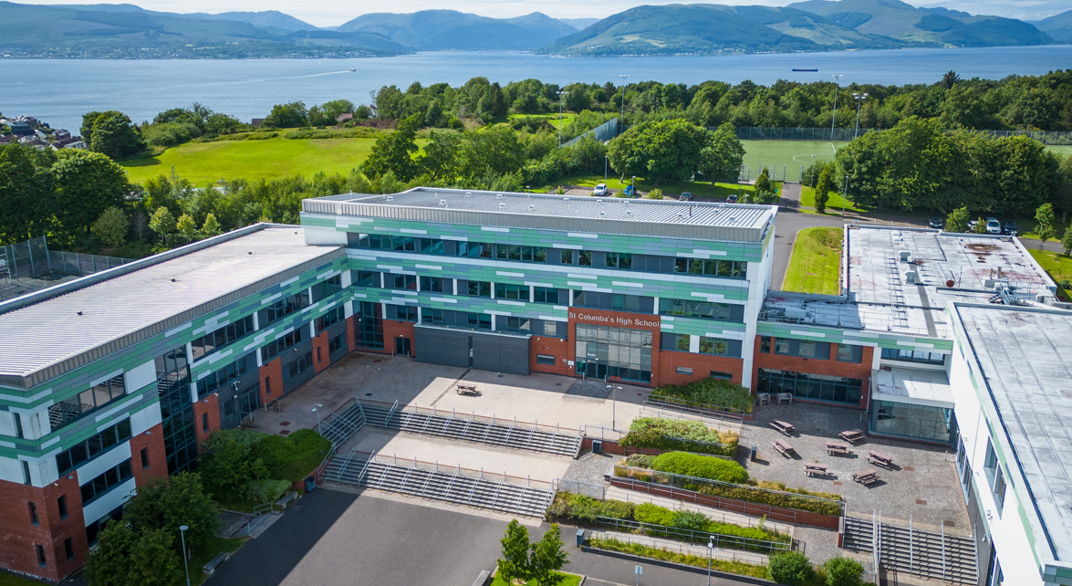


ST COLUMBA’S
FAITH-AMBITION-INCLUSION-PERSEVERANCE
SENIOR PHASE OPTIONS
INFORMATION EVENING: Thursday 6th MARCH 2025

Slide 2

PRAYER
Be Lord Jesus,
a bright flame before me,
a guiding star above me,
a smooth path below me,
a kindly shepherd behind me:
today, tonight and forever.
St. Columba….. Pray for us
ST COLUMBA’S
FAITH-AMBITION-INCLUSION-PERSEVERANCE

Slide 3
HEAD TEACHER’S WELCOME
Mrs Nicola Devine
Head Teacher
ST COLUMBA’S
FAITH-AMBITION-INCLUSION-PERSEVERANCE

Slide 4



SCQF
THE EXPLAINED...
A GUIDE FOR PUPILS & PARENTS
ST. COLUMBA'S HIGH SCHOOL GOUROCK
Notes:
Good evening. I’m Caitlin and I’m one of the SCQF ambassadors.
We are here to raise awareness about what the SCQF is and provide a very brief summary of the framework.
Last year, we achieved Bronze and then Silver SCQF Ambassador status. This year, we have achieved Gold status.
You may recognise the letters and have possibly spotted them on exam certificates. But what do the letters stand for?

Slide 5

S
C
Q
F
Scottish
Credit &
Qualifications
Framework
Notes:
So, what is the SCQF? SCQF stands for the Scottish Credit and Qualifications Framework

Slide 6

Then...
Now...
National 3/4/5
Higher
Advanced Higher
O-Grade
Standard
Grade
Higher
CSYS
NPA
Vocational Qualifications
All have SCQF Credit Points
Notes:
The SCQF helps to promote equality of qualifications. In the past, the only qualifications available were O-grades, Standard grades, Highers and Sixth Year Studies.
Now, all SQA courses and a whole range of other awards and vocational qualifications have SCQF credit points. There are now so many more pathways than there used to be.

Slide 7
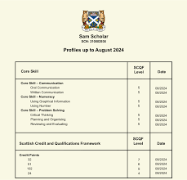
National Qualifications
National 3/4/5/H/AH qualifications
all have an SCQF level
These qualifications develop learners’ knowledge & understanding but also skills
SCQF credit points show how much
learning is involved in achieving each
qualification
One SCQF credit point = 10 hours of learning
SCQF levels and credits are included on
SQA Certificates
Notes:
National qualifications, Highers and Advanced Highers all have SCQF levels.
For example, National 5 is SCQF Level 5, Higher is SCQF Level 6 and Advanced Higher is SCQF Level 7.
There are lots of other qualifications that are not Nationals or Highers that are also levels 5/6/7. You will see these on the option form.
These qualifications don’t just develop learners’ knowledge & understanding but also skills
SCQF credit points show how much learning is involved in achieving each qualification
One SCQF credit point is roughly equivalent to 10 hours of learning.
SCQF levels and credits are included on all SQA Certificates.
I’ll now pass onto Hollie.

Slide 8
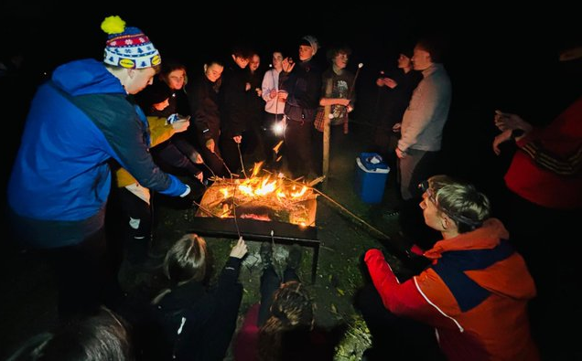


Other programmes/courses
Some other learning programmes that pupils may undertake at school, college or clubs could have an SCQF level and credit points associated with them.
In St. Columba's High School we have an increasing number of wider achievement opportunities available that are on the SCQF.
Notes:
Some other learning programmes that you may undertake at school, college or clubs could have an SCQF level and credit points associated with it e.g. Duke of Edinburgh, Saltire award, Caritas award.
In St. Columba's High School, we have an increasing number of wider achievement opportunities available that are on the SCQF. You will see them all on the options form, for example, Level 5 or 6 awards and National Progression Awards, . We have increased the number of wider achievement awards greatly over the last few years and hope to continue to add to the range of pathways available.
All of the courses available at college are also on the SCQF at different levels.

Slide 9
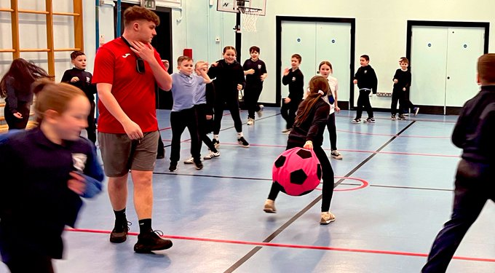
SCQF Points:
Exemplars
Qualification | SCQF credit points | Level
National 4 Biology | 24 | 4
NPA Bakery | 24 | 4
National 5 Spanish | 24 | 5
NPA Photography | 24 | 5
Volunteering Skills (Duke of Edinburgh) | 18 | 5
Higher Drama | 24 | 6
Sports Leadership | 14 | 6
Creative Thinking | 24 | 6
Advanced Higher Maths | 32 | 7
Science Baccalaureate | 104 | 7
Notes:
You can see here the SCQF credit points awarded for different qualifications at different levels.
For example, a National 4 carries 24 credit points at level 4. A Higher carries 24 credit points at level 6. A National Progression award or NPA can carry a range of credit points e.g. NPA photography carries 24 credit points at level 5. The Creative Thinking award carries the same number of points as a Higher.
These are just some examples of what is on offer in our school.
We have leaflets with all of this information on it and you can look up the interactive framework. Come and see us after this presentation to find out more.
I’ll now pass onto Neve.

Slide 10
REASONS WHY WE VALUE THE SCQF:
it helps to embed a culture of AMBITION by
recognising and giving credit for all achievements.
it ensures equal opportunities and parity of esteem
for all young people through the recognition of all types
of qualifications and learning, not just learning that takes
place in the classroom.
it encourages an awareness of different learning options and how they fit with more traditional learning routes.
it provides a flexible approach to meeting the
needs of individuals beyond formal academic
qualifications.
Notes:
Neve –
The SCQF helps to embed a culture of ambition (which is one of our school values). It recognises and gives credit for all achievements and not just formal qualifications gained in the exam hall.
It provides the opportunity for a wide range of flexible and alternative pathways and ensures that ALL young people have their learning and skills development formally recognised.

Slide 11
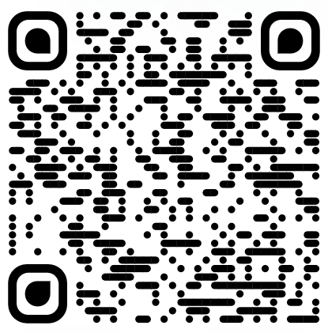
FIND OUT MORE:
(SCQF.ORG.UK)
Notes:
Darsi –
We hope that you now have a clearer understanding of what the SCQF is. We are lucky to have so many varied pathways and opportunities available to us but we also recognise it can all be a bit confusing. So that is where we come in!
If you have any questions about the SCQF, please come and speak to us – we’ll be at this side of the hall – and we have lollipops!
Thank you for listening.

Slide 12
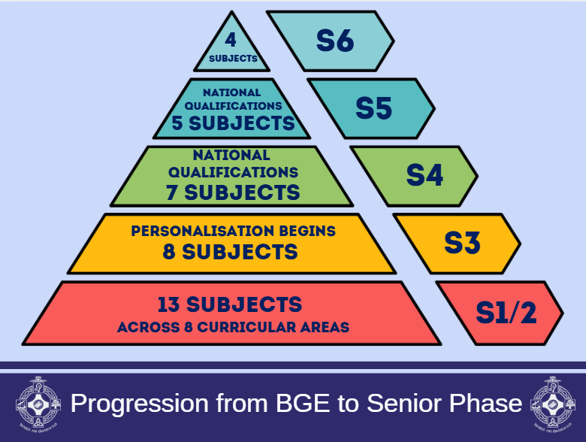

Progression S1-S6
Prayer
Prayer

Slide 13
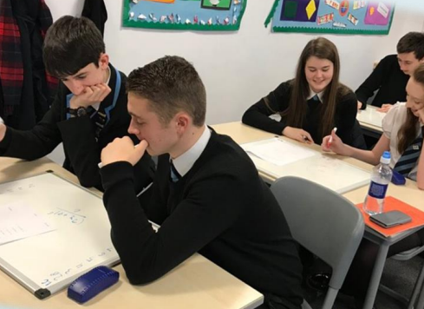
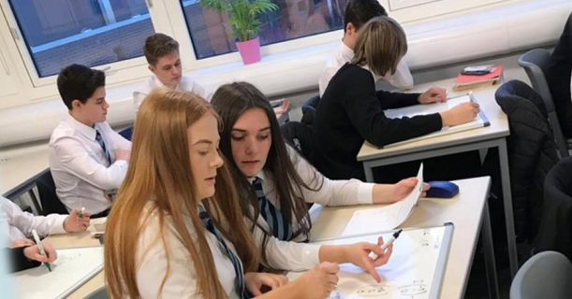
NATIONAL QUALIFICATIONS
National 3, National 4, National 5, Higher and Advanced Higher.
In S4, most pupils will work at National 4 or National 5 Level.
ST COLUMBA’S
FAITH-AMBITION-INCLUSION-PERSEVERANCE

Slide 14
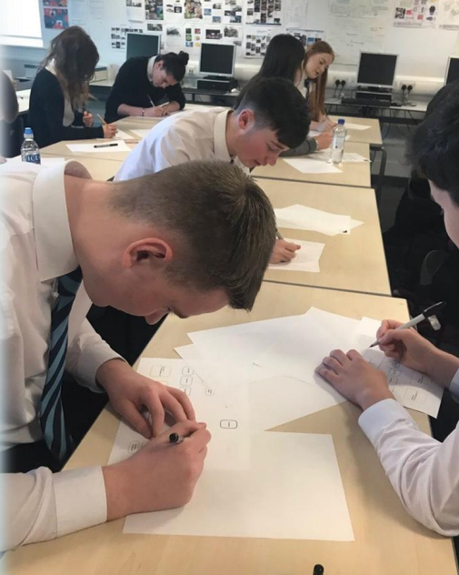
NATIONAL 4
Internally assessed.
No final examination.
Graded as Pass/Fail
Can lead on to further study at National 5.
ST COLUMBA’S
FAITH-AMBITION-INCLUSION-PERSEVERANCE

Slide 15

S4 OPTION CHOICES
7 subjects in S4 for qualifications
Maths and English are compulsory
Pupils must choose 5 additional options from 24 choices
ST COLUMBA’S
FAITH-AMBITION-INCLUSION-PERSEVERANCE

Slide 16
S5 OPTION CHOICES
5 subjects in S5 for qualifications
English or Communication & Literature is compulsory
Pupils must choose 4 additional options from 24 choices
ST COLUMBA’S
FAITH-AMBITION-INCLUSION-PERSEVERANCE

Slide 17
Choose Success
Choices should be based on…
Skills and Strengths
Enjoyment and Interest
If a subject is needed for a career/college/university
Keeping options open
A recommendation of a particular level in that subject
ST COLUMBA’S
FAITH-AMBITION-INCLUSION-PERSEVERANCE

Slide 18
WHAT SHOULD YOU CONSIDER?
Where do you want to go?
University?
College?
Apprenticeship?
Training?
Employment?
Somewhere Else?
ST COLUMBA’S
FAITH-AMBITION-INCLUSION-PERSEVERANCE

Slide 19
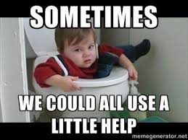
SUPPORT AVAILABLE
Pupils have access to:
Interviews with Careers staff
(Michelle Purdue, Stephanie
Stinson)
The support of our Developing the Young Workforce (DYW)
Coordinator (Joyce Little)
Guidance Interviews
ST COLUMBA’S
FAITH-AMBITION-INCLUSION-PERSEVERANCE

Slide 20

New Courses
We are delighted to offer a range of new courses for pupils in the Senior Phase at a variety of different levels.
These courses will provide pupils with an increasing range of opportunities to gain accreditation and develop skills for the future.
ST COLUMBA’S
FAITH-AMBITION-INCLUSION-PERSEVERANCE

Slide 21
New Courses
Barista and Bakery (S5/6)
Creative Thinking (S5/6)
Criminology
Lab Skills
Mental Health and Wellbeing (S5/6)
Music Tech
NPA Drama (S5/6)
N5 RMPS
Sport & Fitness (S5/6)
Travel & Tourism
ST COLUMBA’S
FAITH-AMBITION-INCLUSION-PERSEVERANCE

Slide 22
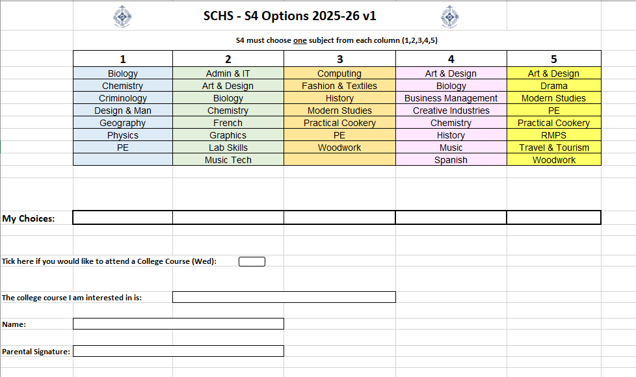

Slide 23
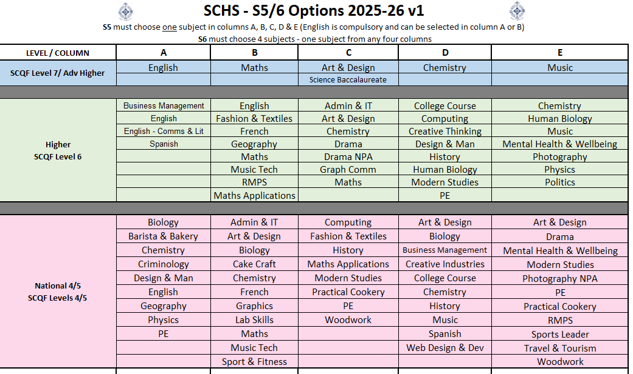

Slide 24
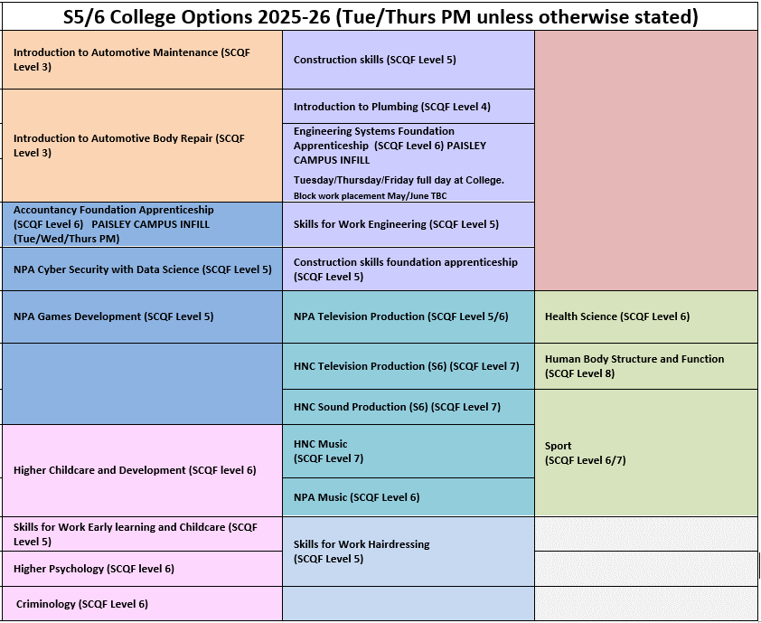

Slide 25
Levels of Accreditation
Each of these courses will offer accreditation on the SCQF Framework as discussed by our young people at the start of our presentation
ST COLUMBA’S
FAITH-AMBITION-INCLUSION-PERSEVERANCE

Slide 26
Decisions Ahead
ST COLUMBA’S
FAITH-AMBITION-INCLUSION-PERSEVERANCE

