Slide 1

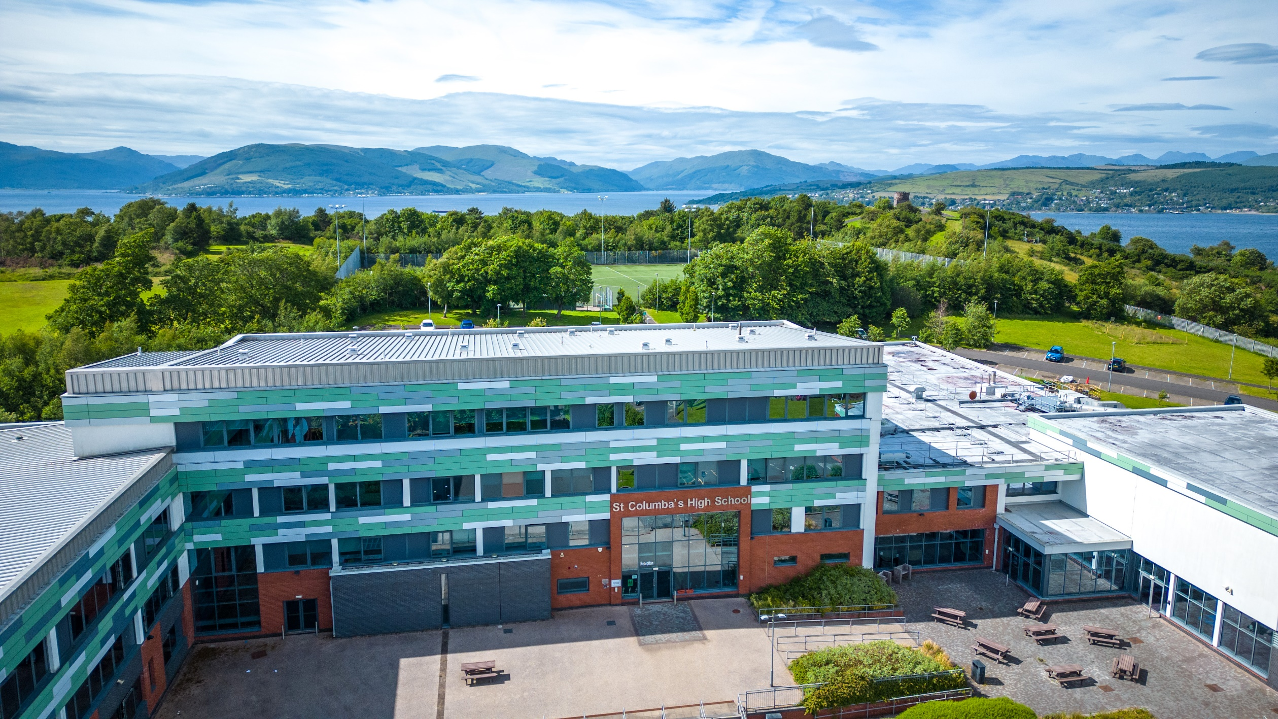
Family Study Skills Workshop – October 2024
Notes:
ND

Slide 2



Prayer
Our Father, who art in heaven,
hallowed be Thy name.
Thy kingdom come, Thy will be done,
on earth, as it is in heaven.
Give us this day our daily bread
and forgive us our trespasses,
as we forgive those who trespass against us;
And lead us not into temptation,
but deliver us from evil.
Amen
St. Columba……….pray for us.
Faith
Ambition
Inclusion
Perseverance

Slide 3

Introduction – Mr McLean
‘Words of Wisdom’ – Darsi McIntyre
S6 Study Programme – Miss Goodfellow
Effective revision strategies and how parents can help – Mrs McGeehan
Study Planning – Mrs Mitchell
Using ‘Achieve’ online revision platform –Mrs Mitchell
Opportunity to discuss subject-specific revision strategies with teachers
Faith
Ambition
Inclusion
Perseverance

Slide 4

National 5 Prelims from 2nd – 13th December 2024
Higher and Advanced Higher Prelims from 7th – 17th January 2025
Supported study starts after October break
S4 Parents’ Evening for S4 -Thursday 14th November 2024
S5/6 Parents’ Evening for S5/6 -Wednesday 20th November 2024
Further tracking reports will be issued in January and March 2025.
Faith
Ambition
Inclusion
Perseverance

Slide 5

Words of Wisdom
Darsi McIntyre - S5
Faith
Ambition
Inclusion
Perseverance

Slide 6
S6 Study Programme
Ms Goodfellow
Faith
Ambition
Inclusion
Perseverance

Slide 7



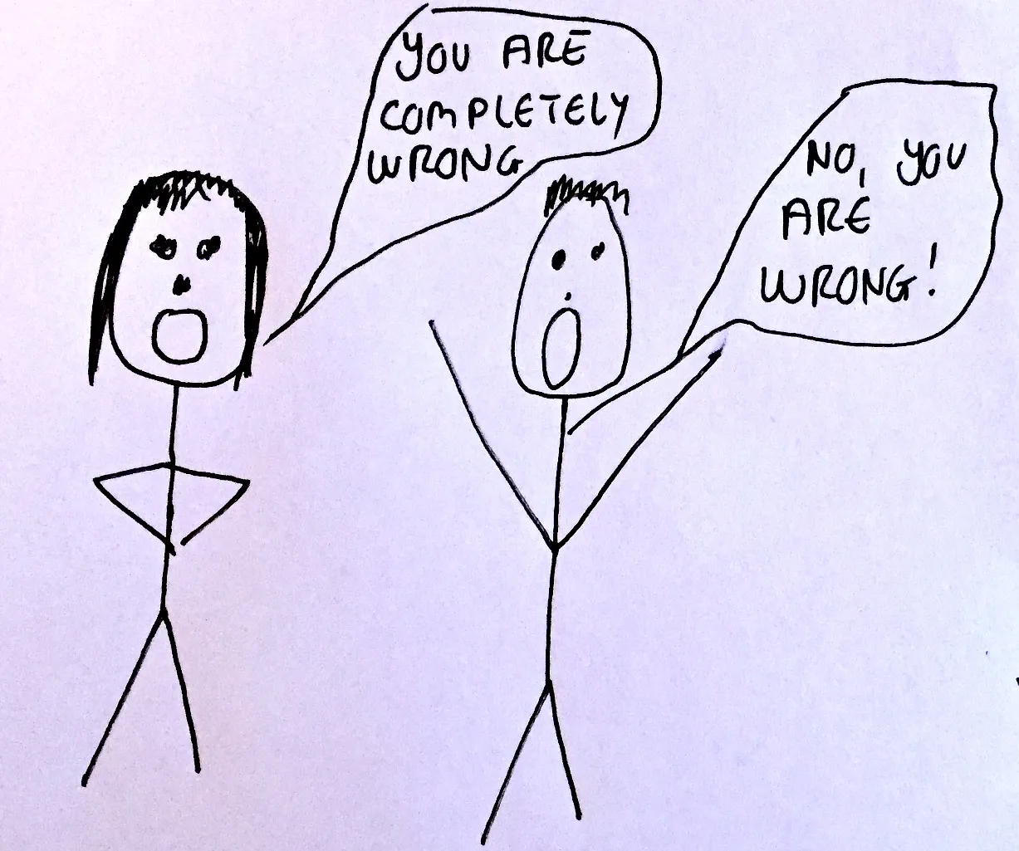

How do you currently feel about helping your child to study?
Write your answers on a PINK flashcard

Slide 8
When you think about studying………which of the following slides do you relate to the most?

Slide 9
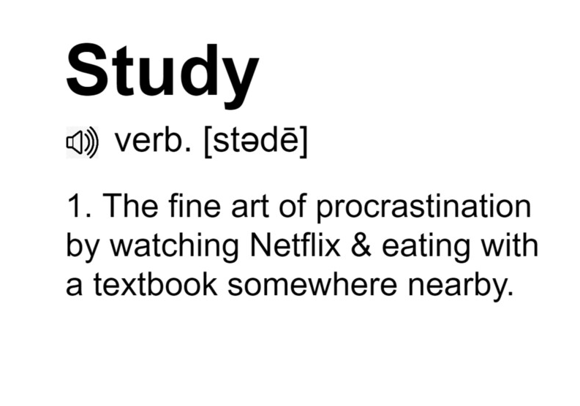

Slide 10
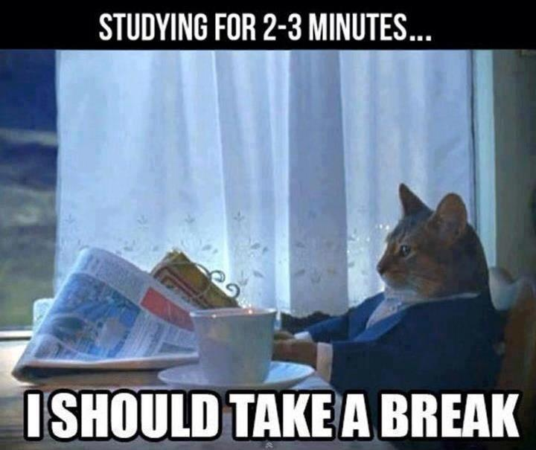

Slide 11


Slide 12


Slide 13
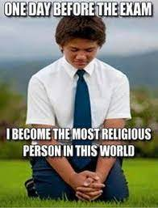

Slide 14
Mrs McGeehan
Faith
Ambition
Inclusion
Perseverance

Slide 15
Memory
You will be given 30 seconds to look at a list of 22 words.
How many will you be able to recall?

Slide 16
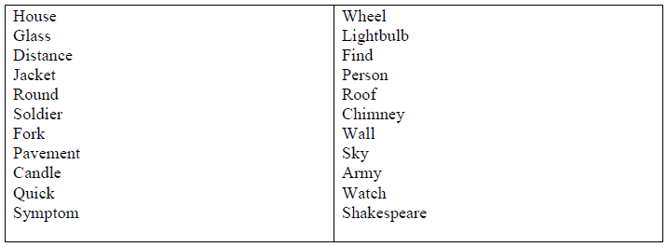
Memory Test (30sec)

Slide 17
How many can you recall?

Slide 18
How did you do?

Slide 19
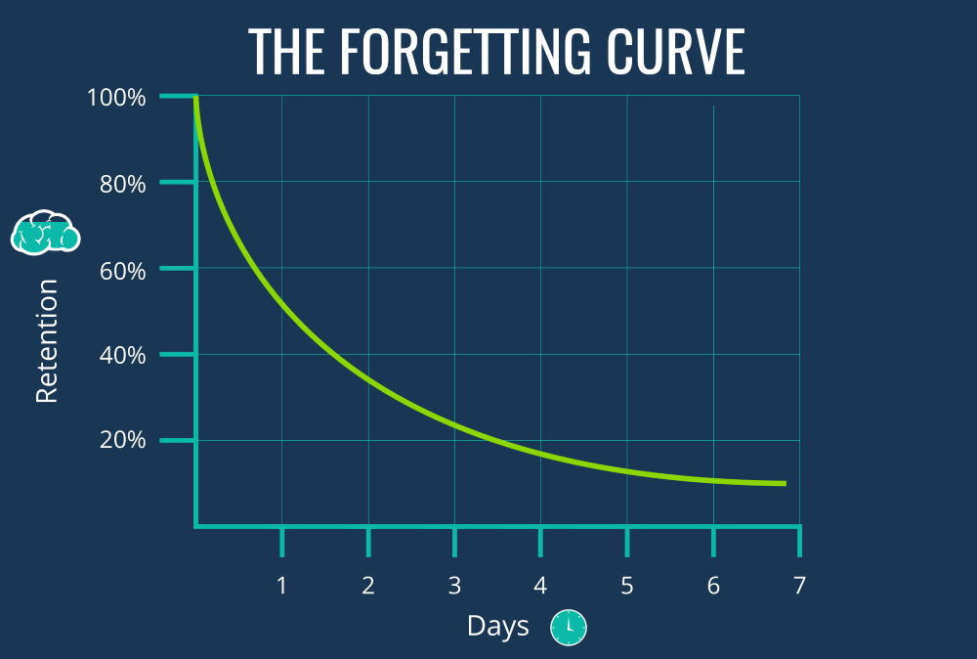
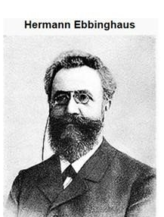
Don’t worry! Our short term memory is only designed to hold a few things at a time.

Slide 20
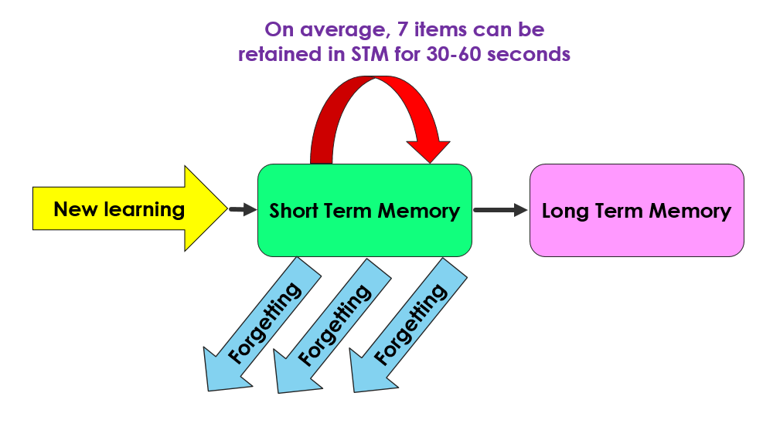
The Challenge…

Slide 21
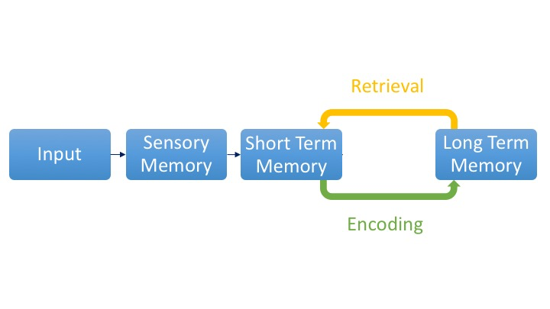
Transferring information from
STM to LTM
Rehearsal
Organisation
Elaboration

Slide 22
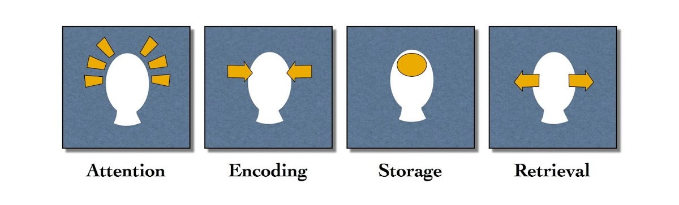
How we learn

Slide 23

What is the most effective way to study?
Spaced Practice
Retrieval Practice

Slide 24
Spaced Practice is…
The opposite of cramming!

Slide 25



Spaced Practice

Slide 26
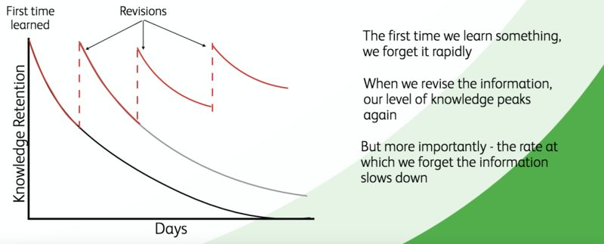
Overcoming the forgetting curve with Spaced Practice

Slide 27


Slide 28
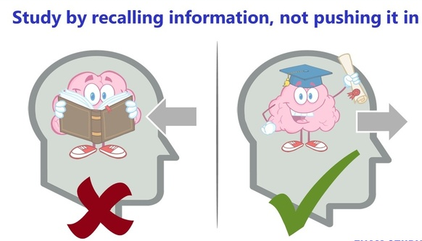
Retrieval Practice

Slide 29
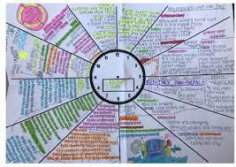







Retrieval Practice

Slide 30


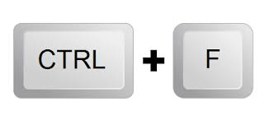
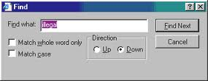

Exam Questions

Slide 31
Mrs Mitchell
Faith
Ambition
Inclusion
Perseverance

Slide 32

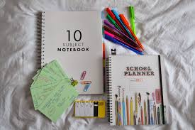


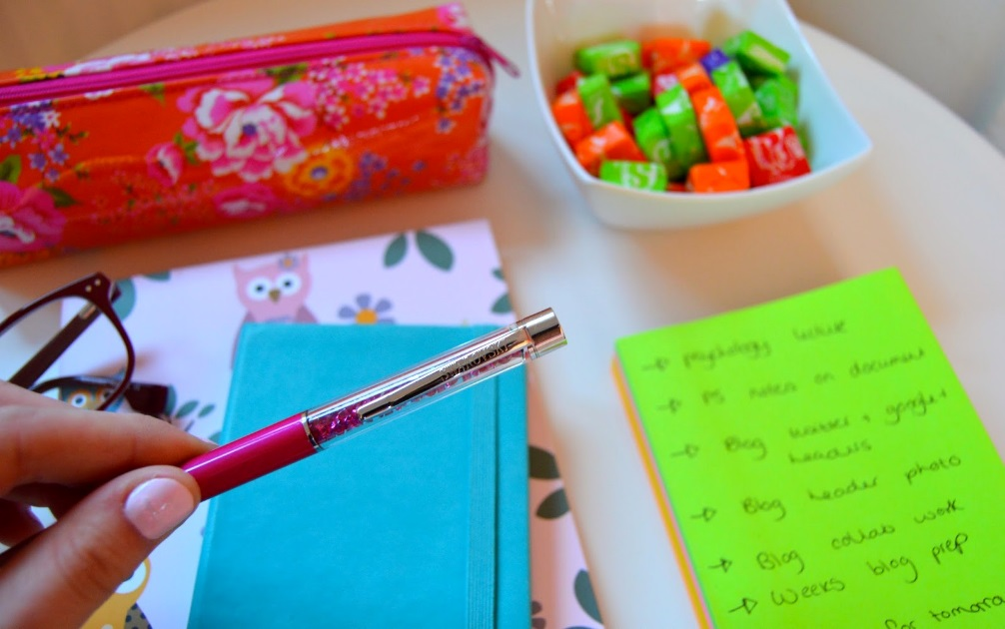
Before you start…

Slide 33

Whilst this may be tempting…..
it would be impossible!
You need to ensure that your plan is balanced and achievable.

Slide 34
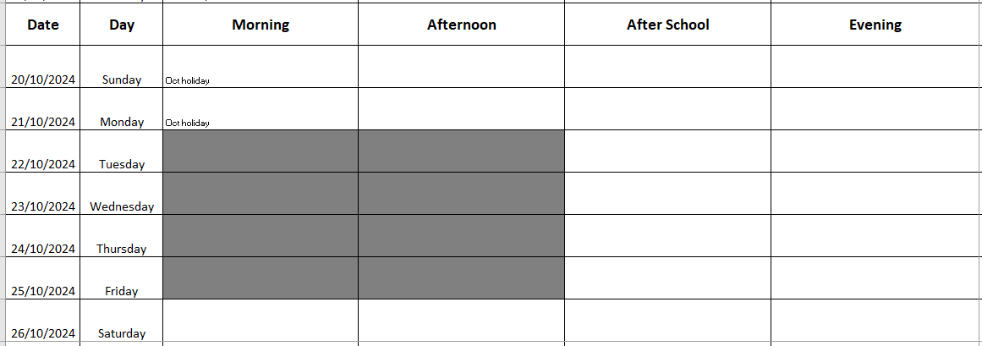
Study Plan(Oct week–Christmas)

Slide 35

Managing your time…
When planning your time you
need to consider the following:
Does your plan cover ALL subjects?
Does it include time for homeworks/assignments?
Have you factored in other commitments?
Have you planned breaks, rests, sleeps?

Slide 36


How can parents/family members help?

Slide 37
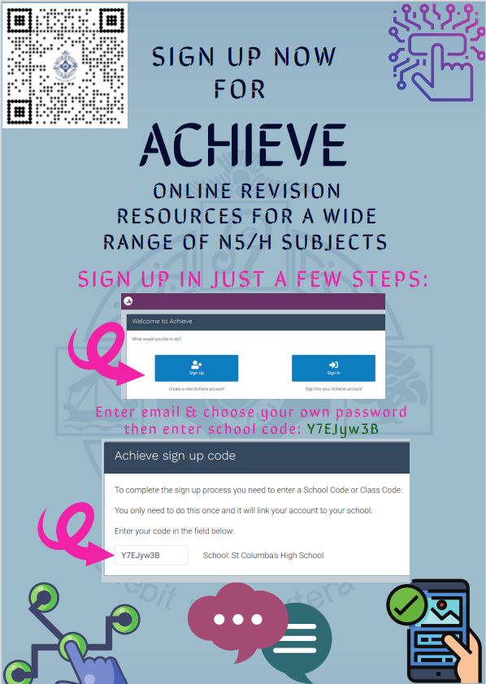
ACHIEVE

Slide 38
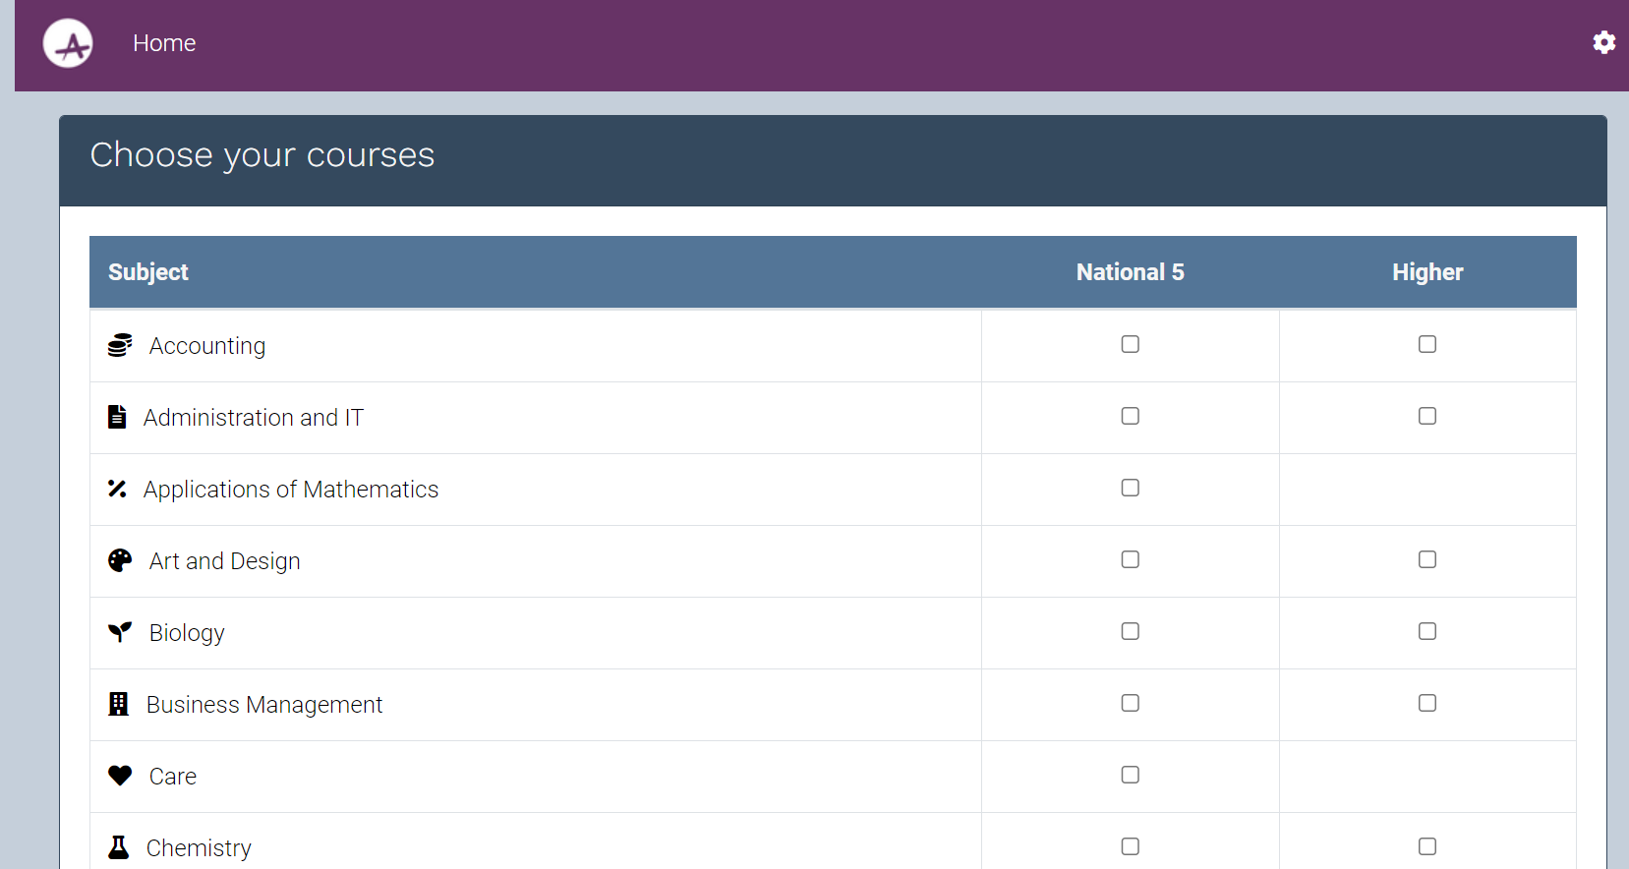
31 different subjects covered.
Most at N5 AND Higher.

Slide 39
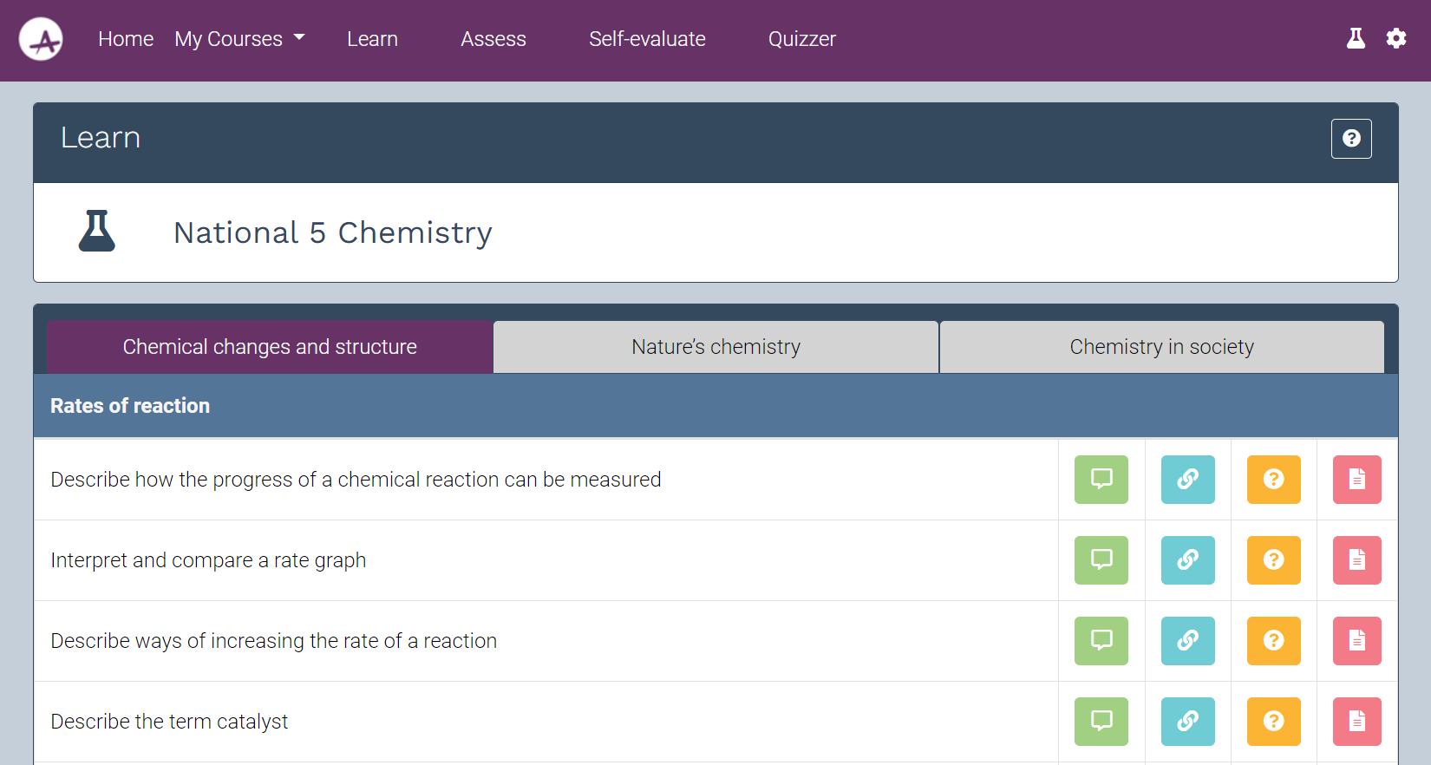
Explanation
Links
Questions
Past Papers

Slide 40

Subject–specific revision advice

Slide 41

How do you feel NOW about helping your child to study?
Please write your answers on a GREEN flashcard on the way out!

