Slide 1
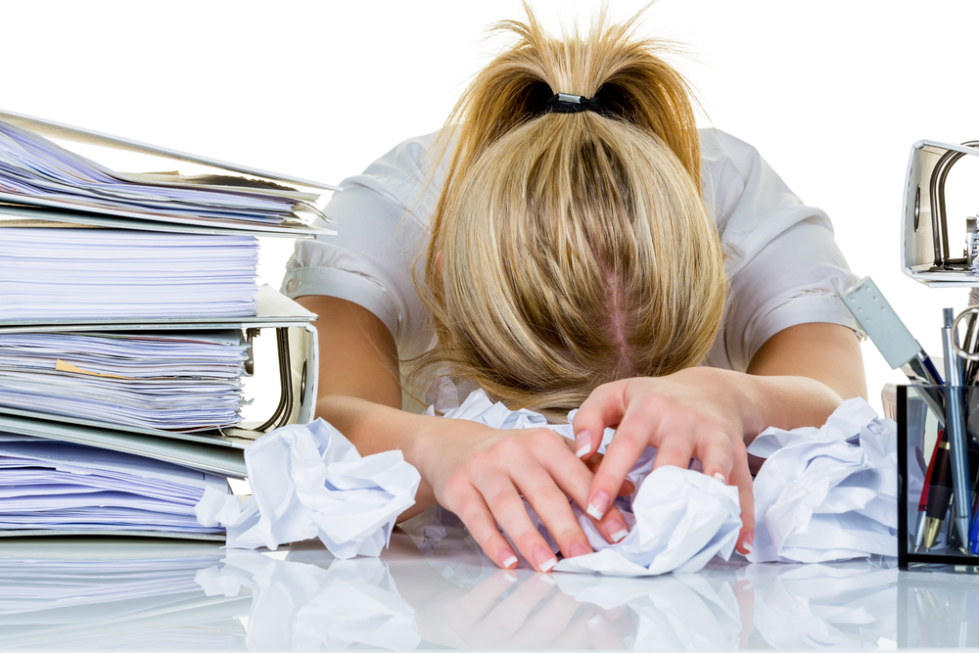
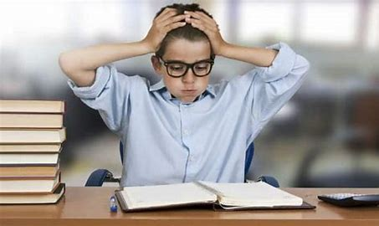
Dealing with Exam stress/anxiety

Slide 2
What does exam stress look/feel like?
Cognitive Symptoms
Memory problems
Poor Concentration
Poor Judgement
Negative thoughts
Anxiety
Worry
Nervousness
Emotional Symptoms
Moodiness
Irritable/Temper
Agitation
Feeling overwhelmed
Loneliness
Isolation
Unhappiness
Physical Symptoms
Muscle Tension
Aches
Stomach problems
Nausea
Dizziness
Chest pain
Racing heart
Colds and allergies
Behavioural Symptoms Appetite changes Sleep changes Social withdrawal Procrastination Avoiding responsibility Substance abuse Nervous habits

Slide 3
The ChildLine National Exam Stress Survey revealed that:
96% of students feel anxious about exams
(no matter what your friends say they ARE stressed too)
59% of students feel pressure from family
64% of students would like more support with exams and exam stress

Slide 4
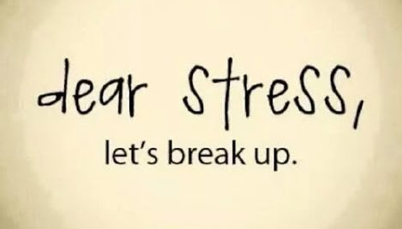
Exam anxiety and stress is NORMAL…
Don’t worry over your worry. That just adds to your stress, take power and be proactive…
You ARE in control!
https://www.youtube.com/watch?v=hnpQrMqDoqE
Notes:
https://www.youtube.com/watch?v=pvM_TtQi9DU

Slide 5
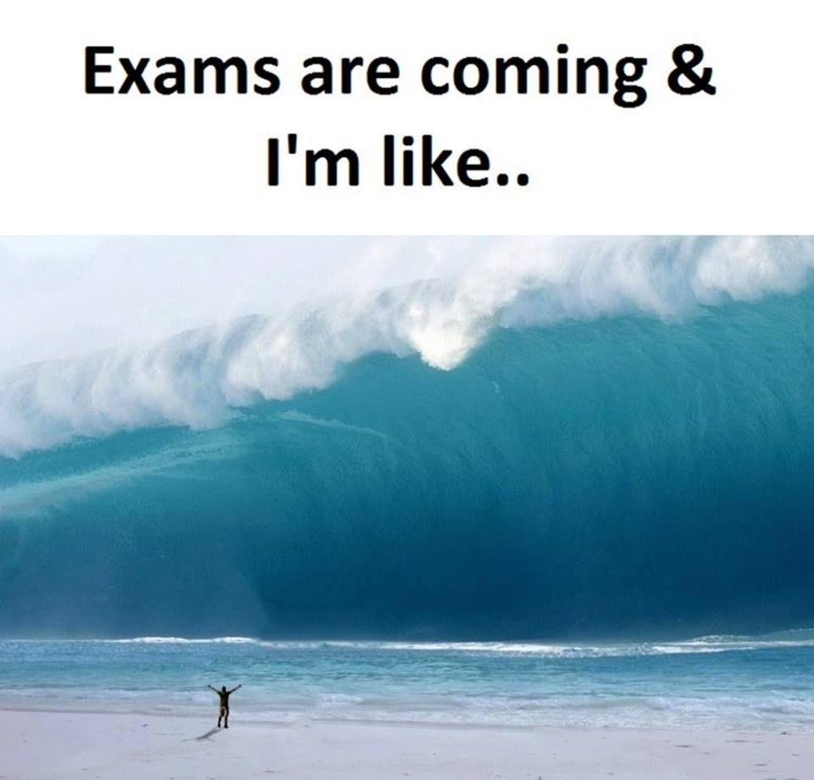
The best way to deal with stress is to feel in control!
One way of dealing with stress is removing the thing that causes you stress.
However, that is not always possible.
Notes:
https://prezi.com/jicorm7d7vkw/are-you-being-smart/?utm_campaign=share&utm_medium=copy

Slide 6
Focus on what you DO know and CAN do…..
Notes:
https://prezi.com/jicorm7d7vkw/are-you-being-smart/?utm_campaign=share&utm_medium=copy

Slide 7
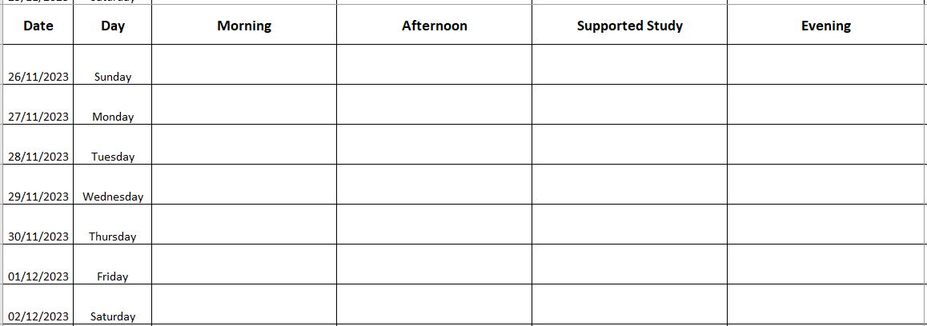
Make a plan – but include breaks!
Notes:
https://prezi.com/jicorm7d7vkw/are-you-being-smart/?utm_campaign=share&utm_medium=copy

Slide 8
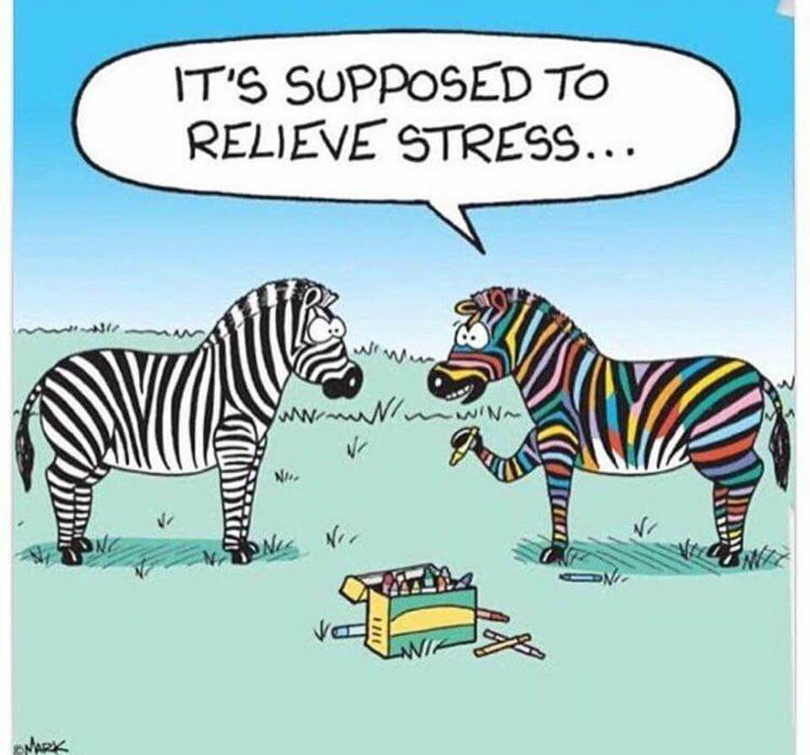
Do something to relax….
Notes:
https://prezi.com/jicorm7d7vkw/are-you-being-smart/?utm_campaign=share&utm_medium=copy

Slide 9
When you feel yourself becoming overwhelmed or thinking negative thoughts…..
STOP – pause for a moment
Take a breath – a slow controlled breath
Observe – notice your thoughts/feelings
Pull Back – what’s another way of looking at this?
Proceed – decide on best response and do it

Slide 10
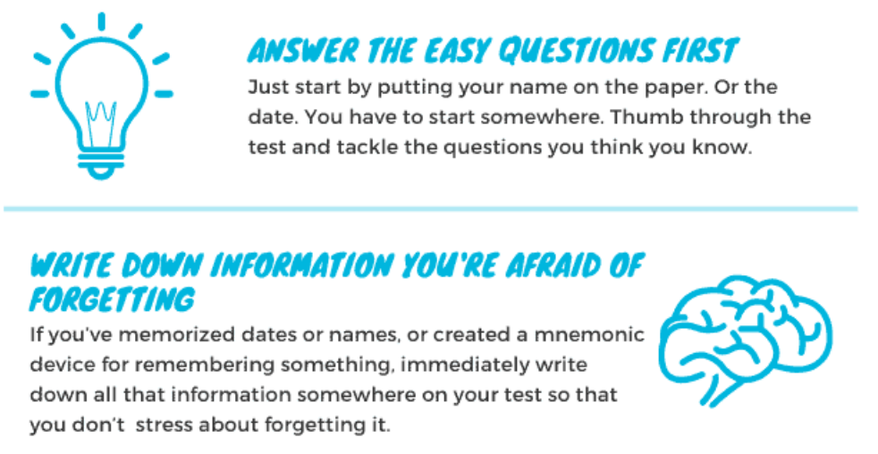
In the exam….

Slide 11
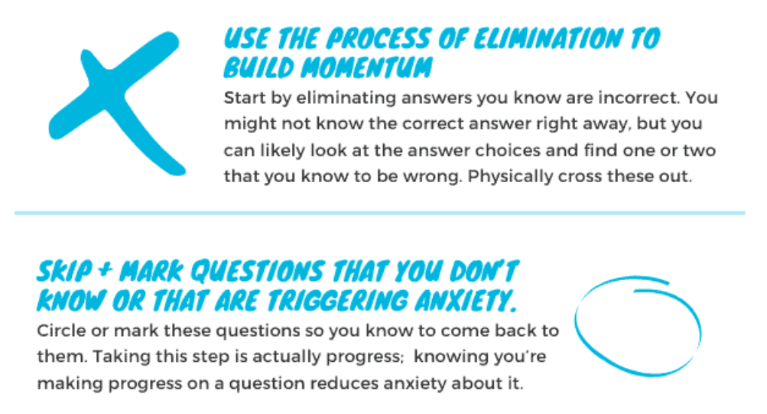
In the exam….

Slide 12
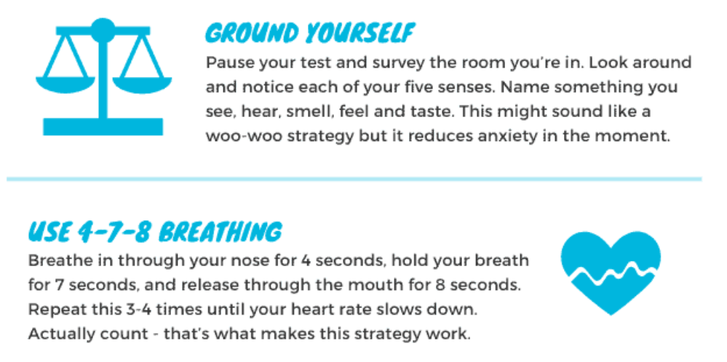
In the exam….

Slide 13
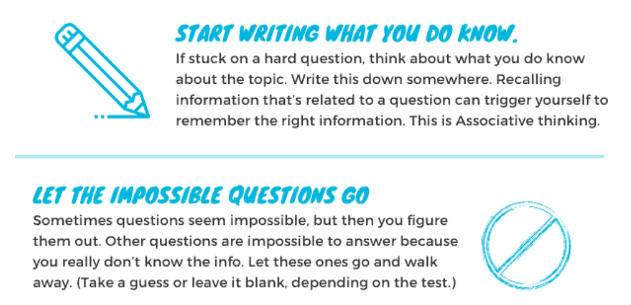
In the exam….

Slide 14
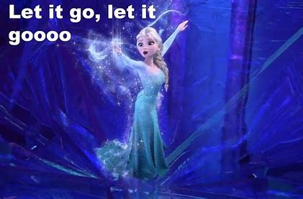
After the exam….
Have a rest…..regroup…..look ahead….

Slide 15
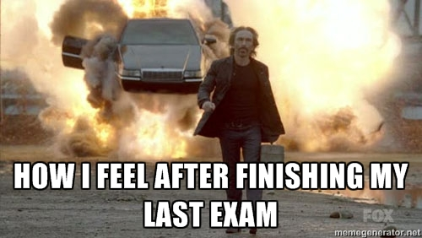
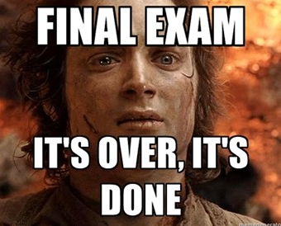
Exams won’t last forever…

