Slide 1
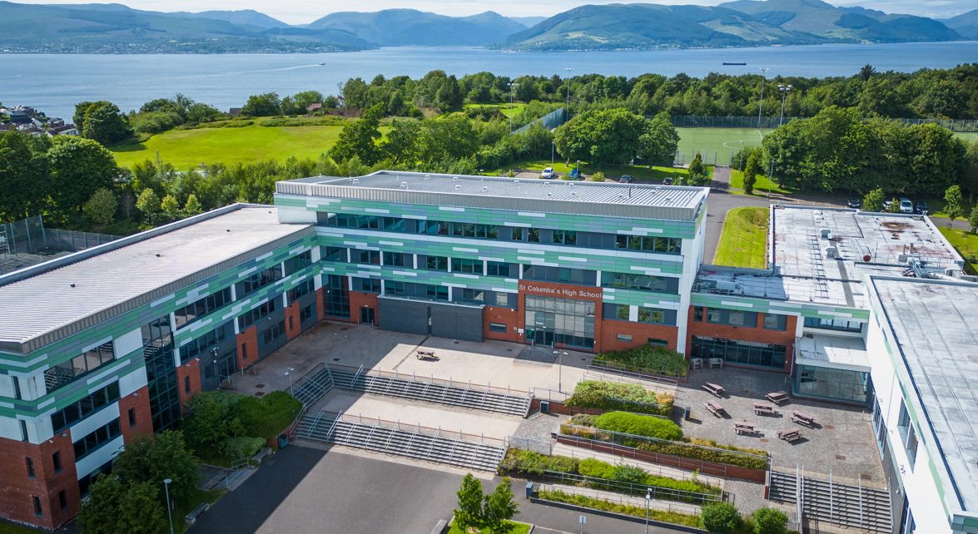
ST COLUMBA’S
FAITH-AMBITION-INCLUSION-PERSEVERANCE
S4 OPTIONS 2023
A GUIDE FOR PUPILS AND PARENTS

Slide 2
FROM BGE TO SENIOR PHASE
Broad General Education (BGE)
Senior Phase (S4/5/6)
ST COLUMBA’S
FAITH-AMBITION-INCLUSION-PERSEVERANCE

Slide 3
TRANSITION AND PROGRESSION
S6
4/5 Subjects plus RE
Senior Phase
National Qualifications
S5
5 Subjects plus RE
6 Subjects Including RE and Core PE
S4
S3
Some personalisation across 8 Curricular Areas
BGE
CfE
S1 & S2
13 Subjects across 8 Curricular Areas
ST COLUMBA’S
FAITH-AMBITION-INCLUSION-PERSEVERANCE

Slide 4
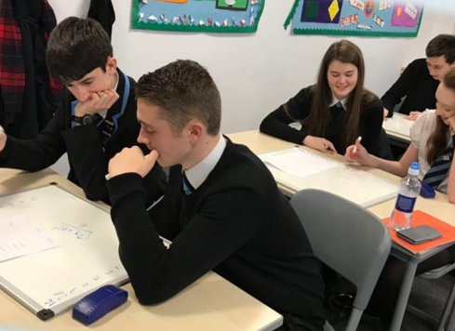
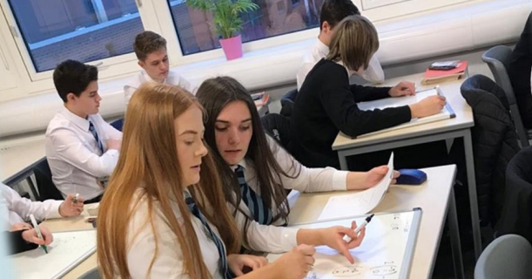
NATIONAL QUALIFICATIONS
National 3, National 4, National 5, Higher and Advanced Higher.
In S4, most pupils will work at National 4 or National 5 Level.
ST COLUMBA’S
FAITH-AMBITION-INCLUSION-PERSEVERANCE

Slide 5
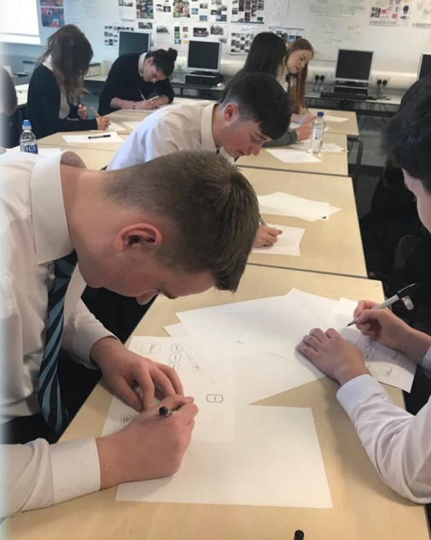
NATIONAL 4
Internally assessed.
No final examination.
Graded as Pass/Fail
Can lead on to further study at National 5.
ST COLUMBA’S
FAITH-AMBITION-INCLUSION-PERSEVERANCE

Slide 6
OPTION CHOICES
6 subjects in S4 for qualifications
Maths and English are compulsory
Pupils must choose 4 additional options from 24 choices
This is a free choice at this stage
ST COLUMBA’S
FAITH-AMBITION-INCLUSION-PERSEVERANCE

Slide 7
WHAT SHOULD YOU CONSIDER?
Where do you want to go?
University?
College?
Apprenticeship?
Training?
Employment?
Somewhere Else?
ST COLUMBA’S
FAITH-AMBITION-INCLUSION-PERSEVERANCE

Slide 8
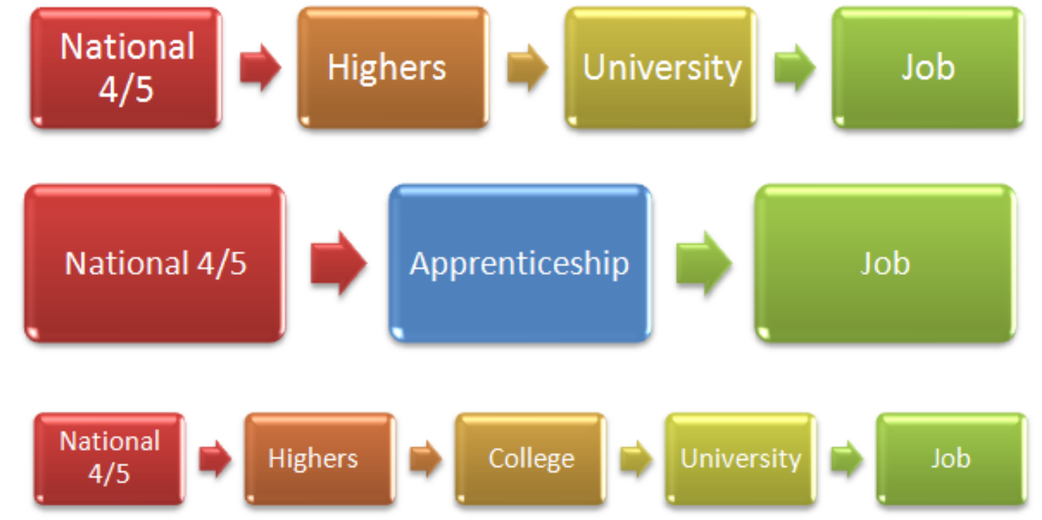
HOW WILL YOU GET THERE?
ST COLUMBA’S
FAITH-AMBITION-INCLUSION-PERSEVERANCE

Slide 9
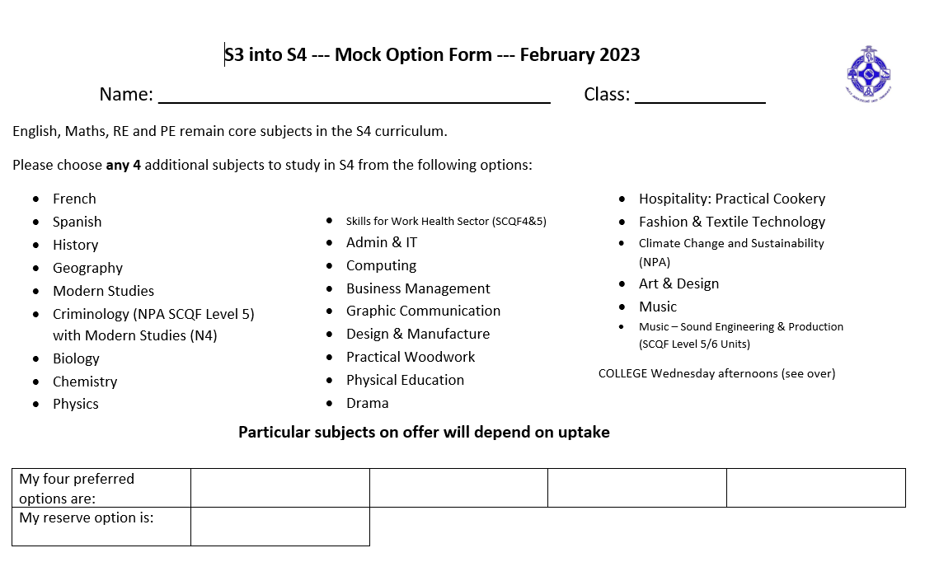

Slide 11
WHICH WAY NOW?
ST COLUMBA’S
FAITH-AMBITION-INCLUSION-PERSEVERANCE

Slide 12
Choose Success
Choices should be based on…
Skills and Strengths
Enjoyment and Interest
If a subject is needed for a career/college/university
Keeping options open
A recommendation of a particular level in that subject
ST COLUMBA’S
FAITH-AMBITION-INCLUSION-PERSEVERANCE

