Slide 1
ST. COLUMBA’S HIGH SCHOOL
FAITH. AMBITION. INCLUSION. PERSEVERANCE.
S2 INTO S3 OPTIONS 2023
KEY INFORMATION FOR PUPILS AND PARENTS

Slide 2
S2 OPTIONS 2023
Dear Parent,
S2 pupils will soon be making their options choices for S3.
This can be a challenging time for young people and we think it is important that they are given as much information as possible to help them to make sensible and informed decisions.
This booklet is designed to outline the rationale behind our curriculum offering in S3 and to provide pupils and parents with some guidance around how to pick subjects most effectively.
This booklet will also outline where you can access useful information to support your child as they make these choices.
School staff will be on hand to provide support and guidance to pupils throughout the options process. Please do not hesitate to contact us at the school should you have any questions or require any additional information.
Thank you, as always, for your continued support.
Mr I McLean
Depute Head Teacher
FAITH. AMBITION. INCLUSION. PERSEVERANCE.

Slide 3
WHERE ARE WE NOW?
We have created an options form which provides pupils with a range of choices and pathways in their S3 studies and beyond.
S2 Report
In March, pupils will be issued with their S2 Report. This will provide comments from teachers about progress and effort in class.
Pupils should use the information in this report, and the feedback from teachers, to support them as they select their options for S3.
FAITH. AMBITION. INCLUSION. PERSEVERANCE.

Slide 4
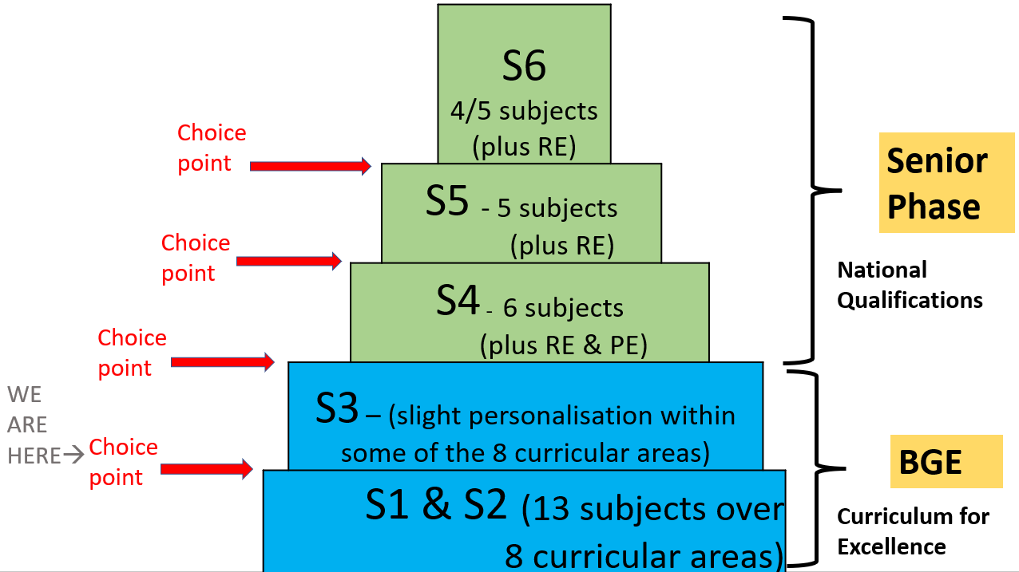
PROGRESSION
Progression
S2 into S3 Options choices are the first in a range of subject choices that pupils will make.
As they move into S4, pupils will be asked to confirm the six subjects that they will study as part of their National Qualifications.
Pupils will then have the opportunity in S5 and S6 to specialise in certain subjects, as well as return to subjects that they had studied earlier in their school career.
Even at this early stage, pupils should consider where their chosen subjects could take them.
FAITH. AMBITION. INCLUSION. PERSEVERANCE.

Slide 5
CURRICULUM DESIGN
Curriculum for Excellence
‘The Curriculum for Excellence has been introduced to raise standards of learning and teaching for all 3 to 18 year olds. It aims to help prepare children and young people with the knowledge and skills they need in a fast changing world’. Scottish Government
In line with the framework of Curriculum for Excellence, the Broad General Education (S1-S3) provides a focus on skills development for pupils across eight curricular areas.
In S3, pupils have the opportunity to add an element of Personalisation and Choice to their curriculum. We encourage pupils to pick a range of subjects across curricular areas.
Languages and Literacy
Mathematics and Numeracy
Sciences
Social Studies
Expressive Arts
Technologies
Religious and Moral Education
Health and Wellbeing
FAITH. AMBITION. INCLUSION. PERSEVERANCE.

Slide 6
CURRICULUM DESIGN
Compulsory Subjects
All pupils will study certain core subjects in S3.
All pupils will study:
English
Mathematics
Physical Education
Religious Education
Citizenship/PSHE
Pupils will then be offered a choice of subjects across five curricular areas:
Pupils should ensure that the subjects they choose cover as many of the curricular areas as possible.
Languages and Literacy | French, Spanish
Sciences | Biology, Chemistry, Physics
Social Studies | Geography, History, Modern Studies
Expressive Arts | Art and Design, Drama, Music
Technologies | Business and Admin, Computing, Fashion and Textiles, Graphic Communication, Design and Manufacture, Practical Cookery, Practical Woodworking,
FAITH. AMBITION. INCLUSION. PERSEVERANCE.

Slide 7
OUR ADVICE TO PUPILS
There are many things for pupils to consider when selecting their option choices.
Enjoyment
Pupils should think carefully about the subjects that they enjoy most. Pupils should reflect on their experience in S1 and S2 and consider those subjects that they enjoyed most.
Skills and Strengths
Pupils should take time to consider the subjects that they perform well in. Pupils should be encouraged to play to their strengths and pick subjects where they have the potential to enjoy success.
Future Careers
Although pupils may not be sure which career path they hope to follow in the future, they should keep in mind that certain career paths may require qualifications in certain subject areas. School staff, careers staff and the extensive range of online resources available to pupils and parents will help support in this.
Keeping your options open
At this early stage, we would advise all pupils to ensure that they select a wide range of subjects across curricular areas. This will help to keep their options open and ensure that all career pathways remain open to them as they move into the Senior Phase.
FAITH. AMBITION. INCLUSION. PERSEVERANCE.

Slide 8
CURRICULUM RATIONALE
Here at St Columba’s we are determined to provide pupils with learning experiences that lead to engagement, enjoyment and success for all learners.
In order to achieve this aim, we are keen to offer pupils the ability to choose subjects which best fit with their own interests and aspirations.
That being said, we would encourage all pupils to pick a varied range of subjects across as many curricular areas as possible.
It is important that pupils do not narrow their curriculum too much in S3 as this could have an impact on their choices in later years.
The options form for S2 into S3 is outlined on the next page. Pupils should take time to review these options and select one subject in each column.
FAITH. AMBITION. INCLUSION. PERSEVERANCE.

Slide 9
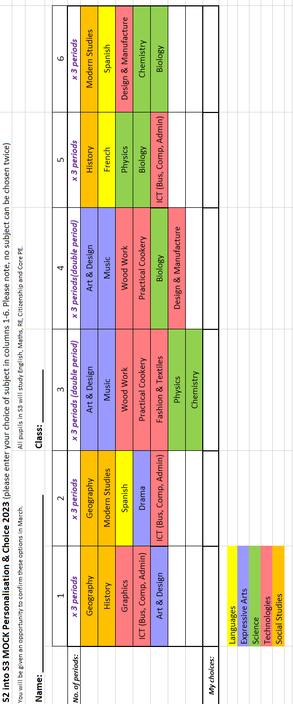
This options form will be given to pupils alongside their S2 report. It should be completed online using the following Form: https://forms.office.com/e/KUfYqCrViZ
S2 INTO S3 OPTIONS FORM

Slide 10
HOW CAN YOU SUPPORT YOUR CHILD?
Supporting your child in their options choices:
There are a number of things that parents can do to support their child as they make their options choices. Always remember that school staff will be available to discuss your child’s options and offer advice and support throughout the process.
Discuss tracking reports and feedback
Consider what your child enjoys
Think about what they are doing well in
Enquire as to which career path they would like to follow
Ask your Son /Daughter why they are picking subjects? Discourage them from selecting subjects based on friendships and perceptions of teachers.
Discuss alternative choices.
Ask advice from staff.
WHAT SUPPORT IS AVAILABLE?
Information on courses for S3 can be accessed on the Transitions section of the school website.
Staff will share with their classes information regarding subjects in their faculty during class time.
Option forms and information will be available online and through year group Teams.
Feedback from the recent S2 Report.
My World of Work – Options Choices Tool https://www.myworldofwork.co.uk/tools/option-choices
FAITH. AMBITION. INCLUSION. PERSEVERANCE.

Slide 11
KEEPING IN TOUCH
HERE TO HELP
We look forward to supporting pupils in the options process.
We will keep in touch with parents throughout the process and will be available to answer any questions that you may have.
Please do not hesitate to contact us should you require additional information.
COMMUNICATING WITH YOU
SCHOOL WEBSITE
https://blogs.glowscotland.org.uk/in/schswebsite/
SCHOOL TWITTER
@_stcolumba
FAITH. AMBITION. INCLUSION. PERSEVERANCE.

