Slide 1
ST. COLUMBA’S HIGH SCHOOL
FAITH. AMBITION. INCLUSION. PERSEVERANCE.
UNIFORM AT ST COLUMBA’S

Slide 2
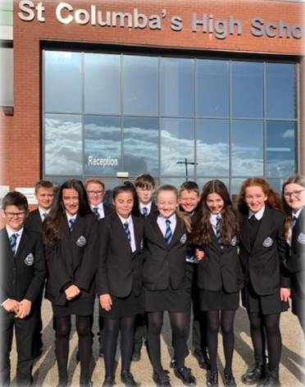
UNIFORM
As we prepare for the new school year in August 2021, we are hopeful that we will be able to return to our traditional standard of uniform across all year groups.
This short presentation is designed to provide everyone with a reminder of the expectations that we have for uniform in our school.

Slide 3
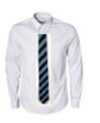
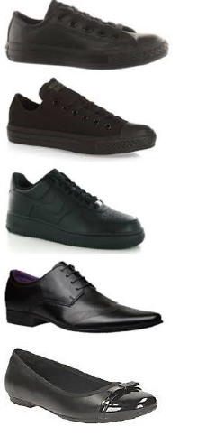
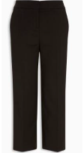
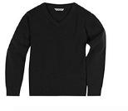
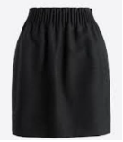
OUR UNIFORM
EXPECTATIONS
The uniform for S1 pupils is as follows:
Blazer
White Shirt/Blouse
Black Trousers/Appropriate Black School Skirt
School Tie
Black Jumper
Black school shoes/trainers featuring no obvious or coloured logos/branding.
A PE Kit when required
Here is the required uniform for pupils at St Columba’s.

Slide 4
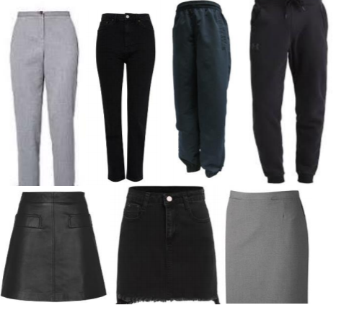
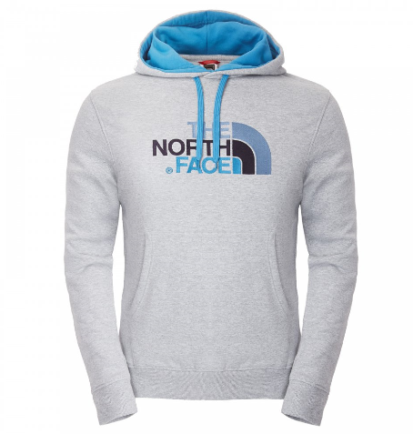
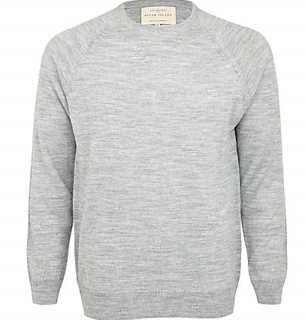
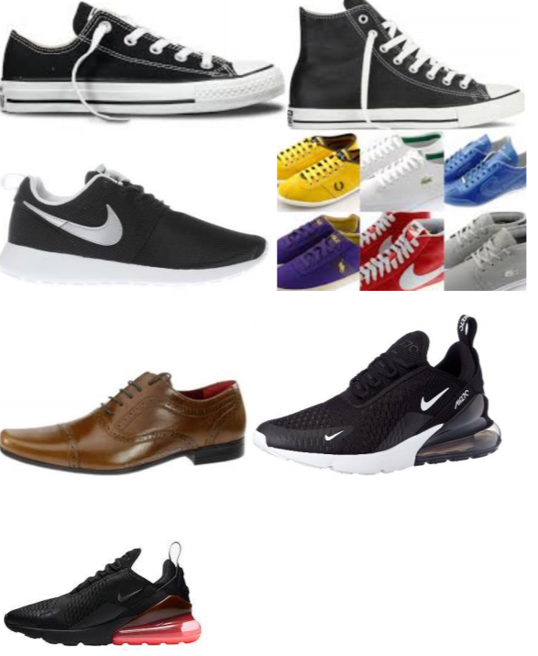
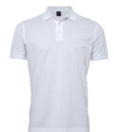
These items should not be worn
Trainers with any obvious colour or branding
Tracksuit tops or hoodies
Polo Shirts
Tracksuit trousers
Grey knitwear/trousers/skirts
OUR UNIFORM
EXPECTATIONS
These are items that should not be worn to school.

Slide 5
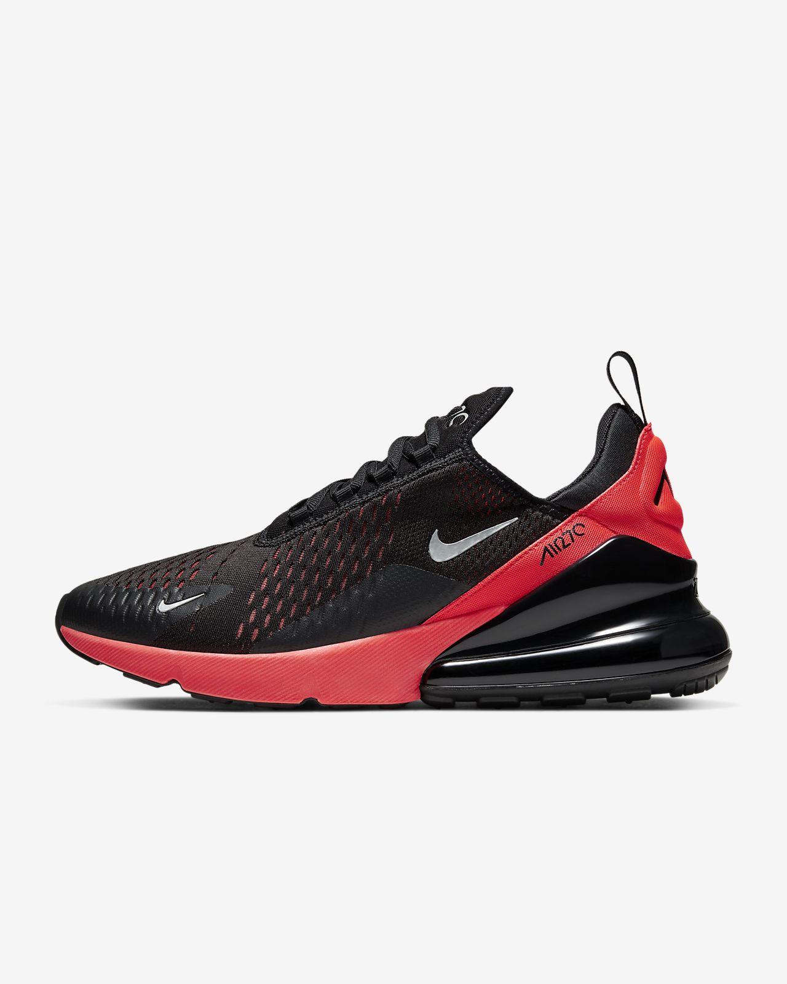
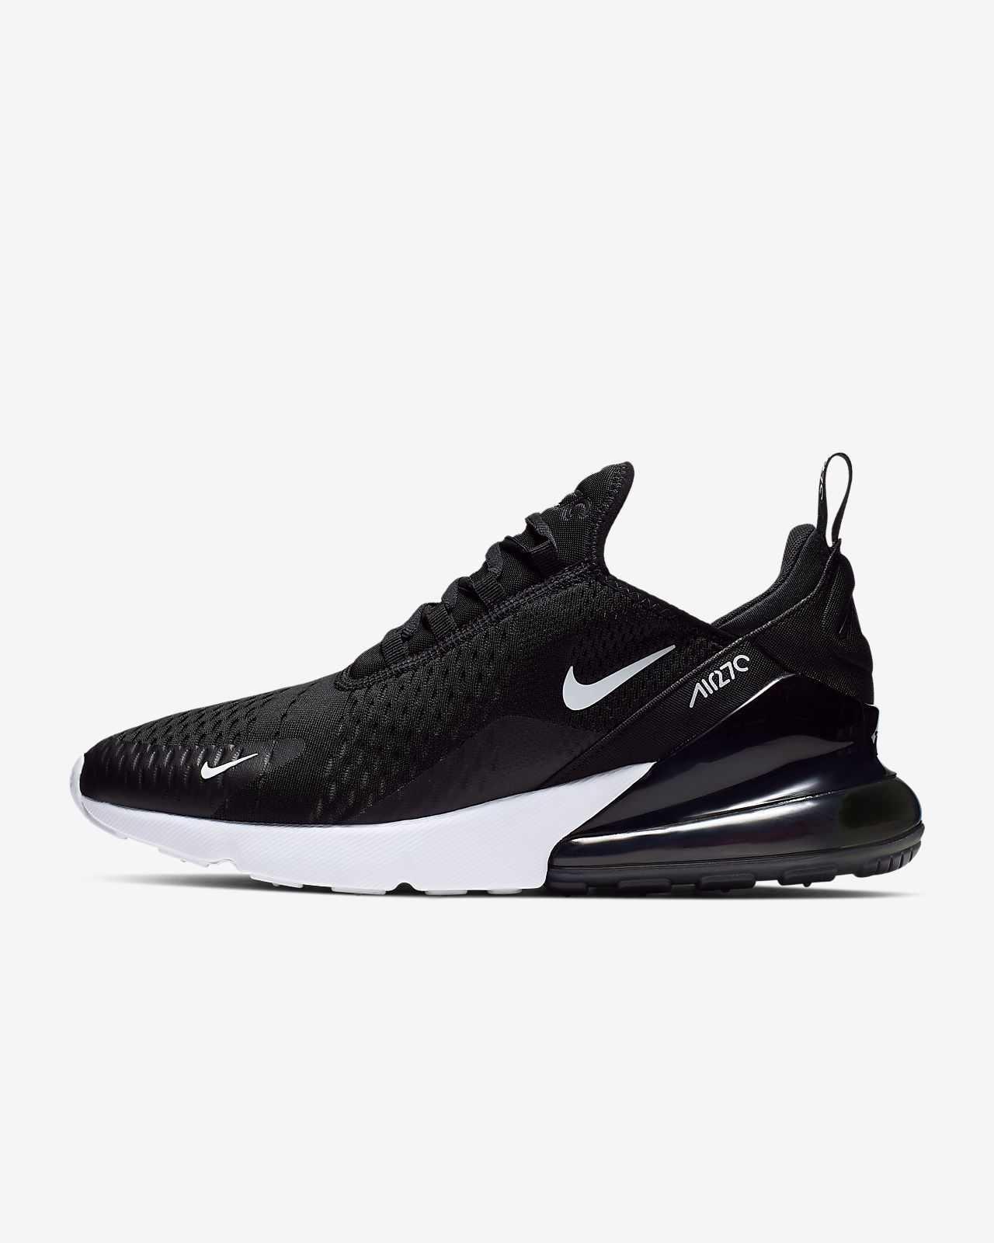
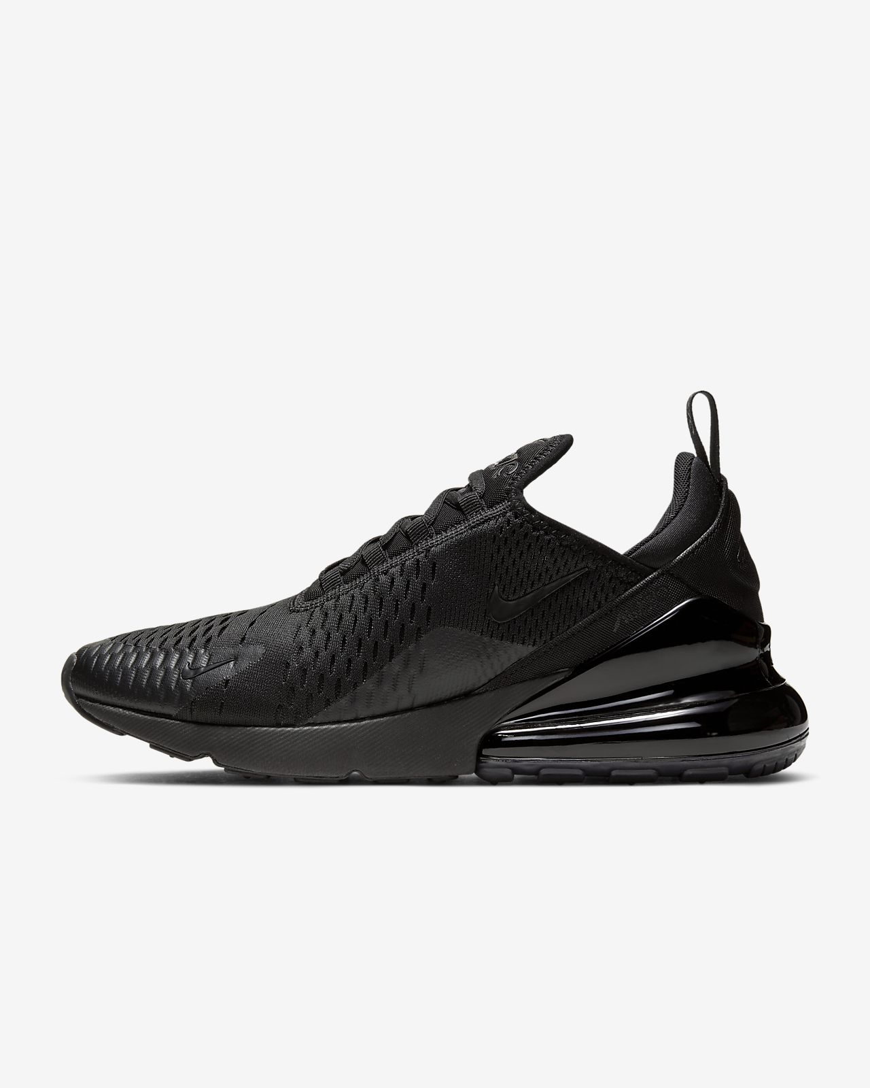
OUR UNIFORM
EXPECTATIONS
Although these trainers are all of a similar style, only one is suitable to wear to school. The third pair are ‘triple black’ and have no obvious colours or markings on them.

Slide 6
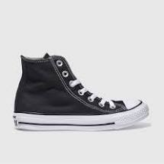
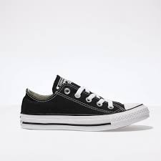
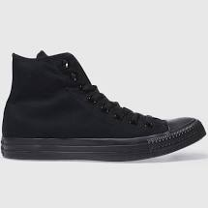
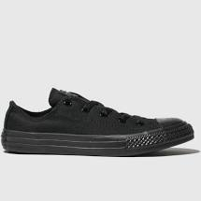
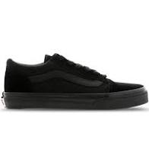
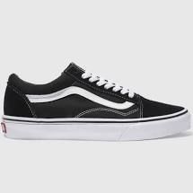
OUR UNIFORM
EXPECTATIONS
Although these trainers are all of a similar style, only one is suitable to wear to school. The correct pairs are ‘triple black’ and have no obvious colours or markings on them.

Slide 7
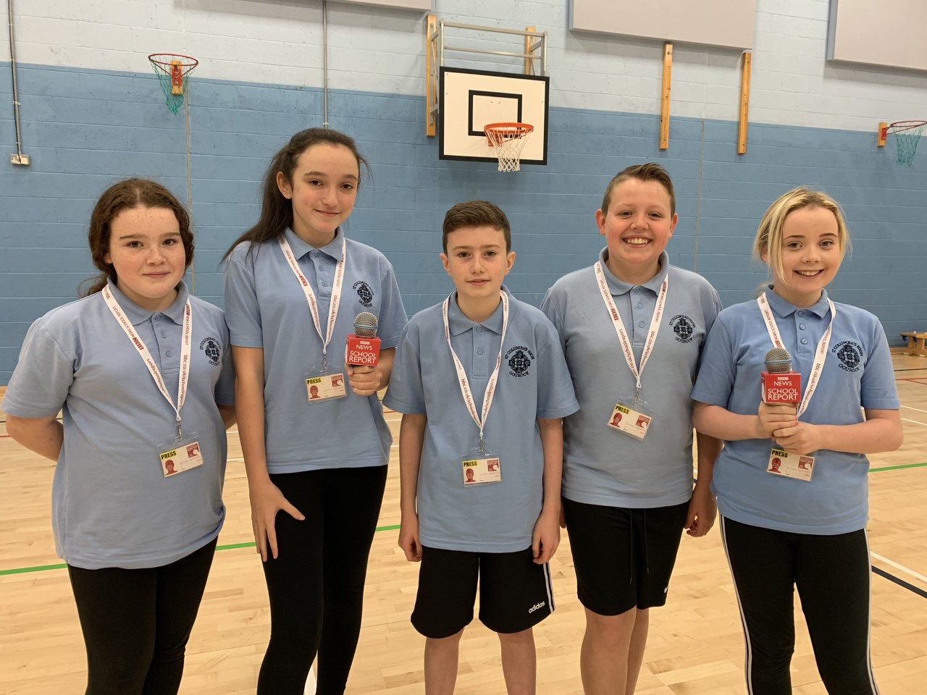
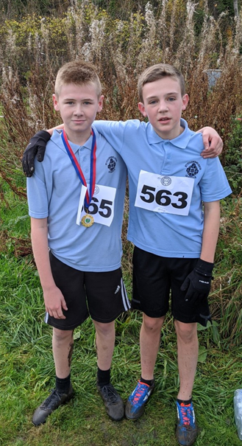
OUR UNIFORM
EXPECTATIONS
We also have a specific polo shirt that should be worn to P.E.
Here are some of our fantastic pupils wearing their P.E. Kit with pride!

