Slide 1
S2 into S3 Curricular Choices February 2021

Slide 2
What lies ahead?
Broad General Education (S1-S3)
Continuation of learning
(not a new start)
Senior Phase (S4-S6)
Notes:
When you begin S3 in May, you will be entering the last year of your Broad General Education. Today we begin the process of personalising your timetable a little.

Slide 3
Progression
 |  |  |  |  | S6 4/5 subjects (plus RE)
 |  |  |  | S5 - 5 subjects (plus RE)
 |  |  | S4 - 6 subjects (plus RE & PE)
 |  | S3 – (slight personalisation within some of the 8 curricular areas)
 | S1 & S2 (13 subjects over 8 curricular areas)
Choice point
Senior Phase
Choice point
National Qualifications
Choice point
WE ARE HERE→
Choice point
BGE
Curriculum for Excellence
Notes:
In S1 and S2 you all followed the same curriculum which comprised of 13 subjects in 8 curricular areas. At the end of S2 you are now being offered a few choices.
You are now at your first choice point.
Before you make your choices it is important to know what lies ahead. As you can see, in S4 pupils will study just 6 subjects in addition to RE and PE which are core subjects.
In S5 this narrows to 5 subjects so it’s important to take the time now to consider what courses are best to follow in S3.

Slide 4
Option Choices
6 subjects in S4 for qualifications.
Maths & English are compulsory.
So S3 must choose 4 subjects from over 22 options.
Notes:
So this time next year, you will be asked to choose just 4 subjects in addition to English and Maths. It is important that you know this and take this into consideration when choosing your subjects for S3.
Don’t worry, however, if you change your mind during S3, you can still pick up another subject in S4 e.g. say you choose Music but not Drama in S3 but you then decide you’d like to do Drama in S4, that’s ok. Ideally you will continue on from S3 into S4 and build on the work in S3 but it is not the end of the world if you change your mind. Your S3 choices do not limit your choices in S4.

Slide 5
Which way now?
Notes:
Now for some of you it’s an easy decision at this point – you know exactly what you want to do and what you need but for others it may not be so clear cut and there may be some twists and turns along the way - and that’s OK! But what must you consider?

Slide 6
Choice should be based on:
Skills and strengths
Enjoyment/interest
If a subject is needed for future career / college / university
Keeping options open
Notes:
Think about what you’re good at.
Think about what you enjoy.
Don’t just take a subject just because your friends are choosing it!

Slide 7
Don’t worry – we’re here to help!
Notes:
Please ask for help in deciding. Speak to your parents, grandparents, brothers, sisters, cousins etc.
Speak to your teachers and ask their advice.
Look online. I know some of you have been looking at My World of work. There is another similar website called planitplus that is good too.

Slide 8
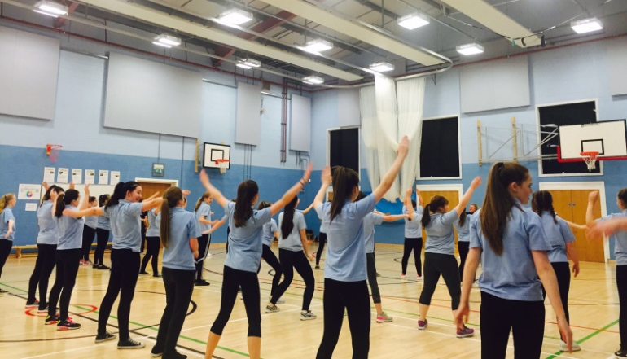
Further Information
www.planitplus.net
www.myworldofwork.co.uk

Slide 9
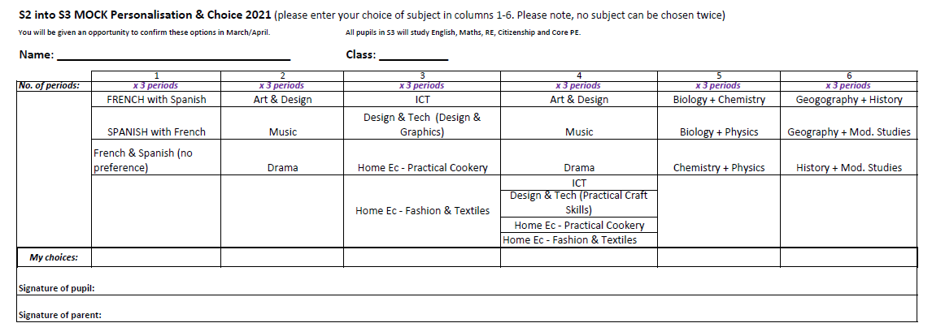
The Mock Option Form
Notes:
Over the next week or so I will come back to you with your final options form where you confirm your choice.
It may be the case that you will asked to choose a second choice in some cases, if your first choice is unavailable. You will then take this form home to get signed and then you’ll hand it back in. Once all the forms are in we’ll be able to start making up the new timetable and the new classes for S3.

