Slide 1
Registration Notices 25th January 2021

Slide 2
Prayer
Dear Lord,
Grant us the faith that enables us to let go of whatever brings us down.
Give us the strength to confront the issues we need to confront and the wisdom to find the solutions that lead us closer to you. Amen.
St. Columba……….pray for us.

Slide 3
This week’s canteen menu
Recipe Challenge
Last week we posted the recipe for Cajun chicken pasta. For the next few weeks we will post a quick and easy recipe from a member of staff.
You can try to guess which member of staff submitted each recipe!

Slide 4
Chicken Curry Ingredients:
2 tbsp sunflower oil
1 onion, thinly sliced
2 garlic cloves, crushed
thumb-sized piece of ginger, grated
6 chicken thighs, boneless and skinless
3 tbsp medium spice paste (tikka works well)
400g can chopped tomatoes
100g Greek yogurt
1 small bunch of coriander, leaves chopped
50g ground almonds
naan breads or cooked basmati rice, to serve
Method:
STEP 1
Heat the oil in a flameproof casserole dish or large frying pan over a medium heat. Add the onion and a generous pinch of salt and fry for 8-10 mins, or until the onion has turned golden brown and sticky. Add the garlic and ginger, cooking for a further minute.
STEP 2
Chop the chicken into chunky 3cm pieces, add to the pan and fry for 5 mins before stirring through the spice paste and tomatoes, along with 250ml water. Bring to the boil, lower to a simmer and cook on a gentle heat uncovered for 25-30 mins or until rich and slightly reduced. Stir though the yogurt, coriander and ground almonds, season and serve with warm naan or fluffy basmati rice.

Slide 5
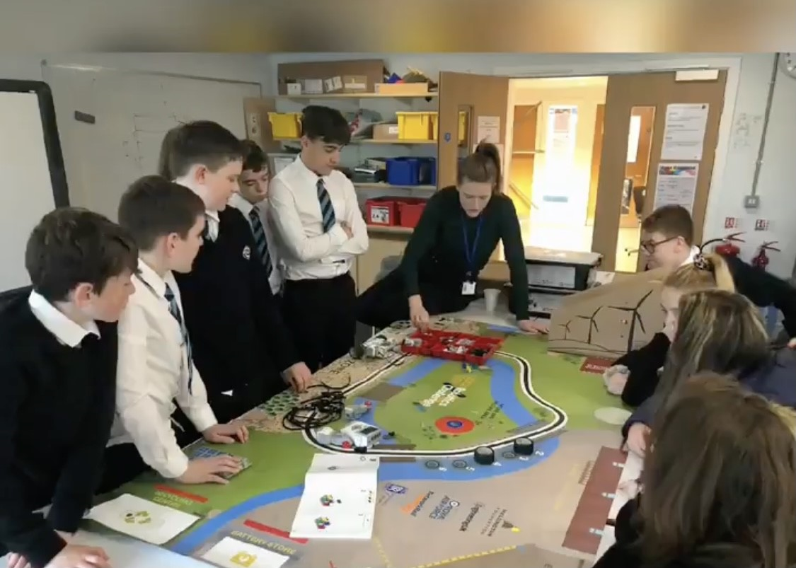
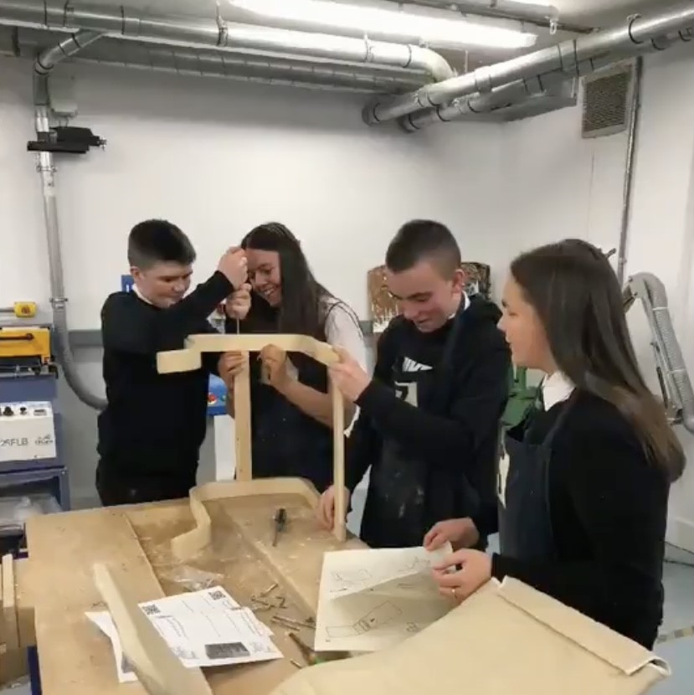
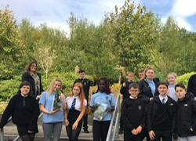
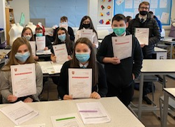
OUR AIMs –
Still the same though we’re not physically in the same building
To offer rich learning experiences which inspire engagement and enable all young people to thrive both within and beyond the classroom.

Slide 6
Daily Registration
Well done to all those who have been registering every day.
Please note, there is no need to register at the weekend!
Please make sure that you ‘like’ the daily post in your year group REGISTRATION Team before 11am.
Occasionally some devices ‘unlike’ the post previously ‘liked’. If you notice this, please reply to the post with a thumbs up .

Slide 7
Remote Learning
Thanks for your hard work and well done on all that you
achieved during week 2!
Based on feedback from pupils and teachers, we are looking at creating a new timetable for live lessons over the next few weeks. We will get this out to you as soon as it is finalised!
We know a number of you were much more organised last week than before. Remember if you need help to get organised there is a video to help you: https://clickv.ie/w/6Vgp
Mr Burke’s top tip is to create a folder called ‘Lockdown Learning’ and then make subfolders in it for each of your subjects. This way, you can save what you are working on and be able to find it again easily.

Slide 8
Live Teams Meetings - BGE
Here is the S1/2/3 timetable of the online check-in sessions for each subject.
Please try and attend as many of these as possible, especially if you have some questions.
Not all calls will require you to be on for the full hour.

Slide 9
Live Teams Meetings – Senior Phase
Here is the S4/5/6 timetable of the online check-in sessions for each subject.
We are still finalising the new timetable and will get this to you as soon as it is ready.
Please make the effort to join these calls if you can.

Slide 10
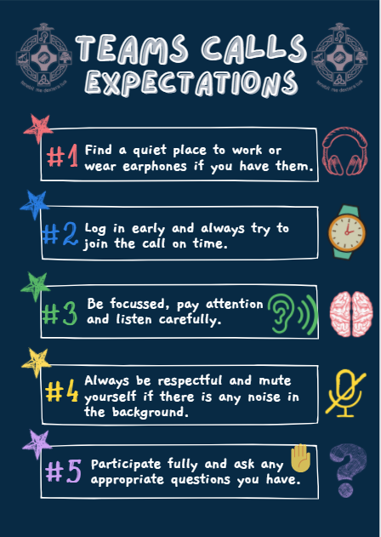
Please follow these expectations when joining a Teams call:

Slide 11
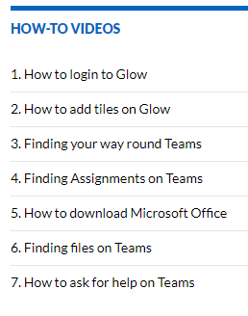
Help with Teams/Glow
Remember that if you have any technical issues there are a number of
‘How to’ videos if you need help with any aspect of Teams or Glow. They can be accessed here:
https://blogs.glowscotland.org.uk/in/schsdigital/ or on ClickView here: https://clickv.ie/w/y6cp
You can also ask for help in the Teams Support channel of your year
group Team.

Slide 12
What to expect each week Overviews of the remote learning each week for each subject was sent to parents last week. They can be accessed here: S1 - https://blogs.glowscotland.org.uk/in/public/schsdigital/uploads/sites/7613/2021/01/08154401/S1-Remote-Learning-Overview.pdf S2 – https://blogs.glowscotland.org.uk/in/public/schsdigital/uploads/sites/7613/2021/01/08154404/S2-Remote-Learning-OVERVIEW.pdf S3 – https://blogs.glowscotland.org.uk/in/public/schsdigital/uploads/sites/7613/2021/01/08154406/S3-Remote-Learning-OVERVIEW.pdf S4/5/6 - https://blogs.glowscotland.org.uk/in/public/schsdigital/uploads/sites/7613/2021/01/08154443/S4-S5-S6-Remote-Learning-OVERVIEW.pdf

Slide 13
Remote learning Working together even though we are not together
Check regularly for updates in each of your Teams.
React to posts to let your teachers know you are engaging with the work.
Join as many live support sessions as you can.
Ask questions in the questions channel of a Team if you are not sure what to do or how to complete the task/assignment.

Slide 14
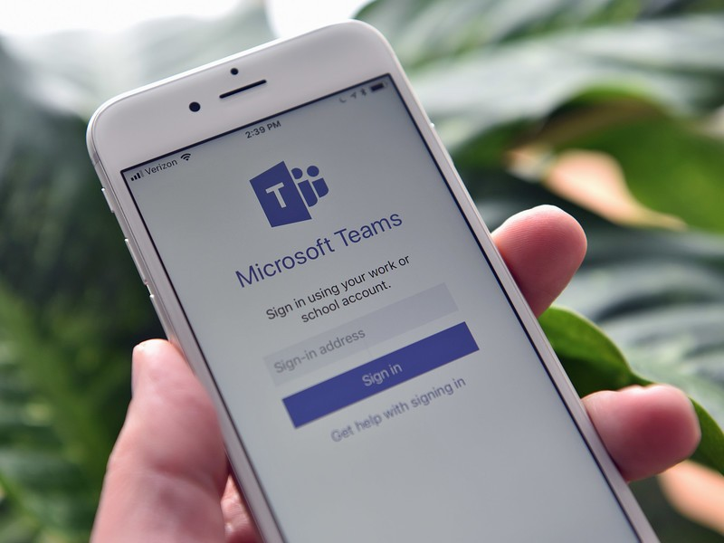
Uploading your work
Office Lens is a really easy way to scan and upload your work onto One Note or Teams.
It’s a free app and is available on Android and IOS devices.
You can also upload a photo of your work in the Teams app on your phone by clicking ‘Add work’ and then choosing the option ‘Upload from this device’.

Slide 15
!! Important Notice for S4/5/6 !! We realise that this is a very uncertain time for you all, in terms of exams, evidence etc. Please do not worry! Whilst we are still waiting on more guidance from SQA, please be assured that when you are able to return to school you will not be given assessments from day 1! Our advice in the meant time is to work hard on the assignments and tasks set each week and ask for help if/when you require it.

Slide 16
Health & Wellbeing
Stay active by walking, running or cycling but remember to follow Government guidelines!
There are lots of fitness challenges you can do at home.
Exercising helps your mental health too.
Make sure you talk to someone of you are feeling anxious or stressed.
Check on your friends and family – are they ok?
Plan breaks away from the screen each day!

Slide 17
Questions? The answer might be here: https://sway.office.com/V9rkuNKuIPFdKUEI?ref=Link

Slide 18
Work Hard & Stay Safe
& remember - we are here to help!

