Slide 1
Registration Notices 18th January 2021

Slide 2
Prayer
Lord,
As we begin this year, give us the confidence to always be ourselves and to use our God-given talents.
When life presents us with challenges, let us know that you are always present with us.
Keep us strong and confident in all that we say and do,
Amen
St. Columba……….pray for us.

Slide 3
This week’s canteen menu
But please remember to help out around the house and tidy up after yourself!
If you are missing Cajun Chicken Pasta, here is the recipe:

Slide 4
Cajun Chicken Pasta
INGREDIENTS:
500g Penne pasta
250g Chicken
40g Margarine
40g Plain flour
15g Cajun spice
25/30g Tomato puree
450ml Semi-skimmed milk
450ml Water
15g Chicken stock cube
100g Natural yoghurt
Onion, black pepper and garlic can be added.
INSTRUCTIONS:
Melt the margarine in a large pot and add flour, Cajun spice, tomato puree, garlic and pepper. Cook for a few minutes.
Dissolve the stock cube in water - add this and the milk to the pot.
Heat the mixture through then add the yoghurt.
Cut the chicken into small chunks or strips and cook it (unless you are using ready cooked chicken).
Cook the pasta, add chicken and then add sauce and stir it through.

Slide 5
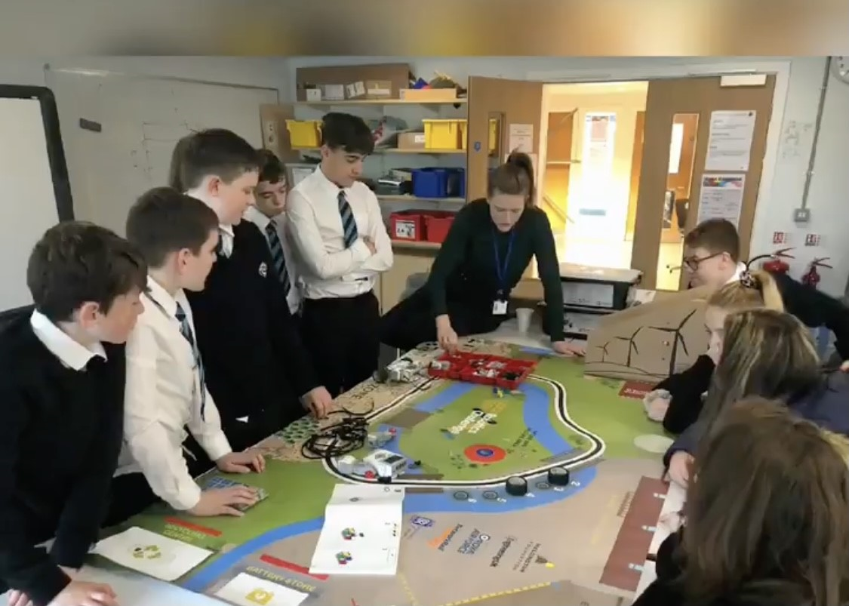
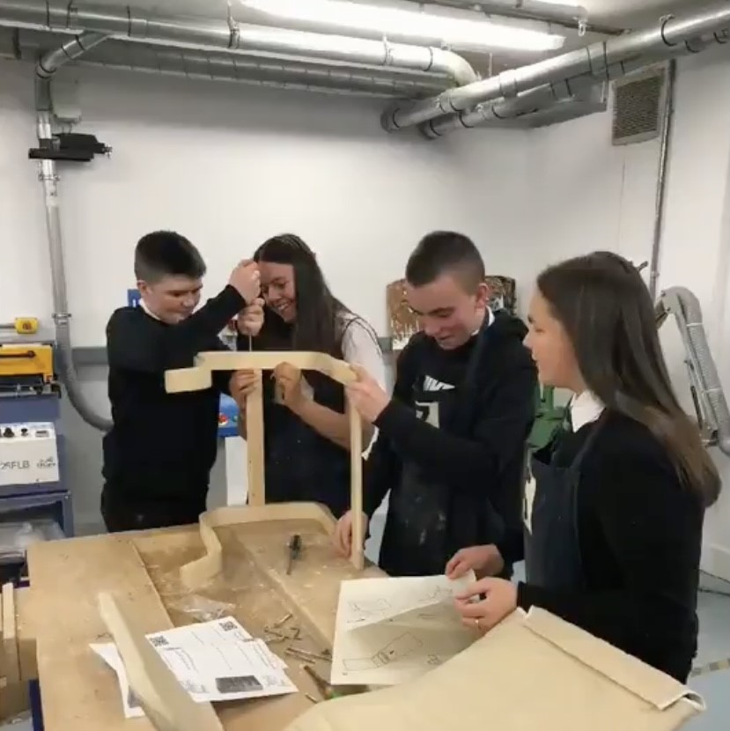
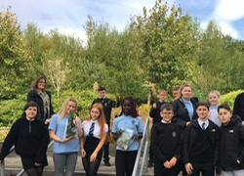
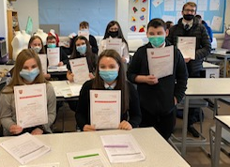
OUR AIMs –
Still the same though we’re not physically in the same building
To offer rich learning experiences which inspire engagement and enable all young people to thrive both within and beyond the classroom.

Slide 6
Daily Registration
It is really important that we know that you are all safe, well and able to get online each day.
Please make sure that you ‘like’ the daily post in your year group REGISTRATION Team.
To allow us to monitor this every day we would ask that you ‘register’ before 11am (so get those alarms set)!
We will be contacting parents of pupils who have not registered to offer support.

Slide 7
Remote Learning
Thanks for your hard work and well done on all that you achieved during week1!
Thanks to all those who provided some feedback too - we have taken on board many of the points and will be acting on them to improve your experience over the next few weeks.
One of the main points raised was that it can be a bit overwhelming knowing where to start and how to get organised.
We have created a short video to help with this.
Please take a look and use it to make a weekly plan:
https://clickv.ie/w/6Vgp
{You can also play a game of guess which teacher is doing the voiceover }

Slide 8
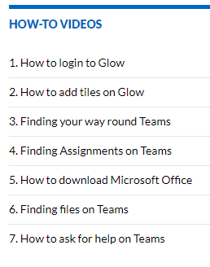
Help with Teams/Glow
Remember that if you have any technical issues there are a number of
‘How to’ videos if you need help with any aspect of Teams or Glow. They can be accessed here:
https://blogs.glowscotland.org.uk/in/schsdigital/ or on ClickView here: https://clickv.ie/w/y6cp
You can also ask for help in the Teams Support channel of your year
group Team.

Slide 9
Uploading your work
Office Lens is a really easy way to scan and upload your work onto One Note or Teams.
It’s a free app and is available on Android and IOS devices.

Slide 10
Live Teams Meetings - BGE
Here is the S1/2/3 timetable of the online check-in sessions for each subject.
Your teachers will tell you a bit more about what they will cover.
Most of these will be live meetings in the appropriate channel of the year group Team.

Slide 11
Live Teams Meetings – Senior Phase
Here is the S4/5/6 timetable of the online check-in sessions for each subject.
We are looking to adapt this over the next week based on some feedback. We will let you know if this schedule changes.

Slide 12
Remote learning Working together even though we are not together
Check regularly for updates in each of your Teams.
React to posts to let your teachers know you are engaging with the work.
Join as many live support sessions as you can.
Ask questions in the questions channel of a Team if you are not sure what to do or how to complete the task/assignment.

Slide 13
What to expect each week Overviews of the remote learning each week for each subject was sent to parents last week. They can be accessed here: S1 - https://blogs.glowscotland.org.uk/in/public/schsdigital/uploads/sites/7613/2021/01/08154401/S1-Remote-Learning-Overview.pdf S2 – https://blogs.glowscotland.org.uk/in/public/schsdigital/uploads/sites/7613/2021/01/08154404/S2-Remote-Learning-OVERVIEW.pdf S3 – https://blogs.glowscotland.org.uk/in/public/schsdigital/uploads/sites/7613/2021/01/08154406/S3-Remote-Learning-OVERVIEW.pdf S4/5/6 - https://blogs.glowscotland.org.uk/in/public/schsdigital/uploads/sites/7613/2021/01/08154443/S4-S5-S6-Remote-Learning-OVERVIEW.pdf

Slide 14
Health & Wellbeing
Stay active by walking, running or cycling but remember to follow Government guidelines!
There are lots of fitness challenges you can do at home.
Exercising helps your mental health too.
Make sure you talk to someone of you are feeling anxious or stressed.
Check on your friends and family – are they ok?
Plan breaks away from the screen each day!

Slide 15
Questions? The answer might be here: https://sway.office.com/V9rkuNKuIPFdKUEI?ref=Link

Slide 16
Work Hard & Stay Safe
& remember - we are here to help!

