Slide 1

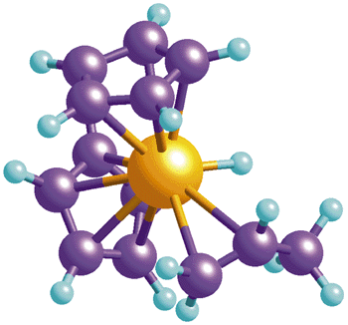
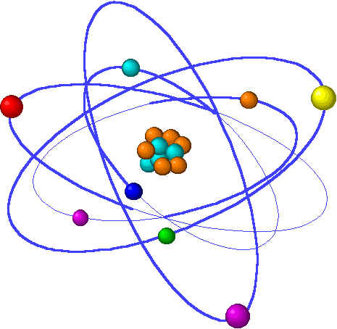
Chemistry
S3 Broad General Education
Metals – Properties and Reactions

Slide 2
Properties of Metals
A property of a substance is a feature or an attribute that
the substance has.
For example:
Iron = very strong
Copper = doesn’t rust
Gold = nice colour!

Slide 3
Conduction
Metals can conduct both heat and electricity.
This is because all metal atoms have free electrons (delocalised electrons) which can move from one atom to the next.
This lets the heat and electricity ‘move’.
e
e
e
e
Metallic

Slide 4
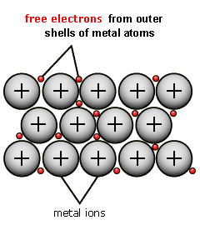
Metallic Bonding & Structure
Most elements in the Periodic Table are metals.
Atoms of metal elements bond by METALLIC BONDING.
A metallic structure exists of a giant lattice of positively
charged ions and delocalised (free) outer electrons.

Slide 5

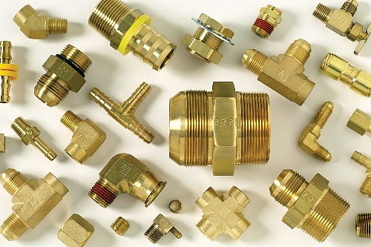
Alloys
To change the properties of metals they can be mixed with
other metals (or carbon).
These are known as ALLOYS.
Examples include:
Steel – iron & carbon (increase strength)
Stainless steel – iron, chromium & nickel (resists rusting)
Solder – lead & tin (melts at low temperature)
Alloys

Slide 6

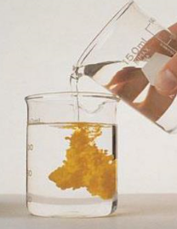


Reactivity Series
Chemists can study many different reactions to work out a REACTIVITY SERIES
A Reactivity Series is a league table of how easily metals
react – with the most reactive at the top.

Slide 7
Reactivity Series

Slide 8
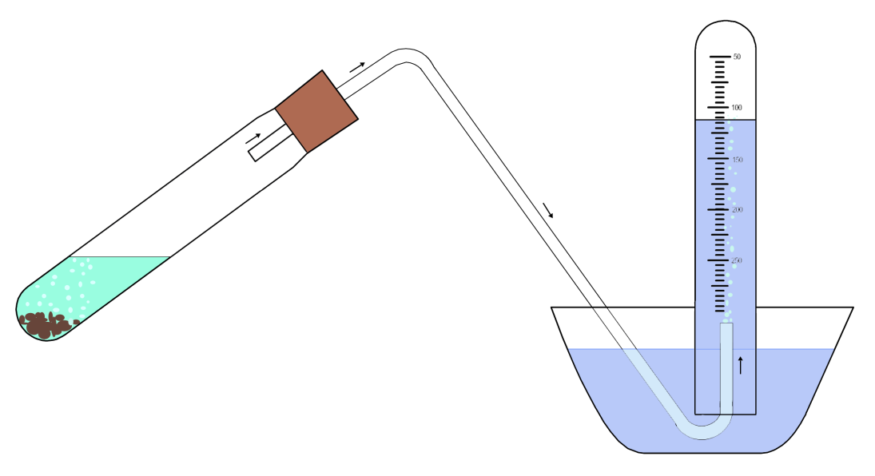
Reaction of Metals with Acids
How to collect your gas:
Delivery tube
Stopper
Upside down
test-tube
full of water
20 cm³ Sulfuric Acid
2 strips of Magnesium
Tub of water
Once you have collected your gas, try and identify it.

Slide 9

Reaction of Metals with Acids
When acids react with metals, they produce
HYDROGEN gas.

Slide 10
Reactivity Series
React
with
acid

Slide 11
Reaction of Metals with Acids
All metals ABOVE COPPER in the Reactivity Series will
react with acid.
Metal + Acid Salt + Hydrogen
Magnesium + Hydrochloric Magnesium + Hydrogen
Acid Chloride
(this is similar to a neutralisation reaction you did in S2)
Separating Salts

Slide 12
What is a Salt?
Salts are compounds which are made when acids react.
Have you seen other substances which will
React with an acid?
Acids can react with:
Metals
Alkalis
Metal Carbonates
Metal Oxides
All these reactions will produce a SALT.

Slide 13
Naming Salts
When salts are named:
the first part of the name comes from the METAL
the second part from the ACID
Example:
Hydrochloric acid + Sodium = Sodium chloride

Slide 14


Naming Salts
If the acid is hydrochloric then the salt will be a chloride.
If the acid is sulfuric the salt will be a sulfate.
If the acid is nitric then the salt will be a nitrate.
Put the information in red, above, into a simple table so that you will remember it!
What will your
headings be??

Slide 15
N5
Reaction of Metals with Oxygen
When metals react with oxygen they make an oxide:
Metal + Oxygen Metal oxide
Magnesium + Oxygen
Aluminium + Oxygen

Slide 16
Reactivity Series
React
with
acid
React
with
oxygen

Slide 17
Flame tests
When compounds containing metals are placed in a flame, they burn with a distinctive colour.
Metal | Flame colour
Flame Testing

Slide 18
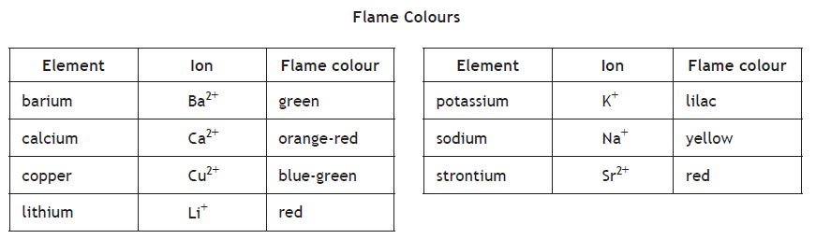
Flame tests
Chemists can use the colour of the flame to tell which metals are present in the compound.

Slide 19
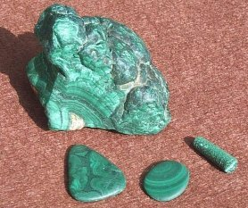
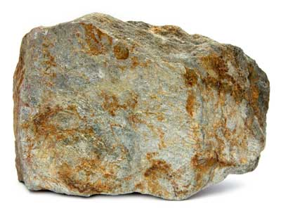
Extracting Metals
Metals exist in the earth’s crust as METAL ORES, the
natural compound which they exist as.
Normally they are found as the oxide (like iron
oxide) but sometimes as carbonates (like copper carbonate).

Slide 20
Extracting Metals
Metals are extracted from their ores in different
ways, depending on the REACTIVITY of the metal.
(More reactive metals are harder to separate from
their ores.)
Extracting Metals

Slide 21
Extracting Metals Summary
Electrolysis
(using electricity)
Heat and carbon
Heat alone

Slide 22
N5
Electrolysis
Electrolysis is the breaking up of compounds using electricity
Negative
electrode
Positive
electrode
-
-
+
-
Solution
+
+
-
+
When a DC current is turned on (ie turn on the power pack), the
charged particles move towards the electrode with the opposite
charge:
METALS (POSITIVE) NEGATIVE ELECTRODE
NON-METALS (NEGATIVE) POSITIVE ELECTRODE

Slide 23

Making Electricity
When pairs of metals are connected together with an
electrolyte (a solution) an electric current will flow.
Voltmeter
V
zinc
copper
Lemon juice acts
as an ELECTROLYTE
In chemistry, this is known as a CELL (but you may call it a battery).
Notes:
23

Slide 24
Cell (or Battery)
V
Metal A
Metal B
Electrolyte
(salt solution)
In chemistry, this is known as a CELL (but you may call it a battery)
An ELECTROLYTE is needed to COMPLETE THE CIRCUIT.

Slide 25
A Simple Cell
V
Metal A
Metal B
Electrolyte
(ionic solution)
A cell must consist of:
2 DIFFERENT METALS
and an ELECTROLYTE
An ELECTROLYTE is a solution containing IONS (charged particles)

Slide 26
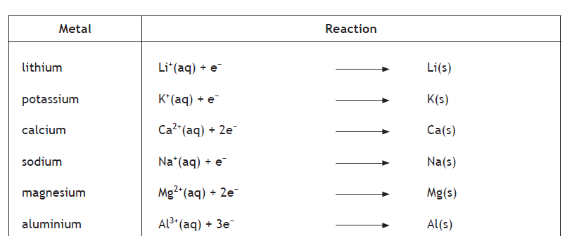
Electrochemical Series
Different pairs of electrodes (metals) produce different voltages.
Using the different voltages produced, metals can be organised
into a ‘league table’ (similar to the Reactivity Series).
This is known as an ELECTROCHEMICAL SERIES.

Slide 27
Electrochemical Series
Reactive metals are more likely to make electrons (electricity).
If you paired aluminium and calcium together – which is going
to make electrons?

Slide 28
A Simple Cell
V
Metal A
Metal B
Electrolyte
(ionic solution)
Metals vary in their ability to PRODUCE electrons.
If METAL A is better at producing electrons than METAL B,
the electrons will move from A to B.

Slide 29
Electrochemical Series
Rules for connecting metals:
    The further apart the metals are in the series, the
    higher the voltage produced
    Mg + Al create a lower voltage than Mg + Cu
    Electrons ALWAYS flow from a metal HIGHER in the
    series to a metal LOWER
    Mg down to Al (NOT Al up to Mg)

Slide 30
Flow of Charged Particles
Electrons flow through
the wire from Mg to Cu
V
Magnesium
Copper
Electrolyte
(ionic solution)
Ions flow between
the electrodes

Slide 31
Electrolyte
An electrolyte is a solution, which contains IONS (charged
particles). An electrolyte completes the circuit, and allows
electricity to be produced.
At a high concentration there are many more ions, which lets
more electricity be produced.

Slide 32
More Complicated Cells
V
Magnesium
Copper
Salt
Bridge
Electrolytes
(solution)
When there are two half cells, an SALT BRIDGE is used to complete
the circuit.

Slide 33
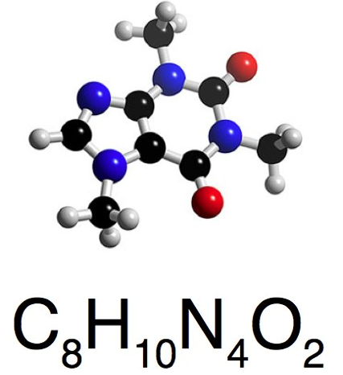
Writing Chemical Formula
The CHEMICAL FORMULA tells us the number of ATOMS of EACH
ELEMENT which are in a compound.
This molecule has
8 x carbon atoms
10 x hydrogen atoms
4 x nitrogen atoms
2 x oxygen atoms
Notes:
33

Slide 34
Writing Chemical Formula
Tells us:
type of atoms
number of atoms
In a substance
For Example:
Na Cl :
Contains 1 sodium atom, 1 chlorine atom
Li₂SO₄ :
Contains 2 lithium atoms, 1 sulphur atom, 4 oxygen atoms
Ca(OH)₂ :
Contains 1 calcium atom, 2 oxygen atoms,
2 hydrogen atoms

Slide 35
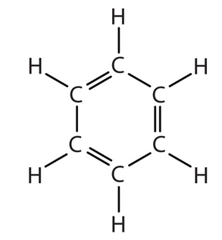

Calculating Formulae
There are 3 different ways to work out formulae depending on the name of the substance.
1. Models / Structures

Slide 36
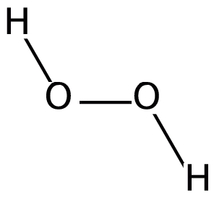
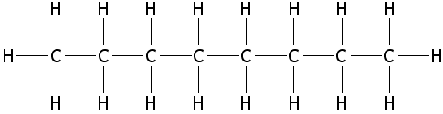
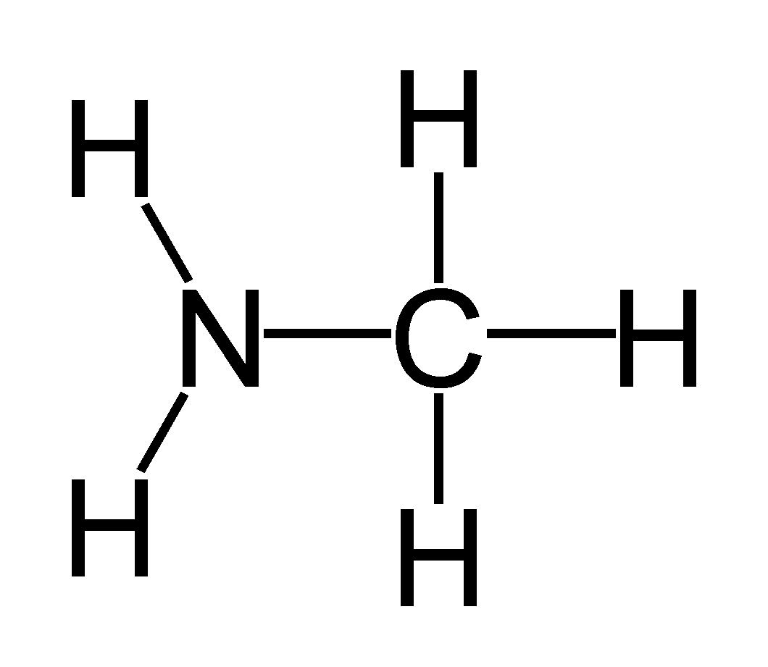
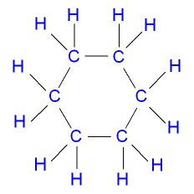
Chemical Formula
Octane
Formula = C₈H₁₈
Hydrogen Peroxide
Formula = H₂O₂
Formula = CH₅N or CH₃ NH₂
Formula = C₆ H₁₂
Methylamine
Cyclohexane

Slide 37
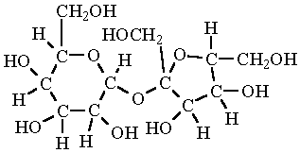
Sucrose
Formula = C₁₂H₂₂ O₁₁

Slide 38
2. Using Prefixes
These rules can only be used if the substance name has a prefix in it such as mono, di, tri, etc
A. Nitrogen monoxide
1 nitrogen
1 oxygen
Formula =
NO

Slide 39
B. Diphosphorous trichloride
2 phosphorous
3 chlorine
P₂Cl₃
Formula =

Slide 40
Prefixes
If the name of the compound contains a PREFIX then we
simply write what the name tells us!
Notes:
40

Slide 41
Valency Rule
VALENCY tells us HOW MANY ATOMS an element will combine with
The valency of most elements can be determined from their GROUP
This mean that all elements in GROUP 1 have a VALENCY of 1
all elements in GROUP 6 have a VALENCY of 2
Notes:
41

Slide 42
Reminder: Valency Rule
This rule uses the valency of the elements to work out how many atoms will combine
Carbon Hydride
C H
4 1
1 4
C₁ H₄
Formula =
CH₄

Slide 43
Transition Metals
The TRANSITION METALS do not have a fixed Valency.
Their VALENCY is indicated by the ROMAN NUMERAL in their name.
BUT – we still use the VALENCY RULE to get their formula.
Example 1:
Copper (I) oxide & Copper (II) oxide
Example 2:
Iron (II) chloride & Iron (III) chloride
Notes:
43

Slide 44
Gram Formula Mass
Mass is how much something weighs.
The mass of a compound can be found by adding together the mass
of all the atoms in the compound’s formula.
(The mass of each element is found in the data table!)

Slide 45
Questions
Gram Formula Mass
To find the formula mass, you add together the mass of each atom.
Example 1: CCl₄
Example 2: MgCl₂

Slide 46
Electron Arrangement
How many protons and electrons would be in these atoms?
(1) Sodium (6) Aluminium
(2) Oxygen (7) Sulfur
(3) Helium (8) Calcium
(4) Nitrogen (9) Potassium
(5) Chlorine (10) Neon
Extra: Do you know how the electrons are arranged around the nucleus???

Slide 47
Electron Arrangement
Electrons orbit (move around) in specific paths (energy levels) around the nucleus of the atom.
Each energy level can hold a maximum number of electrons.
1st Energy Level (holds max 2 electrons)
2nd Energy Level
(holds max 8 electrons)
Nucleus
3rd Energy Level
(holds max 8 electrons)
Could you draw the electron arrangements of the atoms from the previous slide?

Slide 48
Ions
Ions are particles where the number of protons and electrons
are not equal.
Ions form when atoms lose or gain electrons (they do this to have a full outer level, and become stable!)
The number of electrons depends on the VALENCY of the element.

Slide 49
Ions
Metals:
Metal atoms ALWAYS LOSE electrons to form POSITIVE
IONS.
eg Sodium
Sodium is in Group 1 and has a VALENCY 1
so loses 1 electron
The charge is written beside the element symbol:
Na⁺ (a 1+ charge)

Slide 50
Ions
Non-Metals:
Non-metal atoms ALWAYS GAIN electrons to form
NEGATIVE IONS.
eg Chlorine
Chlorine is in GROUP 7 and has a VALENCY 1
so gains 1 electron:
Cl⁻ (a 1- charge)

