Slide 1
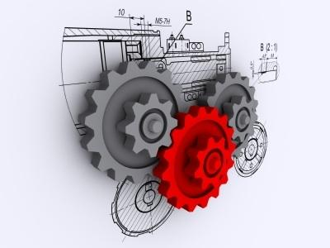

National 5 Business Management
Management of Operations
Notes and Activities Booklet
St Columba’s High School
ICT FACULTY
Name:
Class:
Teacher:

Slide 2
Learning Intentions and Success Criteria Checklist
Below is a list of the learning intentions and success criteria for this unit. These show what you will learn. Your teacher may highlight these to you as you work through the unit and indicate when to check them off when you have been successful.
By the end of the Operations unit and a period of consolidation we will be able to:
Identify and outline the 3 key stages in the operations process;
Outline the key activities carried out in operations;
Identify and describe factors to consider when choosing a supplier;
Describe the problems associated with overstocking and understocking;
Describe the factors to consider in the effective management and control of stock;
Distinguish between labour intensive and capital intensive production and describe their advantages and disadvantages;
Identify and describe the 3 main methods of production and their advantages and disadvantages;
Outline the factors to consider when choosing a method of production;
Justify why it is important for a business to provide high quality products;
Describe ways of ensuring a high quality product;
Identify and describe quality management techniques;
Describe ways of undertaking ethical and environmentally friendly practices and the benefits and costs of doing so;
Describe the use of technology/ICT in the operations department.
Notes:
Teacher should pick learning intentions from these to display to class and bring their attention to when suitable. Pupils could check these off as they go through the course.

Slide 3

National 5 Outcomes and Assessment Standards
Management of Marketing and Operations
Outcome 2 - Operations
Apply knowledge and understanding of how the operations function contributes to the success of small and medium-sized organisations by:
2.1 Describing factors to consider when choosing a suitable supplier
2.2 Describing consequences of over- or under-stocking for an organisation
2.3 Describing factors to consider when choosing a suitable production method
2.4 Outlining methods of ensuring high quality in production practices
2.5 Outlining how technology can be used to contribute to effective operational activity
To pass this area of the unit you will have to show that you have met these Assessment Standards. Your teacher will let you know how the assessment will be carried out and any required conditions for doing it.
You should note that the final exam can ask any of the elements from this unit and not only the standards from the unit assessment.
Notes:
Teacher should pick Assessment Standards from these to display to class and bring their attention to when suitable. Pupils could check these off as they go through the course. The key symbol in used to show learners which pages/slides that contain information which is directly related to the assessment standards for this unit. This should aid them when revising for their unit assessments.

Slide 4
Contents
What is Operations? | 5
Key Activities Carried Out In the Operations Department | 6
Factors to Consider When Choosing a Supplier | 11-12
Stock Storage & Costs and Risks of Storing Stock | 17
Consequences of Overstocking | 18
Consequences of Understocking | 19
Effective Control of Stock (Stock Control System) | 20
Just In Time Stock Control | 23
Labour Intensive Production | 27
Capital Intensive Production | 28
Methods of Production | 30
Job Production: Advantages and Disadvantages | 31
Batch Production: Advantages and Disadvantages | 32
Flow/Mass Production: Advantages and Disadvantages | 33
Factors to consider when choosing a method of production | 34
Benefits of Providing a High Quality Product to Customers | 38
Methods of Ensuring a Quality Product | 40-45
Business Ethics | 48
Ethical & Environmentally Friendly Practices | 49-50
The Use of ICT/Technology in Operations | 55-56

Slide 5
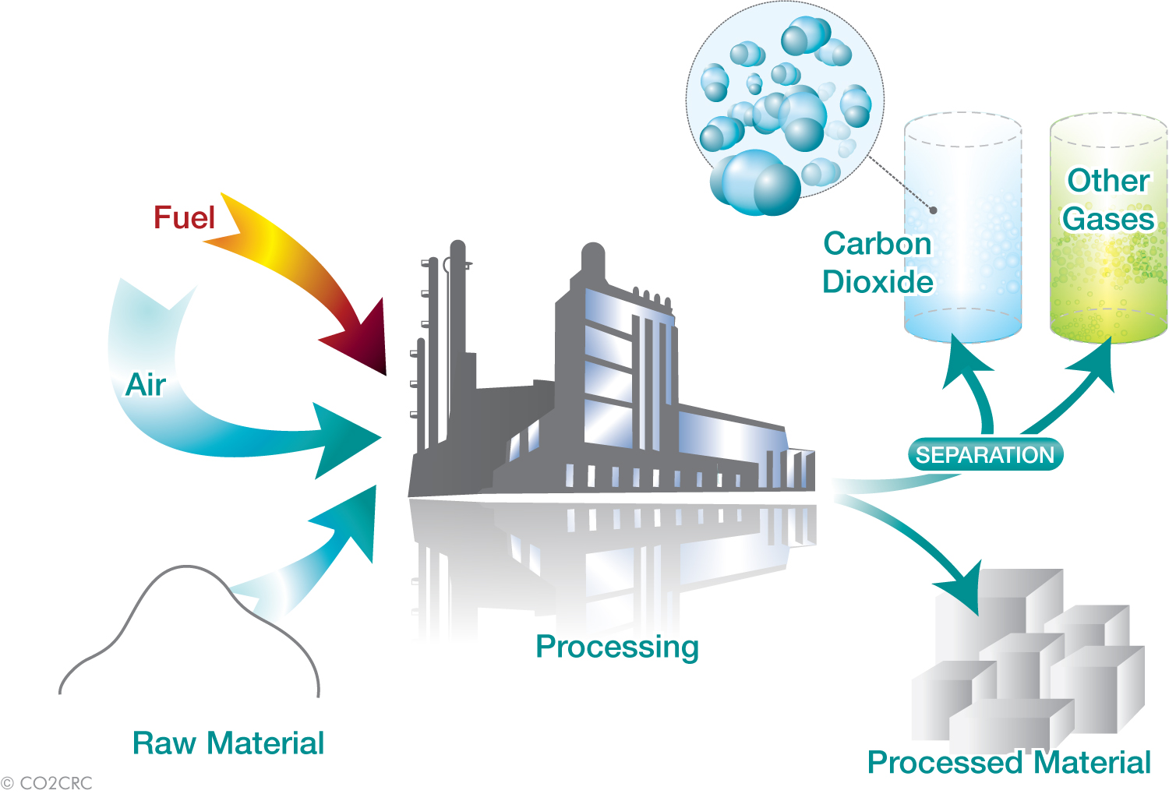
What is Operations?
Operations is the functional area (or department) responsible for manufacturing products ie making (tangible) goods OR providing (intangible) services. They do this by changing inputs ie processing them into outputs during the production process.
Inputs are the factors of production including raw materials
Output is the actual finished product ready for sale
Process is the actual making of the product
When inputs are transformed into outputs during production value is added at each stage of the process so that profit can be made.
The operations department creates wealth by adding value to the product.

Slide 6
Key Activities Carried Out In The Operations Department
They use information from market research to decide what is to be made and also how it is to be made ie the method of production
They work with suppliers to make sure that raw materials are available when they are needed
They help satisfy customers by making products that they need and want
They manage stock levels to make sure nothing runs out and also that they don’t keep too much
The role of the Operations function (or department)
They make (manufacture) products and this can involve both people and machinery
They ensure high quality products are produced

Slide 7

Activity: Input, Process and Output
INPUT, PROCESS AND OUTPUT VIDEO TASK
The following video shows the Operations process for creating jeans:
http://www.youtube.com/watch?v=_KZWe0sYglc
When watching the video, try to fill in the input, process and output for jeans in the table below. Be prepared to share your answers with the class.
Input, Process and Output for a Pair of Jeans
Input | Process | Output

Slide 8


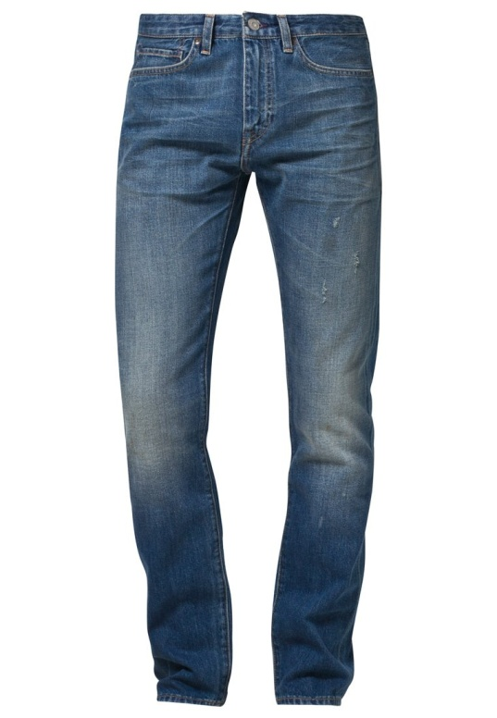
Activity: Input, Process and Output 2
INTERNET RESEARCH TASK
Using the internet to research, create a table in Microsoft Word which shows the Input, Process and Output for 10 products of your choice.
For example:
Product | Input | Process | Output
Jeans | Cotton Dyes Plastic Rocks | Cut, dye, sew, stonewashed, packaged | Jeans

Slide 9

Role of Operations
Questions Booklet Tasks
ROLE OF OPERATIONS
Stage 1: Q1
Stage 2: Q1
Total: 7 marks
HINT: Pay attention to the command words to ensure you answer the question correctly

Slide 10
Activity: Suppliers Intro
PAIRED ACTIVITY
When buying stock it is often the case that a business has a choice of what supplier to order from
The buying staff (part of the Operations Dept) are influenced to buy from one supplier over another by various factors
This is similar to how you choose where to buy items when you have a choice of shops/online retailers who could supply the good/service to you
Using the list of items opposite, discuss with your partner and answer the following in your jotter:
List all of the possible suppliers you could buy it from
Describe as many advantages and disadvantages of each supplier as you can think of
Agree on the ‘best’ supplier to buy from and describe why
A spray tan
A restaurant meal
A pair of jeans
An ipad air
The latest release by your favourite band

Slide 11
Factors to Consider When Choosing a Supplier
The key factors a business needs to take into account when choosing a supplier are:
Price – this needs to be competitive, reasonable and acceptable in relation to the product and the quality ie ‘does it represent value for money’;
Quality – this needs to be acceptable level e.g. in relation to price;
Quantity – are they able to supply the right quantity and be able to do this every time?
Range of products – do they offer only some or all of the products you require?
Location of supplier – the further away they are the longer it will take to deliver;
Reliability/dependability and reputation of the supplier – will they deliver when they say they will and do this every time - what do others think of them?
Flexibility of delivery – do they offer delivery at times that suit you?
Cost of delivery - is there an additional charge for this or is it included in the price?
Discounts/Credit terms – do they offer discounts eg for buying in bulk or is there credit available ie buy now and pay later?

Slide 12
Explanations of Factors to Consider
Below are some explanations as to why businesses take some of these factors into consideration. These notes may be useful if you are asked to ‘explain’ the factors to consider when choosing a supplier. The ‘explanation’ part for each is underlined.
Price – The business will buy from a supplier who offers the best value for money (this may or may not be the cheapest). To get value the business may expect the supplier to offer them a trade discount, loyalty discount, prompt payment discount or bulk buy discount. This will allow the business to improve profitability.
Quality – The business will buy from a supplier who can consistently provide a good enough quality for the business. This will help avoid wastage or the hassle of having to return items. This will allow the business to produce better quality themselves.
Quantity – The business will choose a supplier who can consistently deliver the correct levels of stock, which will help avoid stock shortages and delays in production.
Time (Lead time) – The business will buy from a supplier who can deliver the goods on time consistently and who are able to deliver the goods quickly after receiving the order. This helps to avoid stock shortages.
Location – The business may buy from a local supplier as this may improve their reputation, but they may also do this to enable quicker and cheaper deliveries

Slide 13
Activity: Suppliers 1
SUPPLIERS VIDEO TASK
Watch the following video and answer the questions below in your jotter:
http://www.bbc.co.uk/education/clips/z28k2hv
What is a ‘Farmer’s Market’?
Why would consumers buy from a farmer’s market rather than a supermarket?
What advantage does the restaurant (The Good Shed) gain from locating beside the farmer’s market and buying it’s supplies from the farmer’s market?

Slide 14
Activity: Suppliers 2
SUPPLIERS WRITTEN TASK
Match up the descriptions below with the most appropriate influencing factor:
Description |  | Influencing factor
1 You choose not to buy from a small local supplier as you are concerned that they will not keep up with your levels of demand when your business grows |  | A Price
2 You order from a supplier who have offered a guarantee that their goods will be of excellent quality or you can get your money back |  | B Time (Lead time)
3 You order from a supplier who is offering a promotional price which is 25% cheaper than the competition |  | C Location
4 You order from a local supplier, instead of a cheaper foreign supplier, as the delivery of the goods over a shorter distance is more environmentally friendly and the delivery time is much quicker, and the delivery costs are cheaper |  | D Quality
5 you order from a supplier who offers you a loyalty discount and a bulk buy discount |  | E Quantity
6 You choose to buy from supplier who can deliver the goods within 3 working days and reject a supplier who need 7 days to deliver the good you want |  | F Reputation
7 You order from an online supplier after reading lots of excellent reviews from other satisfied customers who all say the supplier is reliable |  | G Price

Slide 15
Activity: Suppliers 3
SUPPLIERS WRITTEN TASK
For each of the factors below, describe what you would look for/expect from a supplier to your business (the first one is done for you):
Quantity | A supplier who could consistently deliver the correct amount of stock I need to keep my business operating.
Price
Time
Location
Quality
Reputation

Slide 16
Choosing a Supplier
Questions Booklet Tasks
CHOOSING A SUPPLIER
Stage 2: Q2
Total: 3 marks
HINT: Pay attention to the command words to ensure you answer the question correctly

Slide 17
Stock Storage
Stock is an amount of an item held within the business to be used or sold in the future.
Depending on the type of business, various different types of stock may need to be purchased and stored within a business. These could be raw materials, work in progress and/or finished goods
A farmer (primary sector) may store stock of the crops harvested, livestock, fuel for farm vehicles/equipment, etc
A bakery (secondary sector) may store stock of ingredients for their baking, small quantities of finished goods, etc
A hotel (tertiary sector) may store stock of drinks for the bar, food for the kitchen/restaurant, toiletries/towels/bed sheets for the rooms, etc
Costs and Risks of Storing Stock
For each business, space will be required to store the stock suitably eg refrigerated, etc.
This creates the following costs and risks for the business:
Purchase/rent of a warehouse
Heating and lighting
Risk of Theft
Security
Insurance
Risk of items going out of date/out of fashion
Transportation to/from warehouse
Risk of cash tied up in the stock once purchased
Businesses must develop a system of stock management, meaning they order the right amount of stock from suppliers at the right time, keep stock organised, keep records of stock levels, etc.
This avoids overstocking and understocking and the various problems which would come from them.

Slide 18
Consequences of Overstocking
(too much stock)
There are higher storage costs ie more storage space, heating/lighting, maintenance and security is required;
Money is being tied up in stock when it could be used more profitably elsewhere;
Storage space taken up that could be used for something else;
Unsold stock may perish/deteriorate or become out-of-date or no longer be in fashion;
Greater chance of theft by employees and customers.

Slide 19
Consequences of Understocking
(not enough stock)
May be unable to cope with demand particularly unexpected demand;
May run out of stock and production may have to be stopped until supplies arrive;
This means deadlines are missed and sales are lost;
As a result they might lose customers who may go elsewhere if needs cannot be met;
The reputation of the organisation may be damaged;
Organisations holding low stock may have to place more frequent orders, thus increasing administration costs and delivery charges.

Slide 20
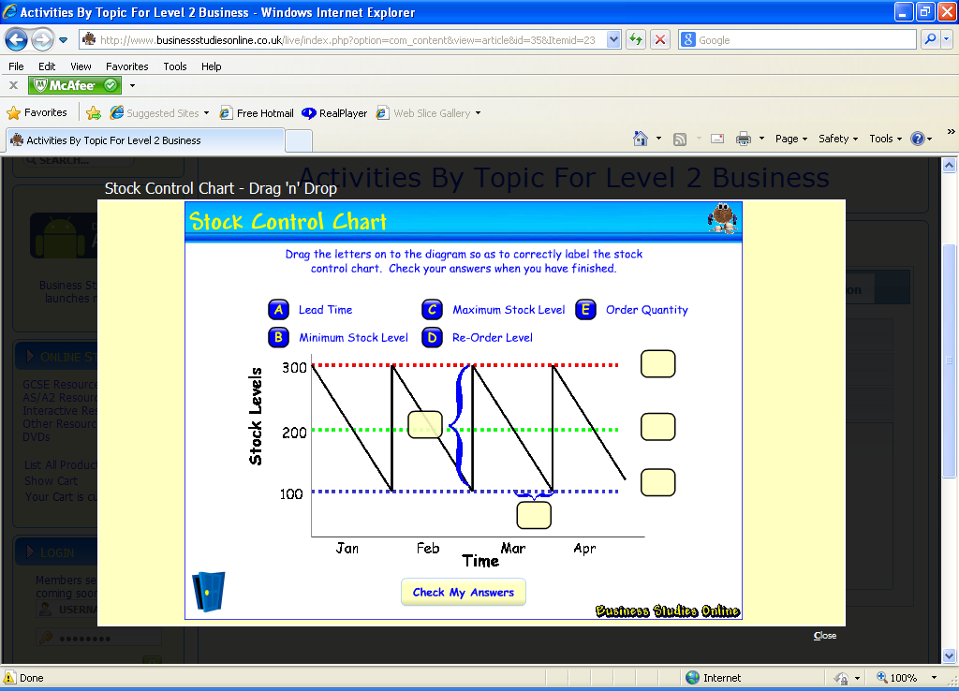
Effective Control and Management of Stock
A MAXIMUM LEVEL
This is the level of stock that should be held in order to minimise costs and the amount of required storage space.
Stock should not go above this level as it means overstocking occurs
B MINIMUM LEVEL
The stock level should not fall below this as shortages could result and production could be halted.
Stock should not go below this level as it means understocking occurs
C RE-ORDER LEVEL
This is the level at which stock should be re-ordered taking into account usage and lead time.
Stock should not fall below minimum level before the new stock arrives.
E LEAD TIME
This is the time taken between when new stock is ordered and it actually arriving at the organisation.
D RE-ORDER QUANTITY
This is the amount of stock ordered to take the back up to maximum once the new stock is delivered.

Slide 21
Activity: Stock Control
STOCK CONTROL TASK
STOCK |  |  |  | Max level
Week 3 |  |  |  | Min level
Wholemeal Flour |  |  |  | Reorder level
10kg bags
 | DATE | DETAILS | STOCK IN | STOCK OUT | BALANCE
Sunday | 20th January | Balance |  |  | 240
Monday | 21st January |  |  | 80 | 160
Tuesday | 22nd January |  | 75 | 80 | 155
Wednesday
Thursday
Friday
Saturday
Closing Balance
The above extract shows the stock control card for an item of stock stored in the warehouse of Jones's Bakery.
Using the information below, complete the stock record card for wholemeal flour and also answer the questions on the next page of your booklet:
Jones predicts that the bakery will use 80 bags of flour a day.
Jones has placed an order with a supplier for 100 bags to be delivered on Thursday, the supplier's lead time is 2 days
The flour Jones uses has a 'Use By' life of only 5 days

Slide 22
Activity: Stock Control (CONTINUED)
STOCK CONTROL TASK (CONTINUED)
Will Jones have enough stock to last him to the end of the week? Yes/No (score out the incorrect answer)
Jones has heard about setting a Max, Min and Reorder level to improve stock management, but he has no idea what these terms mean. Using the table below, describe to Jones what these terms mean and how these levels would help Jones improve his stock management.
In the grid on the previous page, write in appropriate Max, Min and Reorder levels for Jones to use, and give a reason below as to why you have chosen these levels.
Max level
Min Level
Reorder Level
Max level
Min Level
Reorder Level

Slide 23

Just In Time Stock Control
Just In Time
This is a method of stock control which involves getting stocks to arrive just before they are needed in the production process
Advantages
Money is not tied up in stock.
Less space required to store stock.
Reduces deterioration of stock.
Close relationship with suppliers
Disadvantages
If supplies do not arrive on time, this can disrupt production.
Can result in lost sales if supplies are late.
Highly dependent on suppliers.
May lose bulk-buying discounts.
Wrong items/amounts

Slide 24
Effective Stock Control
Questions Booklet Tasks
EFFECTIVE STOCK CONTROL
Stage 2: Q3-9
Total: 33 marks
HINT: Pay attention to the command words to ensure you answer the question correctly

Slide 25
Online Activities:
Stock Control
Carry out the following steps to access the online activities:
Log on to businessed.co.uk
Choose the menu button at the top left
Activities by Topic
Operations
Productivity
Try the Stock Control Chart Activity

Slide 26
Activity: Capital vs. Labour Intensive Production
EXPERT PAIRED TASK
Working in pairs each person should read through the information on the next few pages on either:
Capital Intensive Production (Partner 1)
Labour Intensive Production (Partner 2)
Each partner, now an expert on their type of production, should take it in turns to report back the following, allowing all pairs to gain knowledge on both production types:
What the type of production is (definition)
Advantages and disadvantages of this type of production
VIDEO CLIP TASK
Watch the following video clip and decide if it is capital or labour intensive production:
http://www.bbc.co.uk/learningzone/clips/bridgewater-pottery-made-in-britain/12862.html
The example is _____________ intensive production.

Slide 27


Labour Intensive Production
Labour Intensive
This is where manufacturing of products relies mainly on human effort ie labour in their production processes
Advantages
The product made is of a standardised quality
It is expensive and time consuming to recruit and train employees;
One-off and unique products can be made easily;
Individual customer requirements can be met;
Disadvantages
Machinery doesn’t need breaks and so can work 24/7;
The quality of the work can be variable depending on who carries it out.
Labour is usually relatively readily available;

Slide 28

Capital Intensive Production
Capital Intensive
This is where manufacturing of products relies mainly on technology ie machinery and equipment in their production processes. Usually only machinery is called automation.
Advantages
Workers can be creative and use their initiative.
There is no need to purchase expensive equipment;
Employees require specialist skills and this takes time to learn and training is likely to be required;
Individual customer requirements cannot be met.
Disadvantages
It is expensive to buy the machines and equipment;
Fewer employees are required saving on wage costs;
Breakdowns and stoppages can be expensive and can cause production to stop;
Employees require fewer skills to work machinery compared to labour intensive production so saves costs.
Notes:
Video clip of United Biscuits is available on the staff drive to show to pupils as an example of Capital intensive production.

Slide 29
Activity: Capital vs. Labour Intensive Production
CAPITAL OR LABOUR INTENSIVE?
Whilst watching the video clips, write below if each product is produced in a capital or labour intensive way.
1
2
3
Mini cooper
Wedding Dress
Baked Beans
____________ intensive
____________ intensive
____________ intensive
4
5
6
Nachos
Furniture
Art
____________ intensive
____________ intensive
____________ intensive

Slide 30
Methods of Production
There are 3 methods of production as follows:
Job Production
This is where a single product is made to a customer’s specific requirements. They are unique or one-off and handmade by someone very skilled. This is a labour-intensive method of production.
eg: wedding dress, designer kitchen, oil rig.
Batch Production
This is where similar products are produced in groups or ‘batches’ at the same time before another batch is started. No item goes on to the next stage until they are all ready. A variety of flavours can be produced in batches.
eg: bread, cakes, chocolate bars, tins of soup, cans of beans.
Flow/Mass Production
This is large-scale production where items move continuously from one stage of the production line to the next and each stage adds to it. All products are identical (standardisation). This is a capital-intensive method of production where automation methods are used.
eg: cars, TVs.
The following video clip shows the 3 methods of production:
https://www.youtube.com/watch?v=DTWnQDAhp9k
Notes:
Video Clip: https://www.youtube.com/watch?v=DTWnQDAhp9k

Slide 31


Job Production
Advantages & Disadvantages
Advantages
Designs are able to be changed to meet each customer’s individual requirements;
Customer satisfaction is likely to be increased as a result;
Higher prices can be charged due to the unique/one-off product;
Employees are more likely to be motivated as they are able to use their initiative and creativity.
Disadvantages
Expensive as a result of paying skilled craftsmen higher wages;
A wide variety of tools may be required in order to meet the specific requirements of each particular job;
It can take a long time to complete each unique product;
May not always be able to buy raw materials in bulk and so cost savings might not be made.
Notes:
http://www.youtube.com/watch?v=SvDUEaIqjoI

Slide 32
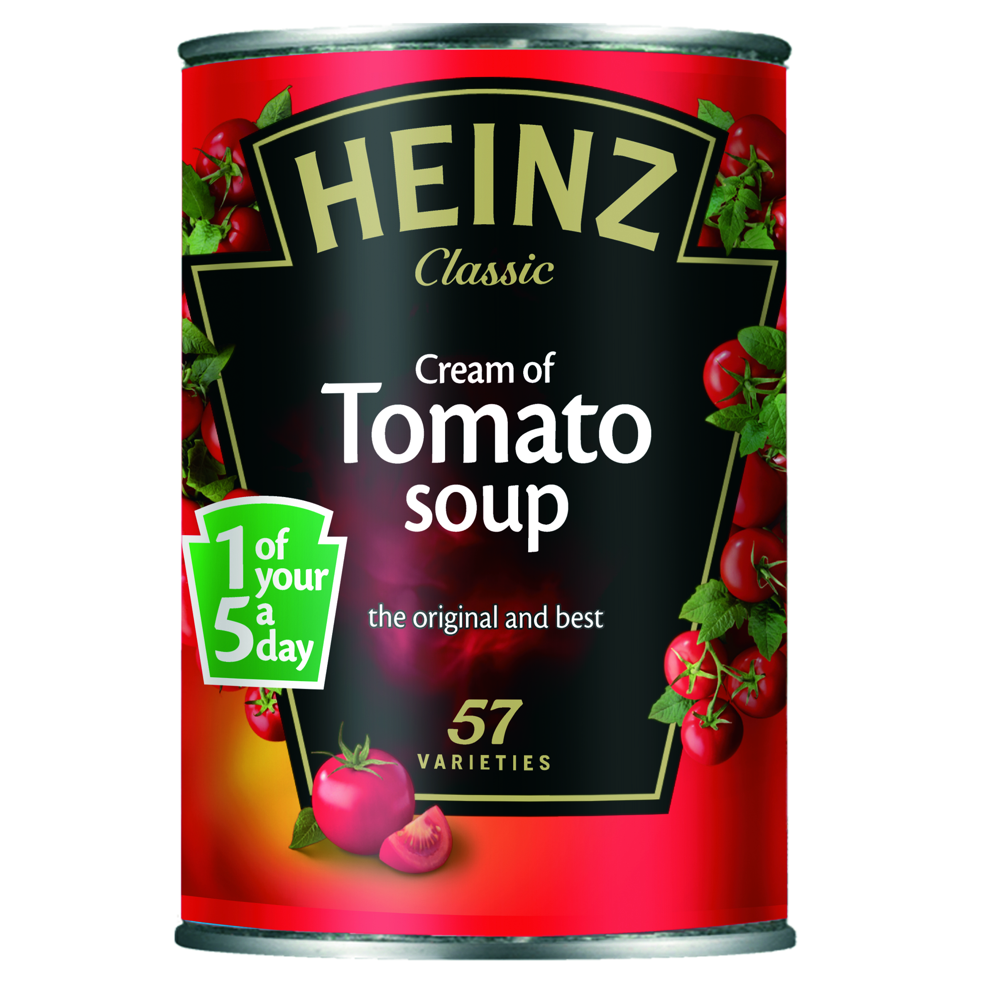

Batch Production
Advantages & Disadvantages
Advantages
Batches can be changed to an extent in order to meet specific customer requirements increasing customer satisfaction;
Reduces the need for costly, highly skilled staff;
Machinery can be relatively standardised, which helps to reduce costs;
May be able to save money as bulk buying of raw materials is possible.
Disadvantages
Expensive machinery is likely to be required;
Machines and employees may sit idle between batches so costs can increase;
If batches sizes are small then the costs of producing each item will still be high and so the price charged can be high;
Any mistakes can result in the whole batch being wasted which costs time and money.
Notes:
http://www.bbc.co.uk/learningzone/clips/production/8487.html

Slide 33

Flow/Mass Production
Advantages & Disadvantages
Advantages
Increases productivity as huge quantities can be produced;
Time and money is saved as machines can do the work faster than humans and do not require breaks and so can work continuously 24/7;
Waste is reduced as machines are more accurate and make less errors than humans;
Much lower labour costs as fewer workers are required.
Disadvantages
Individual customer requirements cannot be met as each product is identical and there must be a high demand for it;
It is costly to buy and set up the technology required ie machinery and equipment;
It is costly if there are faults/machines break down as production may slow down or halt;
Work can be very repetitive for employees.
Notes:
http://newsvote.bbc.co.uk/1/hi/business/7827560.stm

Slide 34
Factors to consider when choosing a method of production
Businesses have to carefully consider how they are going to turn their inputs into outputs. They have to decide which method of production is the best to use to make their products.
What resources are available eg finance, staff, and technology eg machinery and equipment?
How will stock be managed?
What quantity needs to be made? eg flow production is only suitable for large quantities
How does the business intend to make sure that the product is of a high quality?
Factors to consider when choosing a method of production
The actual product being made? i.e. is it unique or are many of the same to be made?
The size of the business and market

Slide 35

Leaflet Task – Methods of Production
METHODS OF PRODUCTION – LEAFLET TASK
Create a leaflet for the St Columba’s ICT Business Education Department. This leaflet will be used to educate others on the different ways in which products can be produced.
You must include all of the following:
  3 different methods of production
  Advantages and disadvantages of each production method
  Labour Intensive Production
  Capital Intensive Production
*Ensure you include real life examples*

Slide 36
Methods of Production
Questions Booklet Tasks
METHODS OF PRODUCTION
Stage 1: Q3-10 (15)
Stage 2: Q10-21 (35)
Total: 50 marks
HINT: Methods of Production = Job, Batch and Flow.

Slide 37
Online Activities:
Methods of Production
Carry out the following steps to access the online activities:
Log on to businessed.co.uk
Choose Activities by Topic
Operations Management Terms
Try the activities!
Production
Try the activities!

Slide 38
Benefits of Providing a High Quality Product to Customers
Customers are less likely to buy from a competitor
Sales and profits are more likely to be maximised so market share increases
A good image and reputation are gained which will encourage new customers
It becomes easier to recruit staff to work in an organisation with a good image and reputation
Benefits Of Providing a High Quality Product To Customers
Customers are more likely to make repeat purchases
Wastage will be minimised which helps to protect the environment

Slide 39
Activity: Quality
QUALITY PAIRED TASK
Today’s highly competitive markets mean that quality products are extremely important to a firm. The clip below will further highlight this:
http://www.bbc.co.uk/schools/gcsebitesize/business/production/locationanddistributionvid.shtml
Improving quality will allow customers to purchase with confidence and feel they are getting value for money and producers to gain an improved reputation and the ability to charge higher prices. Businesses use several methods to check that their goods and services meet quality standards.
In pairs:
Cereal bars
Sportswear
Make up
Cupcakes
Imagine you are a producer of one of the following products.
Decide upon 4 actions you could take to try and ensure your products are produced to a consistent high quality.

Slide 40
Methods of Ensuring a Quality Product
Using Good Quality Raw Materials
Use raw materials that are of a high quality
Advantages – Ensures only the best possible inputs are used
Disadvantages – Might cost more for quality raw materials, requires a reliable and reputable supplier
Employees
Make sure employees have the skills needed to make the product by:
only recruiting the best employees
providing training for employees
Advantages – Fewer errors will be made as employees will know what they are doing, accidents are less likely to happen
Disadvantages – Time consuming to train employees – might involve time away from doing the job, can be expensive to provide training

Slide 41
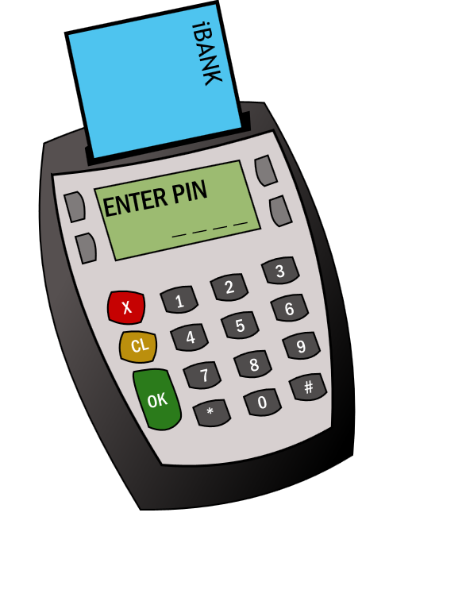

Methods of Ensuring a Quality Product
Maintaining Equipment
Ensure machinery and other technology is well maintained and regularly checked
Advantages – Any faults are hopefully discovered before they become a bigger problem
Disadvantages – Checking equipment regularly may be expensive, production may have to stop when checking machinery, might involve use of a specialist company

Slide 42
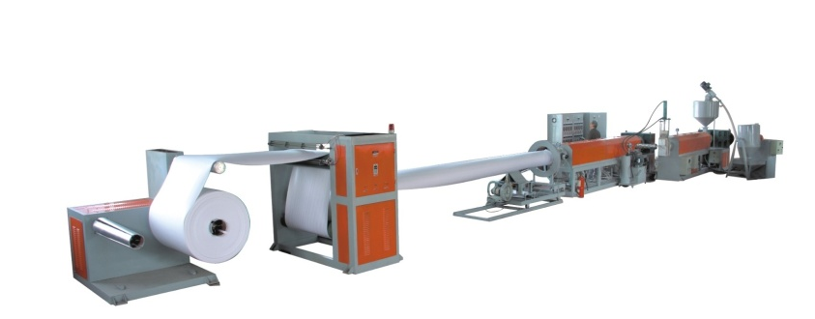
Methods of Ensuring a Quality Product
Quality Control
This is inspecting products at the end of the production process against agreed quality standards. Any unacceptable products are either discarded or sent back for correction.
This results in a reduction of lower quality products being sold to customers. However, it can result in high waste figures.
Quality Assurance
This is inspecting products at each stage in the production process against agreed quality standards. Any unacceptable products are either discarded or sent back for correction.
This reduces the waste figures considerably compared to quality control as faults are detected at an earlier stage.

Slide 43



Methods of Ensuring a Quality Product
Quality Circles
This is where groups of workers from all levels meet to discuss problems related to quality in order to identify solutions so that quality can be improved.
Allows the actual workers doing the job to make suggestions as they may know best where the problems/solutions lie and where improvements in quality can be made.
Benchmarking
The best techniques and practices used by another organisation which is considered to be “the leader/best” in the market are copied in order to make improvements to current practices and so improve quality.
Being considered the industry leader can enhance the company image and reputation.

Slide 44

Methods of Ensuring a Quality Product
Quality Management (previously TQM)
Focuses on quality throughout the whole organisation – not just production. It uses the philosophy of ‘getting it right first time, every time’ as a key to delivering quality at all times. To work fully it must have the commitment of all workers throughout the whole organisation with the aim of staying ahead of the competition by continuously improving. Clearly defined standards, policies and procedures exist and are implemented throughout to ensure quality at all times. All processes are evaluated on a regular basis to ensure that the most up-to-date quality systems are in place. Staff training is an ongoing process as a means of continually improving quality, productivity and motivating employees.

Slide 45





Methods of Ensuring a Quality Product
Quality Standards/Marks & Trade Logos
Achieving a recognised quality standard/mark eg BSI Kitemark, ISO, hotel stars or Investors in People shows that quality has been achieved and approved to a specific standard as set out by an independent organisation.
Achieving a Trade Logo such as the red ‘Lion Mark’ on eggs show that products have met an industry defined standard.
RESEARCH TASK – QUALITY STANDARDS/MARKS & TRADE LOGOS
Using the task sheet provided at subjects\BusinessStudies\Business Management\N4 AND N5 BUSINESS\N5\Operations research each of these to find out what they look like and how they are used.

Slide 46
Methods of Ensuring Quality
Questions Booklet Tasks
METHODS OF ENSURING QUALITY
Stage 1: Q11-12 (5)
Stage 2: Q21-30 (25)
Total: 30 marks
HINT: Pay attention to the command words to ensure you answer the question correctly

Slide 47
Online Activities:
Quality
Carry out the following steps to access the online activities:
Log on to businessed.co.uk
Choose the menu button at the top left
Activities by Topic
Operations
Quality
Try the activities!

Slide 48

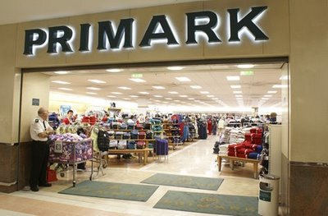

What is business ethics?
Business ethics is what you think is morally correct or not about the actions of a business
Includes working towards the ending of child labour, forced labour, and sweatshops, and looking at health and safety, labour conditions and labour rights.
TASK – GOING GREEN!
As a group brainstorm as many ways as possible that you think a company can go “green”.
See if you can beat the list on the next slide.

Slide 49


Ethical & Environmentally Friendly Practices
Minimising Wastage
Try to minimise wastage by ensuring employees are trained, ensuring machinery is maintained and by not overstocking.
Advantages
May reduce complaints from customers/pressure groups.
It can help to give a competitive advantage over other businesses.
It is good for Public Relations and helps enhance the image and reputation of the business.
Disadvantages
Financial and time costs of providing training and maintaining machinery.
Preventing Pollution
By disposing of any potentially harmful materials e.g. fuel, chemicals, tools, equipment in the most environmentally friendly way.
Advantages
Businesses are avoiding risk of prosecution or fines by following legislation on disposal of waste.
May reduce complaints from customers/pressure groups.
It is good for Public Relations and helps enhance the image and reputation of the business.
Disadvantages
It is likely to be financially expensive to do this (e.g. transport costs).

Slide 50

Ethical & Environmentally Friendly Practices
Recycling
Try to encourage employees to put rubbish in the appropriate coloured bins and by re-using materials used in the production process eg McDonalds recycle the cooking oil they use.
Advantages
Items can be reused to make new products
Takes less energy to recycle than to extract new materials
Limits the items ending up in landfills which reduces cost of landfills as less are required.
Improves the image of the organisation
May give the business an advantage over competitors
May be cheaper to produce using recycled materials
Disadvantages
Need to be sorted into different categories which takes time
Some items can only be recycled a limited amount of times e.g. Paper
May be seen as inferior or to reduce quality
Minimise Packaging
Using only the necessary amount of packaging required which still maintains the product’s quality.
Advantages
This reduces the cost of producing the product i.e. packaging costs
Is also good for the environment so improves the image and reputation of the business
Disadvantages
Eco-friendly recyclable packaging is likely to be more expensive.
Possible drop in the quality of the product in the eyes of the customer.
Notes:
Cosmetics business LUSH aim to minimise packaging: https://www.youtube.com/watch?v=D93eqr0yF1o

Slide 51
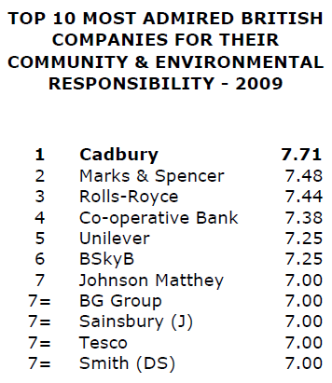
Activity: Ethics and Environmental
ETHICS RESEARCH TASK 1
The list below shows the most ethical organisations in the UK
Choose one of the organisations within the top 4 positions.
Research the company and find out what their environmental
commitments are.
Note their commitments in your jotter and be prepared to take part in a class or paired discussion.

Slide 52






Activity: Ethics and Environmental 2
ETHICS RESEARCH TASK 2
Select a business from the ones below. You will need to research the business on the internet. The aim of the task is to think about the actions of the business and if they are ethical or not.
Would you trade with this business? Give reasons for your answer.

Slide 53

Activity: Ethics and Environmental 3
PRESSURE GROUPS TALK TASK
Many businesses have pressure groups who protest against their business. This may be because they use suppliers who do not treat staff well, because they test on animals, because they harm the environment. Examples of pressure groups are Oxfam and Greenpeace.
Task Part One: Prepare a rousing speech to give to the rest of the class. You should select a company that you want to protest against. State
1: What are the actions of the company
2: Why is this unethical
3: What you want changed
4: Why people should join and support your pressure group.
Task Part Two: A selection of you will then deliver your speeches to the class. The person who gets the most members agreeing with their pressure group at the end of the lesson will win a small prize.

Slide 54
Ethics in Operations
Questions Booklet Tasks
ETHICS IN OPERATIONS
Stage 1: Q13 (2)
Stage 2: Q31-34 (14)
Total: 16 marks
HINT: Pay attention to the command words to ensure you answer the question correctly

Slide 55
The Use of ICT/Technology in Operations
Technology can work 24/7 with no need for breaks and in dirty, dangerous and hazardous situations
Processing products in batches — allows many similar standardised products to be made using pre-programmed machinery.
Online ordering system — streamlined ordering system with quicker timescales between online ordering and delivery.
Increases productivity as work is done faster, more accurately and with less waste and errors
The Use
of
ICT/Technology
in the Operations Department
Use of barcodes to track and monitor the transfer and use of stock in the production process
Automated machinery and robotics can be used to aid and enhance production

Slide 56






The Use of ICT/Technology in Operations
Word processing software (e.g. Microsoft Word) can be used to create order forms/letters to suppliers
Internet software (e.g. Internet Explorer or Google Chrome) can be used to access information e.g. to find a new supplier of raw materials
Spreadsheets software (e.g. Microsoft Excel) can be used to record, monitor and control production targets
E-mail software (e.g. Microsoft Outlook) can be used as a fast and cheap method of communicating with suppliers
Databases or Spreadsheets can record stock usage and stock value eg linked to barcode
The Use
of
ICT/Technology
in the Operations Department
Databases software (E.g. Microsoft Access) can be used to keep computerised suppliers records
Desk Top Publishing software (e.g. Microsoft Publisher) can be used to produce Health & Safety notices and newsletters

Slide 57
Use of ICT/Technology in Operations
Questions Booklet Tasks
USE OF ICT/TECHNOLOGY IN OPERATIONS
Stage 2: Q35-36 (10)
Total: 10 marks
HINT: Pay attention to the command words to ensure you answer the question correctly

Slide 58
Activity: Technology in Operations
DESKTOP PUBLISHING TASK
You should use Microsoft Publisher to carry out the following task.
Choose an organisation from the list below and circle it:
  Tesco Apple Ford Primark
2. Imagine you are working for the operations department of your chosen organisation. As an operations employee, you are to create a Health and Safety poster to display around the rooms of the organisation where their products are made. Your poster should outline the possible dangers which could occur in your organisation and what employees should do.
E.g. For Tesco, staff could injure their backs if they do not lift heavy items properly so they should lift by bending their knees not their backs.

