Slide 1


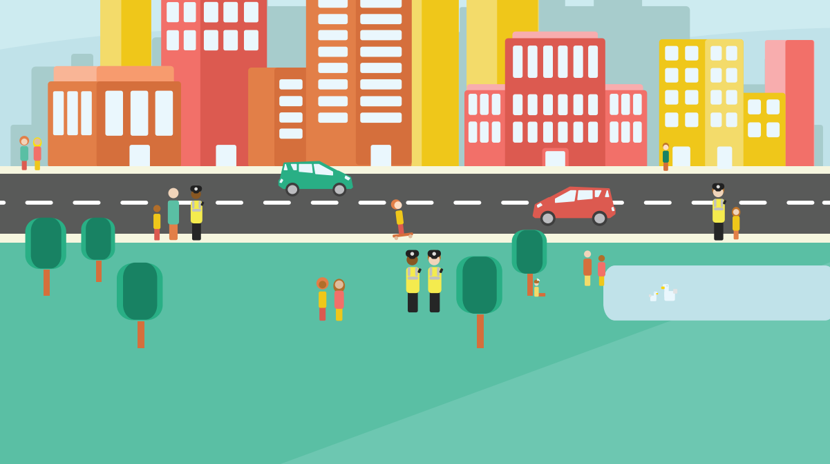
E-Scooters and Electrically Propelled Bikes
PolicingTogetherChildrenAndYoungPeople@scotland.police.uk
Notes:
Introduce yourself and explain the reason for this presentation is due to the misinformation and lack of knowledge about the legality of e-scooters and electrically propelled bikes.
Hi, my name is Verity and I am going to be talking you through this presentation on e-scooters and electrically propelled bikes in Scotland. It is important that you are aware of the laws relating to these so that you stay safe.

Slide 3
Aims and Objectives
Understand the law surrounding the use of E-Scooters and Electrically Propelled Bikes in Scotland
Understand the risks associated with their use
Understand the consequences of illegal use or misuse.
Notes:
We have some aims and objectives to cover during this quick presentation. We want you to understand the law surrounding the use of e-scooters and electrically propelled bikes in Scotland,
We want you to understand the risks associated with their use and
We also want you to understand the consequences of illegal use or misuse.

Slide 4
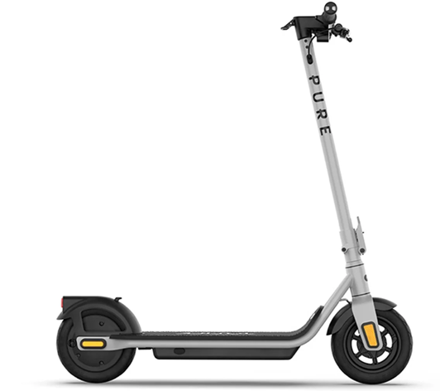
What is an
E-Scooter?
Notes:
First What is an e-scooter?

Slide 5
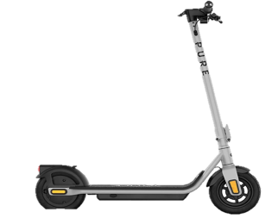
An e-scooter is a two-wheeled ride-on toy or vehicle that has a small motor to make it go. You stand on it, hold the handlebars, and press a button or lever to move forward. It’s like a regular scooter, but it doesn’t need you to push with your foot – it runs on a battery instead.

Slide 6

What is an electrically propelled bike?
Notes:
What is an electrically propelled bike?

Slide 7

An electrically propelled bike is a bike with two wheels that uses an electric motor and a battery to make it go, instead of using an engine. The throttle is on the handlebars. It looks a lot like a regular motorbike but doesn’t make loud noises or have exhaust pipes. Some of these bikes also have pedals just like a regular bicycle.

Slide 8
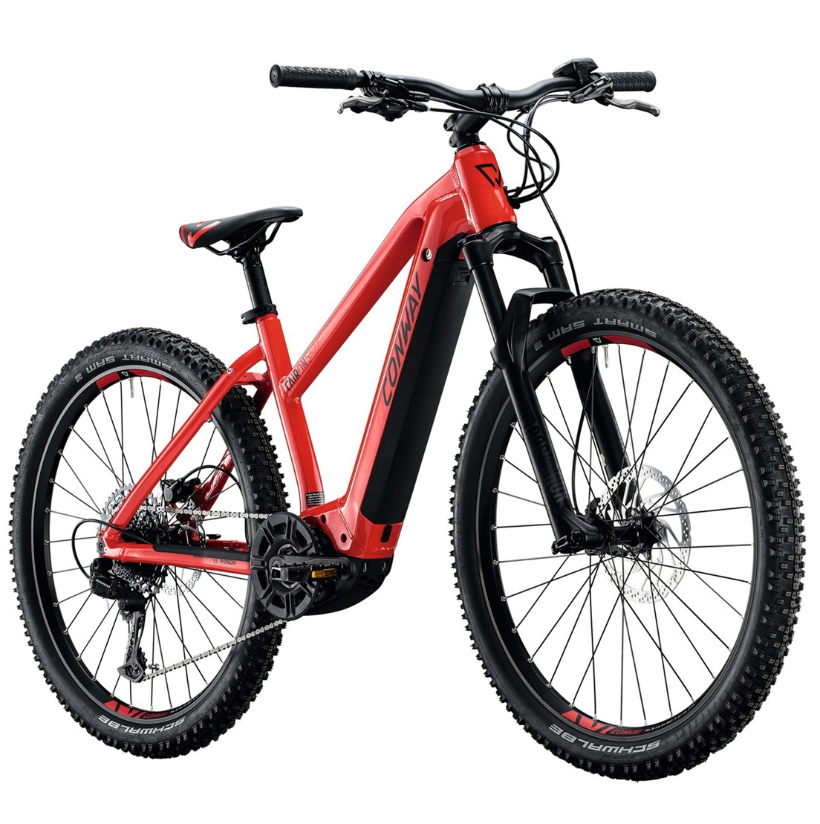
Not to be confused with an electric assisted pedal cycle (pedelec) which can legally assist you up to 15.5 miles per hour with a maximum power of 250 watts. You must be at least 14 years old to ride a pedelec public roads.

Slide 9
True or False
Notes:
Let’s play a quick game of true or false. Put your hand up if you think the answer is true and keep your hand down if you think it is false.

Slide 10
It’s OK to use an E-Scooter as long as you don’t go on the road?
False
Notes:
It’s OK to use an e-scooter as long as you don’t go on the road?
That’s false, e-scooters can only be used in Scotland on private land with the landowner’s permission. There are some council approved schemes that allow scooter use however there are none in Scotland.

Slide 11
It’s OK to use an
E-Scooter as long as you don’t go on the road?
False
Notes:
It’s OK to use an e-scooter as long as you don’t go on the road?
That’s false, e-scooters can only be used in Scotland on private land with the landowner’s permission. There are some council approved schemes that allow scooter use however there are none in Scotland.

Slide 12
You can use an E-Scooter on private land?
True
Notes:
You can use an e-scooter on private land?
Yes, but you must have permission from the landowner first.

Slide 13
You can use an E-Scooter on private land?
True
Notes:
You can use an e-scooter on private land?
Yes, but you must have permission from the landowner first.

Slide 14
E-Scooters are considered motor vehicles under Scottish law, similar to cars and motor vehicles?
True
Notes:
E-scooter are considered motor vehicles under Scottish law, similar to cars and motor vehicles.
This is true and that means that you must have all the same documents and a licence just like you would need to drive a car or motorbike.

Slide 15
E-Scooters are considered motor vehicles under Scottish law, similar to cars and motor vehicles?
True
Notes:
E-scooter are considered motor vehicles under Scottish law, similar to cars and motor vehicles.
This is true and that means that you must have all the same documents and a licence just like you would need to drive a car or motorbike.

Slide 16

1st
Well Done!
Notes:
How did you do?
Did you get them all right?
Don’t worry if you didn’t, we’re going to cover these questions through out the presentation

Slide 17

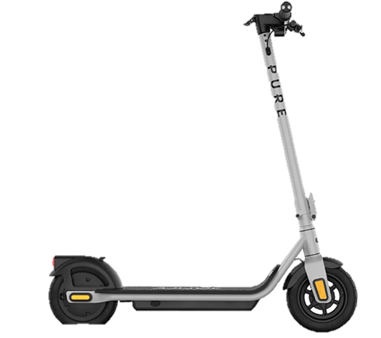
If someone rides an
E-Scooter or an Electrically propelled bike on a public road or in a place where it’s not allowed, they are breaking the law. This law is called the Road Traffic Act 1988.
Notes:
If someone rides an E-scooter or an Electrically propelled bike on a public road or in a place where it’s not allowed, they are breaking the law. This law is called the Road Traffic Act 1988.

Slide 18


Breaking the law means doing something that the rules say you're not allowed to do. Just like schools have rules to keep everyone safe and happy, the law is a set of rules for everyone in the country to follow. These rules are made to protect people, make things fair, and help everyone get along.

Slide 19
Do you need?
E-Scooter, E-Skateboard, Segway, Hover Board
Scrambler, Dirt Bike, Motorcycle, E-Motorcycle, Go-Peds
Licence required when used on a public road
YES
YES
Insurance required when used on a public road or in a public place
YES
YES
Vehicle excise license required when used on a public road
YES
YES
Vehicle registration required when used on a public road or in a public place
YES
YES
Safety equipment required (approved safety helmet)
YES
YES
Allowed on a public road (without any of the conditions above)
No
No
Allowed on a footpath
No
No
Allowed on a cycle route, cycle path or cycle way
No
No

Slide 20

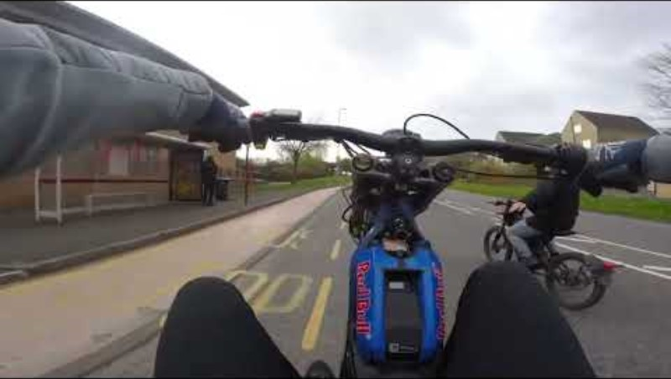
Notes:
We’re now going to watch a short video of someone using an electrically propelled bike. Can you discuss what you see in the video. What are the dangers? Do you think any road traffic laws are being broken? What do the think the consequences of doing this could be for the person riding the bike?

Slide 21
Please load prior to delivering this input
https://youtu.be/rDT1eQMqQRc
Notes:
We’re now going to watch a short video of someone using an electrically propelled bike. Can you discuss what you see in the video. What are the dangers? Do you think any road traffic laws are being broken? What do the think the consequences of doing this could be for the person riding the bike?

Slide 22

Did you notice the rider riding on the pavements?
Did you notice the rider doing wheelies?
Did you notice the rider and the group taking over the roadway?
Who could be at risk of harm in this clip?
Notes:
Did you notice the rider doing wheelies?
Did you notice the rider riding on the pavements and near to the pond?
Did you notice the rider and the group taking over the roadway and paying little care or attention to other motorists on the road?
Who could be at risk of harm in this clip?
The rider, the other riders in the group, other road users and even pedestrians.
Even though we couldn’t see the rider of the featured bike it was noticeable that no one in the group were wearing helmets. There were no licence plates which suggests that none of these bikes are legally allowed on the road.
Did you know that if the rider was stopped by the police that they would be charged with numerous road traffic offences and their bike would be seized and taken away. They would need to provide proof of ownership and documentation previously discussed before it would be returned. All of this would at their cost.

Slide 23
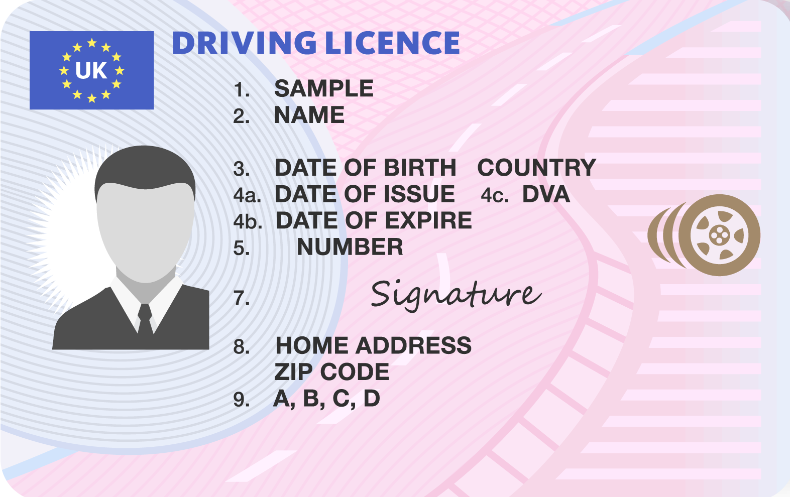
Notes:
Did you know that in some cases you could receive penalty points on your driving licence even before you have applied for one? The more penalty points you have, the higher your insurance premium will be. If you receive 6 penalty points in your first 2 years of driving you will have your licence taken off you until you resit your driving test.

Slide 24
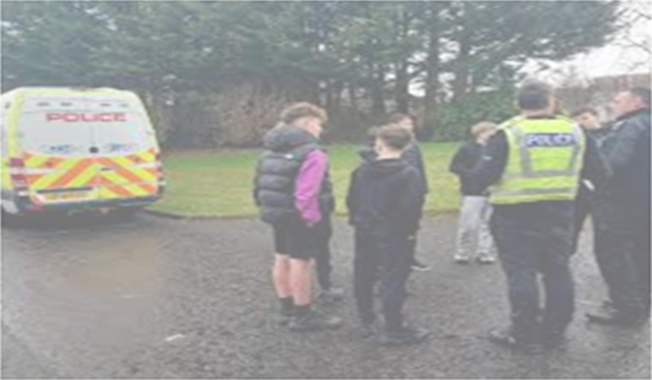
Be Safe
Notes:
Your safety comes first and that is why we have provided you with this presentation.
Although e-scooters and electrically propelled bikes appear to be a fun and environmentally friendly mode of transport it’s important that you are aware of the risks and consequences associated with their use.

Slide 25
Aims and Objectives
Understand the law surrounding the use of E-Scooters and Electrically Propelled Bikes in Scotland
Understand the risks associated with their use
Understand the consequences of illegal use or misuse.

Slide 26

FEEDBACK
WE WANT TO HEAR YOUR FEEDBACK AS THIS WILL HELP US IMPROVE AND DEVELOP THIS RESOURCE.
Notes:
We want to hear your feedback as this will help us improve and develop this resource. Please scan the QR code.

Slide 27
PolicingTogetherChildrenandYoungPeople@scotland.police.uk
Notes:
Thank you from me and all of Police Scotland.

