Slide 1
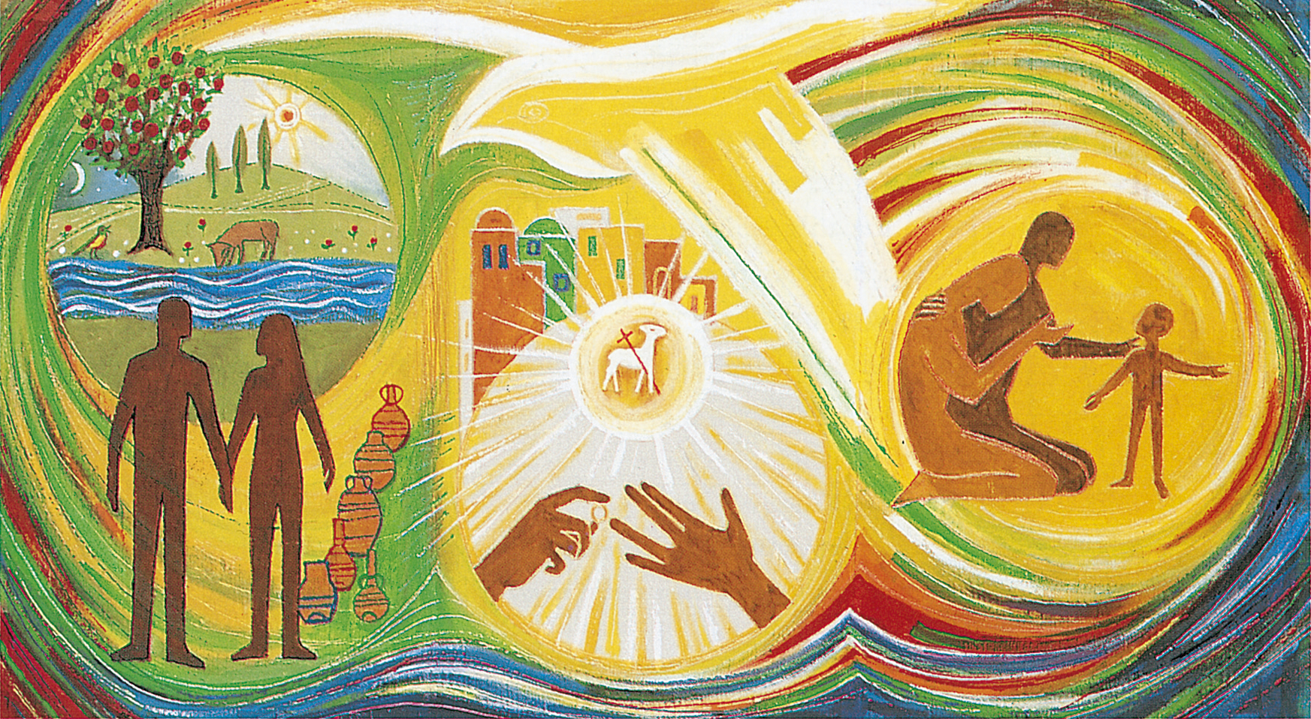
Themes
God gives me life.
God delights in me.
God calls me to love.
God’s loving plan guides my choices.
Notes:
On this slide an image and the 4 Theme titles appear automatically.
This is offered as a preamble to the video which will be shown. The key points to be highlighted relate to the meaning of the 4 themes:
God gives me life. Children will learn that God made us and so he loves us and wants only the best for us.
God delights in me. They will be helped to understand that God gave each of them particular talents, qualities and capacities, including their bodies which should always be cherished and treated with respect and care.
God calls me to love. They will learn that, because God created everyone and loves everyone, we should show respect to all people and not do anything which offends their dignity as God’s creation.
God’s loving plan guides my choices. Children will be helped to understand that, as they grow, they will learn more about how to respond to God’s plan for their lives. As they approach puberty, the time when they begin to see signs of growing from a child into an adult, they will learn about physical and emotional changes. They will also discuss the responsibilities which come with being an adult and a parent, and how these fit into ‘God’s Loving Plan’.

Slide 2


What does this suggest?
Notes:
After showing the video, you might want to pause and give a chance for some comments.
Use the logo to prompt thoughts about what is suggests
colours and crayon letters suggest that it is ‘child-friendly’
traditional symbol of romantic love hints that it is about loving relationships
Cross at the centre indicates God’s presence in our lives, our relationships.

Slide 3
Our approach
A Loving plan
God loves us; our families love us; we love others
We are called by God to share love with others
Building children’s confidence
encouraging healthy attitudes to our bodies
using appropriate words for parts of the body
Careful and gradual
appropriate to age and stage of development
Notes:
The approach of the Catholic school, when dealing with aspects of the Health & Wellbeing curriculum, is to connect children’s learning to their faith formation. So, God’s love is seen to be at the heart of their lives, both now and in the future
We want children to be secure and confident in their understanding of how their bodies function so that they can take god care of them and also show respect for the dignity of each other’s body.
We recognise that children are often surrounded by images which can encourage us to treat the body as an object, rather than a precious gift. We take care that children are not confronted with facts or images for which they are not prepared, emotionally or intellectually.

Slide 4
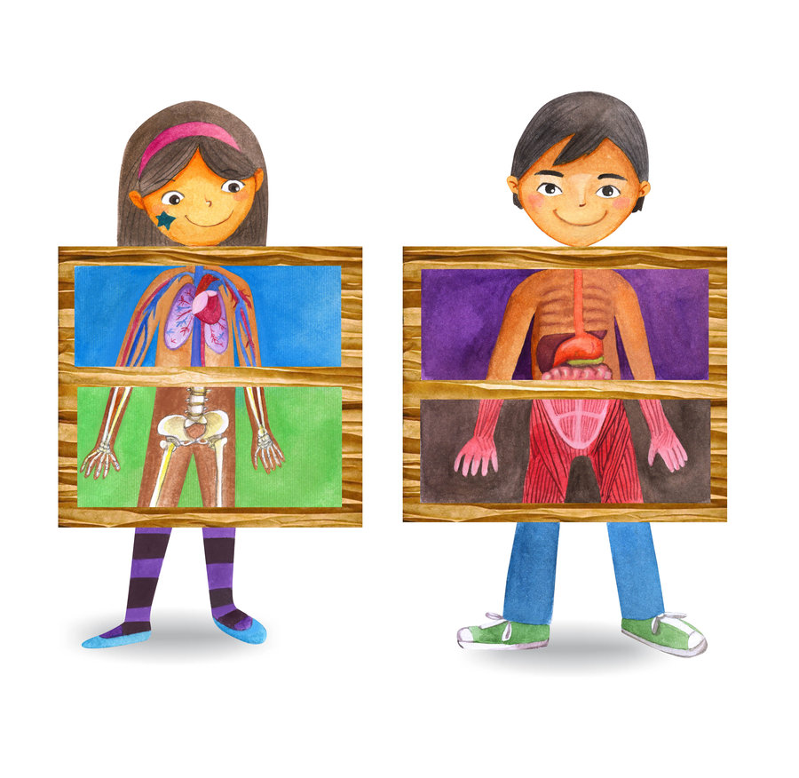
What will children learn?
Early  First  Second levels
how to take care of their bodies
Notes:
The following 6 slides refer to the main content areas of learning which will be gradually from Primary 1 to Primary 7

Slide 5
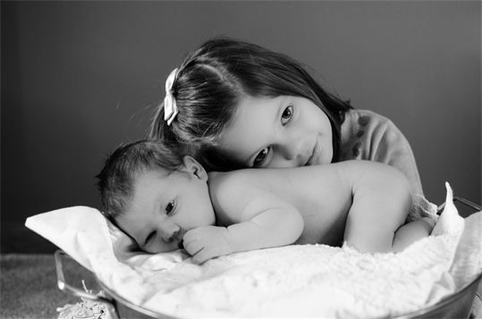
What will children learn?
Early  First  Second levels
their capacity to love family & friends

Slide 6
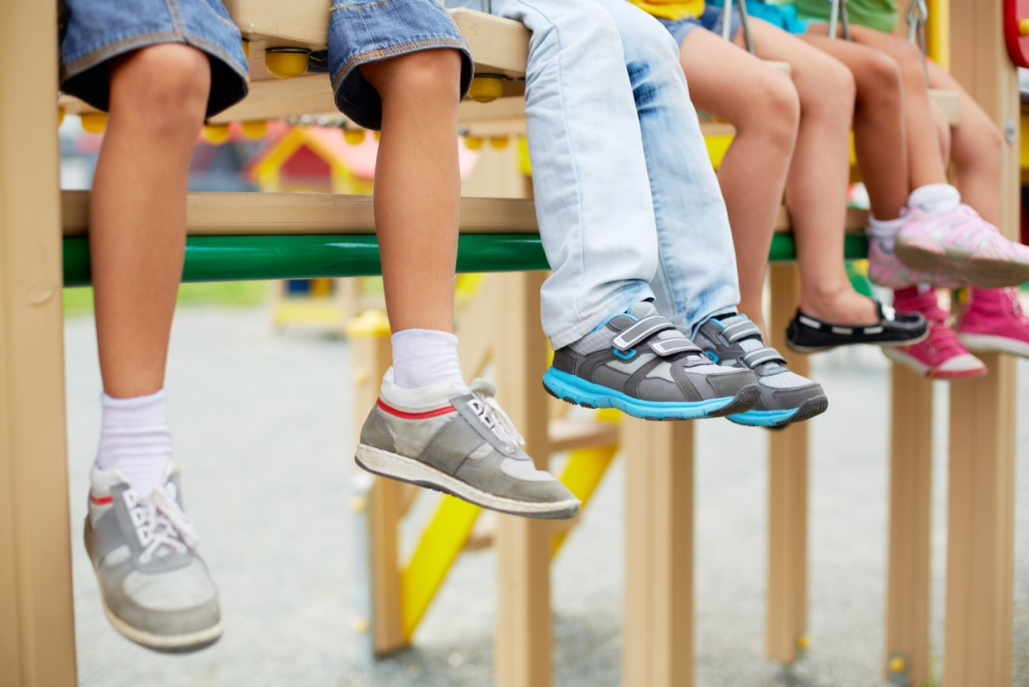
What will children learn?
First  Second levels
how their bodies are changing at different rates

Slide 7
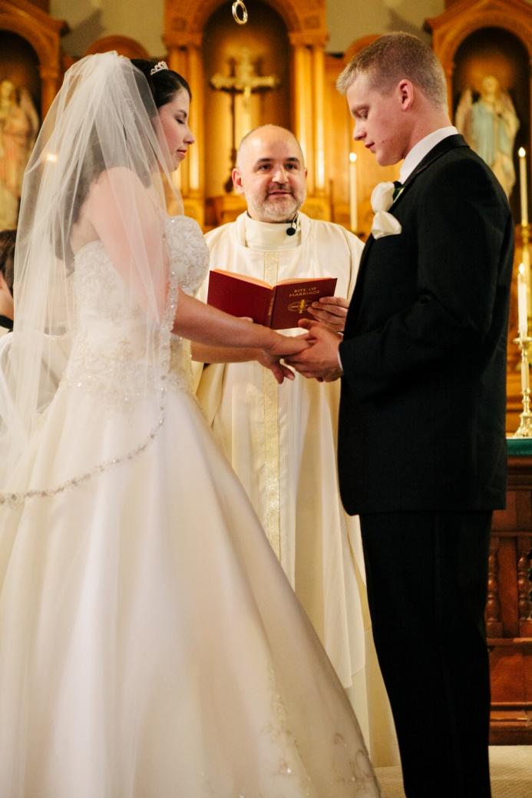
What will children learn?
Second level
how, as adults, they may choose to marry
how we celebrate the Sacrament of Matrimony

Slide 8
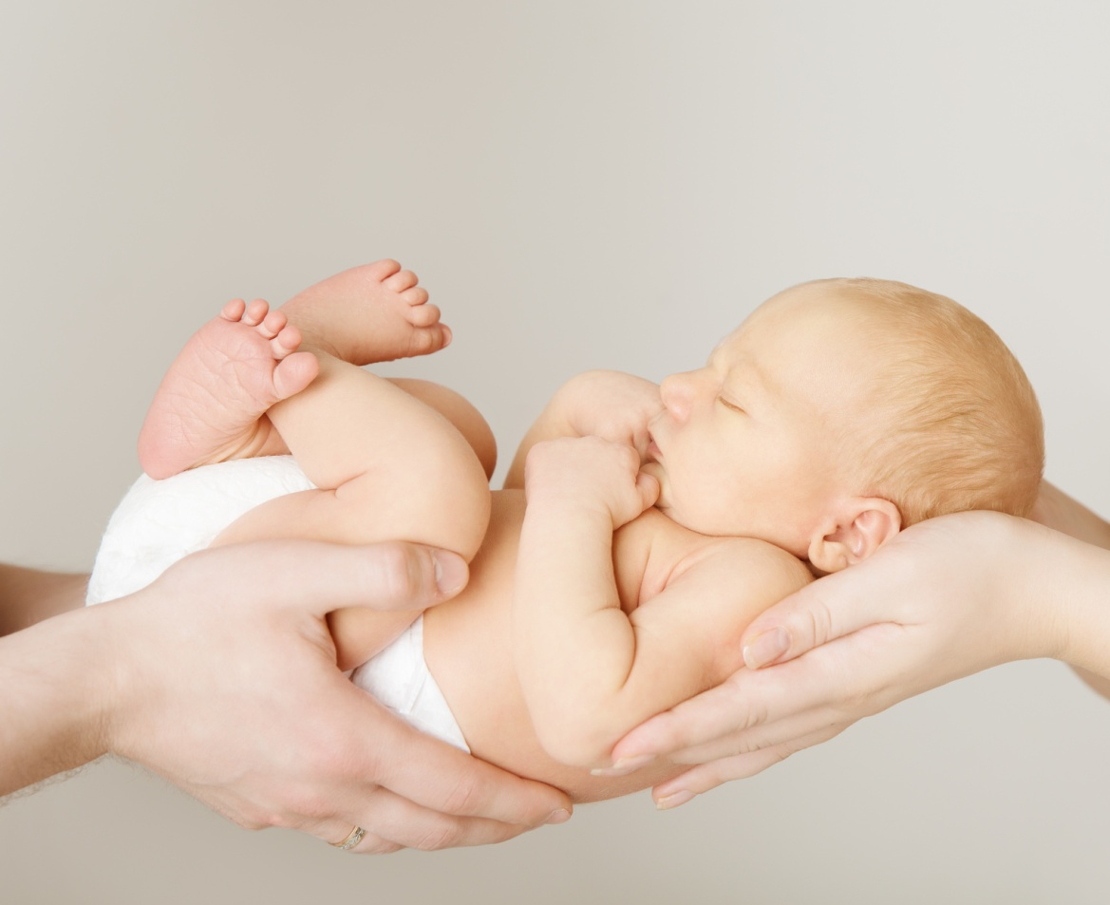
What will children learn?
Second levels
how they may become a parent

Slide 9
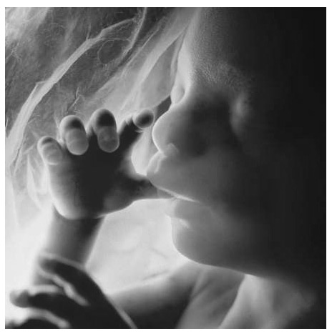
What will children learn?
Second level – Primary 7
how a child is conceived and grows in womb.
Notes:
Some pupil materials for different stages can be displayed for parents to view.

Slide 10
How can parents help?
be positive about your child growing up
equip them with correct language when talking about their body parts
assure them that physical changes in puberty are natural
help them to adapt to changing emotions
how them to know that they are loved for themselves and not for how they look.
Notes:
If these points have not already been made during the presentation, this slide summarises some of the key messages. A leaflet is available to support this – shown on next 2 slides. These could be available for handouts at the end.

Slide 11
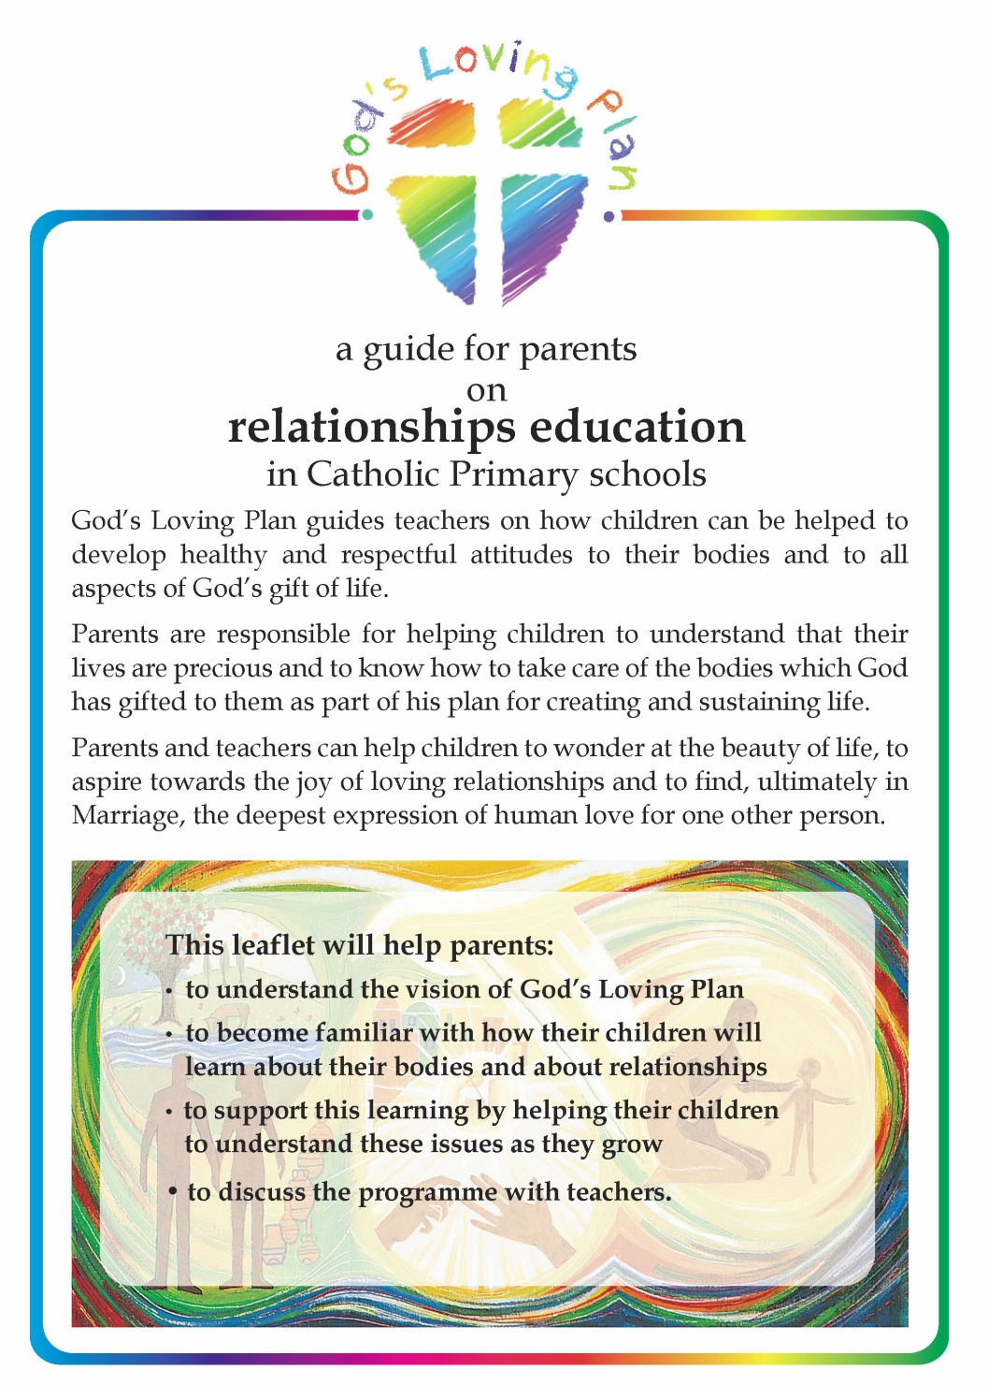
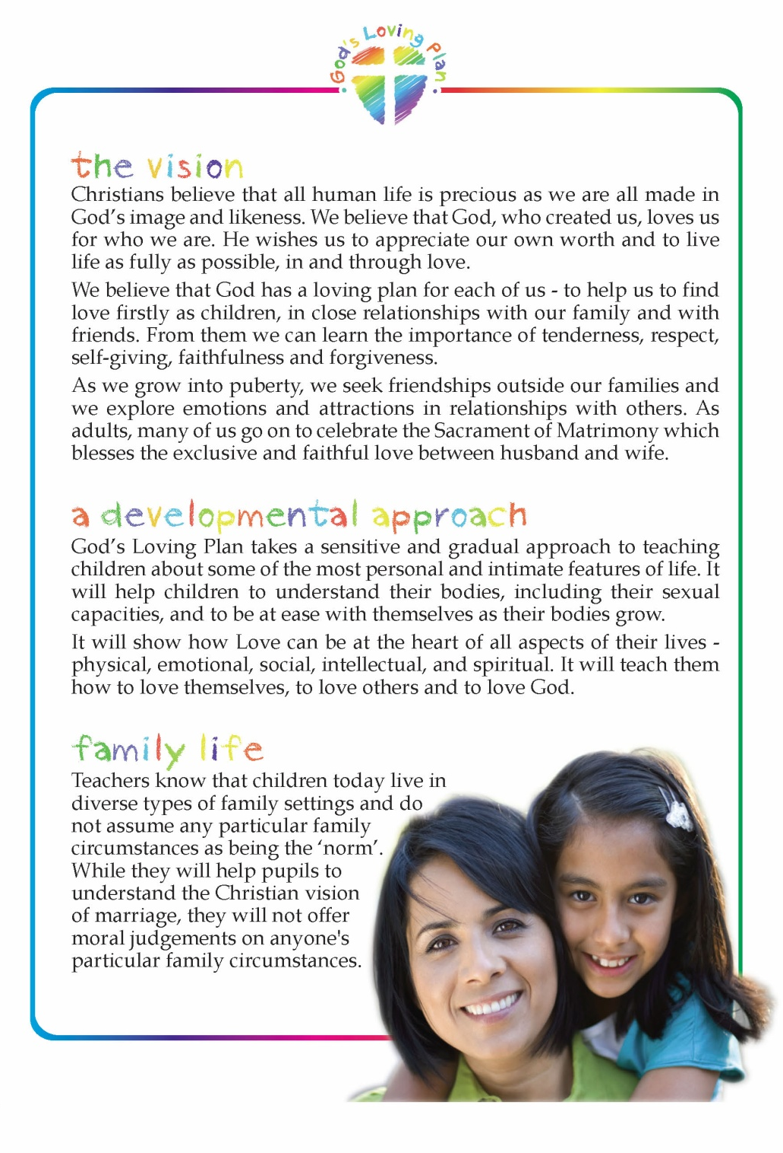

Slide 12
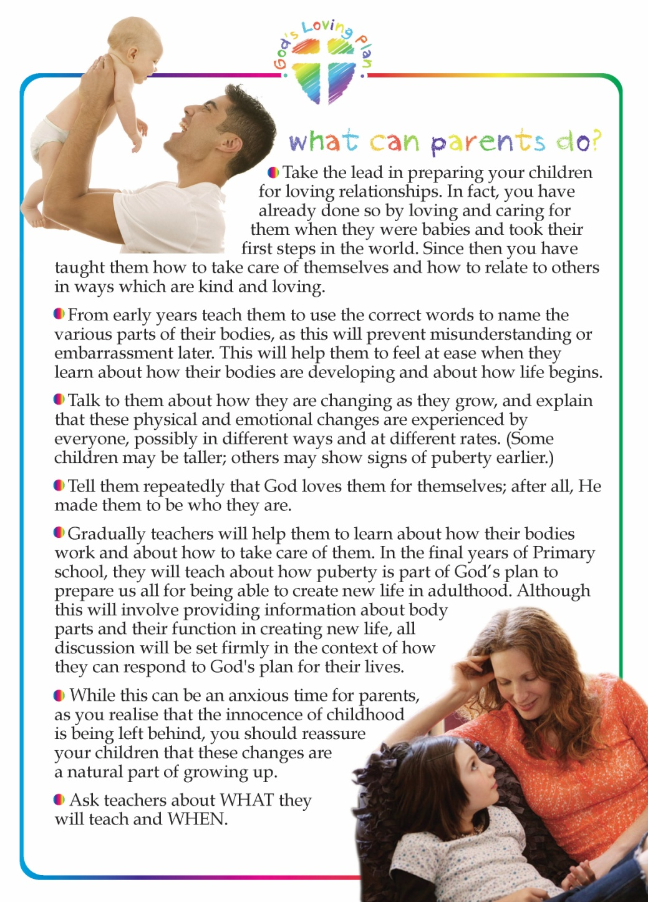
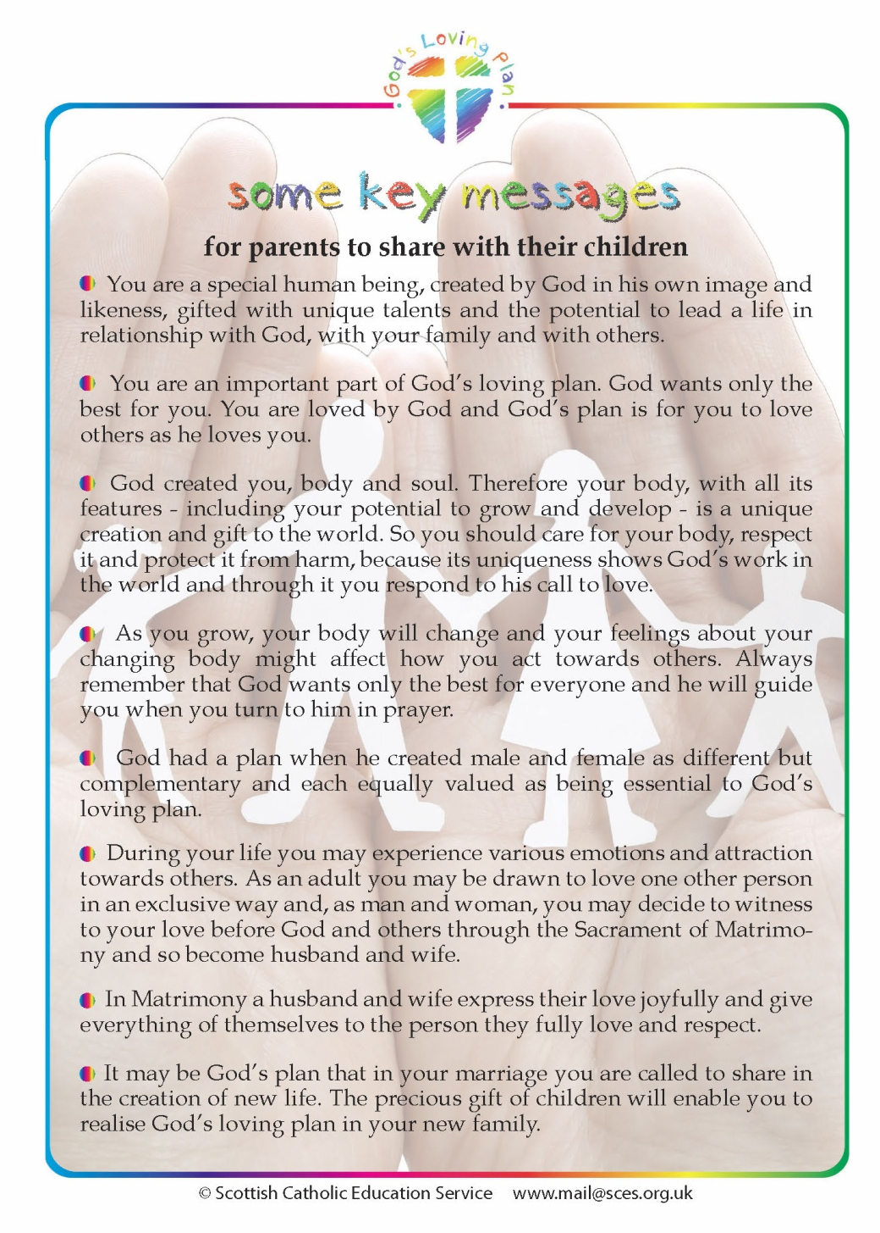

Slide 13

Families come in all shapes and sizes today.
Teachers do not ‘judge’ any family situation.
Marriage will be presented as the ideal setting for family life.
Children will learn how the Sacrament of Matrimony celebrates the loving and faithful commitment of a man and woman.
Notes:
This slide is provided to cover the issue of different family contexts and relationships. So, while children will be offered a vision of Marriage as the ideal, no assumptions or judgement will be made of children’s family contexts.

