Slide 1

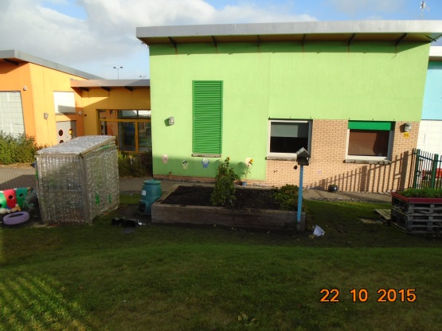
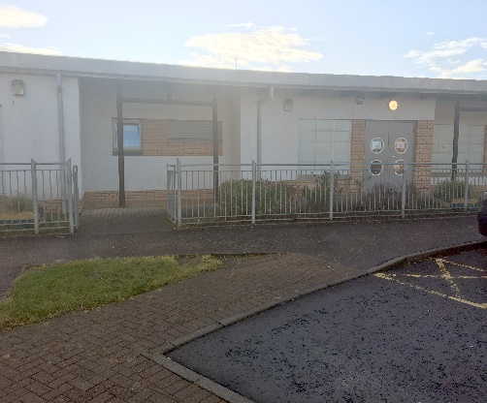
Handbook 2020
Rainbow Family Centre
Oronsay Ave
Port Glasgow
PA14 6DY
Telephone: 01475-715724
Management Team
Acting Head of Centre Sonia McKay
Depute Head of Centre Jenna Hemphill
Senior EYECO Laurette Paxton
Telephone: 01475-715724
Email: INRainbow@glowscotland.onmicrosoft.com
Website: https://blogs.glowscotland.org.uk/in/rainbowfamilycentre/
Twitter:
@RainbowFamilyC

Slide 2
Welcome
Aims vision and values
GIRFEC
Establishment Information
Holiday Information
Staff
Opening Hours
Admissions
Curriculum, Assessment and Arrangements for reporting to Parents
Equal Opportunities and Social Justice
Additional Support Needs
Home and Establishments
Attendance / Non Attendance
Establishments and Community
Medical and Health Care
Child Protection
Behaviour
Clothing
Meals and Snacks
Equalities / Information in Emergencies
Care Inspectorate
Complaints Procedure
Addresses
Data Protection
Contents:

Slide 3
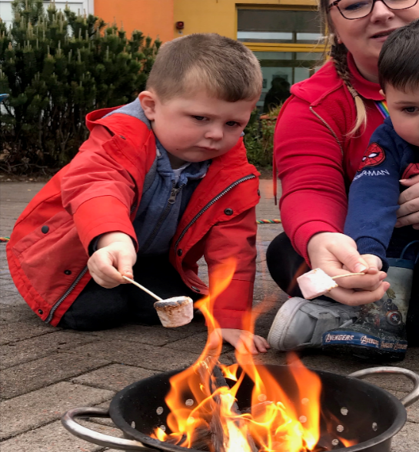
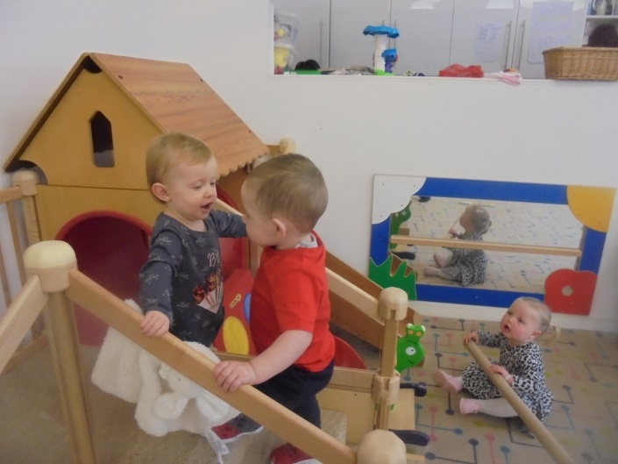
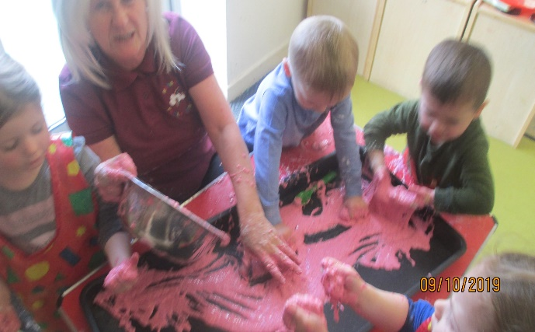
Welcome
Dear Parent/Carer
On behalf of all the staff, welcome to Rainbow Family Centre. We aim to offer a quality, fun programme of learning for you and your child based on individual needs and circumstances. In order to achieve this we provide an appropriate development programme to support your child’s learning. Our curriculum is enhanced by contributions from parents, which are vital in ensuring a child centred approach to learning, and are linked to national curriculum guidelines. This helps us to encourage and support everyone to maximise their full potential of becoming successful learners, confident individuals, responsible citizens and effective contributors.
We will endeavour to encourage children to learn as they play and will value every child’s needs and abilities. Children’s learning is planned and lays the foundations, through play, to help develop literacy and numeracy skills as well as confidence and self esteem.
We hope you will enjoy your time at Rainbow Family Centre and that you will work with us in partnership to help develop your child’s skills and abilities.
Sonia McKay
Acting Head of Centre

Slide 4
Rainbow Family Centre’s
Vision, Values and Aims
“Our vision is to continually work in partnership with our local community, using a multi-agency approach, to ensure our aims, vision and values get it right for every child and family with aspirations and positive outcomes reflecting this”
We aim to provide an inclusive environment for all children, families and the wider community without discrimination or prejudice.
We aim to provide a safe, friendly and caring environment, which is well maintained and resourced, where children and families can feel protected and supported.
We aim to offer activities and programmes within the Centre and in the Wider Community which are suitable for all, and ensure opportunities for children to take part in leisure activities and pursue their individual interests and skills.
We aim to access an environment suitable to support physical communication and mental health for children and families allowing them to make safe and healthy choices and to offer the opportunity for individuals to reach their full potential.
We aim to ensure children and families are receiving the guidance and support required to enhance confidence and self-esteem within the Centre, at home and in the wider community.
We aim to provide a nurturing environment for children and families, where they can form, trust, emotional security and develop quality stable relationships.
In an environment which is supportive and consistent, encouraging a strong sense of self-esteem, we aim to actively listen to all children, parents and carers views taking them into account when making decisions.
We aim to provide an environment where children and families feel they can be responsible for their own learning with appropriate support from all staff.

Slide 5
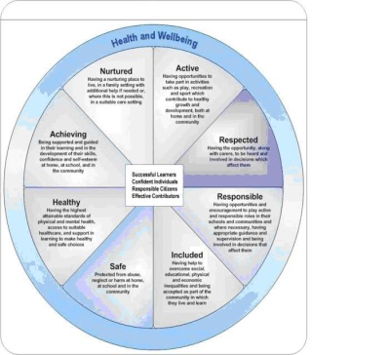
Getting it Right for Every Child
At Rainbow Family Centre our aim is to support every child through our universal GIRFEC Pathway. This pathway ensures a robust safeguarding and child protection ethos and policy. We strive to ensure that every child's care and wellbeing is an integral part of our daily practice, which will be informed and supported by National Guidance and Legislation.
At Rainbow Family Centre we will strive to work continually in partnership with our local community, using a multi-agency approach, to ensure our aims, visions and values are clear and that we are getting it right for every child by providing the best possible care and education for the children using our centre.
By developing our Aims, Visions and values in consideration with The United Nations Convention on The Rights of The Child we will ensure that every child will be made to feel Safe, Nurtured, Respected, Included and given the opportunities to be Active, Responsible, Achieving and be Healthy.
(GIRFEC)
At Rainbow Family Centre we aim to get it right for every child by ensuring;
Nurtured
Every child will be treated as an individual and their needs will be met. We aim to provide a nurturing environment for children and families, where they can form, trust, emotional security and develop quality stable relationships.
Active
Every child will have the opportunity for a range of physical activities both indoors and out. We aim to offer activities and programs, within the centre and in the wider community, which are suitable for all and ensure opportunities for children to take part in leisure activities and pursue their individual interests and skills.
Respected
Every child will have the opportunity to express themselves and have their views taken into consideration. In an environment which is consistent, and encourages a strong sense of self-esteem, we aim to actively listen to all children, parents and carers views taking them into account of decisions we make.
Responsible
Every child will have the opportunity to be responsible for choices within their own learning and have these choices respected by others. We aim to provide an environment where children and families feel they can be responsible for their own learning with appropriate support from all staff, who will support and encourage a sense of right and wrong, and support children to learn appropriate social skills and behavior which will allow them to be considerate to and understand others.

Slide 6
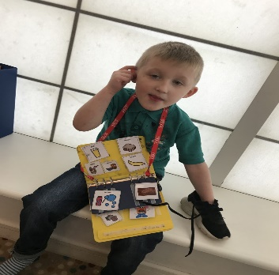
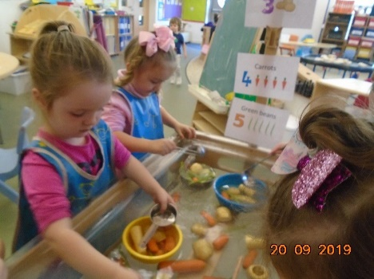
Included
Every child will have the right to be recognised as an individual and included in all aspects of the centre. We aim to promote an inclusive environment for all children, families and the wider community without discrimination or prejudice. We offer the opportunity for children and adults to participate in a safe, caring and supportive environment, to provide individuals with opportunities to participate in activities and programs in the centre and in the wider community, giving everyone the chance to reach their full potential.
Safe
Every child has the right to play in a secure environment which is clean with well-maintained equipment and resources. We aim to provide a safe, friendly and caring environment, which is well maintained and resourced, where children and families can feel protected and supported.
Healthy
Every child will have the opportunity to learn about healthy eating and healthy lifestyles. We aim to access an environment suitable to support physical communication and mental health for children and families allowing them to make safe and healthy choices and to offer the opportunity for individuals to reach their full potential.
Achieving
Every child will have the opportunity to reach their full potential and self-assess their learning. We aim to ensure children and families are receiving the guidance and support required to enhance confidence and self-esteem within the centre, at home and in the wider community. Children and families will gain opportunities to experience positive peer relationships and have their individual educational and social needs met.

Slide 7
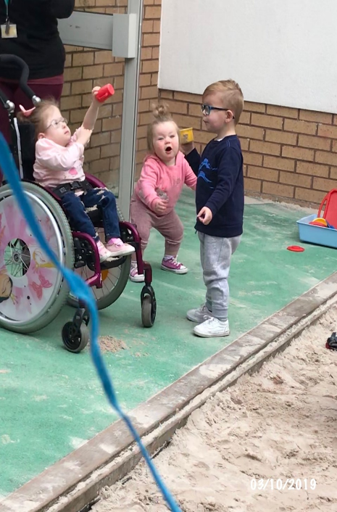
Establishment Information
Rainbow Family Centre
Oronsay Avenue
PORT GLASGOW
Inverclyde
PA14 6DY
Tel: 01475 715724
Email: INRainbow@glowscotland.onmicrosoft.com
Website: https://blogs.glowscotland.org.uk/in/rainbowfamilycentre/
Number of Children
72 full time equivalent 3/5 years
15 full time equivalent 2/3 years
6 full time equivalent 0/2 years
Services Provided
Early Learning and Childcare
Family Support
A wide range of Parent Classes
Community groups
School/Community Links
The Centre works closely with the local Primary Schools and High Schools supporting each other’s events and developments. Enabling continuity within transitions, we also have a very good relationship with the local care home who we regularly work in partnership with to engage in a variety of events and activities.
Transitions
We operate a smooth transition programme from nursery to our primary clusters with a variety of activities, visits and professional dialogue during which we have discussions regarding moderation of the curriculum. We also produce transition reports which we share with parents and primary colleagues.
Wrapround
We offer a limited number of wrapround places at Rainbow for a small fee, if you would like any information regarding this please speak to a member of staff who will be happy to give you further information and provide a Wrapround form should you wish to apply. Completed forms are processed by Education Services and are subject to a credit check.

Slide 8
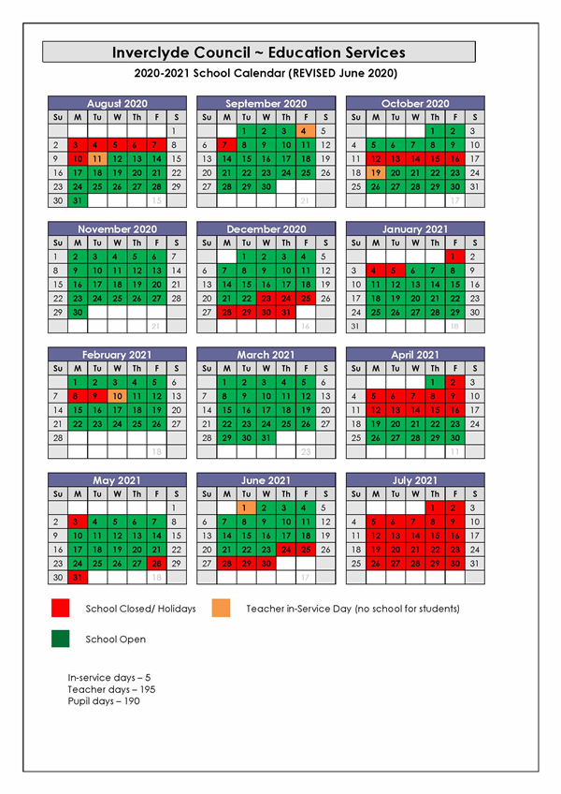
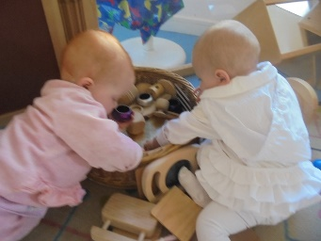
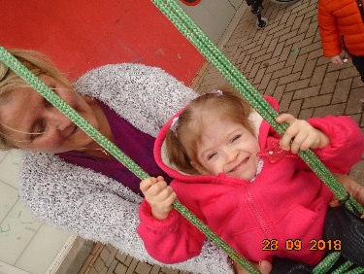
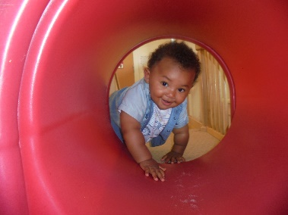
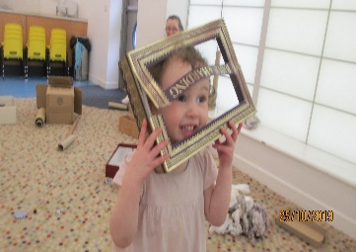
Please find Holiday information for the coming year, we hope this helps you to plan the year ahead for you and your family.

Slide 9
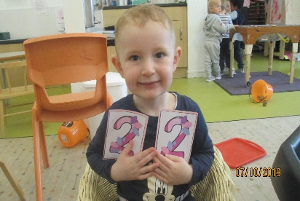
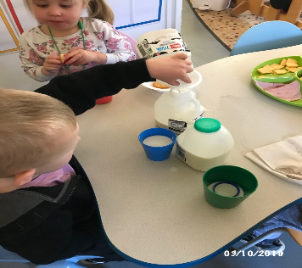
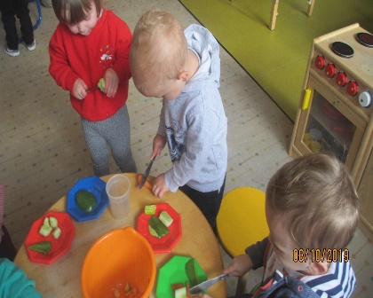
Rainbow Staff
Acting Head of Centre: Sonia McKay
Depute Head of Centre: Jenna Hemphill
Senior Early Years and Child Care Officer: Laurette Paxton
Early Years and Child Care Officers;
Pamela Loughlin Danielle Mathieson
Gillian Kelly Alexandra McEwan
Anne McAlinden Lyndsay Cleary
Ursula Smith Jessie Friel
Jennifer McDade Fiona Semple
Lisa Paterson Carolann Connelly
John Murray Kelly-Ann Glancy
Chloe Hagan
Gillian Harte
Karli Graham
Karen Tolan
Sarah Jayne McEwan
Julie McBrearty
Michelle Murray
Samantha Logan
Terrey McGhee
Nadine Graham
Susan Nichol
Early Years Graduate: Gillian Moore
Modern Apprentice: Rosalind McDonald
Support Assistants;
Zara Green
Ashley Cleary
Simone Sharpe
Family Support Worker: Catherine McIntyre
Clerical Assistant;
Helen Cassidy
Caretaker: Carol Mair
Cleaner: Karen Gregory
Catering Assistant; Marie Lavelle
Norah Donnelly
Contact staff on
Twitter: @RainbowFamilyC

Slide 10
ADMISSION TO NURSERY Session 2020-2021
If your child is three years of age in
Date of Birth: | Admission to nursery
March – July August September | August September October
October November December | November December January
January February | February March
Opening Hours
Rainbow Family Centre is open between 8.00 am until 6pm Monday to Friday. These times are subject to change as required to meet the service. Patterns of attendance for children in our 0-2 and 2-3 year old rooms will vary from the models detailed below please contact the Centre for information about provision in the under 3’s.
Children aged between 3 and 5 years old are now eligible to receive 1140 hours of early learning and childcare. We also have some availability within these models for 2 year olds who’s parents are in receipt of qualifying benefits. Children will be allocated a model of attendance in line with Inverclyde Council’s Early Years Admission Policy. Please contact the nursery for further information about our Admissions Procedures.
The models of attendance for children aged 3-5 years, and eligible 2 year olds, available at the Centre are as follows:
Model 1 over term-time
Monday to Friday – 6 hour days.
Model 2 over 50 Weeks.
Monday 8:10-5:45
Tuesday 8:10-5:45
Wednesday 8:10-12:45 Monday 8.45 am – 3.30 pm
Model 3 over 50 Weeks.
Wednesday 1:50-5:45
Thursday 8:10-5:45
Friday 8:10-5:45
Model 4 over 50 Weeks.
Monday to Friday 8:10 – 12:55
Model 5 over 50 Weeks.
Monday to Friday 1:00-5:45
Please speak to a member of staff for more information.

Slide 11
Our Curriculum
Learning in the Under 3’s
For our younger children we make use of a range of guidance including, Realising the Ambition and the Pre-Birth to Three framework, to promote enquiry, curiosity and creativity through a variety of play experiences. Our staff promote nurture in an environment where wellbeing and communication lay the foundations for our pedagogy.
Learning in the 3-5 Room
We ensure that our children will become Confident Individuals, Successful Learners, Effective Contributors and Responsible Citizens in an environment which supports and encourages children to engage in highly motivating learning experiences which are responsive to the needs of individual children and offer appropriate challenge.
Our experienced staff are guided, in their approaches to learning and teaching, by Curriculum for Excellence which ensures that children have access to high quality learning in all curricular areas. We have piloted aspects of Planning in the Moment to further enhance our children’s experiences and support them as they develop skills and lay the foundations of future learning.
Pedagogy and play
We offer learning experiences that are creative, stimulating and engaging and are delivered within the context of our developed pedagogy for children 0-5 years. All staff are aware of the need to scaffold children’s learning and are mindful of interacting appropriately. We are currently piloting and evaluating a free flow approach which provides children with opportunities to play and learn within mixed age groups, this was a result of research and participation in training events. Children within Rainbow Family Centre have had the opportunity to transition from rooms at their own pace considering their stage of development and not just age, therefore we began this journey that allows children to access space and environments that they can engage more meaningfully within their learning.
Impact
Children are visibly engaged and happy within their play.
Children are assessing risk and building resilience.
Children are interacting with different age groups enhancing social development.
Children are observed as being deeply engaged, showing concentration, creativity, energy and perseverance, evident through our use of observations based on Leuven's scale of wellbeing and involvement.
Children’s transitions are timely and appropriate to stage of development and taken at children's individual pace.

Slide 12
Staff in the Centre encourage and support children in developing self esteem and self confidence in an environment where they are secure, have formed warm, caring relationships, feel safe, confident and good about themselves. This is necessary if children are to learn effectively.
We promote learning by:
Understanding that children learn by building on, and extending their previous learning experiences.
Giving children the right to have a say in planning for their own learning.
Providing a stimulating and challenging environment which encourages the individual child to explore, experiment, discover and understand the world around them.
Acknowledge the importance of social interaction with others at home, at nursery and in the community.
What Active Play Means
Active play is important for the development of children because it is the way a child learns.
Through active play and exploratory situations the individual child is preparing for the next stage in their development and learning.
Free Play
Free play provides children with opportunities to choose from a broad range of activities and experiences. This allows them to develop interests, to try out different ways of learning and to explore materials and relationships while supported by skilled practitioners who are aware of the importance of sensitive intervention, during free play activities, and how these can support or extend the learning experience.
Education for Citizenship
We support the governments’ citizenship priority. The creation of a good citizen is a process which begins at a very early stage in your child’s life. Parents, carers and members of the community and staff within the centre will make a powerful contribution to this process.
Citizenship is about making informed choices and decisions, about taking action individually, and as part of collective processes.

Slide 13
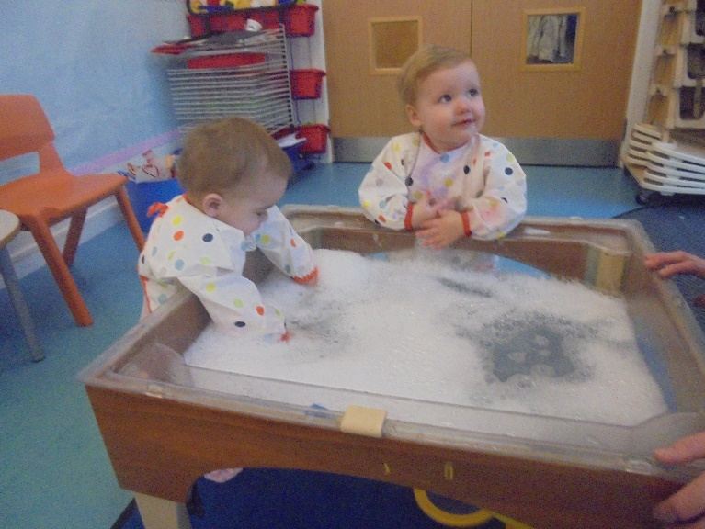
Group Times /Planned Learning Experiences
Group times allow staff to stimulate interests, to teach, develop and practice skills. Group times also provide opportunities to revisit and extend previous learning experiences in order to bring continuity to learning and probe children’s thinking. The observation and assessment of children’s progress will determine the specific activities and experiences provided at such times.
Promotion of a Positive Ethos within the Establishment
Rainbow Family Centre strives to provide a home-like, emotionally secure atmosphere where the staff are friendly, approachable and work towards creating a warm and caring environment.
This fosters positive attitudes and encourages confidence and self esteem which therefore promotes a positive ethos within the Centre
At the centre we operate an open door policy for all users of the service.
Early Intervention
At the Centre we aim to develop children’s literacy skills through play. The Centre provides children with a rich literacy environment. Children are encouraged to take part in activities and experiences that promote interest and develop early skills in reading and writing.
Children are encouraged to listen carefully to sounds and rhymes, to handle books correctly and to engage with stories. They are encouraged to express their thoughts and feelings with regard to stories and rhymes through retelling them in their own words, recalling and predicting events.
Children are encouraged to enjoy books and stories and other language based activities on a daily basis, and every month the children have a rhyme of the month. Staff provide a range of experiences to promote children’s early maths and numeracy skills through a range of play experiences. Staff monitor children’s progress and achievements on a regular basis so that focussed and targeted intervention can be put in place to support children or challenge them in their learning.

Slide 14
Establishment Procedures for Reporting to Parents
At the Centre we operate a Keyworker System. We work with parents to support the learning of the individual child by talking and sharing information on a daily basis. Parents are invited to work alongside keyworkers to develop their child’s personal plan. Each child’s learning journey is located outside each playroom and parents are welcome to browse through their own child’s learning journey and we welcome your contributions and achievements from home. Parents days/evenings are held at regular intervals throughout the year and staff will inform you of these dates.
As we operate an open door policy, parents are welcome to visit the Centre at any time to discuss the progress their child has made at the centre.
Further information on Curriculum for Excellence or the pre-birth to three can be found by logging on to Education Scotland Website www.educationscotland.gov.uk or www.educationscotland.gov.uk/parentzone
Parents can also find other information regarding parenting on both these websites.
Please be aware that, following government guidance due to the Coronavirus pandemic, parents are unfortunately not able to enter the nursery building. Therefore, we are using other methods of reporting to parents. If you have any questions about your child’s progress at nursery please don’t hesitate to call the Centre.
Equal Opportunities and Social Justice
“Inverclyde Education Service is committed to ensuring that no children or members of staff or service users receive less favourable treatment on any grounds including gender, race, disability, age , sexual orientation, religion or belief. We have a moral, social and legal obligation to mainstream and put equality at the heart of everything we do. We aim to promote a culture in which equality of opportunity exists for all. We are opposed to all forms of discrimination, direct or indirect, and aim to eliminate all discriminatory practices. We will ensure, that in our schools and other educational establishments equality permeates the curriculum and underpins all our policies and practices in terms of access to education. We must ensure that all our children achieve their full potential to develop physically, emotionally and academically. Finally, we believe that equality and inclusion should be a given right, where everyone is valued and treated with respect”.

Slide 15
Children with Additional Support Needs
Every member of staff has a responsibility to support the learning of all children. The type of support offered will vary according to the needs of children. This includes consideration given to children who have a disability, children with social, emotional and behavioural difficulties, children with learning difficulties of a specific or general nature, children who are exceptionally able, those who demonstrate underachievement relating to gender issues, children whose learning has been interrupted through absence or illness, bilingual children who have English as an additional language, travelling children and those children whose family circumstances impact on attendance and learning. Partner agencies may be asked to offer support where necessary.
The authority’s policy in relation to provision for additional support needs
A child or young person’s needs are identified at the earliest possible stage and can be met in a number of ways, for example by adaptations to the curriculum or learning environment, as well as input from the Support for Learning Teacher and on occasion support from visiting specialists. The appropriateness of the support is determined through a process of assessment, planning and monitoring, working jointly with parents and carers, and is regularly reviewed.
The arrangements made by the authority in making appropriate arrangement for keeping under consideration the additional support needs of each such child and young person and the particular additional support needs of the children and young persons so identified.
Learning outcomes for children and young people with additional support needs are set out in a plan and all educational establishments hold regular review meetings with parents and carers to determine needs and the most appropriate supports. Everyone’s views are equally important in order to consider what is currently working and how to determine next steps
The other opportunities available under this Act for the identification of children and young persons who -
have additional support needs,
Children and young person’s needs are identified in a number of ways, and the process of assessment is an ongoing, shared process with partnerships with parents and carers at the forefront. On some occasions health service staff or other partner agencies make children known to Education Services. Other additional support needs may be notified to Education Services by parents themselves or identified by one of a range of staff working closely with the child, for a co-ordinated support plan.
The coordinated support plan is a statutory document which ensures regular monitoring and review for those children and young people who have one.
require, or would require, a co-ordinated support plan,
Some children and young people will have additional support needs arising from complex or multiple factors which require a high degree of co-ordination of support from both education and other agencies in order that their needs can be met. In these cases, the school will hold a meeting to decide whether the child or young person meets the criteria.

Slide 16
The role of parents, children and young persons in the arrangements referred to in paragraph (b),
You have the right to ask the education authority to establish whether your child needs a coordinated support plan. Your child can make this request themselves, if they are aged 16 or over. You and your child, if they want to, will attend a meeting with staff at their school. Other professionals from different agencies who may be involved in providing support for your child will also attend. If your child does not want to attend meetings or feels unable to, their views must still be sought and considered.
The mediation services provided
Inverclyde’s mediation service can be accessed by contacting Tony McEwan, Head of Inclusive Education, Culture and Corporate Policy at the address below
e) the officer or officers of the authority from whom parents of children having additional support needs, and young persons having such needs, can obtain advice and further information about provision for such needs.
For further advice please telephone 01475 712842
or write to;
Education Services
105 Dalrymple Street
GREENOCK PA15 1HU
Further Information
Organisations which provide advice, further information and support to parents of children and young people with additional support needs include:
(a) Children in Scotland: Working for Children and Their Families: Enquire – the Scottish advice and information Service for additional Support for Learning
www.enquire.org.uk
(b) Scottish Independent Advocacy Alliance
www.siaa.org.uk
(c) Scottish Child Law Centre
(d) www.sclc.org.uk

Slide 17
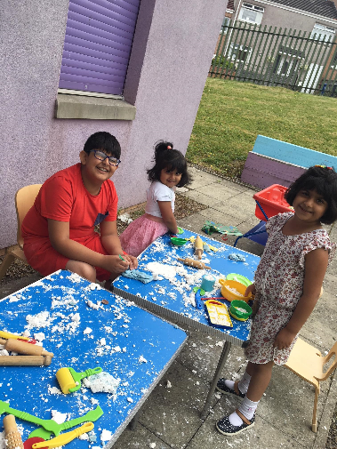
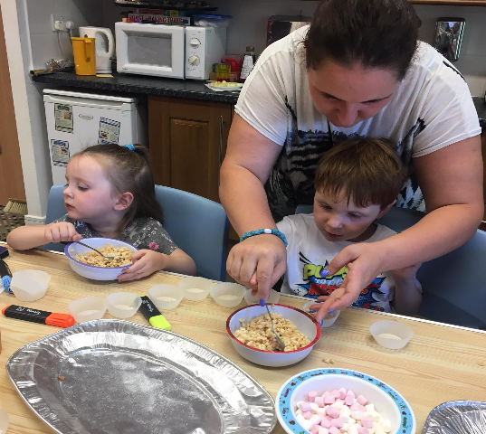
Home Links and parental participation
We encourage active participation in your child’s learning. It is important to develop a partnership model where we work together to enable your child to maximise their potential. We will regularly share with you a record of your child’s achievements and would be grateful for any contributions you make to enable us to celebrate your child’s achievements at home and the community here at the nursery.
The Family Support Worker offers support and advice to all service users within the centre. The Family Support Worker is also available to support residents within the community with any issues that may arise. The centre’s Family Support Workers offers a variety of activities e.g. Baby Massage, Family Cooking, Book Bug, Parent/Carer Toddler Group, Eat Wise Drop a Size. The Family Support Worker works alongside a variety of agencies e.g. Barnardo’s, Community Learning and Development, Social Work and Health Services. This partnership enables us to offer parents a holistic and targeted service.
The centre produces a newsletter on a regular basis to keep you informed of events and planned activities which will supports your child’s learning. If you would like to become involved in any way in your child’s learning while they are at nursery or have anything you would like to be included within the newsletter please speak to a member of staff. As we are committed to working in collaboration with all parents/carers this is in line with Inverclyde councils parental involvement strategy.
*At present due to the COVID situation our Community groups and classes are suspended until further notice. However, if you require any support or advice please don’t hesitate to contact the Centre.
Attendance
We would encourage parents/carers to use the place allocated at all times.
We do understand however that at times your child will be unable to attend due to sickness or other issues. On these occasions please phone us (715724) or get someone to come and tell us. This is especially important for parents/carers who are requested to financially contribute to the cost of the service. If we do not here from you it is Council Policy that your child’s keyworker will contact you using the contact numbers provided.

Slide 18
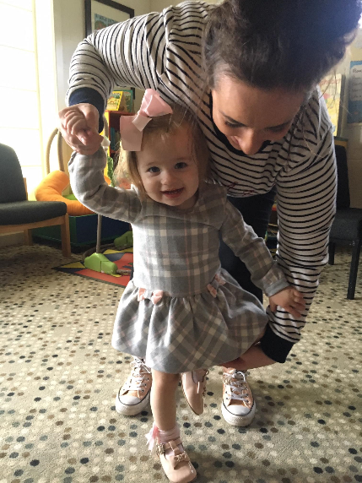
Non Attendance
In the event of you being unable to attend the Centre for a period of two weeks or more a letter will be sent to you to enquire if we can help in any way. This may be delivered in person by our Family Support Worker.
Unfortunately, due to demand, if you still cannot attend a further letter is sent asking you to discuss with staff any difficulties you may have. We must point out at this stage that a date, by which you may contact the Centre, is set and if there is no contact at this time your child’s name is required to be removed from the register. This does not mean you cannot reapply if your circumstances change.
Establishment/Community
Parents/carers are welcome to come into the Centre at any time and join in activities with staff and children.
Our Family Support Worker is also involved in the organising and running of various adult classes and groups, which you are welcome to come and join. We would encourage parents/carers to take an active part in the life of the Centre e.g. Bookbug sessions, Parent & Toddler Groups, Keep fit, Cookery classes etc.
The Centre operates an open door policy and we welcome comments and ideas from people in the local community for activities they may wish to attend.
*At present, due to the COVID situation our Community groups and classes are suspended until further notice.

Slide 19
Medical and Health Care
At enrolment parents/carers are asked to give information about their child’s health. It is important that your child’s keyworker is kept informed of any medication that your child requires or of any known illness or allergies. Please keep staff informed so that information can be kept up-to-date at all times.
If your child requires medication, during his/her time at the Centre, you should discuss these requirements with your child’s keyworker. Prescribed drugs will be given at the discretion of the Head of Centre and you will need to fill in a form which authorises nursery staff to administer the drugs to you child in line with Care Inspectorate guidance.
Forms are available at the nursery to be completed by yourself and your child’s keyworker.
If your child becomes ill while at the Centre we will inform you of the situation. If we are unable to contact you we will contact
your emergency numbers given at enrolment. It is important to keep emergency contact information up-to-date at all times particularly if you change phone number.
If your child has a minor accident while at Centre, the incident will be dealt with and recorded. We will inform you at the time, if necessary, or when you collect your child.
There is a qualified first aid worker within the Centre and an appointed first aider. If at any time your child is ill with an infectious condition please contact the Centre for advice as to how long your child should remain off nursery so as to help protect other users of the Centre. A child who is unwell will always wish to be at home.
In line with Inverclyde Council policy no smoking is allowed within any of the Centre buildings. If you do smoke outside of the Centre we would ask you to do so with consideration for others. Please do not smoke within the grounds, or the car park of the nursery.
The Centre has two designated disabled parking areas, please only park in these spaces if you are in receipt of a blue badge. The Centre participates in an oral hygiene programme, dental and eye screening programmes.
Thank you for your support in this matter.
Child Protection in Inverclyde
Inverclyde Council Education Services has Child Protection Guidelines and Procedures which all schools and establishments are required to follow. Education Services work very closely with other agencies namely Police Scotland, Social Work Services, NHS Greater Glasgow and Clyde and the Children’s Reporter to support children. Common responsibilities of all staff are to protect children from abuse and exploitation, to respond appropriately when abuse is identified, and to ensure whenever possible that all children are able to exercise their right to be raised in a warm, stimulating and safe environment with the support of staff, their families and carers.

Slide 20
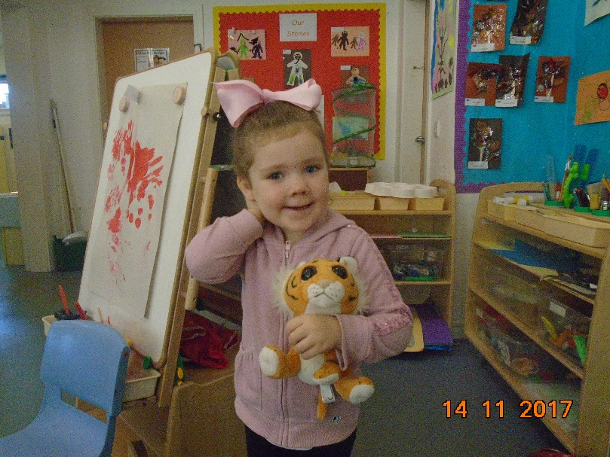
Behaviour;
The Centre operates a positive behaviour policy this is in line with Inverclyde Councils positive relationships positive behaviour policy.
At Rainbow Family Centre we use a tool called PATHS to promote positive behaviour;
We aim to create an environment were children are encouraged to behave in a positive manner, showing respect and tolerance towards peers and staff.
Our PATHS programme aims to promote alternative thinking strategies in children increasing their social competence and social understanding (PATHS, 2015), alleviating aggression and undesirable behaviour in the centre. The PATHS programme conceptualises various areas of curriculum for excellence (Scottish Government, online) including building positive relationships with peers, self-esteem, problem solving, self-control and children understanding and dealing with their emotions.
The rational for this project is based on previous research that early intervention that promotes social and emotional development can positively improve mental and physical health as well as having a significant impact on children’s educational attainment (Allan, 2011). Underpinning this is The Standard for Childhood Practice ensuring the responsibility in making sure all children are provided with opportunities and programmes that will promote positive behaviour, self-control and independence (SSSC, 2015). In consultation with the staff team we identified the need for change to improve our children’s learning and development, PATHS was suggested by a couple of members of staff, as we had training previously from the educational psychologist who reinforced John Bowlby’s theory of emotional attachment (McLeod, 2007) to which the majority of staff could identify with the children in our care. At that point we made a shared decision to introduce PATHS which would embed the children (Scotland) Act in promoting and ensuring the wellbeing of the children and families in the centre.

Slide 21

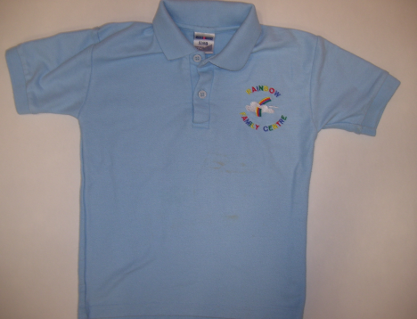
Clothing
We would ask that children do not wear their best clothes to the Centre. This can often restrict their play as they worry about getting dirty.
Sweatshirts and polo shirts with the Rainbow Centre logo are available to buy in Smiths shop in West Blackhall Street, Greenock.
Inverclyde Council operates a policy of no jewellery for all its children and in the interest of your child’s safety we would ask that you respect this. Similarly there are forms of dress which are unacceptable in establishment, such as items of clothing which:
potentially encourage faction (such as football colours)
could cause offence (such as anti-religious symbolism or political slogans)
could cause health and safety difficulties, such as loose fitting clothing, dangling earrings, or clothing made from flammable materials for example shell suits in practical activities
could cause damage to flooring
carry advertising, particularly for alcohol or tobacco; and
could be used to inflict damage on other pupils or be used by other to do so
The Council is concerned at the level of claims being received regarding the loss of children’s clothing and/or personal belongings. Parents are asked to assist in this area by ensuring that valuable items and unnecessarily expensive items of clothing are not brought to the establishment. Parents should note that the authority does not carry insurance to cover the loss of such items and any claims submitted are likely to be met only where the authority can be shown to have been negligent.
Parents should note that the activities the children may become involved in may be restricted because health and safety requirements state that jewellery of any kind must not be worn where children are undertaking physical activities. This includes jewellery worn as a result of body piercing.

Slide 22
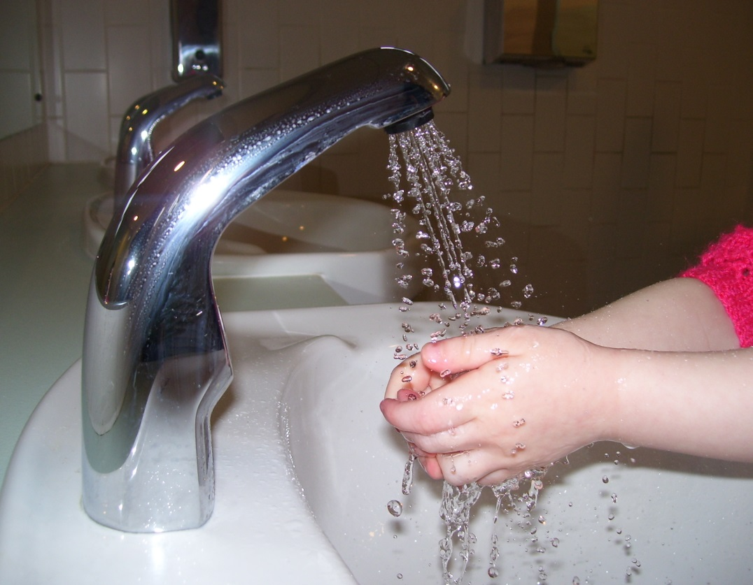
Meals and Snacks
Within the Centre we aim to provide a healthy eating policy. Snack is provided both morning and afternoons. Children in the 3-5 room are entitled to a healthy lunch depending on their model of attendance. A limited number of lunches are available in our 0-2 and 2-3 year old rooms depending on individual needs. Please speak to a member of staff for more information.

Slide 23

The Equality Statement for Inverclyde Establishments
‘Inverclyde Education Service is committed to ensuring that no children or members of staff or service users receive less favorable treatment on any ground including gender, race, disability, age, sexual orientation, religion or belief. We have a moral, social and legal obligation to mainstream and put equality at the heart of everything we do. We aim to promote a culture in which equality of opportunity exists for all. We are opposed to all forms of discrimination, direct or indirect, and aim to eliminate all discriminatory practices. We will ensure that, in our schools and other educational establishments, equality permeates the curriculum and underpins all our policies and practices in terms of access to education. We must ensure that all our children achieve their full potential to develop physically, emotionally and academically. Finally, we believe that equality and inclusion should be a given right, where everyone is valued and treated with respect.’
Information in Emergencies
We make every effort to maintain a full educational service, but on some occasions circumstances arise which lead to disruption. Establishments may be affected by, for example, severe weather, and temporary interruption of transport, power failures or difficulties of fuel supply.
In such cases, we shall do all we can to let you know about the details of closure or re-opening. We shall keep you in touch by using letters, notices in local shops and community centres, announcements in local churches and announcements in the press and on local radio.
Our evacuation location in the event of a major emergency is
Craigmarloch Primary School Telephone 01475 715345
Boglestone Community Centre Telephone 01475 715771
Further information can be located within the nursery building.

Slide 24
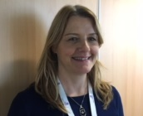
Care Inspectorate
The Centre is inspected on a regular basis by the Care Inspectorate to ensure we maintain a high quality of provision in line with the National Care Standards outlined by the agency.
Care Inspectorate
Social Care and Social Work Improvement Scotland
4th Floor
1 Smithhills Street
PAISLEY
PA1 1EB
Tel: 0141 – 843 – 4230
Rainbow Family Centre, CS2003016250
Inspector: Ann McIntosh Email: ann.mcintosh@careinspectorate.com ( Mobile: 07879115804 )

Slide 25
Complaints Procedure
Parents / Carers can raise concerns about the service direct to the Care Inspectorate at their address below, or on the Enquiry Line Number, However if you have any concerns please do not hesitate to speak to any member of the management team who will be happy to listen to any concerns or issues you may have and put systems in place to resolve if at all possible.
Care Inspectorate
Ann McIntosh
1 Smithhills Street
Paisley
PA1 1EB
Tel: 0141 -843-4230
Enquiry Line Number 08456009527
Parents/Carers can also raise concerns to Inverclyde Council
Send your complaint by post to
Complaints
Inverclyde Council
Customer Service Centre
Municipal Buildings
Clyde Square
Greenock PA15 1LY
Email to: comments@inverclyde.gov.uk
Useful Addresses
Ruth Binks, Corporate Director
Education, Communities & Organisational Development
Municipal Buildings
Clyde Square
Greenock PA15 1LY
Tel: 01475 – 717171
Linda Wilkie Early Years Manager
Education Services
Customer Service Centre
Municipal Buildings
Clyde Square
Greenock PA15 1LY
Tel: 01475 – 717171

Slide 26

Local Councillors
David Wilson (Con & Unionist)
Inverclyde East
Tel: 01475 717171
E-mail: david.wilson@inverclyde.gov.uk
Stephen McCabe (Labour)
Inverclyde East
Tel: 01475 712727
E-mail: stephen.mccabe@inverclyde.gov.uk
Christopher Curley (SNP)
Inverclyde East
Tel: 01475 712975
E-mail: christopher.curley@Inverclyde.gov.uk
General Data Protection Regulations and Data Protection (GDPR) Act 2018
Information on children, parents and guardian is stored on a computer system and may be used for teaching, registration, assessment and other administrative duties. In processing personal information, Inverclyde Council must comply with the General Data Protection Regulations and Data Protection Act 2018.
Although this information is correct at time of presenting, there could be changes affecting any of the matters dealt with in the document –
(a) Before the commencement or during the course of the school year in question.
In relation to subsequent years.
For further information please refer to https://www.inverclyde.gov.uk/site-basics/privacy

