Slide 1



CIC Update &
Inverclyde CIC Strategy
Ellis McAteer
Curriculum Development Officer
ellis.mcateer@inverclyde.gov.uk

Slide 2


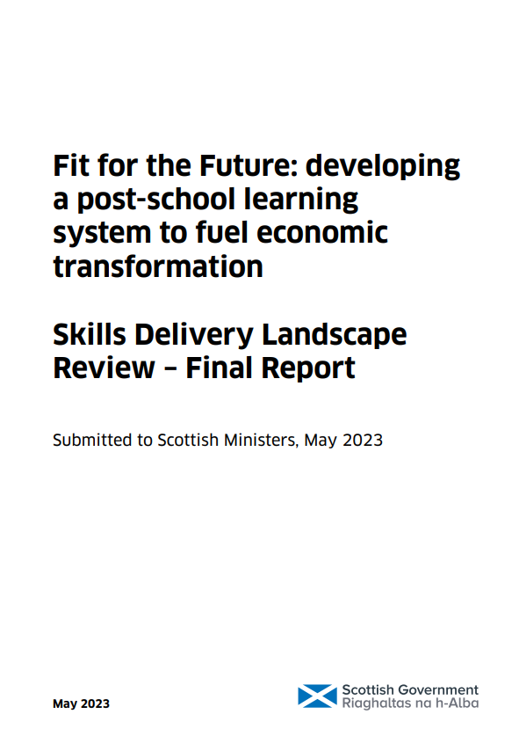
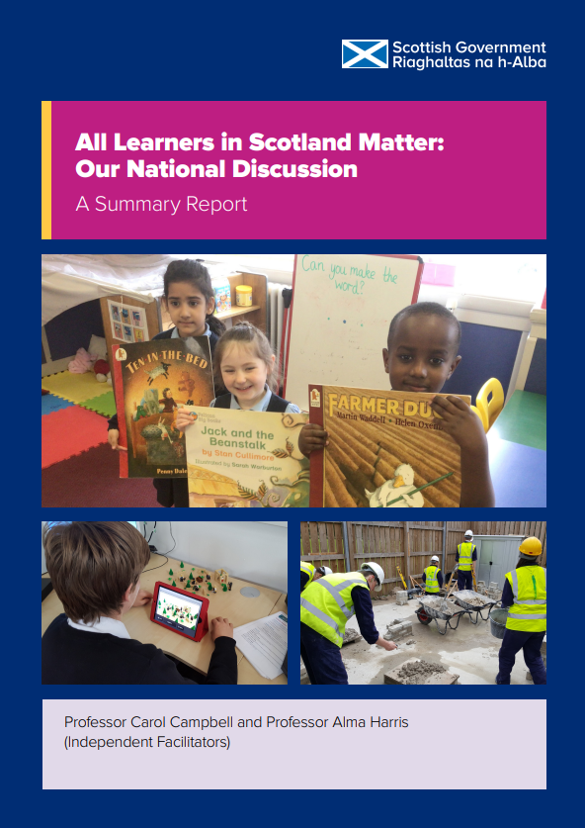

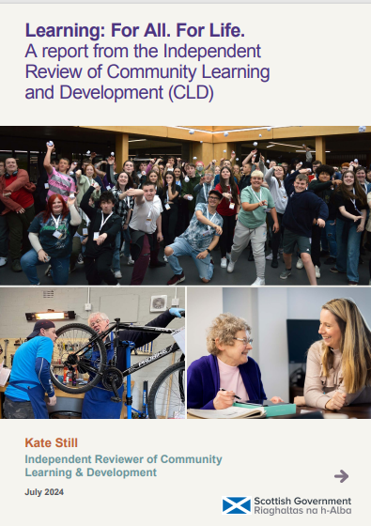
Why are we embarking on CIC?
OECD
Review
2021
Muir
Review
2022
Skills
Delivery
Review
2023
National
Discussion
Report
2023
Review of
Assessment &
Qualifications
2023
Review of
CLD
2024

Slide 3
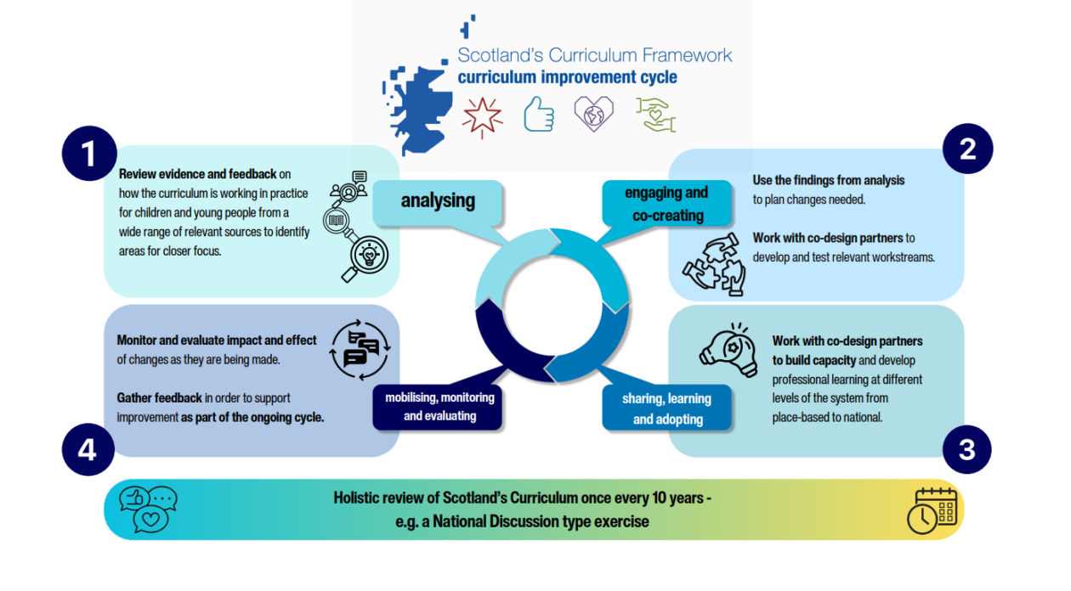
The Improvement Cycle

Slide 4
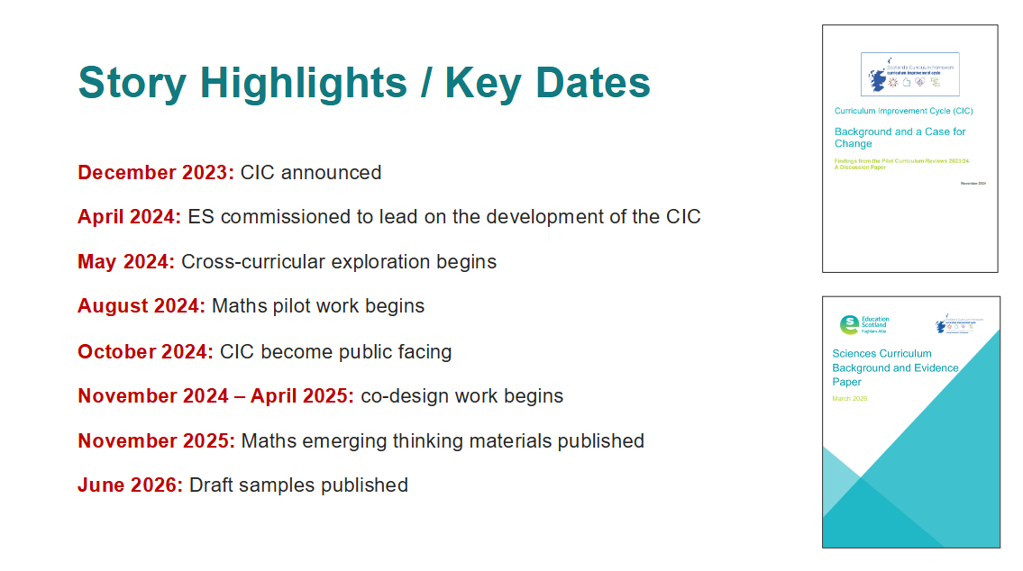
Timeline so far…
Month | CIC Milestone
December 2023 | CIC announced.
April 2024 | ES commissioned to lead on CIC.
May 2024 | Cross-curricular exploration begins.
August 2024 | Maths pilot work begins.
October 2024 | CIC became public facing.
November 2024 – April 2025 | Co-design work begins.
November 2025 | Maths emerging thinking materials published.
June 2026 | Draft samples published.

Slide 5
Timeline going forward…
Month | CIC Milestone
September 2026 | Draft KDU model and curriculum guidance available.
September - November 2026 | Feedback period for the KDU model.
December 2026 | Review and reflection point.
January 2027 | Final refreshed curriculum design guidance and KDU model published.
Spring 2027 | Digital tool released.
Summer 2027 | Assessment and qualifications alignment activity.
August 2028 | Implementation of KDU model.
Notes:
process.

Slide 6
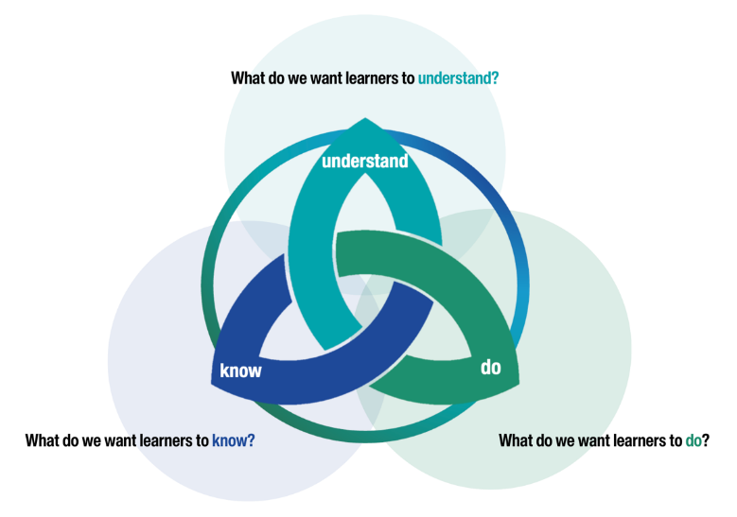
What is changing?
Focus of change: the technical framework
Experiences & Outcomes and Benchmarks will be phased out
The new framework will be underpinned by a Know – Do – Understand approach
It will clarify the knowledge and skills that will support the development of key conceptual understanding at each level.

Slide 7

Moving to a concept-based curriculum
A concept-based curriculum has been widely adopted within international education because they provide a framework that can operate across diverse cultural and contextual settings.
By organising learning around transferable concepts rather than fixed content, they create coherence when context varies.

Slide 8

Notes:
.

Slide 9
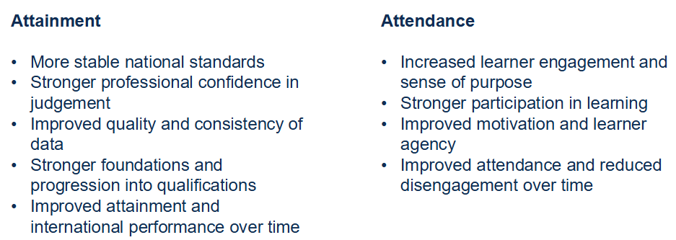
Theory of Change
The refreshed curriculum aims to provide greater clarity in what learners need to know, do, and understand with progression make more relevant and engaging.

Slide 10
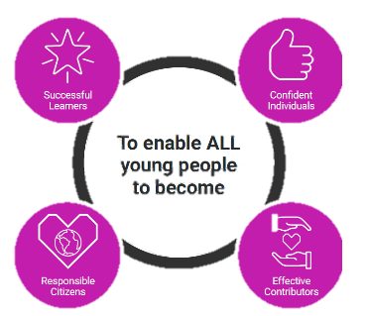

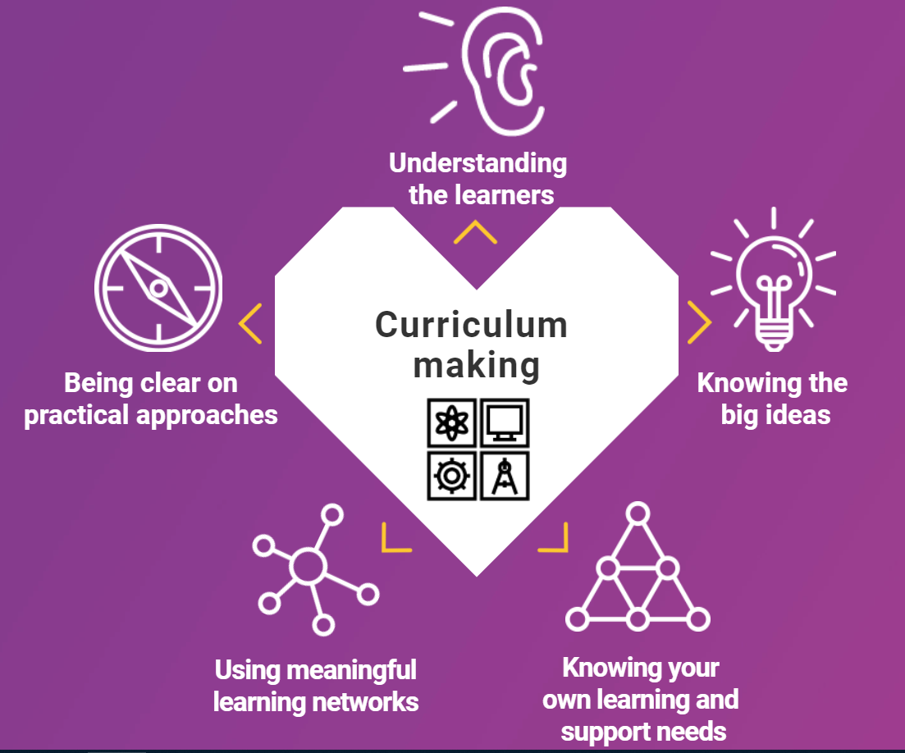
What is not changing?
why | what | how
 | + entitlements
To enable ALL young people to be

Slide 11

What is not changing?

Slide 12
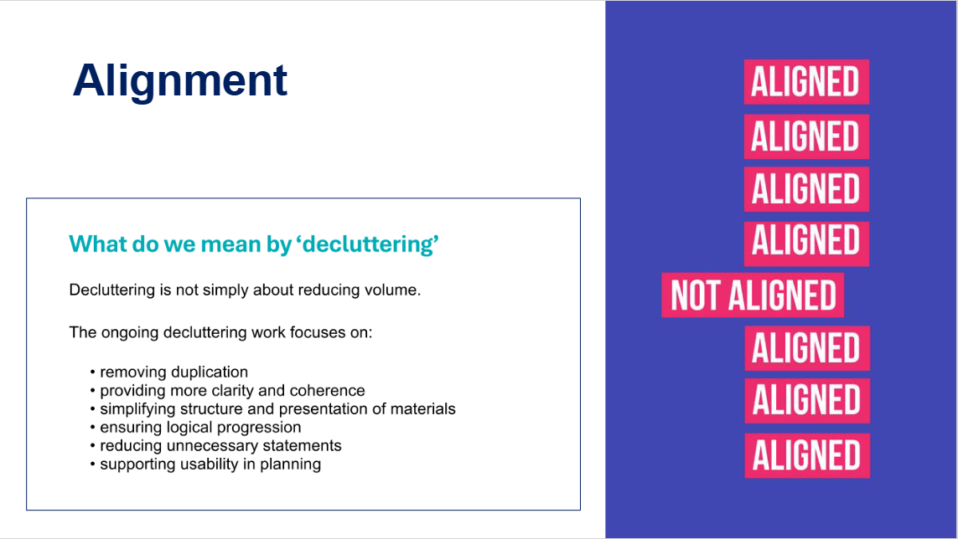
Alignment
Decluttering is not simply about reducing volume.
The ongoing decluttering work focuses on:
Removing duplication
Providing more clarity and coherence
Simplifying structure and presentation of materials
Ensuring logical progression
Reducing unnecessary statements
Supporting usability in planning

Slide 13
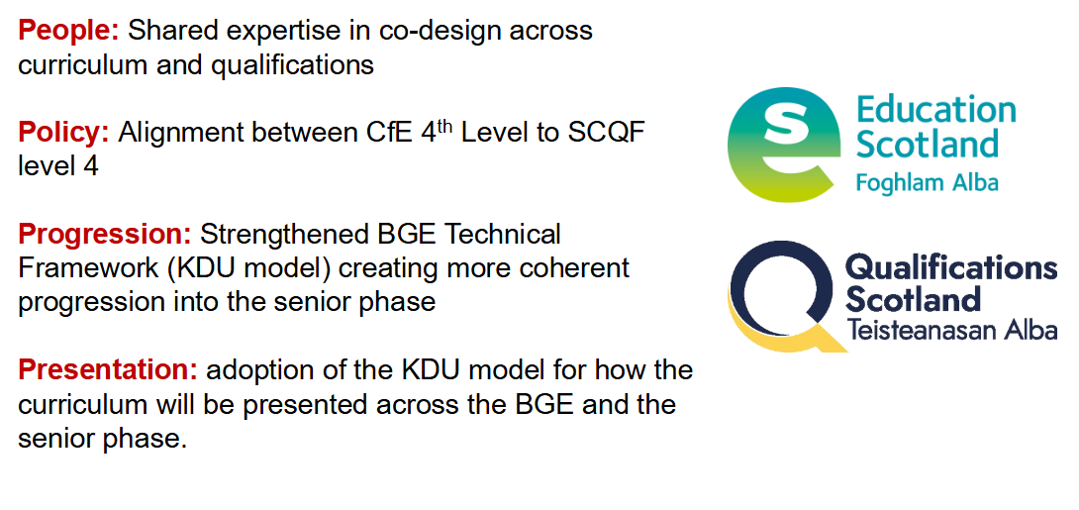
Curriculum and Qualification Alignment

Slide 14
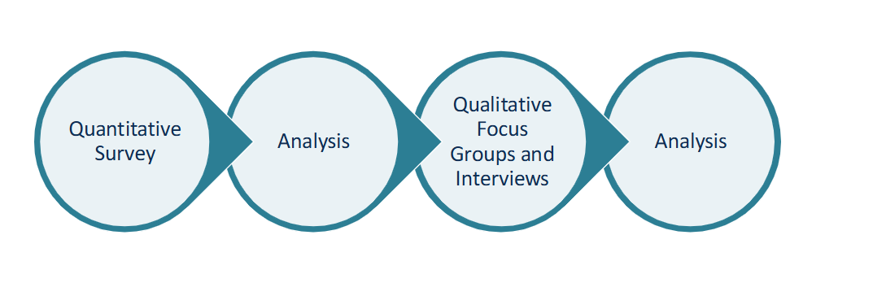
Feedback Mechanism
If you are interested in contributing, please complete the registration form by Friday 11th September.

Slide 15

New Curriculum Guidance
Purpose:
Replace old guidance (Building the Curriculum series)
Single source of truth
Practical and useful for all sectors
Realising the Ambition (RtA) will remain the national practice guidance for early years.

Slide 16
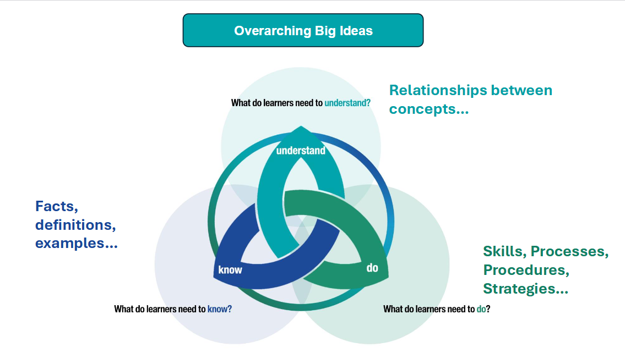
The KDU model

Slide 17
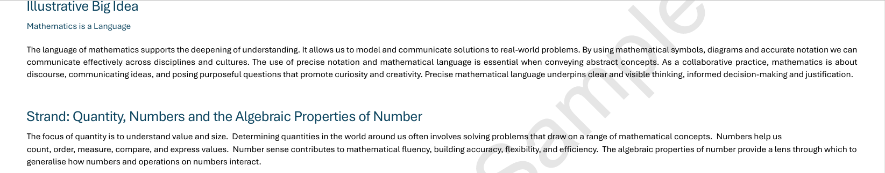
KDU example
Big Ideas
Guide curriculum design and planning, ensuring learning reflects the needs of learners, communities and the four capacities.
Explain the purpose of learning
Support interdisciplinary learning (IDL) by highlighting connections across curriculum areas.

Slide 18
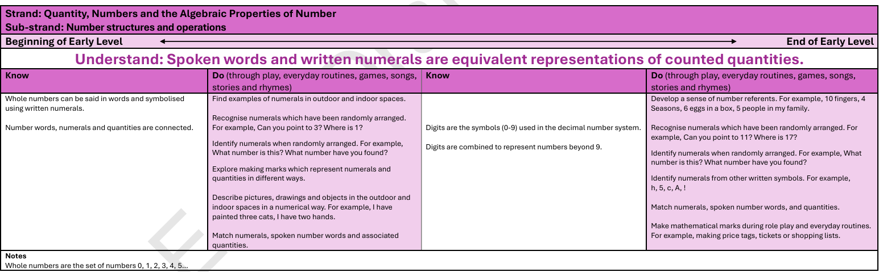
KDU example

Slide 19
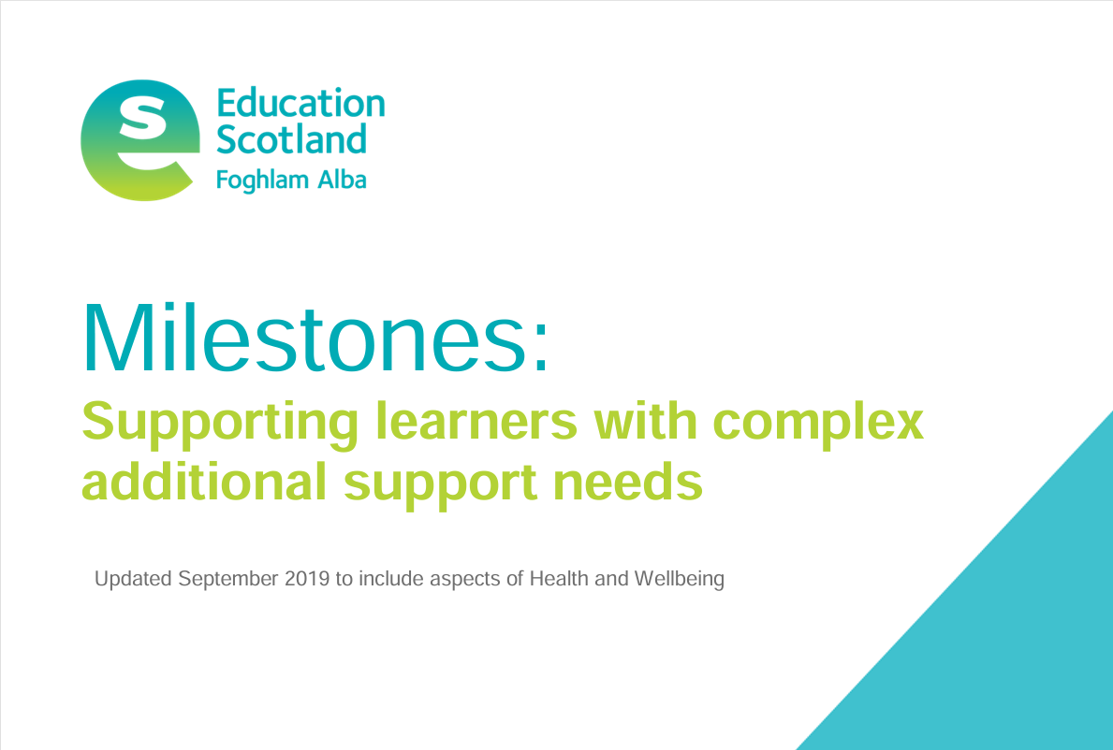
ASN Milestones and the KDU
A group of 15 practitioners, teachers and leaders of provision for learners with complex needs are currently mapping the existing milestones to the KDU.
This will ensure all learners see themselves in our KDU model.
The co-creation group hope to complete this work in time for September release.

Slide 20
Responsibilities of All
All educators have responsibility for developing children and young people’s:
Mental, emotional, social and physical health
Communication, language and literacy
Numeracy
Work is being undertaken to explore updated definitions of these responsibilities, embed them fully in the KDU model and ensure that educators are supported in these responsibilities.
Notes:
.

Slide 21
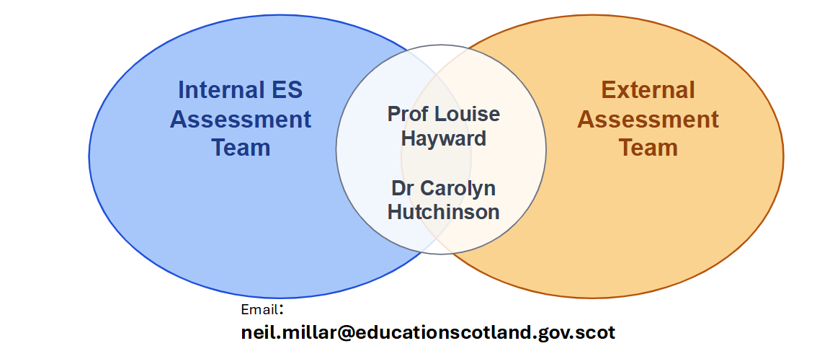
Assessment

Slide 22
CIC in Inverclyde
Leaders and practitioners have the knowledge and confidence to act on CIC outcomes
A shared, consistent understanding of CIC across all establishments
Leaders and practitioners leading improvement within their own context
Capacity
Coherence
Confidence

Slide 23
Aim and Key priorities
To develop a shared vision, understanding and approach to the CIC across Inverclyde, building leadership capacity and strengthening curriculum design and pedagogy to improve outcomes for all learners.
Communication & Engagement
Curriculum Rationale
Leading Curriculum Improvement
Pedagogical Development
CIC Understanding

Slide 24
What does success look like?
Leaders confidently leading curriculum design
Effective approaches to learning, teaching and assessment
Strong curriculum networks and cluster collaboration
Staff engaging meaningfully with CIC outcomes

Slide 25
Evidencing impact
Increased consistency across establishments
Improvement plans linked to CIC
Increased practitioner confidence
Evidence in practice

Slide 26

Achieving priorities
CLPL for staff
Curriculum rationale development
CIC leadership event
CIC Implementation Group
CIC Network
Monthly Newsletter
CIC guidance for adding into SIPs

Slide 27
Professional Learning
An introduction to the Curriculum Improvement Cycle (CIC) | Early years, primary, secondary, EAL, ICOS | This awareness-raising session provides an introduction to the Curriculum Improvement Cycle (CIC). Participants will explore the rationale for the CIC, key timelines and engage with the draft materials published to date. The session is designed to build understanding and confidence, ensuring practitioners are well informed before engaging more deeply with the CIC documentation and implementation process. | Unlimited | 6 sessions available to choose from: 22nd Sept 29th Sept 7th Oct 21st Oct 11th Nov 18th Nov 4 - 5.30pm Online | Ellis McAteer | Gateway
CIC Leadership Event | Heads of establishments | In person, whole day session for head teachers and leaders, focussing on shared sense making and planning of the CIC. This will enable leaders to be confident in supporting their staff to engage meaningfully with the CIC. | Unlimited | 23rd October tbc | Ellis McAteer Education Scotland | Further information to follow via email
Curriculum Rationale | Heads of establishments | This session will support school leaders to review and refresh their curriculum rationale. Participants will explore a structured process for evaluating their current rationale, considering learner needs, local context and stakeholder voice, and identifying priorities for curriculum improvement. | Unlimited | tbc | Ellis McAteer | Further information to follow via email

Slide 28
Professional Learning
Leading the How of Change: Facilitated learning for strategic leadership | Headteachers and those who hold the GTCS Standard for Headship | The influence of a school leader in leading change and improvement cannot be underestimated. Research has highlighted that successful change leaders not only articulate the 'what' of change but are also well versed in the thinking behind the 'why'. Strategic change necessitates intentional direction, and successful leaders are crucial in navigating the process from start to finish; they are able to lead the 'how' of change. Through co-designing this offer with school and system leaders, these messages resonate with their experiences of leading change. | Places on this programme are limited and once a venue has reached capacity the application form for that venue will close. | tbc | Education Scotland | Link to register: Education Scotland Professional Learning If you have any questions about your application, email edspll@educationscotland.gov.scot.
Understanding the technical framework | Early years, primary, secondary, EAL, ICOS | This professional learning session will support practitioners to develop a clear understanding of the Know, Do, Understand (KDU) model within the Curriculum Improvement Cycle. Participants will explore the purpose and structure of the framework, examine how knowledge, skills and understanding are interconnected, and consider how the model can be used to inform curriculum design, learning, teaching and assessment. | Unlimited | tbc | Ellis McAteer | Gateway

Slide 29
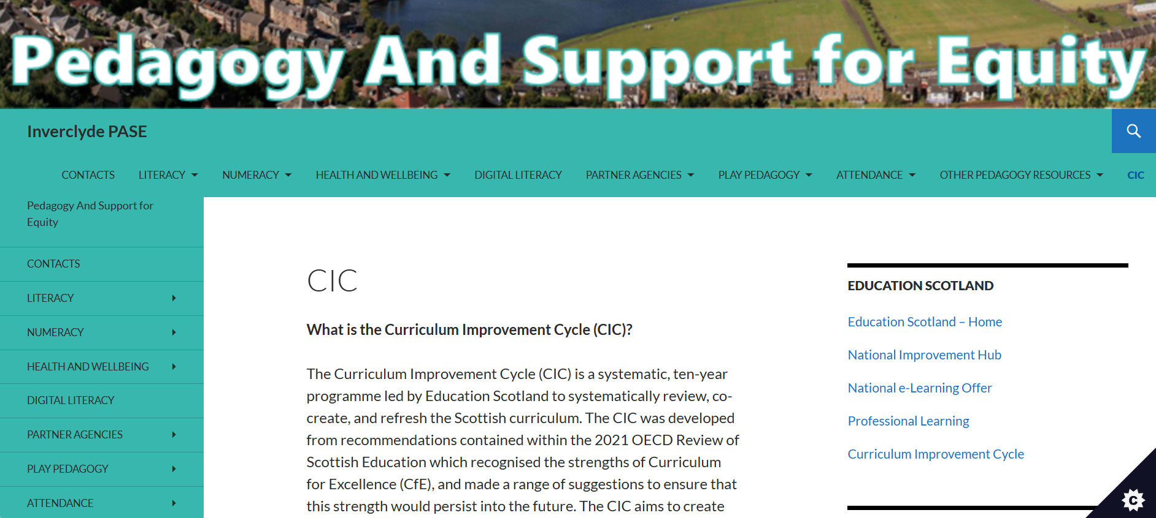
PASE

Slide 30

Thank you
Ellis McAteer
Curriculum Development Officer
ellis.mcateer@inverclyde.gov.uk

