Slide 1

Undertaking observations to support next steps
Ellis McAteer
Strategic Pedagogical Lead
Notes:
Hi everyone, I hope you're all well. Thank you for having me today. For those who don't know me, name is Ellis McAteer, I am one of the Strategic Pedagogical Leads within the Attainment Challenge Team. I have been asked to come here today to do a wee session on undertaking observations to support children's next steps in their learning. I understand you have gone through a bit of a curriculum flip recently, and are undertaking expeditionary learning – which I think is absolutley amazing and I am really looking forward to hopefully coming to see some of it in action. So I am here today really to chat to you a bit about how you can use observations to support learning, teaching and assessment and ultimately improve outcomes for children and support progression. Please be aware that today will be a bit of a whistle stop tour, but I will share my contact details with you at the end and I am more than happy to arrange some more time to come out and work with anyone who would like to explore this a bit further. Predominantly, my background is early years, so I am also available to support anyone on their play pedagogy journey.

Slide 2


What is the funniest or most interesting thing you have seen on holiday?
Notes:
So just to start us off, I'd like you to take, 1 minute, in pairs to tell each other either the funniest or most interesting thing you have seen whilst on holiday. Don't worry, I am not going to ask you to feedback.
Okay so, times up. I hope you've all had a chance to share something? This was just an opportunity for you to talk about something memorable that you have witnessed, something you have seen, noticed or... observed. Observations happen everyday, whether they are intentional or not. They are an amazing way to gain valuable information about something, and of course, today we will be talking about using observations to support children's next steps in their learning.

Slide 3
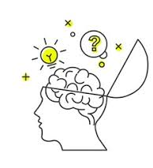
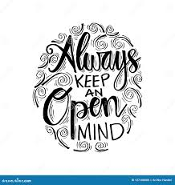
“Children approach their learning with wide eyes and open minds, so their educators too need wide eyes and open minds to see clearly and to understand what they see.”
Notes:
You need to have an open mind so that you are not pre-determining the outcome of the observation, before it has even taken place. If you observe a child with an opinion of what the child is going to achieve, the observation will not be true or accurate nor will it give you the information you are looking for. This can be difficult to do, especially when we know the children so well – but we must try to keep an open mind. This is not to say we can't use our knowledge of the child to help support our understanding and evaluation of the children's learning, but be mindful not to do this until after you have observed.

Slide 4

Observation enables us to:
Gain knowledge of what the child can do and understand their strengths.
Appreciate what the child’s interests are and where they like to learn best.
Understand how the child is disposed to learning.
Assess the child’s knowledge and the progress they are making.
Notes:
Okay so, why do we observe? What benefits do observations have for us as the teacher? Here we have the key purposes of observations, as stated by Education Scotland.
Observation enables us to:
Gain knowledge of what the child can do and understand their strengths. When we observe a child in their play and learning, we get to see first hand, their critical thinking, problem solving, planning and analysis taking place.
Appreciate what the child's interests are and where they like to learn best. When we give children autonomy of their learning, we begin to really see what sparks their interest.
Understand how the child is disposed to learning. How do they approach different situations? Are their learning behaviours as you expected them to be?
Access the child's knowledge and the progress they are making. This of course ties in with observation as a form of assessment - which we will talk a bit more about later on.
So we can see here already, that there are many benefits to observations. But we may only truly reep the benefits if we are observing effectively, and know what we are looking for.

Slide 5

Noticing
Skilled practitioners observe all the time. They use observations to make accurate judgements about how to support children’s learning.
Skilled practitioners continually carry-out informal observations. They notice the subtleties of what children are doing and saying.
This informal and on-going approach is an essential part of tuning-in to and supporting children’s learning.
This form of observing is a key part of responsive planning, where responses to children are made ‘in the moment’ and successfully supports and extends learning.
Notes:
Noticing and observing go hand in hand. You can notice things when you observe, and you can observe through noticing. Noticing is a key skill for professionals and a vital aspect of observations that involves being aware and mindful of situations.
Skilled practitioners observe all the time. They use observations to make accurate judgements abut how to support children's learning. If you are ever unsure about a child's understanding of something, take the time to observe them in real time, in a scenario that will allow them to demonstrate that skill you are looking for. This should allow you to identify what scaffolding needs to be put in place to extend the children's learning further.
Skilled practitioners continually carry out informal observations. They notice the subtleties of what children are doing and saying. This re-inforces the fact that observations are happening all of the time. You may notice, overhear something or gain a piece of information about a child that you weren't expecting to gather, just through the subtle act of noticing.
This informal and on-going approach is an essential part of tuning-in to and supporting children's learning. Noticing children's approaches to their play and learning can really help you tune into how and what they are thinking.
This form of observing is a key part of responsive planning, where responses to children are made in the moment and successfully supports and extends learning. Through the act of noticing, we can often respond to children in the moment and provide an immediate element of support.

Slide 6


Can you share 3 things that you notice about this picture?

Slide 7

Ethical Observations
Parent/carers understand why we observe and what we are recording.
When observing children, practitioners are mindful of the child’s rights.
Observation is about really listening to children and looking at what their play has to tell us.
Writing an observation should never come in the way of supportive, adult interaction.
Notes:
When we are undertaking observations and "noticing" children's learning taking place, we need to make sure we are remaining ethical. Something that I am sure you are all aware of, but it is important to mention it.
Parents and carers understand why we observe and what we are recording, if anything. Observations aren't always recorded, but sometimes they are. Whether this is through pictures, videos or a written observation, it is important we keep families involved in their children's learning.
When observing children, practitioners should be mindful of the child's rights. This goes without saying that we need to be mindful that we are respecting children's rights at all times and that this is something that is at the forefront of our practice. I understand you are working towards a UNCRC badge at the moment, so this is a great way to be incorporating this and talking to the children about their rights during their play and learning.
Observation is about really listening to the children and looking at what their play has to tell us. This ties in with that quote from the beginning, about not pre-determining the outcome. We owe it to the children to listen to them, and understand the difference between interacting and interfering.
Writing an observation should never come in the way of supportive, adult interaction. So if you are choosing to write about an observation in the moment, which is great, sometimes you do have to take a wee note there and then so you remember or take a photograph of something brilliant, but be mindful that this is not taking away from an opportunity to meaningfully interact. The chances are you will gain more from this interaction than what you will from taking notes at that very second. You can always come back to this.

Slide 8


Involving children
Article 12 of the United Nations Convention on the Rights of the Child focuses on participation and the child’s right to express their views and have them taken seriously.
It is good practice to involve children in helping to gather information about their learning and important that they are aware of the information we hold about them.
When children participate in the observation process, they may ask to take photographs or videos or have their words written down.
Making learning visible in this way can help children to understand why we observe and help them to reflect on their learning.
Notes:
Again, this ties in well with the ethics of observations and that is of course, the UNCRC Rights of the Chid. Article 12 focuses on respect for children's views. So it is important to keep this in mind when conducting learning observations, particularly if you are taking photographs, videos or are writing down what children have said. By making this observation process explicit to children and making the learning visible, we can help children better understand how we are supporting their learning through observations and help them to reflect on this.

Slide 9


‘Child-centred play pedagogy requires us to take the lead from the children. This approach actively responds to the individual and constantly changing needs of a child. A child’s voice is interpreted by our observations of their actions, emotions and words. These observations are central to assessment and inform us what children need.’
Realising the Ambition, 2020: 46
Notes:
How we observe children in their learning majorly focuses on child centred pedagogy being put into practice. This quote here amplifies that nicely. Essentially, observation is at the heart of child centred pedagogy. It requires us to take the lead from children and actively respons to the individual and constantly changing needs of a child. Much like you do already, but possibly with a slightly different outlook. When observing children in their play or exploration, we should be mindful of respecting the child's voice and not always intervening unless necessary. Now this can mean their literal voice and the words they are using but this can also be their physical actions or body language that are communicating something. Anything that gives you a better insight into that child's understanding. Just ensuring that the child's voice is heard and valued. Again, tying in with the rights of the child.

Slide 10
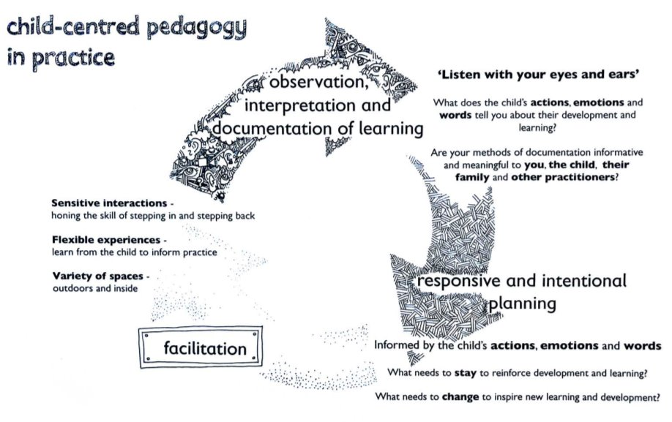
How do we effectively observe learning?
Child-centred pedagogy in practice
Notes:
So here we have a child centred pedagogy observation cycle. This gives us an outline of how we can effectively observe learning and use what we have observed to inform our planning. I just want you to take a wee minute, on your own, to read through this and have a think about this cycle. Does any of it resonate with you? Do you feel that you currently do this effectively within your practice?
This cycle focuses heavily on child centred pedagogy – which lends in extremely well with your expeditionary learning. Learning by doing and allowing children to have autonomy over their learning and encourage curiosity. Being responsive to children and planning in this way can be difficult when shifting from intentional planning that you will be more used to. So this is not a pedagogy that will change overnight. It will take time for you to get used to, for you to make it work in a way that suits both you and the learners in your class. However, I do think this image is a good one to keep in mind and refer to – right through the school.

Slide 11

Pause and reflect...
When did you last observe a learner?
Do you feel your observations help you to understand the children you work with in the way that Susan Isaacs describes?
Understanding Learners
“… we can imaginatively feel their fears and angers, their bewilderments and triumphs; we can wish their wishes, see their pictures and think their thoughts.” Isaacs, 1929: 15
Notes:
I'd now like to give you a chance to reflect on a recent observation you have taken of a learner. If you can do this in pairs or small groups. I will give you 5 mins to discuss, and again, I am not looking for you to feedback. This is an opportunity for you to have a chat with your colleagues about your current observation practice. You may wish to use the previous image as a prompt for discussion.
I am sure we can all conclude that observations are happening all the time, this is nothing new to you – its about refining particularly for expeditionary learning.

Slide 12
Observation methods: Rating scales
Level | Wellbeing | Signals
5 | Extremely High | The child looks happy and cheerful, smiles, cries out with pleasure. They may be lively and full of energy. Actions can be spontaneous and expressive. The child may talk to him/herself, play with sounds, hum, sing. The child appears relaxed and does not show any signs of stress or tension. He/she is open and accessible to the environment. The child expresses self-confidence and self-assurance.
4 | High | The child shows obvious signs of satisfactions (as listed under level 5). However, these signals are not constantly present with the same intensity.
3 | Moderate | The child has a neutral posture. Facial expressions and postures show little or no emotion. There are no signs indicating sadness or pleasure, comfort or discomfort.
2 | Low | The posture, facial expression and actions indicate that the child does not feel at ease. However, the signals are less explicit than under level 1 or the sense of discomfort is not expressed the whole time.
1 | Extremely Low | The child clearly shows signs of discomfort such as crying or screaming. They may look dejected, sad, frightened or angry. The child does not respond to the environment, avoids contact and is withdrawn. The child may behave aggressively, hurting him/herself or others.
e.g. Leuven's scale of wellbeing and involvement
Notes:
If you are allowing children to explore and learn through a play-based environment and are unsure if a particular child or a group of children are fully engaged or questioning if they are gaining anything from the experience, they can be "rated" through an involvement or wellbeing scale; depending on what information you are looking to gather. An example of this, and a method which is used most commonly is the Leuven Scale. I believe this is something that Janet did last year?

Slide 13
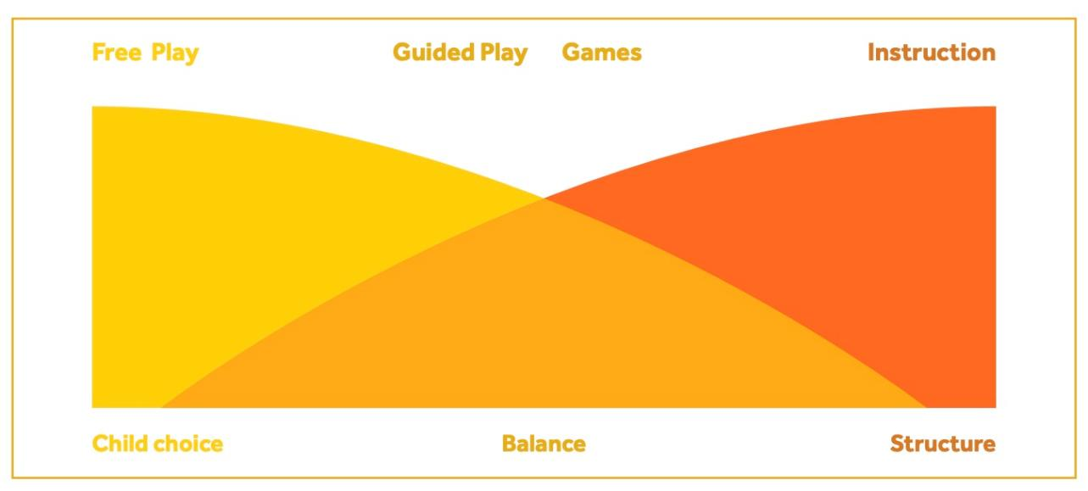
A Spectrum of Practice...
Jensen et al. (2019)
Notes:
This image here gives us a bit of a breakdown of play in practice. I thought this was really important to share as I often find that play, particularly in schools can be misinterpreted or taken too far into one end of the spectrum or the other. Now you will have heard me mention play a few times today already, this is not just for the infant classes, this is very relevant for the entire school, particularly with the experiences you are offering through your expeditionary learning. Research suggests that children can learn through play in a range of practices: from children’s self-chosen and self-directed play to more guided forms of play and games designed around specific goals – much like the lesson plans you will have created. Each practice has benefits for children’s learning and the adult’s role in the different play positions from observing and offering materials and support in children’s free play to more intentional, direct instruction can be all as effective as one another. These positions are not seen as distinct and separate, but more as overlapping, interacting elements of the same play practice. In a day, you may assume several positions in relation to the children to facilitate play. It is all about balance.

Slide 14
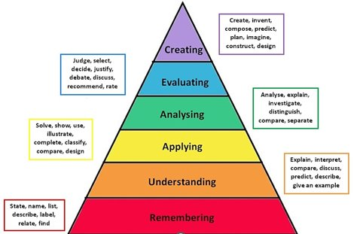
Effective Observations and Quality Questioning
Notes:
Conducting an effective observation doesn't always mean that there is no adult interaction. In fact, supporting children and scaffolding their learning is essential for progression. A way in which we can do this is through effective questioning. For example, using the work of Blooms, which I am sure you will already be familiar with. Blooms is all about making connections and encouraging deeper thinking. This can be done through narrating children's experiences through your interactions with them and posing questions which allow for this higher order thinking to take place.

Slide 15
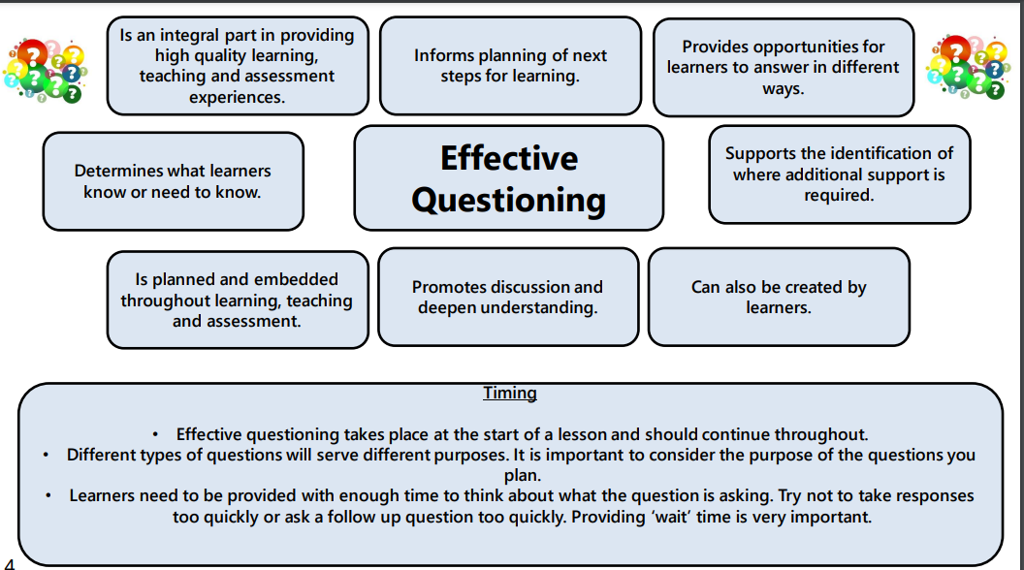
Notes:
This is a slide taken directly from Education Scotland on effective questioning. The top part details some more benefits of using effective questioning in the classroom, which can be transferred through your experiences within expeditions. I will give you a wee minute to have a read at that.
The bottom part here mentions timing, something that is really important to note. We need to ensure we are giving our learners enough time to answer the question we have posed to them, and not pressurise them, particularly if they are invested in something. Providing enough wait time is very important.
Does anyone know the average time a teacher tends to give children to answer a question? 3 seconds. We need to be patient, and possibly even more so through active learning or play-based experiences. It is also important to mention here that your questions may not always be pre planned or thought out, they may change and happen in the moment depending on what you are observing at that time. But the more we do this, the more skilled we become in understanding when a question will be valuable and inform assessment of children's learning and support next steps.

Slide 16
Consider...
What types of questions do you commonly ask?
Do the types of questions you ask support children's next steps?
Reading Task
Notes:
So I want to give you a chance just now to reflect on the types of questions you find yourself asking in your practice and think about how this supports learners next steps.
If you can take a few minutes firstly to read over the sheet, and then take a few minutes afterwards to chat in your groups about your thoughts. Do you find yourself asking more closed questions than open?

Slide 17
Observation Cycle
Observation Cycle
Notice
Analyse
Act
What did I notice?
What does this tell me? What does this mean?
What will I do now? What will the child do now?
Notes:
When we are carrying out observations. We can use and refer to this simple observation cycle model, which includes three main components – notice, analyse and act.

Slide 18
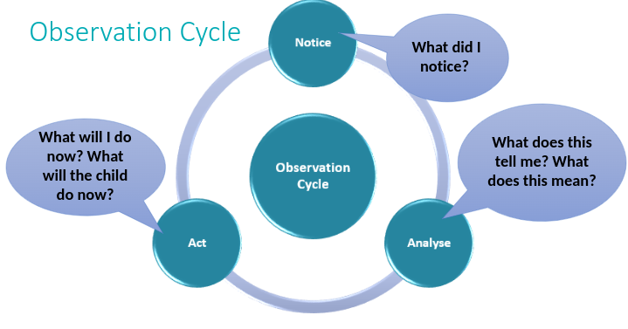
Watch the video and use the Observation Cycle to...
Notice and Analyse.
Notes:
Okay so I would now like to give you the opportunity to put this into practice. I am going to show you a short video clip of a recorded learning observation. We will mainly be focusing on the noticing and analysing aspect today. The reason for that is that we don’t know enough about the children in the videos to really focus on the action and understand what the next steps may look like for that child, but what we can do is maybe put some suggested actions in for how you may extend that learning further.
To give you a bit of background info, this was an observation taken of a child during an outdoor loose parts play session. Whilst watching this, I want you to write down some notes, solely about what you notice. I don't want you to analyse this part just now, although thoughts may start to run through your head about what this observation tells us about that child. But for now, during the clip if we can just try to notice. What are the key things that you pick up from the video? What skills is that child demonstrating? Is there anything that the child says or does that you think is important?
I will then give you 5 mins to chat in groups and discuss what you have noticed and analyse your observation to explore what this tells us.

Slide 19
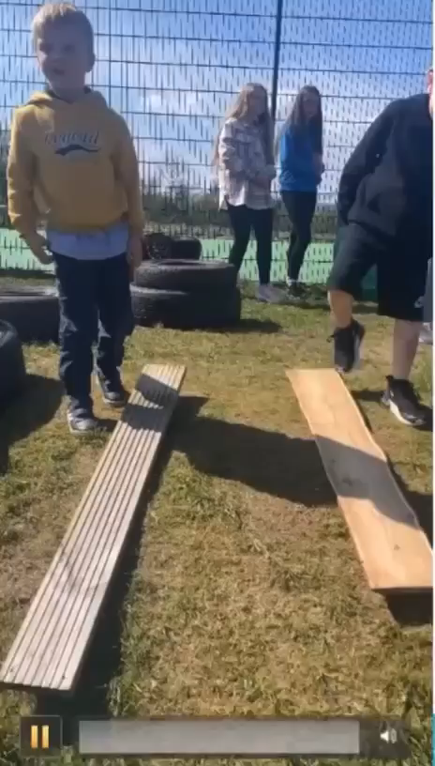

Slide 20
Notice | Analyse | Act
I noticed that the learner: Verbalised his thoughts and actions Adopted a trial-and-error approach Confidently adapted his body weight to balance Shared success with a peer Worked out solutions to a problem Demonstrated determination to get it right Worked well on his own Remained focused on the activity despite other distractions | The learner demonstrated: Verbal reasoning Independence Resilience Determination Problem solving skills Experimenting An awareness of speed, gradient, force A good sense of balance and co-ordination Gross motor skills The ability to make assessments and judgements of his own learning – reflection for improvement A good attention span | Lots of links to science, numeracy, technologies, health and well-being etc. Further discussion around how and why the board moved on different surfaces, exploring the reason for this Exploration of how objects move on different surfaces, using different materials and comparing these – possibly measuring the time it takes, the total distance. Using this to link in with information handling and displaying results. Further learning and exploration about the science of gravity, gradient, force etc.
Notes:
So, I wanted to note down what I noticed from this observation, how I analysed this information and then a possible action route.

Slide 21
What will I do now?
So what?
Now what?
What?
What did I notice?
What does this tell me? What does this mean?
Notes:
What? What did I notice?
So what? How can I analyse that?
Now what? How do I act upon this?

Slide 22

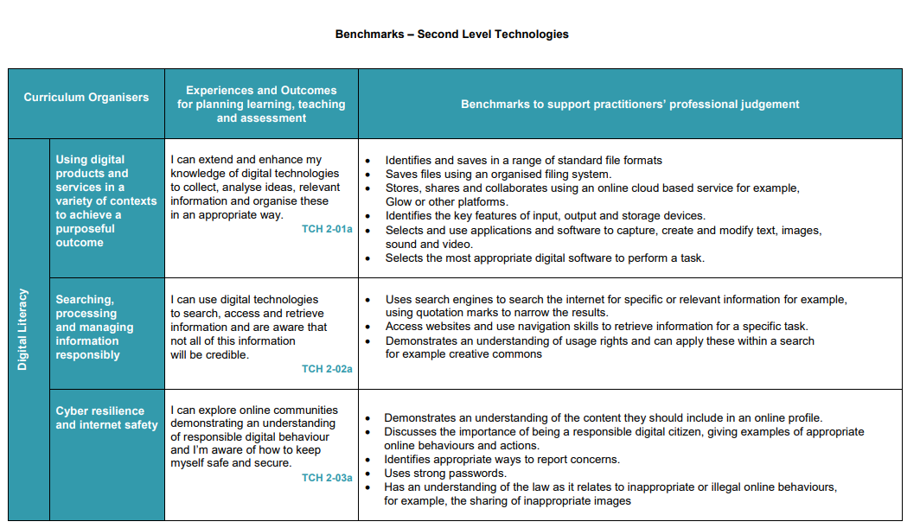
How do we know what to observe?
What are the next steps?
Notes:
So.. Now that we have covered a little about why we observe, when we observe and how we observe, we need to know what we do next. So what now? We have observed, what do we do with this information? How do we know what information we are looking for? What are the next steps to ensure these observations and useful, informative and support planning, learning, teaching and assessment?
This is where, of course, we need to be making use of the benchmarks. We all know that the benchmarks set out the expectations for children and what they should be able to do by each level. So we need to be making sure we are using this so that there is clear progression from P1 to P7 through the expeditionary learning.

Slide 23
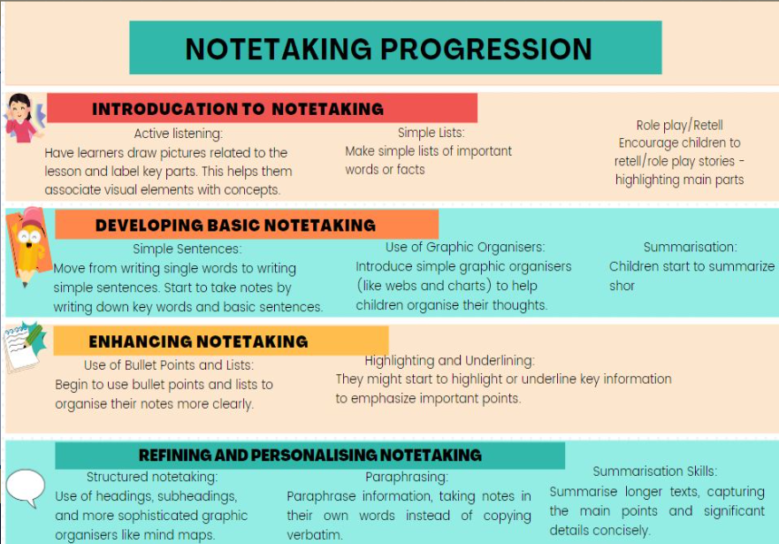
Importance of Progression...
Notes:
This slide has been taken from Inverclyde's writing framework and thought it would be good to use as an example. So if you were working on note taking, and children were asked to demonstrate note taking through at some point through their expeditionary learning, you would expect to observe a more detailed and refined approach in second level, than what you would compared to the introduction stage in early level. We need to be mindful that although we are taking children's lead and allow them to be curious and explore through play-based learning approaches, we as the adult, have an important role to ensure children are being challenged and that the progression between levels is evident.

Slide 24
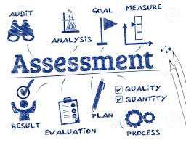

Observation as Assessment
‘When we work with children, when we play and talk with them, when we watch them and everything they do, we are witnessing a fascinating and inspiring process: we are seeing young children learn. As we think about what we see, and try to understand it, we have embarked on the process that I call “assessment”. I am using the term to describe the ways in which, in our everyday practice, we observe children’s learning, strive to understand it, and then put our understanding to good use.’
Drummond, 1993:13
Notes:
I really like this quote to again, reinforce the fact of observations being used as a method of assessment. When we are observing we should be asking ourselves...
What skills are they demonstrating?
Are they applying apply skills and knowledge from prior learning?
Are they able to transfer these skills into other areas?
What outcomes are they covering through this learning?
What do the benchmarks say?

Slide 25


Reflecting on Observations
‘Some of our observations will be written down, but there will be other things that we have noticed and remembered during the day. Spending time reflecting on observations enables us to consider what children are interested in or curious about, what ideas they are exploring, or skills they are developing.’
Realising the Ambition, 2020: 66
Notes:
It is important that we are taking the time to reflect on our practice and reflect on the observations we have taken from that day. Particularly if they have not been written down. We need to make sure we are using these vital observing and noticing opportunities to inform our planning and next steps for children. Taking some time at the end of each day to digest what you have observed, evaluate what this means and how you will use this information going forward. This is predominantly where most of your analysing and acting will happen.

Slide 26
Round Up...
Keep an open mind; don't predetermine the outcome of an observation
Ensure your observations are ethical and are respectful of children's voice and their rights
Make use of benchmarks to ensure challenge and progression
Effectively observe by using Notice, Analyse, Act
Use effective questioning to deepen the quality of observations
Notes:
So, like I said at the beginning, I understand this has been a bit of a whistle stop tour and I have thrown a lot at you. I appreciate you will need to take some time to digest everything and consider what you may want to adapt in your practice to allow for more effective observations leading to more challenge and progression. Like I said at the beginning, I am really eager to come out and get to see some fantastic teaching and learning happening through your expeditionary learning, and with this, I would be more than happy to support anyone who might want it or even just to engage in further dialogue about observations with anyone who would find it beneficial. I hope you have taken something away from today. I would appreciate your feedback and I will share this link with you. If I can ask that you fill this out before leaving today. If anyone has any questions I will stay here for another while if anyone would like to come and chat about anything or alternatively, I have shared my contact information with you if its something you would like to discuss in the future or if there is anything you think of once you have left. Thank you for your time today – I really appreciate it!

Slide 27



Thank you for your time.
Please get in touch with any questions/feedback! ☺
gw21mcateerellis@glowmail.org.uk
ellis.mcateer@st-ninians.inverclyde.sch.uk
@miss_mcateer
For Scotland's learners, with Scotland's educators

