Slide 1




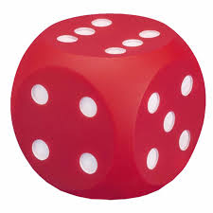
Developing Early Number Sense
Ellis McAteer
Strategic Pedagogical Lead

Slide 2


Session Aims
To enhance / refresh your knowledge and understanding of number sense and subitising
Highlight the crucial role that outdoor play and block play have in developing children's number sense ​
Provide examples of high-quality experiences, resources and support materials that can be used to enhance your practice

Slide 3
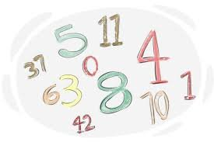

What is Number Sense?
Number sense is the ability to understand numbers and the relationships between them.
One-to-one correspondence: Understanding that each number in a count relates to a specific object
Cardinality: Understanding that the last number counted is the number of objects in the set
Stable order: Knowing that numbers come in a set order, such as 2 before 3
Number identification: Recognising and naming numbers
Subitising: Looking at a group of objects and knowing how many there are, without having to count

Slide 4
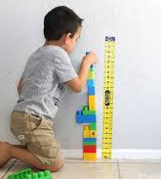
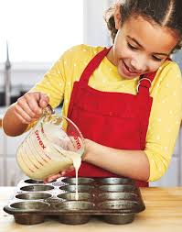
Foster a numeracy rich environment: Exposing children to numeracy in their environment e.g. numbers, scales, numicon, height chart, blocks, rulers, measuring tapes, measuring jugs etc.
Incorporate number into daily conversations: For example, use words like "less or "more" to draw attention to changes in amounts or size
Explore mathematics through different contexts: Using storybooks, puzzles, puppet play, and games with dice
Involve children in cooking/baking/messy experiences: Stir, pour, fill, and mix to become familiar with counting, measuring, adding, and estimating
Rhymes and songs: Sing number rhymes and songs like "Round and round the garden" or "12345 Once I Caught a Fish Alive"
Make counting part of everyday life: Count objects, stairs, number of children etc.

Slide 5
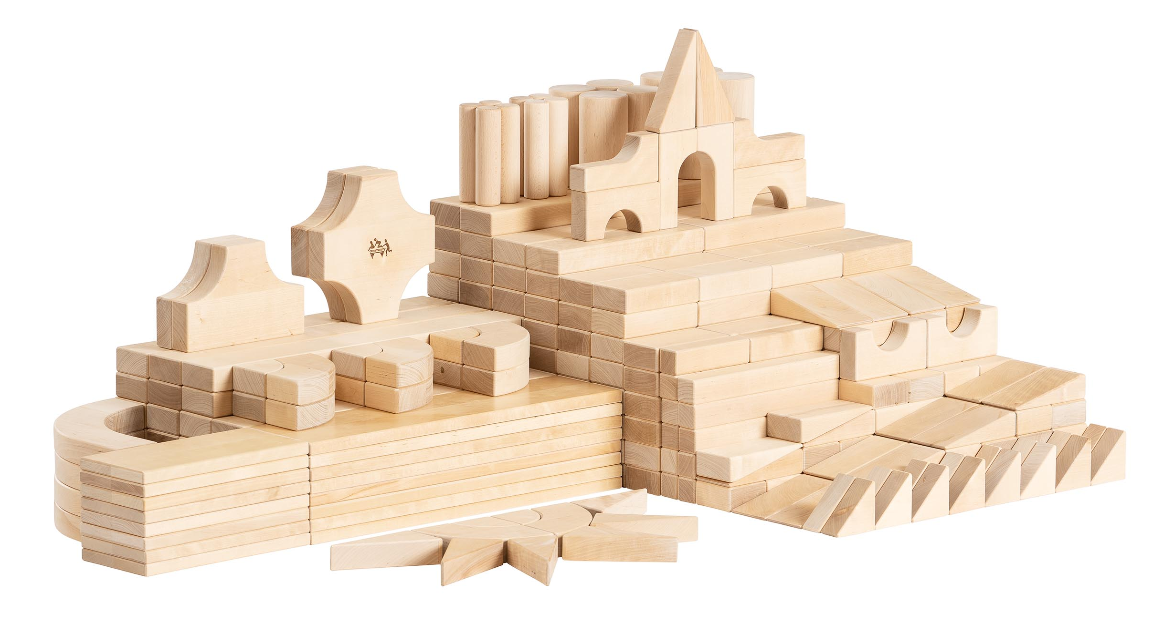

Block Play
Block play offers particularly rich mathematical learning opportunities by demanding children engage with concepts of estimation, data, fractions, uncertainty, measurement and number naturally as part of their play.
"The mathematical relationships of unit blocks are discovered by the children in pursuit of their own creative ideas." Gura, 1992: 79

Slide 6
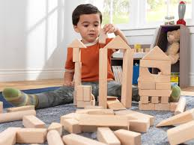
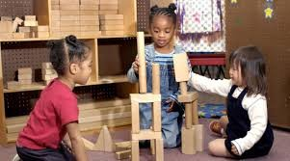
Why Block Play?
A study that evaluated the block constructions of four-year-olds (in 1982) and compared them with their test scores in high school (in 1998) supported the hypothesis that a child’s ability to create complex block constructions can predict mathematical ability.​

Slide 7
Block Play - Mathematical Concepts
Symmetry
Sorting
Pattern
Measure
Shape
Problem-solving
Counting
Estimation
Fractions
Probability
"Because it involves measuring lengths, widths, and heights (if only by eye), block play develops a child’s ability to mentally visualize relationships. Such manipulations are similar to those used in geometry and algebra during the child’s later school years" (Henniger, 1987).

Slide 8
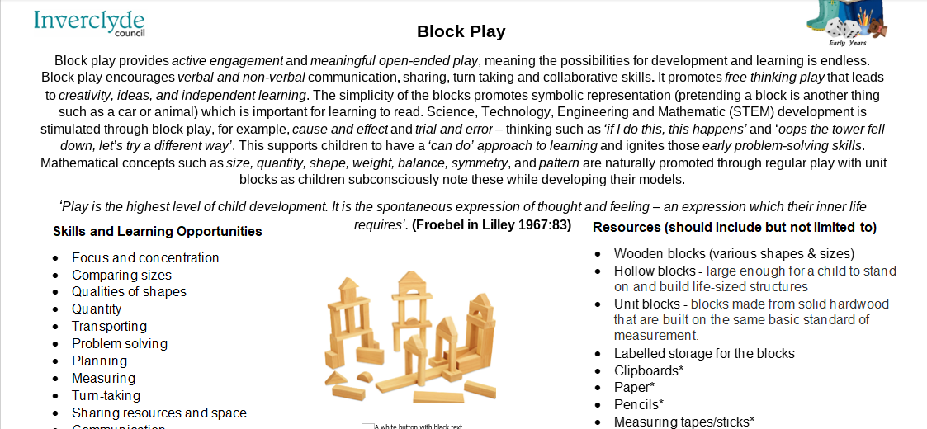

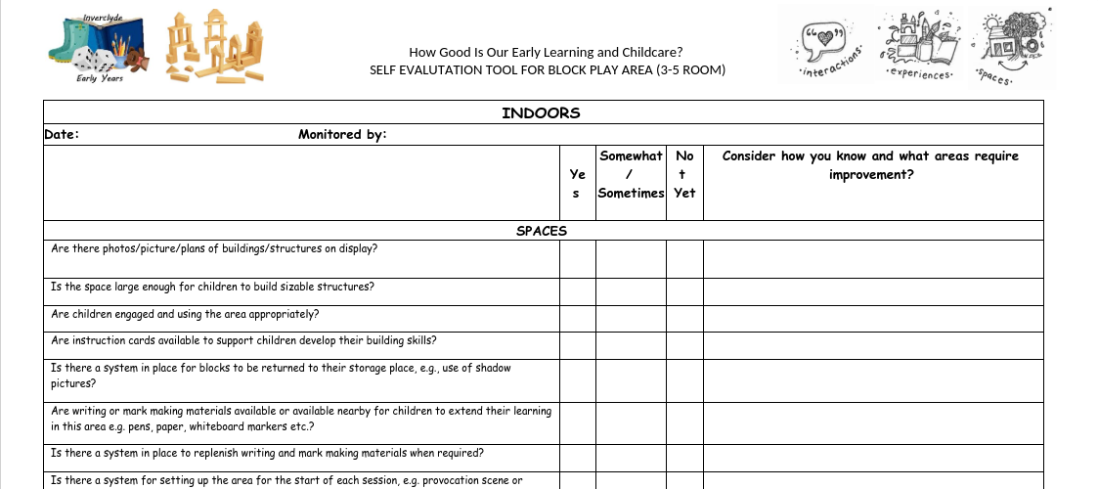
Block Play Area Card
Block Play Audit Tool

Slide 9
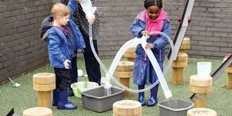
Outdoor Play
Outdoor play should naturally offer particularly rich experiences and creative opportunities to secure mathematical understanding in real and relevant contexts. Playful curiosity and discovery supports the development of learners' early numerical concepts.

Slide 10
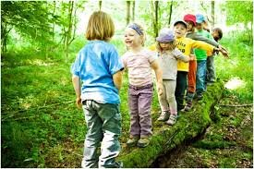
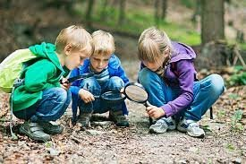
Why Outdoors?
Knight (2011) suggests that children will become more creative outdoors where they have freedom to be “innovative, flexible and adaptable” and that this environment will stimulate creative mathematical thinking.

Slide 11
Outdoors - Mathematical Concepts
Symmetry
Pattern
Direction
Time
Measure
Shape
Subitising
Problem-solving
Counting
Sorting
"When using the outdoors environment, the children can construct on a larger scale, explore the world first-hand and experience natural phenomena such as weather, the changing seasons and shadows" (Maynard and Waters, 2007).

Slide 12
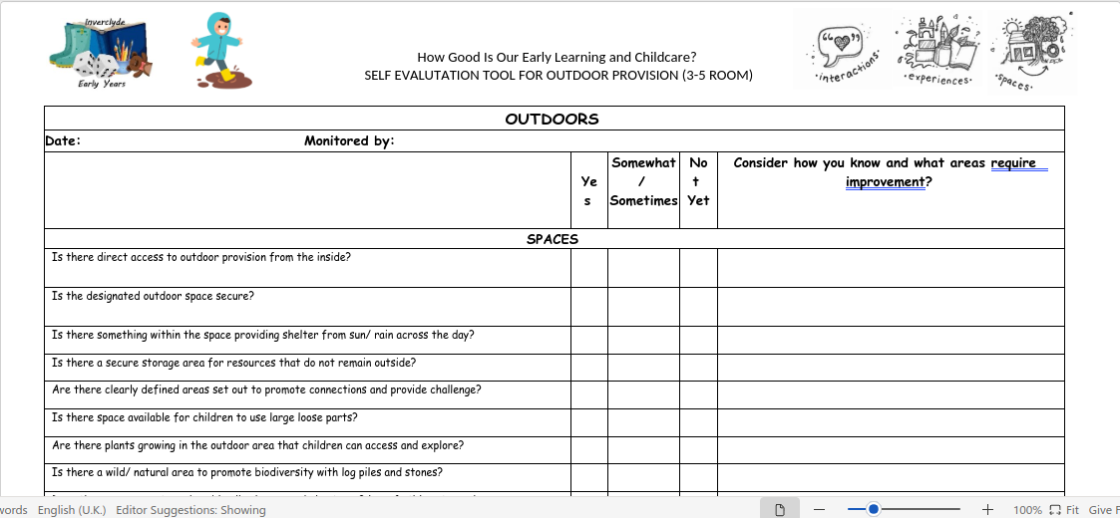


Regularly self-evaluate and assess if your outdoor environment, resources and provocations on offer are effective in promoting mathematical exploration, catered to the children’s current interests, abilities and needs.

Slide 13


Numbers are confusing!
I am three (years old), but also five in a headcount of a queue.
One is a little number, but I can see a huge numeral one on a billboard.
Five is bigger than two, but two donuts weigh more than five peas.
One grain of rice is too few, but one watermelon is too many.
When I count, I say a new number for each item, so how do I know what number is correct?

Slide 14
Why can counting be problematic?
You need to learn ‘the song’.
You need to associate the song with quantity.
You need to remember the sequence of it correctly.
You need to sing it forwards and backwards.
You need to be able to start and stop the song from random points.
You need to remember that you say one name per thing.
You need to remember that the last number tells you how many.
Sometimes you are asked to do it for no apparent reason.
Nominal, Ordinal and Cardinal numbers cause confusion.
It doesn’t help you to calculate when you run out of fingers!
Notes:
Counting is REALLY hard to learn! There is so much going on and as an adult it is hard to pull apart all the strings from the knot of it!
How many parents have you encountered that think their wean “knows their numbers” because they can sing the song of 1,2,3 etc? But we know it’s so much more!
Look at what we are expecting of our wee ones as they develop number sense!
And we surround them with numbers! Numbers are all around! And yes we need them to recognise all these uses for numbers but how hard is it when it’s all happening at once.
*DEMONSTRATE COUNTING FROM DIFFERENT STARTING POINTS* - what is 3? What about this time?
Nominal numbers are for labels, ordinal numbers are for sequence, cardinal numbers for quantity – but we switch between these without pause or explanation.

Slide 15

Subitising
Subitising is an essential skill in developing number sense in the early years.
Subitising is the ability to look at a group of objects and knowing how many there are, without having to count.
Notes:
The answer, I believe (and there are several articles I can share to back me up!) is in starting with subitising. It’s actually where we all started, but our current (old) model of number teaching trains us out of it!
Many of us do it naturally but just never discuss it! I didn’t even know it was a thing until I heard Karen Wilding talking about it.
It is mentioned in the SEAL maths approach but not recognised as the natural starting point and written off as recognising dice patterns. It is much more and so much more valuable.

Slide 16
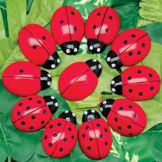
Why is Subitising Important?
By focusing on developing concept images of quantity we are helping children to calculate!
Subitising makes sense of 1+3 = 2+2 = 1+1+1+1 = 2+1+1 = 4
It helps learners with pattern recognition
Children are able to avoid over-relying on counting, or rote counting with little understanding
Notes:
The answer, I believe (and there are several articles I can share to back me up!) is in starting with subitising. It’s actually where we all started, but our current (old) model of number teaching trains us out of it!
Many of us do it naturally but just never discuss it! I didn’t even know it was a thing until I heard Karen Wilding talking about it.
It is mentioned in the SEAL maths approach but not recognised as the natural starting point and written off as recognising dice patterns. It is much more and so much more valuable.

Slide 17
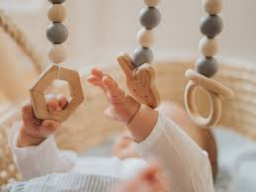

Noticing
Humans are born with the innate skill to notice things from birth.
Notes:
It’s a survival skill that we are born with. The earliest people needed to notice things to survive.

Slide 18

Where does it begin?
Babies learn to notice and recognise these visual images and amounts from birth without knowing the name of the number or being able to count.
Notes:
Babies are preprogrammed to look for the pattern of 3, to look at faces and begin to connect and attach.
Research has shown that this pattern of 3 can be subitised easily by very young children. This concept image helps to start our understanding of quantity. In fact some early civilisations had names for 1-3 then just called the rest more than 3!

Slide 19
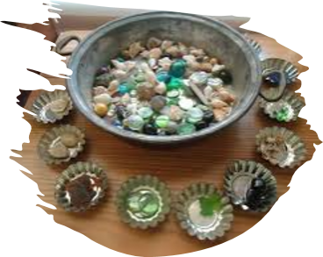
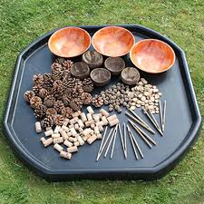
Classification and Sorting Activities
These type of activities strengthen the skills of noticing which can help children to sharpen their concept images of amounts, i.e. subitising.
Notes:
The answer, I believe (and there are several articles I can share to back me up!) is in starting with subitising. It’s actually where we all started, but our current (old) model of number teaching trains us out of it!
Many of us do it naturally but just never discuss it! I didn’t even know it was a thing until I heard Karen Wilding talking about it.
It is mentioned in the SEAL maths approach but not recognised as the natural starting point and written off as recognising dice patterns. It is much more and so much more valuable.

Slide 20
Perceptual Subitising
Perceptual subitising is how you perceive the image straight away. What do you see? How do you see it?
Notes:
OK so what do YOU see and how DO you see this ?
Can you see the 2 here and one here? Can you see 1,1,1? What about this as a 2 and 1 here?
You will be seeing this quantity at a glance without thinking about it. Most folk can perceptually subitise up to 3 with ease. Above 3 might rely more on regular patterns for you to perceptually subitise like a dice pattern, numicon or 10 frame.
If you flash the pattern then you prevent children from being able to count. If they continue to want to count, just reduce the amount of time they get to see it.
We can use any number of things to teach this. We have powerpoints on the Team to encourage children to notice amounts. These can be printed out to make books.
When starting this, if you are using real objects remember to keep the cognitive load low by making them all the same type, size and colour.
Ask “What do you see? How do you see it?” Role model seeing the amount but accept any answer. Then add another/ change the arrangement and ask “What do you see now? What has changed? What has stayed the same?” We are trying to encourage children to develop conservation of number ie you can move things around but the quantity doesn’t change unless one is added or taken away.
We can use flash cards, loose parts, paper plate game, memory games with these.
When demonstrating with objects and placing on DO NOT COUNT them on, instead say one, and another one and another one to reinforce ‘one’.
Dice games promote and reinforce perceptual subitising, as will the use of 5 or 10 frames in displays.

Slide 21
How do you see this?
Let’s shift the focus from right or wrong answers to being able to explain your reasoning!​
Notes:
While I can perceptually subitise this familiar pattern thanks to my experiences of dice and domino games, I still see this a certain way.
Think about how you recognise it. It blew my mind that others saw something different from me. I see a square with one in the middle. Does anyone see a combination of triangle and pair?
While we are perceptually subitising due to it’s familiarity, this arrangement way of thinking about it is an example of conceptual subitising.
We can even promote perceptual subitising without children saying what they see or naming the quantity. This would be by asking them to throw fingers – “Show me this many” for different patterns.
A great way to consolidate perceptual subitising is 3 Not 3 videos or books where children just call out if they see 3 or not 3. You can turn these into games where if they see 3 they dance or grab something along the lines of the traffic lights game.

Slide 22
Conceptual Subitising
Conceputal subitising is how you put the bits together. What do you see? How do you see it?
Notes:
OK so what do YOU see and how DO you see this ?
Can you see the 2 here and one here? Can you see 1,1,1? What about this as a 2 and 1 here?
You will be seeing this quantity at a glance without thinking about it. Most folk can perceptually subitise up to 3 with ease. Above 3 might rely more on regular patterns for you to perceptually subitise like a dice pattern, numicon or 10 frame.
If you flash the pattern then you prevent children from being able to count. If they continue to want to count, just reduce the amount of time they get to see it.
We can use any number of things to teach this. We have powerpoints on the Team to encourage children to notice amounts. These can be printed out to make books.
When starting this, if you are using real objects remember to keep the cognitive load low by making them all the same type, size and colour.
Ask “What do you see? How do you see it?” Role model seeing the amount but accept any answer. Then add another/ change the arrangement and ask “What do you see now? What has changed? What has stayed the same?” We are trying to encourage children to develop conservation of number ie you can move things around but the quantity doesn’t change unless one is added or taken away.
We can use flash cards, loose parts, paper plate game, memory games with these.
When demonstrating with objects and placing on DO NOT COUNT them on, instead say one, and another one and another one to reinforce ‘one’.
Dice games promote and reinforce perceptual subitising, as will the use of 5 or 10 frames in displays.

Slide 23
How do you see this?
Let’s shift the focus from right or wrong answers to being able to explain your reasoning!​
Notes:
While I can perceptually subitise this familiar pattern thanks to my experiences of dice and domino games, I still see this a certain way.
Think about how you recognise it. It blew my mind that others saw something different from me. I see a square with one in the middle. Does anyone see a combination of triangle and pair?
While we are perceptually subitising due to it’s familiarity, this arrangement way of thinking about it is an example of conceptual subitising.
We can even promote perceptual subitising without children saying what they see or naming the quantity. This would be by asking them to throw fingers – “Show me this many” for different patterns.
A great way to consolidate perceptual subitising is 3 Not 3 videos or books where children just call out if they see 3 or not 3. You can turn these into games where if they see 3 they dance or grab something along the lines of the traffic lights game.

Slide 24
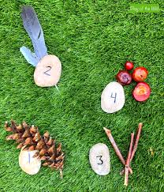
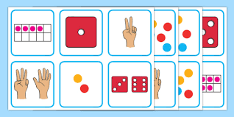
Teaching Subitising
Focus on teaching 1-3 first – both perceptual and conceptual in all sorts of experiences with both large and small items wherever the opportunity arises. The bigger the variety, the deeper the learning!
Language to use - “What did you see?” “How did you see it?” “You didn’t need to count that, you just knew it was 3!”
Avoid asking - “How many?” as this often prompts children to count. Instead, try saying “What did you see?” “How did you see it?” “I can see three, what can you see?”
Notes:
So for it to work well we need to really strongly establish perceptual and conceptual subitising to 3. And I mean really focus until there is no hesitation in seeing 3,2,and 1 and talking about them in lots of ways.
Not until that is well established consistently would we move on to 4 and the process starts again. Then we can introduce 5 frames for subitising and repeat the processes for 4 and 5 and 6.
The aim is to establish really strong concept images of the quantities so the more often we can practice the skill (any time you don’t NEED to count) the better.
This doesn’t mean that we won’t be counting things you can’t subitise. Like sounds for example or large quantities that can’t be placed in a ten frame.

Slide 25


Subitising Top Tips
Keep the cognitive load low! Ensure there is as little to distract from the quantity as possible. Make all the things in the group as similar as possible (the same type, size, shape and colour).
If you just glimpse, you don’t have time to count!
Subitise with as many different things as possible to promote the skill and keep it engaging. Indoors and out! Make sure you vary size and situation but use same type, size, colour & shape within an activity.
Notes:
Current practice almost unteaches subitising. We want to strengthen that skill and we can do it a range of ways with a variety of tools.
Firstly and possibly hardest of all is for us to role model NOT counting if we can subitise! With noticing there is no wrong answer and with subitising the focus is not on the correct answer but in sharing reasoning. This reflects a shift found in maths in high school too! If you can explain your thinking you are not just reciting by rote. This is a big change from how most of us were taught!
So don’t count just to check! If they see something different that’s great! We all see things differently. They might not even see a quantity at first, but role model noticing the quantity. And what an insight you get into wee brains!
KEEP THE COGNITIVE LOAD LOW! In other words give them as little to distract form the quantity as possible. Make all the things in the group as similar as possible. Round things seem to lower the load the best, corners and sides are things to notice!
But subitise with as many different things as possible to promote the skill and keep it engaging. Make sure you vary size and situation.

Slide 26

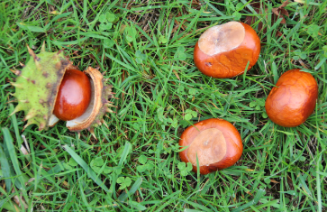
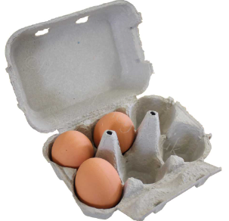


Notes:
What do you see here? How do you see it?

Slide 27
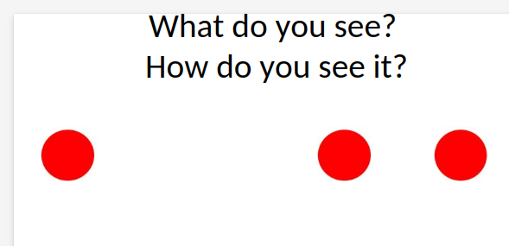
Let's Try It!

Slide 28
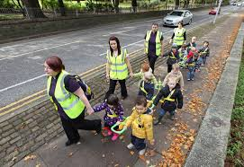
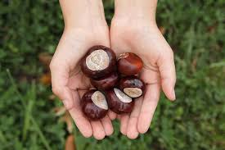

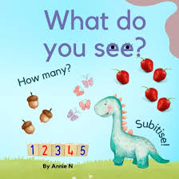
Ways to facilitate and encourage subitising...
Notes:
Current practice almost unteaches subitising. We want to strengthen that skill and we can do it a range of ways with a variety of tools.
Firstly and possibly hardest of all is for us to role model NOT counting if we can subitise! With noticing there is no wrong answer and with subitising the focus is not on the correct answer but in sharing reasoning. This reflects a shift found in maths in high school too! If you can explain your thinking you are not just reciting by rote. This is a big change from how most of us were taught!
So don’t count just to check! If they see something different that’s great! We all see things differently. They might not even see a quantity at first, but role model noticing the quantity. And what an insight you get into wee brains!
KEEP THE COGNITIVE LOAD LOW! In other words give them as little to distract form the quantity as possible. Make all the things in the group as similar as possible. Round things seem to lower the load the best, corners and sides are things to notice!
But subitise with as many different things as possible to promote the skill and keep it engaging. Make sure you vary size and situation.

Slide 29
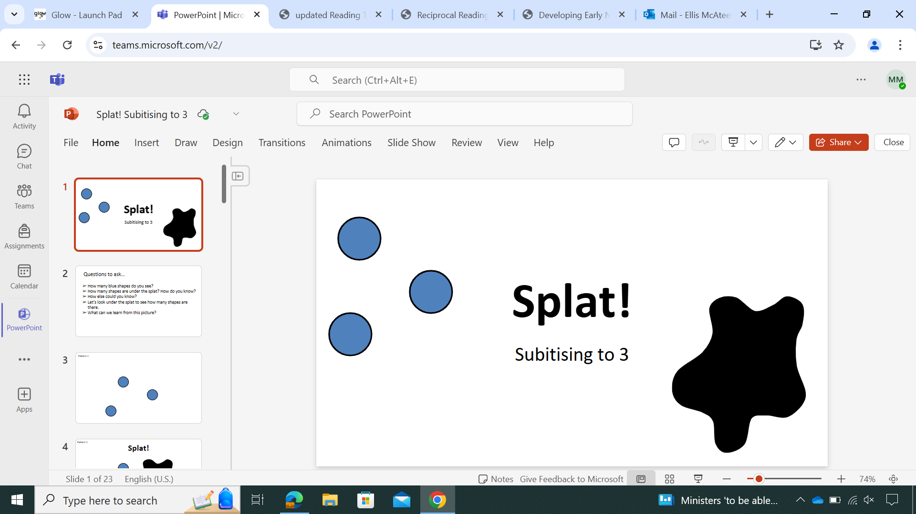
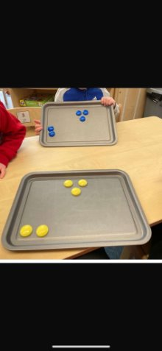
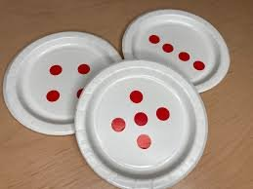
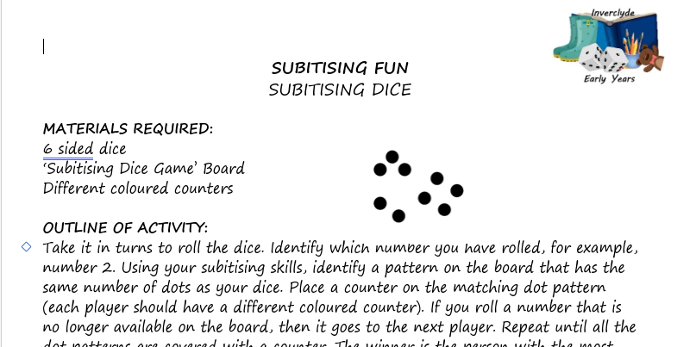


Subitising Games

Slide 30

Where does counting fit in?
Count to explore number order rather than calculate
Finding out ‘how many?' When items can’t be seen as a pattern e.g. counting pages in a book
Count to explore and practice ‘ordinality’ of the number system; hearing the word order we use when counting in different sized groups (1’s, 2’s, 5’s etc.) and in different directions
Notes:
Counting is REALLY hard to learn! There is so much going on and as an adult it is hard to pull apart all the strings from the knot of it!
How many parents have you encountered that think their wean “knows their numbers” because they can sing the song of 1,2,3 etc? But we know it’s so much more!
Look at what we are expecting of our wee ones as they develop number sense!
And we surround them with numbers! Numbers are all around! And yes we need them to recognise all these uses for numbers but how hard is it when it’s all happening at once.
*DEMONSTRATE COUNTING FROM DIFFERENT STARTING POINTS* - what is 3? What about this time?
Nominal numbers are for labels, ordinal numbers are for sequence, cardinal numbers for quantity – but we switch between these without pause or explanation.

Slide 31
How can we tackle large numbers?
What do you see? How do you see it?
Is it easy to subitise this way? Is there a better method?
Notes:
I am not going to lie – this makes my brain just say “NOPE” - even as I was making this up I had to stop and move these around to count and check I had the same amount in each of the slides. This image says “too many, don’t even bother trying” to me!

Slide 32
Do we count them?
Even if we line up and count, there is still a chance for error.
Is there a more efficient method?
Notes:
Ever try to count and loose track of the number? Had to get anyone to check your head count before because you got different amounts each time? I still struggle in a line! I’m still at the concrete stage – I want to touch and move these as I count..
Now look. I swear these are the same quantities – I copied and pasted the group of dots as a whole and moved them around for each slide.

Slide 33
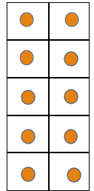
We can use 10 frames!
3 frames are full
1 frame has 2 in it
= 32
Notes:
3 full frames of 10 and 2 of the next set.
We can do this with the children and they would understand it! Last year I had a wee one who was fascinated with big amounts and loved that he could write and understand the total without having to know all the names of the numbers in the right order!
*There is a right and wrong way to use 10 frames and you NEVER count on them! They are subitising tools . But at a glance you can see how many more you would need to make it 40!

Slide 34
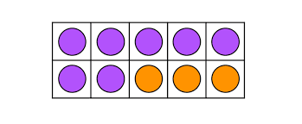
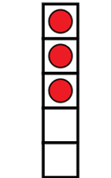
5 Frames and 10 Frames
5 frames and 10 frames are helpful for subitising because they help children visualise numbers and see patterns, which helps them to develop a strong number sense.
Notes:
3 full frames of 10 and 2 of the next set.
We can do this with the children and they would understand it! Last year I had a wee one who was fascinated with big amounts and loved that he could write and understand the total without having to know all the names of the numbers in the right order!
*There is a right and wrong way to use 10 frames and you NEVER count on them! They are subitising tools . But at a glance you can see how many more you would need to make it 40!

Slide 35
5 Frames and 10 Frames Top Tips
Begin with 5 frames and then move onto 10
Never count on a 5 or 10 frame
Make sure there are no gaps when filling a frame
Avoid asking 'how many'?
Use language of 'full' and 'not full'
Allow children to see the whole number, as well as the parts that make up that number up e.g. 9 is the same as 5 and 4 or 11 is the same as 10 and 1.
Notes:
3 full frames of 10 and 2 of the next set.
We can do this with the children and they would understand it! Last year I had a wee one who was fascinated with big amounts and loved that he could write and understand the total without having to know all the names of the numbers in the right order!
*There is a right and wrong way to use 10 frames and you NEVER count on them! They are subitising tools . But at a glance you can see how many more you would need to make it 40!

Slide 36
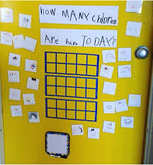
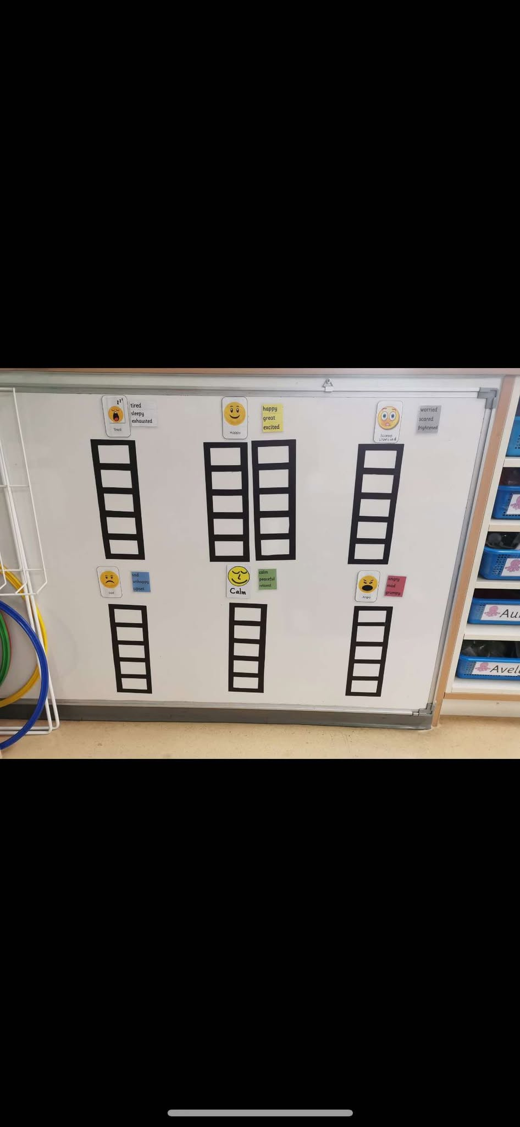
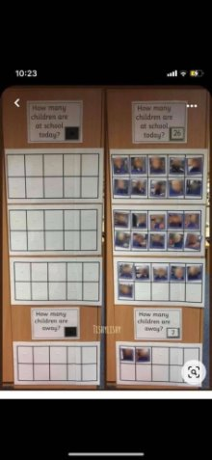
5/10 Frame Self-Registration
Notes:
3 full frames of 10 and 2 of the next set.
We can do this with the children and they would understand it! Last year I had a wee one who was fascinated with big amounts and loved that he could write and understand the total without having to know all the names of the numbers in the right order!
*There is a right and wrong way to use 10 frames and you NEVER count on them! They are subitising tools . But at a glance you can see how many more you would need to make it 40!

Slide 37
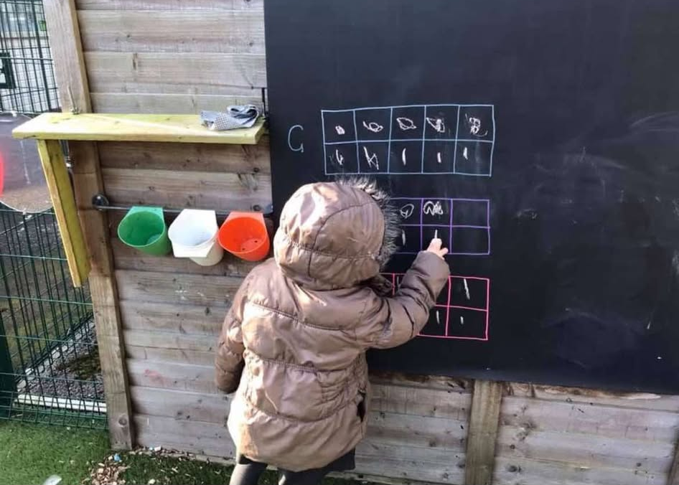
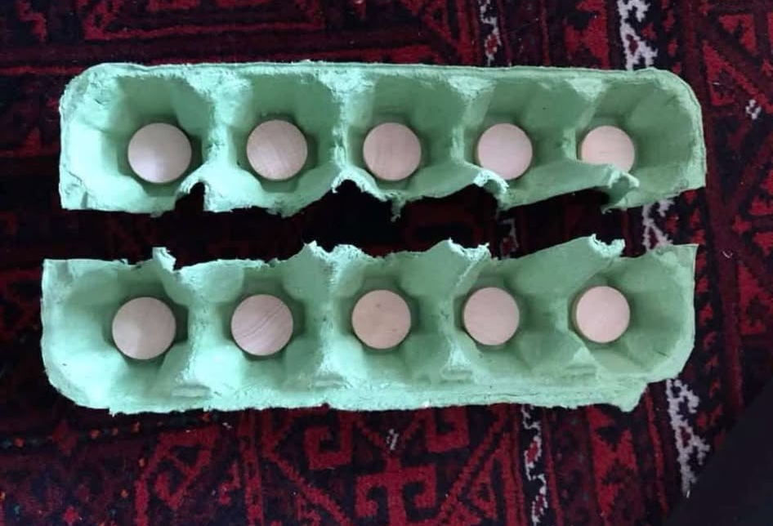
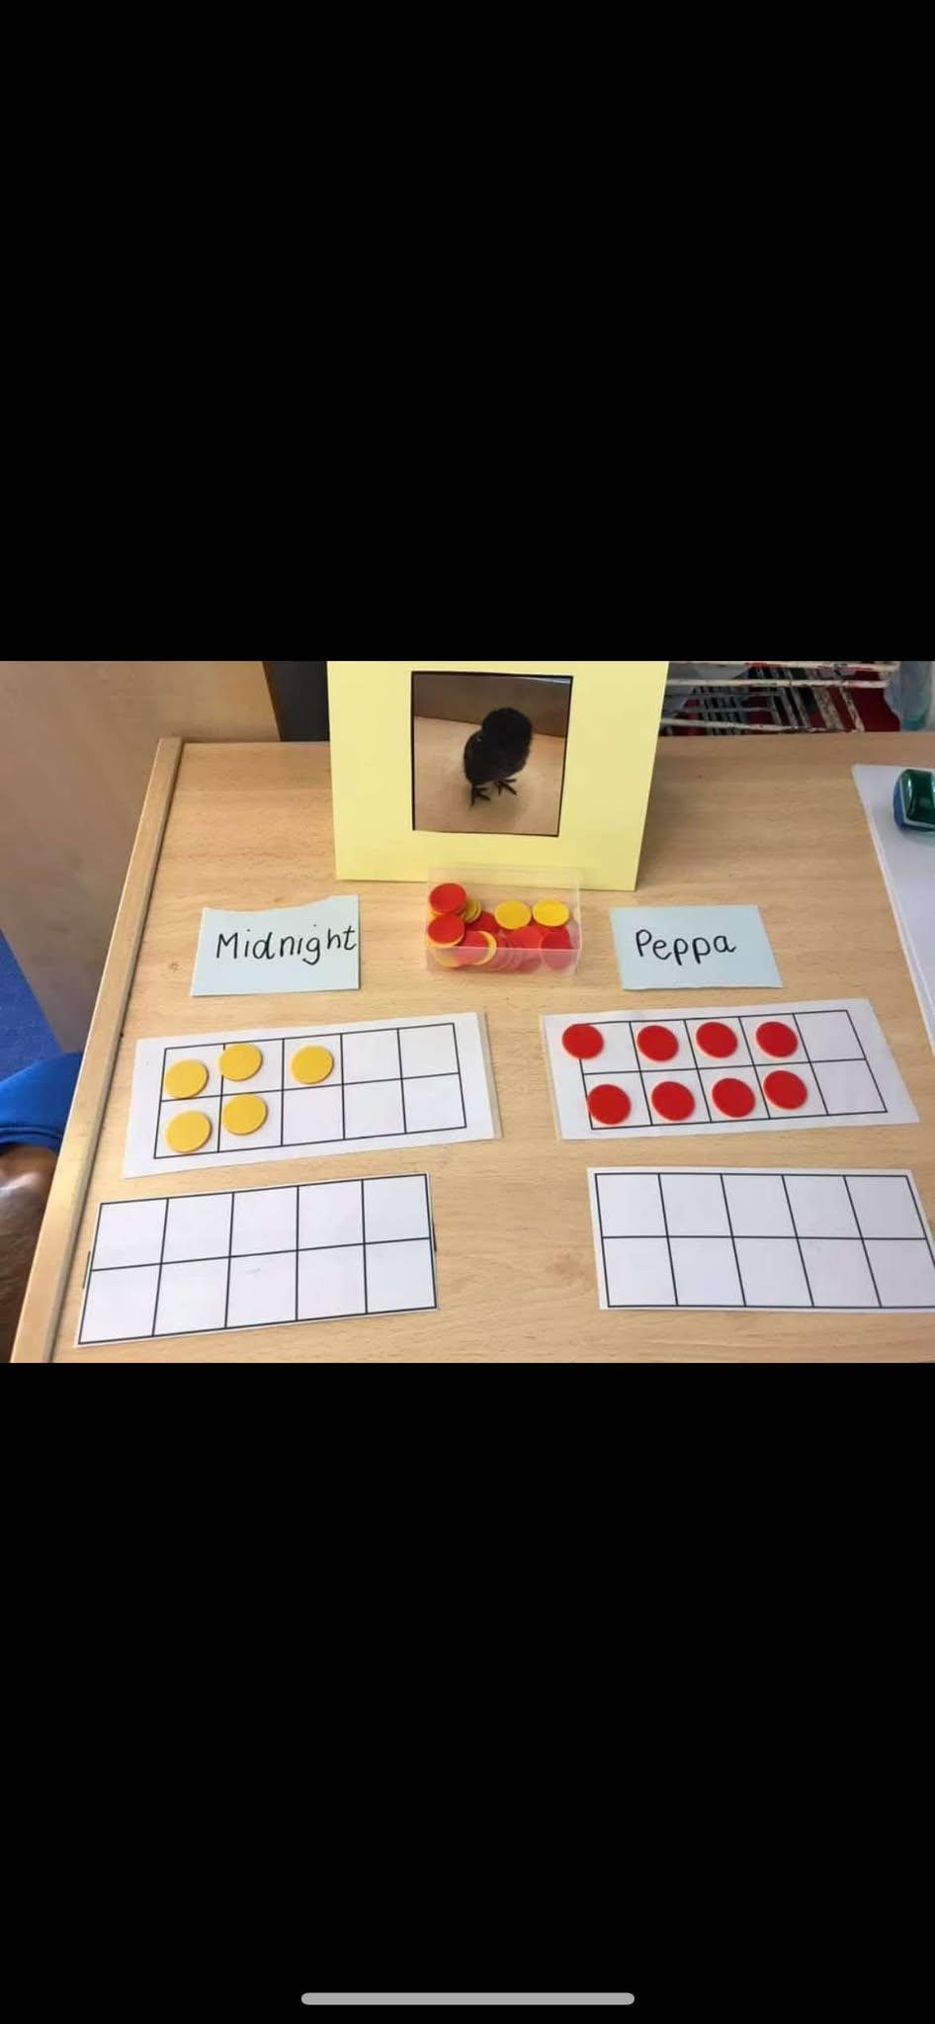
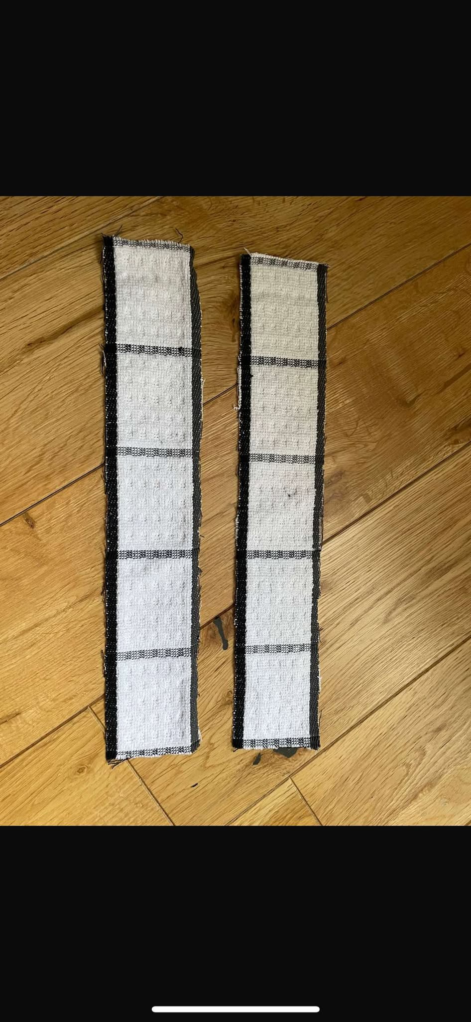

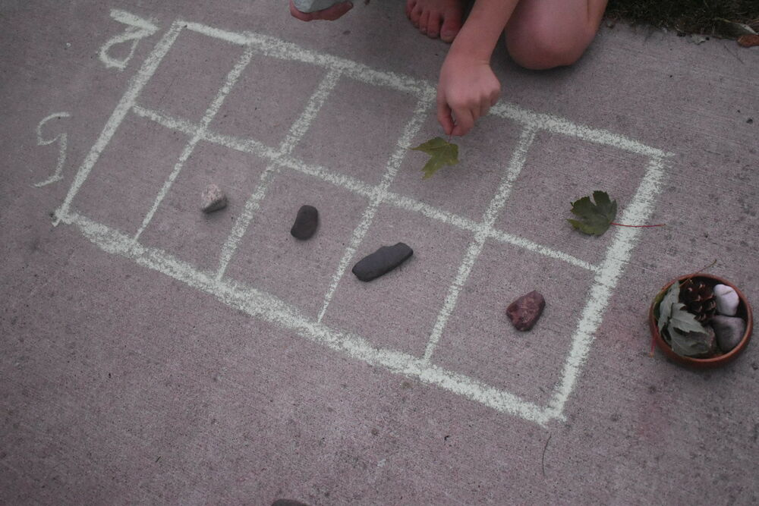


Slide 38
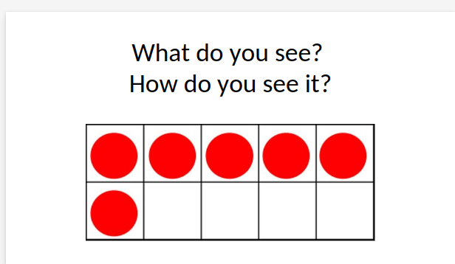
Let's Try It!

Slide 39
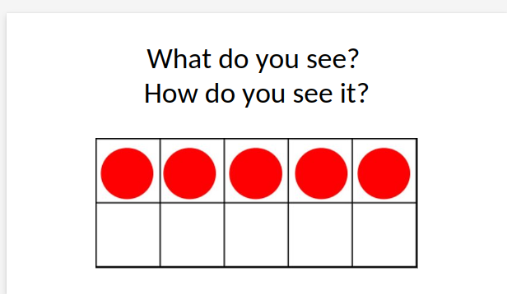

Slide 40

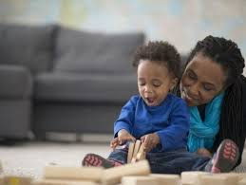
Involving Parents
Parent Information Session/Workshop/Stay and Plays
Information Leaflets and Posters
Home Learning Bags

Slide 41


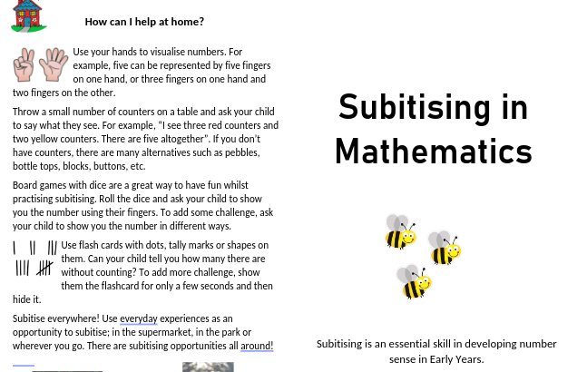

Support Materials/Resources
Inverclyde ELC Subitising Team​s Page
Inverclyde Subitising YouTube Channel​
Inverclyde Numeracy Strategy​ (SWAY)
CMO Training Team​s Page
Block play and maths https://shorturl.at/gRlEZ
Maths outdoors https://shorturl.at/Ow6IE
Notes:
It’s a lot to take in.
I’m hoping it has made a bit of sense. It certainly messed with my head as I was hearing about it all. But I had real “of course!” moments. I hope you have too.
We have made a Teams page to support you in using this. There are lots of ideas and support materials on there for you to use as well as training videos on these aspects. And if you can’t access this, I can email you a youtube link for the videos too.

Slide 42

Additional CPD Opportunities
Credits given to the excellent number sense training by Karen Wilding.
Find her yourself at:
www.eymaths.co.uk
https://twitter.com/eymaths_karen?lang=en
https://www.youtube.com/channel/UCF7b31eemNHalOm6UIG6eiQ
https://www.facebook.com/groups/609926063189767/about/
Notes:
It’s a lot to take in.
I’m hoping it has made a bit of sense. It certainly messed with my head as I was hearing about it all. But I had real “of course!” moments. I hope you have too.
We have made a Teams page to support you in using this. There are lots of ideas and support materials on there for you to use as well as training videos on these aspects. And if you can’t access this, I can email you a youtube link for the videos too.

Slide 43




Please get in touch with any questions/feedback and evaluate today’s session using the QR code.Thank you!
ellis.mcateer@st-ninians.inverclyde.sch.uk
@miss_mcateer

