Slide 1
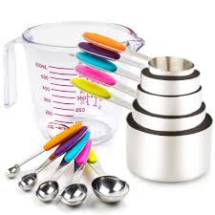
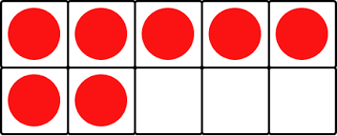
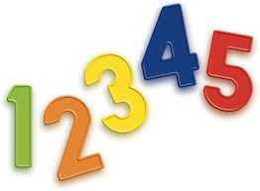
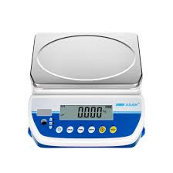
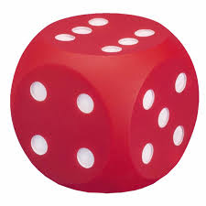
Developing a Numeracy Rich Environment
Ellis McAteer
Strategic Pedagogical Lead
Notes:
Hi everyone and welcome to today's session on developing a numeracy rich environment. If anyone has any questions during the session, as always please feel free to pop it in the chat box or raise a hand and you can unmute your mic. I know on a previous session, some people had difficulties accessing the chat box, so if that is the case again today, just unmute your mic if you are comfortable in doing so. I will also share my email address at the end if there is anything you want to get in touch about. The session today will be finished for 4.30pm and I will share the evaluation form that we would ask you to complete before you leave the call, so I will make sure there is time at the end to do this.

Slide 2

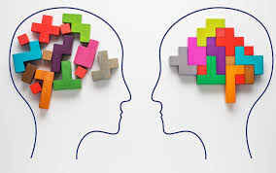
Session Aims
Explore the key features of a numeracy rich environment
Highlight the crucial role that a numeracy rich environment plays in supporting children's numeracy development
Explore the role of the adult in extending numeracy learning through a rich environment
Provide examples of high-quality experiences, resources and support materials that can be used to enhance your practice
Notes:
Here are our aims for today. So this is what we are hoping to achieve by the end of the session and what I would like you to be able to take away from it.
We are going to explain what a numeracy rich environment is, and explore the key features of it.
We will highlight the crucial role that a numeracy rich environment plays in supporting children's numeracy development.
Explore the role of the adult in extending numeracy learning through a rich environment.
We will then provide some examples of high-quality experiences, resources and support materials that can be used to enhance your practice.
Now, I appreciate we have a mixture of people on the call today. Some from early years and some from primary. So I have tried my best to make sure that the information I am sharing today is relevant for everyone, but you will know yourself that depending on the setting or school you are in, depending on the age and stage of the learners you have in front of you, you will need to make adaptations to suit you and your learners. Like with everything. However, the key themes and main messages I will sharing with you today are appropriate for everyone, particularly those who are in a play-based classroom or wanting to incorporate some more may into your class.

Slide 3
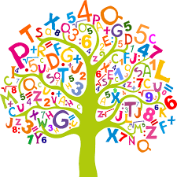
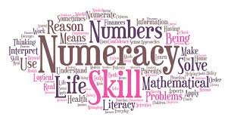
What is a Numeracy Rich Environment?
A numeracy-rich environment refers to a setting that naturally encourages mathematical thinking, problem-solving, and the application of numerical concepts in everyday activities and experiences.
Notes:
So, firstly.. What actually is a numeracy rich environment? How do we officially define it? Well, as you can see from the slide, a numeracy rich environment refers to a setting that naturally encourages mathematical thinking, problem-solving, and the application of numerical concepts in everyday activities and experiences. It is a space that integrates and provides opportunities for children to explore number, pattern, money, measure, shape and mathematical language through relevant, real-life experiences, making numeracy and maths accessible and engaging for all.
So you are not always having to necessarily sit children down and teach them the order of numbers, or teach them what it means to measure and weigh, or how to share items equally, which we know there absolutely is a time and a place for as it is all about balance, however, it is about allowing children to naturally develop this understanding, through their play within your classroom or learning environment, which can then be further supported by your input and direct instruction at other times. These experiences are best facilitated through a rich continuous provision within your learning environment and through thoughtful provocations and learning experiences set out by you, as the skilled teachers and practitioners. Your rich continuous provision is your environment. What you have in your environment, what it looks like, what the children have access to throughout the day. The idea is that if your environment is set up correctly, it will help you to support children to develop their knowledge and understanding of numeracy and its place in the real world by providing opportunities to use and explore numbers freely. Your resources available and spaces should be well thought out and planned for, so that children are supported to achieve their targets and individual learning goals. This will then also aid in your direct teaching of numeracy and maths.

Slide 4
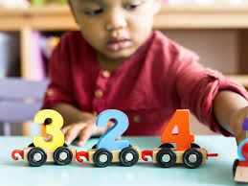
Why Numeracy?
"A child’s mathematical development begins long before they enter school. Early experiences with numbers, patterns, and problem-solving lay the foundation for future success in mathematics and beyond."
— National Association for the Education of Young Children (NAEYC)
Notes:
A question I am sure none of you are thinking, but lets just set the scene. Why numeracy? Why does the environment need to be numeracy rich? Why is this so important for children? We've firstly got a quote here that you can see from the slide, it says "A child’s mathematical development begins long before they enter school. Early experiences with numbers, patterns, and problem-solving lay the foundation for future success in mathematics and beyond." Early years and early primary is so crucial for children in all aspects of their learning, but particularly in numeracy. Numeracy learning in at the earliest stage is essential because it builds the foundation for lifelong learning, problem-solving, and success in both academic and everyday life. Early exposure to numbers, patterns, shapes, and measurements helps children develop critical thinking and reasoning skills that benefit them as they grow. Numeracy, as you will know, is cross-curricular and underpins much of what is taught throughout a child's entire curriculum. Numeracy across learning, not just within numeracy. So the skills children develop, much like their literacy, will lay the foundations for success in other areas.

Slide 5
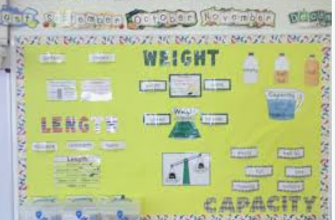
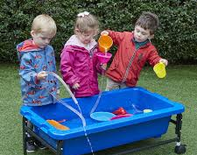
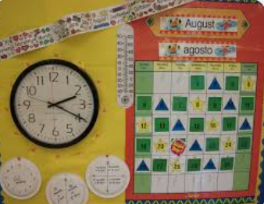
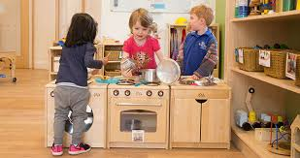
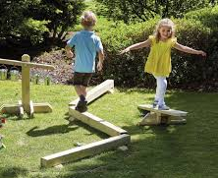
When children play and learn in an environment that is numeracy rich, with skilled adults who encourage and promote mathematical thinking, they:
Become more confident in their mathematical abilities
Develop their number sense
Are more comfortable taking risks and making mistakes​
Develop their creativity and logical thinking
Have opportunities to problem solve and reason
Develop a LOVE for maths!
Notes:
So what does numeracy learning support children with? If we get our learning environment correct, what will the impact be? Well, ultimately, when children play in an environment that is numeracy rich, with skilled adults who encourage and promote mathematical thinking, they:
Become more confident in their mathematical abilities – Confidence is key! The more children are exposed to numeracy and maths within their environment, the more familiar they will become and the more confident they will feel in their abilities. Your encouragement also builds this confidence.
Develop their number sense – Quite self explanatory, again, if children are using number in their everyday life, they will develop their knowledge and understanding of numbers and number relationships.
Are more comfortable taking risks and making mistakes - Taking risks and making mistakes is a big part of numeracy. Trial and error. Trying out new ways to problem solve until you find a way that leads you to success. We want children to be comfortable in doing this and not be afraid, so if they have opportunities to do this within their environment, it will become normal for them, and less intimidating.
Develop their creativity and logical thinking - Numeracy and mathematics require a balance of logical thinking and creativity to solve problems, understand patterns, and apply mathematical concepts to real-life situations.
Have opportunities to problem solve and reason – Again, huge areas within numeracy that are important for children to have opportunities to engage in, especially through real life experiences.
Develop a LOVE for maths! - This one is really important. We want children to have positive attitudes towards numeracy and maths and be excited by it. We want them to find this learning fun and exciting, so it is important we make this learning engaging, and try link it to children's interests where possible.
So you can see from here, there is so much that children can learn from being exposed to a numeracy rich environment, alongside skilled adults who encourage and promote mathematical thinking through your direct teaching input and conversations with the children.

Slide 6

What does the research tell us?
Children's mathematical knowledge at school entry is the strongest predictor of both later math success and success in other academic domains. Duncan et al. (2007)
In the UK, almost 78% of adults have numeracy skills below the equivalent of a GCSE grade A-C. This deficiency affects their ability to manage personal finances, employment prospects, and overall well-being. (DfE, 2017)
Feeling inadequate or embarrassed about maths skills can negatively affect self-confidence and social interactions. (DfE, 2017)
A numeracy-rich classroom helps students develop the confidence and competence to tackle numerical tasks in the real world. This is crucial for personal and professional development. (Making Maths Count, 2016)
Learners in numeracy-rich classrooms typically demonstrate enhanced mathematical abilities, improved critical thinking, and greater overall academic success compared to their peers in less numeracy-focused environments (EEF)
Notes:
So, we've explored why early numeracy learning is so crucial and you will all know this from first-hand experience..but what does the research say? Does this back up what we already know? Let's look at these statements together. I will give you a wee minute firstly to read through them, then we can discuss what this is telling us.
Children's mathematical knowledge at school entry is the strongest predictor of both later math success and success in other academic domains. Duncan et al. (2007) - So whatever experiences children have with numeracy learning, in their early years, before they enter school, strongly corelates with their later success in not only mathematics, but also other academic areas, as we know numeracy is cross curricular. Again, re-iterating the importance of numeracy learning in nursery.
In the UK, almost 78% of adults have numeracy skills below the equivalent of a GCSE grade A-C. This deficiency affects their ability to manage personal finances, employment prospects, and overall well-being. - Without adequate numeracy skills, children are more likely to struggle in later life. We need to intervene at the earliest possible stage to avoid this happening.
Feeling inadequate or embarrassed about math skills can negatively affect self-confidence and social interactions. - If children do not foster the love for maths at an early age, build resilience and are confident in their abilities as well as being comfortable with making mistakes, they are more likely to suffer from self-doubt and continue to struggle with numeracy and maths as they progress through school. We want to develop this confidence and positive attitude as soon as we can, so that children don't feel embarrassed, it s just part of their every day life.
A numeracy-rich classroom helps students develop the confidence and competence to tackle numerical tasks in the real world. This is crucial for personal and professional development. This is a quote taken from the make maths count report from Education Scotland. This again, is highlighting the benefits to children in learning in a numeracy rich space.
Learners in numeracy-rich classrooms typically demonstrate enhanced mathematical abilities, improved critical thinking, and greater overall academic success compared to their peers in less numeracy-focused environments. This is from the EEF – Education Endownment Foundation. Learners in a rich numeracy learning space, typically demonstrate these enhances skills, compared to their peers. So why wouldn’t we want to do this and create this for our learners?
These statistics highlight further, the importance of fostering numeracy skills from an early age, as they are linked to better educational achievements, employment opportunities, and economic stability in later life. Again, I am sure everyone would have been quite confident in being able to say this anyway, as we have all lived It we have experienced it, but it is always good to get the research to confirm this and solidify the purpose of creating these numeracy rich spaces.

Slide 7

Is there an area / space within your learning environment that is particularly 'numeracy rich'?
Notes:
Ok.. I just want to give us a wee chance to pause and reflect on what we have heard so far. Before we go on to talk about what actually makes a space numeracy rich, I want to give you a moment to think about your own spaces. If you currently in your setting or your school, have a look around. If you are not, have a think about your playroom, your classroom, your school as a whole, your areas, your spaces. Is there currently anywhere that you would describe as being numeracy rich? It might be outdoors. Why? What about the area makes you say that? Think of it's features, what it allows children to do. I will give you a wee minute or two to think about it and chat with colleagues if you are sharing a computer. If you could then pop into the chat box and we will look at some of the responses. Don't over think it! Just go with what first comes to mind. No answer is a wrong answer here.
Great, thank you all for your comments. Lots of really good examples there. So let's look at it in more detail!

Slide 8

What makes a space 'numeracy rich'?
Visible learning: Numbers, mathematical tools, and concepts are everywhere
Vocabulary: Children are encouraged to talk about numbers and mathematical concepts through their play - they are immersed in mathematical language and vocabulary role modelled by practitioners
Technology:
Risk-taking and problem solving: Children are encouraged to try new things and learn from mistakes and are given opportunities to problem solve where possible
Real-world connections: Children are given opportunities to apply math to everyday situations
Notes:
So we have defined a numeracy rich environment, we know what it is and what it should support learners to do. But what does this actually look like? What are the key features of a numeracy rich environment?
Firstly, use of visible learning. Numbers, mathematical tools, and concepts are everywhere, where relevant. Making use of displays and where appropriate, incorporating charts, number lines, shapes, clocks, calendars, measurement tools. Things that children will be looking at every day, that they will subconsciously begin to take in, and eventually make use of.
Vocabulary and mathematical language. This is key for you as the adult. Children should be encouraged to talk about numbers and mathematical concepts through their play and everyday learning experiences – they should be immersed in mathematical language and vocabulary role modelled by practitioners. Encouraging the use of terms like "more than," "less than," "equal to," "half", "small, medium and large" etc. We want children to hear this mathematical language being used in context, so they can replicate this appropriately and truly understand what is means. This will be embedded most effectively, if it is done through children's play, through inter-disciplinary learning experiences, or linked to something they are interested in. It is important to also display this vocabulary where relevant, to support children to make connections with the word and its meaning.
Technology Integration. Educational apps, interactive whiteboards, laptops and other digital tools that enhance learning. I know this isn't always easy as these things can cost a lot of money, but, where you can, using technology can be key for supporting numeracy understanding, particularly as we are becoming a more digitally literate society and children will need to develop the appropriate skills with this.
Risk-taking and problem solving opportunities. Children should be encouraged to try new things and learn from mistakes wherever possible. There should be an abundance of opportunities, from the youngest age, to problem solve where possible. Be clever about the amount of information you give to children. We do not want to spoon feed them everything. Let there be an element of trial and error, as this is a huge skill within numeracy and maths and will encourage children to think critically.
Real-world connections and real-life contexts. Using every day experiences to provide greater context to learning. Shopping, cooking, sports scores, daily timetabling, use every day life events to embed and teach numeracy. If children cannot see the correlation between numbers and mathematical concepts and the real world, their learning will never be fully embedded. Providing children with opportunities to use numeracy in real life scenarios as much as you can, even when you are not engaging in a numeracy lesson. Really simple experiences, such as setting the table, measuring themselves and others on a height chart, using a set of scales, counting jotters or pieces of paper or pencils, subitising objects, using 10 frames as morning check ins or lunch registration, pouring and filling measuring jugs, using a calendar, using a phone and phonebook, visiting the shop – the list goes on. It doesn't always have to be complicated. Again, adapt these experiences dependent on the age and stage of the learners. There should always be an element of challenge.

Slide 9
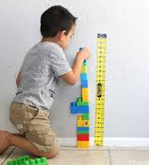

The physical environment
Incorporate number into daily conversations
Explore mathematics through different contexts
Make counting and subitising part of everyday life
Create a numeracy positive culture
Notes:
So...how do we do this? Where do we begin?
We’ve spoken a bit about visible learning, so lets look at the physical environment and what this looks like for the children. What would your spaces look like if you were a child? What would interest them and spark their natural mathematical curiosity? What resources should we have out? What should the physical environment offer? Exposing children to numeracy in all areas of the playroom and classroom with various items such as scales, numicon, height charts, blocks, rulers, measuring tapes, measuring jugs etc that children can use through their play and learning. As well as this, having numbers in your environment dotted around wherever relevant. A good way to do this, and to ensure it is meaningful and relevant for the children is for example, numbering books in the story corner. This might help if you rotate your books, it will allow you to keep track of what books you have used. Children might pick up their favourite book and know it is called, The Tiger Who Came To Tea, but they also might begin to recognise that this is book number 4, and place it back on the shelf in the correct place, in order. This of course is more suitable for young learners, but you can adapt this and even have sums on your books as an alternative, and children have to order them that way. Be creative! Having a visible daily morning numeracy challenge is another simple one. This doesn't have to be done in a jotter, maybe its a hands on activity, or a challenge set for children during free time or outdoor play. You may also use 10 frames for children to self register, supporting subitising. You may also choose to display objects in a way that highlights differences in size, to allow children to choose accordingly, for examples, bowls in the house corner, jugs in the water tray etc. Being mindful about visible numeracy in your environment and role modelling how to use this, and how it supports you in your every day life. Another example would be displaying a clock, a calendar and regularly using these and referring to the changes in time. Or having a thermometer that the children can measure the temperature with. Allowing them to take on this responsibility and become independent in their learning.
Incorporate number into daily conversations. Again, we spoke about this before, in terms of vocabulary being a massive feature of your numeracy rich environment. This can be visible, adding appropriate mathematical vocabulary to displays, but it doesn't always need to be. In fact, most of this comes from your dialogue and interactions with the children. For example, use words like "less or "more" to draw attention to changes in amounts or size for younger children. For older children, using words like comparison, estimate, the sum of, etc. But making sure you make an effort to use and role model this type of vocabulary outwith numeracy lessons to ensure breadth and depth of knowledge.
Explore mathematics through different contexts, allowing children to explore number in different ways and different situations, not always just as a textbook or whiteboard lesson. Absolutely, you can utilise small group times or direct teaching time for a more focused, direct input, but ensuring children have access to storybooks, puzzles, puppet play, and games with dice, dart boards for example, to vary the experiences. Sing number rhymes and songs, read stories that involve number and talk to children about it. For children in primary settings, this is where you plan for children to explore maths through other subjects in the curriculum – IDL and topic work. Make sure children can transfer the skills they have learned in a standalone numeracy lesson, to other areas. This supports and fosters the culture you create, that numeracy is embedded within your classroom everywhere, not just for an hour a day when you have timetabled for it.
Make counting and subitising part of everyday life: Subitising groups of objects indoors and out, counting stairs, number of children etc. Moving between subitising and counting where appropriate. Make this a normal part of every day life to show children the relevance of number and its use.
Create a numeracy positive culture is also extremeley important…something we will touch on in a minute or two.

Slide 10
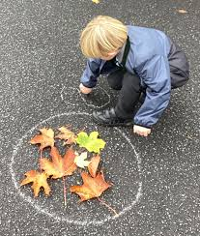
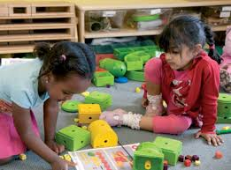
Embedding numeracy in your areas
Role-play areas
Block play
Construction
Sand and water
Cooking/baking
Malleable
Puzzles and games
Digital technologies
Loose parts
Songs, rhymes, and stories
Outdoor learning
…. there are opportunities everywhere!
Notes:
There are opportunities for you to embed numeracy experiences absolutely everywhere, in all areas of the playroom and classroom. This will differ slightly for primary settings, depending on how play-based your classroom is and the space you have got. But you can absolutely still take inspiration from this. We will not go through each one, but I will give you some examples. To start off with, in your house corner, you can have things like a phone, a phone book, a calendar, restaurant menus with prices, a calculator, various shapes and sizes of bowls, cups, measuring spoons, weighing scales, the list goes on. Really simple, every day items that allow children to explore numbers and their use and relevance within every day life. We will touch on block play a wee bit more later, but block play in itself, with no other resources, offers children rich opportunities to explore mathematical concepts, so simply having this as an area in your playroom is already offering this. However, you can certainly add things or have a loose parts area available near by with things like measuring tapes, rulers, stopwatches, sand timers etc. Other really simple ideas, children having access to measuring spoons and measuring jugs in sand and water play, shape cutters and playdoh tools for malleable play, puzzles and games offer opportunities in itself, particularly with the use of dice, digital technologies and making use of the whiteboard, cooking and baking opportunities where children are using recipes, weighing and measuring, songs, rhymes and stories that include numbers, and then of course the wealth of opportunities available to children outdoors. Again, we will touch on outdoors in a wee bit more detail soon.
But as you can see and as you have heard, there are so many opportunities for you to incorporate numeracy into all areas of your room. And its all really simple things! You don't have to spend a fortune, a lot of these items are things you will already have in your nursery or things you can bring from home.

Slide 11
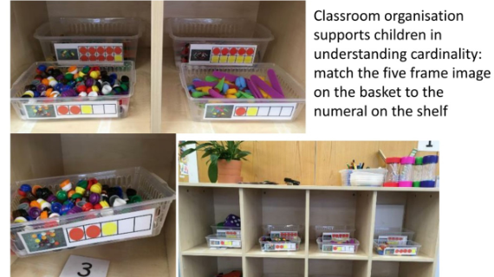
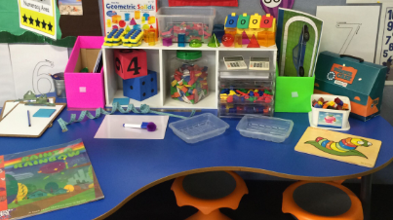
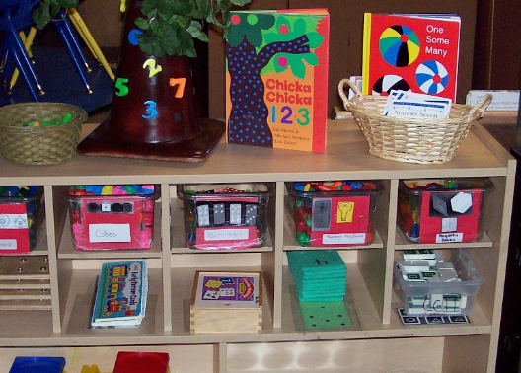
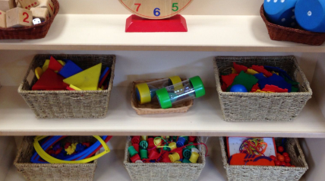
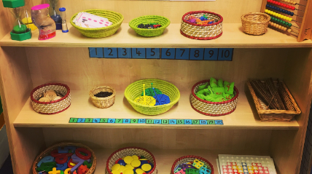

Slide 12

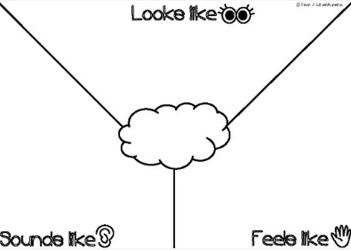
Creating the Culture
What does your numeracy rich environent...
Look like?
Feel like?
Sound like?
What are your maths ‘norms’?
Notes:
Creating a numeracy-positive culture in Scottish classrooms is essential to help students develop confidence, enthusiasm, and skills in mathematics. You want children to feel like an important part of this culture, that their thoughts and feelings and heard and acted on. We know that there can often be a lot of anxiety around numeracy and maths, particularly for older children, so it is important that from the get go, we create this numeracy and maths positive culture. An easy way to do is is by creating your numeracy and maths charter, or Y chart, some sort of agreement that you make with the children at the beginning of the year and adhere to. What do you want your numeracy rich environment to look like, feel like and sound like? What are your math norms? For early years, I appreciate this a bit more tricky to do, but it is absolutely something worth talking to the children about and even engaging in this activity with your colleagues for your own planning and self-evaluation, so you are all on the same page.

Slide 13
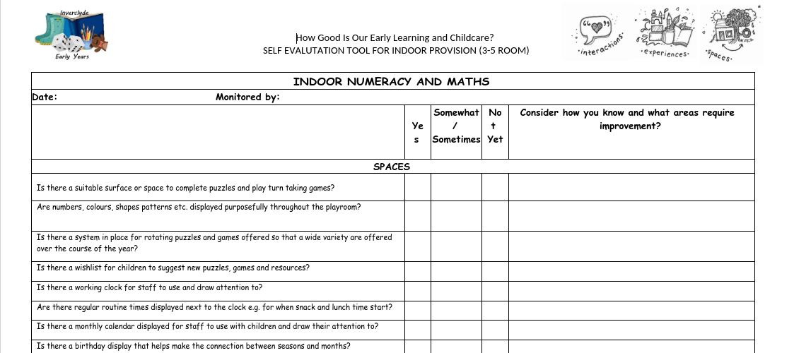


Regularly self-evaluate and assess if the environment resources and provocations on offer are effective in promoting mathematical exploration, catered to the children’s current interests, abilities and needs.
Notes:
Here is a useful tool you may or may not have already seen and possibly used in your setting. This is a numeracy provision audit tool, there is one for outdoors and one for indoors. This is great for self-evaluation and for regularly evaluating your spaces to ensure they are rich in numeracy opportunities which are catered to children's current interests, abilities and individual needs. If you would like a copy of this, I can email it directly to you or you can access it on the CMO training team. If you are not a member of the team or want a copy sent, I will share my email address at the end and you can get in touch. I would really encourage the use of this, as it gives you a great place to start in your journey to a numeracy rich environment. I would say this is more for early years settings, however, if you are working in a class in lower primary and are play-based, you might also find this useful.

Slide 14
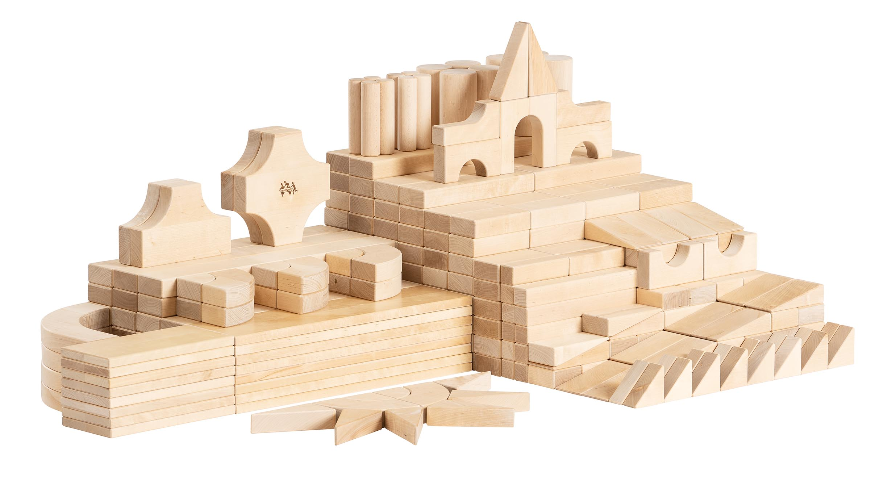
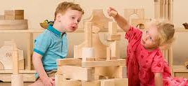
Block Play
"The mathematical relationships of unit blocks are discovered by the children in pursuit of their own creative ideas." Gura, 1992: 79
Notes:
So I know I briefly mentioned block play earlier on, but I did want to just speak about this in greater detail. As you may know, block play offers particularly rich mathematical learning opportunities by demanding children engage with concepts of estimation, data, fractions, uncertainty, measurement and number naturally as part of their play. As the quotation on the slide says, "The mathematical relationships of unit blocks are discovered by the children in pursuit of their own creative ideas." In other words, children naturally become familiar with mathematical relationships and concepts through block play.

Slide 15
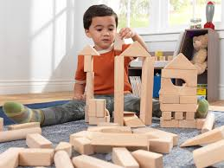
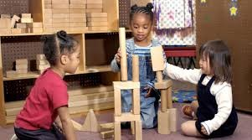
Why Block Play?
A study that evaluated the block constructions of four-year-olds (in 1982) and compared them with their test scores in high school (in 1998) supported the hypothesis that a child’s ability to create complex block constructions can predict mathematical ability.​
Notes:
In-case anyone wasn't quite sold on this yet, although I know many of you will already have areas in your establishment dedicated to block play, there is research that backs this up and have been many studies conducted which evidences the positive impact on children's numeracy. One study, conducted back in 1982, evaluated the block constructions of four-year-olds and compared them with their test scores in high school. The study supported the hypothesis that a child’s ability to create complex block constructions can predict mathematical ability, as the children who had regular access to block play in nursery and engaged in these experiences, had better mathematics scores in high school, compared to children who did not engage in this type of play on a regular basis. I appreciate that blocks, particularly the community playthings blocks that we would recommend to use, are not cheap, however, if your establishment does not yet have them and happens to have a bit of money in your next budget, I would strongly advise to invest. They are absolutely an investment and last you forever! If your school has a set or a few set of these, I would absolutely encourage you to see about borrowing them or gaining access for a while to allow your children to engage with the resource.

Slide 16
Block Play - Mathematical Concepts
Symmetry
Sorting
Pattern
Measure
Shape
Problem-solving
Counting
Estimation
Fractions
Probability
"Because it involves measuring lengths, widths, and heights (if only by eye), block play develops a child’s ability to mentally visualize relationships. Such manipulations are similar to those used in geometry and algebra during the child’s later school years" (Henniger, 1987).
Notes:
Here on this slide, lists some of the mathematical concepts that a child can explore and become familiar with, through engaging in block play experiences. So you've got:
Symmetry
Sorting
Pattern
Measure
Shape
Problem-solving
Counting
Estimation
Fractions
Probability
So much learning potential! If you have a block play area within your establishment, and have observed children closely in their play, you will most definitely have witnessed children in action, developing all of these important skills. You've also got this great quote, which sums it up quite nicely - "Because it involves measuring lengths, widths, and heights (if only by eye), block play develops a child’s ability to mentally visualize relationships. Such manipulations are similar to those used in geometry and algebra during the child’s later school years" (Henniger, 1987). So there again, we can see the link between children's block play experiences and their later numeracy and maths education.

Slide 17
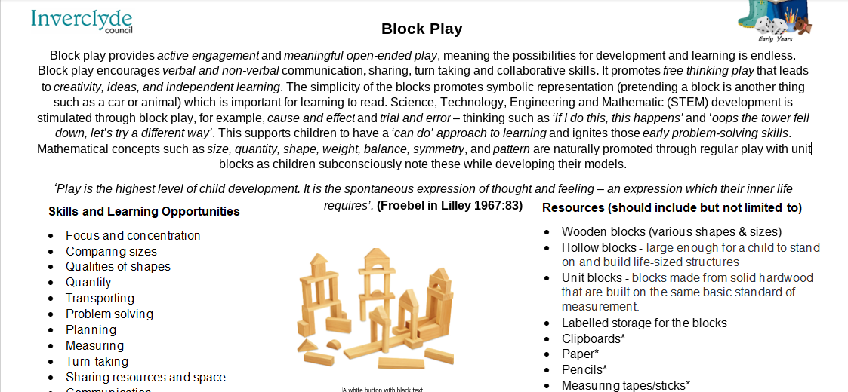

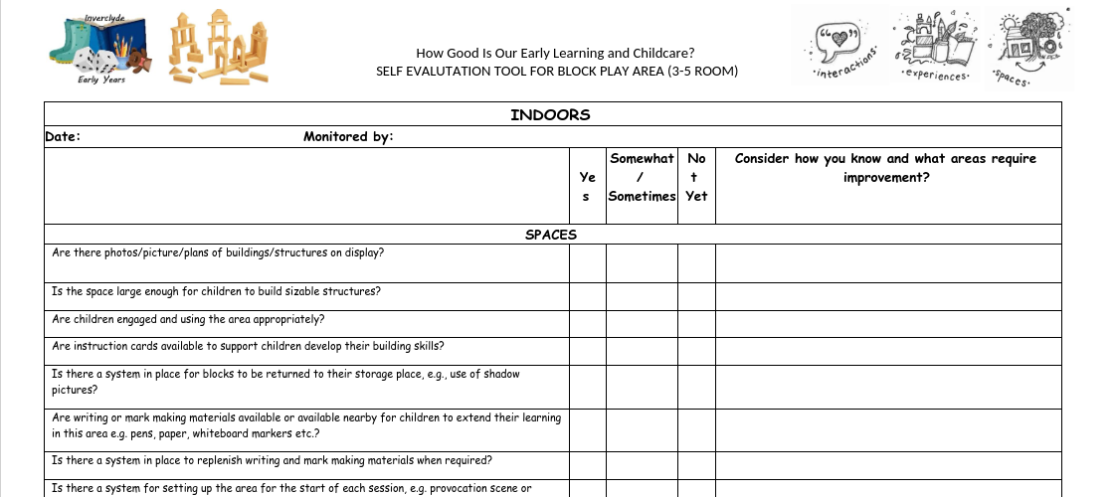
Block Play Area Card
Block Play Audit Tool
Notes:
Here are some other resources, specifically for block play. Again, you may have already seen these but incase anyone hasn't and is interested in using them. There is an area card for block play, which details the skills and learning opportunities available to children, alongside possible resources that you could add to extend the learning in this area. As well as this, there are links to the es and os, children's rights and GIRFEC, as well as practitioner questions on the back that you might want to ask yourself or chat through with a colleague when setting up the area. In addition, there is the block play audit tool, if you are looking to do a specific deep dive into the area and want to complete the audit to assess and self-evaluate. Again, I am more than happy to email these over or you can access them on the CMO training team.

Slide 18
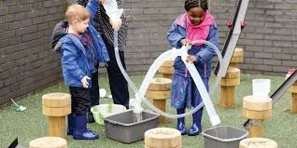
Outdoor Play
"Outdoor play offers children invaluable opportunities to develop numeracy skills through hands-on experiences. We can build confidence in maths concepts before children even perceive their play as mathematics."- Julia Robertson
Notes:
I wanted to also shine a light on outdoor play specifically, as you'll hopefully know, the wealth of numeracy opportunities that the outdoors can provide young children with. Often described as 'nature's classroom', outdoor play naturally offers particularly rich experiences and creative opportunities to secure mathematical understanding in real and relevant contexts. Opportunities for this playful curiosity and discovery supports the development of learners' early numerical concepts. As it says on the slide, "Outdoor play offers children invaluable opportunities to develop numeracy skills through hands-on experiences. We can build confidence in maths concepts before children even perceive their play as mathematics."

Slide 19
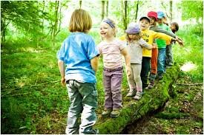
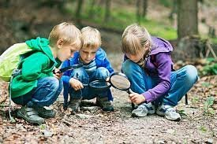
Why Outdoors?
Knight (2011) suggests that children will become more creative outdoors where they have freedom to be “innovative, flexible and adaptable” and that this environment will stimulate creative mathematical thinking.
Notes:
So, why outdoors? Knight (2011) suggests that children will become more creative outdoors where they have freedom to be “innovative, flexible and adaptable” and that this environment will stimulate creative mathematical thinking. The great thing about the outdoors is that it is free and it does not have an age limit. Purposeful, rich outdoor learning to support numeracy and maths is for everyone!

Slide 20
Outdoors - Mathematical Concepts
Symmetry
Pattern
Direction
Time
Measure
Shape
Subitising
Problem-solving
Counting
Sorting
"When using the outdoors environment, the children can construct on a larger scale, explore the world first-hand and experience natural phenomena such as weather, the changing seasons and shadows" (Maynard and Waters, 2007).
https://www.youtube.com/watch?v=9kFVwgqsVjQ
Notes:
Here on this slide, lists some of the mathematical concepts that a child can explore and become familiar with, through engaging in outdoor play experiences. So you've got:
Symmetry
Pattern
Direction
Time
Measure
Shape
Subitising
Problem-solving
Counting
Sorting
I am going to show you a short video, from learning through landscapes, just to show you an example of how to incorporate numeracy learning outdoors.
Again, SO much learning! In an environment that children can freely explore, promoting their natural curiosity. Engaging in outdoor play provides numerous benefits, as we know, outwith numeracy and maths learning. It has been proven that children's physical, mental, social, and emotional well-being are improved when playing outdoors. It stimulates their creativity and imagination by being in nature and open spaces. It can improve concentration through activities like exploring and building structures that enhance focus and attention span. We also know it can reduces stress and anxiety as being in nature and the outdoors can have a calming effect, reducing cortisol levels. And another great quote, you've got here is "When using the outdoors environment, the children can construct on a larger scale, explore the world first-hand and experience natural phenomena such as weather, the changing seasons and shadows" (Maynard and Waters, 2007). Lots of research out there that strongly advocates for outdoor learning, particularly in relation to numeracy development. We know that this is something we as an authority also promote.

Slide 21
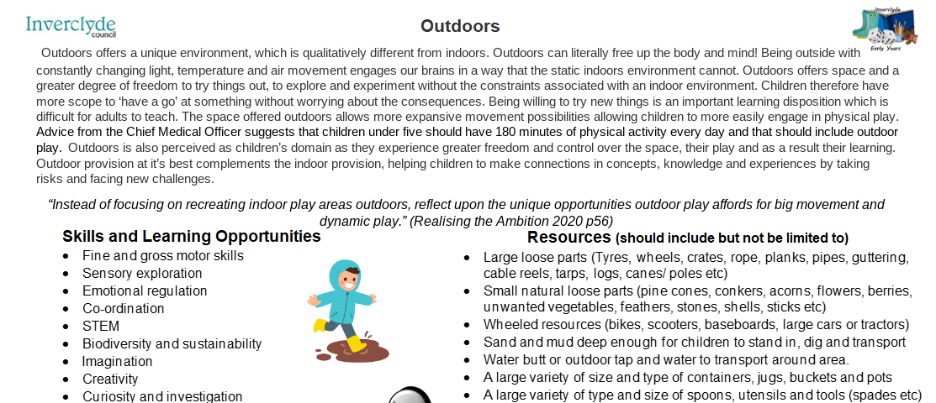
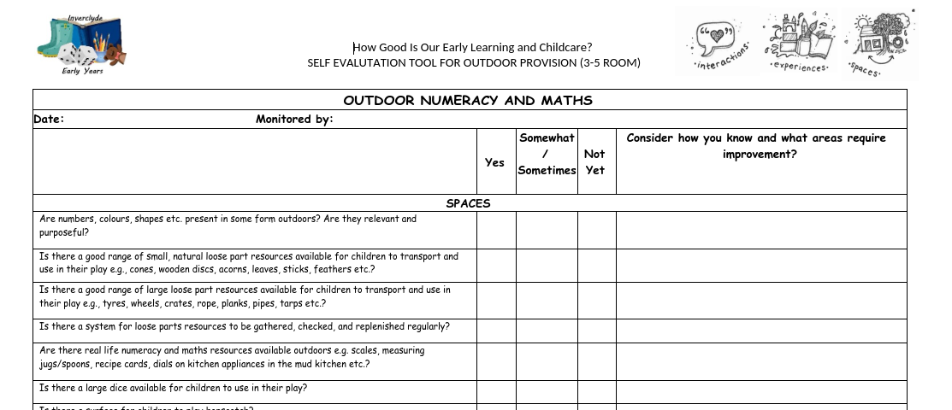
Outdoors Area Card
Outdoor Audit Tool
Notes:
So, we've got the same resources here for oudoors, as we do for block play. The area card and then the audit tool to self-evaluate and assess if your outdoor environment, resources and provocations on offer are effective in promoting mathematical exploration, catered to the children’s current interests, abilities and needs.

Slide 22
What do you think your role is?
Notes:
So, I just want to give us another moment to stop, digest what you have heard and reflect. What is your role in all of this? You have such an important part to play. Once a numeracy rich environment has been achieved, children have access to a block play area, to the outdoors, and they can explore numeracy and mathematical concepts naturally through the provocations and experiences set out through a rich continuous provision, you've made sure there are opportunities for numeracy learning in all areas of the playroom. What happens there? Is our job done? What is our role from there? I will give you a minute or two to have a think about it, discuss with anyone you are with and then again, if I can please ask that you pop your thoughts into the chat box.

Slide 23
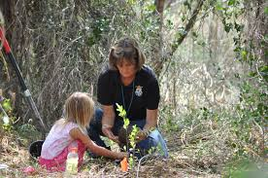

The Role of the Adult
Creating
Encouraging
Modelling
Engaging
Observing
Reviewing
Notes:
So, as you will know, the role of the adult is crucial in developing and maintaining a numeracy rich environment. Without you, it doesn't happen! The role you play is imperative, for a number of reasons. You can see here on the slide, I have listed a few 'actions' or 'roles' you take on. Lets go through them together.
Firstly, you are responsible for creating. Creating the numeracy rich environment that we want children to be immersed in. All that we have spoken about today, the physical environment, the visible learning, the resources and experiences on offer, the numeracy atmosphere – you are creating that. You are setting this environment up, to allow for the rest to happen.
Encouraging. Encouraging children to notice numbers in their environment, such as on clocks, calendars, or doors. Being supportive and encouraging children to become confident in their own mathematical abilities and develop a positive attitude towards maths. Encouraging a growth mindset by praising effort and persistence in problem-solving, Making numeracy fun, engaging, and relevant to children's lives to reduce anxiety around maths. Your encouragement can be the difference between a child trying and succeeding, and not bothering.
Next we have modelling. Being a role model for the children. Role modelling vocabulary, using mathematical language in context during their play and experiences. Using and encouraging terms like "bigger," "smaller," "more than," "less than," "half," and "equal to." Modelling how to use different resources, how they link to real life.
Engaging, this is all about your interactions with the children. Engaging with the children in their play and links in with the previous point about modelling. Promoting real-life numeracy experiences and getting involved in it alongside the children. Engaging children in practical activities such as setting the table (counting plates/cups), baking (measuring ingredients), or shopping role-play (handling money). Asking open-ended questions to develop problem-solving and reasoning skills (e.g., "How many steps do we need to take to reach the tree?"). Engaging with the children, of course, but also with families and the community. We will talk a wee bit more about this in the next slide.
We then have observing. You are all so experienced in this area already, you complete observations every single day, whether you write them up or not. You are observing the children, observing the engagement in areas, to understand how you can extend learning, how you can adapt and tailor experiences to the children for them to reach their targets. This is how your numeracy rich environment continuously evolves and develops for the better.
And lastly, reviewing. Taking all that you have observed and self-evaluating. Evaluating your spaces, your areas, your resources and your practice. How could you develop and adapt? How can you extend the learning. Identifying children’s current interests and embedding numeracy in those areas. Challenging children’s thinking further by introducing new concepts through play. You know your children best, so you are looking to constantly improve, so that they can constantly improve.
So you can see from here, nothing can run effectively without you. Children rely on you to support and direct them. And you all do this on a daily basis, so it's about recognising this and working towards your own development! Which you clearly are committed to doing, just by being on this session today.

Slide 24

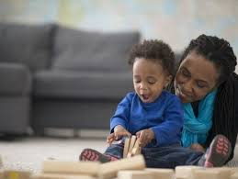
Involving Parents
Parent Information Session/Workshop/Stay and Plays/PAT PALS
Information Leaflets and Posters
Home Learning Bags
Notes:
We all know that working with and involving parents, families and the community where possible is super important. Providing guidance to parents on how to incorporate numeracy at home through everyday activities, keeping them involved in their children's learning. Involving families in numeracy-related events, such as stay and play sessions or PAT PAL sessions focused around numeracy and maths, parents workshops, parents evening, providing information leaflets and posters about numeracy development. You might even want to make use of home learning bags and send some fun and engaging activities that children can play with their families at home. Lots of which I am sure you are already doing, but it is important to mention. If anyone is interested in sending out some parent leaflets or home learning bags, the CMO training team has some examples on there that you can use and adapt as you wish.

Slide 25


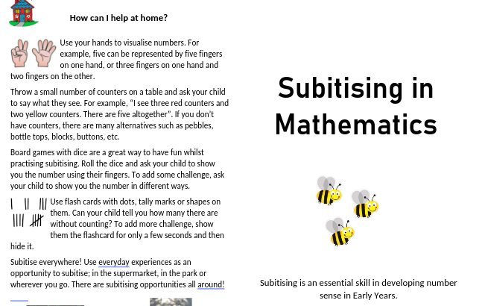
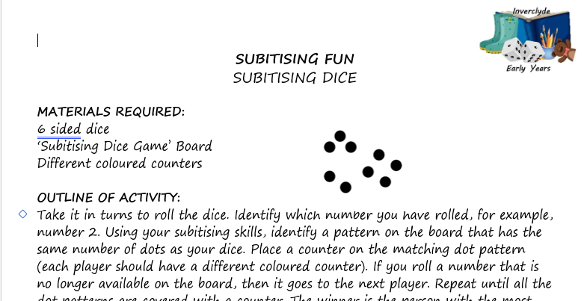


Support Materials/Resources
Inverclyde ELC Subitising Team​s Page
Inverclyde Subitising YouTube Channel​
Inverclyde Numeracy Strategy​ (SWAY)
CMO Training Team​s Page
Block play and maths https://shorturl.at/gRlEZ
Maths outdoors https://shorturl.at/Ow6IE
PASE
Notes:
I wanted to direct you to some different places where you can access additional information and resources that you may find useful. Firstly, there are a couple of teams pages that if you aren't already a member of, I would really recommend. We have our CMO training team where you can access all of the audit tools, area cards, parents leaflets and home learning activities. There is also the Inverclyde ELC Subitising teams page that has all the information and resources to support you with subitising and early number sense. Along with there, there is the Inverclyde Subitising Youtube Channel that has a series of training videos. There is the Inverclyde Numeracy Strategy, which is currently unavailable as it is going through a refresh at the moment, but it is due to be re-launched on the 8th May and will then be available to everyone in the form of a SWAY. It will be along the same lines as the Literacy Framework, but obviously for numeracy. I have then attached some useful documents all about block play and maths outdoors and lastly, the PASE webblog that you can access online, just with a simple google search and you will find training powerpoints and other resources on there from ex CMOs and we will also be adding to this as well. Similarly, if anyone would like these slides sent over, please let me know and I can absolutely arrange that.

Slide 26

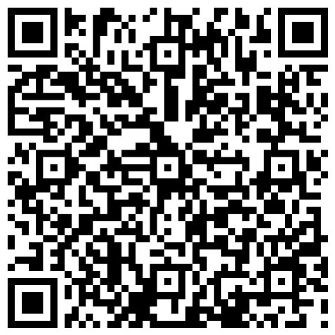


Please get in touch with any questions/feedback and evaluate today’s session using the QR code.Thank you!
ellis.mcateer@st-ninians.inverclyde.sch.uk
@miss_mcateer
Notes:
Okay everyone, that takes us to the end of today's session. Thank you all so much for joining today and for your engagement. I hope you have taken something away from the session today, or are even leaving with a sense of re-assurance that your current practice is effective. This may have been a refresher for you, and just re-inforced the same messages that you already aware of. This is not something that needs to be difficult, it can be developed using really simple strategies. If I can please ask that before you leave the call, you scan the QR code on the screen and fill in an evaluation form. It is really important for our data records. I have also put my email address on the slide, do not hesistate to get in touch if you have any questions or want to talk about anything further.

