Slide 1




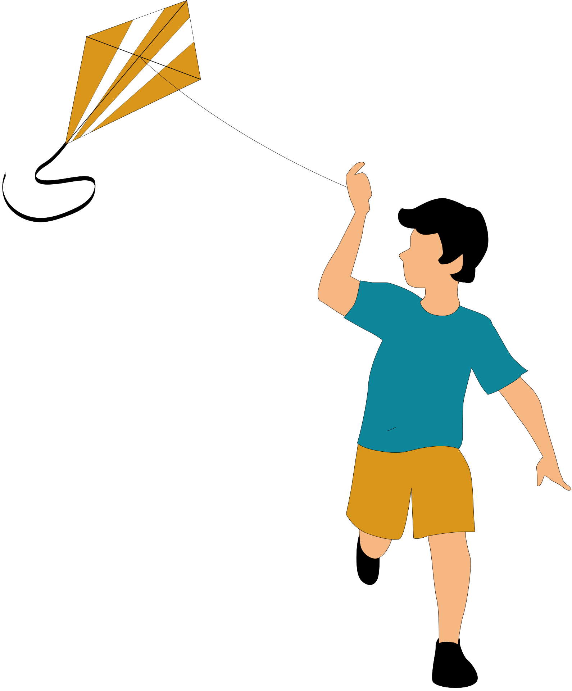

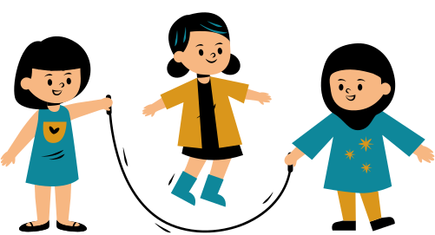

OPAL Assembly

Slide 2
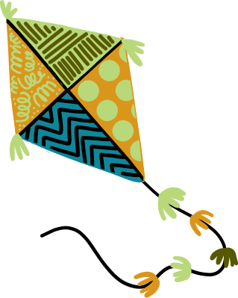

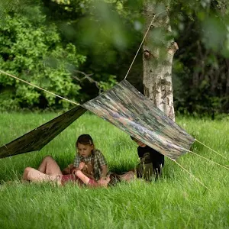
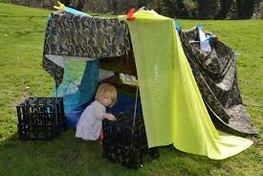
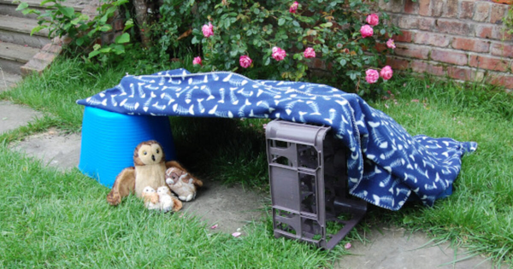
OPAL at Newark
Our OPAL equipment will be introduced again to the playground one zone at a time this year!
This week our focus is about safe, creative den building using wooden pallets and den building materials.

Slide 3



Safety in the Playground
Thinking - Think before you do something
Checking - See if it’s safe to walk /climb on/build with (ask someone if you are not sure)
Looking- Make sure its not broken before using it

Slide 4

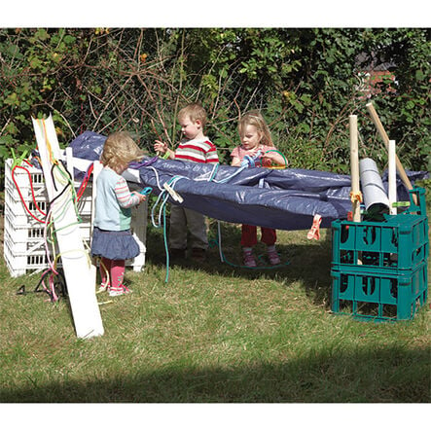

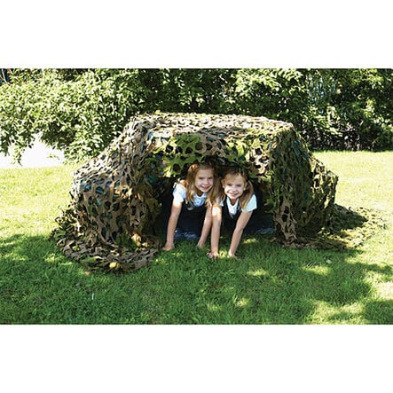

Den Building
Den building is creating shelters using different materials.
• Builds creativity
• Encourages problem solving
• Promotes teamwork

Slide 5
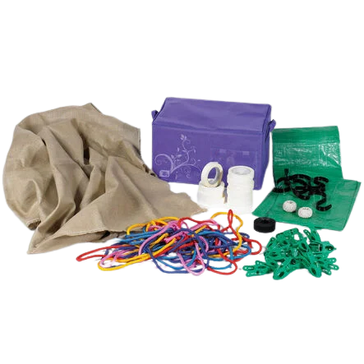
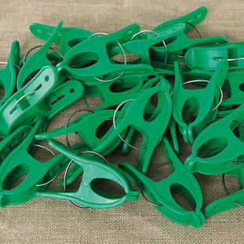
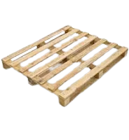
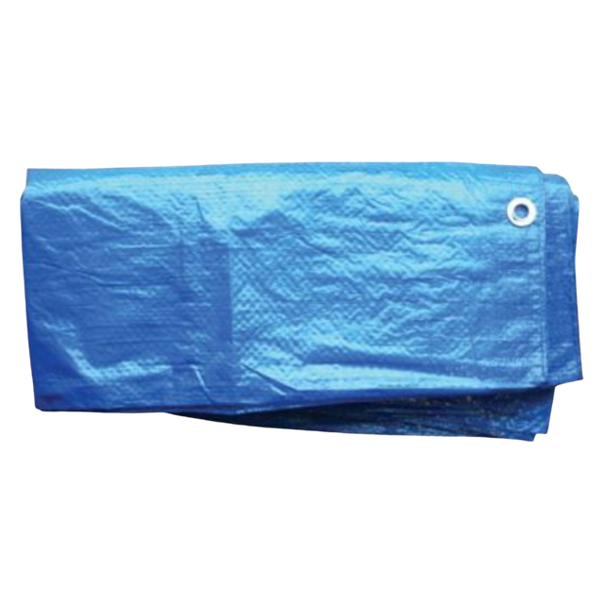
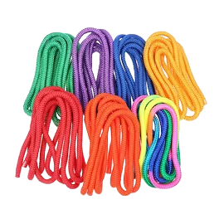
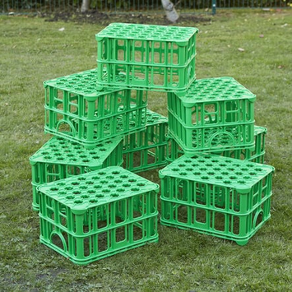
Den Building Kits & Wooden Pallets
What could you use to build a den?
• Wooden pallets
• Tarpaulins
• Crates
• Rope
• Sticks and natural materials

Slide 6


Wooden Pallets-Safety
Always check pallets for damage
Carry with a partner
Always check there are no nails
sticking out
Take your time-no throwing or pushing them roughly

Slide 7
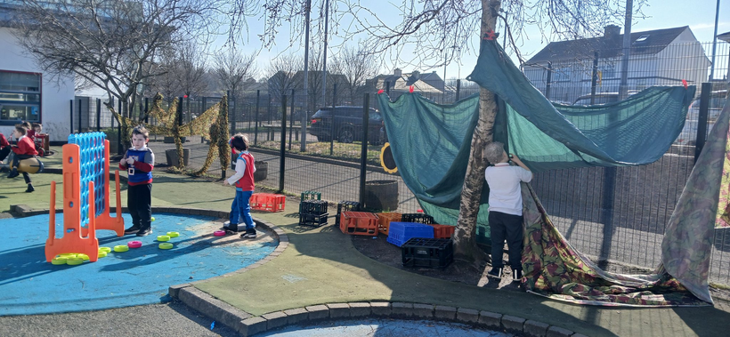
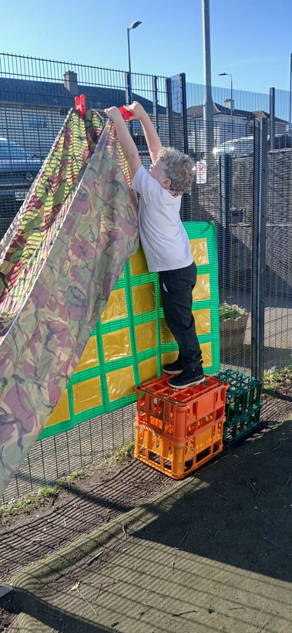
Building Safely
Stack crates and pallets carefully and no higher than your waist
Ensure your build is secure and stable
Ropes and clips are not for hurting anyone
Crates can be jumped off but not on-they are not trampolines

Slide 8
For every zone we need to assess it as a school
What are the benefits? | What are the risks? | What can we do to make sure everyone is safe in this zone?

Slide 9
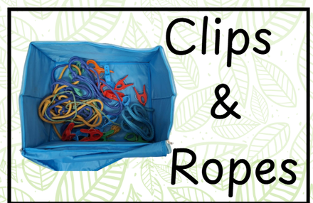
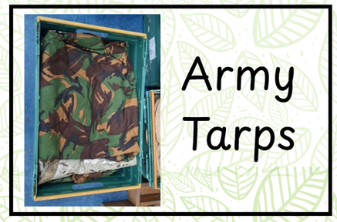


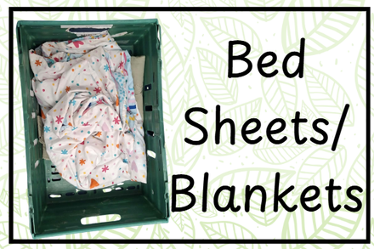

For every zone we need to assess it as a school
The den building equipment has been organised and labelled in the shed in the middle playground. Den building will only be allowed in the middle playground because we need space to add lots of new zones.
The area will be labelled Zone 1.

Slide 10

Next week...
All classes will get the chance to go out and use the den building equipment next week, so they can explore it and learn how to properly tidy it away!

Slide 11
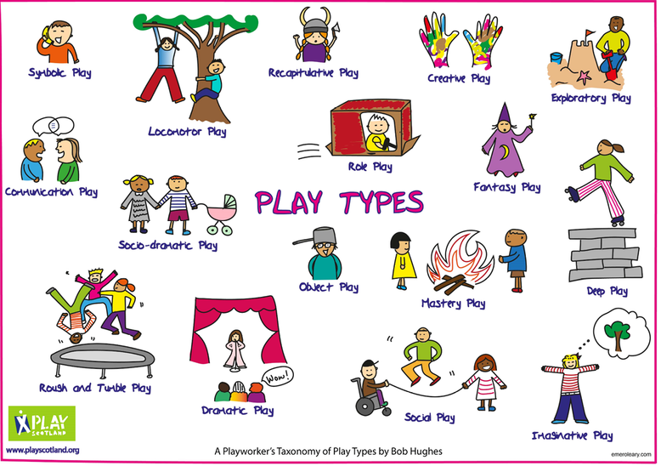
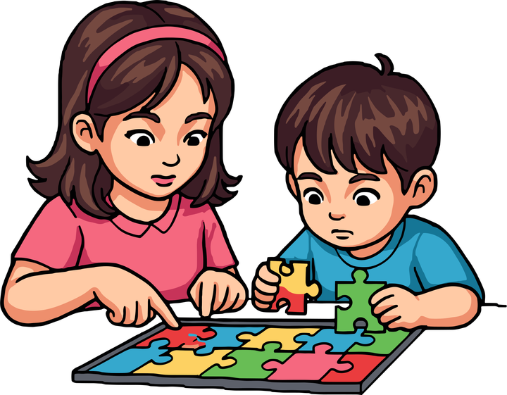


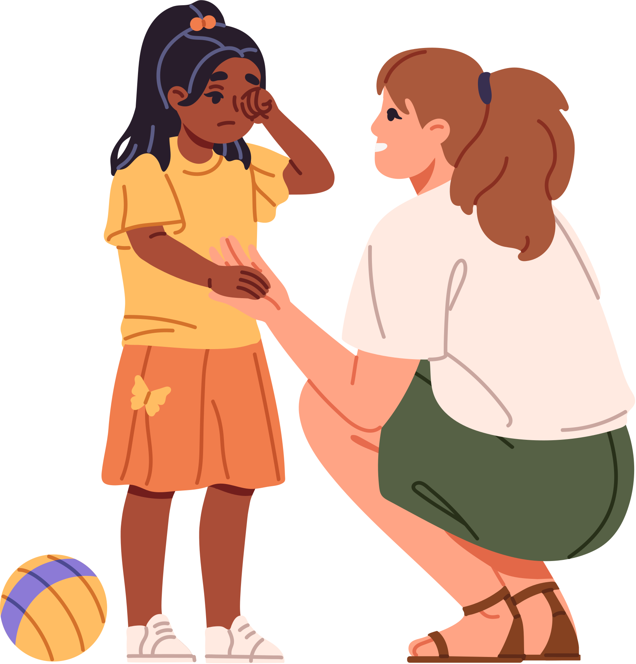
Risk Awareness
•Think before you build
• Check for hazards
• Ask an adult if unsure
• Play safely and responsibly
Work as a team! #TogetherWeShine
Remember!
• Share ideas
• Take turns
• Help each other
• Listen and communicate
HAVE FUN!
BE CREATIVE!
WORK TOGETHER!
Respect the Playground and Each Other
  Look after all of the equipment-put it back where it belongs, no throwing equipment
  Keep the playgrounds tidy-EVERYONE tidies up!
  When the bell goes make sure there is no equipment left out
  If you are unsure about anything, ASK AN ADULT

