Slide 1

Primary School Menu
Week 1
Catering

Slide 2
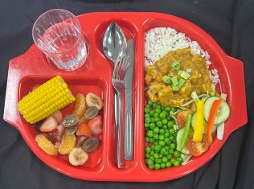
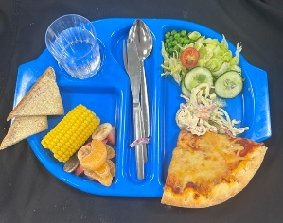
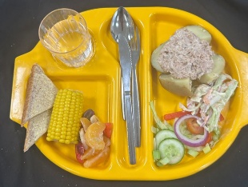
Primary School Menu
Week 1 - Monday
Quorn Katsu Curry with Boiled Rice
Cheese & Tomato Pizza
Baked Potato with Tuna Mayo
( or Cheese ) & Coleslaw

Slide 3
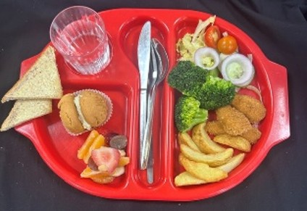
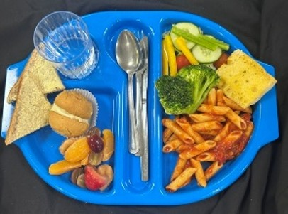
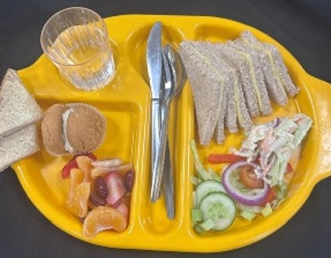
Primary School Menu
Week 1 - Tuesday
Chicken Goujons with Potato Wedges
Tomato & Basil Pasta with Garlic Bread
Cheese Sandwich & Coleslaw

Slide 4
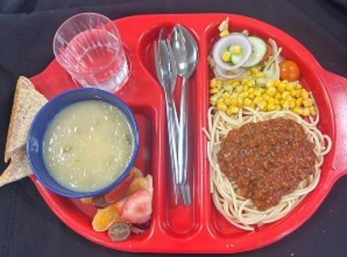
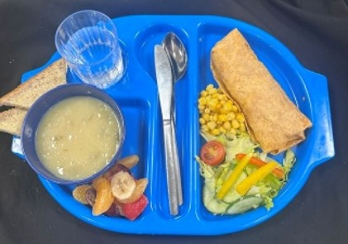
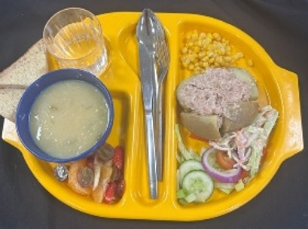
Primary School Menu
Week 1 - Wednesday
Beef Bolognaise with Pasta
Quorn Burrito Wrap
Baked Potato with Tuna Mayo
( or Cheese ) & Coleslaw

Slide 5
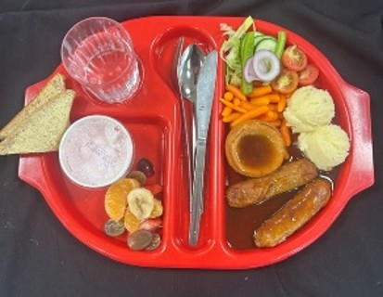
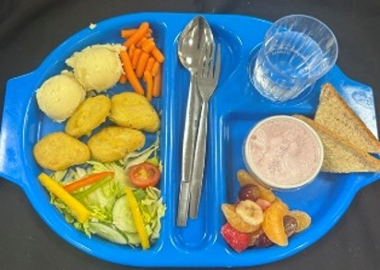
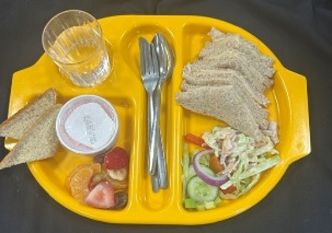
Primary School Menu
Week 1 - Thursday
Sausages with Onion Gravy, Mashed Potatoes & Yorkshire Pudding
Quorn Dippers with Mashed Potato
Chicken Sandwich & Coleslaw

Slide 6
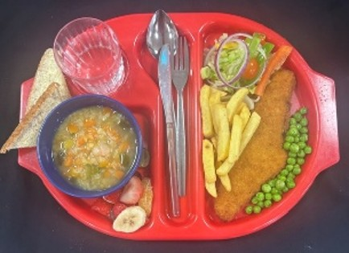
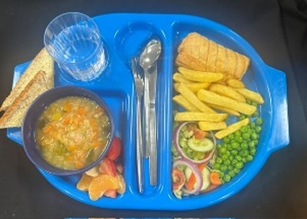
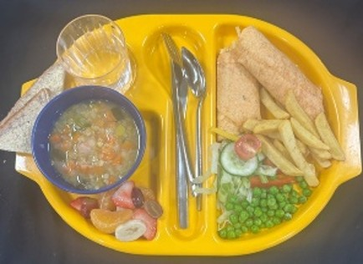
Primary School Menu
Week 1 - Friday
Fish & Chips
Vegan Sausage Roll & Chips
Cheese Wrap with Chips

