Slide 1




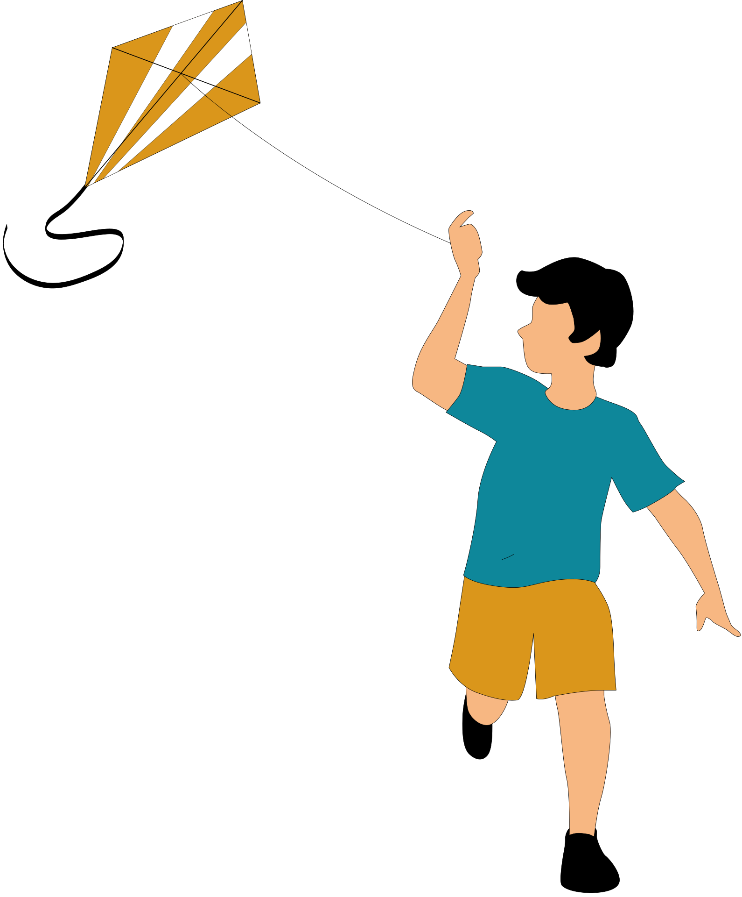

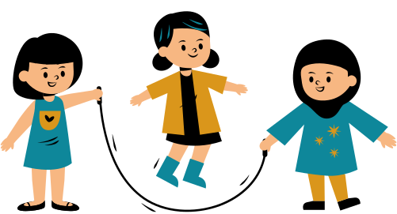

OPAL Assembly
Week 2

Slide 2
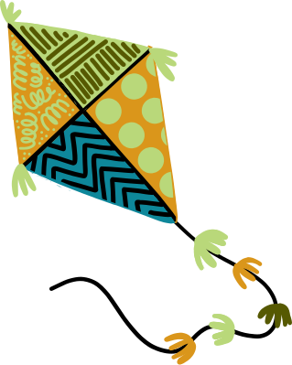

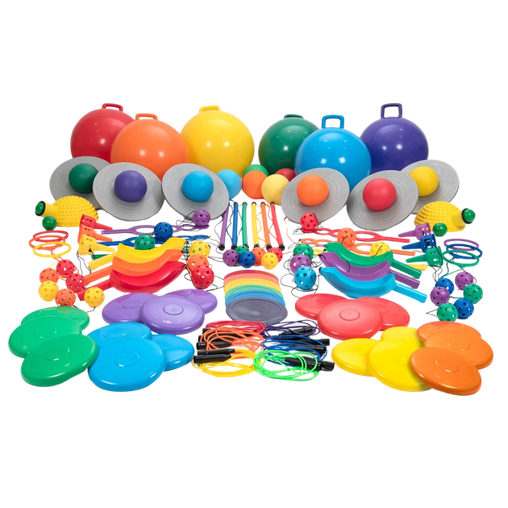
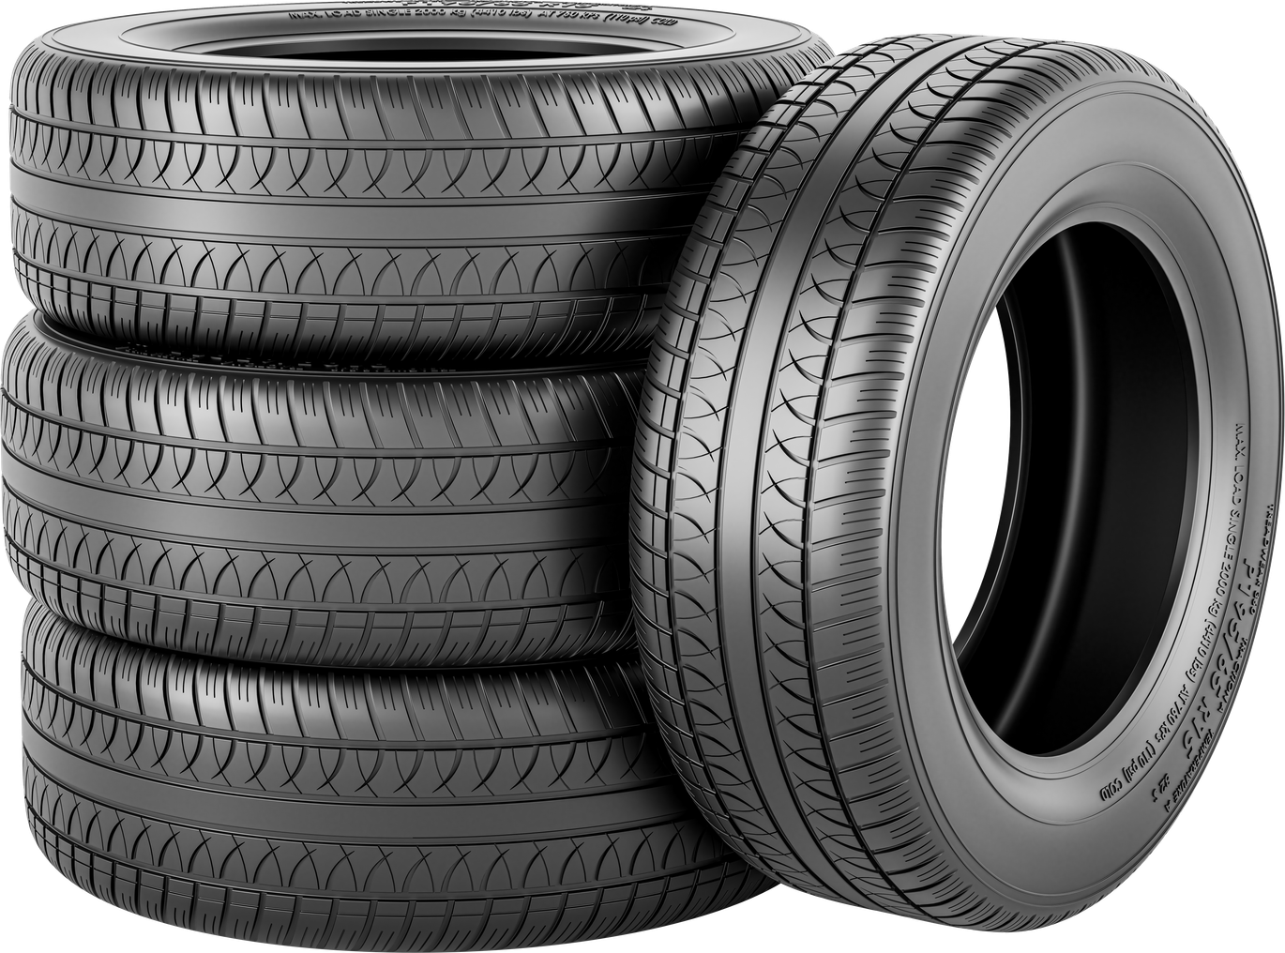
OPAL at Newark
Every couple of weeks we will have a focus on different skills we can develop through OPAL and how to use different equipment safely in the playground or an update on how OPAL is going in Newark.
This week our focus is about safe use of the tyres, space hoppers and playground equipment. Where do things belong?

Slide 3
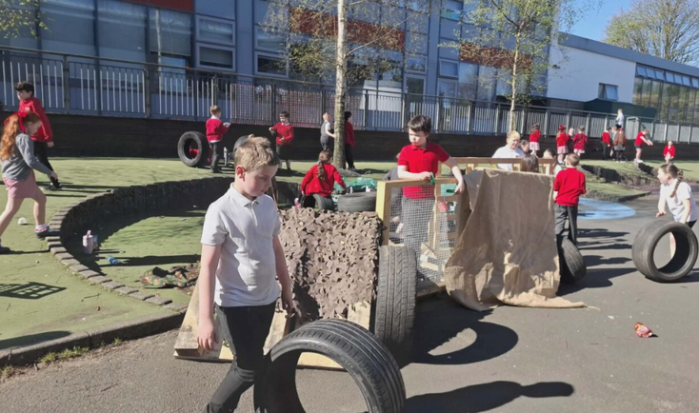
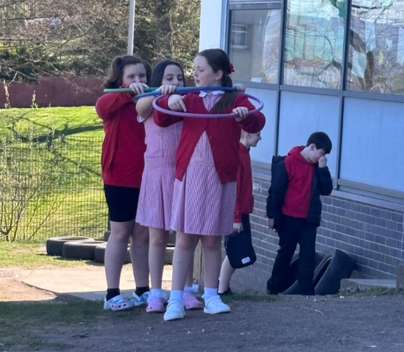
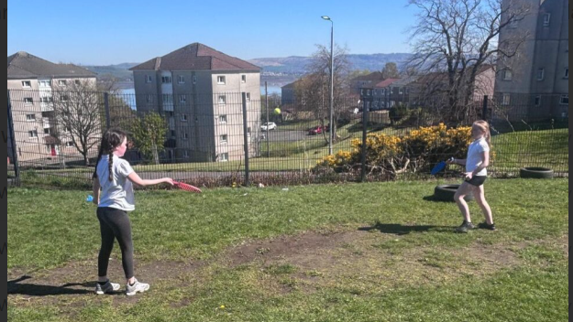

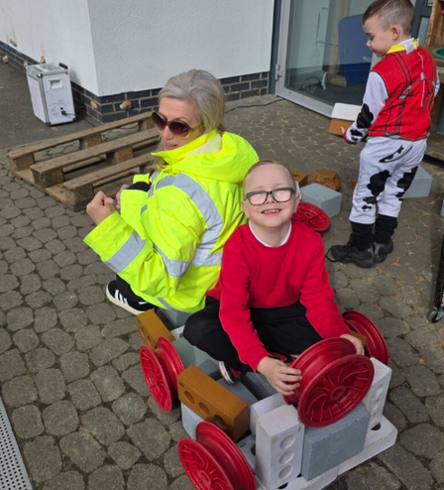
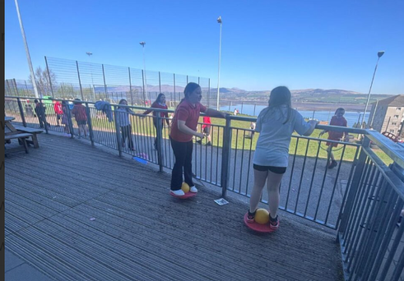
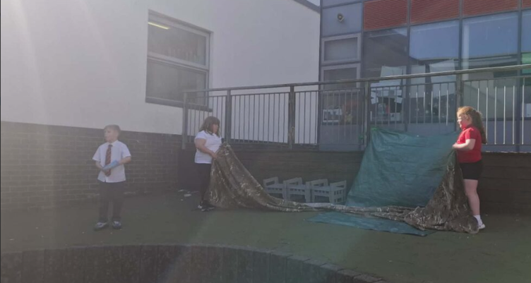
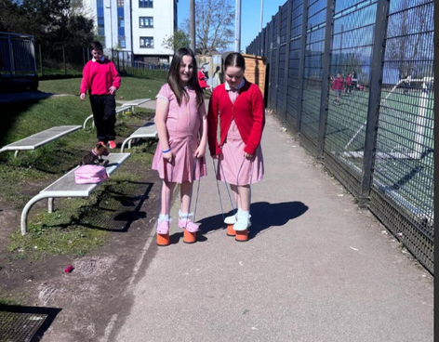
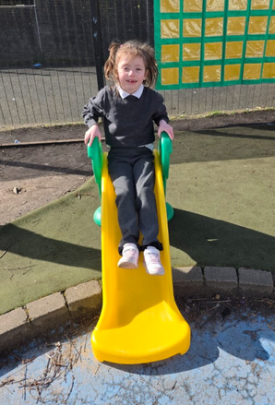
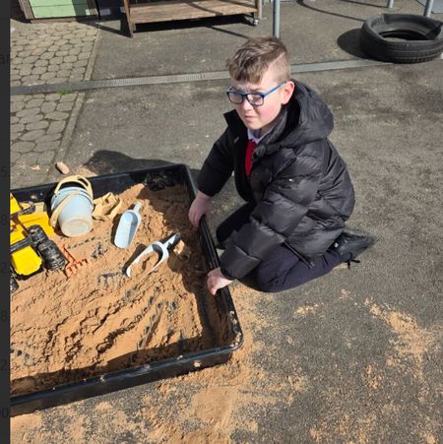
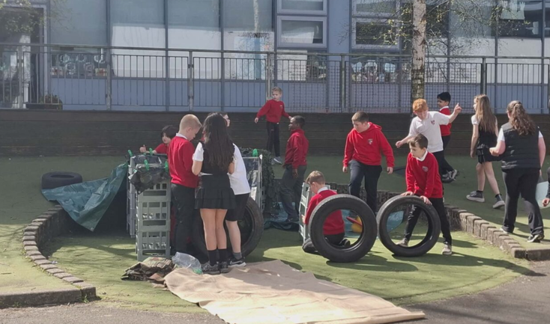
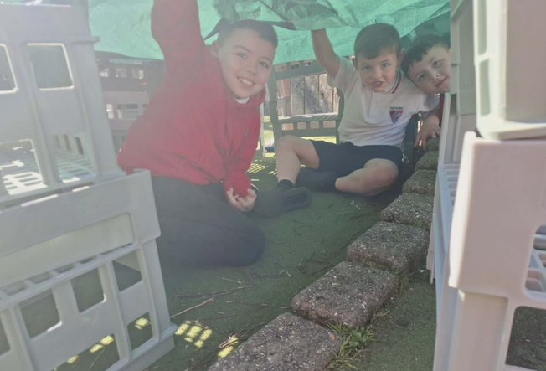
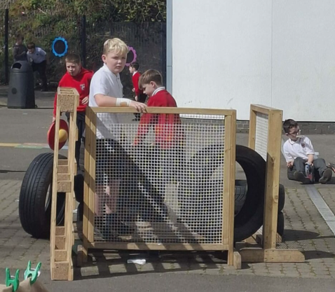
But first...Let’s Celebrate!

Slide 4

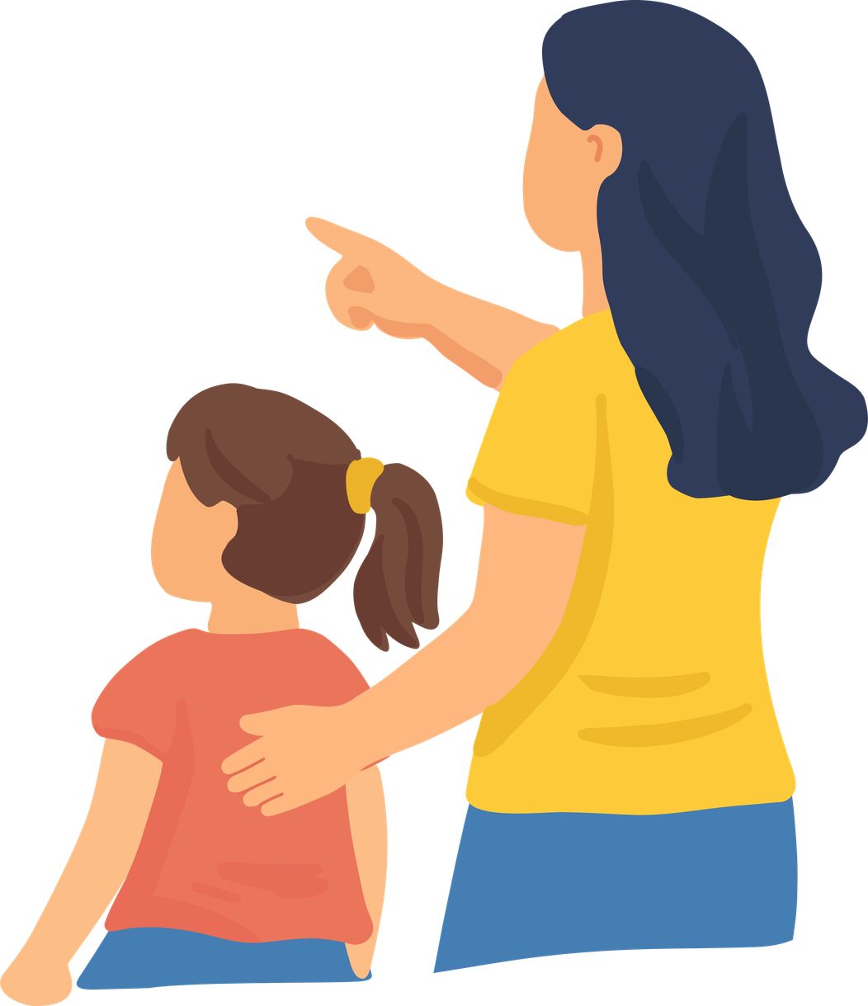

Safety in the Playground
Thinking - Think before you do something
Checking - See if it’s safe to walk /climb on/build with (ask someone if you are not sure)
Looking- Make sure its not broken before using it

Slide 5

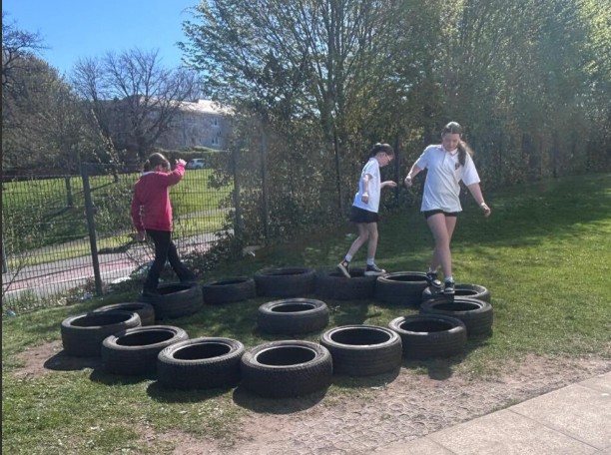
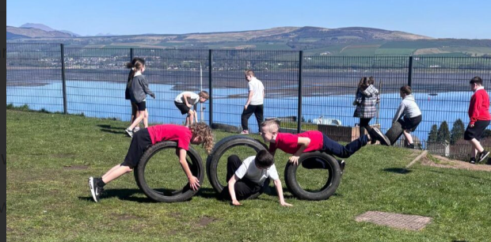
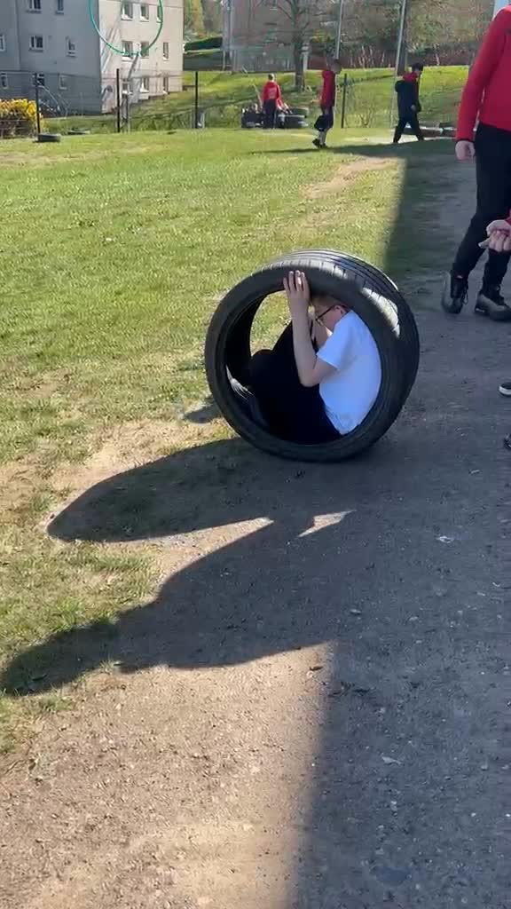


Tyres
Tyres can be used for lots of things-stacking, building, rolling, obstacle courses and much more.
• Builds creativity
• Encourages problem solving
• Promotes teamwork

Slide 6

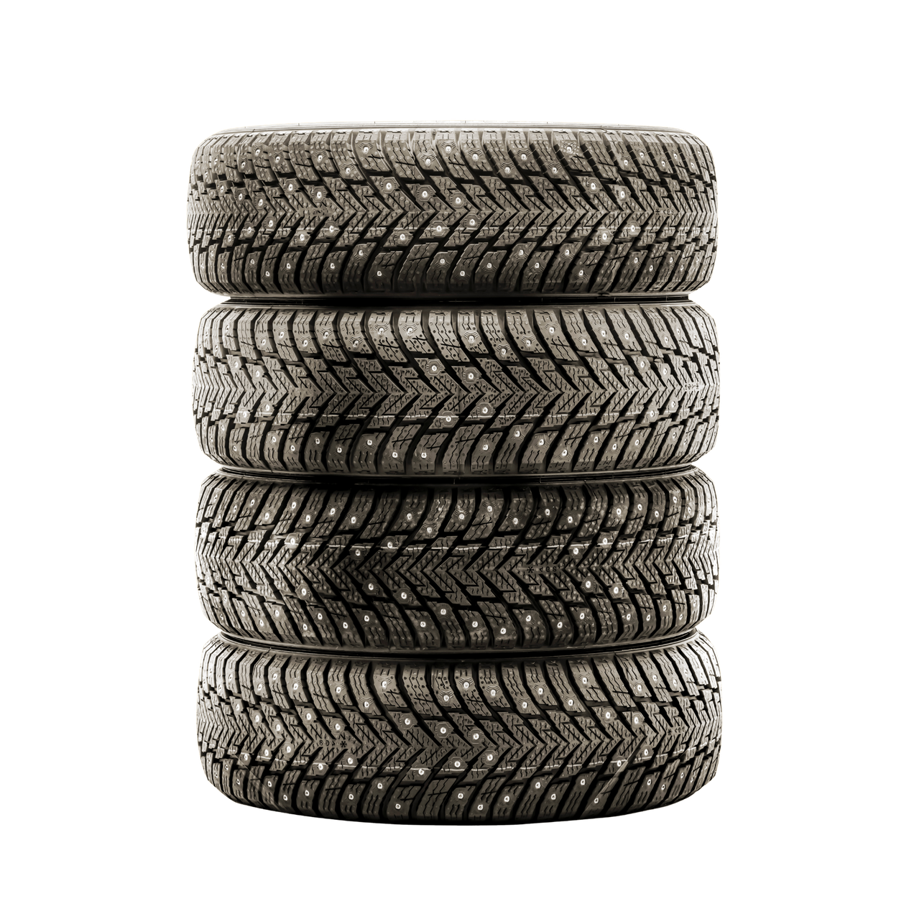

Tyres-Safety
Stack no higher than your waste
If heavy, carry with a partner
If staff have put them down to separate areas/zones, leave them be.
Take your time-no throwing or pushing them roughly

Slide 7
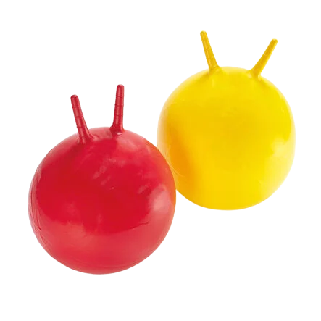
Space Hoppers
Space Hoppers are a new addition to the Upper school playground as of today:
  No kicking or throwing them
  Only use on the grass area beside the MUGA (outlined by tyres)
  Put away in wheeled bucket
  Bounce and have fun!

Slide 8
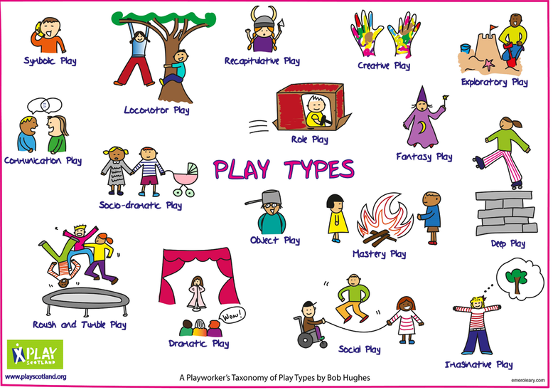
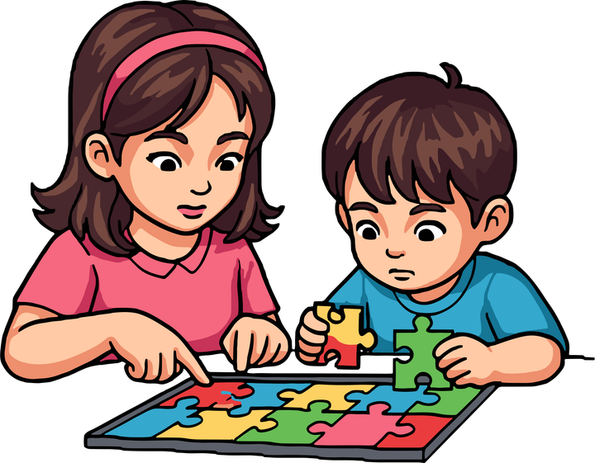


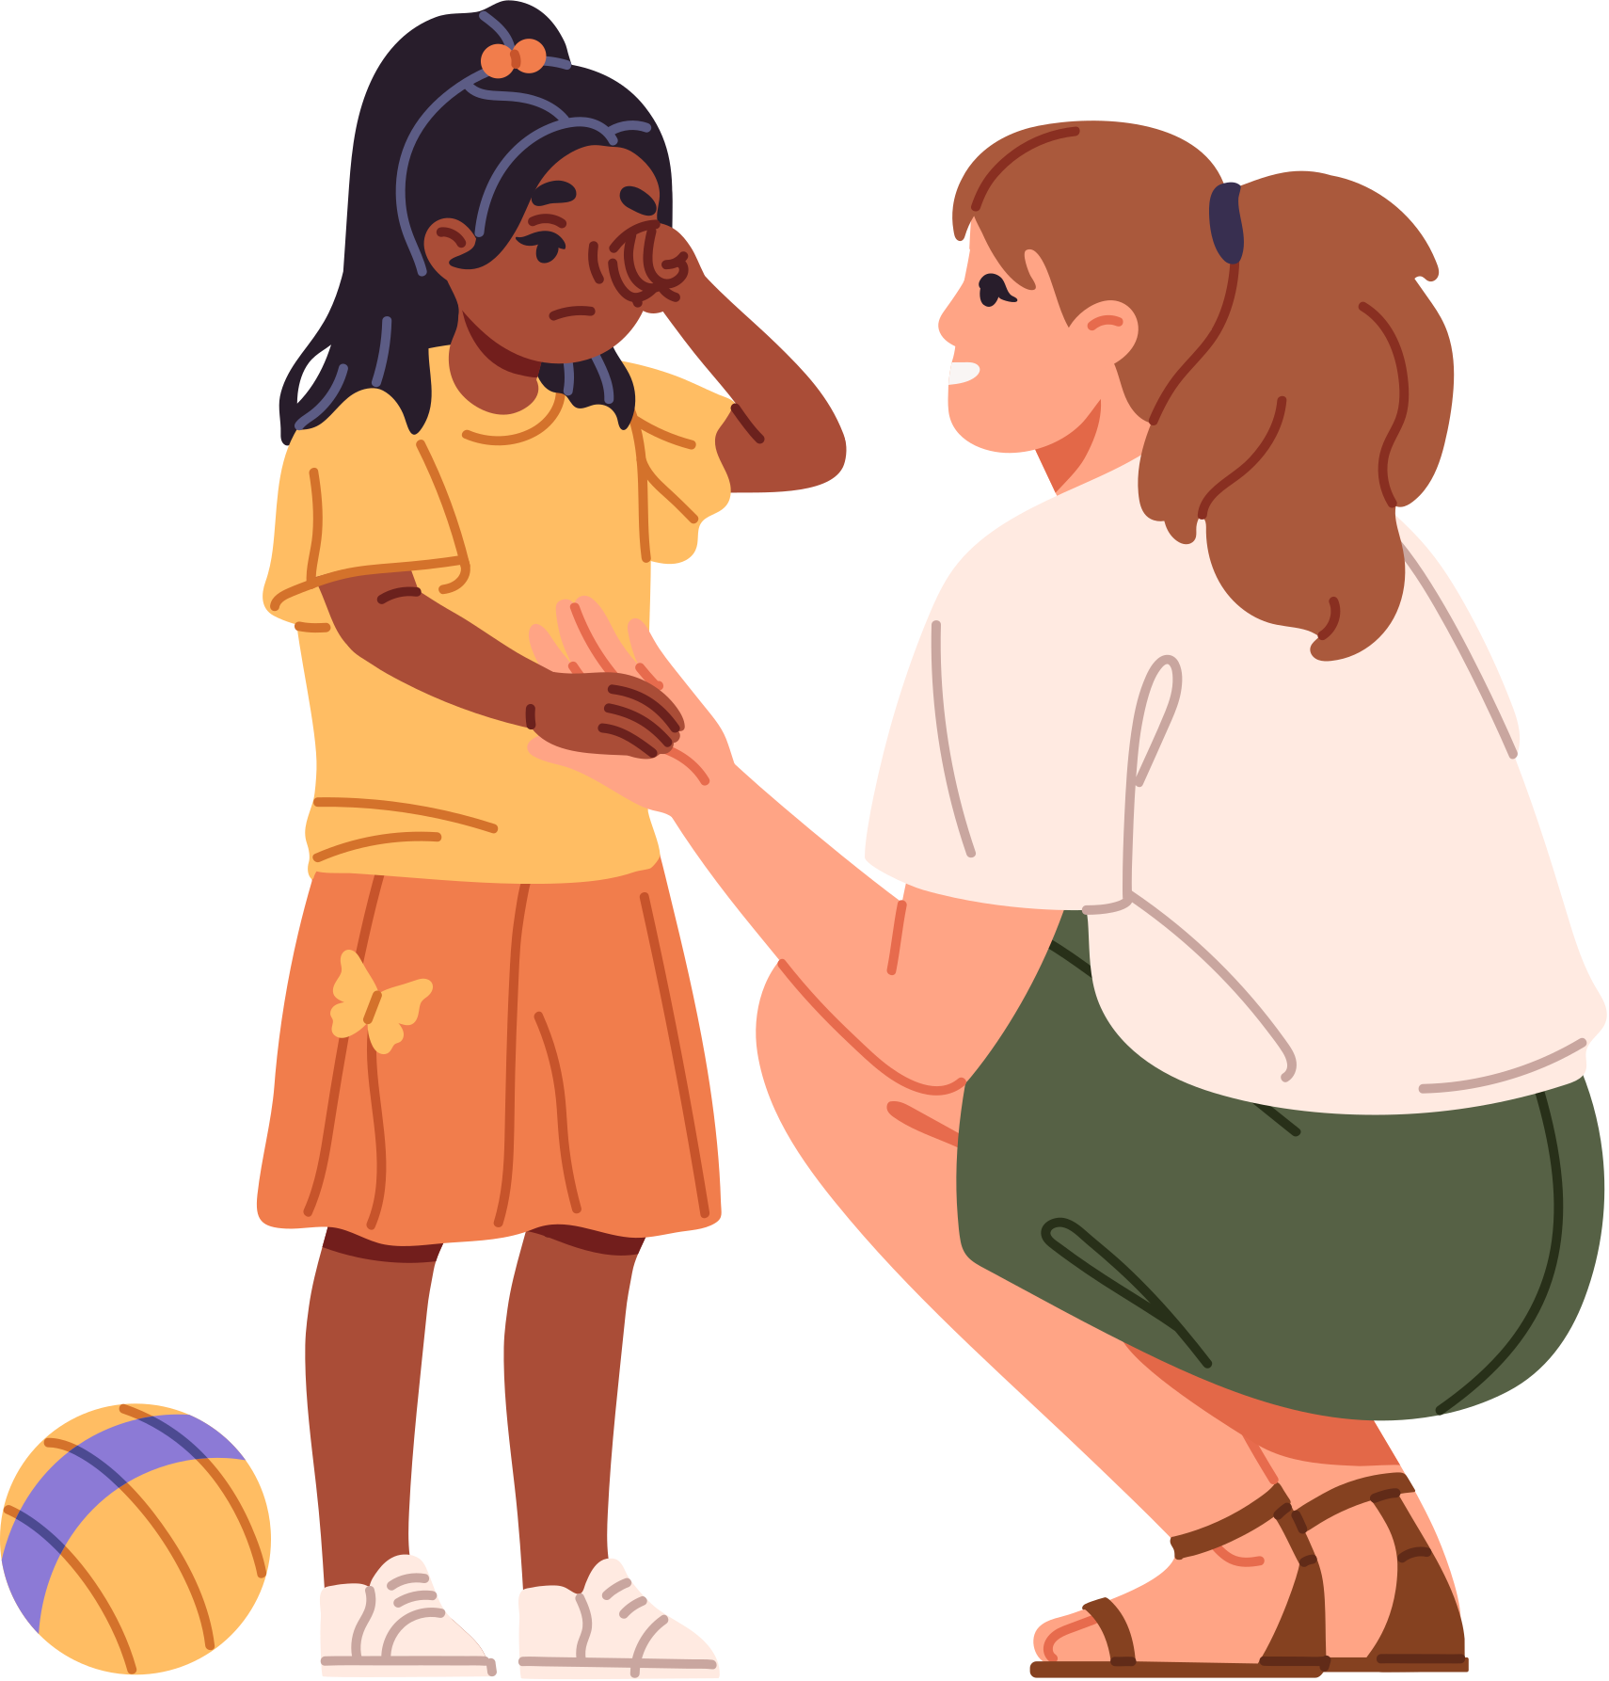
Risk Awareness
•Think before you build
• Check for hazards
• Ask an adult if unsure
• Play safely and responsibly
Work as a team! #TogetherWeShine
Remember!
• Share ideas
• Take turns
• Help each other
• Listen and communicate
HAVE FUN!
BE CREATIVE!
WORK TOGETHER!
Respect the Playground and Each Other
  Look after all of the equipment-put it back where it belongs, no throwing equipment
  Keep the playgrounds tidy-EVERYONE tidies up!
  When the bell goes make sure there is no equipment left out
  If you are unsure about anything, ASK AN ADULT

